Slide 1
Informatics 121 Software Design I
Lecture 15
Duplication of course material for any commercial purpose without the explicit written permission of the professor is prohibited.

Slide 2
Announcements
There will be discussion this Friday

Slide 3
Today’s lecture
Architecture design
Expert behaviors
Design studio 3

Slide 4
Architecture
“The conceptual core”
“That what really makes it work”
“Principal set of design decisions”
“Essence of the solution”

Slide 5
Architecture

Slide 6
Architecture

Slide 7
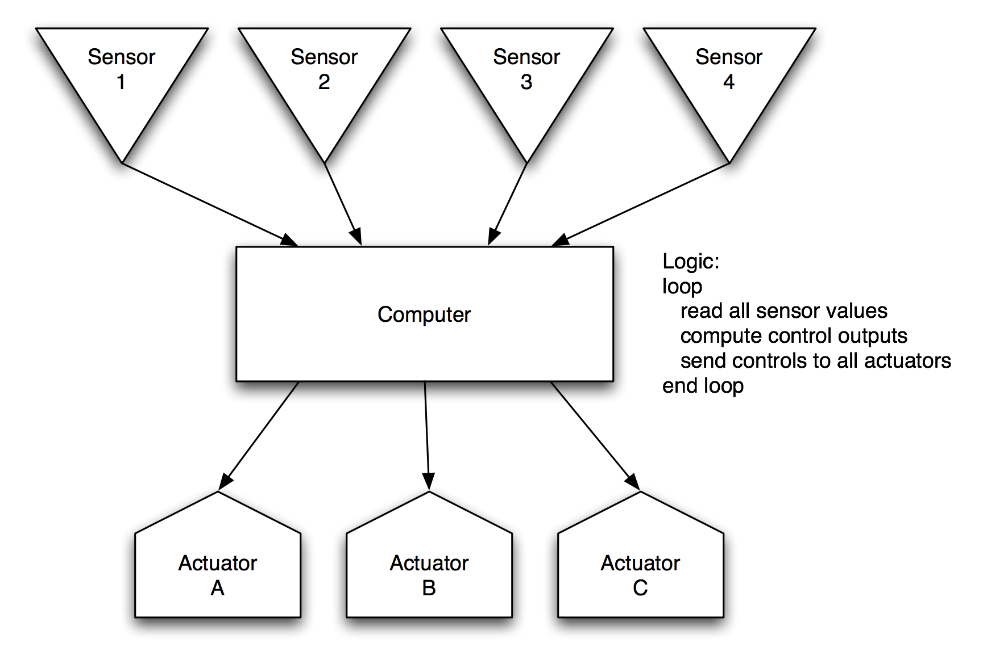
Architecture

Slide 8
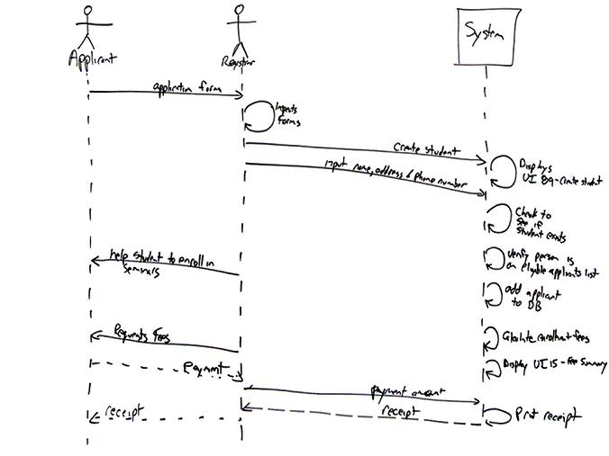
Architecture

Slide 9
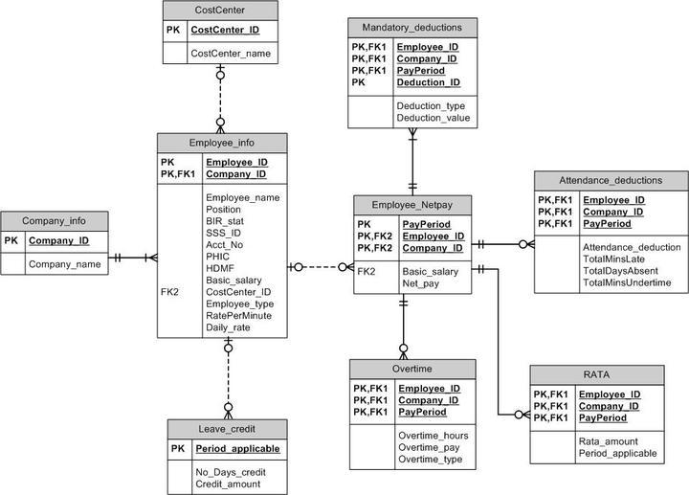
Architecture

Slide 10
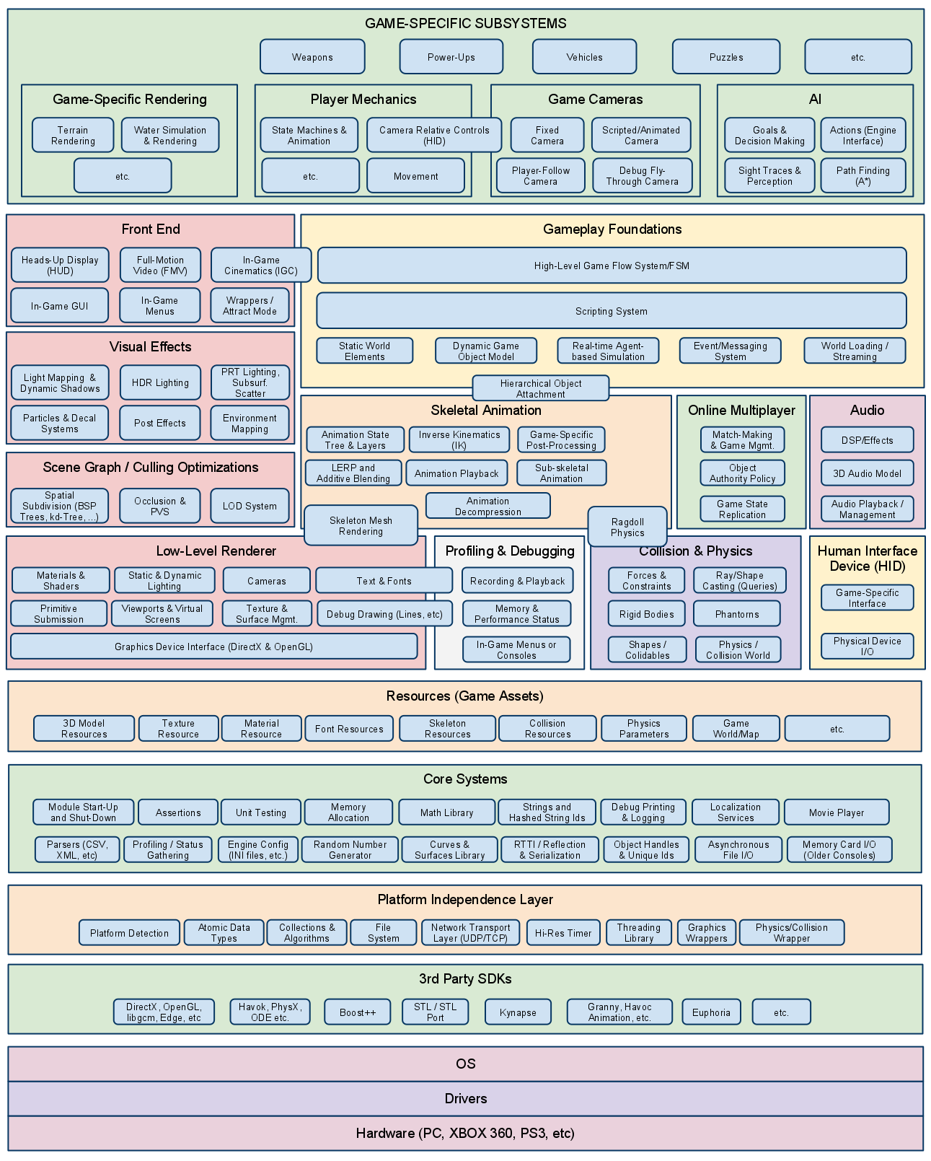
Architecture

Slide 11
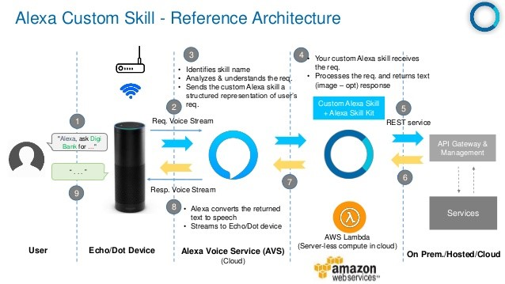
Architecture

Slide 12
Architecture
Components and connectors
Data model
Protocol
Interface
Naming
Algorithm
…

Slide 13
Practice: frietwagens

Slide 14
Practice: instant message

Slide 15
Design studio 3
Hand out

Slide 16
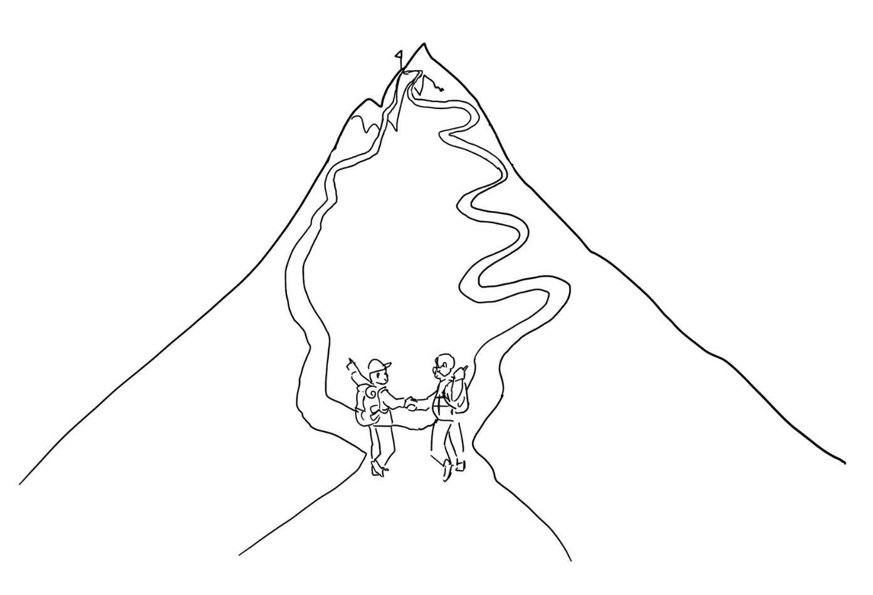
Experts agree to disagree

Slide 17
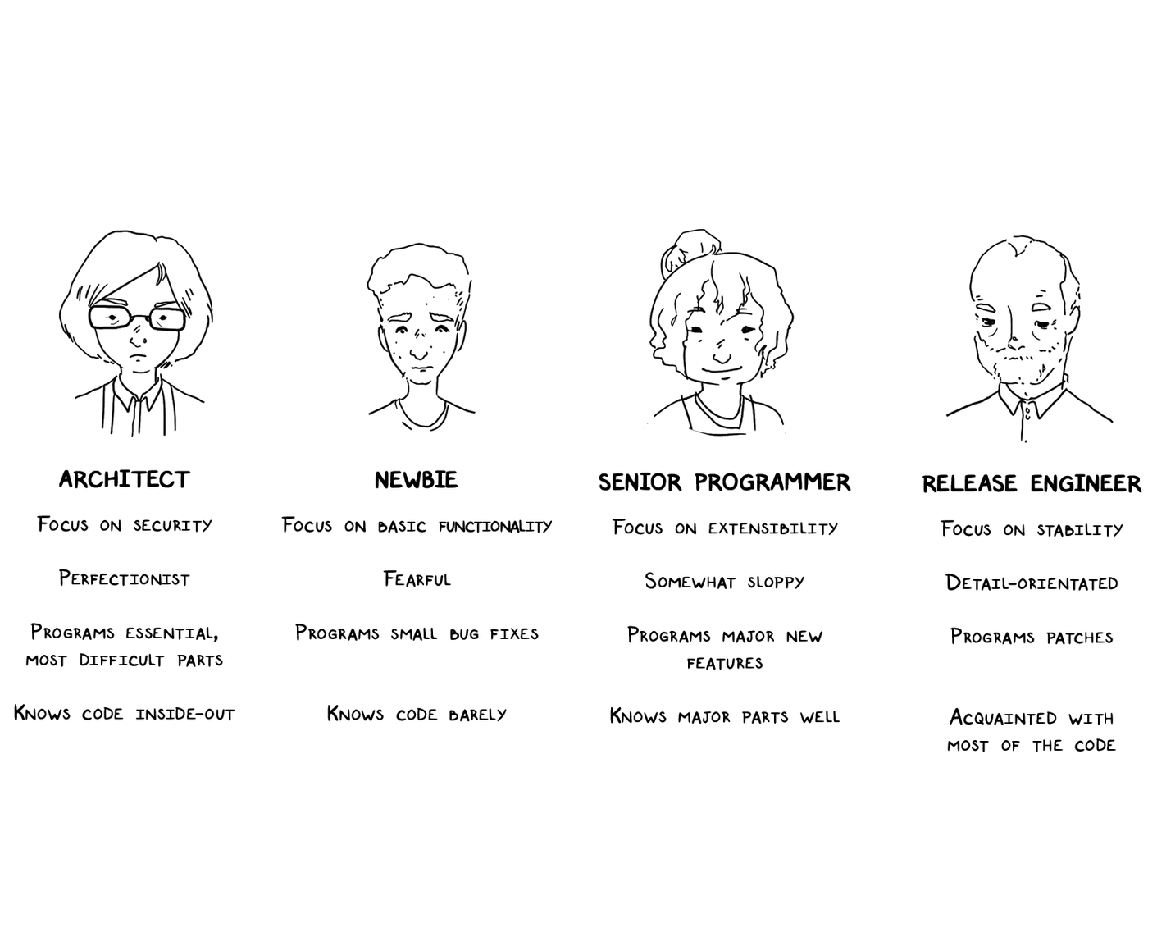
Experts use design methods (selectively)

Slide 18
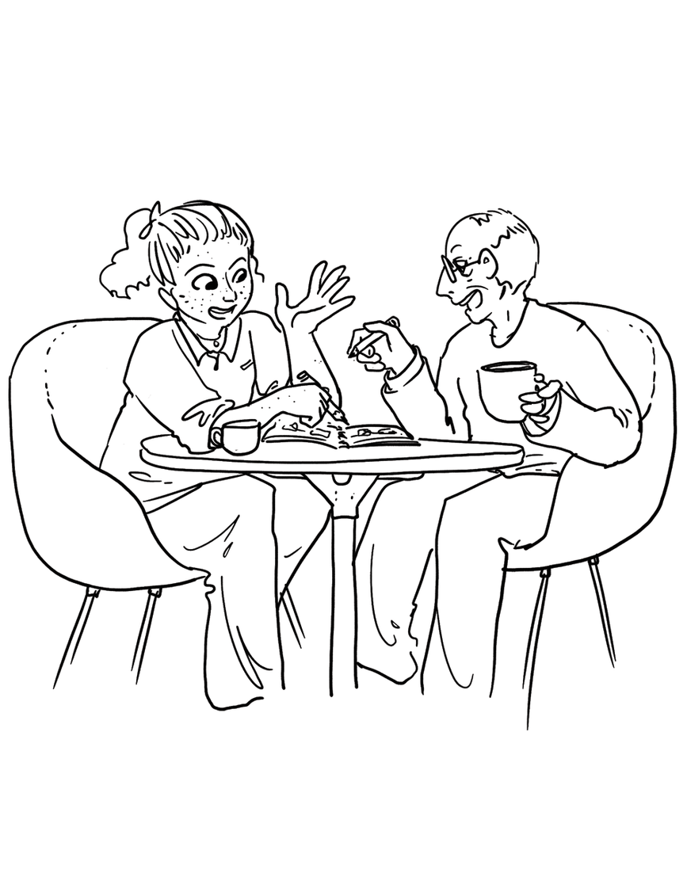
Experts externalize their thoughts

Slide 19
Experts keep sketches

Slide 20
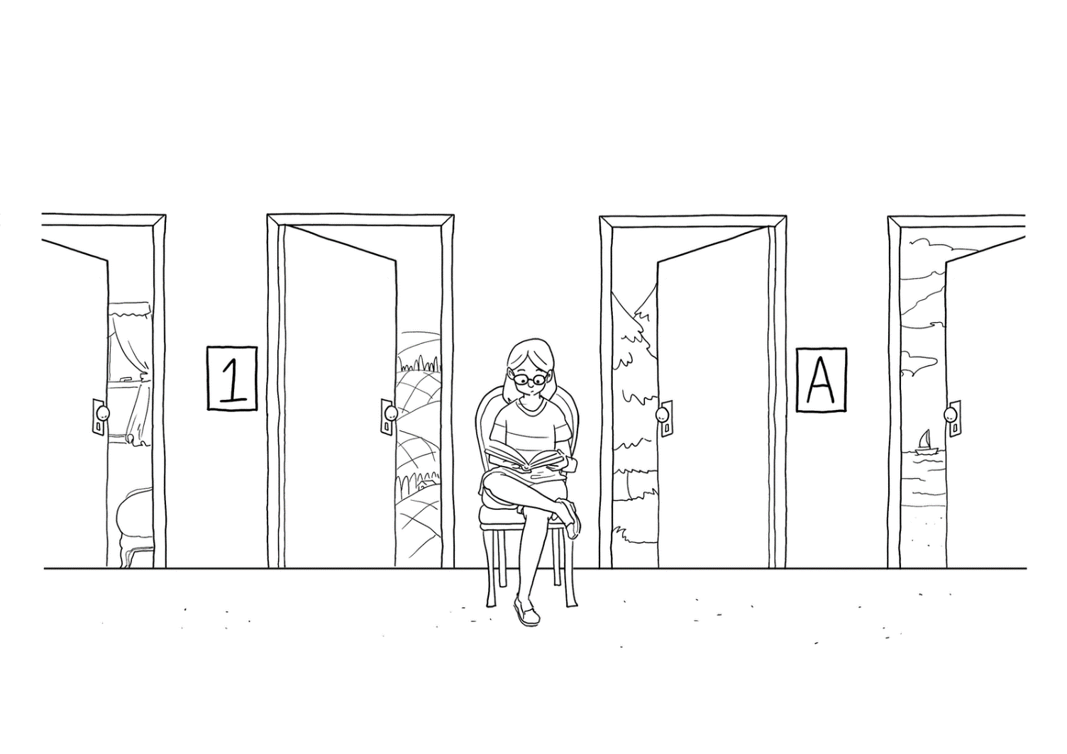
Experts keep options open

Slide 21
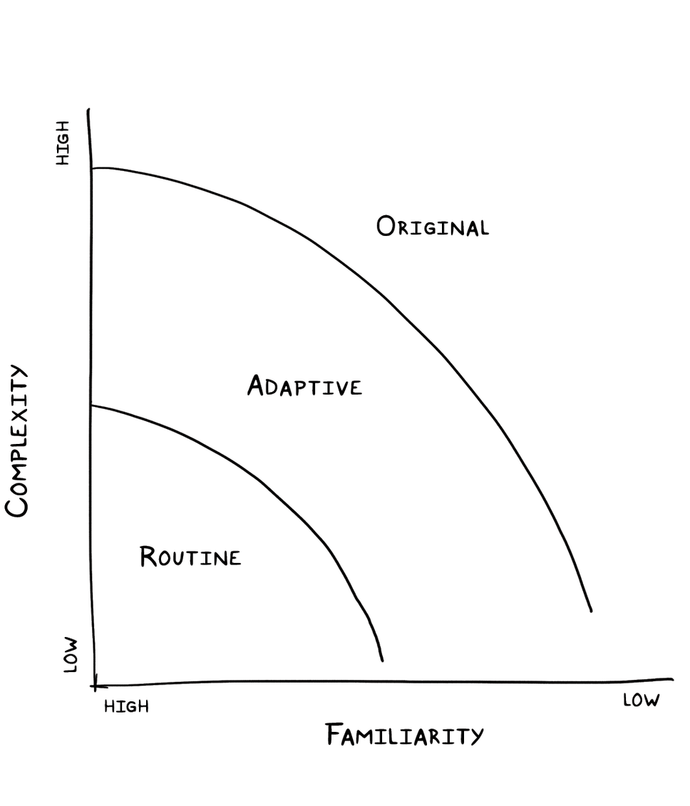
Experts adjust to the degree of uncertainty present

Slide 22
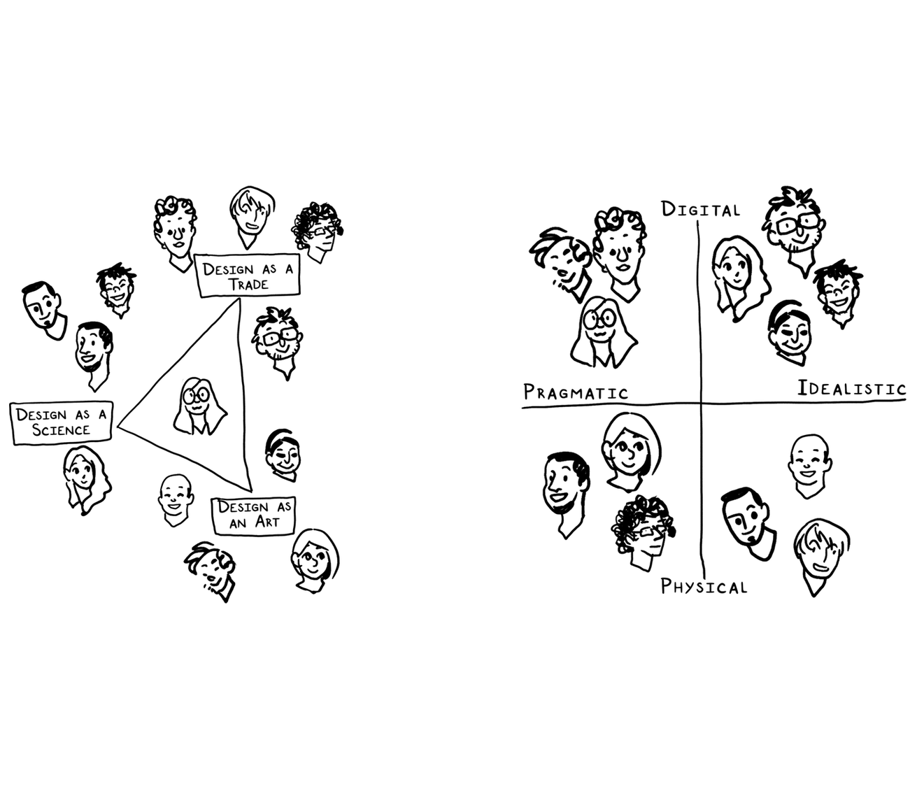
Experts explore different perspectives

Slide 23
Experts play the fool

Slide 24
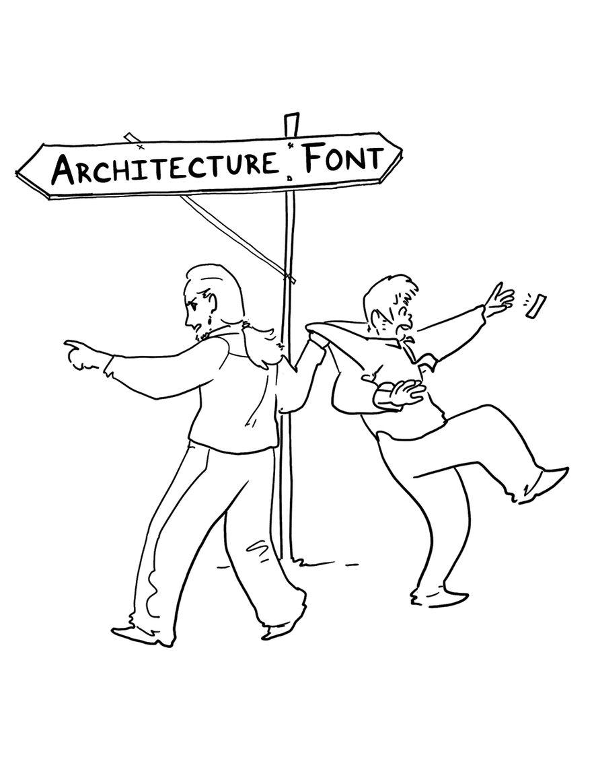
Experts curtail digressions

Slide 25
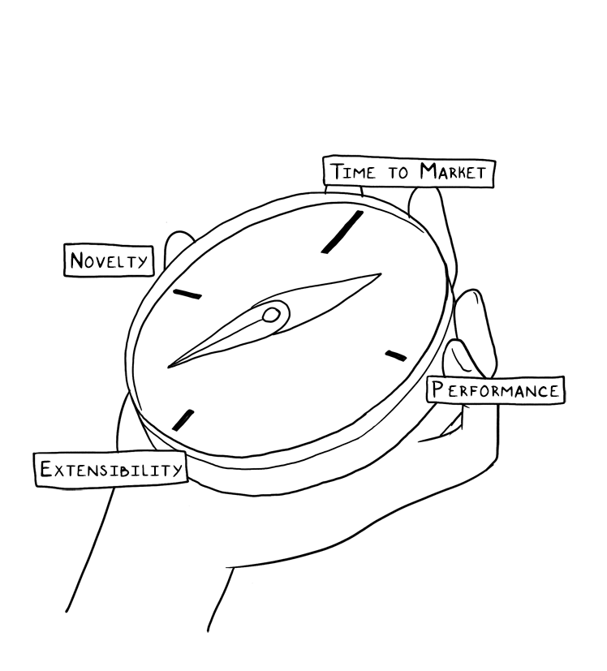
Experts retain their orientation

Slide 26
Design studio 3
Linecept
intermediate artifacts are graded
Questions?

