Slide 1
Informatics 121 Software Design I
Lecture 6
Duplication of course material for any commercial purpose without the explicit written permission of the professor is prohibited.

Slide 2
Discussion
There will be discussion this upcoming Friday
Please join your designated discussion

Slide 3
Today
Four types of design
Expert behaviors
French fries and mayonnaise
Design studio 1

Slide 4
Design
designer
plan
maker
change in the world
other stakeholders
audience
experiences

Slide 5
Feasibility and desirability
feasibility
designer
plan
maker
change in the world
other stakeholders
audience
experiences

Slide 6
Feasibility and desirability
feasibility
designer
plan
maker
change in the world
other stakeholders
audience
experiences
desirability

Slide 7
Four types of design
desirability
what is it to accomplish?
how does one interact with it?
feasibility
what is its conceptual core?
what are its implementation details?

Slide 8
Four types of design
what is it to accomplish?
satisfactory experience
how does one interact with it?
change in the world
what is its conceptual core?
plan for realization
what are its implementation details?

Slide 9
Four types of software design
what is it to accomplish?
application design
satisfactory experience
how does one interact with it?
interaction design
change in the world
what is its conceptual core?
architecture design
plan for realization
what are its implementation details?
implementation design

Slide 10
Design a mobile phone messaging system
what is it to accomplish?
application design
satisfactory experience
how does one interact with it?
interaction design
change in the world
what is its conceptual core?
architecture design
plan for realization
what are its implementation details?
implementation design

Slide 11
Design a word processor
what is it to accomplish?
application design
satisfactory experience
how does one interact with it?
interaction design
change in the world
what is its conceptual core?
architecture design
plan for realization
what are its implementation details?
implementation design

Slide 12
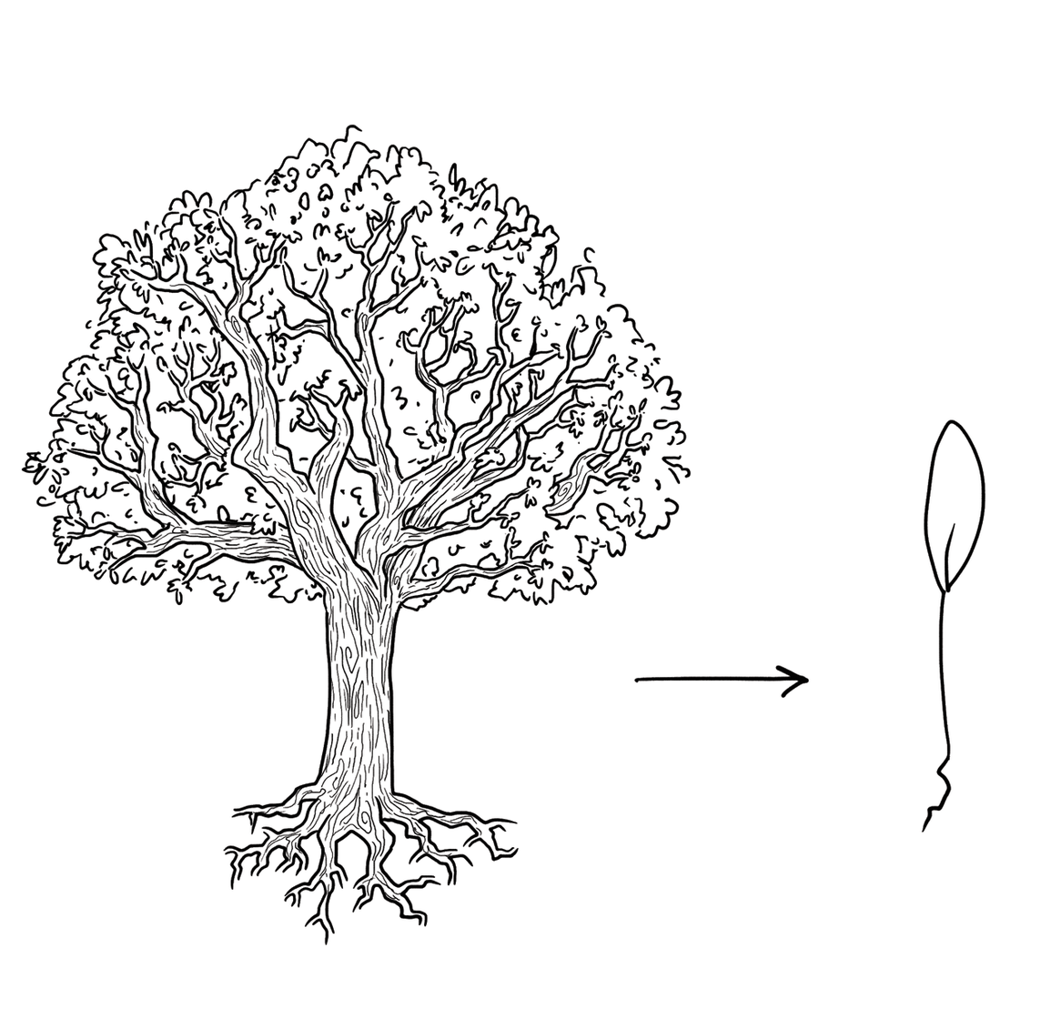
Experts focus on the essence

Slide 13
Experts prefer solutions that they know work

Slide 14
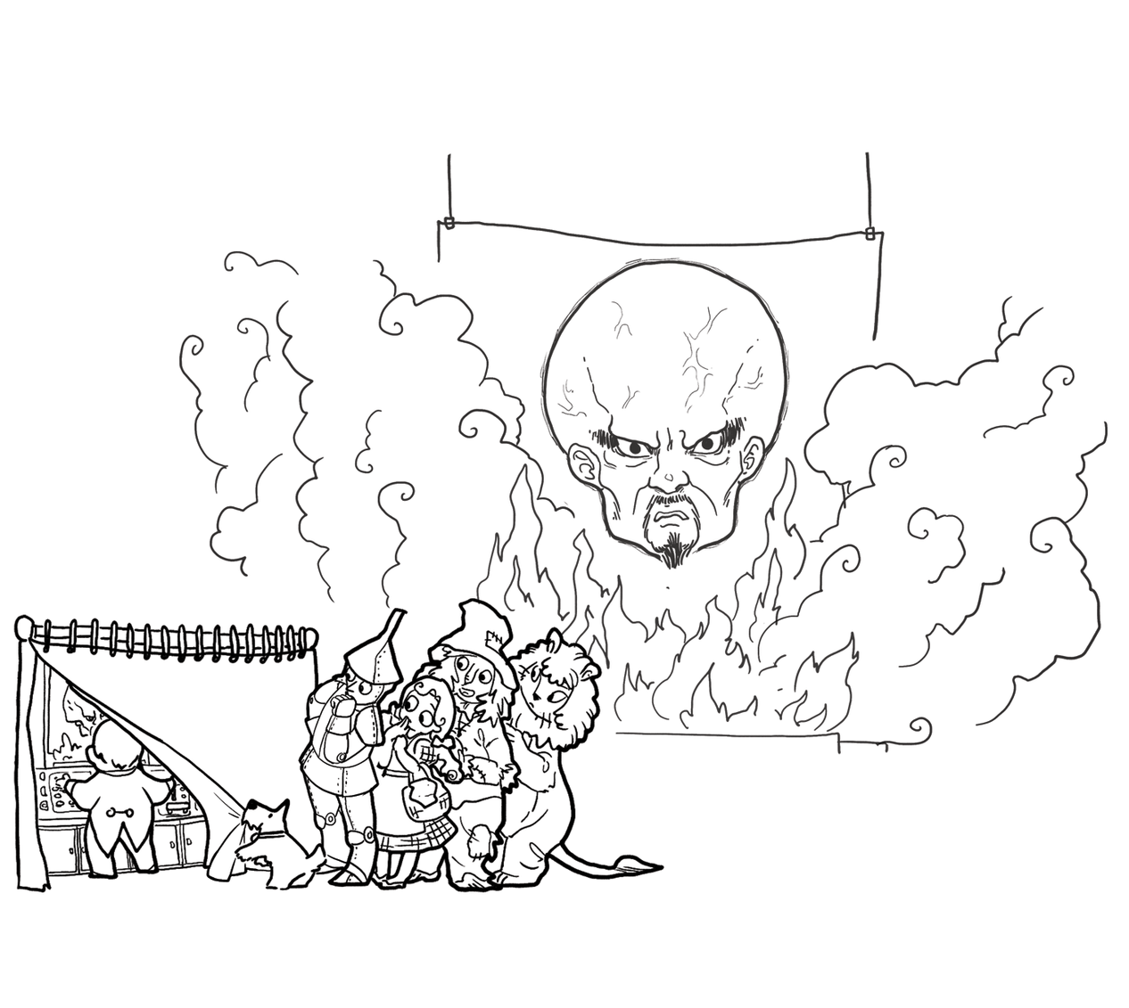
Experts address knowledge deficiencies

Slide 15
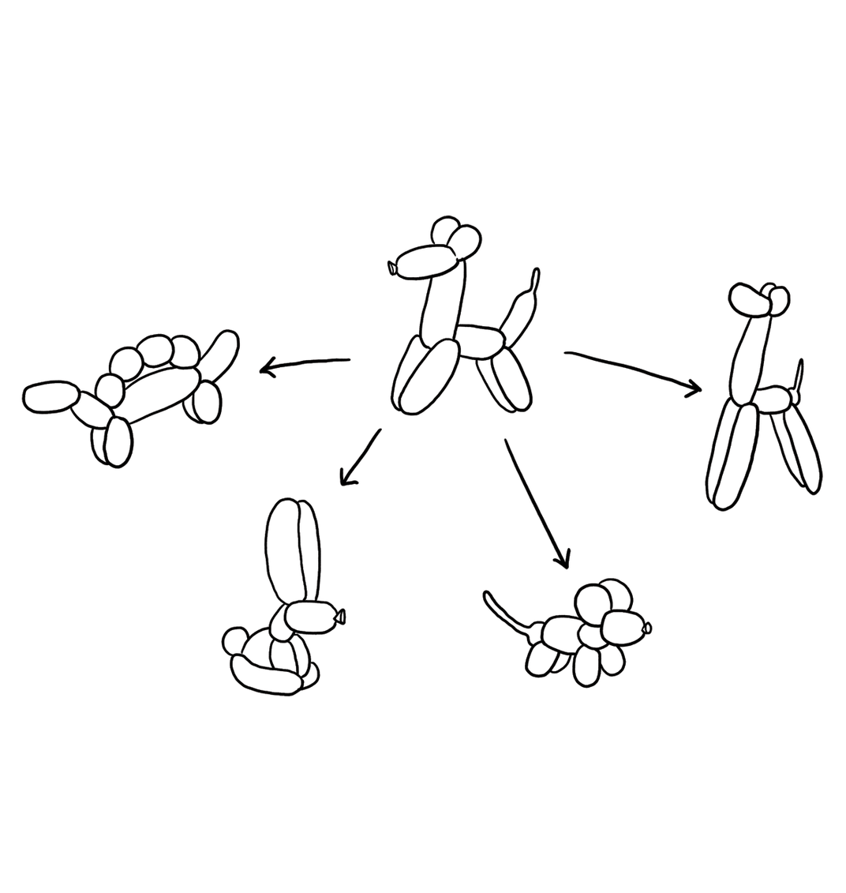
Experts generate alternatives

Slide 16
Experts are skeptical

Slide 17
Design cycle
synthesize
goals
constraints
assumptions
decisions
ideas
analyze
evaluate

Slide 18
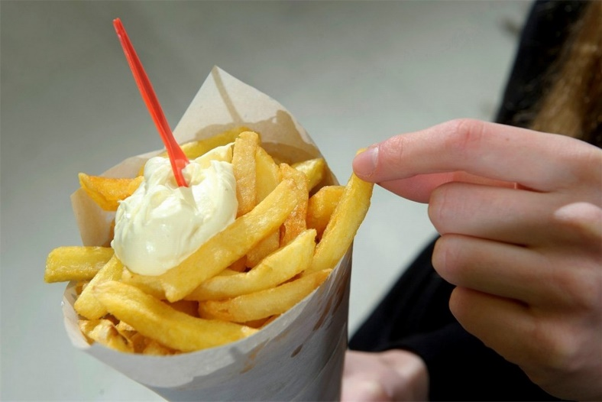
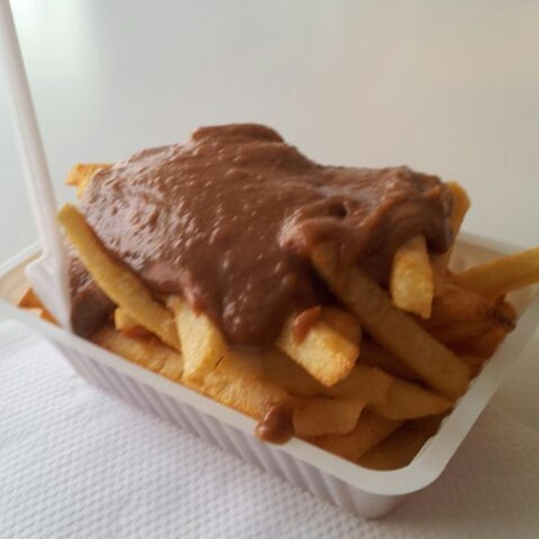
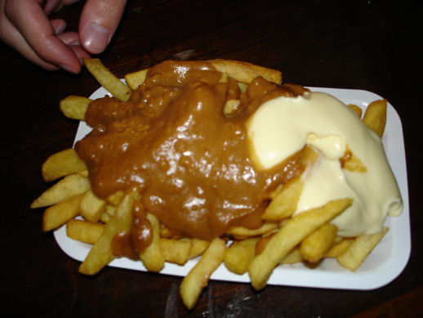
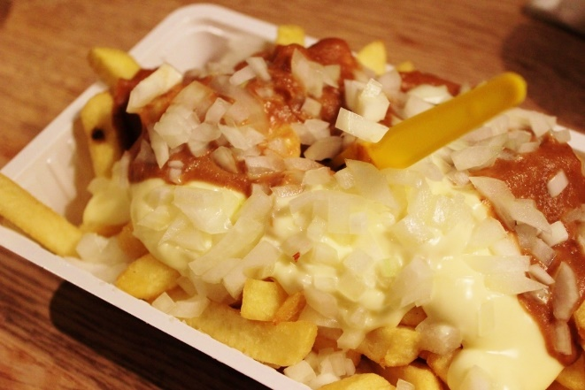
French fries and mayonnaise

Slide 19
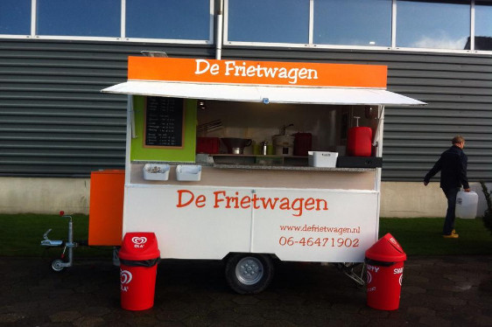
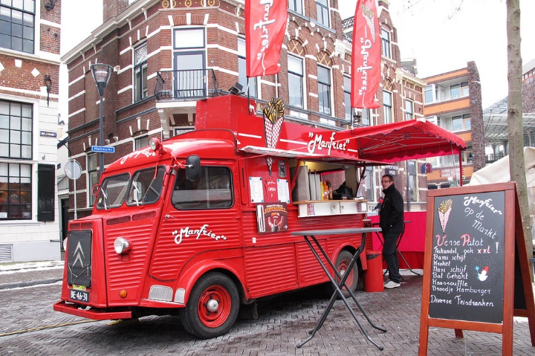
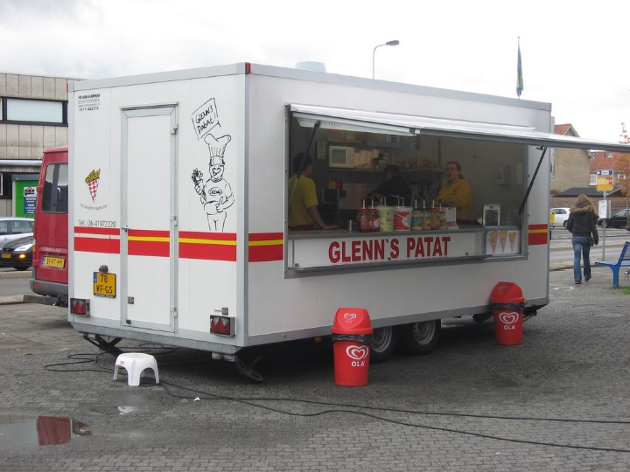
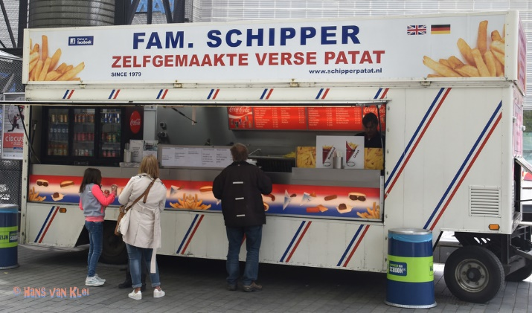
French fries and mayonnaise

Slide 20
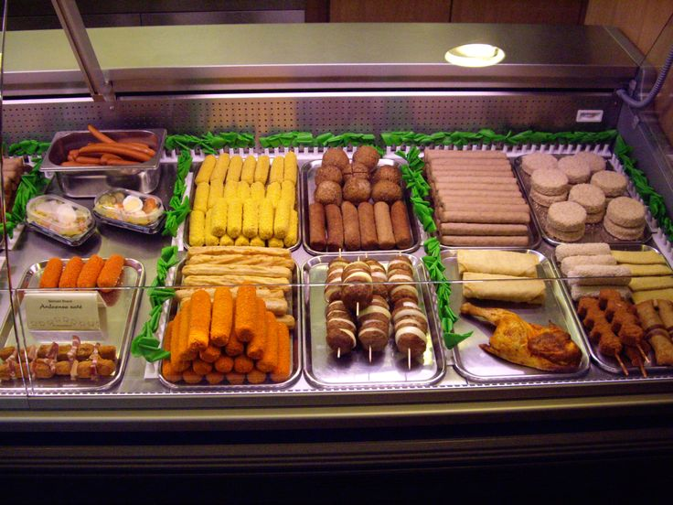
French fries and mayonnaise

Slide 21
Reflection
What were key steps forward?
Did it help to consider goals, constraints, assumptions, ideas, and decisions separately?
Did it help to explicitly step through analysis, synthesis, evaluation? (Did we?)
How will you make sure to continue to do this?

Slide 22
Design studio 1 (part 2)
Your client is RobotKid, a new company that aims to help kids who cannot attend school be part of school as much as possible. RobotKid is a software company, and in particular wants to leverage existing telerobots to provide an outstanding experience that goes beyond ‘just being there’.
The company has sought you and your team out, because you are excellent designers. All of the software design is in your hands, as RobotKid has the idea protected (meaning no competition), but has no idea how to actually design the software.

Slide 23
Design studio 1 (part 2)
As a team, design RobotKid in terms of the functionality it will offer and how the audience will interact with it
Make sure that you explicitly identify goals, constraints, and assumptions
Make sure to consider at least three different approaches, highlight tradeoffs among the approaches, and discuss why you chose the approach you took
briefly document the approaches you considered but did not adopt

Slide 24
Design studio 1 (part 2)
Practice what you have learned about experts:
focus on the essence
prefer solutions that they know work
address knowledge deficiencies
generate alternatives
are skeptical
Due Thursday October 24, at noon (through GradeScope and Linecept)
make sure to identify all group members

Slide 25
Design studio 1 (part 2)
All intermediate artifacts must be uploaded to Linecept
all results from every in-person meeting
all results from every virtual meeting
all results from any work you do on your own
Results should be uploaded as a scan, photograph, or PDF
attributable as to who participated
Handout with basic Linecept info

Slide 26
Design studio 1 (part 2)
Team members will assess other team members
in terms of the contributions they make
in terms of enabling others to make contributions

