Slide 1
Informatics 121 Software Design I
Lecture 7
Duplication of course material for any commercial purpose without the explicit written permission of the professor is prohibited.

Slide 2
Discussion
Team evaluations due Tuesday
There will be discussion this upcoming Friday
Please join your designated discussion

Slide 3
Today
French fries and mayonnaise
Design studio 1

Slide 4
Four types of software design
what is it to accomplish?
application design
satisfactory experience
how does one interact with it?
interaction design
change in the world
what is its conceptual core?
architecture design
plan for realization
what are its implementation details?
implementation design

Slide 5
Keep in mind
designer
plan
maker
change in the world
other stakeholders
audience
experiences
synthesize
goals
constraints
assumptions
decisions
ideas
analyze
evaluate

Slide 6
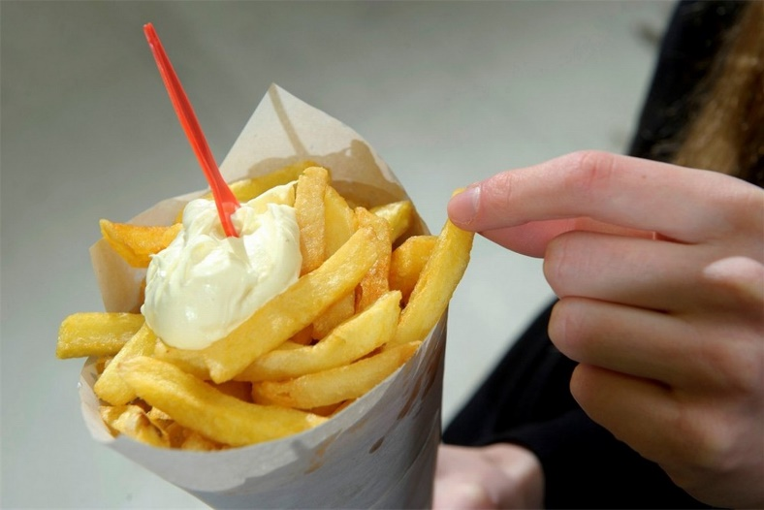
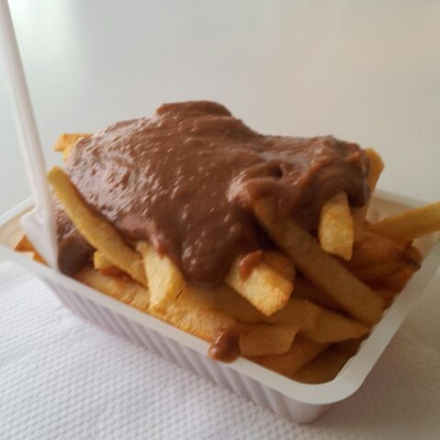
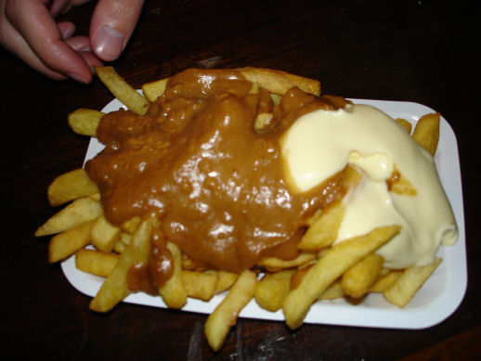
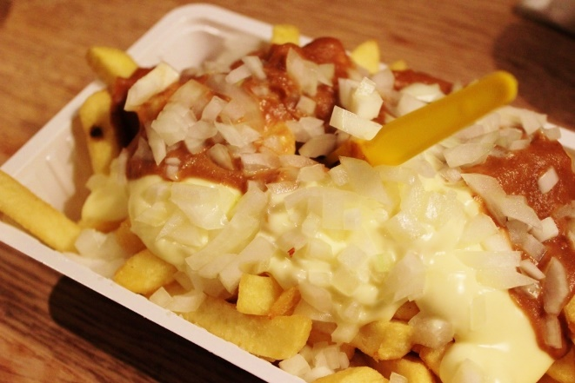
French fries and mayonnaise

Slide 7
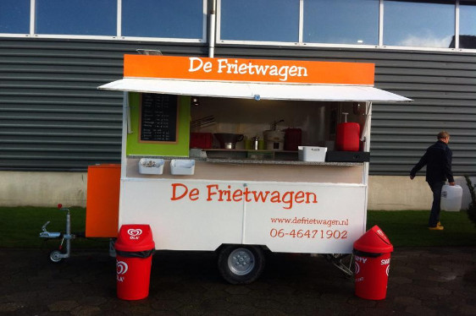
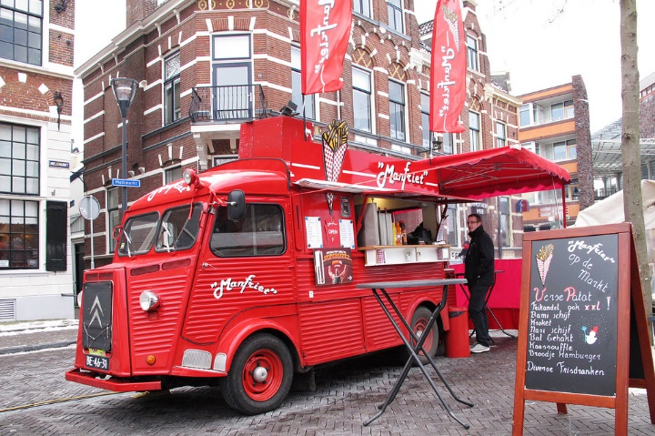
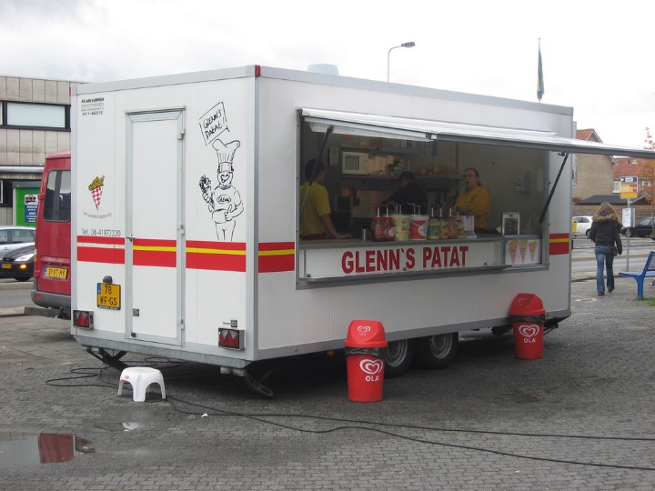
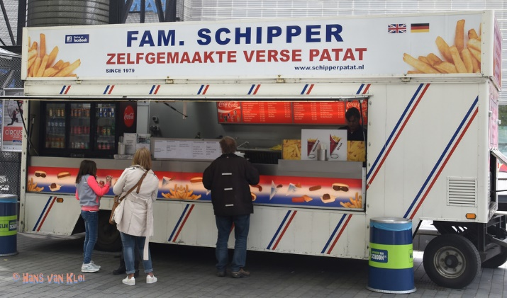
French fries and mayonnaise

Slide 8
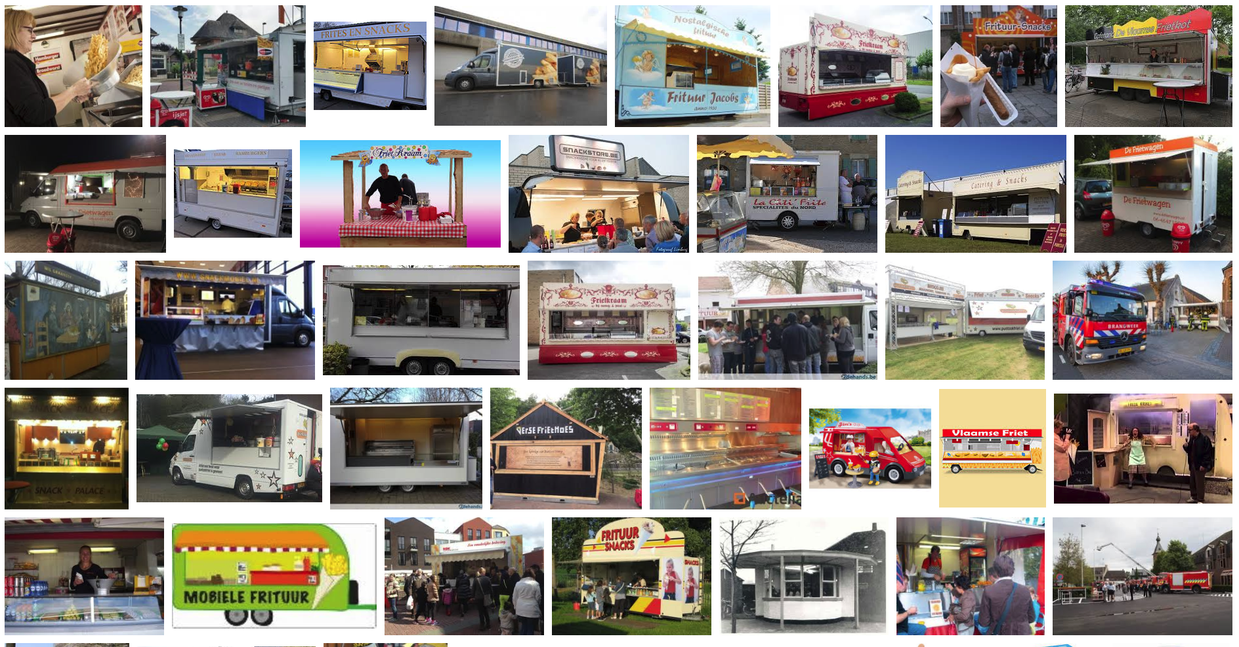
French fries and mayonnaise

Slide 9
Experts...
...focus on the essence
...prefer solutions that they know work
...address knowledge deficiencies
...generate alternatives
...are skeptical

Slide 10
Design studio 1 (part 2)
Your client is RobotKid, a new company that aims to help kids who cannot attend school be part of school as much as possible. RobotKid is a software company, and in particular wants to leverage existing telerobots to provide an outstanding experience that goes beyond ‘just being there’.
The company has sought you and your team out, because you are excellent designers. All of the software design is in your hands, as RobotKid has the idea protected (meaning no competition), but has no idea how to actually design the software.

Slide 11
Design studio 1 (part 2)
As a team, design RobotKid in terms of the functionality it will offer and how the audience will interact with it
Make sure that you explicitly identify goals, constraints, and assumptions
Make sure to consider at least three different approaches, highlight tradeoffs among the approaches, and discuss why you chose the approach you took
briefly document the approaches you considered but did not adopt

Slide 12
Design studio 1 (part 2)
Practice what you have learned about experts:
focus on the essence
prefer solutions that they know work
address knowledge deficiencies
generate alternatives
are skeptical
Due Thursday October 24, at noon (through GradeScope and Linecept)
make sure to identify all group members

Slide 13
Design studio 1 (part 2)
All intermediate artifacts must be uploaded to Linecept
all results from every in-person meeting
all results from every virtual meeting
all results from any work you do on your own
Results should be uploaded as a scan, photograph, or PDF
attributable as to who participated
Handout with basic Linecept info

Slide 14
Design studio 1 (part 2)
Team members will assess other team members
in terms of the contributions they make
in terms of enabling others to make contributions

