Slide 1
Predicates and Quantifiers

Slide 2
Propositional Logic Not Enough
Given the statements:
  “All men are mortal.”
  “Socrates is a man.”
It follows that “Socrates is mortal.”
This can’t be represented in propositional logic.
Need a language that talks about objects, their properties, and their relations.

Slide 3
Introducing Predicate Logic
Predicate logic uses:
  Variables: x, y, z, …
    These represent objects, not propositions
  Predicates: P, Q, …
    These express properties of objects
  Example: let x be an integer and P denote the property “is a perfect square”; then P(x) means “x is a perfect square”
  Predicates are also called Propositional functions
    They are a generalization of propositions
    They become propositions (and have truth values) when their variables are replaced by actual values
  Example: P(9) is a true proposition, P(8) is a false

Slide 4
Propositional Functions
Examples:
  Let P(x) denote “x > 0”; then:
    P(–3) is F.
    P(0) is F.
    P(3) is T.
  Let R(x, y, z) denote “x + y = z”; Find these truth values:
    R(2, –1, 5) ≡ 2 – 1 = 5 is F.
    R(3, 4, 7) ≡ 3 + 4 = 7 is T.
    R(1, 3, z) ≡ 1 + 3 = z is not a proposition

Slide 5
Compound Expressions
Connectives from propositional logic carry over to predicate logic.
If P(x) denotes “x > 0,” then:
  P(3) ∨ P(–1) is T
  P(3) ∧ P(–1) is F
Expressions with variables are not propositions and therefore do not have truth values. For example,
  P(3) ∧ P(y)
  P(x) → P(y)
They become propositions when:
  variables are bound to values, or
  the expressions are used with quantifiers

Slide 6
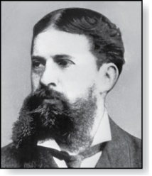
Quantifiers
Charles Peirce (1839-1914)
Quantifiers express the meaning of the words all and some:
  “All men are Mortal.”
  “Some cats do not have fur.”
The two most important quantifiers are:
  Universal Quantifier, “For all,” symbol: ∀
  Existential Quantifier, “There exists,” symbol: ∃
Quantifiers are applied to values in a given domain U
∀x P(x) asserts P(x) is T for every x in the domain
∃x P(x) asserts P(x) is T for some x in the domain

Slide 7
Universal Quantifier
  ∀x P(x) is read as:
    “For all x, P(x)” or
    “For every x, P(x)”
Examples:
  If P(x) denotes “x > 0” and U is the domain of integers, then ∀x P(x) is F.
  If P(x) denotes “x > 0” and U is the domain of positive integers, then ∀x P(x) is T.
  If P(x) denotes “x is even” and U is the domain of integers, then ∀x P(x) is F.

Slide 8
Existential Quantifier
∃x P(x) is read as
  “For some x, P(x)”, or
  “There is an x such that P(x),” or
  “For at least one x, P(x).”
Examples:
  If P(x) denotes “x > 0” and U is integers, then ∃x P(x) is T.
  If P(x) denotes “x < 0” and U is positive integers, then ∃x P(x) is F.
  If P(x) denotes “x is even” and U is integers, then ∃x P(x) is T.

Slide 9
Thinking about Quantifiers as Loops
To evaluate ∀x P(x) loop through all x in the domain.
  If at every step P(x) is T, then ∀x P(x) is T.
  If at a step P(x) is F, then ∀x P(x) is F and the loop terminates.
To evaluate ∃x P(x) loop through all x in the domain.
  If at some step, P(x) is T, then ∃x P(x) is T and the loop terminates.
  If the loop ends without finding an x for which P(x) is T, then ∃x P(x) is F.
Even if the domains are infinite, we can still think of the quantifiers in this fashion, but the loops may not terminate.

Slide 10
Thinking about Quantifiers as Conjunctions and Disjunctions
A proposition with ∀ is equivalent to a conjunction of propositions without quantifiers
A proposition with ∃ is equivalent to a disjunction of propositions without quantifiers.
Example: If U consists of the integers 1, 2, 3 then:
Even if the domains are infinite, we can still think of the quantifiers in this way, but the expressions will be infinite.

Slide 11
Properties of Quantifiers
The truth value of quantifiers depend on both the function P(x) and the domain U.
Examples:
  Assume P(x) is “x < 2”
  If U is positive integers then ∃x P(x) is T, but∀x P(x) is F.
  If U is negative integers then both ∃x P(x) and ∀x P(x) are T.
  If U consists of 3, 4, and 5 then both ∃x P(x) and∀x P(x) are F.

Slide 12
Translating from English to Logic
Example 1: Translate this sentence into predicate logic: “Every student in this class has taken a course in Java.”
Solution:
First decide on the domain U.
  Solution 1: If U is all students in this class, define a propositional function J(x) denoting “x has taken a course in Java” and translate as ∀x J(x).
  Solution 2: But if U is all people, also define a propositional function S(x) denoting “x is a student in this class” and translate as ∀x (S(x)→ J(x)).
  Note: ∀x (S(x) ∧ J(x)) is not correct. What does it mean?

Slide 13
Translating from English to Logic
Example 2: Translate the following into predicate logic: “Some student in this class has taken a course in Java.”
Solution:
First decide on the domain U.
  Solution 1: If U is all students in this class, then
  ∃x J(x)
  Solution 1: But if U is all people, then translate as ∃x (S(x) ∧ J(x))
  Note: ∃x (S(x)→ J(x)) is not correct. What does it mean?

Slide 14
Equivalences in Predicate Logic
Statements with predicates and quantifiers are logically equivalent iff they have the same truth value
  for every predicate used in these statements and
  for every domain used for the variables in the expressions
The notation S≡T indicates that S and T are logically equivalent.
Example: ∀x ¬¬S(x) ≡ ∀x S(x)

Slide 15
Negating Quantified Expressions
  Example: Express “Every student in this class has taken a course in Java.”
  The domain is students in this class
  J(x) is “x has taken a course in Java”
  The statement is: ∀x J(x)
Negate the statement: “It is not the case that every student in this class has taken Java.”
  ¬∀x J(x)
This implies that: “There is a student in this class who has not taken calculus.”
  ∃x ¬J(x)

Slide 16
Negating Quantified Expressions
  Now Consider: “There is a student in this class who has taken a course in Java.”
  ∃x J(x)
Negating the statement: “It is not the case that there is a student in this class who has taken Java.”
  ¬∃x J(x)
This implies that: “No student in this class has taken Java,” or (more awkwardly) “Every student in this class has not taken Java.”
  ∀x ¬J(x)

Slide 17
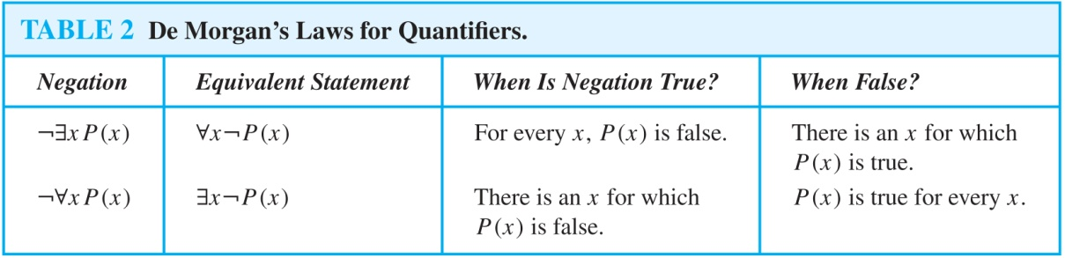
De Morgan’s Laws for Quantifiers
The formal rules for negating quantifiers are:

