Slide 1
Rules of Inference

Slide 2
Valid Arguments
An argument is a sequence of propositions.
All but the final proposition are called premises.
The last statement is the conclusion.
The Socrates Example
  We have two premises:
    “All men are mortal.”
    “Socrates is a man.”
  The conclusion is:
    “Socrates is mortal.”
The argument is valid if the premises imply the conclusion.

Slide 3
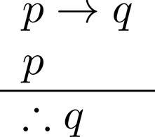

Arguments in Propositional Logic
Formal notation of an argument:
  the premises are above the line
  the conclusion is below the line
      If it is raining then streets are wet
      It is raining
      Streets are wet
How do we know that this argument is valid?

Slide 4
Arguments in Propositional Logic
How do we know that this argument is valid?
  Use truth tables
    Tedious: table size grows exponentially with number of variables
  Establish rules to incrementally build argument
p | q | p→q | p ∧ (p→q) | (p ∧ (p→q)) → q
T | T | T | T | T
T | F | F | F | T
F | T | T | F | T
F | F | T | F | T

Slide 5
Arguments in Propositional Logic
An argument form is an abstraction of an argument
  It contains propositional variables
  It is valid no matter what propositions are substituted into its variables, i.e.:
  If the premises are p₁ ,p₂, …,p_{n} and the conclusion is q then
  (p₁ ∧ p₂ ∧ … ∧ p_{n} ) → q is always T (a tautology)
If an argument matches an argument form then it is valid
Example:
  ( (p → q ) ∧ p ) → q is a tautology
  Hence the following argument is valid:
  ( (if it’s raining → streets are wet) ∧ it’s raining) → streets are wet
Inference rules are simple argument forms used to incrementally construct more complex argument forms

Slide 6
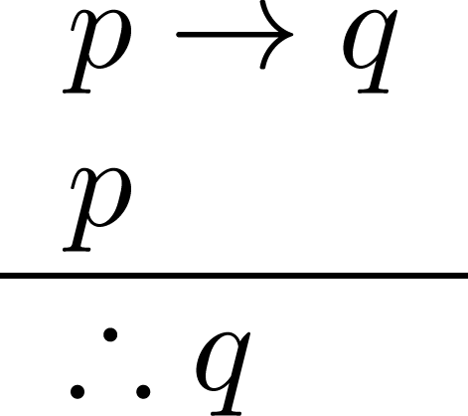
Modus Ponens
Corresponding Tautology:
(p ∧ (p →q)) → q
Example:
Let p be “It is snowing.”
Let q be “I will study math.”
“If it is snowing then I will study math.”
“It is snowing.”
“Therefore I will study math.”

Slide 7
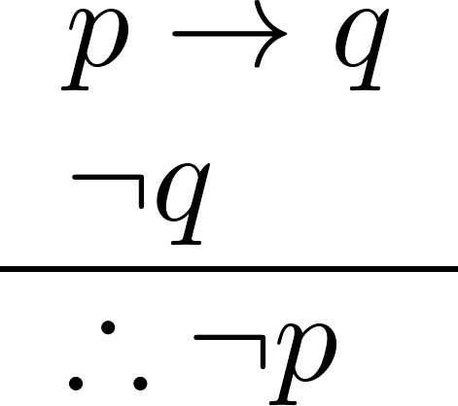
Modus Tollens
Corresponding Tautology:
(¬q ∧ (p →q)) → ¬p
Example:
Let p be “it is snowing.”
Let q be “I will study math.”
“If it is snowing, then I will study math.”
“I will not study math.”
“Therefore, it is not snowing.”

Slide 8
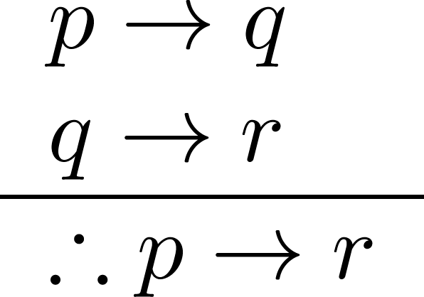
Hypothetical Syllogism
Corresponding Tautology:
((p →q) ∧ (q→r)) → (p→r)
Example:
Let p be “It snows.”
Let q be “I will study math.”
Let r be “I will get an A.”
“If it snows, then I will study math.”
“If I study math, then I will get an A.”
“Therefore, if it snows, I will get an A.”

Slide 9
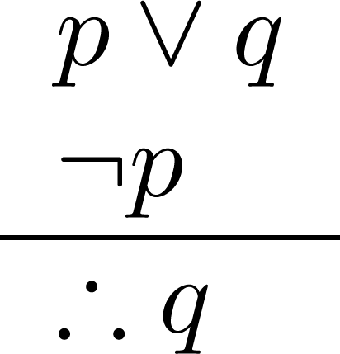
Disjunctive Syllogism
Corresponding Tautology:
(¬p ∧ (p ∨q)) → q
Example:
Let p be “I will study math.”
Let q be “I will study literature.”
“I will study math or I will study literature.”
“I will not study math.”
“Therefore, I will study literature.”

Slide 10
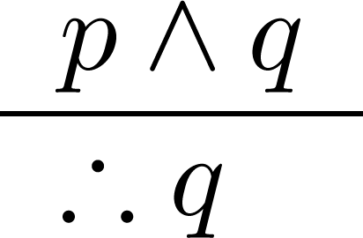
Simplification
Corresponding Tautology:
(p∧q) → q
Example:
Let p be “I will study math.”
Let q be “I will study literature.”
“I will study math and literature”
“Therefore, I will study math.”

Slide 11
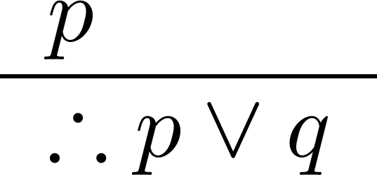
Addition
Corresponding Tautology:
p → (p ∨q)
Example:
Let p be “I will study math.”
Let q be “I will visit Las Vegas.”
“I will study math.”
“Therefore, I will study math or I will visit Las Vegas.”

Slide 12
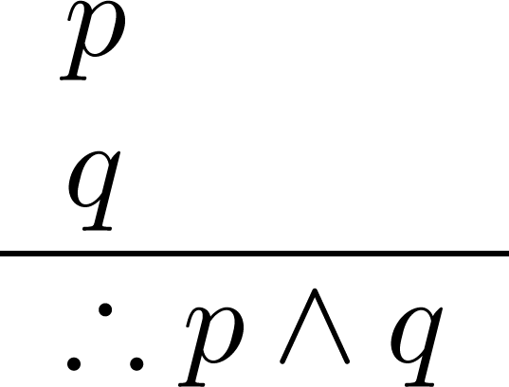
Conjunction
Corresponding Tautology:
((p) ∧ (q)) →(p ∧ q)
Example:
Let p be “I will study math.”
Let q be “I will study literature.”
“I will study math.”
“I will study literature.”
“Therefore, I will study math and literature.”

Slide 13
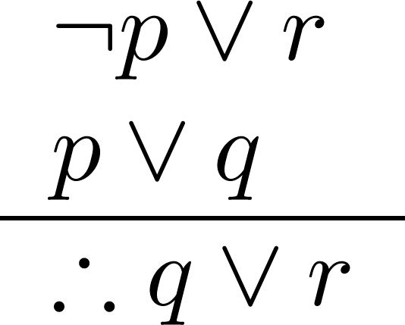
Resolution
Corresponding Tautology:
((¬p ∨ r ) ∧ (p ∨ q)) → (q ∨ r)
Example:
Let p be “I will study math.”
Let r be “I will study literature.”
Let q be “I will study physics.”
“I will not study math or I will study literature.”
“I will study math or I will study physics.”
“Therefore, I will study physics or literature.”

Slide 14
Valid Arguments
Example: Given these hypotheses:
  “It is not sunny this afternoon and it is colder than yesterday.”
  “We will go swimming only if it is sunny.”
  “If we do not go swimming, then we will take a canoe trip.”
  “If we take a canoe trip, then we will be home by sunset.”
  Construct a valid argument for the conclusion:
  “We will be home by sunset.”
Solution:
Choose propositional variables:
  p: “It is sunny this afternoon.”
  q: “It is colder than yesterday.”
  r: “We will go swimming.”
  s: “We will take a canoe trip.”
  t: “We will be home by sunset.”
Translate into propositional logic
¬p ∧ q
r → p
¬r → s
s → t
∴ t

Slide 15
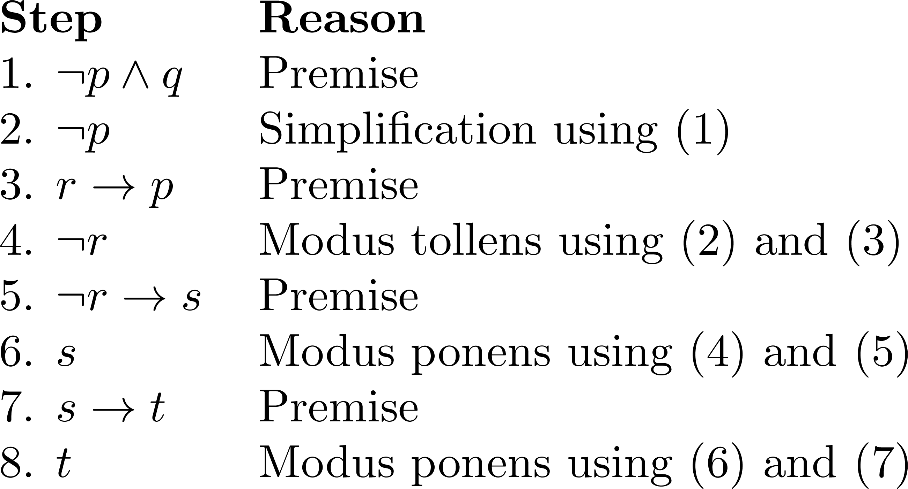
Valid Arguments
¬p ∧ q
r → p
¬r → s
s → t
∴ t
3. Construct the Valid Argument
Notes:
Note that a truth table would have 32 rows since we have 5 propositional variables.

Slide 16
Common Fallacies:
Affirming the conclusion
This confuses necessary and sufficient conditions.
Example:
    If people have the flu, they cough.
    Alison is coughing.
    Therefore, Alison has the flu.
  This argument is not valid:
    Other things, such as asthma, can cause someone to cough.
    Having the flu is a sufficient condition for coughing, but it is not necessary

Slide 17
Common Fallacies:
Denying the hypothesis
This also confuses necessary and sufficient conditions.
Example:
    If it is raining outside, the sky is cloudy.
    It is not raining outside.
    Therefore, it is not cloudy.
  This argument is not valid:
    Skies can be cloudy without any rain.
    Rain is a sufficient condition of cloudiness, but it is not necessary.

Slide 18
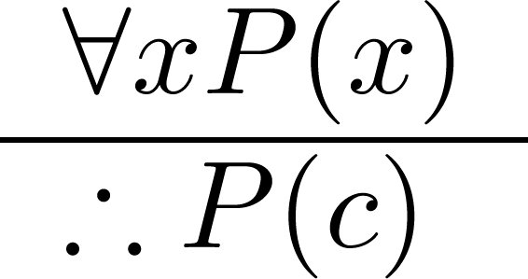
Universal Instantiation (UI)
If a predicate is true for all elements x in the domain then it is true for any specific element c
Example:
  The domain consists of all dogs and Fido is a dog.
  “All dogs are cuddly.”
  “Therefore, Fido is cuddly.”
This rule allows us to remove a quantifier

Slide 19
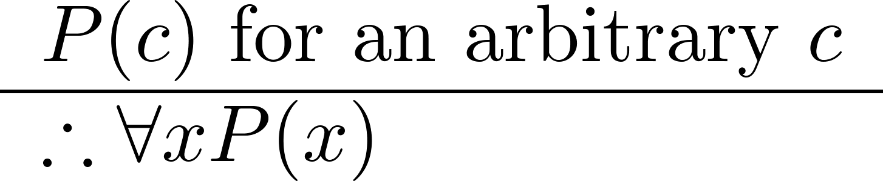
Universal Generalization (UG)
If a predicate is true for any element c in the domain then it is true for all elements x
Example:
  The domain consists of the dogs Fido, Spot, and Buddy.
  “Fido is cuddly, Spot is cuddly, Buddy is cuddly.”
  “Therefore, all dogs in the domain are cuddly.”
This rule allows us to introduce a quantifier

Slide 20
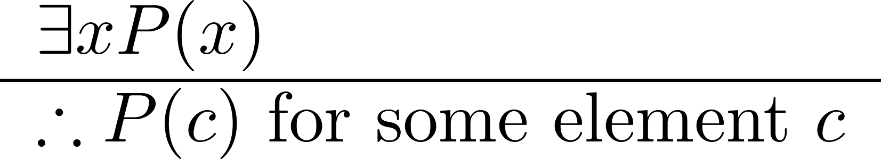
Existential Instantiation (EI)
If a predicate is true some element in the domain then it is true for some specific element c
Example:
  “There is someone who got an A in the course.”
  “Let’s call her c and say that c got an A”

Slide 21
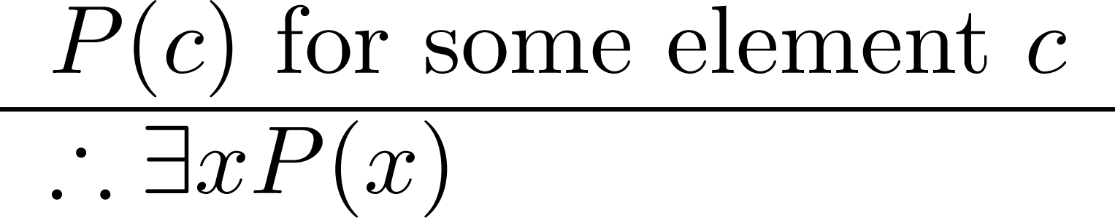
Existential Generalization (EG)
If a predicate is true for a specific element c in the domain then there exists an element x for which it is true
Example:
  “Michelle got an A in the class.”
  “Therefore, there is someone who got an A in the class.”

Slide 22
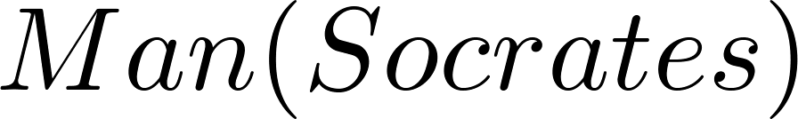
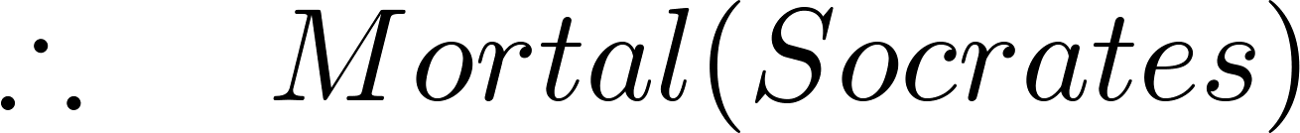
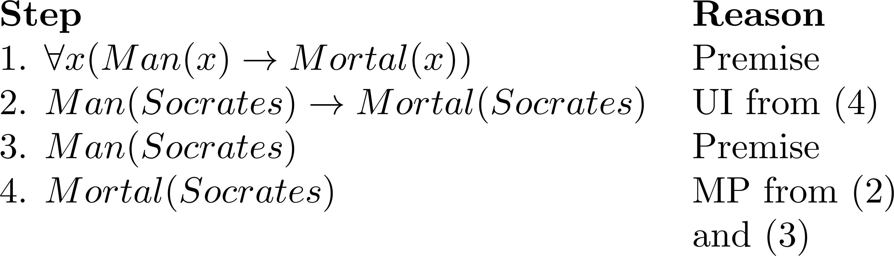
Returning to the Socrates Example
1

Slide 23
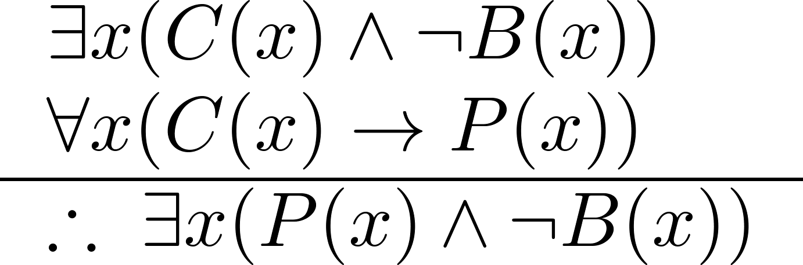
Using Rules of Inference
Example: construct a valid argument showing that:
  “Someone who passed the first exam has not read the book.”
follows from the premises
  “A student in this class has not read the book.”
  “Everyone in this class passed the first exam.”
Solution: Let
  C(x) denote “x is in this class”
  B(x) denote “x has read the book”
  P(x) denote “x passed the first exam”

Slide 24
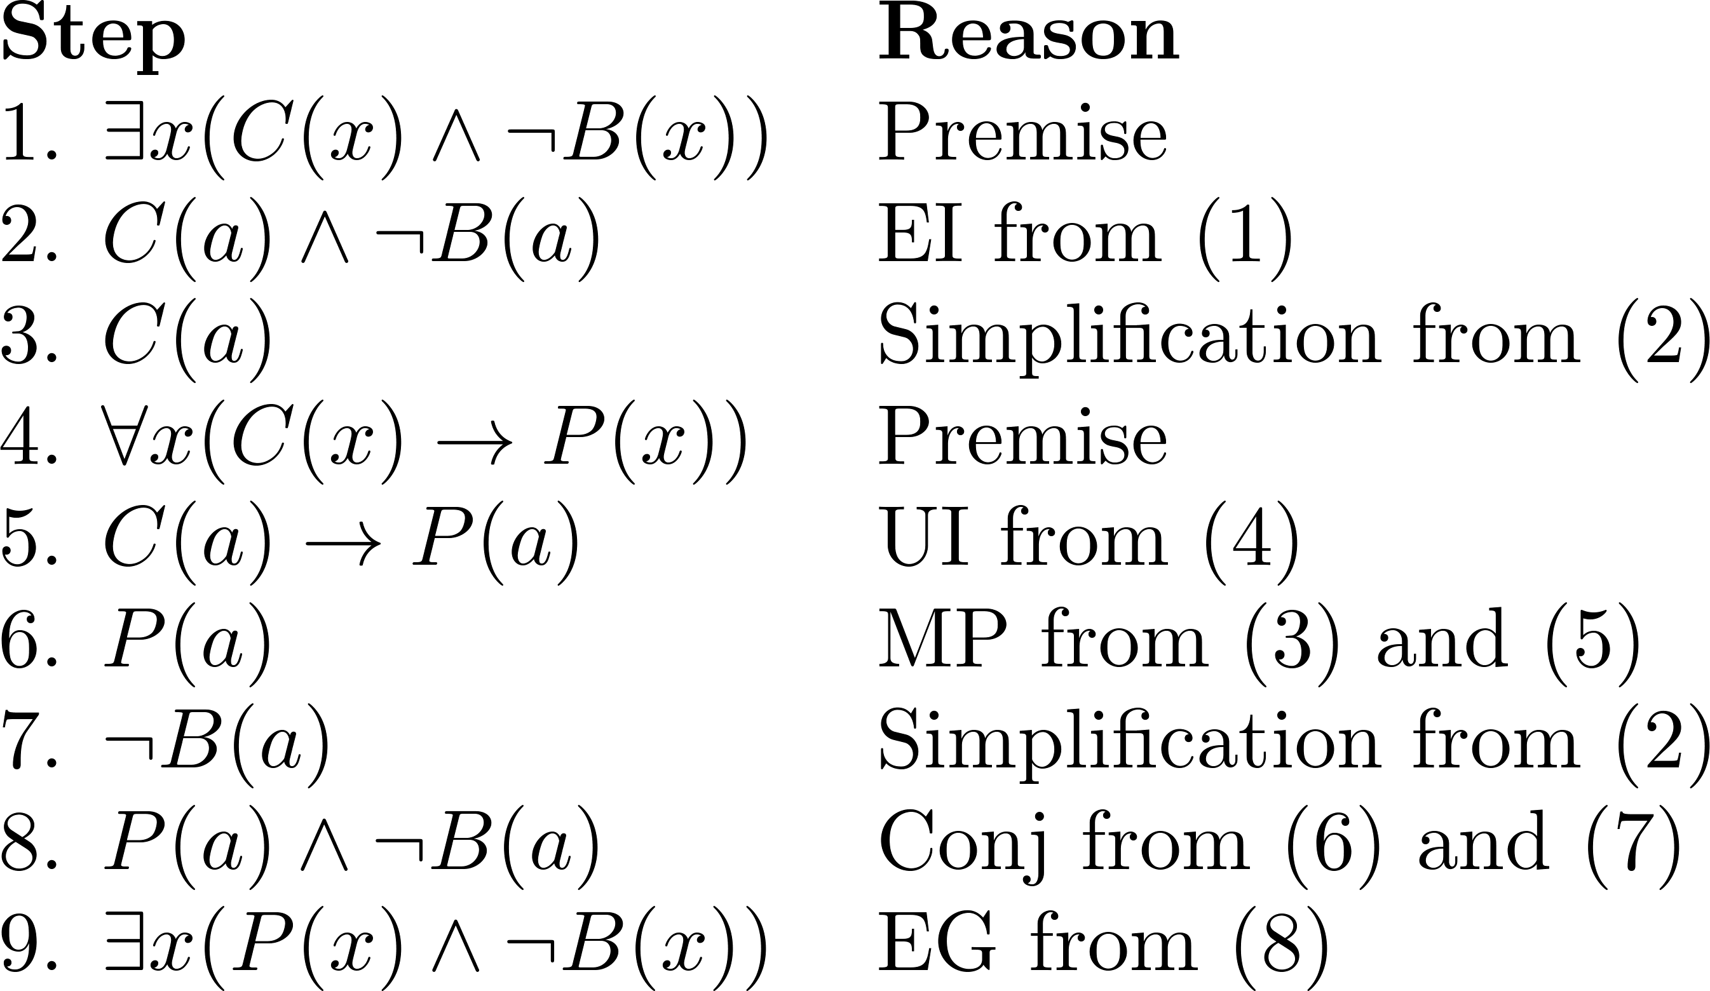
Using Rules of Inference
  Valid Argument:

