Slide 1
Introduction to Proofs

Slide 2
Introduction to Proofs
A proof is a valid argument that establishes the truth of a statement.
Previous section discussed formal proofs
Informal proofs are common in math, CS, and other disciplines
  More than one rule of inference are often used in a step.
  Steps may be skipped.
  The rules of inference used are not explicitly stated.
  Easier to understand and to explain to people.
  They are generally shorter but it is also easier to introduce errors.

Slide 3
Definitions
A theorem is a statement that can be shown to be true using:
  definitions
  other theorems
  axioms (statements which are given as true)
  rules of inference
A lemma is a ‘helping theorem’ or a result that is needed to prove a theorem.
A corollary is a result that follows directly from a theorem.
A conjecture is a statement proposed to be true.
  If a proof of a conjecture is found, it becomes a theorem.
  It may turn out to be false.

Slide 4
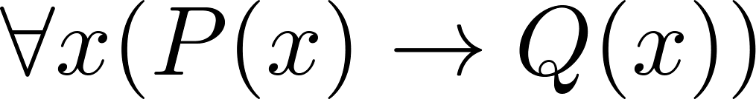


Proving Theorems: Conditionals
Many theorems have the form:
To prove them, we consider an arbitrary element c of the domain and show that:
The original statement follows by universal generalization
So, we need methods for proving implications of the form:

Slide 5
Working with Integers and Reals
Important definitions:
  An integer n is even if there exists an integer k such that n = 2k
  An integer n is odd if there exists an integer k, such that n = 2k + 1
  Note that every integer is either even or odd and no integer is both
  A real number r is rational if there exist integers p and q such that r = p/q and q≠0.
  We can also assume that p and q have no common factors

Slide 6
Proving Conditional Statements: p → q
Direct Proof: Assume that p is true. Use rules of inference, axioms, and logical equivalences to show that q is also true.
Example: Give a direct proof of the theorem “If n is an odd integer, then n² is odd.”
Solution:
  Assume that n is odd. Then n = 2k + 1 for an integer k.
  Squaring both sides of the equation, we get:
  n² = (2k + 1)² = 4k² + 4k +1 = 2(2k² + 2k) + 1
  2k² + 2k is an integer, let’s say r
  So n² = 2r + 1 and hence n² is odd.
  This proves that if n is an odd integer, then n² is an odd integer.

Slide 7
Proving Conditional Statements: p → q
Example: Give a direct proof of the theorem “If c ≥ 6 then c²+c > 2c”
Solution:
  Assume that c ≥ 6.
  Simplify the conclusion:
  Subtract c from both sides of c²+c > 2c to get c² > c.
  c is always positive so divide both sides by c to get c > 1.
  With this simplification, the theorem states “If c ≥ 6 then c > 1”
  This is always true and hence the original formulation is also true

Slide 8
Proving Conditional Statements: p → q
Proof by Contraposition: Assume ¬q and show ¬p is true also
  Recall that (¬q → ¬p ) ≡ (p → q)
  This is sometimes called an indirect proof method
  We use this method when the contraposition is easier to demonstrate than the proposition
  Consider this method when p is more complicated than q
Examples:
  For any integer k, if 3k+1 is even then k is odd
  If n is an integer and n2 is odd then n is odd
  If n3+5 is odd then n is even

Slide 9
Proving Conditional Statements: p → q
Example: Prove that if n is an integer and 3n+2 is odd, then n is odd.
Solution:
  p ≡ 3n+2 is odd
  q ≡ n is odd
  First state the contrapositive: ¬q → ¬p
    If n is even (not odd) then 3n+2 is even (not odd)
  Assume n is even (¬q). So, n = 2k for some integer k.
  Thus 3n+2 = 3(2k)+2 = 6k +2 = 2(3k+1) = 2j for j = 3k+1
  Therefore 3n+2 is even (¬p).
  Since we have shown ¬q → ¬p , p → q must hold as well
    If 3n+2 is odd then n is odd

Slide 10
Proving Conditional Statements: p → q
Example: Prove that for an integer n, if n² is odd, then n is odd.
Solution:
  Use proof by contraposition: if n is even then n² is even
  Assume n is even: n = 2k for some integer k
  Hence n² = 4k² = 2 (2k²)
  Since 2k² is an integer, n² is even
  We have shown that if n is even, then n² is even.
  Therefore by contraposition, for an integer n, if n² is odd, then n is odd.

Slide 11
Proof by Contradiction
  Another indirect form of proof
  To prove p, assume ¬p
  Derive a contradiction q such that ¬p → q
  This proves that p is true
  Why is this reasoning valid:
    A contradiction (e.g., r ∧ ¬r) is always F, hence ¬p → F
    Since ¬p → F is true, the contrapositive T→p is also true

Slide 12
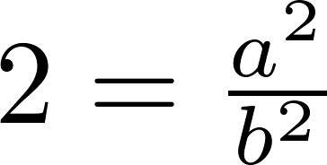
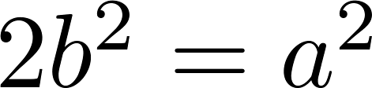
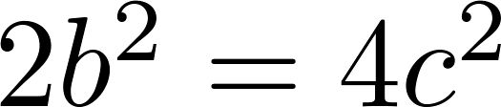
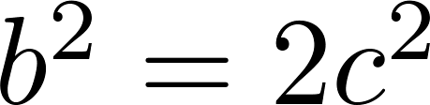
Proof by Contradiction
Example: prove by contradiction that √2 is irrational.
Solution:
  Suppose √2 is rational.
  Then there exists integers a and b with √2=a/b, where b≠0 and a and b have no common factors
  Then and
  Therefore a² must be even. If a² is even then a must be even (shown separately as an exercise).
  Since a is even, a = 2c for some integer c, thus
and
  Therefore b² is even and thus b must be even as well.
  If a and b are both even they must be divisible by 2. This contradicts our assumption that a and b have no common factors.
  We have proved by contradiction that our initial assumption must be false and therefore √2 is irrational .

Slide 13
Proof by Contradiction
  Can also be applied to prove conditional statements: p → q
  To prove p → q, assume ¬(p → q) ≡ (p ∧ ¬q)
  Derive a contradiction such that (p ∧ ¬q) → F
  This proves the original statement
Example: Prove that if 3n+2 is odd, then n is odd (n is an integer).
Solution:
  p ≡ 3n+2 is odd
  q ≡ n is odd
  Assume: p ∧ ¬q
    3n+2 is odd ∧ n is even
  Since n is even, n = 2k for some integer k.
  Thus 3n+2 = 3(2k)+2 = 6k +2 = 2(3k+1) = 2j for j = 3k+1
  Therefore 3n+2 is even
  This contradicts the assumption that 3n+2 is odd
  Since the assumption implies F, the original statement is T:
    If 3n+2 is odd then n is odd

