Slide 1
Representing Boolean Functions

Slide 2
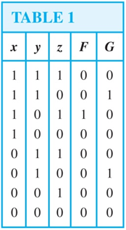
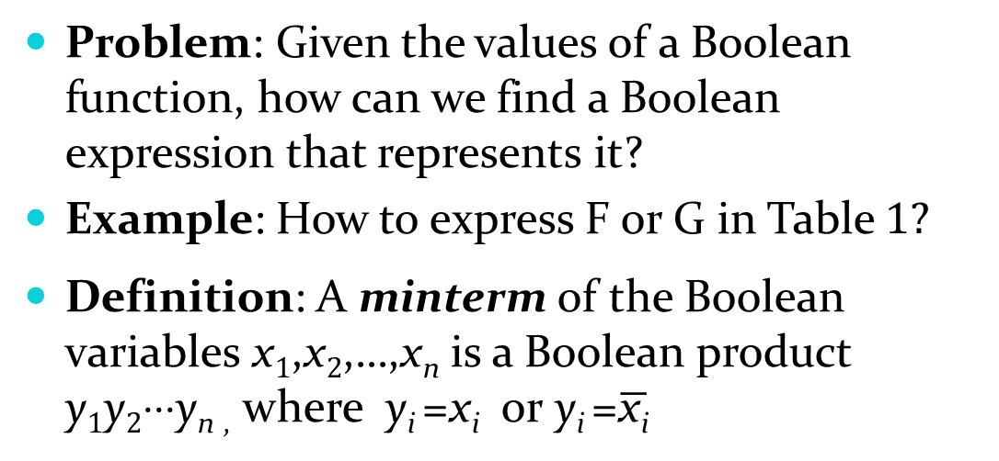
Sum-of-Products Expansion
Problem: Given the values of a Boolean function, how can we find a Boolean expression that represents it?
Example: How to express F or G in Table 1?
Definition: A minterm of the Boolean variables x₁,x₂,…,x_{n} is a Boolean product y₁y₂⋅⋅⋅y_{n ,} where y_{i} =x_{i} or y_{i} =$\overline{\text{x}\text{i}}$
Definition: Any Boolean function can be represented as the sum of those minterms that yield a 1
  This is called the sum-of-products expansion or the disjunctive normal form of the Boolean function

Slide 3
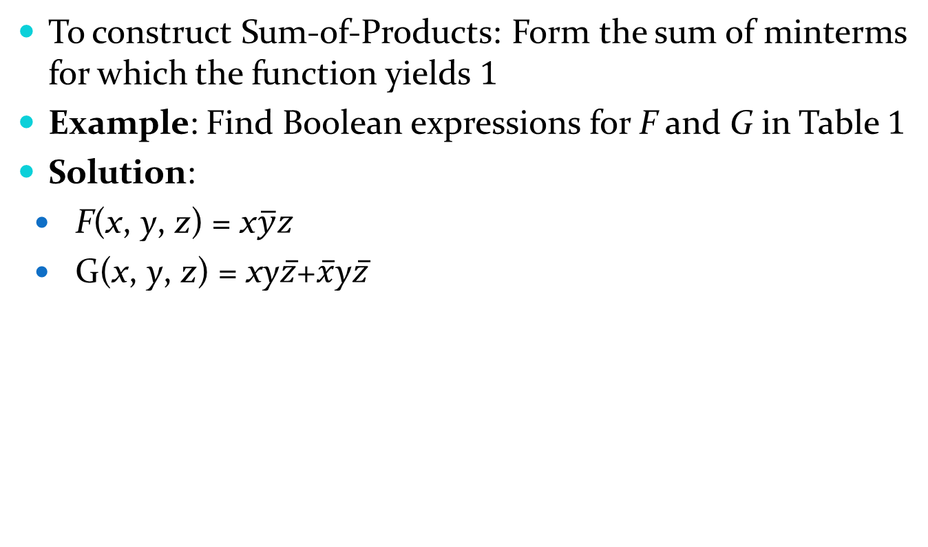
Sum-of-Products Expansion
To construct Sum-of-Products: Form the sum of minterms for which the function yields 1
Example: Find Boolean expressions for F and G in Table 1
Solution:
  F(x, y, z) = x$\overline{y}z$
  G(x, y, z) = xy$\overline{z}$+$\overline{x}$y$\overline{z}$

Slide 4
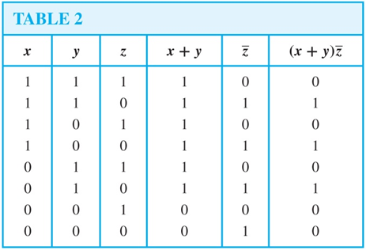

Sum-of-Products Expansion
Example: Find the sum-of-products for F(x,y,z) = (x+y)$\overline{z}$
Solution 1: First build the table for F. Then form the sum of minterms that have the value 1
F(x, y, z) = xy$\overline{z}$ + x$\overline{y}\overline{z}$ + $\overline{x}$y$\overline{z}$

Slide 5
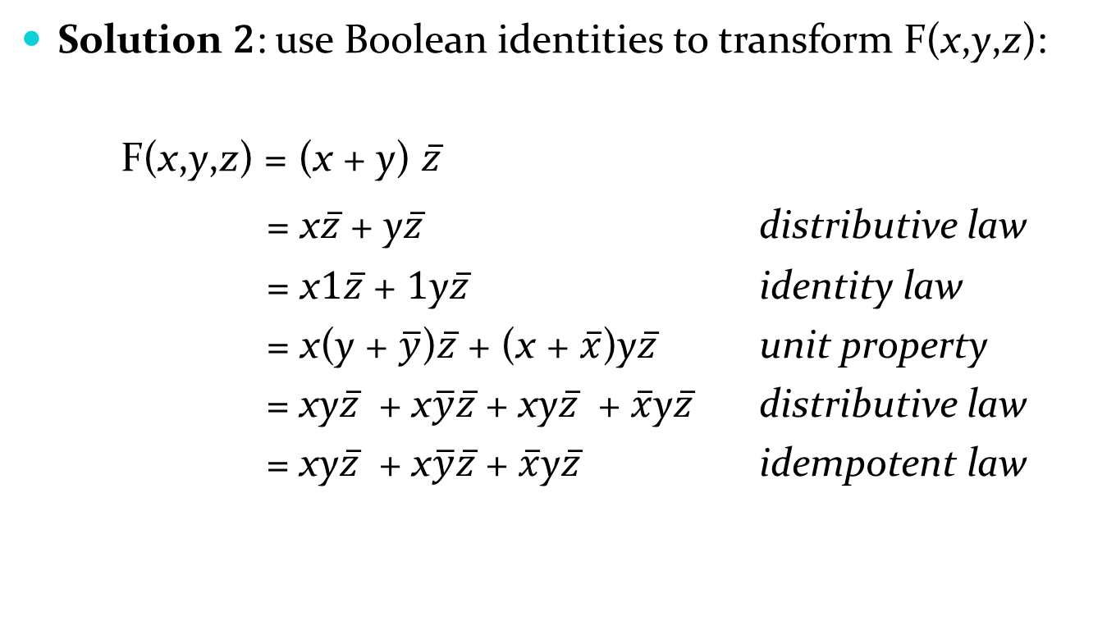
Sum-of-Products Expansion
Solution 2: use Boolean identities to transform F(x,y,z):
  F(x,y,z) = (x + y) $\overline{z}$
= x$\overline{z}$ + y$\overline{z}$ distributive law
= x1$\overline{z}$ + 1y$\overline{z}$ identity law
= x(y + $\overline{y}$)$\overline{z}$ + (x + $\overline{x}$)y$\overline{z}$ unit property
= xy$\overline{z}$ + x$\overline{y}\overline{z}$ + xy$\overline{z}$ + $\overline{x}$y$\overline{z}$ distributive law
= xy$\overline{z}$ + x$\overline{y}\overline{z}$ + $\overline{x}$y$\overline{z}$ idempotent law

Slide 6
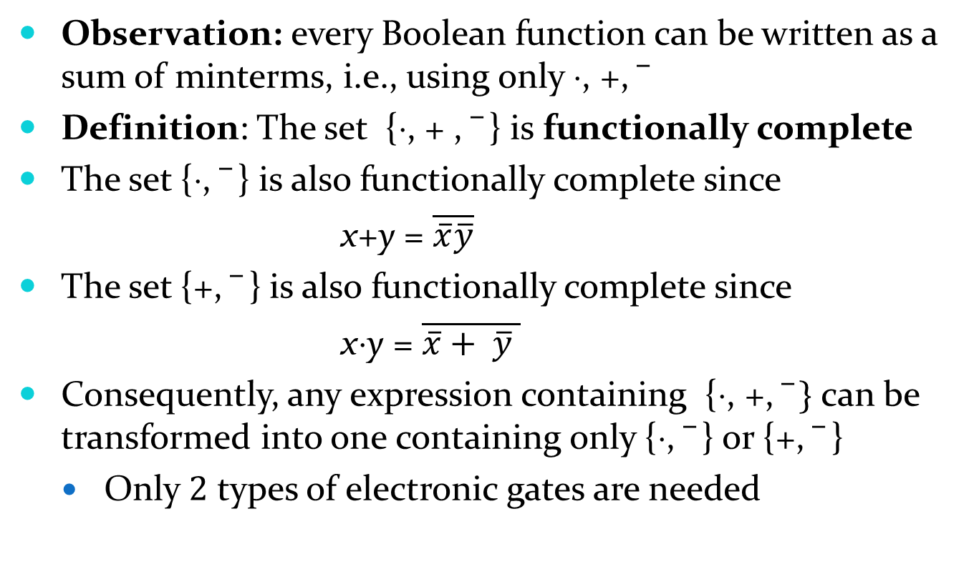
Functional Completeness
Observation: every Boolean function can be written as a sum of minterms, i.e., using only ⋅, +,
Definition: The set {⋅, + , } is functionally complete
The set {⋅, } is also functionally complete since
  x+y = $\overline{\overline{x}\overline{y}}$
The set {+, } is also functionally complete since
  x⋅y = $\overline{\overline{x}+ \overline{y} }$
Consequently, any expression containing {⋅, +, $\overline{ } \}$ can be transformed into one containing only {⋅, } or {+, }
  Only 2 types of electronic gates are needed

