Slide 1
Logic Gates

Slide 2
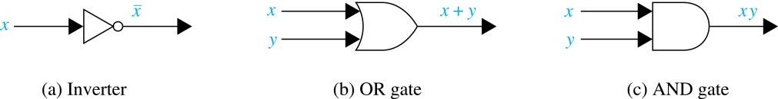
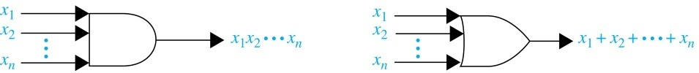
Logic Gates
Gates are basic elements of electronic circuits
  Each implements a Boolean operation
  Input: one or more Boolean variables
  Output: result of the Boolean operation
Examples:

Slide 3
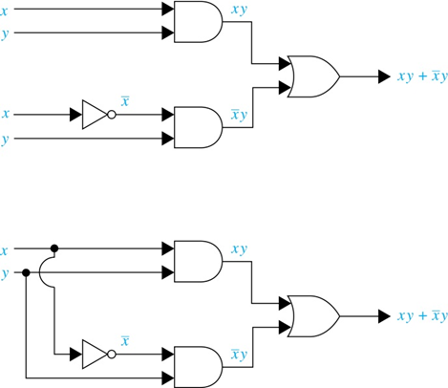
Combinations of Gates
Combinational circuits
  output depends on only current inputs; no state
  constructed using combinations of AND, OR, NOT gates
Different ways of
drawing a circuit

Slide 4
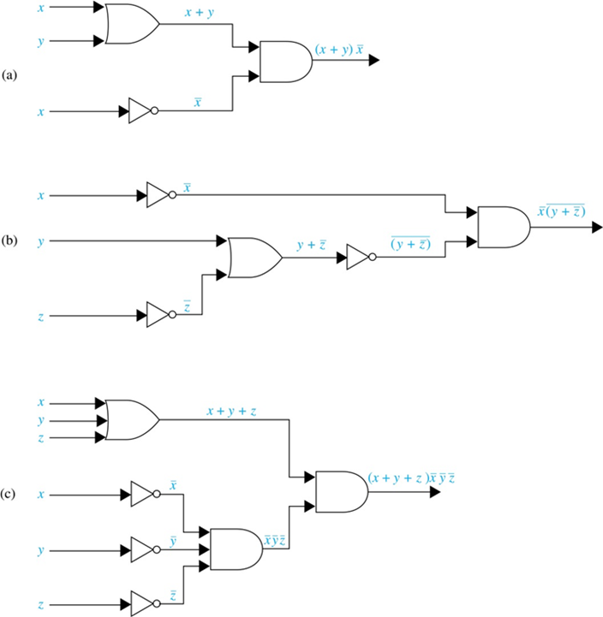
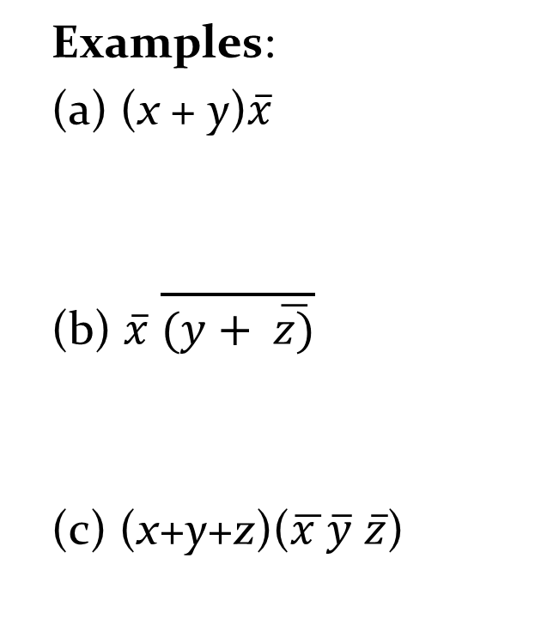
Combinational Circuits
Examples:
(a) (x + y)$\overline{x}$
(b) $\overline{x}$ $\overline{(y+ \overline{z)}}$
(c) (x+y+z)($\overline{x }\overline{y} \overline{z}$)

Slide 5
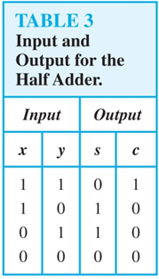
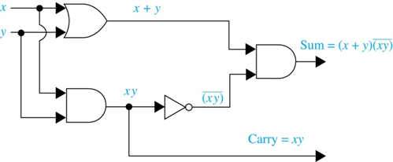

Adders
Adder: a circuit to add two positive integers
The first step is to build a half adder:
  does not accept a carry from a previous addition
  adds two bits: s = x$\overline{y}$+$\overline{x}y$ = (x+y)$(\overline{xy})$
  produces a carry: c = xy

Slide 6
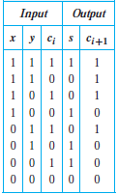
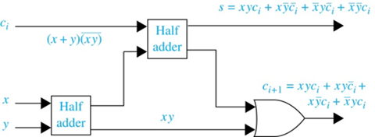
Full Adder
Accepts 2 bits x and y and a carry c_{i}
Produces sum x+y and carry c_{i+1}

Slide 7
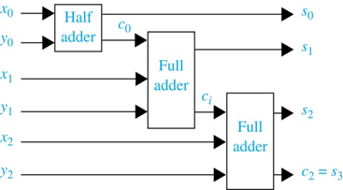
Multiple-Bit Adders
A half adder and multiple full adders can be used to produce the sum of n bit integers.
Example: A circuit to add 2 three-bit integers.

