Slide 1
Languages and Grammars

Slide 2
Introduction
Syntax: form of a sentence (is it valid)
Semantics: meaning of a sentence
Valid: the frog writes neatly
Invalid: swims quickly mathematics
Grammar: rules that specify syntactically correct sentences
natural language grammars are complex
formal languages have well-defined rules of syntax
important in the study of programming languages

Slide 3
Phrase-Structure Grammars
Definitions:
A vocabulary V is a finite, nonempty set of symbols
A sentence over V is a string of finite length of symbols
The empty string or null string λ contains no symbols
V* is the set of all sentences over V; a language is a subset of V*
A production is a rule that specifies the replacement of a string with another string ; z₀ → z₁ means that z₀ can be replaced by z₁
Elements of V that can not be replaced by other symbols are terminals
Elements that can be replaced by other symbols are nonterminals

Slide 4
Phrase-Structure Grammars
A phrase-structure grammar is a tuple G=(V, T, S, P)
V is a vocabulary
S is the start symbol
T ⊂ V are terminal symbols
P is a finite set of productions
N = V−T is the set of nonterminal symbols
Example : G =(V, T, S, P), where V={a, b, A, B, S}, T={a,b}, S is the start symbol, and P={S→Aba, A→BB, B→ab, AB→b}
What is the language of G? (All valid sentences?)

Slide 5
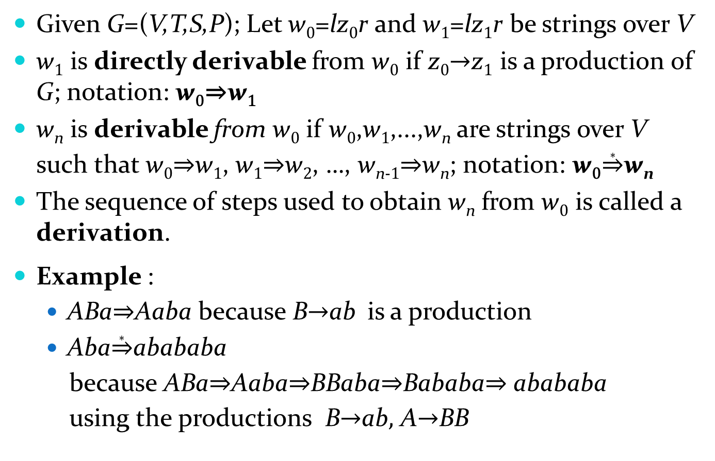
Derivations
Given G=(V,T,S,P); Let w₀=lz₀r and w₁=lz₁r be strings over V
w₁ is directly derivable from w₀ if z₀→z₁ is a production of G; notation: w₀⇒w₁
w_{n} is derivable from w₀ if w₀,w₁,...,w_{n} are strings over V such that w₀⇒w₁, w₁⇒w₂, …, w_{n-1}⇒w_{n}; notation: w₀$\underset{⇒}{∗}$w_{n}
The sequence of steps used to obtain w_{n} from w₀ is called a derivation.
Example :
ABa⇒Aaba because B→ab is a production
Aba$\underset{⇒}{∗}$abababa
because ABa⇒Aaba⇒BBaba⇒Bababa⇒ abababa
using the productions B→ab, A→BB

Slide 6
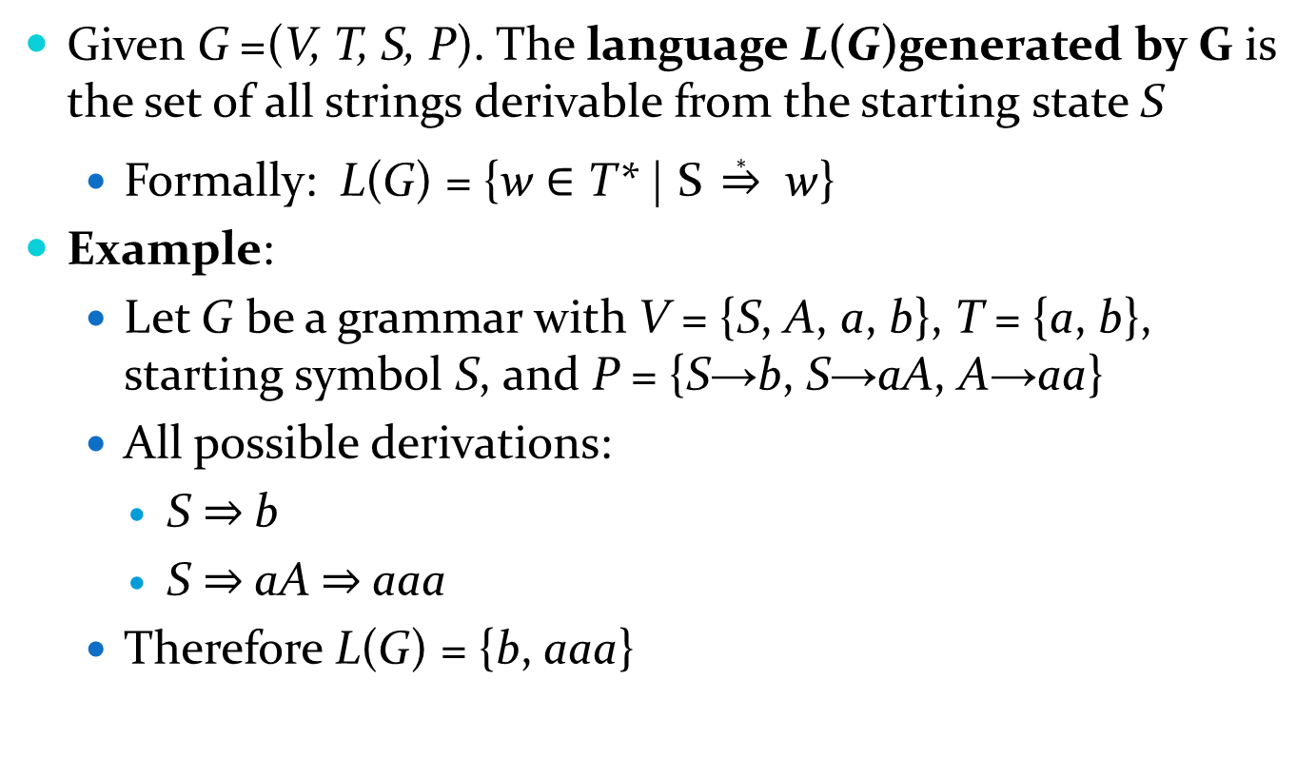
Language Generation
Given G =(V, T, S, P). The language L(G)generated by G is the set of all strings derivable from the starting state S
Formally: L(G) = {w ∈ T* | S $\underset{⇒}{∗}$ w}
Example:
Let G be a grammar with V = {S, A, a, b}, T = {a, b}, starting symbol S, and P = {S→b, S→aA, A→aa}
All possible derivations:
S ⇒ b
S ⇒ aA ⇒ aaa
Therefore L(G) = {b, aaa}

Slide 7
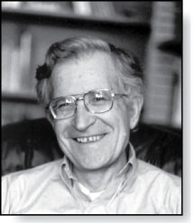
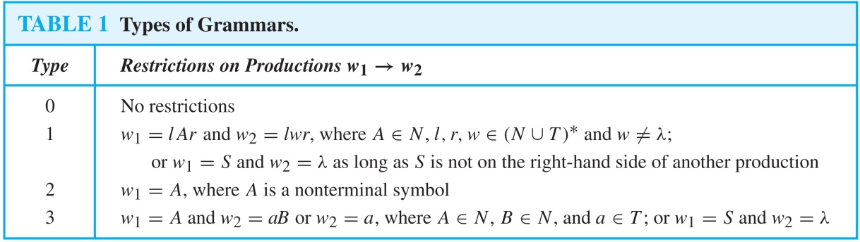
Types of Grammars
Noam Chomsky
Type 1 grammars are context-sensitive
Type 2 grammars are context-free
Most programming languages are of type 2

Slide 8
Derivation Trees
A derivation generated by a context-free grammar can be shown as an ordered rooted tree, called parse tree
The root of the tree represents the start symbol
The internal vertices represent the nonterminal symbols
The leaves represent the terminal symbols
For each production A→w used, the vertex A has as children the vertices that represent each symbol in w, in order from left to right

Slide 9
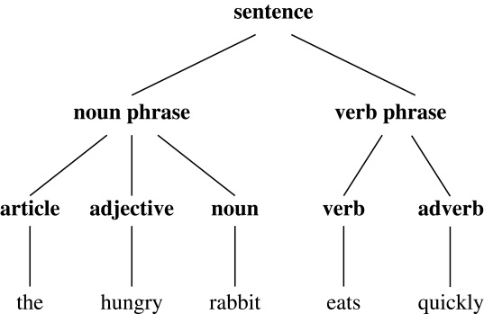
Derivation Trees
Example:
sentence → noun phrase followed by a verb phrase
noun phrase → article followed by an adjective followed by a noun
noun phrase → article followed by a noun
verb phrase → verb followed by an adverb
verb phrase → verb
article → a
article → the
adjective → large
adjective → hungry
noun → mathematician
noun → rabbit
verb → eats
verb → hops
adverb → quickly
adverb → wildly

