Slide 1
Finite-State Machines with Output

Slide 2
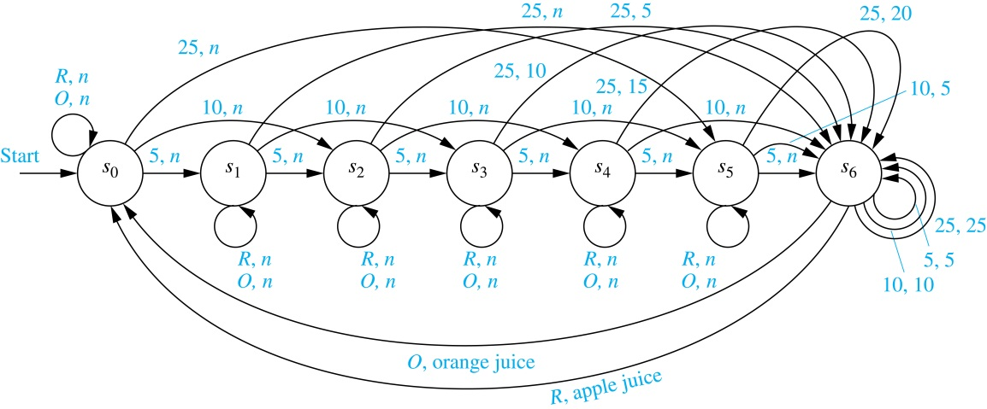
Example of a FSM with Output
A vending machine accepts nickels (5¢), dimes (10¢), and quarters (25¢). When 30¢ or more has been deposited, the machine returns the amount over 30¢. The customer can then press an O-button to receive orange juice or an R-button to receive apple juice

Slide 3
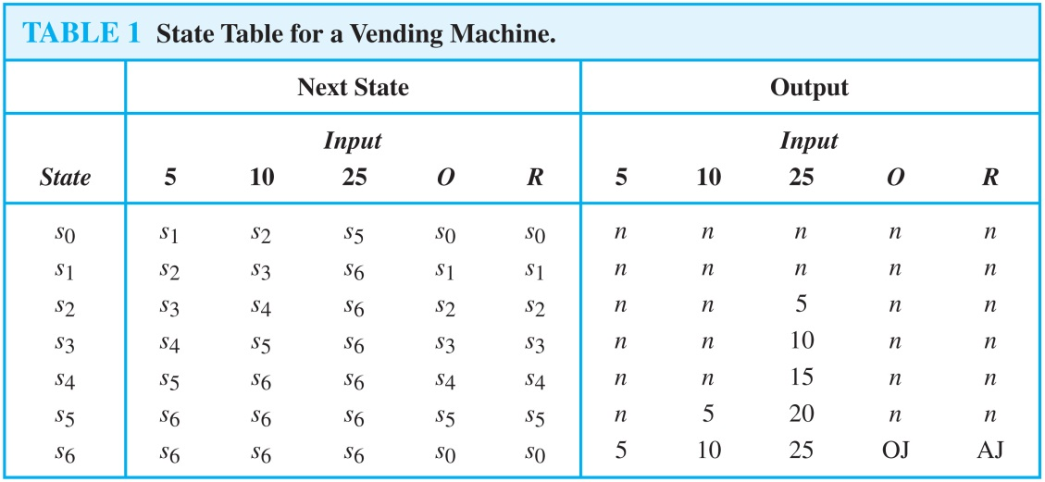
Example of a FSM with Output
The same FSM can be represented using a table

Slide 4
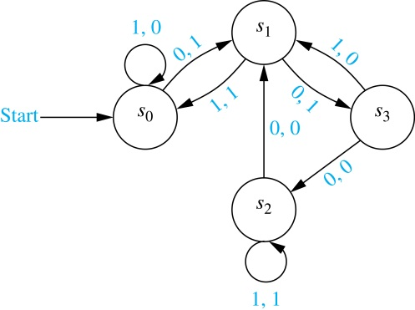
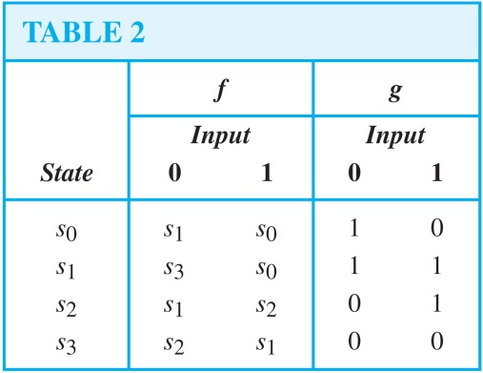
FSMs with Outputs
A finite-state machine M = (S, I, O, f, g, s₀) consists of:
  a finite set S of states
  a finite input alphabet I
  a finite output alphabet O
  an initial state s₀
  a transition function f
  an output function g
Example 1:
  S = {s₀, s₁, s₂, s₃}
  I = {0, 1}
  O = {0, 1}
  Initial: s₀
  f, g: state table/diagram

Slide 5
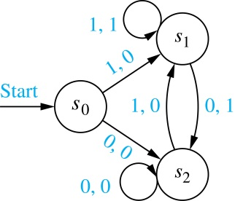
FSMs with Outputs
Example 2: unit-delay machine
  given the bit string x₁x₂…x_{k} it produces 0x₁x₂…x_{k-1}

Slide 6
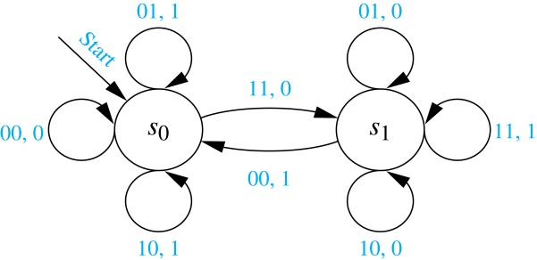
FSMs with Outputs
Example 3: adding machine for binary integers
  given (x_{n}…x₁x₀)₂ and (y_{n}…y₁y₀)₂ it produces their sum

