Slide 1
Sets

Slide 2
Sets
A set is an unordered collection of objects.
the students in this class
the positive integers
The objects in a set are called the elements, or members of the set. A set is said to contain its elements.
The notation a ∈ A denotes that a is an element of the set A.
If a is not a member of A, write a ∉ A

Slide 3
Describing a Set: Roster Method
S = {a,b,c,d}
Order not important
S = {a,b,c,d} = {b,c,a,d}
Each distinct object is either a member or not; listing more than once does not change the set.
S = {a,b,c,d} = {a,b,c,b,c,d}
Ellipses (…) may be used to describe a set without listing all of the members when the pattern is clear.
S = {a,b,c,d,…,z }

Slide 4
Roster Method
Examples:
Set of all vowels in the English alphabet:
V = {a,e,i,o,u}
Set of all odd positive integers less than 10:
O = {1,3,5,7,9}
Set of all positive integers less than 100:
S = {1,2,3,…,99}
Set of all integers less than 0:
S = {…,-3,-2,-1} = {-1,-2,-3,…}

Slide 5
Set-Builder Notation
Specify the properties that all members must satisfy
Examples:
S = {x | x is a positive integer less than 100}
O = {x | x is an odd positive integer less than 10}
A predicate may be used:
S = {x | P(x)}
Example:
S = {x | Prime(x)}

Slide 6
Some Important Sets
Some sets, e.g. all real numbers, cannot be listed (even using ellipses)
Use special notation: R
Other infinite sets can be expressed using other sets
Example: Positive rational numbers:
Q⁺ = {x ∈ R | x = p/q, for some positive integers p, q}
We predefine some important sets to reduce the notation
Z = integers = {…,-3,-2,-1,0,1,2,3,…}
Z⁺ = positive integers = {1,2,3,…} = {x ∈ Z | x > 0}
N = natural numbers = {0,1,2,3,…} = {x ∈ Z | x ≥ 0}
R = real numbers
R⁺ = positive real numbers = {x ∈ R | x > 0}
Q = rational numbers = {p/q | p ∈ Z, q ∈ Z, and q≠0}
C = complex numbers

Slide 7
Interval Notation
Ranges of real numbers can be expressed as intervals:
[a,b] = {x | a ≤ x ≤ b}
[a,b) = {x | a ≤ x < b}
(a,b] = {x | a < x ≤ b}
(a,b) = {x | a < x < b}
closed interval [a,b]
open interval (a,b)

Slide 8
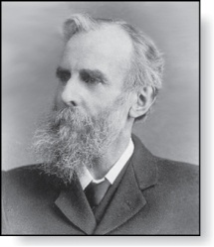
Venn Diagrams
John Venn (1834-1923)
Cambridge, UK
Used to represents sets graphically
The universal set U is the set containing all elements of the domain
Sets are shown as circles or other closed shapes
Example:
U = set of all letters
V = set of vowels
U
V
a e i
o u

Slide 9
Other important concepts
The empty set is the set with no elements.
Notation: {} or ∅
Important to note: ∅ ≠ { ∅ }
Sets can be elements of sets:
{{1,2,3}, a, {b,c}}
{N,Z,Q,R}

Slide 10
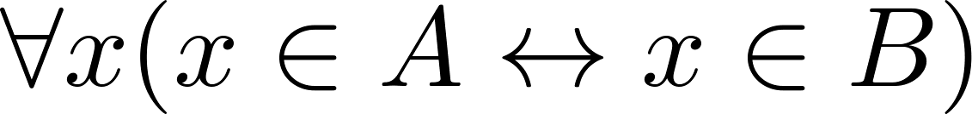
Set Equality
Definition: Two sets are equal iff they have the same elements.
Formally: if A and B are sets, then A = B iff
Examples:
{1, 3, 5} = {3, 5, 1}
{1, 5, 5, 5, 3, 3, 1} = {1, 3, 5}

Slide 11
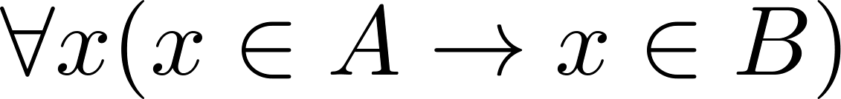
Subsets
Definition: The set A is a subset of B, iff every element of A is also an element of B.
Formally:
Notation: A ⊆ B
Examples:
N ⊆ Z ⊆ R
Z ⊈ R⁺
Theorem: For every set S:
∅ ⊆ S
S ⊆ S
Venn Diagram
U
B
A

Slide 12
Subsets
Showing that A is a subset of B:
To show that A ⊆ B, show that if x belongs to A, then x also belongs to B.
Showing that A is not a subset of B:
To show that A ⊈ B, find an element x ∈ A with x ∉ B
Such an x is a counterexample to the claim that x ∈ A implies x ∈ B

Slide 13
Another look at Equality of Sets
Recall that A = B, iff
Using logical equivalences, A = B iff
This is equivalent to
A ⊆ B and B ⊆ A
Thus to show A = B we can show that each set is a subset of the other

Slide 14
Proper Subsets
Definition: If A ⊆ B, but A≠B, then A is a proper subset of B
Notation: A ⊂ B
Formally: A ⊂ B iff
U
B
A

Slide 15
Set Cardinality
Definition: If there are exactly n distinct elements in S where n is a nonnegative integer, then S is finite. Otherwise it is infinite.
Definition: The cardinality of a finite set A, denoted by |A|, is the number of (distinct) elements of A.
Examples:
Let S be the letters of the English alphabet. Then |S|=26
|{1,2,3}| = 3
|ø| = 0
|{ø}| = 1
The set of integers is infinite

Slide 16
Power Sets
Definition: The set of all subsets of a set A, denoted by P(A), is called the power set of A.
Examples:
A = {a,b}, P(A) = {ø, {a},{b},{a,b}}
A = {3}, P(A) = {ø, {3}}
A = ø, P(A) = {ø}
A = {ø}, P(A) = {ø, {ø}}

Slide 17
Tuples
The ordered n-tuple (a₁,a₂,…..,a_{n}) is the ordered collection that has a₁ as its first element and a₂ as its second element and so on until a_{n} as its last element.
Two n-tuples are equal if and only if their corresponding elements are equal.
2-tuples are called ordered pairs.
The ordered pairs (a,b) and (c,d) are equal if and only if a = c and b = d.

Slide 18
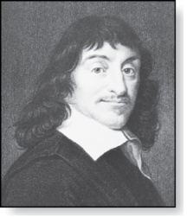
Cartesian Product
René Descartes (1596-1650)
Definition: The Cartesian Product of two sets A and B, denoted by A × B is the set of ordered pairs (a,b) where a ∈ A and b ∈ B .
Example:
A = {a, b} B = {1, 2, 3}
A × B = {(a, 1), (a, 2), (a, 3), (b, 1), (b, 2), (b, 3)}
Definition: A subset R of the Cartesian product A × B is called a relation from the set A to the set B. (Relations will be covered in depth in a later chapter. )

Slide 19
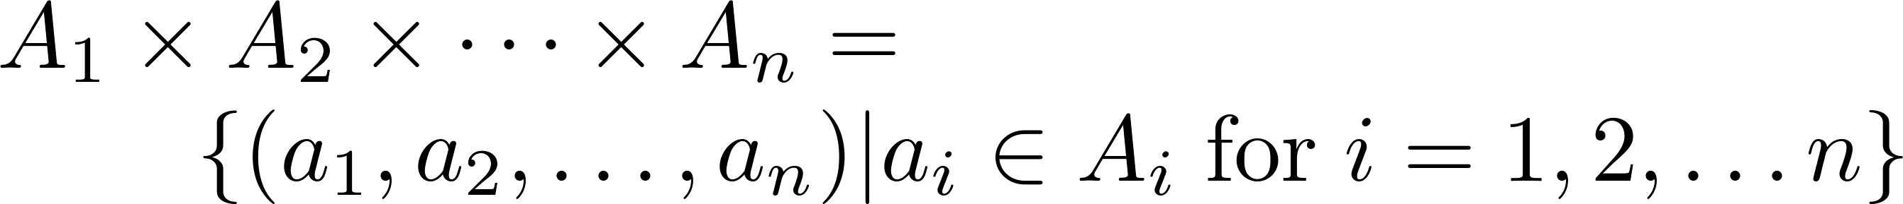
Cartesian Product
Definition: The Cartesian product of the sets A₁,A₂,……,A_{n}, denoted by A₁ × A₂ × …… × A_{n} , is the set of ordered n-tuples (a₁,a₂,……,a_{n}) where a_{i} belongs to A_{i} for i = 1, … n.
Example: Construct the Cartesian product of the sets A = {0,1}, B = {1,2} and C = {0,1,2}:
A × B × C = {(0,1,0), (0,1,1), (0,1,2),(0,2,0), (0,2,1),
(0,2,2),(1,1,0), (1,1,1), (1,1,2), (1,2,0), (1,2,1), (1,1,2)}

