Slide 1
Representing Relations

Slide 2
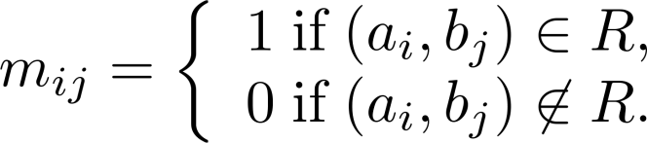
Representing Relations Using Matrices
A relation between finite sets can be represented using a zero-one matrix
Suppose R is a relation from A = {a₁, a₂, …, a_{m}} to B = {b₁, b₂, …, b_{n}}
R is represented by the matrix M_{R} = [m_{ij}], where
Informally: M_{R} has a 1 in (i,j) when a_{i} is related to b_{j} and a 0 if a_{i} is not related to b_{j}

Slide 3
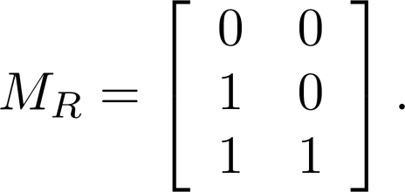
Representing Relations Using Matrices
Example 1:
  Suppose that A = {1,2,3} and B = {1,2}
  Let R be the relation from A to B such that (a,b) ∈ R if a > b
  Show R as a matrix
  Solution: R = {(2,1), (3,1), (3,2)}

Slide 4
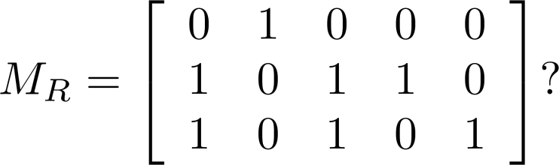
Representing Relations Using Matrices
Example 2: Let A = {a₁, a₂, a₃} and B = {b₁, b₂, b₃, b₄, b₅} Which ordered pairs are in the relation R represented by the matrix:
  Solution:
R = {(a₁,b₂), (a₂,b₁),(a₂,b₃), (a₂,b₄),(a₃,b₁), (a₃,b₃), (a₃,b₅)}

Slide 5
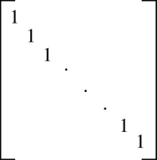
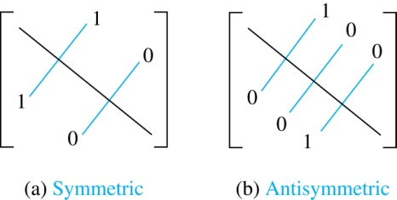
Determining Properties from Matrices
If R is a reflexive relation, all the elements on the main diagonal of M_{R} are equal to 1
R is symmetric iff m_{ij}=1 whenever m_{ji}=1
R is antisymmetric, iff m_{ij}=0 or m_{ji}=0 when i≠j

Slide 6
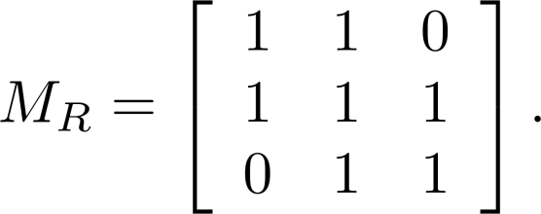
Determining Properties from Matrices
Example: Consider the following relation R on a set
  Is R reflexive, symmetric, and/or antisymmetric?
Solution:
  Because all the diagonal elements are equal to 1, R is reflexive
  Because M_{R} is symmetric, R is symmetric
  Because both m_{1,2} and m_{2,1} are 1, R is not antisymmetric

Slide 7
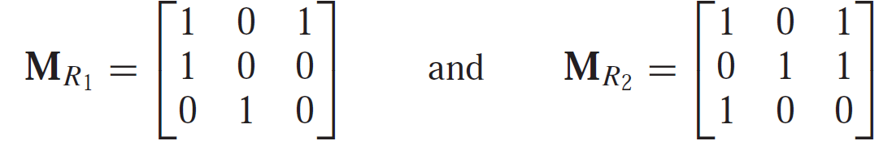
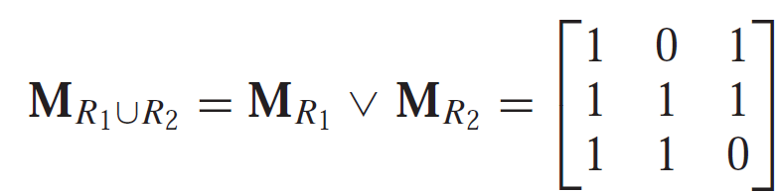
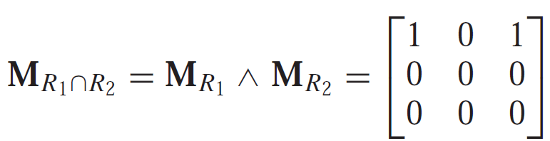
Combining Relations using Matrices
M_{R1∪R2}= M_{R1}∨ M_{R2} and M_{R1∩R2}= M_{R1}∧ M_{R2}
Example:

Slide 8
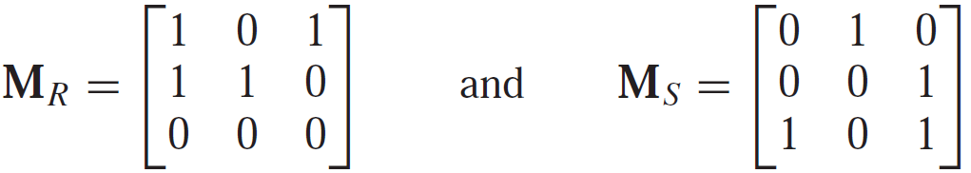
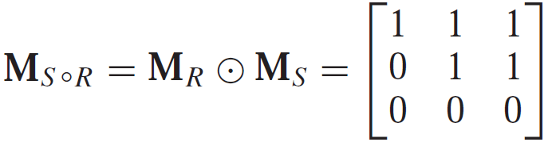
Combining Relations using Matrices
M_{S ◦R} = M_{R} ⊙ M_{S}
Example:
M_{R}^{n} = M_{R} ⊙ M_{R} ⊙ … ⊙ M_{R}

Slide 9
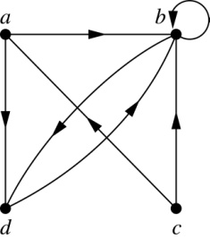
Representing Relations Using Digraphs
Definition:
  A directed graph, or digraph, consists of a set V of vertices (nodes), a set E of ordered pairs of elements of V called edges (arcs)
  a is called the initial vertex of the edge (a,b)
  b is called the terminal vertex of this edge
  An edge of the form (a,a) is called a loop
Example: Digraph with:
  vertices a, b, c, d;
  edges (a,b), (a,d), (b,b), (b,d), (c,a), (c,b), (d,b)

Slide 10
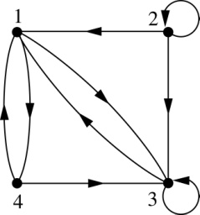
Representing Relations Using Digraphs
Each vertex is an element of a set A
Each edge (a,b) represents an element of the relation R on A
Example: What are the ordered pairs in the relation represented by this directed graph?
Solution:
(1,3), (1,4), (2,1), (2,2), (2,3), (3,1), (3,3), (4,1), (4,3)

Slide 11
Determining Properties from a Digraph
Reflexivity: A loop must be present at all vertices in the graph
Symmetry: If (x,y) is an edge, then so is (y,x)
Antisymmetry: If (x,y) with x≠y is an edge, then (y,x) is not an edge
Transitivity: If (x,y) and (y,z) are edges, then so is (x,z)

Slide 12
Determining Properties from a Digraph
Example 1:
a
b
c
d
Reflexive: No, there are no loops
Symmetric: No, there is an edge from a to b, but not from b to a
Antisymmetric: No, there is an edge from d to b and b to d
Transitive: No, there are edges from a to b and from b to d, but not from a to d

Slide 13
Determining Properties from a Digraph
Example 2:
a
b
c
d
Reflexive: No, there are no loops
Symmetric: No, for example, there is no edge from c to a
Antisymmetric: Yes, whenever there is an edge from one vertex to another, there is not one going back
Transitive: Yes, there an edge from a to b for (a,c), (c,b)

