Slide 1
Closures of Relations

Slide 2
Closures of Relations
Let R be a relation on a set A
Let P be a property, such as reflexivity, symmetry or transitivity
The closure S of R with respect to P is the smallest superset of R that has the property P
Consequently, S is a subset of every relation with property P that contains R

Slide 3
Reflexive Closure
The reflexive closure of R on a set A is the smallest relation S ⊇ R such that (a,a) ∈ S for all a ∈ A
That is, S must contain the diagonal
    Δ = {(a,a) | a ∈ A}
Example 1: The relation R = {(1,1),(1,2),(2,1),(3,2)} on the set A={1,2,3} is not reflexive
  The reflexive closure S of R is R ⋃ Δ
  Add the two missing elements (2,2) and (3,3):
    S = {(1,1),(1,2),(2,1),(2,2),(3,2),(3,3)}

Slide 4
Reflexive Closure
Example 2: What is the reflexive closure of the relation R = {(a,b) | a<b} on the set of integers?
R ⋃ ∆ = {(a,b)| a<b} ⋃ {(a,a)| a ∈ Z} = {(a,b)| a≤b}

Slide 5
Symmetric Closure
The symmetric closure of R on a set A is the smallest relation S ⊇ R such that if (a,b) ∈ S then (b,a) ∈ S for all a,b ∈ A
Definition: Let R be a relation from a set A to a set B. The inverse relation from B to A, denoted by R⁻¹, is the set of ordered pairs {(b,a)|(a,b) ∈ R}
Therefore, S = R ⋃ R⁻¹
Example: Consider R = {(a,b)| a>b} on Z⁺
S = R ⋃ R⁻¹ = {(a,b)|a>b} ⋃ {(b,a)|a>b} = {(a,b)|a≠b}

Slide 6
Paths in Directed Graphs
Definition: A path from a to b in a directed graph G is a sequence of edges (x₀,x₁), (x₁,x₂), …, (x_{n-1},x_{n}), where x₀=a and x_{n}=b
  This path is denoted as x₀,x₁,x₂, …, x_{n-1},x_{n} and has the length n
The same path may be shown in a relation:
  x₀,x₁,x₂, …, x_{n-1},x_{n} is a path in R if
  (x₀,x₁) ∈ R, (x₁,x₂) ∈ R , …, (x_{n-1},x_{n}) ∈ R

Slide 7
Transitive Closure
The transitive closure of R on a set A is the smallest relation S ⊇ R such that (a,b) ∈ S if there is a path from a to b for all a,b ∈ A
Example: Consider a “parent” relation:
  R = {(a,b)| a is a parent of b}
  R² = R ∘ R is the “grandparent” relation
  R² = {(a,c)| a is a parent of b and b is a parent of c}
  R³ = R² ∘ R is the “great grandparent” relation, etc.
  R* = R ⋃ R² ⋃ … ⋃ R^{n} is the complete “ancestor” relation
Expressed using matrices:
    M_{R*} = M_{R} ∨ M_{R2} ∨ … ∨ M_{Rn}

Slide 8
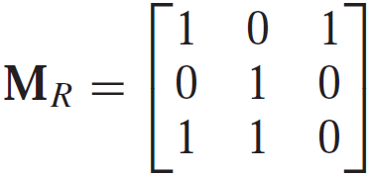
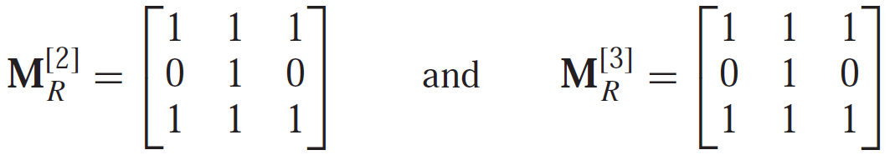
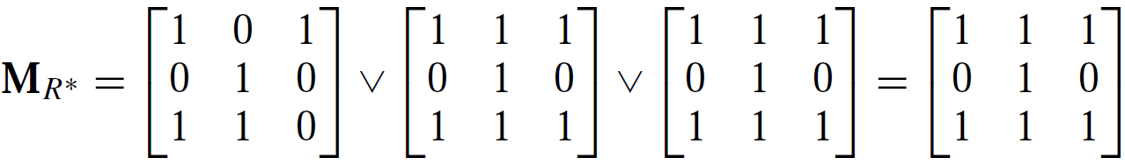
Transitive Closure
Example 2: Find the transitive close of the matrix M_{R}:

