Slide 1
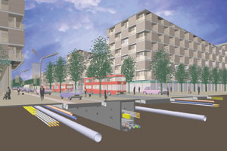

Ride: a Resilient IoT Data Exchange Middleware Leveraging SDN and
Edge Cloud Resources
Kyle E. Benson, Guoxi Wang, Young-Jin Kim*, Nalini Venkatasubramanian
University of California-Irvine & *Nokia Bell Labs
IoTDI 2018, Orlando, Florida, USA

Slide 2


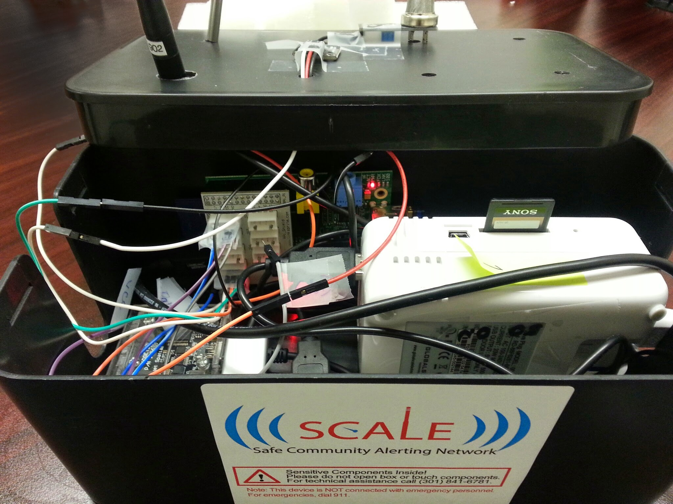

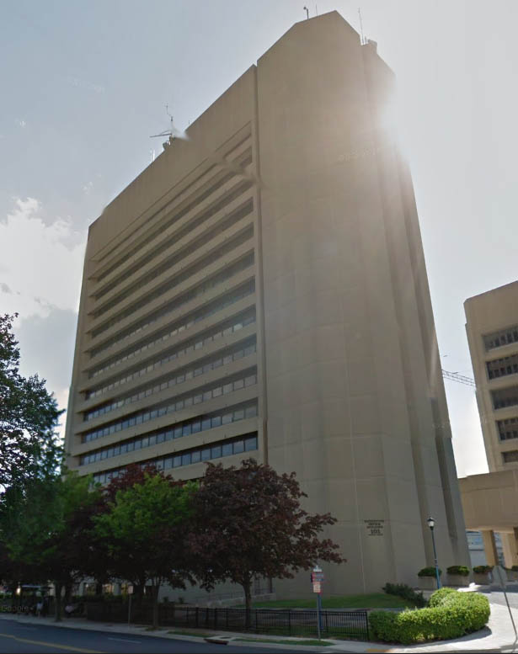

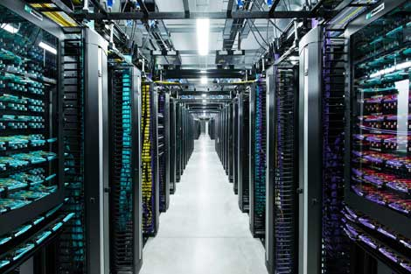


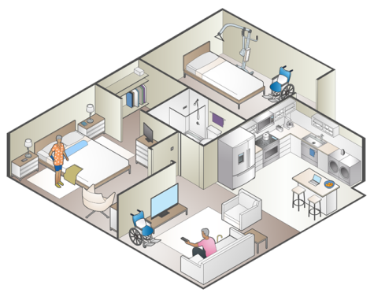
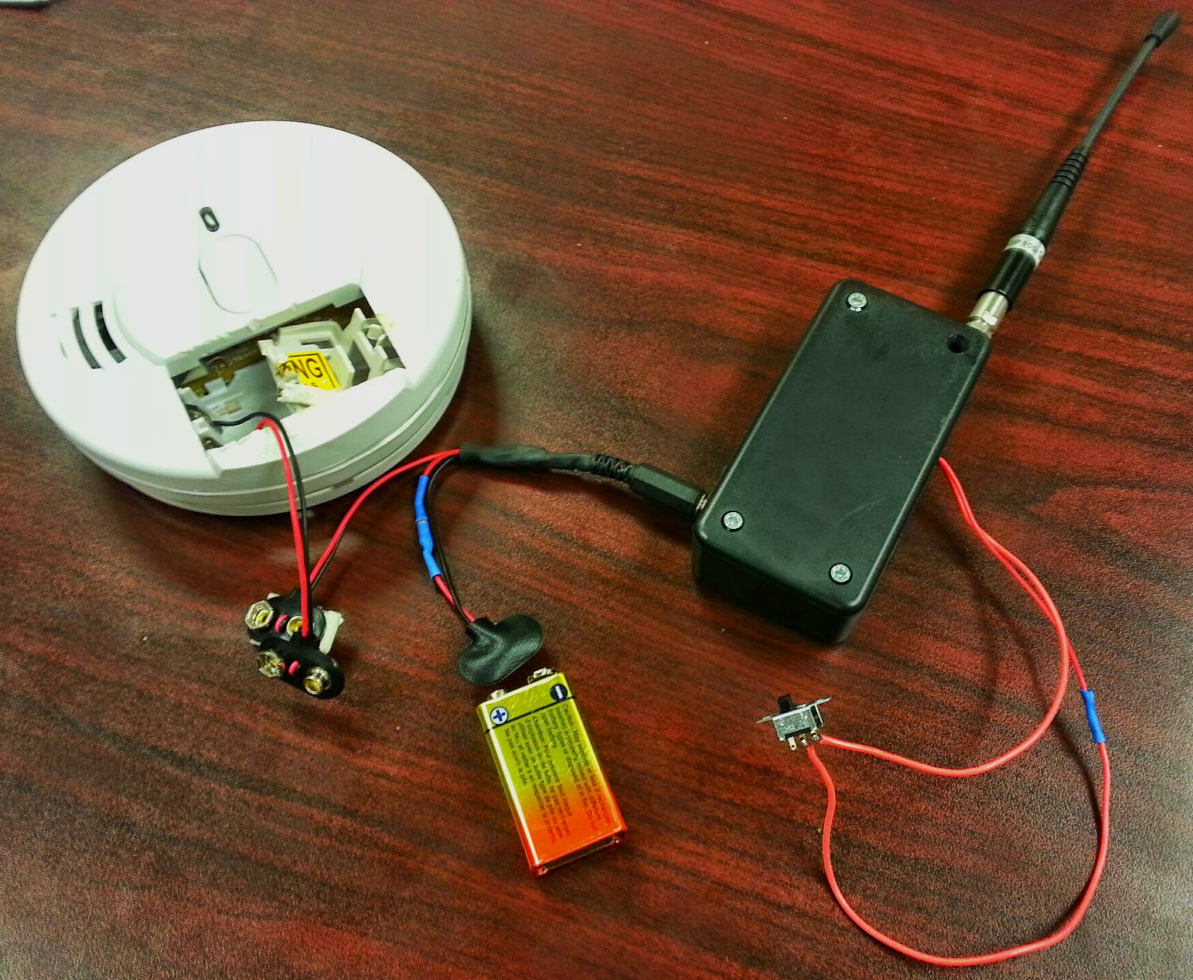


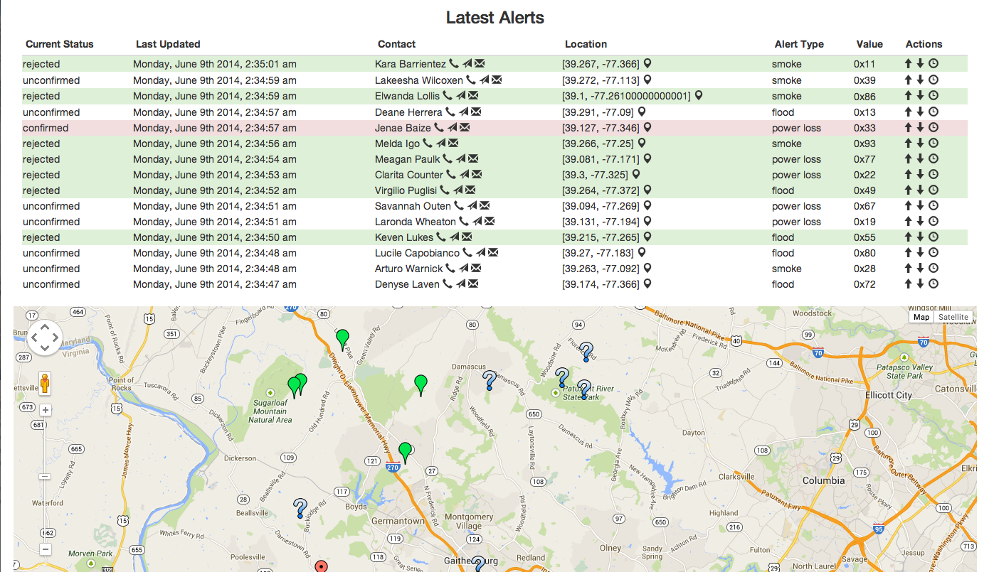

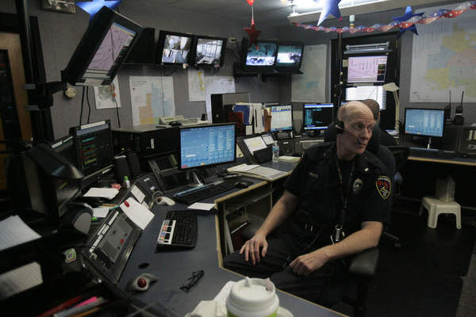




“Democratizing safety by bringing the Internet of Things (IoT) to everyone”
SCALE sends emergency message
Long-range wireless antenna
Analytics / Alerting Cloud
Emergency?
Yes!
Resident / Caretaker
Resident in distress
Dispatch Center
First responders arrive
Notes:
Inspired by IoT-enhanced emergency response possibilities, we explored the use of off-the-shelf IoT hardware in creating a smart safe home / community environment.
Multi-sector team of organizations demonstrating IoT for community safety in response to 2013 White House/NIST SmartAmerica Challenge
I led development on SCALE as an Innovation Fellow in Montgomery County, MD in Spring 2014. Many thanks to other primary devs Guoxi and Qiuxi.
[WORKFLOW OVERVIEW]
SCALE has since expanded to include many more partners and served as a testbed for various research projects in our group.

Slide 3


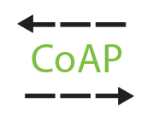







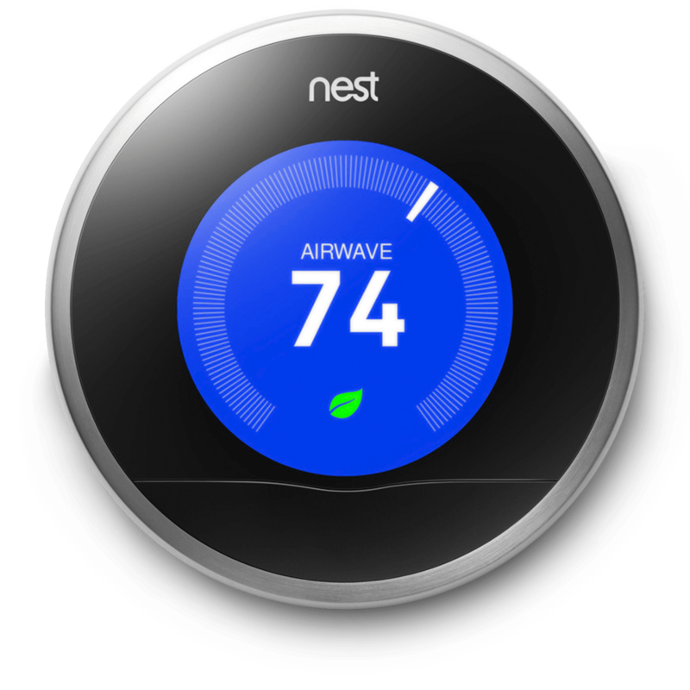

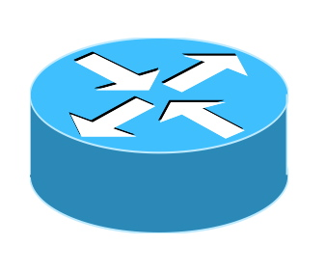










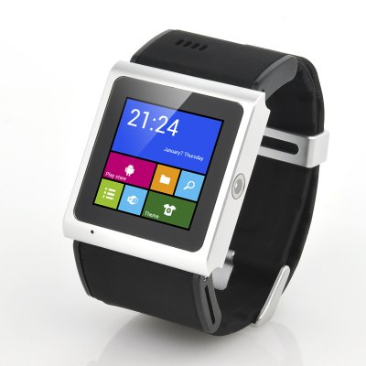
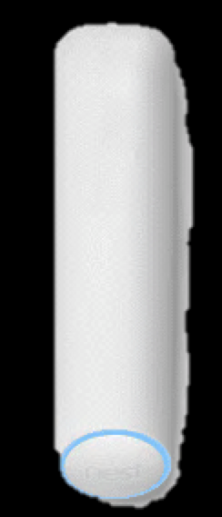
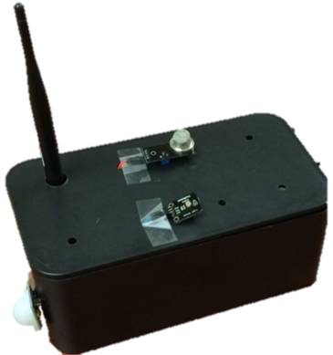



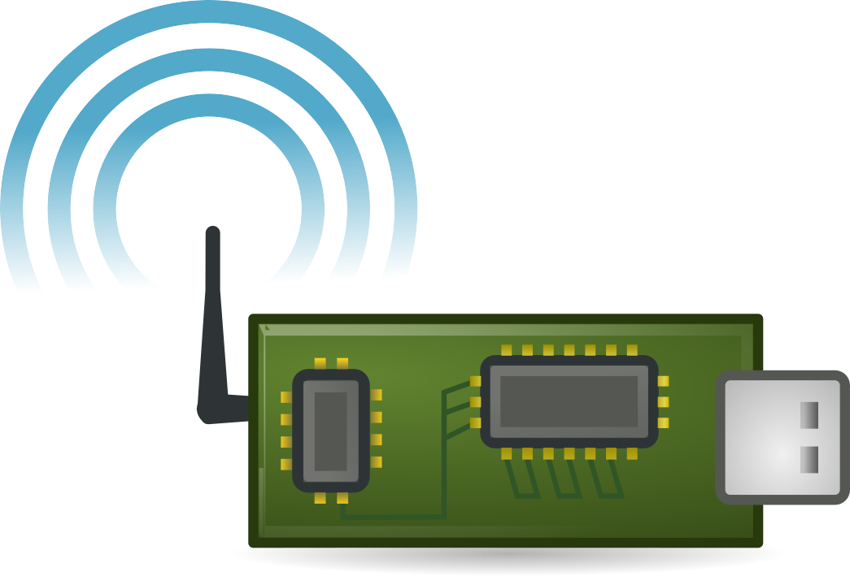





IoT Data Exchange
Data
Exchange
Cloud Services
User
Applications
Communications
Networks
Constrained
devices!
Devices
Spaces
Physical Events
& Actions

Slide 4
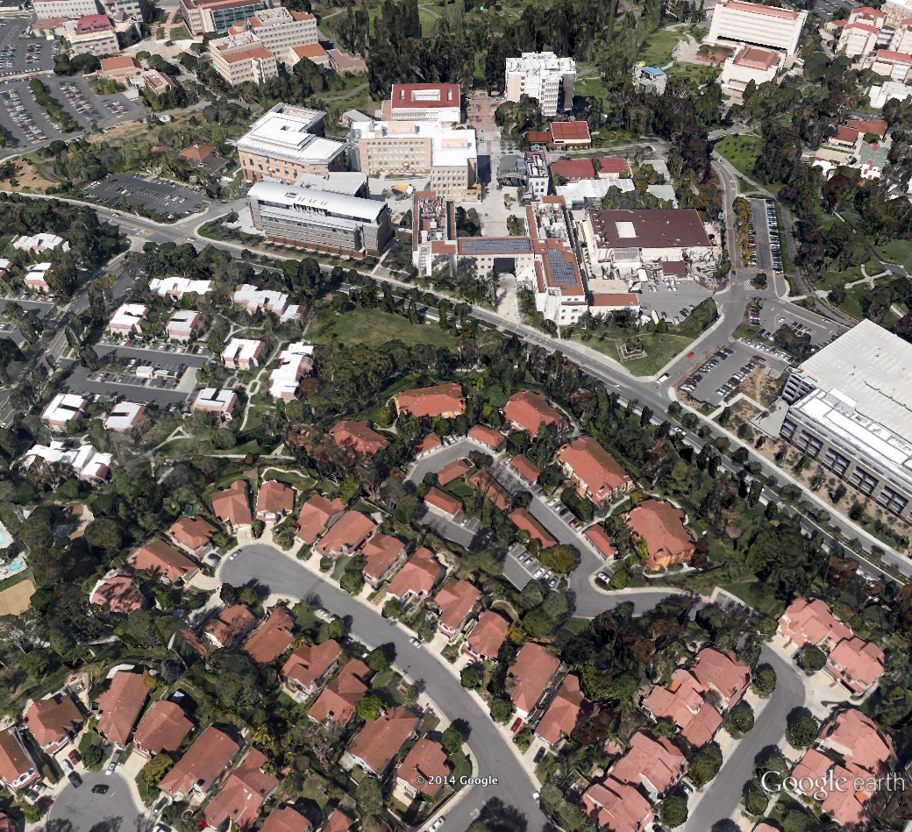

Mission-Critical IoT Scenario:
Smart Campus Earthquake Safety
Notes:
Stop elevators, notify users on phones and query if okay (didja feel it?)
Alert users with infrastructure: sirens, flashing lights for the deaf
Begin monitoring environment: fires, gas leaks

Slide 5
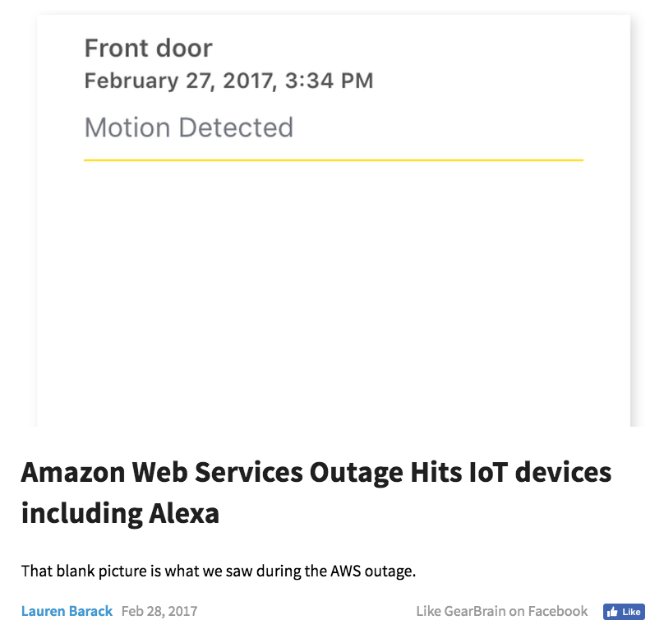
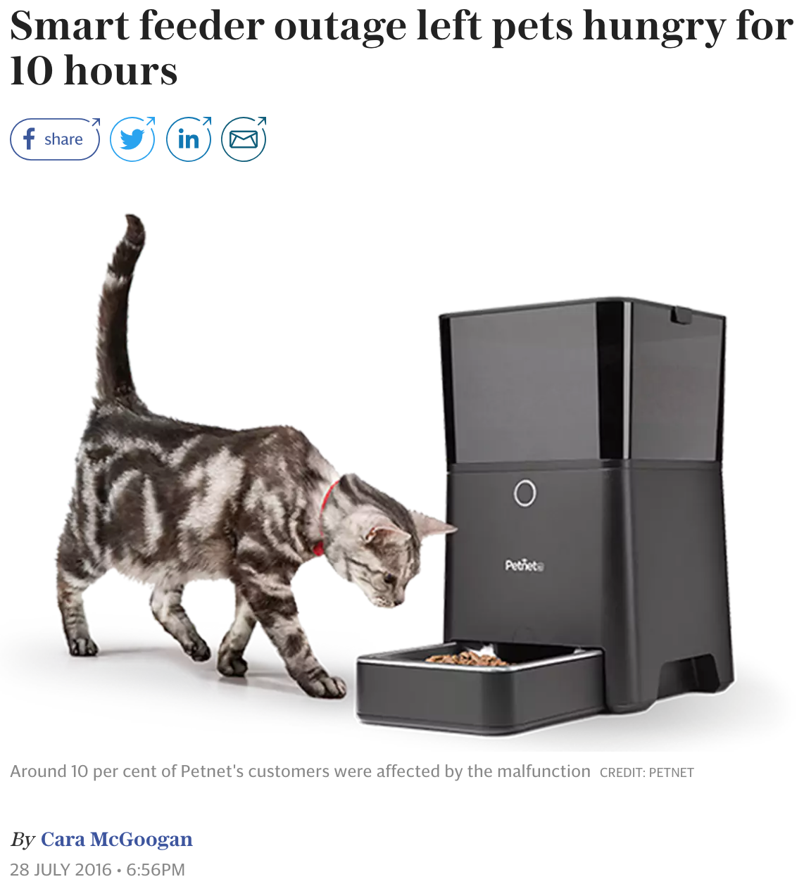
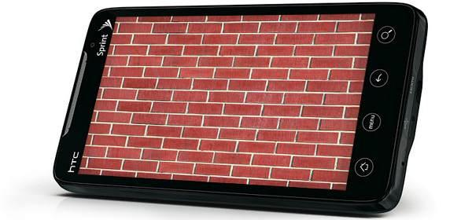
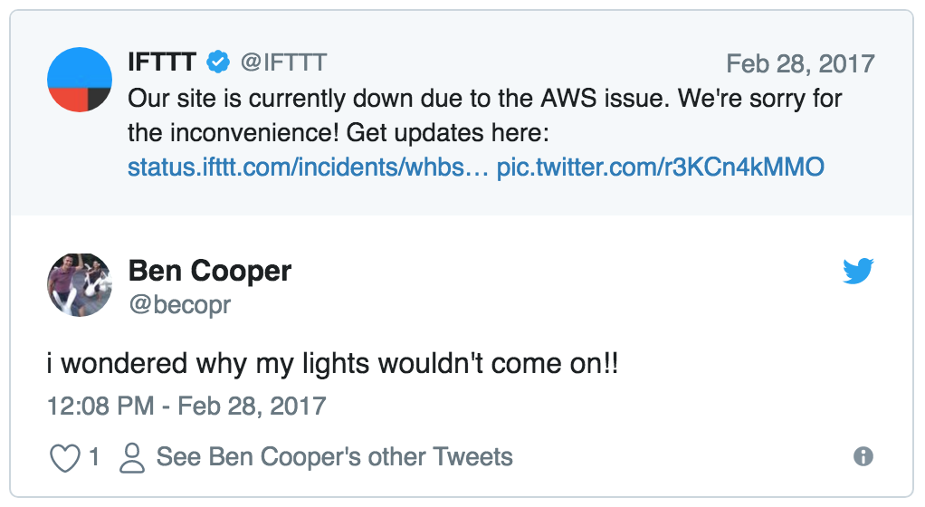
IoT Data Exchange Resilience
?
User
Applications
Ensuring operation despite challenging conditions e.g. failures.
Data
Exchange
Cloud Services
Communications
Networks
We identified this challenge during SCALE in 2014…
Devices
?
Spaces
?
?
?
?
Physical Events
& Actions

Slide 6


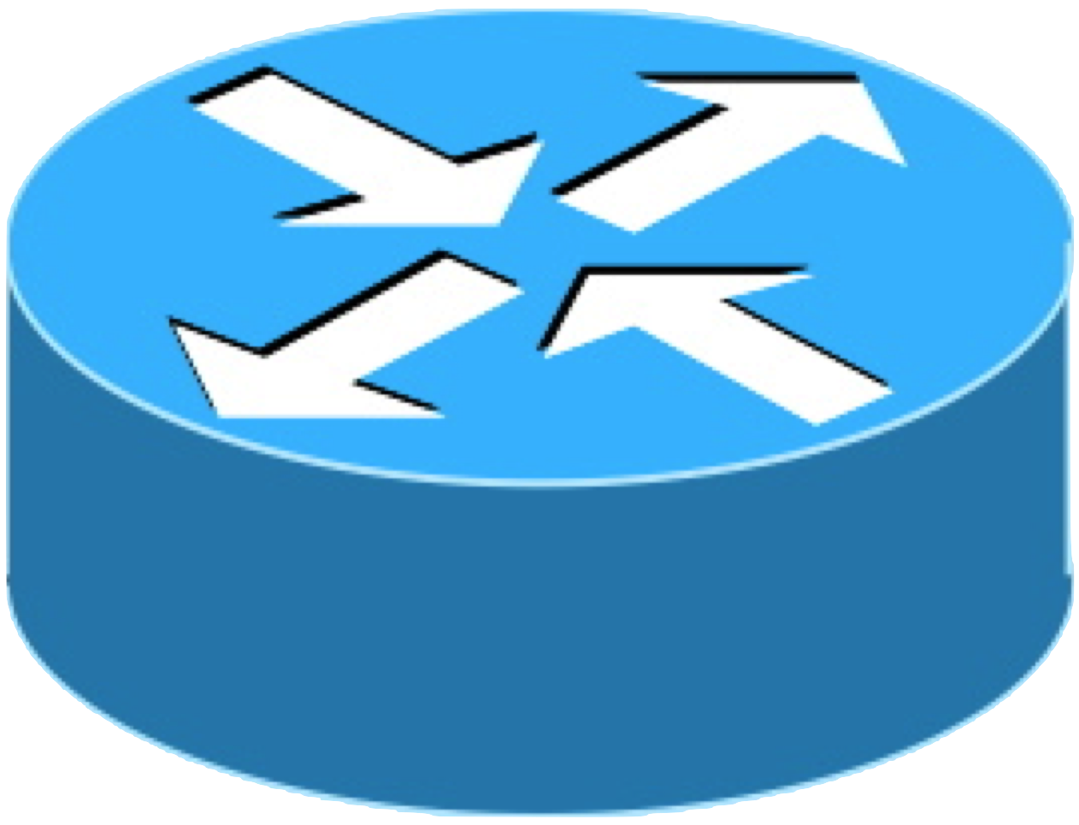
Edge Computing for IoT DX Resilience
User
Applications
Data
Exchange
Ride leverages resources at the network edge for:
Resilience to cloud disruptions e.g. edge fail-over in response to wide-area network failures
Decreased latency
Localized operation e.g. local situational awareness generation
…
Cloud Services
…
Edge Infrastructure
Diverse networking for resilience (i.e. different routes and physical networks).
Communications
Networks
Software-defined networking (SDN) enables more flexible management of these diverse networks!
IoT Devices
Notes:
-------
SPEECH
Edge computing is frequently discussed in the context of 5G, whose architecture allows running services nearer to the base stations for…
Different network routes, which may or may not mean entirely different physical network technologies.
------

Slide 7
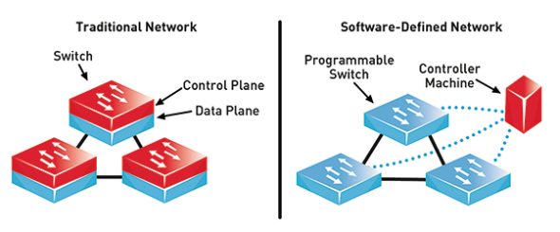


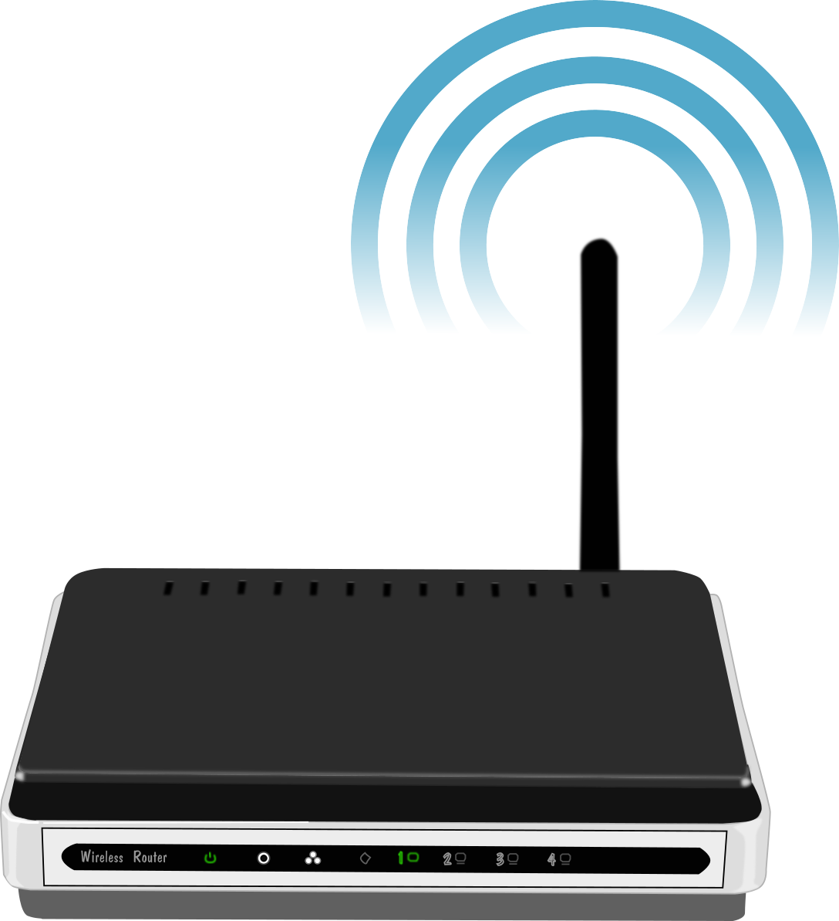
Software-Defined Networking (SDN)
VPN, QoS, security
Ride Middleware
Net. Services
…
Application workflows
Various APIs
source: Dungay 2016
SDN Controllers
…
Local IoT Controller
Control Plane
virtual net abstraction
Centralized Network State
unified APIs
Data Plane
Virtual
Switches
…
Physical
Switches
physical infrastructure
Notes:
-----
SPEECH:
SDN lets us manage physical network infrastructure with the same abstractions / APIs used for managing virtual networks of cloud services…
Centrally viewing network state to optimize the whole IoT communications network from the SDN controllers, where we…
This allows us to deploy network services such as those in our Ride m/w to centrally manage IoT networking along with rides services for managing IoT data exchange and application workflows…
So what are these services?
-------

Slide 8



Ride: A Resilient IoT Data Exchange Middleware
Leveraging SDN and Edge Cloud Resources
Smart (IoT) Community Safety Apps
Applications
Problem: regional infra. failures/ cloud service disruptions
  Viewed from local (campus/community) perspective.
  The organization controls local infrastructure and deploys IoT devices there…
Proposed solution: leverage local edge resources when needed
  I.e. during cloud service disruptions.
  SDN facilitates local network infrastructure awareness & control.
  Ride captures app requirements.
situational awareness
Users
app reqs.
alerts
sensed events
State Awareness
Ride-C
resilient IoT data collection
Ride-D
resilient alert dissemination
Data Exchange
Middleware
Net
App
Cloud
service
monit-
oring
Edge
fail-over
adapt net.
alerts
SDN
Physical
Infrastructure
Notes:
------
SPEECH
Treat app logic as a black box
Awareness… enables Ride to be both application and network aware
------------

Slide 9
Ride Research Questions
Ride-C
How to ensure cloud service stability or edge fail-over according to application-specified resilience requirements?
Without over-burdening constrained IoT devices or edge network infrastructure?
Ride-D
How to leverage network awareness for more resilient local alerting?
Without over-burdening constrained IoT devices or edge network infrastructure?

Slide 10
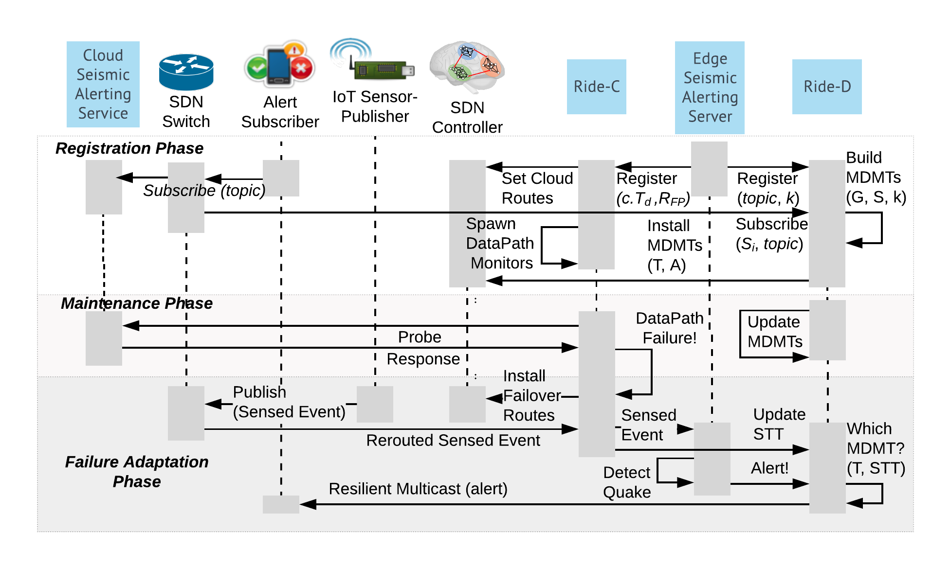
Ride Workflow
Initialization
Register apps & their requirements
Maintenance
Gather network state awareness
Adaptation
Cloud path or edge fail-over
Configure Ride-C cloud service monitoring
Configure Ride-D local alert dissemination routes
Update requirements (e.g. new subscriptions)
Local resilient multicast alerting

Slide 11
Ride Workflow
Register applications’ resilience requirements and subscriptions. Configure CDP monitoring and MDMTs.
Maintain network state awareness, cloud data paths, and MDMTs.
Adapt to failures via SDN-based CDP/edge fail-over. Gather updated network awareness for resilient local alerting.

Slide 12

Ride-C: Resilient Data Collection
Cloud Alerting Server
Adaptive Probing and Failover
Edge Alerting Server
Setting Up Data Collection Routes
Path Purpose | Line
Data Collection
Probing
Failover

Slide 13
Ride-C Algorithm
  Monitors multiple Cloud Overlay Paths for resilient data collection.
Max. Detection Time
App Requirements
Probing Interval
Max. False Positive Rate
    Conserves resources e.g. bandwidth.
Adaptive Probing
Failure Detection Parameters
Average Round-trip Time
Network State
Path Loss Rate
    Meets detection
    time requirement.
  Adaptation Process:
    Number of Probes for Detection
      Maximum False Positive Rate, Link Loss Rate
    Probe Interval:
      Number of Probes for Detection, Maximum Detection Time
Notes:
OUTPUT PARAMS: # Probes that timed out after a period

Slide 14
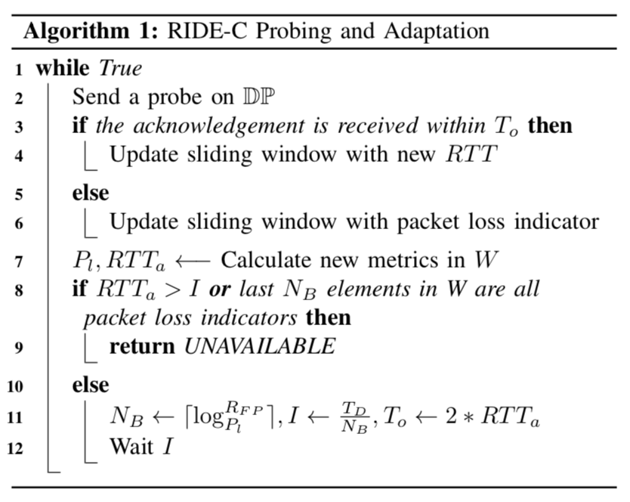
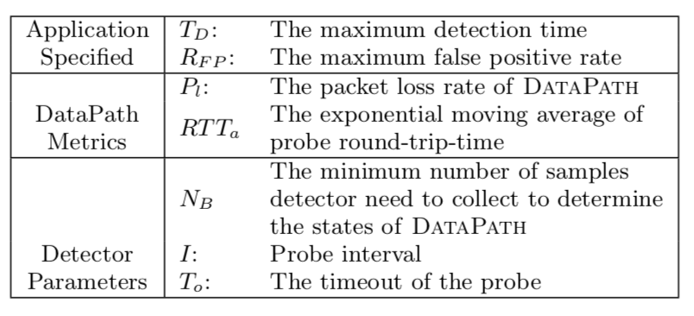
Ride-C Algorithms
  Monitors DataPaths to the cloud.
  Adaptive probing adjusts interval:
    Conserves resources e.g. bandwidth.
    Meets detection time requirement.

Slide 15
Ride-D: Resilient Alert Dissemination
sensor1
|T1 ^ STT| < |T2 ^ STT|
sensor3
Edge Alerting Service
sensor2
Data Collection path (Ride-C)
MDMT 1
MDMT 2
MDMT 1 & 2
Successfully-
Traversed
Topology*
Maximally-Disjoint Multicast Trees*
Cloud is down!
*Pre-configured via SDN
(OpenFlow flow rules)
No device burden!
Notes:
--------
Speech
Operating in edge mode, so local Time critical earthquake warning
Multicast lets us reach relevant subscribers with efficient network bandwidth usage (e.g. rich notifications)
To enhance resilience (i.e. improve reachability despite local failures), we exploit topological diversity by constructing MDMTs…
Multicast path protection is not new… but our technique for selecting the tree at alert-time rather than using one as a primary and one as backup is!
Network-aware tree selection based not on known link status, which takes time for control plane to gather, but on sensor publications recently-received via functional links:
We consider the local sensor data collection paths configured by Ride-C; produce a by-product of that phase: STT
*SDN enables STT
sensor1’s data never delivered, so MDMT 2 “overlaps” with STT more than MDMT 1

Slide 16
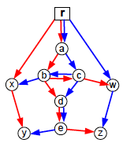
Ride-D Algorithms
MDMT
Construction
Network-aware
MDMT Selection
steiner: bounded low cost appx. (Hwang 1992)
diverse-paths: one subscriber at a time
red-blue: edge-disjoint pair of trees
Iteratively increase weight of used edges
Disjoint paths generated using (Zheng 2010)
Split topology recursively using Bejerano 2013’s skeleton list data structure
Min-cost multicast trees NP-Hard! Heuristics:
min-missing-links from STT
max-overlap-links with STT
max-reachable-subscribersvia complete STT paths
max-link-importance: hybrid of others
Sum of STT links’ importance:
# subscriber-paths traversing the link.
STT indicates likely functional paths from Ride-C data paths → heuristics:
Source: Bejerano 2013
Notes:
---------
SPEECH
Because generating even a single multicast tree of min cost is NP-Hard, we compared several heuristics derived from existing algorithms…
One of our key contributions is the mechanism for selecting MDMTs in a network-aware manner and the following proposed policies:
- some look at the overlap of STT and MDMTs, one the # subscribers reachable via intersection of STT and MDMT, and our best policy combines these two to consider the importance of MDMT links present in STT
Steiner: minimum spanning tree of the metric closure subgraph
Diverse-paths: min-cost network-flow based, start with subscriber closest to server, add paths to MDMT with max overlap to reduce cost
Red-blue: trims links to create mdmt

Slide 17
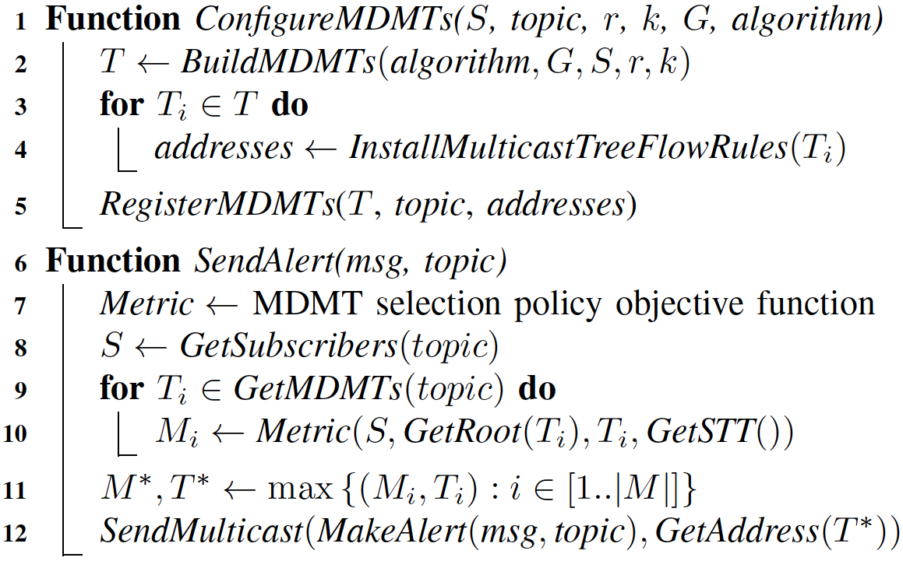


Ride-D Algorithm Details
min-missing-links
max-overlap-links
max-reachable-subscribers
max-link-importance
Notes:
---------
SPEECH
Because generating even a single multicast tree of min cost is NP-Hard, we compared several heuristics derived from existing algorithms…
One of our key contributions is the mechanism for selecting MDMTs in a network-aware manner and the following proposed policies:
- some look at the overlap of STT and MDMTs, one the # subscribers reachable via intersection of STT and MDMT, and our best policy combines these two to consider the importance of MDMT links present in STT
------
MAYBE: Pictures: could show the little ‘4 constellations’ diagram on right with big ? Mark
----------
BACKUP notes
Steiner: minimum spanning tree of the metric closure subgraph
Diverse-paths: min-cost network-flow based, start with subscriber closest to server, add paths to MDMT with max overlap to reduce cost
Red-blue: trims links to create mdmt
TODO: runtime complexities!
TODO: explain difference between min-missing and max-overlap

Slide 18
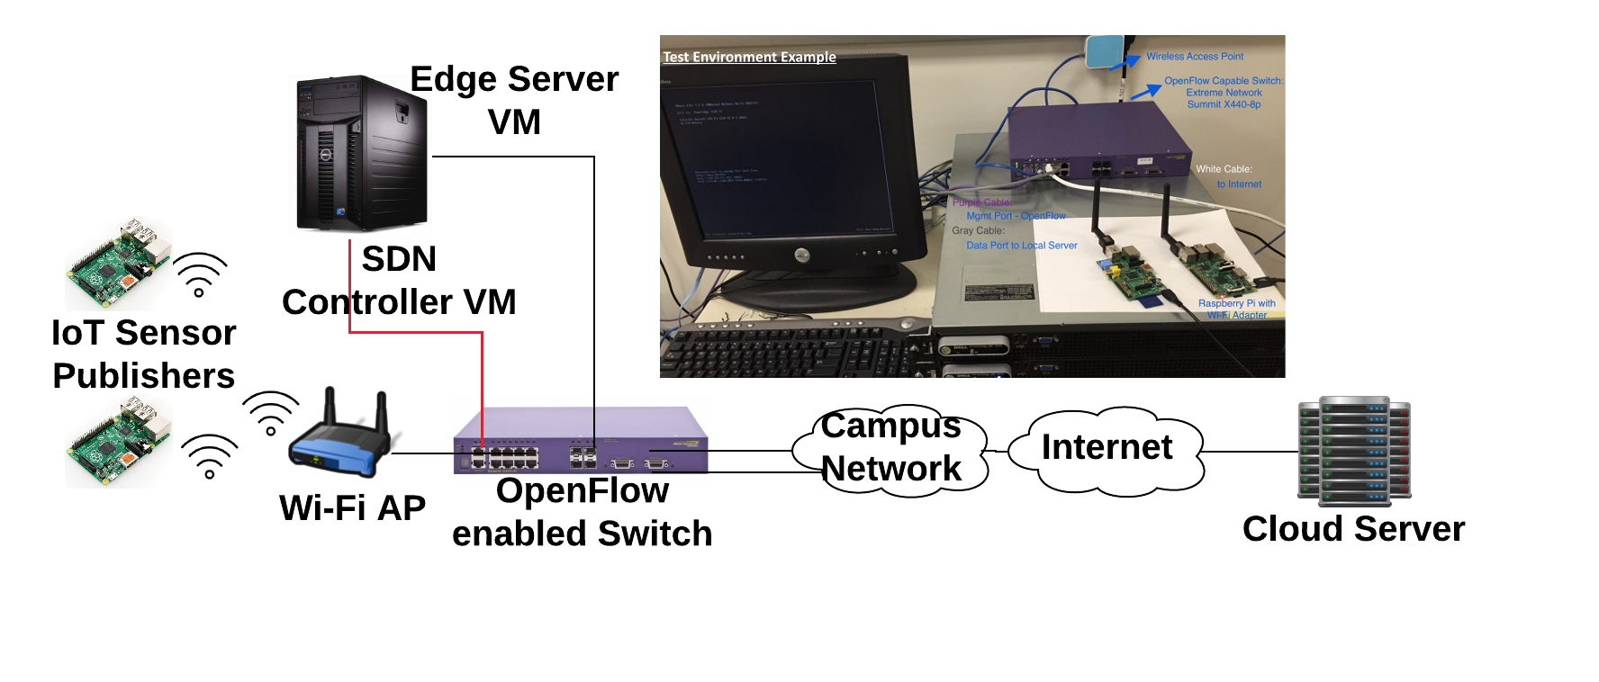
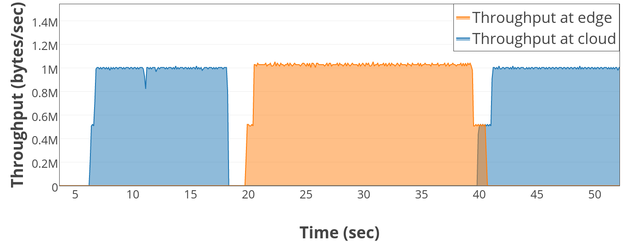
Real-world Test-bed
Unplug
Ethernet cables
Reconnect
Ethernet cables

Slide 19
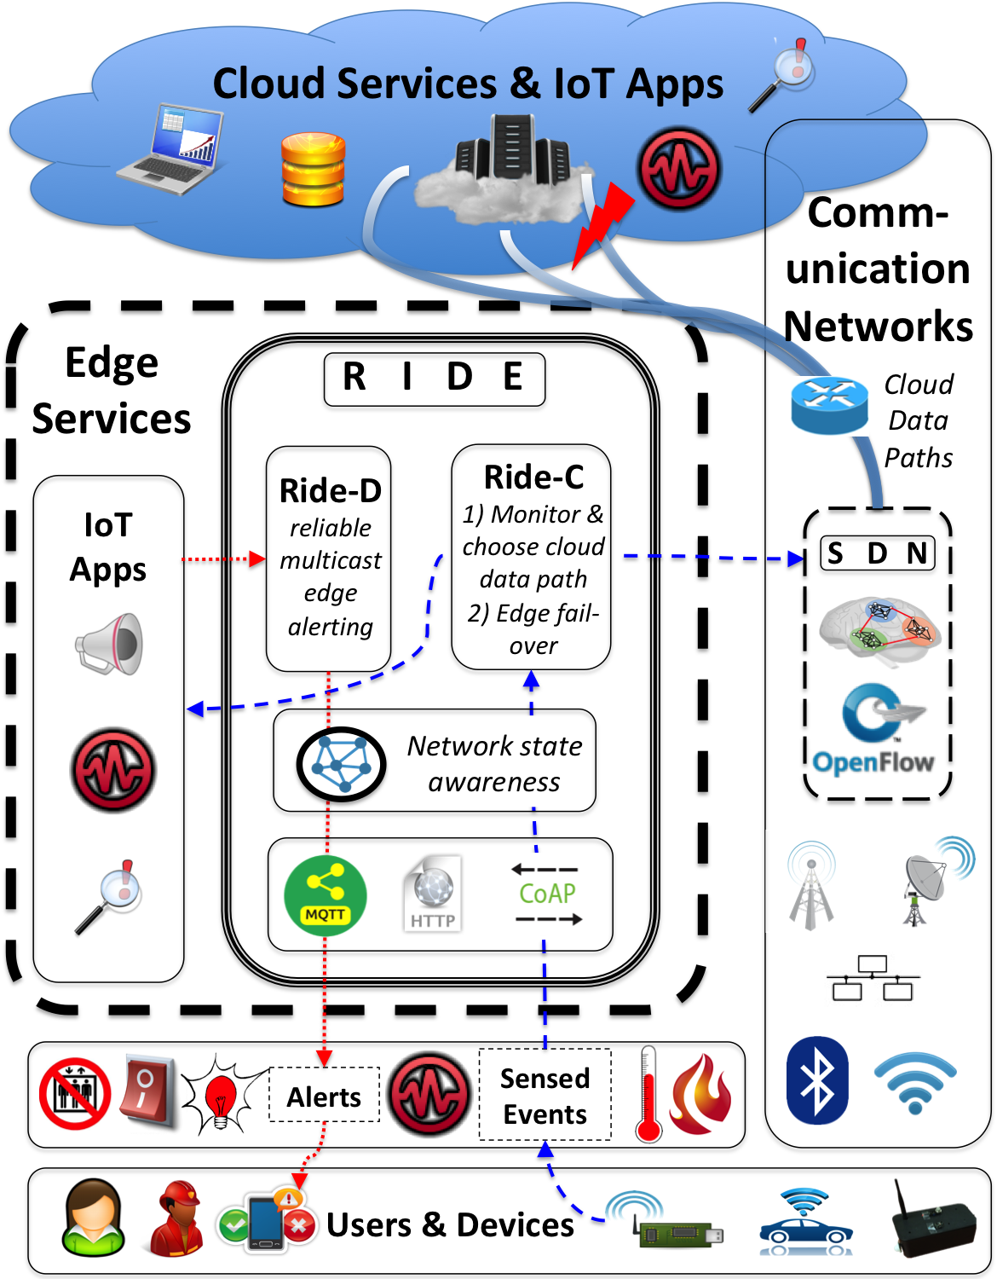

Slide 20
SDN Experiment
Previous Architecture
SDN Controller
Network APP
Drawbacks:
Need to develop controller-specified APP
Hard to integrate with Mininet
Northbound API
Core Services
Southbound API

Slide 21
SDN Experiment
Current Architecture
Topology Manager
Network APP w/ NetworkX
SDN Controller
Network APP can leverage NetworkX API
Topology Manager API Supported:
  Find path between two nodes
  Build/Install flow rules on SDN switches
  Get current network topology
  Get statistics
  ...
REST API
Northbound API
Core Services
Southbound API
Notes:
In the future, onos application

Slide 22
Experimental Setup
Generate synthetic campus network topologies
Network failures
(uniformly-random)
Emulate an IP network (via Mininet)
Configure Ride-enabled SCALE clients as:
Event publishers & Alert subscribers
(uniformly random)
Output events → parse & plot results
Notes:
Need to talk about Mininet and get across how difficult it was to setup our test-bed environment that other group members will be using

Slide 23
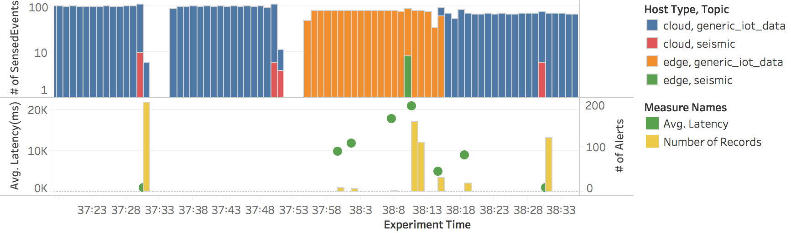
End-to-end Experiments
Earthquakes trigger seismic data uploads and failures
Cloud path fail-over misses a few secs.
Edge fail-over & local net failures
Cloud path recovery
High data loss/delay during local failure and edge fail-over indicates needed improvements to SDN fail-over mechanism (e.g. partial pre-installation of fail-over routes).
Notes:
-----
SPEECH
Scenario includes several different earthquakes each of which …. To showcase different aspects of Ride
The Top bars represents alerting services’ view of received event data
Bottom bars represent alert subsribers’ view of received alert data
(Time placement of quakes not realistic: only for simplicity of demonstration….)

Slide 24
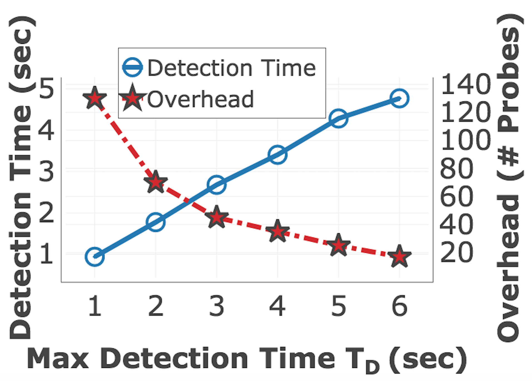
Ride-C Parameters: Detection Time / Overhead Trade-off
Ride-C meets or exceeds detection time requirement.
If app can tolerate a few seconds of failure detection time, Ride-C can significantly reduce probing overhead.

Slide 25
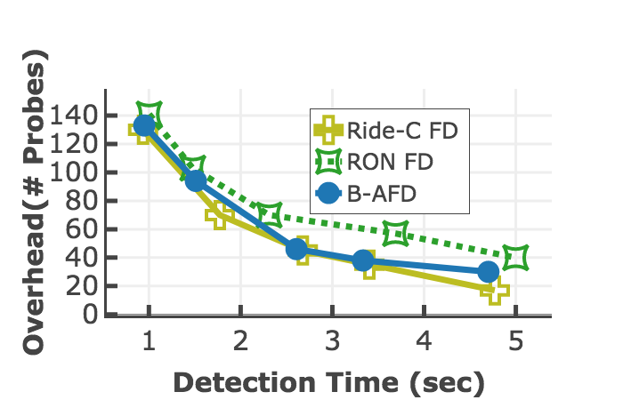
Ride-C Comparison with Previous Related Works
Ride-C detects failures with lower overhead while satisfying detection time requirements.
* RON FD: Andersen et al. 2001
* B-AFD: Dong et al. 2014
Notes:
-----
SPEECH
We see that the adaptive failure detectors always perform with lower overhead compared with RON

Slide 26
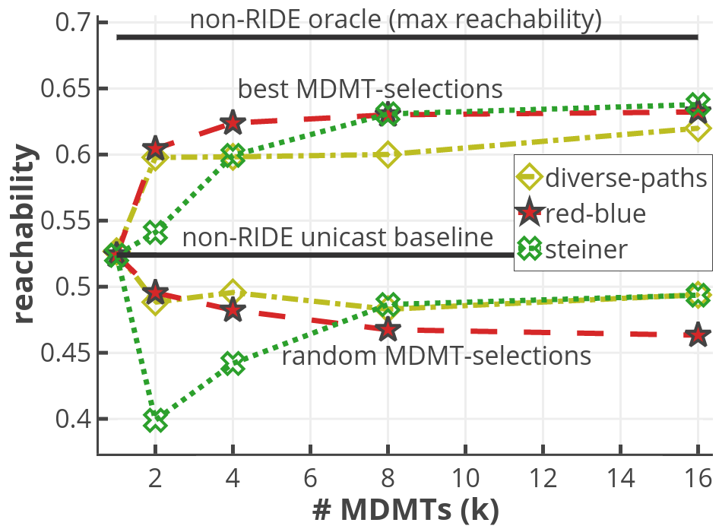
Ride-D MDMT-Construction
diminishing returns →
red-blue
for k<4
Correct selection > unicast
(rate of alert delivery to subscribers)
worse than unicast due to trees’ fragility!
Notes:
-------
Ride-D large-scale evaluations done in purely simulated setup.

Slide 27
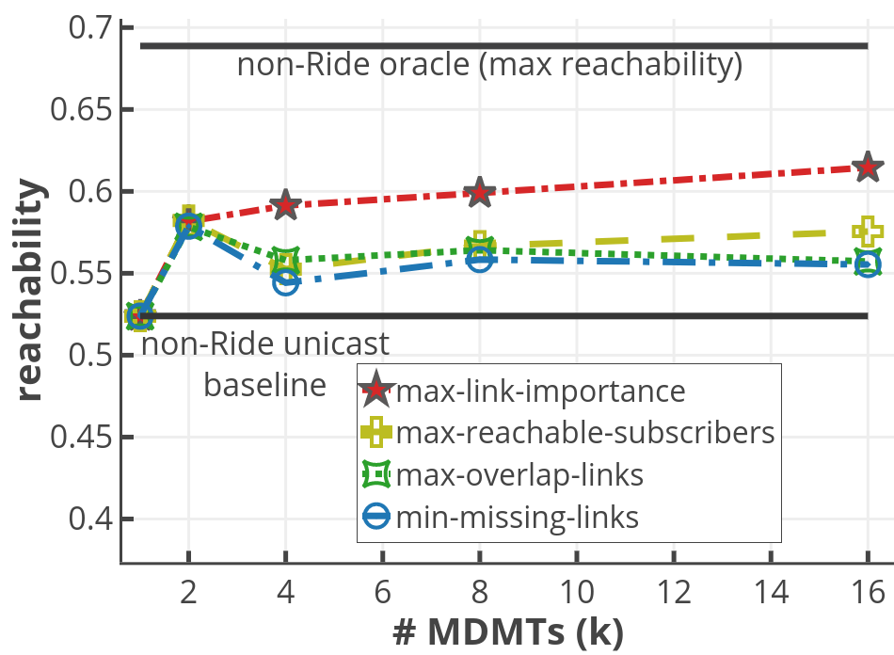
Ride-D MDMT-Selection
max-link-importance
for k > 2
State-aware heuristics better
(rate of alert delivery to subscribers)
Notes:
-------
Results shown for red-blue construction, but others appear similar

Slide 28
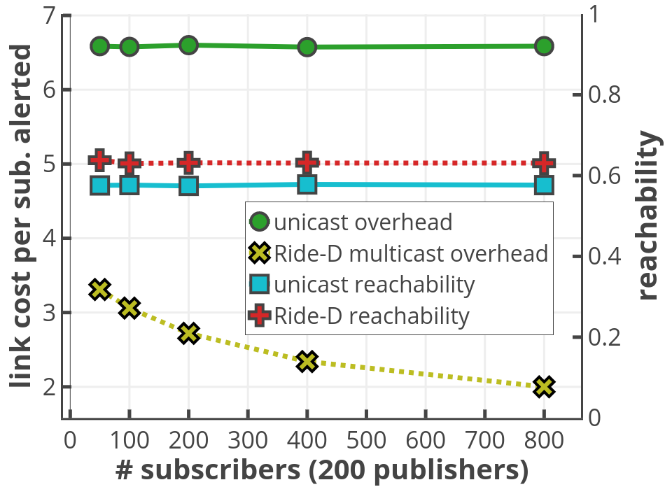
Ride-D Overhead Improvement
Ride-D multicast improves overhead
Resilience holds with increasing subscribers
More subscribers → more improvement
Notes:
-------
LINK COST: total cost for that MDMT: metric cost for construction algs.

Slide 29
Conclusions
Future Directions
We demonstrated Ride: a Resilient IoT Data Exchange middleware
  Adapts to cloud disruptions and local failures using SDN and edge resources
  Avoids over-burdening constrained IoT devices
  Practical feasibility study
Ride shows promise; much more to explore!
Ride-C: Data collection
  Improve SDN fail-over time.
  Intelligently split data across multiple cloud data paths.
Ride-D: Alert dissemination
  Adaptively re-transmit by gathering further network state from alert responses (ACKs)
  Integrating P2P-style resilient application-layer multicast to forward alerts between subscribers
Notes:
Could easily try out passing to neighbor devices using CoAP observe
Could look at MQTT “ALM” with CoAP lateral pass

Slide 30




Thank you!
Questions??
kebenson@uci.edu
Try out and expand on Ride:
github.com/KyleBenson/ride
Acknowledgements
CNS-1143705, CNS-0958520, 70NANB17H285
CNS-1450768, CNS-1528995

