Slide 1
Usage of the Libraries Website on Smart Phones
Arpit Bansal
Richard Cau
Deepa Prabhu

Slide 2
Overview
Library Mobile Site Statistics
Our Project
Our Views – What We Liked!
Our Views – What We Found Difficult to Use!
Our Bias
Methods We Will Employ
Finding People to Interview
Questions We Will Ask
Plans
Activities and Time Plan (Table)
Questions

Slide 3
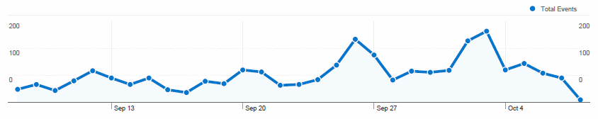
Library Mobile Site Statistics
Has been getting roughly 100 users/day since school started
Most visited pages are the front page and library hours page

Slide 4
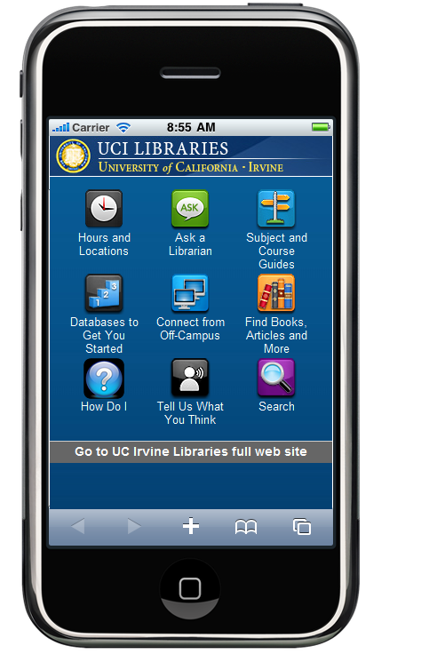
Our Project
Actual Usage of the Library Website on Smart Phones
  Do people want this?
  Will they be willing to use it?
Interface Design
  Easy to navigate (i.e. intuitive)?
Services Available/Needed
  Will users watch “How Do I” videos on their smart phones?
http://www.lib.uci.edu/mobile

Slide 5
Our Views - What We Liked!
Simple front page
  Looks like a app
  Fairly intuitive to navigate
Some pages are mobile friendly
  Use of drop-down tabs to save space
  Most text size is legible
Examples on next slide

Slide 6

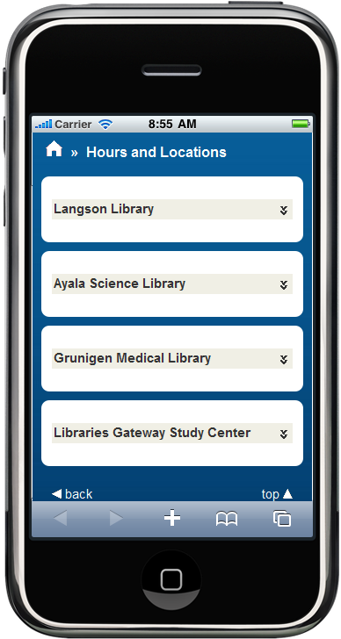
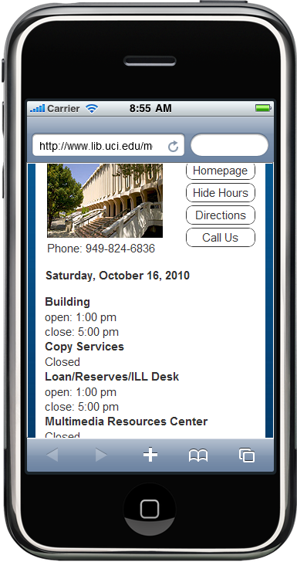





What We Liked - Example
Hours Page
(Mobile Friendly)
Easily Navigated to Find Library Hours

Slide 7
Our Views – Difficult to Use!
Small Screen
  Might be stressful to eyes
Non-mobile Friendly Sites Annoying to Use
  Have to constantly resize pages
Possible Impact to Users
  Popularity restricted
  May have many unused Services
Examples on next slide

Slide 8
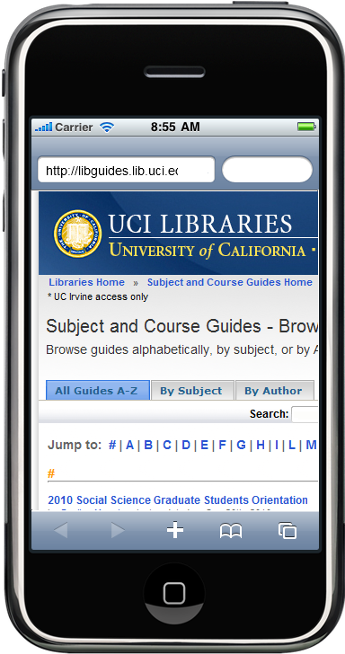

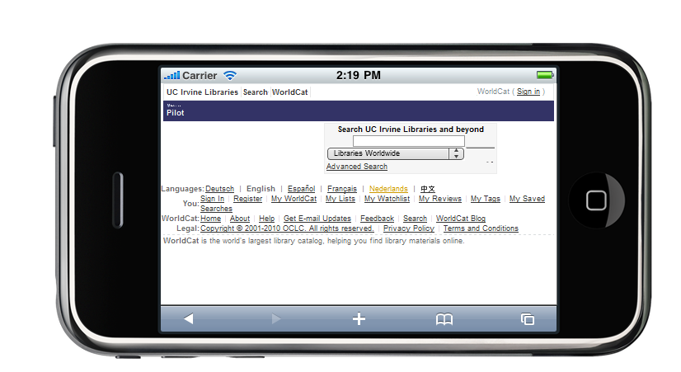


Difficult to Use - Examples
Cannot read text without zooming in. Limits viewable content
Sideways view to see whole page results in text too small to read

Slide 9
Our Biases
We’re unfamiliar with using smart phone browsers
  Perhaps users who are familiar with browsing websites on smart phones will find the non-mobile friendly sites easier to use
We’re slow-handed (i.e. typing/texting)
  People who can type/text on a smart phone quickly may find it easier to use
Essentially, final evaluation results may be different from our views ☺

Slide 10
Methods We Will Employ
Interviews!
Preferably with people who have already used the mobile site
We will be supplying an incentive
Pilot testing
  Interview 2-3 users and refine questions for future interviewees (iterative process)
Follow-up Questionnaires
  Possibly ask past interviewees about newly found matters

Slide 11
Finding People to Interview
Method 1
  Request library to post a banner on website asking for willing interviewees (DENIED)
Method 2
  Request for interviewees using UCI mailing list(s) (aided by Prof. Kobsa)
Method 3
  Asking people around campus directly (Last Resort)

Slide 12
Questions We Will Ask
Following Questions Supplied by Customer
  We will rephrase and expand on these general questions
What do they use their smartphones for?
Do people like the search button on the mobile site?
Would they prefer if it searches only the mobile site, or the full library site?
Do people want to do database searches on a mobile device?
Would people want to watch tutorial videos on a mobile device?
What would people want on the main page of the mobile site?
Do they like what's there already?
Do they have ideas for useful Libraries-related mobile applications?

Slide 13
Plans
Interview 3 groups of users
  Undergraduates, Graduates, and Faculty
  3 members from each group
Interview a set of 2-3 people to remove redundancy (pilot test)
  Develop more interview questions
  Rephrase current interview questions
Issue follow-up questionnaires if necessary
Finally, based on our analysis, suggest improvements to the interface/mobile site

Slide 14
Activities and Time Plan
Week | Activity | Personnel
1-3 | Meet with customer and preparation for initial presentation. | All
4 | Prepare interview questions and find/set appointments with interviewees for pilot testing. | Questions: AB, DP Contact: RC
5-6 | Conduct Interviews and refine questions | Groups of 2
7 | Analyze Interviews and report findings to customer. May perform follow-up survey. | Grads: AB UGrads: RC Faculty: DP
8 | Pre-final Presentation and determine if additional information is needed. | All
9-10 | Final report and Interface improvement suggestions. | All
LEGEND: AB = Arpit Bansal, RC = Richard Cau, DP = Deepa Prabhu

Slide 15
Questions??
and any volunteers to be interviewed?

