Slide 1
Project 7: Testing Suggested Modifications to a User Interface for Source Code Search
Customer: Rosalva Gallardo
Team members:
Susan Lin
Buda Chiou
Jim Milewski
Marcos Mercado
October 19, 2010

Slide 2
Agenda
Project background & overview
Project phases
Usability problems that we’re dealing with
Methods that the team is going to employ to address the usability problems
Project Plan
Q&A

Slide 3
Project background & overview
Original Experiment
  Customer goals were:
    Understand the strategies and information software developers use when they select a source code search result from the Web
    Identify the relationship among strategies, information used, and successful completion of the experiment’s tasks.
Notes:
“How many have searched on the web for source code?” “what strategies do you use when searching for source code?”

Slide 4
Project background & overview
New Experiment
  Customer goals are:
    Same as in the original experiment
    Analyze how an enhanced GUI will influence users’ decisions on the information they use.
  Variants:
    New participants
    Use of an enhanced treatment GUI
    Use of a log mechanism to assist in the collection of experiment data related to GUI usage.
Notes:
Talk a little about baseline GUI and treatment GUI
Also, customer:
was surprised that the additional information (technical and social metrics) was only used 12.5%-50% of the time. Customer wants to see if changing the presentation of this information will influence users' decisions on what information they use.
Customer expects the results of the 2nd experiment to be similar to the first one. Customer expects that not many users will use the additional information even though now it is more eye-catching. Customer believes that choosing the information users analyze in the search result depends on the background, past experiences, personality, and other personal abilities and styles.
Our team wants to compare:
Ex2 baseline with Ex2 treatment
How much additional components were used?
What evidence shows that additional components assisted participants in selecting the right candidates?
Were the additional components of help or hindrance in completing the task successfully?
Ex2 treatment with Ex1 treatment
Did the GUI changes make a difference?
What evidence shows that the modified GUI helped or hindered participants in selecting the right candidates?
Ex1 baseline with Ex2 baseline
Since the baseline GUI and the experiment remained identical as in the original experiment conducted by the customer, what evidence shows that the experiment results are at most halfway identical?

Slide 5
Project phases
Implement user interface enhancements to experiment’s treatment GUI.
Implement an automated log mechanism to capture certain events during GUI usage.
Conduct new experiment
Analysis of results
Notes:
Mention that these are high-level project phases. If necessary, specify the GUI enhancements and the events we’re capturing:
Begin & end of each experiment task
Mouse clicks on GUI components (e.g., search result title)
Scrolling across the list of source code results
Use of an enhanced Treatment GUI
Analysis of results: We want to focus on the analysis of information (GUI elements) used and not so much in the strategies but the experiment covers both.

Slide 6
Usability problems that we’re dealing with
Usability problem | Customer’s View | Team’s initial thoughts
Users failed to quickly understand the information provided in the search results. | “We argue that evaluation performance can be improved by increasing understanding of search results…” (Gallardo & Sim. “StrategiesInfoUsed_Paper_v10.pdf”, p.1. In submission to CHI’10) | We believe that in order to increase understanding of search results, interface needs to be easy to understand at first glance.
Sorting of results was not available to users. | Allow users to sort by popularity and software quality metrics. This may help users choose the best candidate. | Agree with customer
Notes:
Mention what customer said:
“changing the way additional information is shown (i.e. using graphs instead of text) can help users to understand a result faster.”

Slide 7
Usability problems that we’re dealing with
Usability problem | Customer’s View | Team’s initial thoughts
Additional information (popularity and technical metrics) was shown to assist users in choosing the best candidate. This information was ignored or not frequently used. | Surprisingly, metrics were only used 12.5%-50% of the time. Change the presentation and location of these metrics to make them more eye catching. | The additional information should mix graphics and text to make it more appealing. However, it should not give a cluttered feel to the interface.
Idem | Perhaps the additional information was ignored because seemed irrelevant to the user. Include information about people who wrote the reviews on each candidate (one of the popularity metrics). | We will perform comparative analysis of similar web sites as well as brainstorming sessions to decide what information to include.

Slide 8
Methods that the team is going to employ to address the usability problems
Comparative Analysis
  performed by team to propose user interface changes
Automatic testing
  performed by team to ensure technical implementation of GUI and log mechanism are error-free
Cognitive walkthrough
  performed by team to ensure GUI elements and log mechanism are error-free for experiment participants
Interview
  performed by participants during experiment (audio and GUI interactions will be recorded)
Pilot tests
  performed by team and/or participants
Usability experiment
  performed by participants during experiment and reviewed during analysis

Slide 9
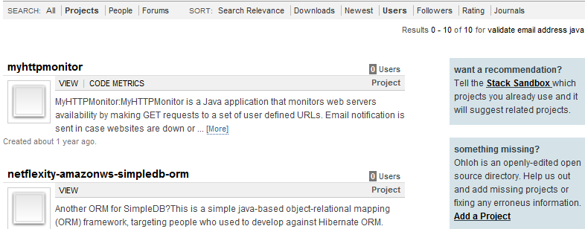
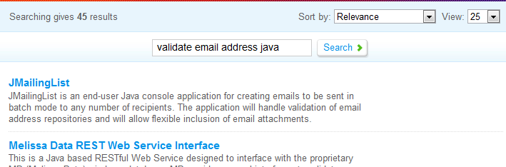
Comparative Analysis
Google Code, Koders.com, Source Forge, Ohloh

Slide 10
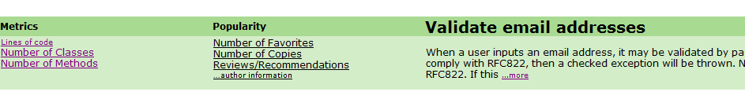
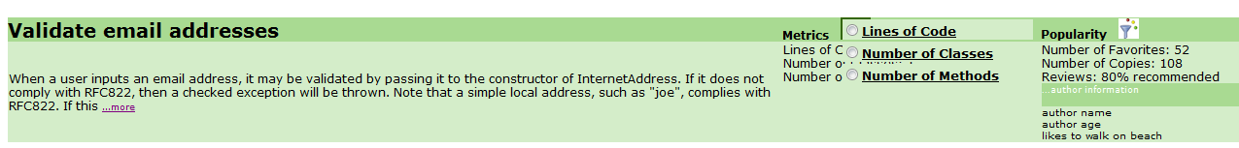
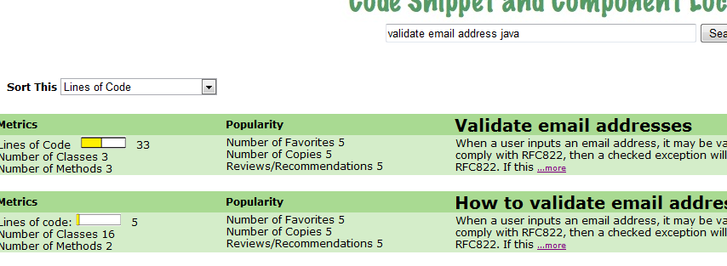
Prototypes

Slide 11
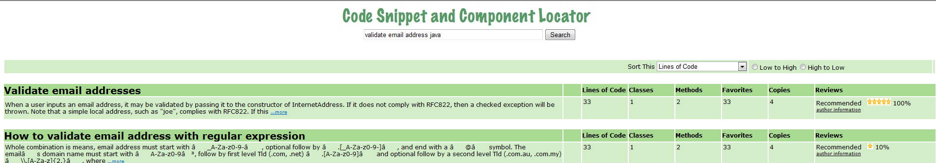
http://www.jimsplace949.com/GUIFinal2.aspx

Slide 12
Methods that the team is going to employ to address the usability problems (continued)
  Number & type of users:
    16 ICS students with experience in Java (13 graduate-level and 3 undergraduate).
  Tasks for users and questions we will ask them:
    CSV task: Find the best source code to read a CSV file and place the data into a list of strings.
    DIFF task: Find the best source code to compare two text files and show the differences.
    EMAIL VALIDATION task: Find the best source code to validate email addresses.
    TIMEZONE task: Find the best source code to convert date & time between different time zones.
Notes:
CSV task: Find the best source code to read a CSV file and place the data into a list of strings.
DIFF task: Find the best source code to compare two text files and show the differences.
EMAIL VALIDATION task: Find the best source code to validate email addresses.
TIMEZONE task: Find the best source code to convert date & time between different time zones.

Slide 13
Methods that the team is going to employ to address the usability problems (continued)
  Strategies for involving users
    Recruitment email
    Use of incentives
  Where…
    Will meet them in the Hana Lab
    Each meeting will last 1.5-2 hrs

Slide 14
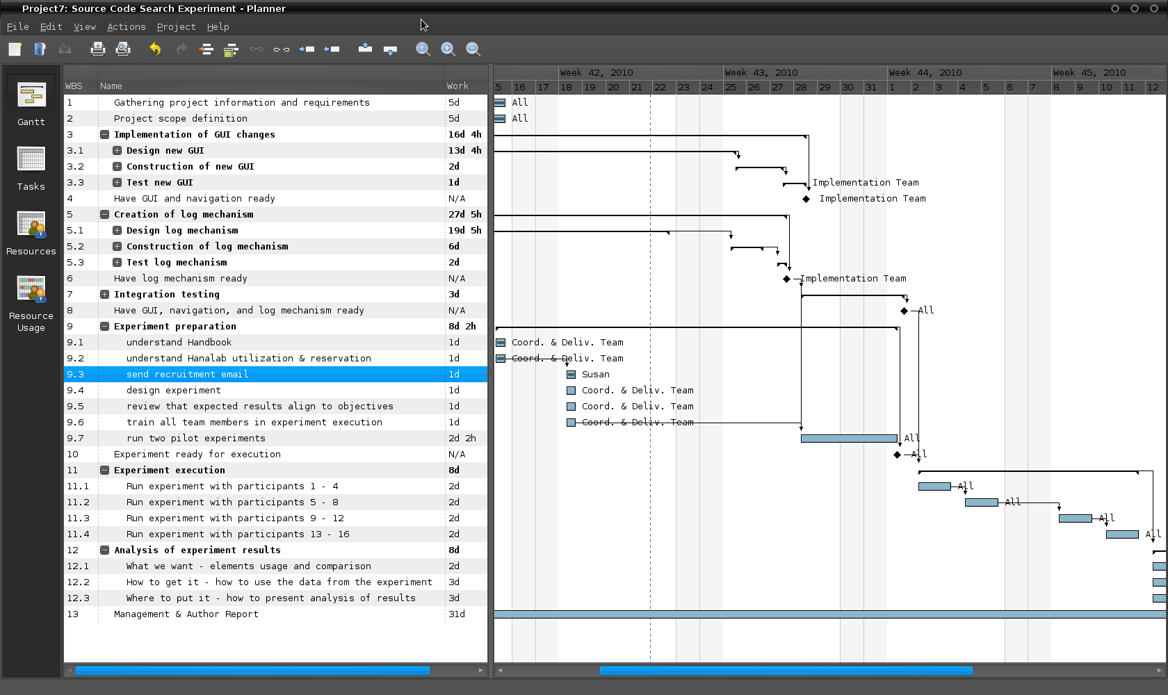
Project Plan overview
http://www.jimsplace949.com/ProjPlan_Project7_SrcCdSrchExperiment.html

Slide 15
Q&A

