Slide 1
Usability and Utility of TopicLens A visualization system for the exploration of topic models and social networks
Sunil Gahlawat, Lu Gan, Miya Sylvester, Yiran Wang

Slide 2
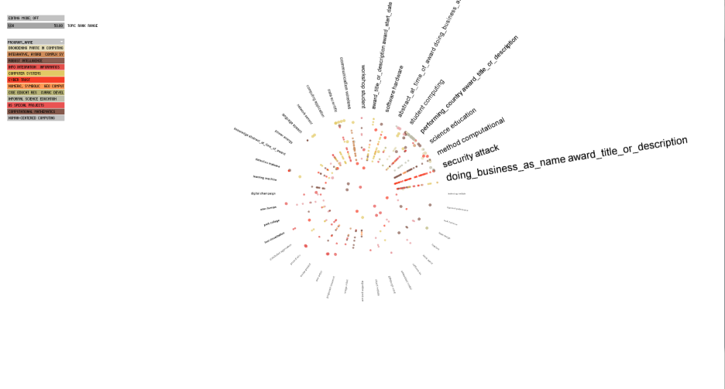
Overview
Identifying and classifying usability defects, including overlooked problems in system.
Study whether the design elements and aesthetics enhance the Usability of the program.
Evaluate User satisfaction/User experience in terms of ease of learning, retention, efficiency, and reliability.

Slide 3
User Study Set-Up
Observation Methods used:
Note Taking
Audio recording
Camtasia video screen capture
Pre-Survey
Part 1 experiment (Editing Mode Off)
Tutorial 1 video
Quiz 1
Hands on experimentation
Part 2 experiment (Editing Mode On)
Tutorial 2 video
Quiz 2
Hands on experimentation
Scenario
Part 3 Interview Questions
Post-Survey

Slide 4
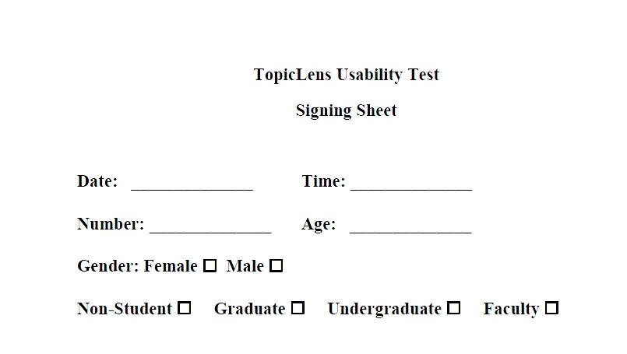
Pre-Survey: Signing Sheet for Participant

Slide 5
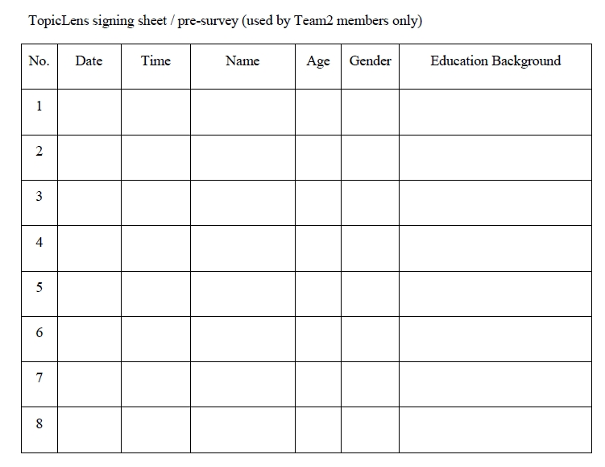
Participant Log

Slide 6
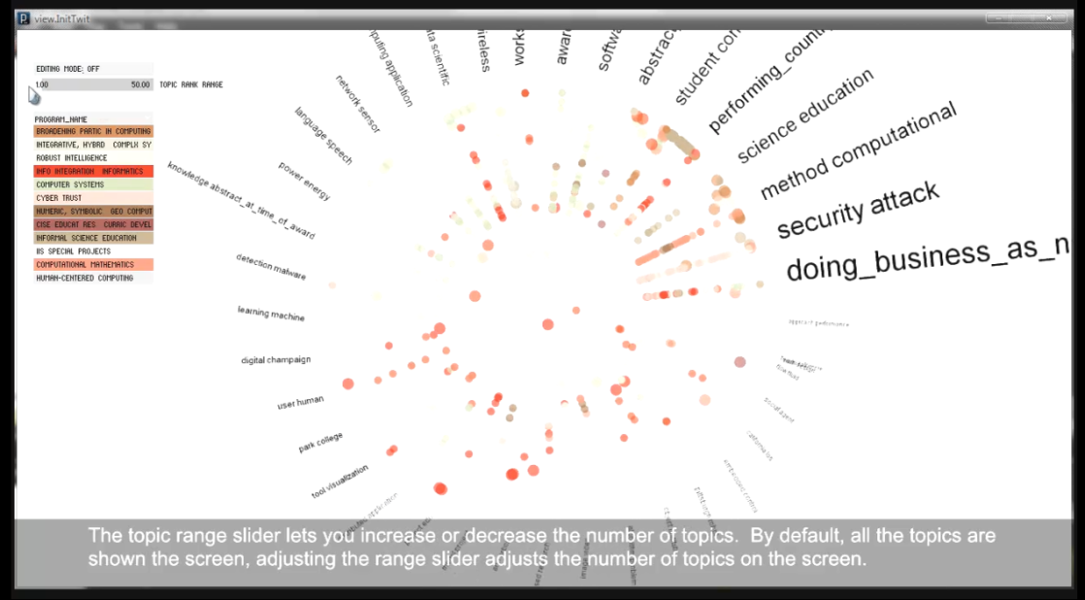
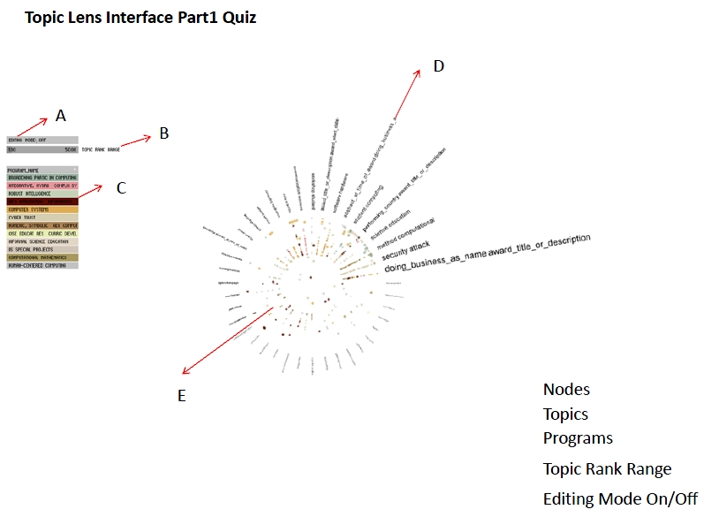
Part 1 experiment: Editing Mode Off
Tutorial 1:
Quiz1:

Slide 7
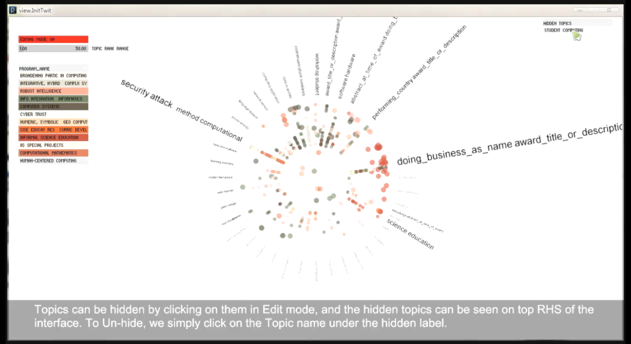
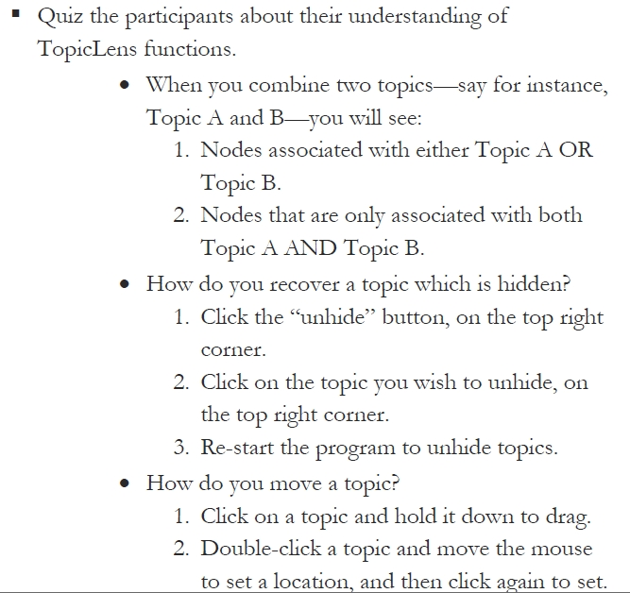
Part 2 experiment: Editing Mode On
Tutorial 2:
Quiz2:

Slide 8
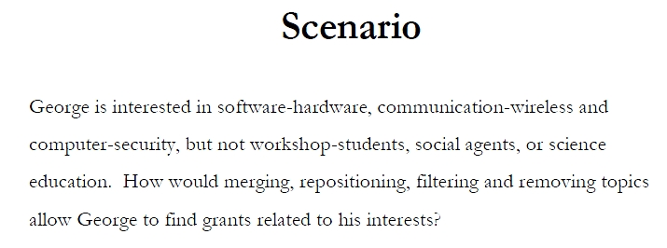
Part 2 experiment: Editing Mode On

Slide 9
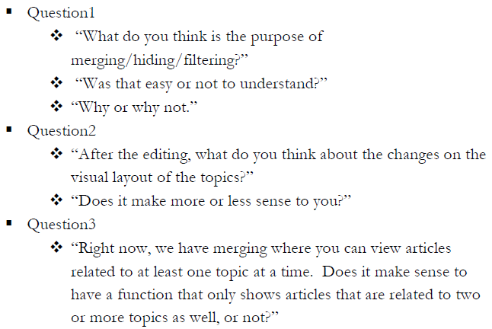
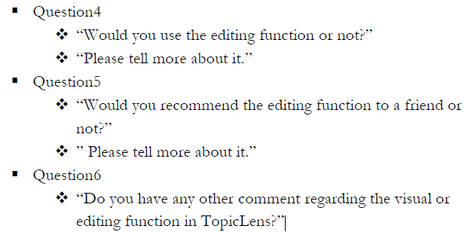
Part 3: Open Ended Questions

Slide 10
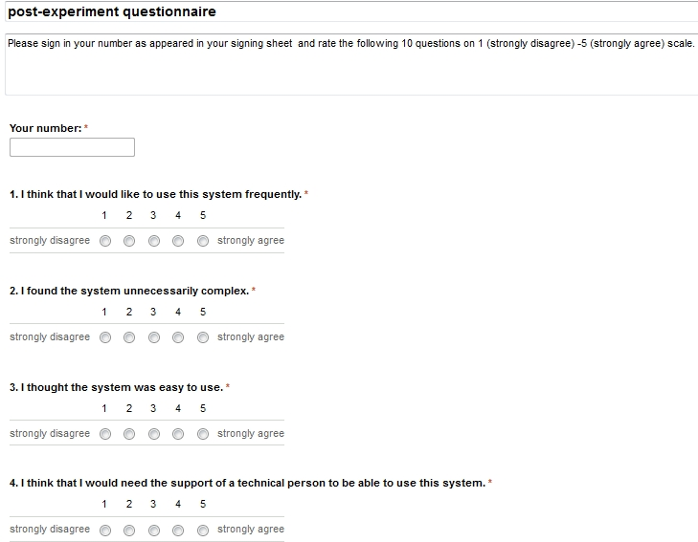
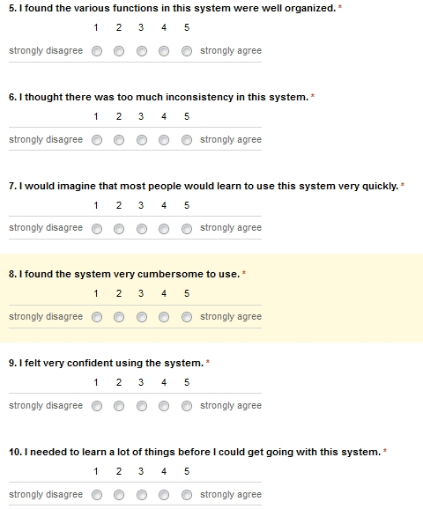
Post-Survey Questionnaire

Slide 11
User Study Participants
Locations: | Library/UCI housing
Total Number of participants: | 8
Average Time for User Study: | 36min 30sec

Slide 12
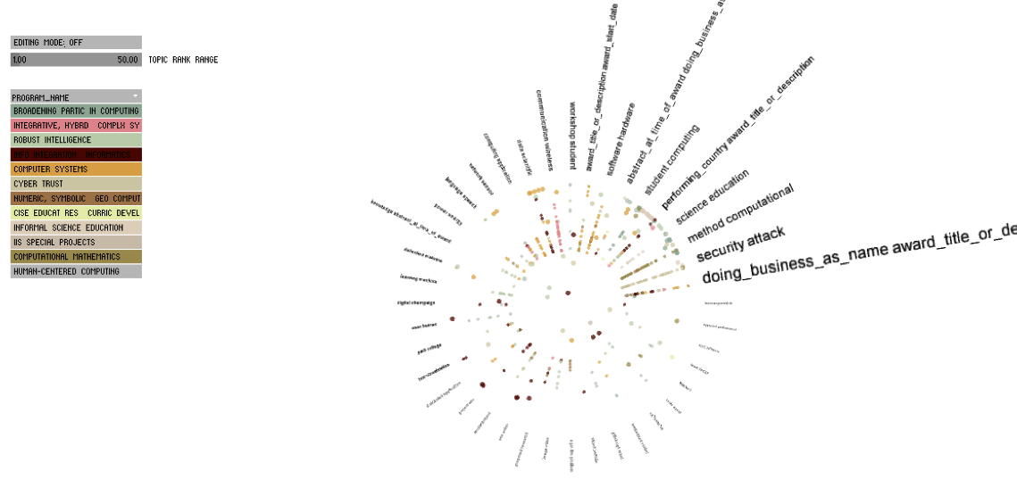
Heuristic Evaluation
No alphabetical indexing of topics
The background colors of program boxes sometimes make the label unreadable
grant titles are not easily readable and go out of screen sometimes
Font size is not adjustable

Slide 13


Heuristic Evaluation
Grey Text not legible
Titles of topics overlap when dragged together

Slide 14

Heuristic Evaluation
No pan function
Reset/return button missing
No maximum zoom in limit (leads to blank screen)
Initial zoom abruptly increases the size of the nodes
Range slider design could be better (users can miss the two slider bars)

Slide 15
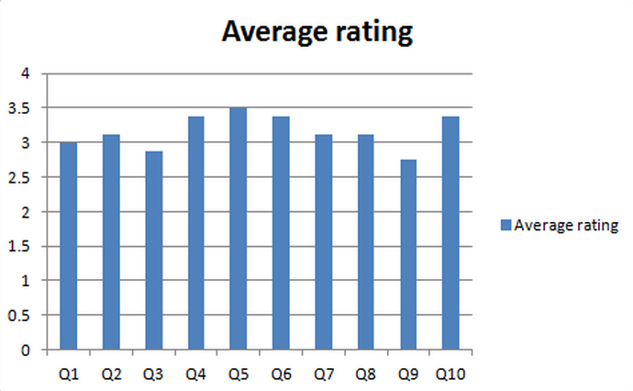
Post-Experiment Survey
Post-experiment questionnaire on System Usability Scale (SUS)
Average rating of 10 questions: 3.16

Slide 16
Preliminary Results (1)

Slide 17
Preliminary Results (2)

Slide 18
Preliminary Results (3)

Slide 19
Preliminary Results (4)

Slide 20
Timeline

