Slide 1
Transport Protocol Enhancements for Thin Streams
Magda El Zarki
Prof. of CS
Univ. of CA, Irvine
Email: elzarki@uci.edu
http://www.ics.uci.edu/~magda

Slide 2
Game Traffic – A Thin Stream
What is a THIN stream?
Thin streams have very small packet sizes and very high inter packet arrivals (IAT)

Slide 3
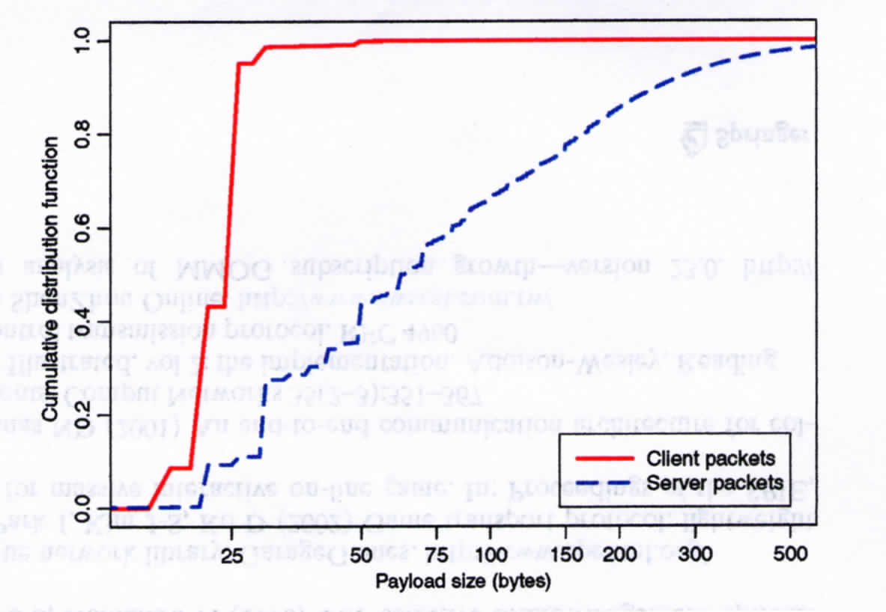
Thin Stream Traffic – Packet Size

Slide 4
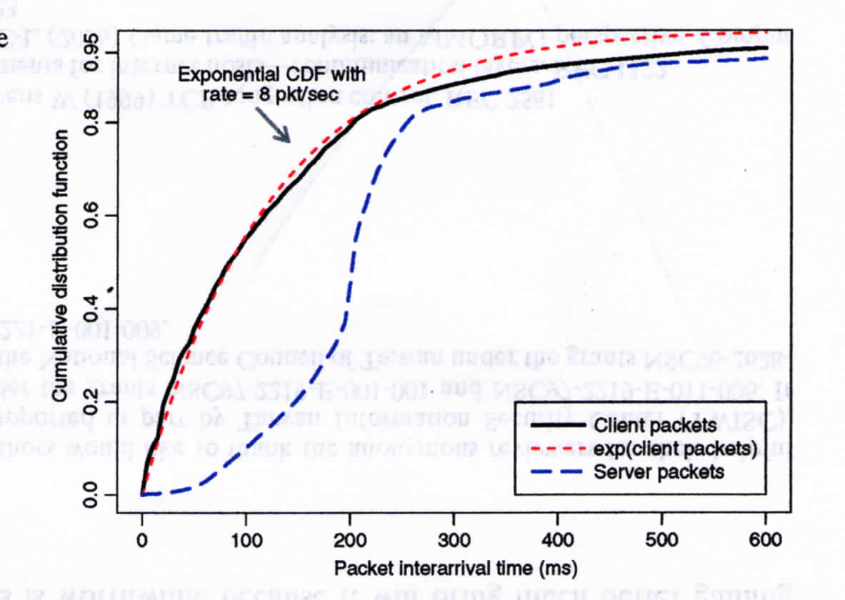
Thin Streams - IAT

Slide 5
Transport Protocols
User Datagram Protocol (UDP)
  Send a message (datagram) and forget about it
  No guaranteed delivery
  No guaranteed ordering
Transmission Control Protocol (TCP)
  Guaranteed, in-order stream of data from one host to another

Slide 6
UDP Segment Layout – Header 8bytes
Bits | 0 15 | 16 31
0-31 | Source Port | Destination Port
32-63 | Length | Checksum
64+ | Data
Notes:
Figure 3.4

Slide 7
TCP
In comparison to UDP, TCP offers:
  A connection-oriented services with bi-directional (full-duplex) communication
  Reliable transmission of messages in each direction
  Congestion avoidance, using variable rate transmission
  In order, and non-duplicate delivery of information
Applications place the data bytes into an outgoing buffer
The buffer is streamed in the form of segments to the receiver
At the receiver, the segments are dismantled and the data is stored in a buffer byte by byte, and pushed to the application.

Slide 8
Layout of a TCP Segment – Header 20-40bytes
Bits | 0 15 |  |  | 16 31
0-31 | Source Port |  |  | Destination Port
32-63 | Sequence Number (SN)
64-95 | Acknowledgement Number (ACK)
96-127 | Data Offset | Not Used | Flags | Receive Window
128-159 | Checksum |  |  | Urgent Pointer
160-191 | Options (Optional)
160+ 192+, 224+, etc. | Data
Notes:
Figure 3.10

Slide 9
Thin Streams and UDP
Works for some traffic types that do not need high reliability. Games, other than FPS, with lower latency constraints, may prefer not to use UDP because of out of order delivery and packet losses.
Sometimes used by games in conjunction with a middleware layer that adds TCP like behavior to the packet stream. UDT and ENet are such examples.

Slide 10
Thin Streams and TCP
Why wont TCP work?
  Game packets are very small, overhead of TCP is very high in comparison
  -> A very high percentage of the observed traffic in traces is overhead – ACKS and headers
In-order processing of packets causes additional delays
Congestion control unnecessary as game traffic is application-limited (the application is very light load).
Fast-retransmit, a method to counter delays with retransmissions, ineffective with game traffic as inter-arrival times (IAT) between packets is very long.

Slide 11
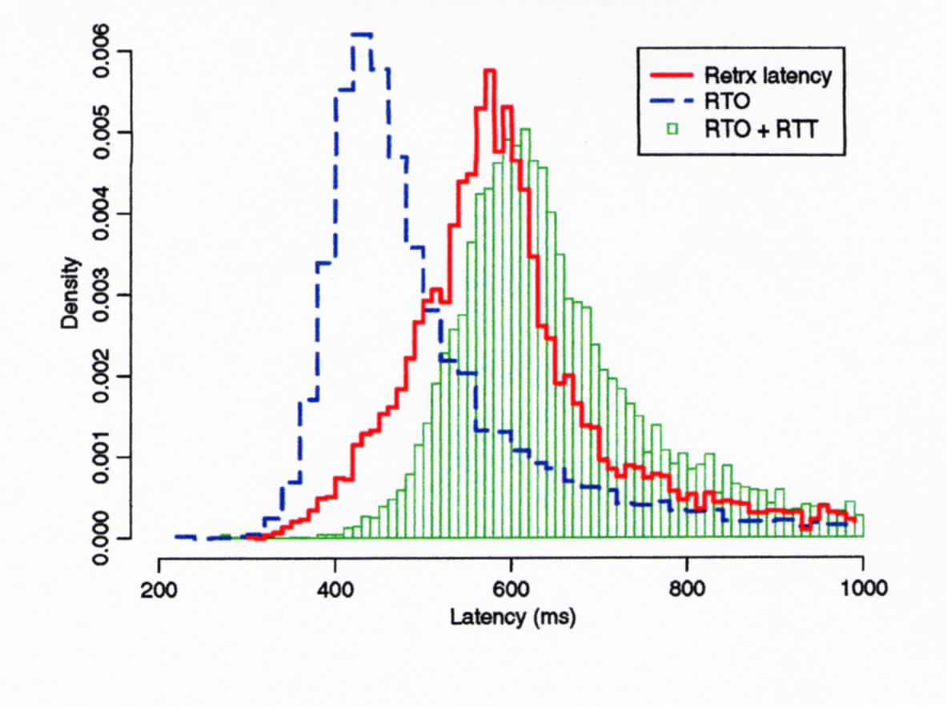
Avg. Latency of dropped/lost packets
RTT – Transmission Time
and time to receive ACK
Is the minimum delay
for one retransmission
when IAT is very low.

Slide 12
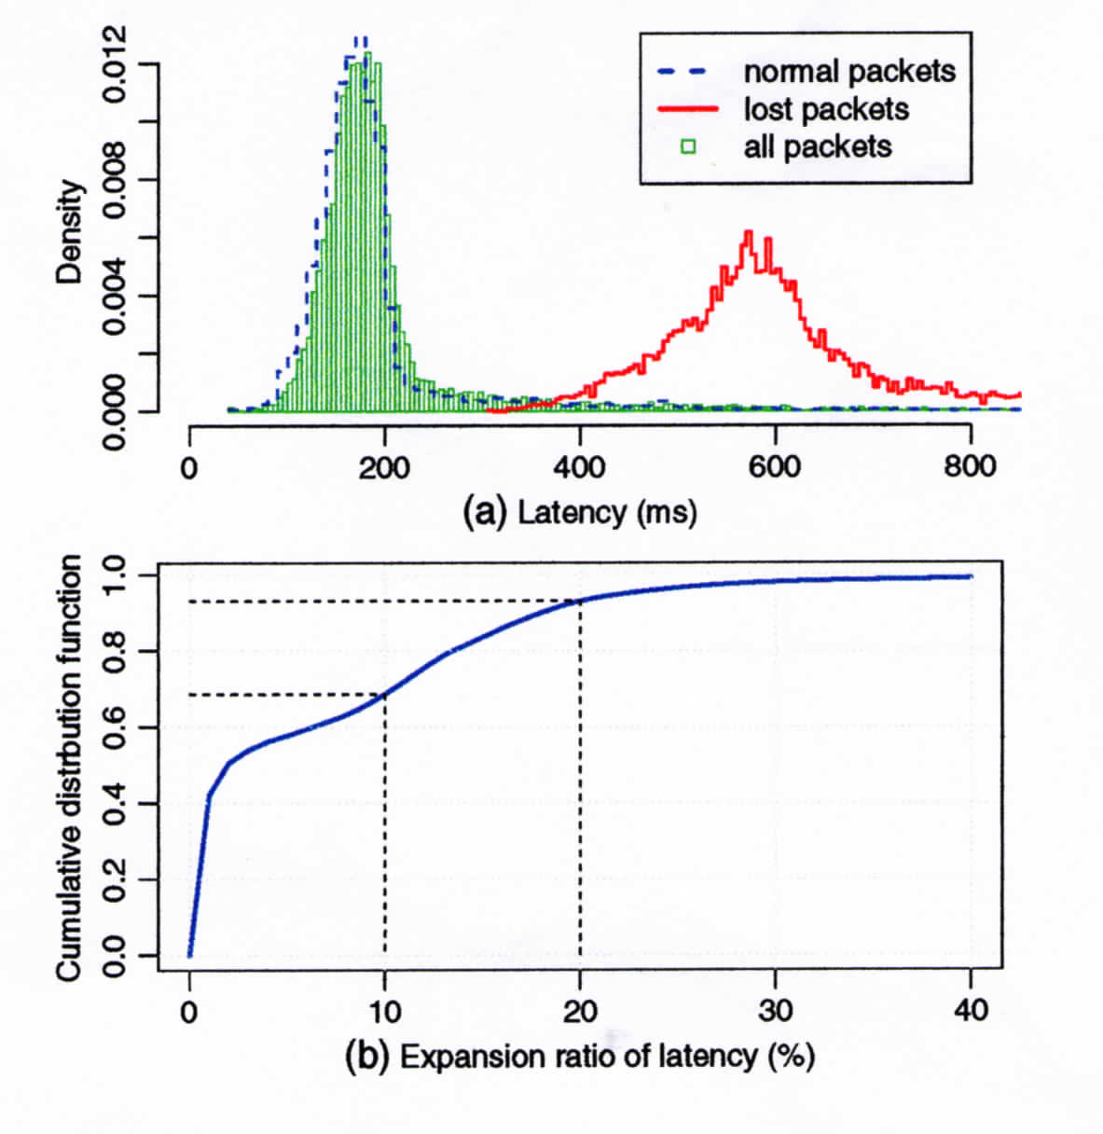
Increased latency caused by Packet Losses that trigger control mechanisms

Slide 13
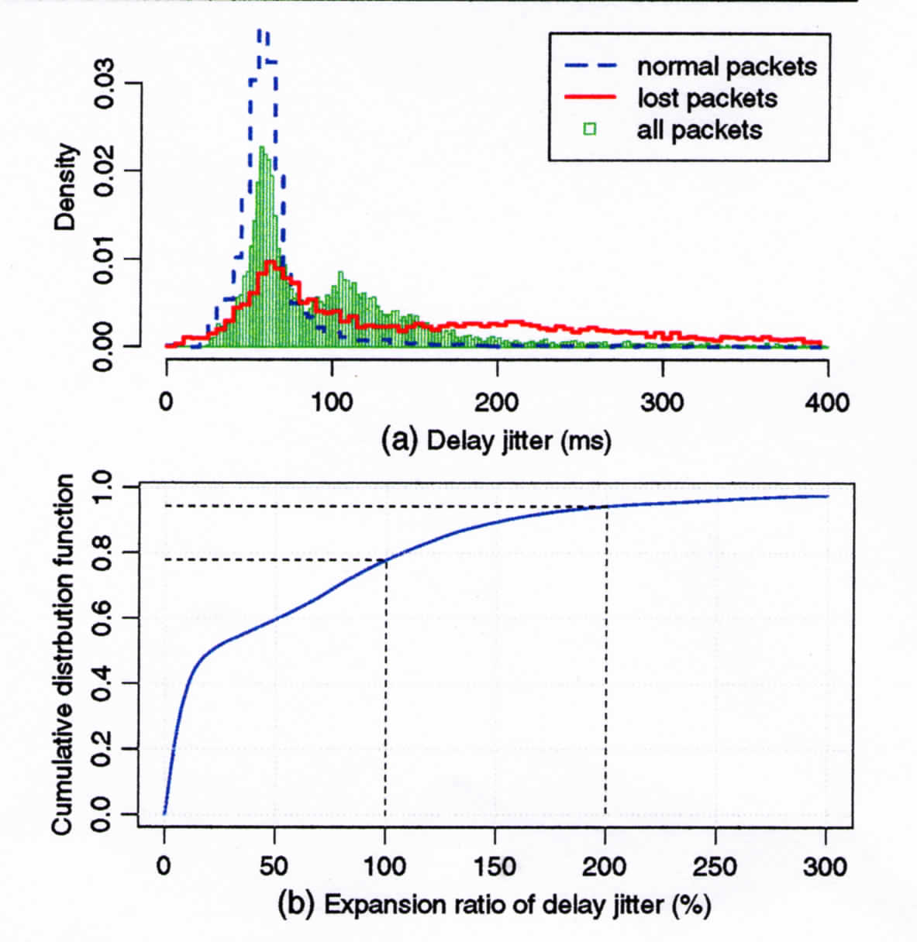
Increased jitter caused by Packet Losses that trigger control mechanisms

Slide 14
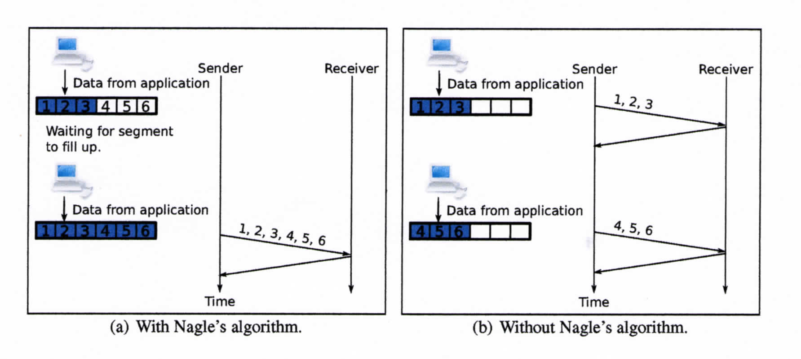
Nagle’s Algorithm – not suited for Thin Streams
Aim to conserve bandwidth. Data only delayed if there are unACKed segments for the connection

Slide 15
Thin Streams and TCP – What can be Done
Modifications to TCP parameters/thresholds to avoid latencies caused by congestion control and retransmission mechanisms
Adding class distinctions to the traffic flow to identify different packet types for preferential treatment

Slide 16
1. In-Order Delivery
Packets wont be delivered to the application until all previous packets have been received and delivered
  Retransmission and re-ordering due to a loss increases latency
In some games, players will often perform many fast actions in sequence.
  Each action is often an incremental update on previous state
  Throwing away a delayed packet is a viable option as you only want to see the present view and not what it was a second or two ago. It will cause jerkiness.
However, in many games, actions do need to be seen in succession as it could impact game play.

Slide 17
2. Congestion Control
Congestion control policy is designed for greedy traffic streams that have to be network limited
By contrast, thin streams are application limited
When there is no action on the link, i.e., the IAT > RTO (timeout), TCP sets the congestion window (amount of traffic a sender may send - cwnd) = 2 and keeps it there so long as this condition doesn’t change– this is called restart after idle period policy
  prevents an application from suddenly dumping a large burst of traffic into the network after a period of silence.
  Cwnd at the old value does not reflect current network conditions - may have changed
  For games that means e.g., a player could suddenly have three actions: “sneak,” “move,” and “attack’’ and only two will go out and 3rd has to wait for window to increase – long delay!

Slide 18
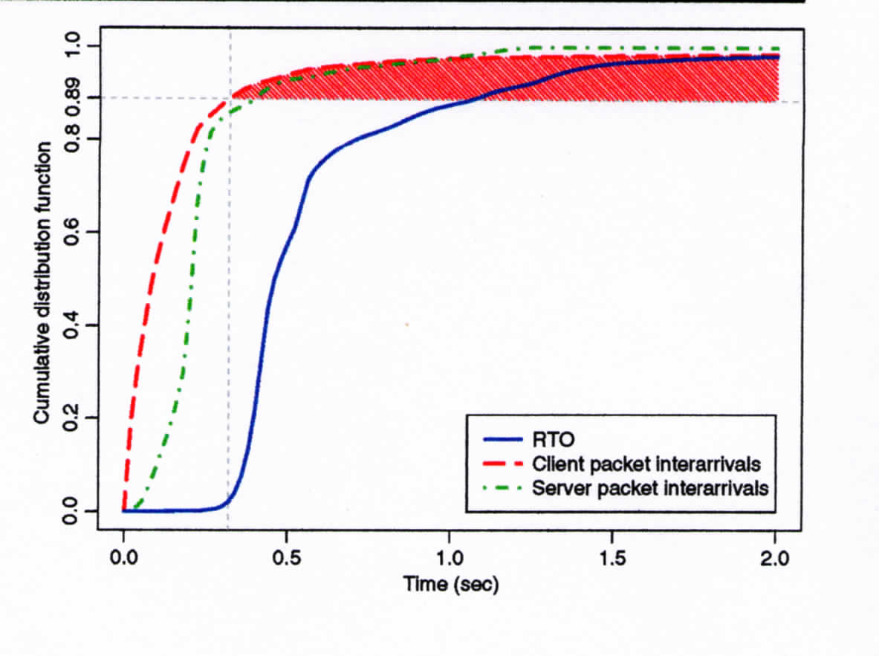
Congestion Control and Thin Streams

Slide 19
3. Fast Retransmit - Loss Recovery
To detect a loss in TCP:
  Retransmission timer expires (RTO)
  Fast retransmit – triggered by 3 duplicate ACKs of same packet
Because of high IAT, not enough traffic during RTO period. Means that fast retransmit will never be triggered.
  SACK - Selective repeat – sends ACK for each received data packet. No waiting for duplicate ACKs
  recommend that every network game employing TCP should guarantee the SACK option is enabled at both ends.

Slide 20
Duplicate Packet Definition
The definition of a series of duplicate acks is strict in that each ack packet must not contain data, must have the same receiver window size, and must have the same acknowledgement sequence number. By this definition, if a receiving host sends a data packet to a sender that is waiting for more duplicate acks in that connection, the count of duplicate acks will be reset to zero. Thus, the fast retransmit mechanism will not be triggered unless the counting of duplicate acks is not interrupted, even if sufficient duplicate acks are released. Most duplicate ack accumulations are interrupted by data packets sent from the game clients. This happens because game traffic is bi-directional, so the game clients may have data to release before sufficient duplicate acks are generated

Slide 21
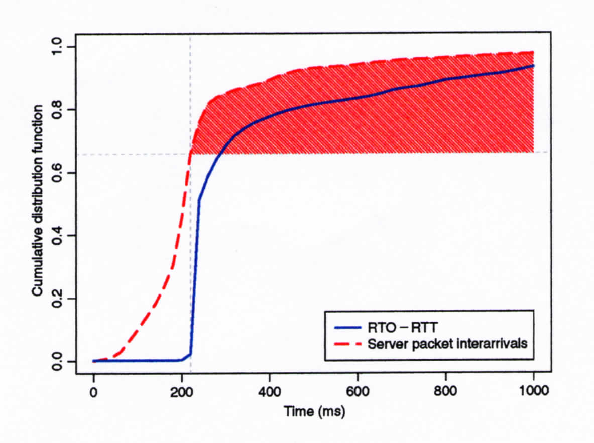
IAT vs RTO-RTT

Slide 22
Proposed TCP enhancements
Simple tweaks to some TCP calculations to bypass or change some actions if a thin stream is detected.
Break down the data into different types of streams and tailor the packet handling to attain the best possible transport strategies for each one.

Slide 23
1. Thin Stream Detection
The thin-stream detection mechanism must be able to dynamically detect the current properties of a stream.
The application should not have to be aware of the detection mechanism, nor have to feed data about its transmission rate to the network stack; it should be transparent to the application.
Should not introduce any new mechanism. The chosen approach is based on an already existing counter of unacknowledged packets.
Mechanism effect:
            If ( tcp_stream_is_thin) {
            apply modifications
            } else {
            use normal TCP
            }

Slide 24
What enhancements do we want for thin stream traffic?
Removal of exponential backoff: To prevent an exponential increase in retransmission delay for a repeatedly lost packet, the exponential factor is removed.
Faster Fast Retransmit: Instead of waiting for 3 duplicate ACKs before sending a fast retransmission, we retransmit after receiving only one.
Redundant Data Bundling: Data is copied (bundled) from the unacknowledged packets in the send buffer into the next packet if space is available

Slide 25
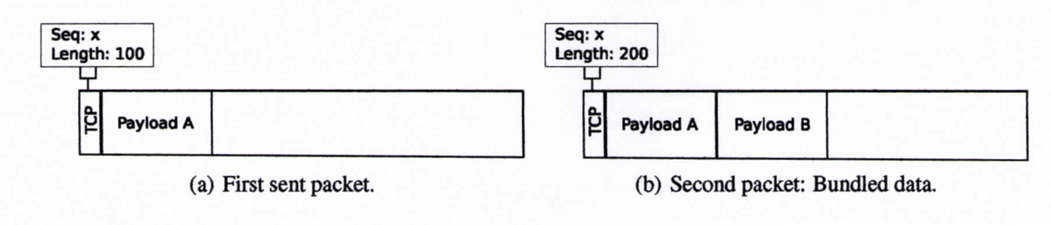
Bundling of Data

Slide 26
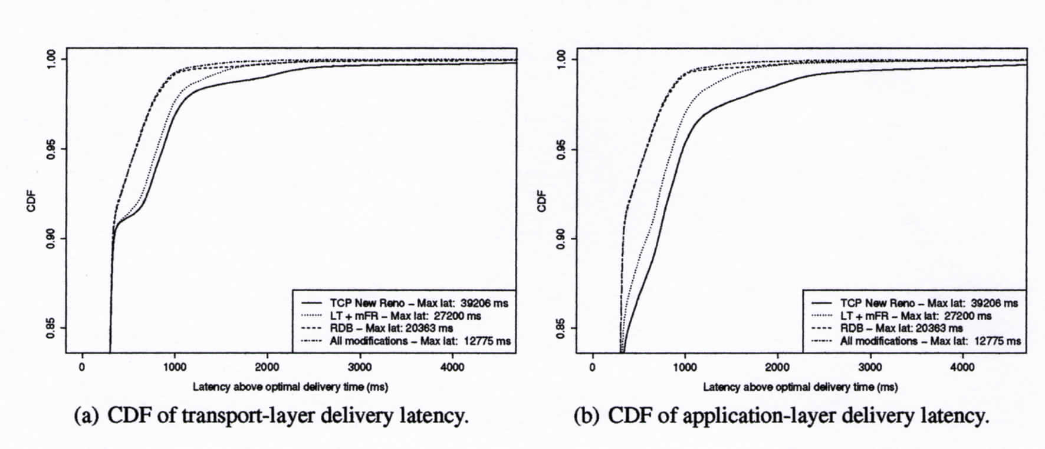
Performance

Slide 27
2. Using content classification
For MMORPGs, the authors classify game messages generated by players into three types: move, attack, and talk messages.
  Move messages report position updates when an avatar moves or goes to a new area. Since only the latest location in the game play matters, the server simply discards out-of-date move messages.
  Attack messages correspond to an avatar’s combat actions when it engages in fights with opponents. Such messages cannot be lost because each action will have some impact on the target. However, if several successive attack messages describe the same combat action against the same target, out-of-order arrivals of these messages can be tolerated.
  Talk messages convey the contents of conversations between players. Must be transmitted in order and reliably.

Slide 28
Transport Options for Different Content
Multi-streaming: With this option, different types of game messages can be put into separate streams, each of which processes the messages independently.
Optional Ordering: Can reduce the latency overhead because it allows some types of messages to be processed at the receiver as soon as they are received without being buffered if their preceding messages have not arrived.
Optional Reliability: With this option, messages that do not require reliable transmission can simply be ignored if they are lost in the network.

Slide 29
Content-based transport strategies
MRO Strategy: MRO only uses multi-streaming (M); that is, it guarantees transmission reliability (R) as well as packet ordering (O) for a particular traffic type. Under this strategy, game messages are classified into traffic types, e.g., move, attack, and talk. Separate streams are used to handle each.
MR Strategy: MR implements both multi-streaming (M) and optional ordering (O). This strategy provides two kinds of streams: ordered streams and unordered streams.
M Strategy: M combines all three options, that is, multi-streaming (M), optional ordering (O), and optional reliability (R). Under this strategy, there are three kinds of streams: ordered and reliable streams (OR), unordered and reliable (R) streams, and unordered and unreliable streams.

Slide 30
Evaluate the effect of the three content-based strategies on a live trace of Angel’s Love
P_{MRO} implements the MRO strategy, which puts move, attack, and talk messages into three separate ordered and reliable streams (OR).
P_{MR} is based on the MR strategy. It transmits move and attack messages via two unordered and reliable (R) streams individually, while talk messages are put into one ordered and reliable stream (RO).
P_{M} employs the M strategy, which transmits move messages via one unordered and unreliable stream, attack messages via one unordered and reliable (R) stream, and talk messages via one ordered and reliable (RO) stream.

Slide 31
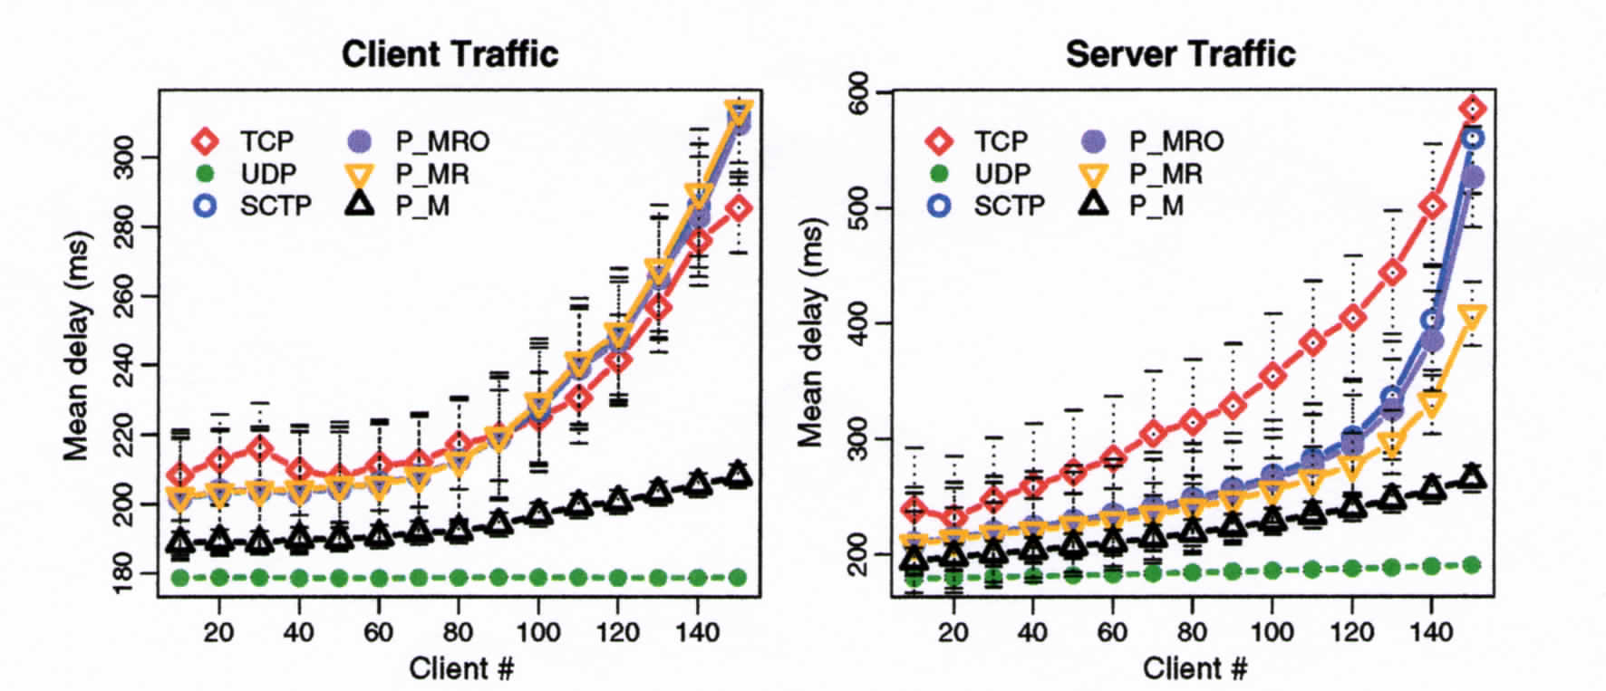
Compare to TCP, UDP, SCTP - Latency
Used traces of Angel’s Love, a mid-scale, TCP-based MMORPG on a test bed in a lab.

Slide 32
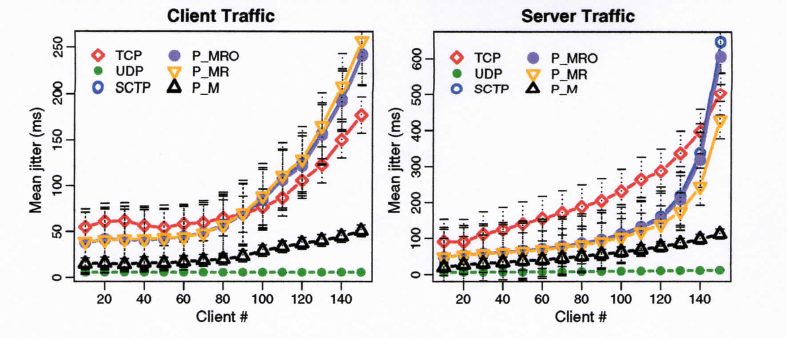
Jitter Performance

Slide 33
References
``On the challenge and design of transport protocols for MMORPGs,’’ Chen-Chi Wu, Kuan-Ta Chen, Chih-Ming Chen, Polly Huang, Chin-Laung Lei, Multimedia Tools and Appl. (2009) 45:7–32.
``TCP Enhancements for Interactive Thin-Stream Applications,’’ Andreas Petlund, Kristian Evensen, Carsten Griwodz, Pål Halvorsen, in Proceedings of NOSSDAV ’08, Braunschweig, Germany, 2008.
``The Fun of using TCP for an MMORPG,’’ Carsten Griwodz, Pål Halvorsen, in Proceedings of NOSSDAV ’06 Newport, Rhode Island, USA, 2006.
``Latency Evaluation of Networking Mechanisms for Game Traffic,’’ Szabolcs Harcsik, Andreas Petlund, Carsten Griwodz, Pål Halvorsen, in Proceedings of NetGames’07, Melbourne, Australia, September 19-20, 2007.
http://www.youtube.com/watch?v=RR-BtWgRJek

