Slide 1
Ch. 12 Cloud Services
Magda El Zarki
Dept. of CS
UC, Irvine

Slide 2
The Cloud
Cloud Computing
Cloud Networking

Slide 3
Cloud Computing
Basic idea: renting instead of buying IT
  It is a solution that provides users with services that can be drawn upon on demand and invoiced as and when used.
  Suppliers of cloud services, in turn, benefit as their IT resources are used more fully and eventually achieve additional economies of scale.
Cloud Computing offers flexibility whilst simultaneously reducing costs
Players in the large world of clouds are:
  Software as a Service SaaS providers
  Platforms as a Service (PaaS) - Outsourcing and hosting providers
  Infrastructure as a Service (IaaS) providers – only hardware

Slide 4
History
Early 90s - Grid Computing a forerunner of cloud computing – targeted scientific computing
August 24, 2006 will go down as the birthday of Cloud Computing as we now know it – utility computing for enterprises (or enterprise computing):
On this day Amazon made the test version of its Elastic Computing Cloud (EC2) public -> flexible computing resources accessible via the Internet.
Cloud Computing, the term, first became popular in early 2007. The first entry in the English Wikipedia was in March 2007.

Slide 5

User View of Cloud Computing

Slide 6
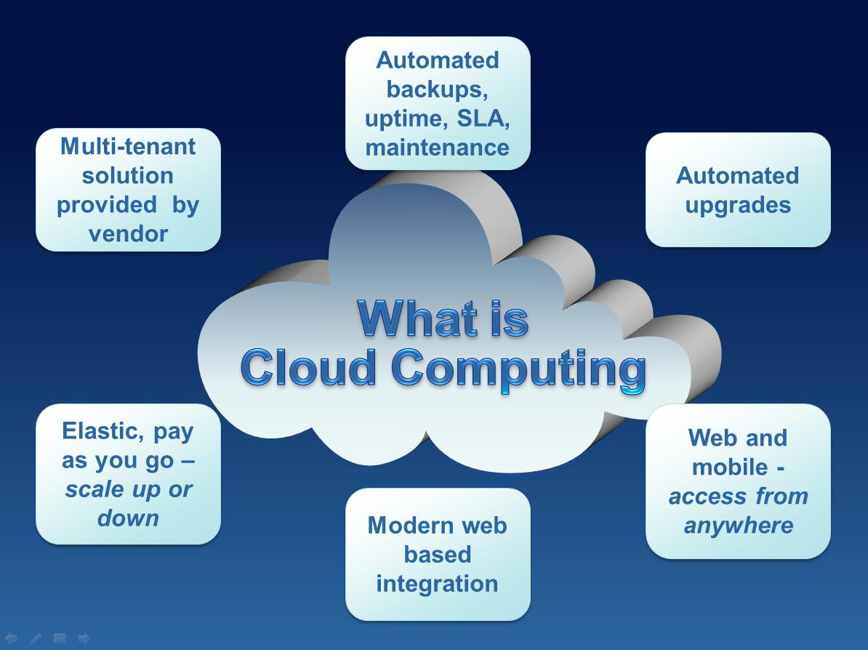
From a Business Perspective

Slide 7
Migrating to the Cloud – Hybrid Clouds
Combination of Internal (Private) and Public – Interim solution
Migration to the public cloud poses some problems for clients:
  Security
  Legacy systems – cost
  Trust – handing over full control
Bridges are built that interface proprietary systems to the public cloud

Slide 8
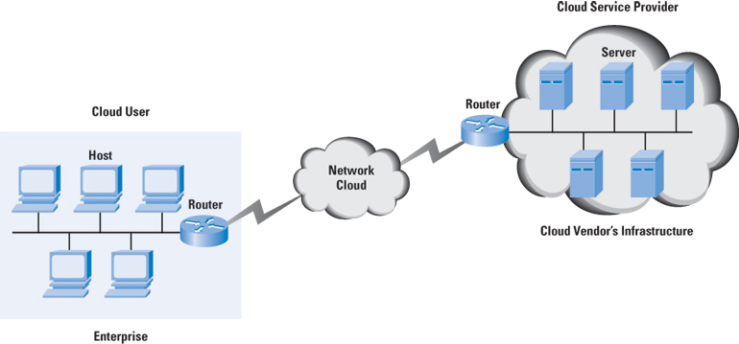
A Cloud Service Scenario

Slide 9
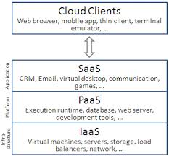
Cloud Delivery Models

Slide 10
Software as a Service (Saas)
Applications are supplied by the service provider – no individual licenses for software products.
These applications could be in human resources, finance, or customer relationship management, …...
The user does not manage or control the underlying cloud infrastructure or individual application capabilities.
The interface to the software is usually through a web browser.
The pricing of such a SaaS service is typically on a per-user basis for a fixed bandwidth and storage.
Monitoring application-delivery performance is the responsibility of the SaaS provider.

Slide 11
Platform as a Service (PaaS)
Allows a cloud user to deploy consumer-created or acquired applications using programming languages and tools supported by the service provider.
  Provides a software platform on which users can build their own applications and host them on the PaaS provider's infrastructure.
  The software platform is used as a development framework to build, debug, and deploy applications. It often provides middleware-style services such as database and component services for use by applications.
The user:
  Has control over the deployed applications and, possibly, application hosting environment configurations;
  Does not manage or control the underlying cloud infrastructure including network, servers, operating systems, or storage.
Pricing for PaaS can be on a per-application developer license and on a hosted-seats basis.

Slide 12
Infrastructure as a Service (IaaS)
An IaaS provider offers you "raw" computing, storage, and network infrastructure so that you can load your own software, including operating systems and applications, on to this infrastructure.
The user is able to deploy and run arbitrary software, which can include operating systems and applications.
The user:
  does not manage or control the underlying cloud infrastructure, but
  has control over operating systems, storage, deployed applications, and possibly limited control of some networking components, e.g., host firewalls.
Services offered by this delivery model include: server hosting, web servers, storage, computing hardware, operating systems, virtual instances, load balancing, Internet access, and bandwidth provisioning.
Pricing for the IaaS can be on a usage or subscription basis. CPU time, storage space, and network bandwidth (related to data movement) are some of the resources that can be billed on a usage basis.

Slide 13
Virtualization
Virtualization software is used to run multiple Virtual Machines (VMs) on a single physical server to provide the same functions as multiple physical machines.
Known as a hypervisor, the virtualization software performs the abstraction of the hardware to the individual VMs.
A hypervisor is implemented on a server either directly running over the hardware (a Type 1 hypervisor) or running over an operating system (OS) (a Type 2 hypervisor).
The hypervisor supports the running of multiple VMs and schedules the VMs along with providing them a unified and consistent access to the CPU, memory, and I/O resources on the physical machine.
A VM typically runs an operating system and applications. The applications are not aware that they are running in a virtualized environment, so they do not need to be changed to run in such an environment. In some instances they maybe –> paravirtualization which requires some modifications

Slide 14
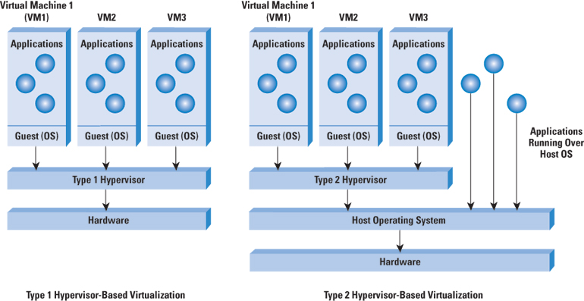
Virtualization

Slide 15
Public, Private and Internal Clouds
Cloud service providers whose data centers are external to the users of the service (businesses or individuals) are known as public clouds—both the infrastructure and control of these clouds is with the service provider.
A variation on this scenario is the private cloud. Here, the cloud provider is responsible only for the infrastructure and not for the control.
  This setup is equivalent to a section of a shared data center being partitioned for use by a specific customer.
  Note that the private cloud can offer SaaS, PaaS, or IaaS services, though IaaS might appear to be a more natural fit.
An internal cloud is a relatively new term applied to cloud services provided by the IT department of an enterprise from the company's own data centers. Internal cloud is often defined as a private cloud.

Slide 16
Existing cloud infrastructure
The cloud computing infrastructure at Amazon, Google, and Microsoft (as of mid 2012)
  Amazon is a pioneer in Infrastructure-as-a-Service (IaaS)
  Google's efforts are focused on Software- as-a-Service (SaaS) and Platform-as-a-Service (PaaS)
  Microsoft is involved in PaaS
Private clouds are an alternative to public clouds. Open-source cloud computing platforms such as
  Eucalyptus
  OpenNebula
  Nimbus
  OpenStack
can be used as a control infrastructure for a private cloud.

Slide 17
Service Level Agreement (SLA)
SLA - a negotiated contract between the customer and CSP; can be legally binding or informal. Objectives:
  Identify and define the customer’s needs and constraints including the level of resources, security, timing, and QoS.
  Provide a framework for understanding; a critical aspect of this framework is a clear definition of classes of service and the costs.
  Simplify complex issues; clarify the boundaries between the responsibilities of clients and CSP in case of failures.
  Reduce areas of conflict.
  Encourage dialog in the event of disputes.
  Eliminate unrealistic expectations.
Specifies the services that the customer receives, rather than how the cloud service provider delivers the services.

Slide 19
Cloud Computing - Summary
It is very attractive to the users:
  Economic reasons
    low infrastructure investment
    low cost - customers are only billed for resources used
  Convenience and performance
    application developers enjoy the advantages of a just-in-time infrastructure they are free to design an application without being concerned with the system where the application will run;
    the potential to reduce the execution time of compute-intensive and data-intensive applications through parallelization. If an application can partition the workload in n segments and spawn n instances of itself, then the execution time could be reduced by a factor close to n.
Cloud computing is also beneficial for the providers of computing cycles - it typically leads to a higher level of resource utilization.
However – it is not ideal for all applications:
  Applications with a complex workflow and multiple dependencies, as is often the case in high-performance computing.
  Applications which require intensive communication among concurrent instances.
  When the workload cannot be arbitrarily partitioned.

Slide 20
Cloud Computing Infrastructure
The most significant infrastructure discussion is related to:
  the data center,
  the interconnection of data centers, and
  their connectivity to the users (enterprises and consumers) of the cloud service.

Slide 21
Cloud Computing and Networking
A cloud user connects to the network to access the cloud resources.
The cloud is accessible through a public network (the Internet) or through a private network.
Response-time guarantees depend upon this connectivity.
  Some cloud vendors offer dedicated links to their data centers and provide appropriate SLAs for uptime or response time and charge for such SLAs.
  Others implement a best-effort scheme but provide tools for monitoring and characterizing application performance and response time, so that users can plan their bandwidth needs.

Slide 22
Data Center Networking
The most common network architecture for enterprises is the three-layer architecture with access, aggregation or distribution, and core switches.
The data center requires a slightly different variation to this layering.
  The data center consists mainly of servers in racks interconnected through a Top-of-Rack (TOR) Ethernet switch which (access), in turn, connects to an aggregation switch, sometimes known as an End-of-Rack (EOR) switch which connects to a core router.

Slide 23
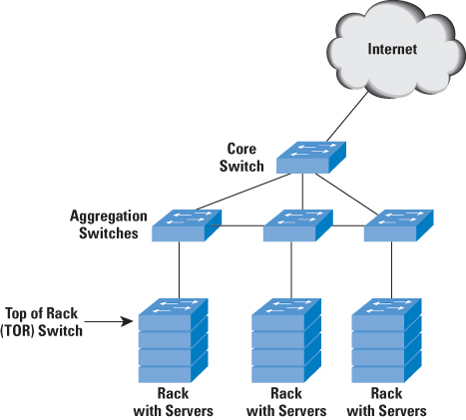
Data Center Network Architecture

Slide 24
Protocols for Data Center Networking
The IEEE is working on new protocols and the enhancement of existing protocols for data centers.
  IEEE 802.1Qbb enables FCoE (Fiber Channel* over Ethernet) guarantees through an Ethernet link. Fibre Channel is a reliable protocol as compared to best-effort Ethernet.
    FCoE is enabled through a Priority Flow Control (PFC) mechanism in the IEEE 802.1Qbb standard.
  IEEE 802.1Qau provides end-to-end congestion notification through a signaling mechanism propagating up to the ingress port (the port connected to the server Network Interface Card (NIC))
  IEEE 802.1aq defines shortest-path bridging. Similar to the work being done in the IETF TRILL (Transparent Interconnect of Lots of Links) working group
    forward packets across the shortest path between the endpoints (servers) to reduce latency, instead of the root bridge based topology used in the Spanning Tree Protocol (STP)
    It is an incremental advance to the Multiple Spanning Tree Protocol (MSTP), which uses the Intermediate System-to-Intermediate System (IS-IS) link-state protocol to share learned topologies between switches
  IEEE 802.1Qaz, known as Enhanced Transmission Selection (ETS).
    Allows lower-priority traffic to burst and use the unused bandwidth from the higher-priority traffic queues, thus providing greater flexibility.
*Fiber channel is a protocol used between servers and storage devices

Slide 25
Cloud Networking
Network as a Service – NaaS
  A framework that integrates current cloud computing offerings with direct, secure, user access to the network infrastructure
  Users can easily deploy custom routing and multicast protocols
  Users can efficiently implement advanced network services, such as:
    in-network data aggregation, redundancy elimination
    smart caching
    duplication

Slide 26
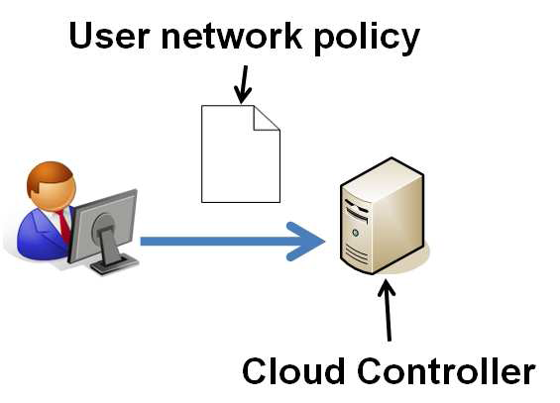
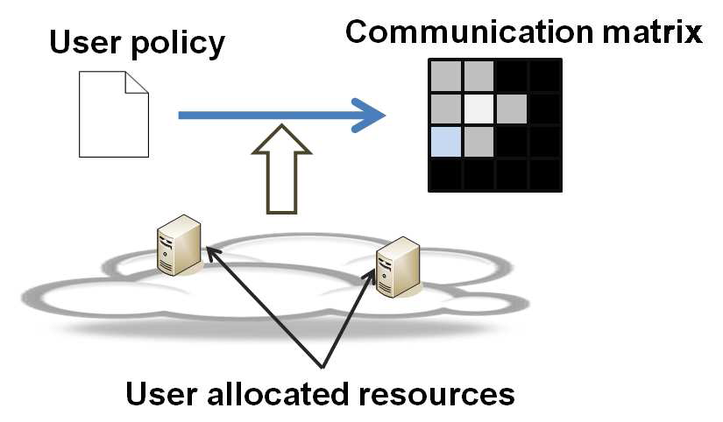
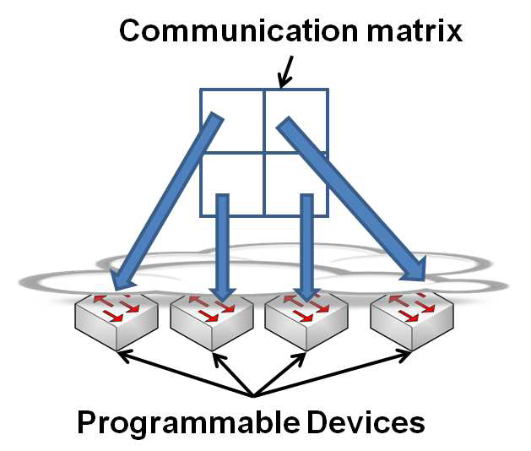
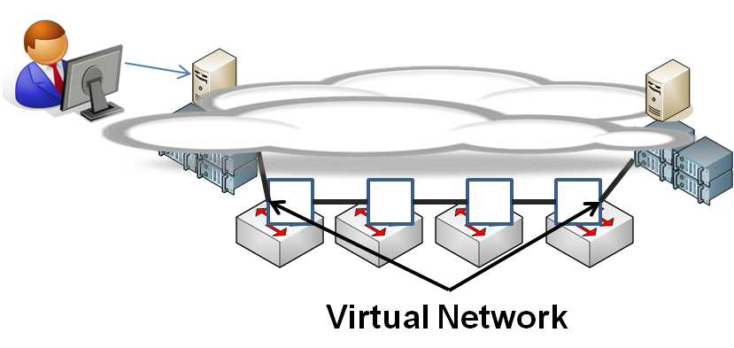

Slide 27
Cloud Gaming
Online gaming, all the game logic is executed at game clients, and the game servers are only responsible for maintaining consistent game states among multiple game clients
In cloud gaming, computer games run on cloud servers and users interact with games over the Internet, via thin clients, which run on commodity PCs, TVs with set-top boxes, and mobile devices.
Usually implemented as IaaS

Slide 28
Current Cloud Gaming Services
OnLive
StreamMyGame
GaiKai (Sony)
G-Cluster
OTOY
Ubitus
T5-Labs
CiiNOW
Nvidia Grid

Slide 29
Cloud Gaming Models
Streaming
Graphics
Hybrid – Streaming and Graphics

Slide 30
Cloud Gaming Traffic
The only data that is available is for video streaming cloud services.
Questions that need to answered in this domain:
  Q1: Does the network traffic for different game genres (such as first-person vs. omnipresent) differ from each other?
  Q2: Does the network traffic for cloud games differ from traditional games?
  Q3: Does the network traffic change with different network conditions?

Slide 31
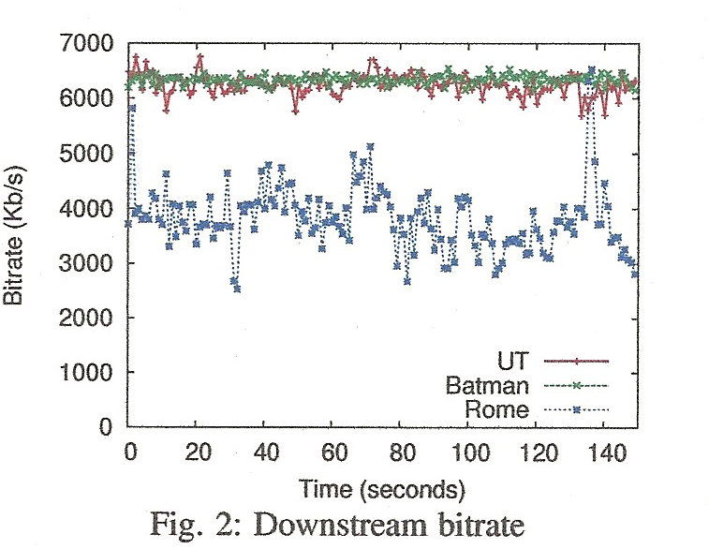
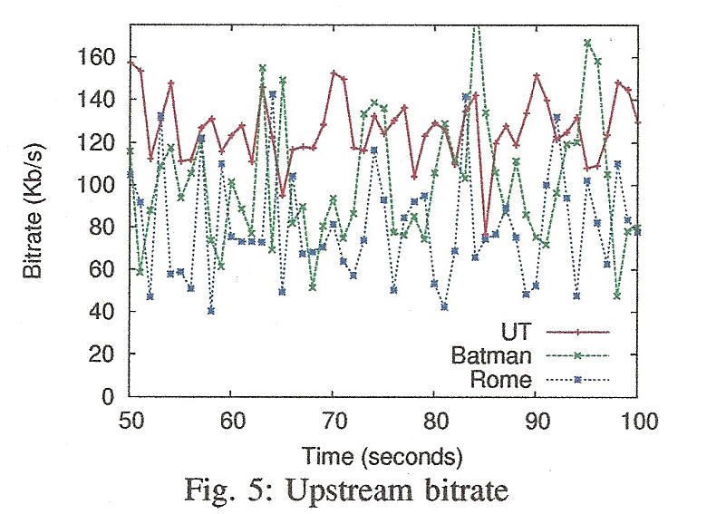
Video Traffic vs Game Traffic
    Answer Q1: The characteristics of game traffic are similar for all genres, but total bitrates for downstream and upstream traffic can vary by as much as 50%.
      First and Third person avatar 50% > omnipresent
Answer Q2: Downstream traffic is more similar to downstream live video, while upstream traffic is only somewhat similar to upstream traditional game traffic.

Slide 32
Comparison continued
Answer Q3: Some streaming services do not appear to adapt bitrates to loss or latency, but do adapt to capacity limits. Frame rates adapt to both capacity limits and loss, but not to latency.
  60fps no loss -> 30fps and 15fps with losses and lower bit rate

Slide 33
Comparison Contd.
Application | Bitrate (Kbps) | Packet Size (bytes) | InterPkt Arr. (msec)
Trad. Game | 67 | 75 | 45
Virtual Env. | 775 | 1027 | 9
Live Video | 2222 | 1314 | 0.1
Thin Client Cloud | 6247 | 1203 | 0.7
Pre-recorded Video | 43914 | 1514 | 0.1

Slide 34

Showing some Screen Shots

Slide 35


Thin Client Streaming

Slide 36
Comparing two streaming services
OnLive targets temporal resolution: they want the player to enjoy 60 frames per second gaming because it helps with the latency challenge and there's also the sense that a faster moving image makes it harder for the human eye to track video compression artifact.
Gaikai's solution appears to be quite the opposite: halving the frame-rate but effectively doubling the image quality. Combine that with more powerful servers running the games at much higher graphical settings and the result is a dramatically improved look to the games you're playing.

Slide 37
CiiNOW

Slide 38
Nvidia
Gaming as a Service GaaS
Benefits

Slide 39
GamingAnywhere: Open Source Gaming
An open cloud gaming system
The first open cloud gaming testbed in the literature.
GamingAnywhere, can be used by cloud gaming developers, cloud service providers, and system researchers for setting up a complete cloud gaming testbed.
Algortihms, standards, protocols, and system parameters can be rigorously evaluated using real experiments, impossible on public cloud systems.
Cross-platform: Implemented on Windows, Linux, OS X, and Android.

Slide 40
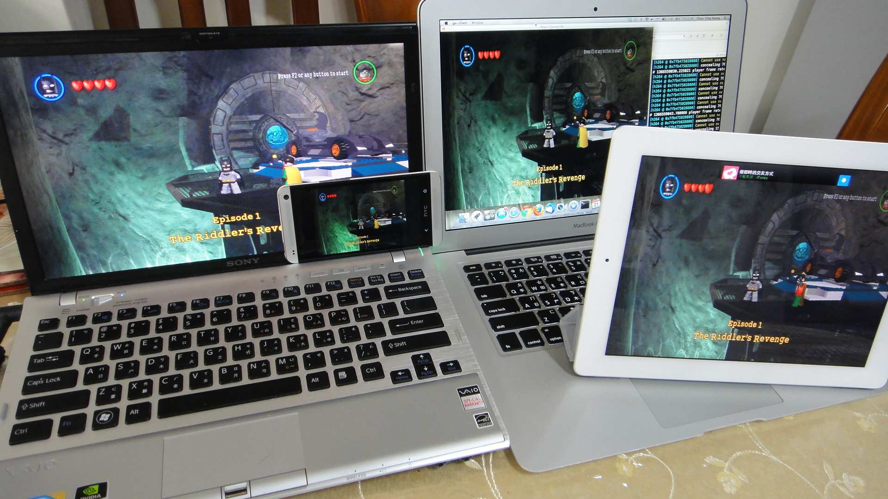
Platform Support

Slide 41
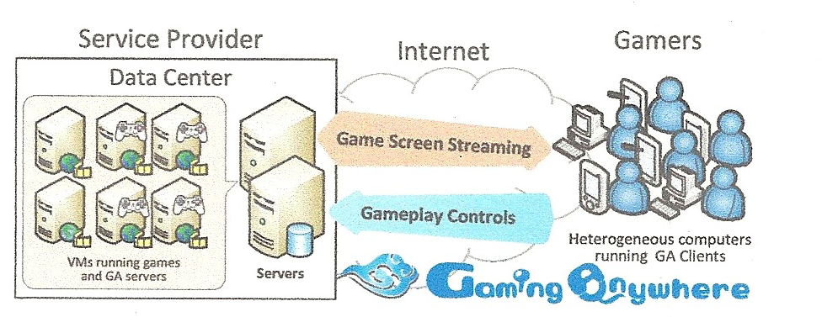

Slide 42
Design Objectives
Extensibility
Protability
Configurability
Openness: Publicly available – Gaming Anywhere

Slide 43
Extensibility
Adopts a modularized design.
All components can be easily modified or replaced
  both platform-dependent components such as audio and video capturing and,
  platform-independent components such as codecs and networks protocols

Slide 44
Protability
the server supports Windows and Linux,
the client supports Windows, Linux, and OS X
new platforms can be easily included by replacing platform-dependent components

Slide 45
Configurability
Conduct experiments for real-time multimedia streaming applications with diverse system parameters.
A large number of built-in audio and video codecs are supported.
GamingAnywhere exports all available configurations to users so that it is possible to try out the best combinations of parameters by simply editing a text-based configuration.

Slide 46
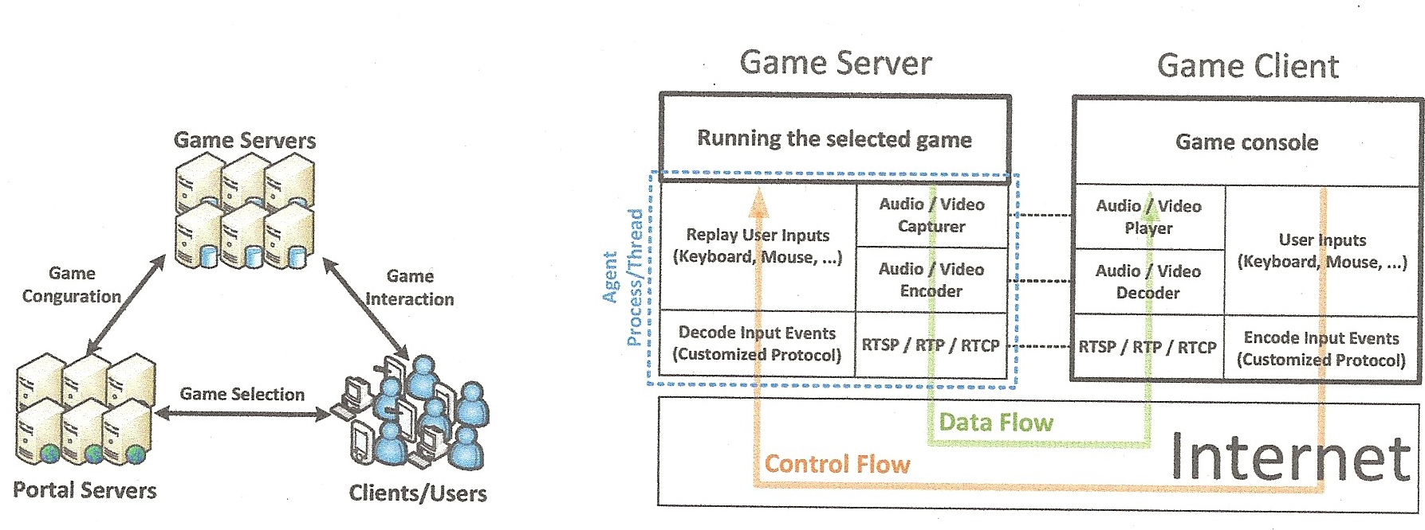

Slide 47
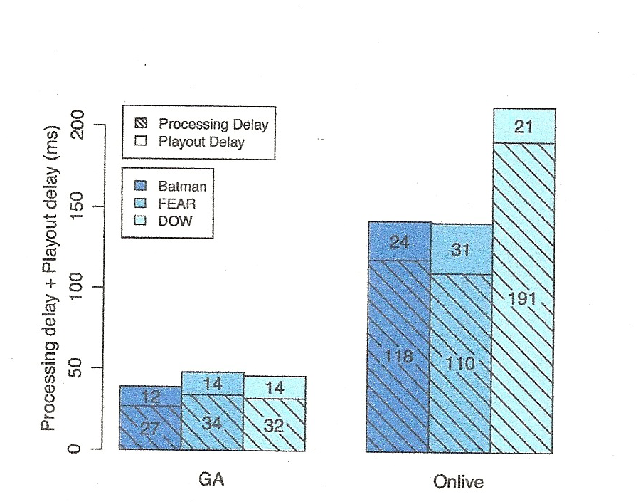
Performance of GamingAnywhere

Slide 48
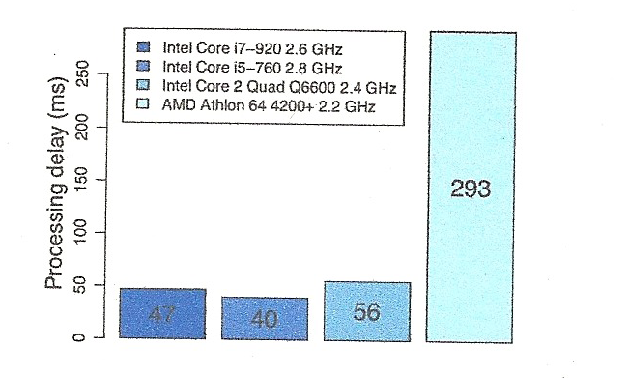
Impact of CPU

Slide 49
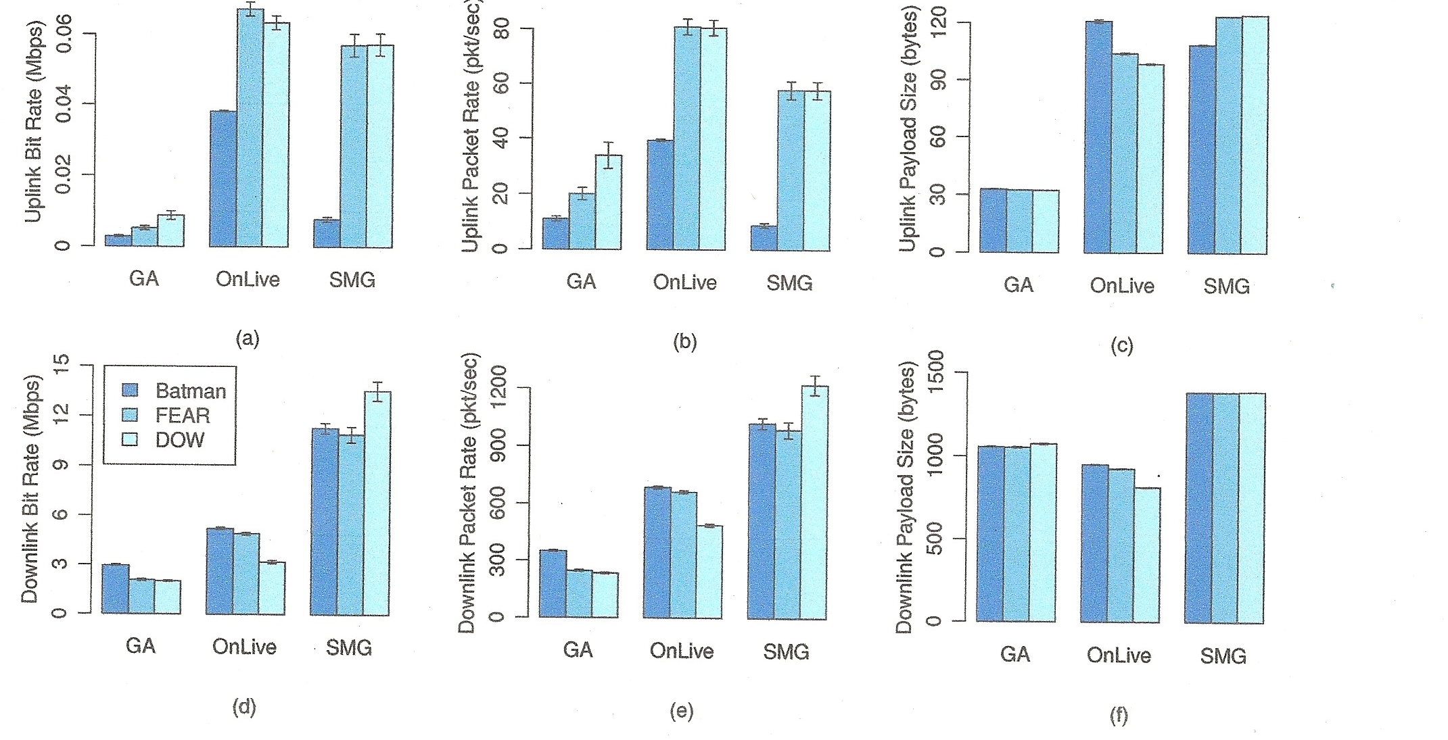
Network Performance

Slide 50
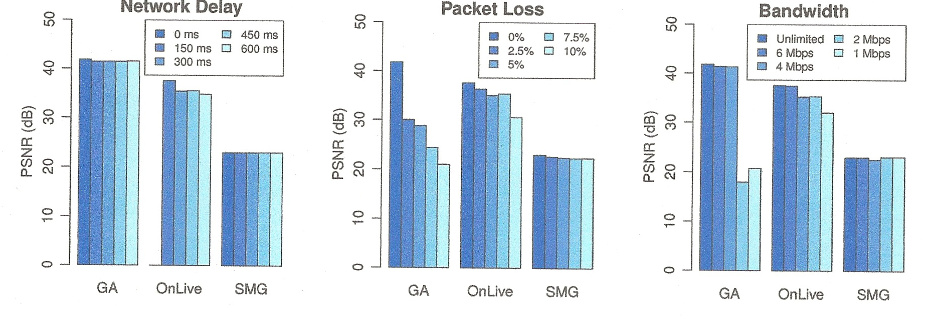
Video Quality - PSNR

Slide 51
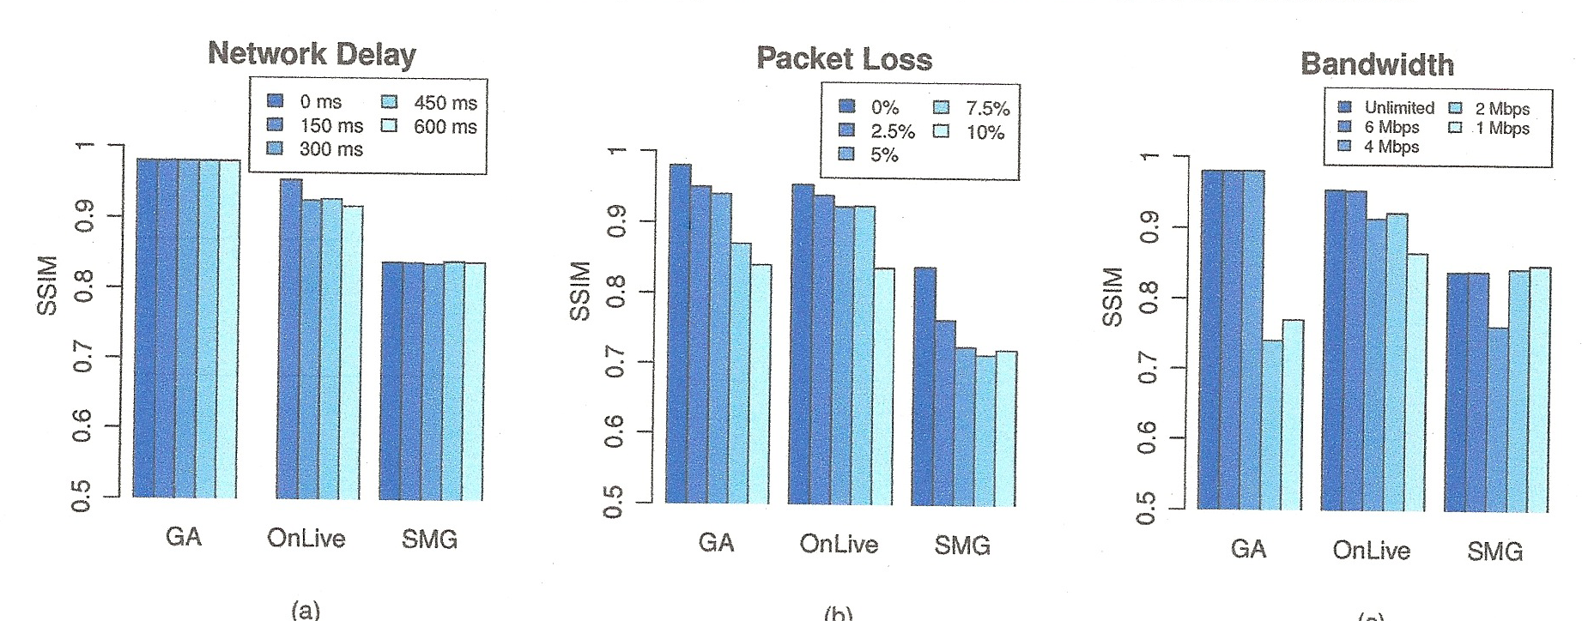
Video Quality compared to PC

