Slide 1
Requirements and Constraints

Slide 2
Game Perspective
Requirements and Constraints
- Requirements on consistency
- Requirements on latency
- User response to inconsistency and latency

Slide 3
Consistency : System Perspective
C1 : Local changes replicated at each site
C2 : Simulation should not diverge over time
C3 : Casual order of events should be preserved
C4 : Temporal and motion characteristics of events should be preserved

Slide 4
Consistency : Plausibility and Fairness – A User’s Perspective
C5 : The joint perception of events should be plausible
C6 : The outcome of the events should be fair – fair outcome and fair access
C7 : The system should preserve the users’ intentions

Slide 5
Latency Impact

Slide 6
Impact: Timings Activity Onset
Car_{A}
Car_{B}
Car_{A}
Car_{B}
CarA
A=1, V=0
Car_{B}
A=1, V=0
CarA
A=1, V=1
Car_{B}
A=1, V=1
CarA
A=1, V=2
Car_{B}
A=1, V=2
CarA
A=1, V=3
Car_{B}
A=1, V=3
Client_{A}
Client_{B}
Notes:
Figure 11.1

Slide 7
Impact: Inconsistent State Changes
Door is Closed & Unlocked
Door is Closed & Unlocked
Door is Closed & Locked
Lock Door
Open
Door
Door is Open & Unlocked
Can’t apply open state
Door is Open & Locked
Client_{A}
Client_{B}
Notes:
Figure 11.2

Slide 8
Impact: Fireproof Players
Shooter
(Player_{A})
Target
(Player_{B})
Client_{A}
Server
Client_{B}
Notes:
Figure 11.3

Slide 9
Impact: Shooting Around Corners
Shooter
(Player_{A})
Target
(Player_{B})
Client_{A}
Server
Client_{B}
Notes:
Figure 11.4

Slide 10
More on Latency and Game Playability
Prof. Magda El Zarki
Dept. of CS
Univ. of CA, Irvine
Email: elzarki@uci.edu
http://www.ics.uci.edu/~magda

Slide 11
Typical Latencies
Latencies differ over different networks and the type of last mile access a user has can add a significant amount to the overall delay of data transmission.
  LAN latencies are low – typically 10ms or less
  Dial up modems – hundreds of msecs
  Cable and DSL –typically tens of msecs but can vary to 100msecs
  Backbone latencies within a continent are around 50msecs and cross continent can easily reach hundreds of msecs.

Slide 12
Impact of Latency
Depends very much on the “game type”
Player interactions can be very sensitive to latency – e.g., shooting an enemy with a rifle.
Some game scenarios, such as amassing an army or moving troops over a terrain will not be affected as much by latency.
Some latencies can be visually masked – e.g., large explosions, multiple shots/strikes (e.g., machine gun), a lot of activity such as a group attack on a monster.

Slide 13
Categorizing Player Actions
Precision
Deadline
The precision and deadline requirements for a player action determine the effects of latency on that action.

Slide 14
Precision
Precision is the accuracy required to complete an action successfully.
Precision is the size of a distant opponent and the player’s weapon/tool and its target range.
  E.g., sniper carrying a rifle shooting at a distant player vs a machine gun and an attack on a tank.

Slide 15
Deadline
Deadline is the time required to achieve the final outcome of the action such as a lap in a race.
Deadline is the time to target an opponent with a weapon or spell before the opponent moves out of range.

Slide 16
Further understanding of requirements
The precision and deadline requirements are determined not only by the action itself but also
  By the game’s interaction model,
  and
  By the player’s game perspective.

Slide 17
Interaction Model
The interaction model defines how a player interacts with the game world and is typically classified as either:
  the avatar model
  the omnipresent model

Slide 18
Interaction Models contd.
In the avatar model, the player interacts with the game through a single representative character, and player actions are defined in terms of commanding it.
  The avatar exists at a particular location in the virtual world and can influence only the immediate locality.
  First-person shooter (FPS) games, role-playing games (RPG), action games, sports games, and racing games are all examples of game genres with an avatar-interaction model.
In the omnipresent model, players view and simultaneously influence the entire set of resources under their control. Real-time strategy games such as Rise of Nations and construction and simulation games are genres of this model.

Slide 19
Latency Acceptability
Lower
Casting Area Spell
Exploring (God Game)
Run command
Shooting Rockets
Fighting (God Game)
Precision
Aiming & Shooting Machine Gun
Combat
Moving (God Game)
Vehicle Racing
Aiming Weapon / Shooting Sniper
Highest
Mouse Control
Drinking Health Potion
Building (God Game)
Avatar Control
Camera Control
Tightest
Deadline
Lowest
Immediate Control Tasks
Several tasks plotted on the Precision/Deadline axes. Based on Claypool and Claypool (2006).

Slide 20
Game Perspective
Defines how a player views the game world on a screen.
Games with the avatar interaction model typically have either a first-person perspective where the player sees through the eyes of the avatar or a third-person perspective where the player follows an avatar in the virtual world.
The perspective used by games with the omnipresent-interaction model is often variable, giving players an aerial perspective or bird’s-eye view of the virtual world while also allowing them to zoom in to a third-person or even a first-person perspective for finer granularity of control over individual resources.

Slide 21
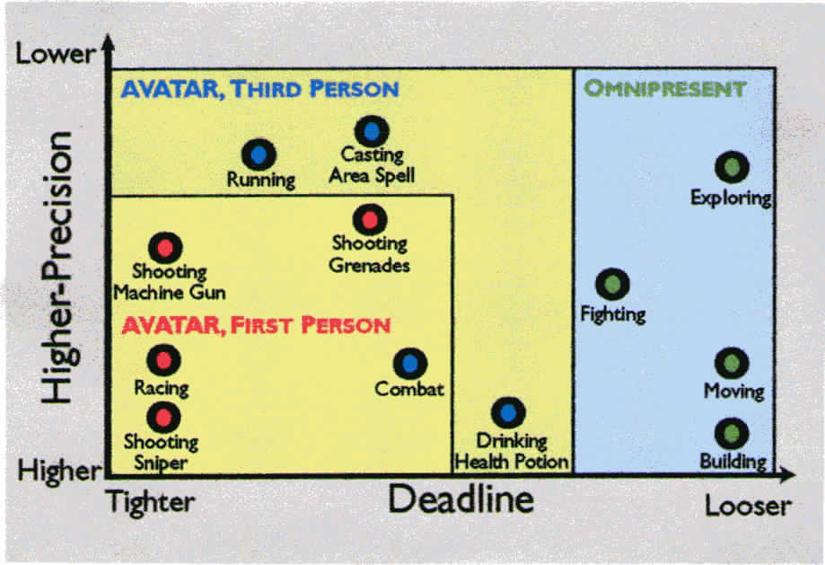
Precision – Deadline Game Requirements

Slide 22
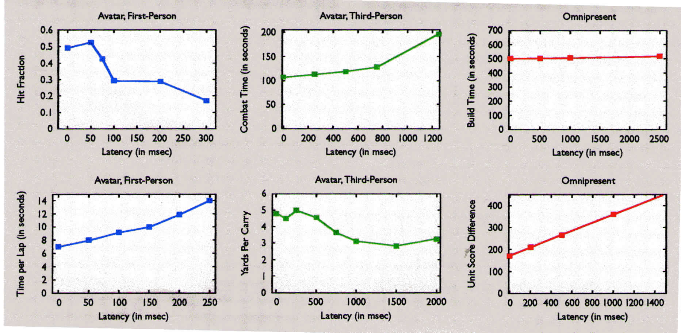
Playability vs Latency for Different Interaction Models
Unreal
Tournament 2003
Everquest 2, complete a fight
Warcraft III, build
technology tree
Car Racing
Madden NFL 2004
Age of Mythology

Slide 23
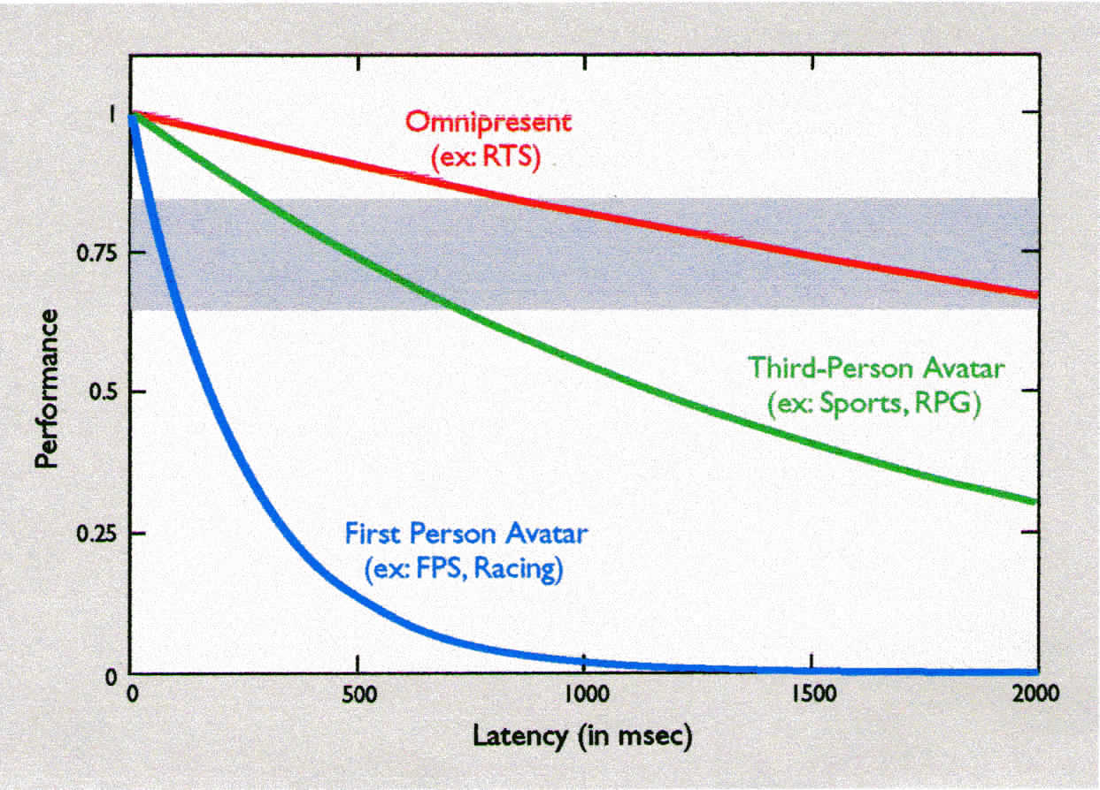
Performance vs latency for different classes of online games

Slide 24
Ball Park Numbers for Designers
Model | Perspective | Example Genres | Sensitivity | Thresholds
Avatar | First person | FPS, racing | High | 100msec
 | Third person | Sports, RPG | Medium | 500msec
Omnipresent | Several | RTS, Sim | Low | 1,000msec

Slide 25
Why do we need numbers??
For:
Game designers. So they know the latency tolerances of different player actions, helping them apply latency compensation techniques, as needed
Network designers. So they are able to create infrastructures providing quality of service (QoS) for online games and other interactive applications
Game players. So they are able to make informed choices about their Internet connections and QoS purchases affecting latency and hence gameplay.

Slide 26
Reference
Latency and Player Actions in Online Games. Mark Claypool and Kajal Claypool. COMMUNICATIONS OF THE ACM, November 2006/Vol. 49, No. 11

Slide 27
Network Impairments: Packet Loss, Delay and Jitter
Network Measurements:
  Performance Parameters - e.g., average end to end delay, maximum jitter, % packet loss
  Service Guarantees – Quality of Service (QoS) that a particular application can expect or contract for.
  Service Contracts – Ensure that e.g., 95% of time one (or more) of the QoS parameters is met on all traffic flows related to an application or service traversing a network
How to capture the impact of network impairments on end users and applications? Quality of Experience
  User experience
  Impact on game playability

Slide 28
QoS vs QoE
QoS – Quality of Service:
  network characteristics/behavior
  Network performance guarantees given by network provider based on measurements taken over time
QoE – Quality of Experience:
  impact of network performance on end user
    some imperfections may go unnoticed
    some imperfections may render application/service useless
  impact not always captured by network measurements
    a 5% packet loss could be invisible if it affects background
    a missed target due to a 100ms delay can affect game outcome

Slide 29
Online Games
System
Consistency
Game
Responsiveness
Player /Client
Game Playability
Client /Server
Network Transmission
Precision
Inconsistency
Player/Player
Loss
Latency
Jitter
Fairness
Perception
QoE
QoS
Properties
of QoE
Tradeoffs
Compensation
Algorithm

