Slide 1
Sankofa – An Edugame on West African Culture
Project Leads: Magda El Zarki and Pat Seed
University of Ca, Irvine

Slide 2
Sankofa: "go back and seek it"
An Akan saying signifies that as one marches forward, the past must never be forgotten
The game narrative is based on West African tales, folklore and myths told via the well known Anansem folktales – the legendary Spider and keeper of stories.
The game retrieves the history of the Akan people, their rich culture and daily life over the past 4 centuries.

Slide 3
The Game

Slide 4
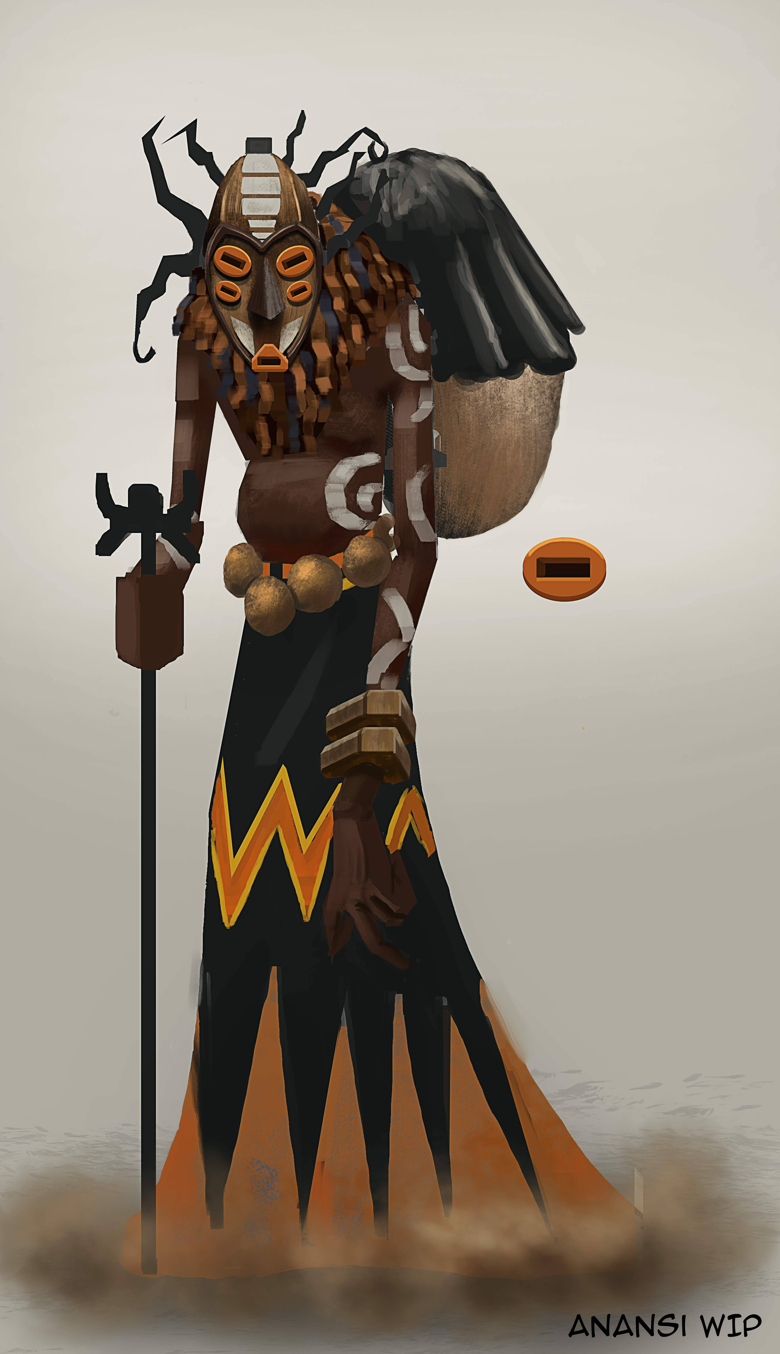
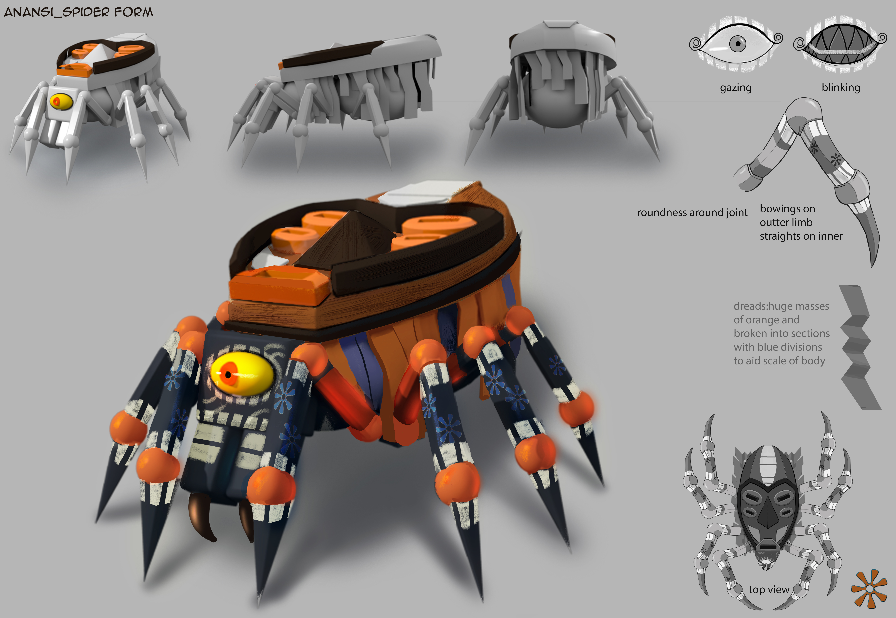
Anansem

Slide 5
Sankofa the Game
Through engaging adventure gameplay with roleplaying game (RPG) elements, the Sankofa videogame will bring this world to life.
The player lives their own story as one of the Akan people.
Anansem, your companion, helps you control spirits to complete feats and solve puzzles in a sequence of challenges that drawn from his folktales
All the surroundings, actions, and characters are recreations of historically accurate places, people, and their traditions

Slide 6
Photos Concept Art

Slide 7
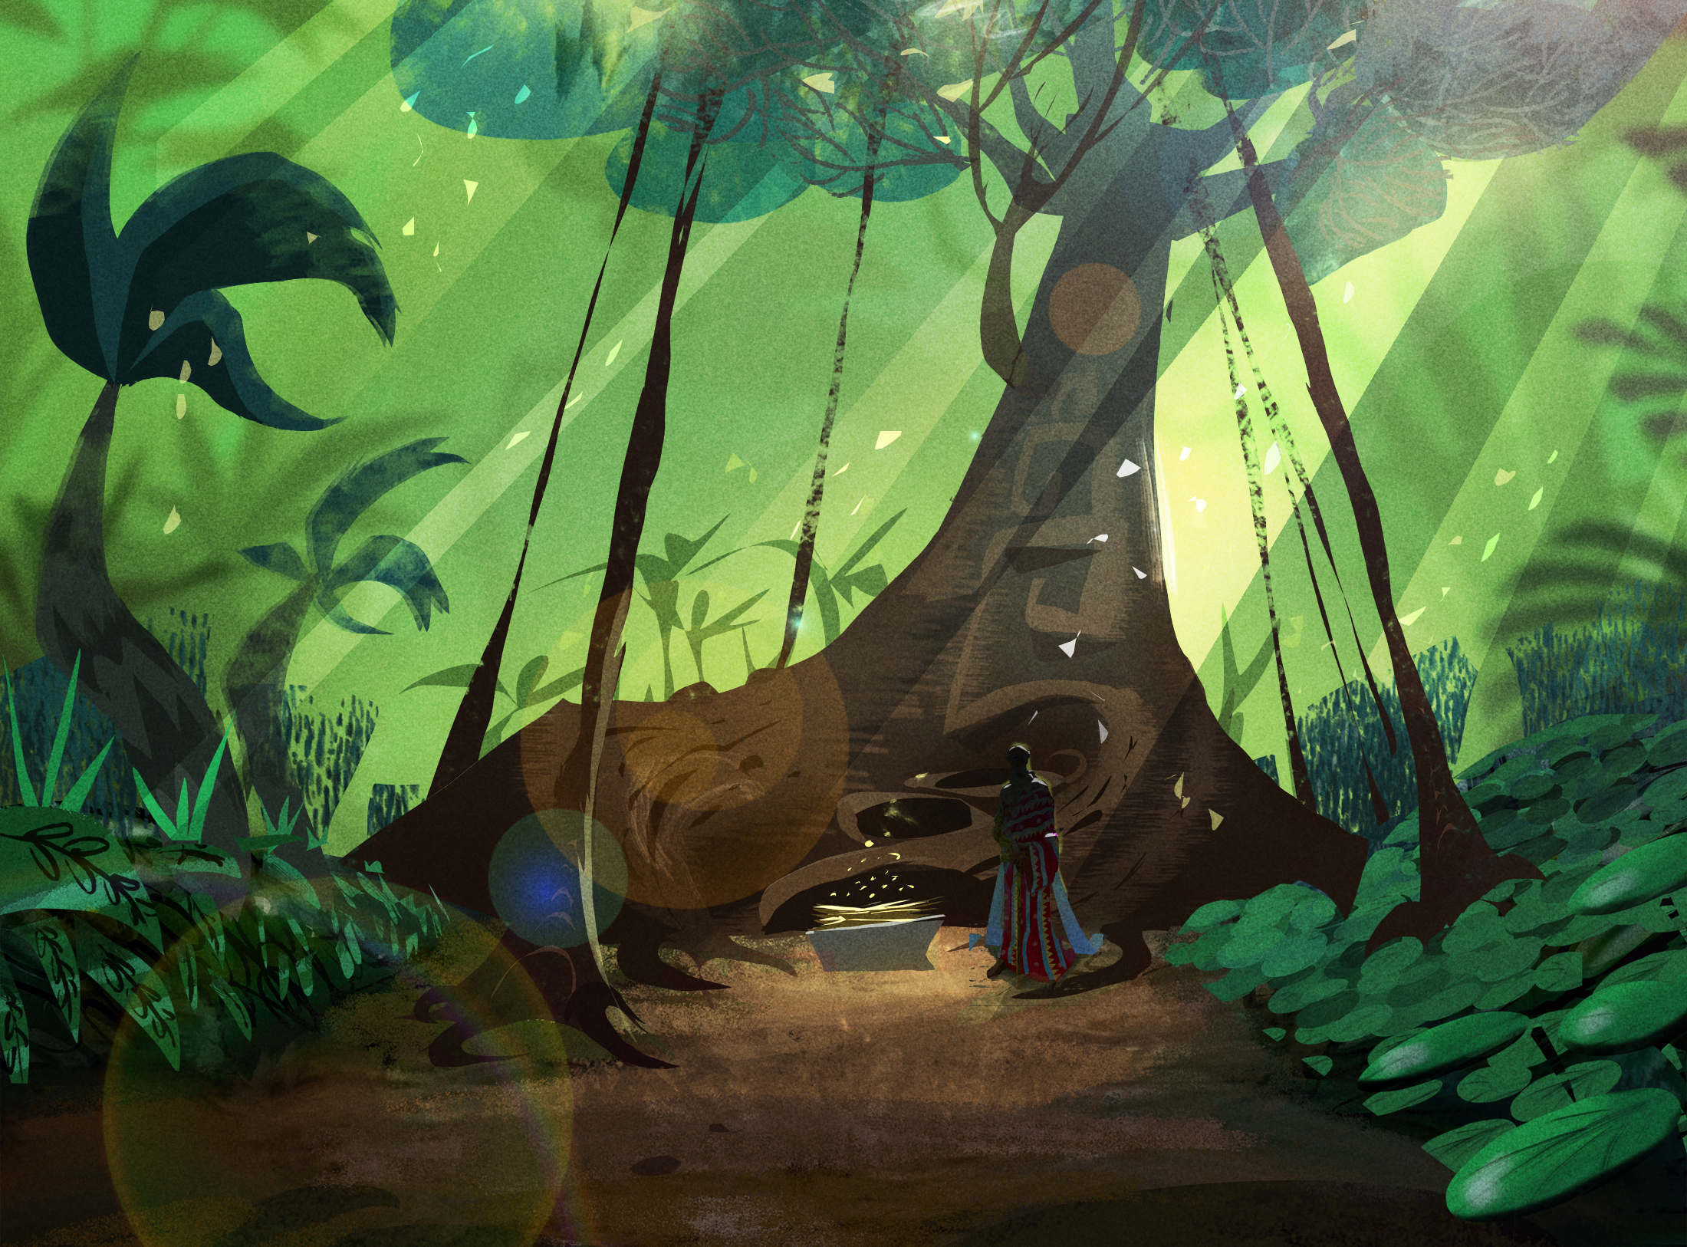
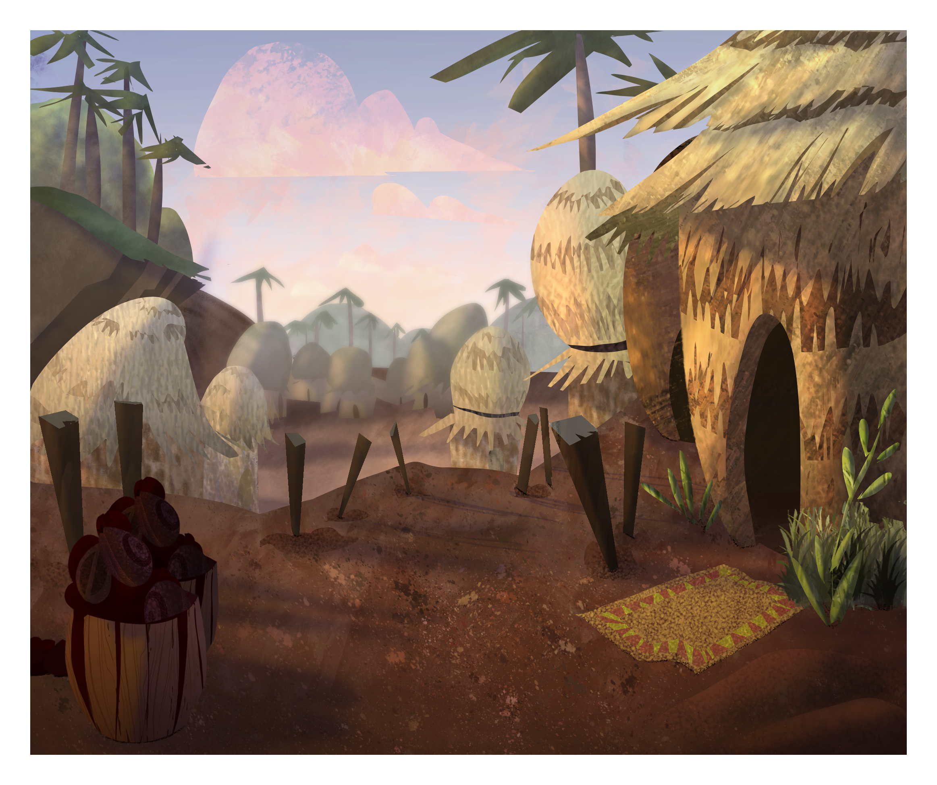
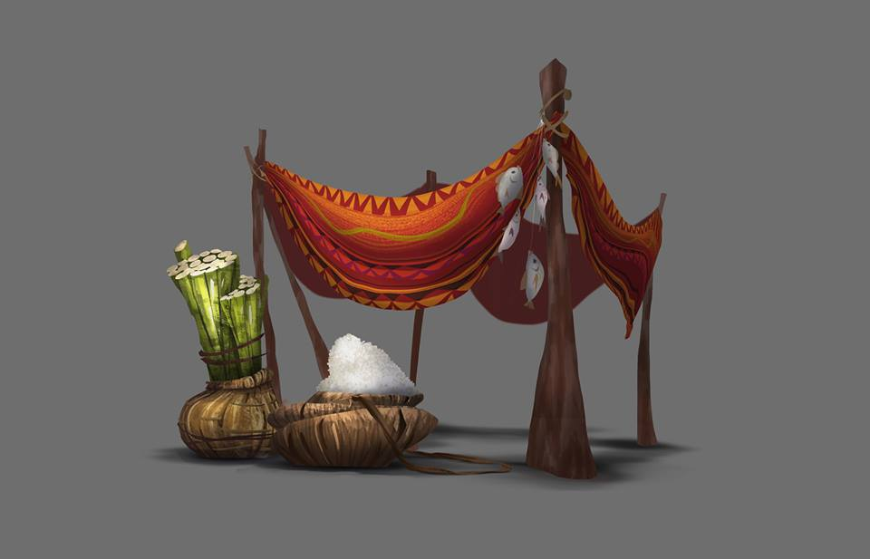
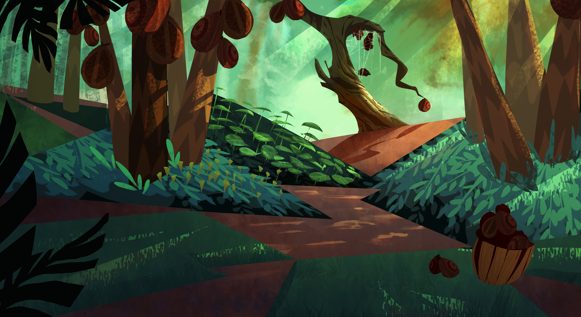
Game Art

Slide 8
An EduGame
Sankofa is a genre of game that teaches via incidental learning.
An interactive medium that invites a proximity to cultural history that neither reading nor cinematic viewing can recreate.
Through virtual participation, the player learns cultural practices such as libations and the all-important process of choosing a name for a baby.
The game includes the player in these moments, explaining the motivation for the ritual actions.

Slide 9
The Environments
A local village where the story starts
A vibrant and bustling marketplace where the player meets many different people (in-game friends) and learns about their trades
The forest where the player is introduced to the local flora that the healer needs to create the health potions

Slide 10
Local Village

Slide 11
Market Place

Slide 12
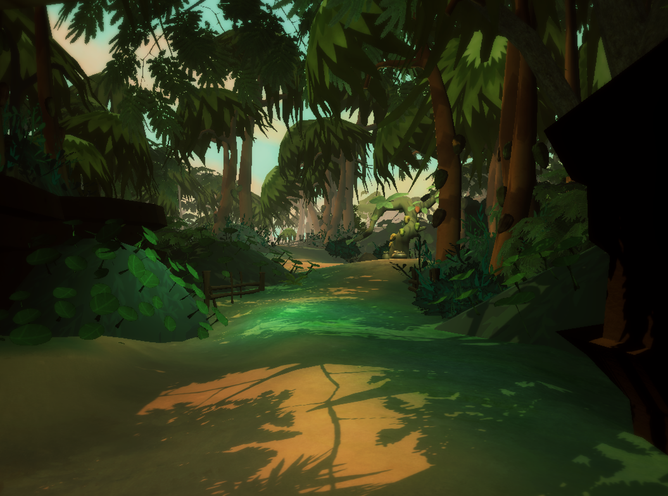
Forest

Slide 13
The People
Anansem
Healer
Drummer
Woodcutter
Herder
Weaver
…......

Slide 14
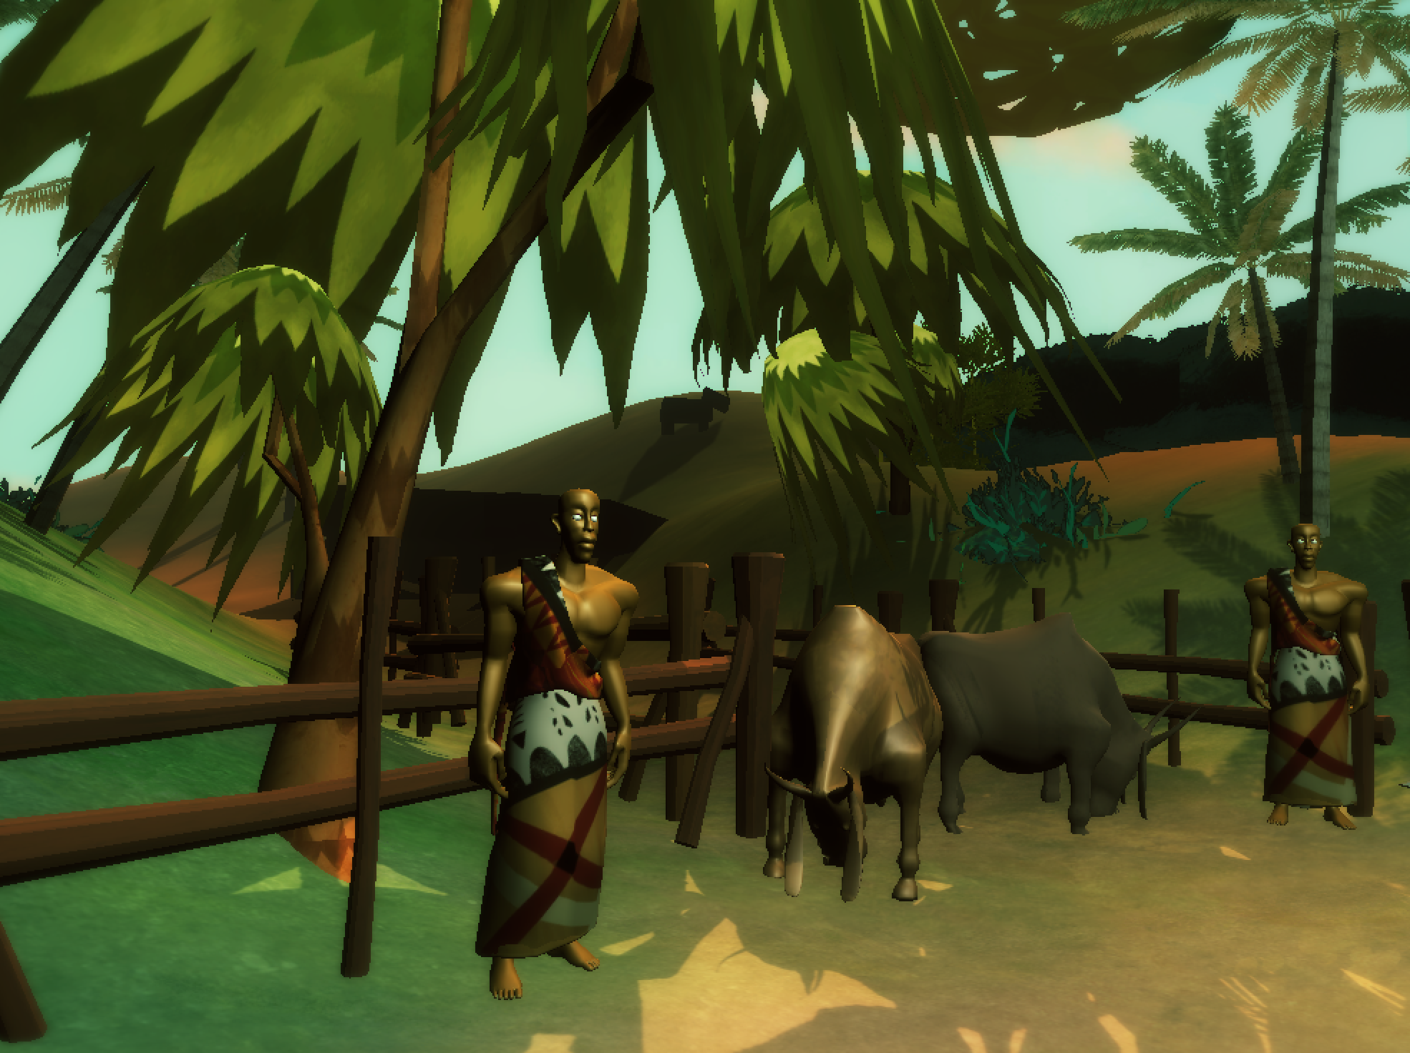
People

Slide 15
Modular Approach
The game is designed in a modular fashion that allows it to be deconstructed into individual learning modules that can be used by educators to create short targeted classroom lessons.
Game assets such as 2D art and environments will be made available for lesson construction.
Game and all teaching materials and developed lessons will be hosted on a website.

Slide 16
Learning Module Examples
Opening scene: a map, given to the child by the father, can be used to create a geography learning module.
For example, a puzzle game, where the map is an outline of the African continent and the pieces are the African countries.
The school child could be asked to solve the puzzle and then identify geographic features such as desserts, rivers, mountain ranges, etc..
A zoomed in map of West Africa, can be used to identify the countries, their major cities, and other aspects of the region.

Slide 17
Learning Module Examples
Marketplace: player interacts with those who work or trade there. A lesson on the societal aspects of the Akan:
The woodcutter can show the player how to spell his/her name in adrinka symbols with the wooden stamps of Akan symbols he has carved.
The student will then be asked to craft their name by choosing from options to select their day, birth order, and location of birth, and other characteristics included in naming in Akan culture.

Slide 18
Learning Module Examples
Some other possible settings:
Drummers in the marketplace will show different rhythms, encouraging the player to play along to match them in fun mini-games.
Weaver can show how a kente cloth tells a story, and help the player to understand the meanings of colors, shapes, and patterns in order to create an in-game kente cloth to tell a story of their very own.
The popular game of Oware
…....... and so on

Slide 19
Oware

Slide 20
The Team
The Sankofa team is currently led by two PIs at UCI:
Professor Magda El Zarki, from Dept. of Computer Science and
Professor Pat Seed from Dept. ­­
They are joined by:
Professor Hilary Wilder, from Dept. of Educational Leadership & Professional Studies at William Paterson University of New Jersey, and
Ms. Elise Woodson, a retired teacher from the Los Angeles school district, and the current Education Curator at the Los Angeles based Californian African American Museum (CAAM).
Jessica Kernan, a game designer with a experience in the game industry, will lead the development team.
And…... Love to add you to this list! ☺

Slide 21
Summary
The power of games for engagement and participation is well known. It only makes sense therefore that we should harness that power to teach the new generation of school children, a generation that is very media savvy.
Our Goals:
Complete development of the Sankofa edugame
Develop a sequence of teaching modules
Game assets, such as 2D art will be made available for the public to use to create their own games, presentations and stories.
Asset libraries will also be created that are mobile friendly, to allow for the development of games that will be more accessible for a larger audience.

Slide 22
Resources
To view the game:
YouTube Link: https://youtu.be/GhcTa7ejN4g
Vimeo Link: https://vimeo.com/160777877
To play the game and see more on the Project:
http://ivecg.uci.edu/west-africa-history-culture/
NOTE: The website is under development and will become available by soon. (email: elzarki@uci.edu for further information)

Slide 23
Thank You!!

