Slide 1


Chapter 3
Transport Layer
A note on the use of these Powerpoint slides:
We’re making these slides freely available to all (faculty, students, readers). They’re in PowerPoint form so you see the animations; and can add, modify, and delete slides (including this one) and slide content to suit your needs. They obviously represent a lot of work on our part. In return for use, we only ask the following:
Computer Networking: A Top Down Approach
If you use these slides (e.g., in a class) that you mention their source (after all, we’d like people to use our book!)
If you post any slides on a www site, that you note that they are adapted from (or perhaps identical to) our slides, and note our copyright of this material.
Thanks and enjoy! JFK/KWR
All material copyright 1996-2016
J.F Kurose and K.W. Ross, All Rights Reserved
7th edition
Jim Kurose, Keith Ross
Pearson/Addison Wesley
April 2016

Slide 2
Chapter 3 Outline
3.1 transport-layer services
3.2 multiplexing and demultiplexing
3.3 connectionless transport: UDP
3.4 principles of reliable data transfer
3.5 connection-oriented transport: TCP
  segment structure
  reliable data transfer
  flow control
  connection management
3.6 principles of congestion control
3.7 TCP congestion control

Slide 3

















Introduction –Why a Transport Layer?
application
transport
network
data link
physical
provide logical communication channel between app processes running on different hosts
transport protocols run in end systems
  send side: breaks app messages into segments, passes to network layer
  rcv side: reassembles segments into messages, passes to app layer
more than one transport protocol available to apps
  Internet: TCP and UDP
logical end-end transport
application
transport
network
data link
physical

Slide 4
Transport vs. Network Layer
network layer: logical communication between end devices (hosts)
transport layer: logical communication between processes
  relies on network layer services
  (can) enhance network layer services
human analogy:
12 kids in Ann’s house sending letters to 12 kids in Bill’s house:
hosts = houses
processes = kids
app messages = letters in envelopes
transport protocol = Ann and Bill who sort the letters from and to the kids
network-layer protocol = postal service

Slide 5
Orientation
more than one transport protocol available to apps on the Internet
  TCP and UDP
not all apps use the transport layer
  directly over IP, e.g., OSPF
  interactions with ICMP

Slide 6
Transport-layer Services
reliable, in-order delivery (TCP)
  congestion control
  flow control
  connection setup
unreliable, unordered delivery: UDP
  no-frills extension of “best-effort” IP
services not available:
  delay guarantees
  bandwidth guarantees
application
transport
network
data link
physical
network
data link
physical
network
data link
physical
network
data link
physical
logical end-end transport
network
data link
physical
network
data link
physical
network
data link
physical
network
data link
physical
application
transport
network
data link
physical

Slide 7
Chapter 3 outline
3.1 transport-layer services
3.2 multiplexing and demultiplexing
3.3 connectionless transport: UDP
3.4 principles of reliable data transfer
3.5 connection-oriented transport: TCP
  segment structure
  reliable data transfer
  flow control
  connection management
3.6 principles of congestion control
3.7 TCP congestion control

Slide 8
Port Numbers
UDP and TCP use port numbers to identify logical connections between processes
a globally unique address for a logical connection on a host is the tuple <IP address, port number>
the tuple identifies one end of the logical end-to-end connection to a process on a host
Multiplex on Protocol
Field in IP Header
Multiplex on to IP
Datagram

Slide 9
Restricted Port Numbers (0 – 1023)
16 bits are reserved for port numbers in the transport layer header --> 2¹⁶ = 65,535 ports per host.
well known Internet applications have reserved port numbers – know as “well known” port numbers
when connecting to one of these applications, a specific port number (taken from a list) is used.
some of the well known port numbers are listed in the table below
port #s port #s

Slide 10

Multiplexing/demultiplexing
multiplexing at sender:
demultiplexing at receiver:
use header info - port #s - to
deliver received segments
(from P3, P4) to correct process
handles data from multiple processes (P1,P2)
adds transport header (includes port #s for demultiplexing)
application
application
P1
P2
application
socket
P3
transport
P4
process
transport
network
transport
network
link
network
link
physical
link
physical
physical

Slide 11
How demultiplexing works
host receives IP datagrams
  each datagram has:
    source IP address, destination IP address
    protocol type
  each datagram carries one transport-layer segment
    each segment has source and destination port number
host uses IP addresses, protocol field & port numbers to direct segment to appropriate process in transport layer (TCP or UDP)
32 bits
source port #
dest port #
other header fields
application
data
(payload)
TCP/UDP segment format

Slide 12
Connectionless demux: example
Destination port =
6428
Source port = 9157
Source port = 5775
application
application
P1
application
P3
P4
transport
transport
Server S
transport
network
network
link
network
link
physical
link
physical
physical
PC A
source: port: 6428, IP: S
dest: port: 9157, IP A:
source: port: 6428, IP: S
dest: port: 5775, IP: B
PC B
source: port: 9157, IP: A
dest: port: 6428, IP: S
source: port: 5775, IP: B
dest: port: 6428, IP: S

Slide 13
Connectionless (UDP) demultiplexing
when creating datagram to send via UDP, an application must specify
  destination IP address
  destination port #
this is done via a socket – a small program that is used to pass information between the application and the transport layer.
when host receives UDP segment:
  checks destination port # in segment
  directs UDP segment to socket with that port #
IP datagrams with same dest. port #, but different source IP addresses and/or source port numbers will be directed to same socket at destination

Slide 14
Connection-oriented TCP demux
TCP socket identified by 4-tuple:
  source IP address
  source port number
  dest IP address
  dest port number
demux: receiver uses all four values to direct segment to appropriate socket
server host may support many simultaneous TCP sockets:
  each socket identified by its own 4-tuple
e.g., web servers have different sockets for each connecting client

Slide 15
Connection-oriented demux: example
3 segments from 3 different connections, all destined to IP address: B,
dest port: 80 are demultiplexed to different sockets
application
application
P4
P5
P6
application
P3
P2
P3
transport
transport
network
transport
network
link
network
link
physical
link
physical
server: IP address B
physical
host: IP address A
source IP, port: B, 80
dest IP, port: A, 9157
host: IP address C
source IP, port: C, 5775
dest IP, port: B, 80
source IP, port: A, 9157
dest IP, port: B, 80
source IP, port: C, 9157
dest IP,port: B, 80

Slide 16
Chapter 3 outline
3.1 transport-layer services
3.2 multiplexing and demultiplexing
3.3 connectionless transport: UDP
3.4 principles of reliable data transfer
3.5 connection-oriented transport: TCP
  segment structure
  reliable data transfer
  flow control
  connection management
3.6 principles of congestion control
3.7 TCP congestion control

Slide 17
UDP: User Datagram Protocol [RFC 768]
“no frills,” “bare bones” Internet transport protocol
“best effort” service, UDP segments may be:
  lost
  delivered out-of-order to app
connectionless:
  no handshaking between UDP sender, receiver
  each UDP segment handled independently of others
UDP use:
  streaming multimedia apps (loss tolerant, rate sensitive)
  DNS
  SNMP
need reliable transfer over UDP:
  add reliability at application layer
  application-specific error recovery!

Slide 18
UDP: segment header
length, in bytes of UDP segment, including header
32 bits
source port #
dest port #
length
checksum
why use UDP?
demuxing
why not use TCP?
no connection establishment (which can add delay)
simple: no connection state at sender, receiver
small header size
no congestion control: UDP can blast away as fast as desired
application
data
(payload)
UDP segment format

Slide 19
UDP checksum
Goal: detect “errors” (e.g., flipped bits) in transmitted segment
sender:
calculate checksum over header and payload and parts of IP header (IP addresses)
sender puts checksum value into UDP checksum field
receiver:
compute checksum of received segment
computed checksum equals checksum field value??
  NO - error detected, drop segment
  YES - no error detected But maybe errors nonetheless? Yes!

Slide 20
Chapter 3 outline
3.1 transport-layer services
3.2 multiplexing and demultiplexing
3.3 connectionless transport: UDP
3.4 principles of reliable data transfer
3.5 connection-oriented transport: TCP
  segment structure
  reliable data transfer
  flow control
  connection management
3.6 principles of congestion control
3.7 TCP congestion control

Slide 21
Channel with errors and losses
Errors:
error detection - underlying channel may flip bits in a packet – packet is corrupted – extra bits (checksum) used to detect error
to recover from errors when detected
  acknowledgements (ACKs): receiver explicitly tells sender that packet received OK. No further action at sender
  negative acknowledgements (NAKs): receiver explicitly tells sender that packet had errors
    sender retransmits packet
Losses:
packets (data and ACKs and NAKs) may get lost
  header corrupted (error detection) – packet dropped
  buffer overflow in network devices – packet dropped
recovery from losses:
  how do we know a packet is lost?

Slide 22
Recovery has a flaw!
assumption:
underlying channel can corrupt and also lose packets (data, ACKs, etc)
checksum, ACKs, retransmissions, etc., can help recover from errors and losses …
but they are not enough on their own!! -> need a recovery scheme to handle complex scenarios
receiver and sender not always aware of what is going on at other end, e.g.:
  no packets arriving at receiver – lost packets or sender done?
  sender gets no ACKs – packet lost or ACK lost?
recovery approach:
use a timer to recover from lack of “visibility”
  sender waits a reasonable amount of time (timeout) for an ACK to a transmitted packet
  retransmits if no ACK received in this time
but if a packet or an ACK) just delayed (i.e., not lost)?
  sequence numbers come into play to recover from discrepancies/duplicates at receiver

Slide 23
Recovery to avoid flaw!
sender adds sequence number to each packet
receiver uses seq no. to ACK
sender sets a timer for a packet to detect a loss
receiver can also detect if a gap in seq no.
delays and timers can cause duplicate reception
receiver uses Seq # to detect duplicates
sender doesn’t know what happened at receiver!
receiver can’t tell sender what happened if nothing received

Slide 24
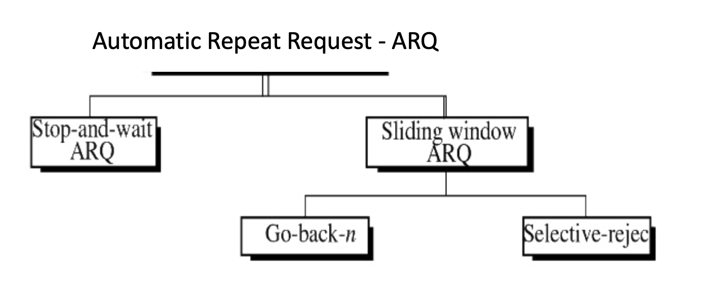
Error Control Schemes - ARQ

Slide 25
Simple Scheme: Stop and Wait
Handles Recovery FLAW
does not use NAKs
stop and wait
seq # 0, 1, alternate
sender sends packet with seq # 0
waits for receiver response
  Response (ACK) must have received packet seq #
sender then sends next packet with seq # 1, etc.
process repeats

Slide 26

Stop and Wait with Seq. Nos
sender
receiver
sender
receiver
send pkt0
pkt0
send pkt0
pkt0
rcv pkt0
rcv pkt0
ack0
send ack0
ack0
send ack0
rcv ack0
rcv ack0
send pkt1
pkt1
send pkt1
pkt1
rcv pkt1
X
ack1
send ack1
loss
rcv ack1
send pkt0
pkt0
rcv pkt0
timeout
resend pkt1
ack0
send ack0
pkt1
rcv pkt1
ack1
send ack1
rcv ack1
send pkt0
pkt0
(a) no loss
rcv pkt0
ack0
send ack0
(b) packet loss

Slide 27
Stop and Wait with Seq. Nos
sender
receiver
sender
receiver
send pkt0
pkt0
send pkt0
pkt0
rcv pkt0
rcv pkt0
ack0
send ack0
send ack0
rcv ack0
ack0
send pkt1
pkt1
rcv ack0
rcv pkt1
send pkt1
pkt1
send ack1
rcv pkt1
ack1
send ack1
ack1
X
loss
timeout
resend pkt1
pkt1
rcv pkt1
timeout
resend pkt1
rcv ack1
pkt1
rcv pkt1
pkt0
(detect duplicate)
send pkt0
send ack1
ack1
(detect duplicate)
ack1
rcv pkt0
rcv ack1
send ack1
rcv ack1
ack0
send ack0
pkt0
send pkt0
pkt0
send pkt0
rcv pkt0
rcv pkt0
ack0
(detect duplicate)
ack0
send ack0
send ack0
(c) ACK loss
(d) premature timeout/ delayed ACK

Slide 28
Stop-and-wait performance
sender
receiver
first packet bit transmitted, t = 0
last packet bit transmitted, t = L / R
first packet bit arrives
RTT
last packet bit arrives, send ACK
ACK arrives, send next
packet, t = RTT + L / R
- if RTT=30 msec, one 8kbit packet every 30 msec
→ ~270kbits/sec throughput over 1 Gbps link
- network protocol limits use of physical resources!

Slide 29
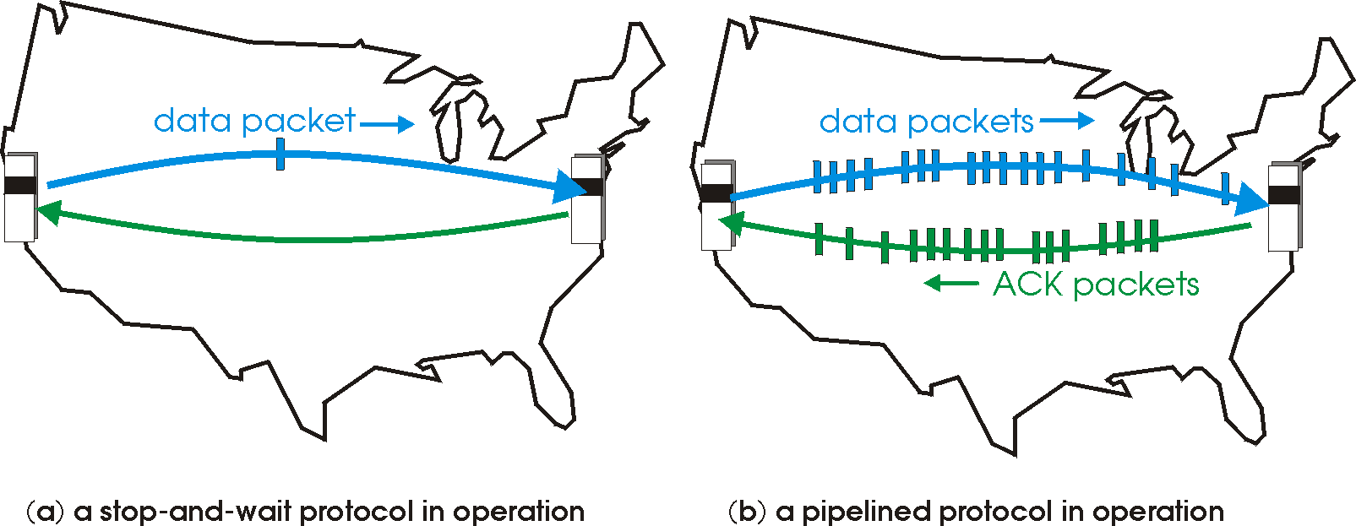

Pipelined protocols
pipelining: sender allows multiple, “in-flight”, yet-to-be-acknowledged pkts
  range of sequence numbers must be increased
  buffering at sender and/or receiver
two generic forms of pipelined protocols: go-Back-N, selective repeat

Slide 30
Pipelining: increased utilization
sender
receiver
first packet bit transmitted, t = 0
last bit transmitted, t = L / R
first packet bit arrives
RTT
last packet bit arrives, send ACK
last bit of 2nd packet arrives, send ACK
last bit of 3rd packet arrives, send ACK
ACK arrives, send next
packet, t = RTT + L / R
3-packet pipelining increases
utilization by a factor of 3!

Slide 31
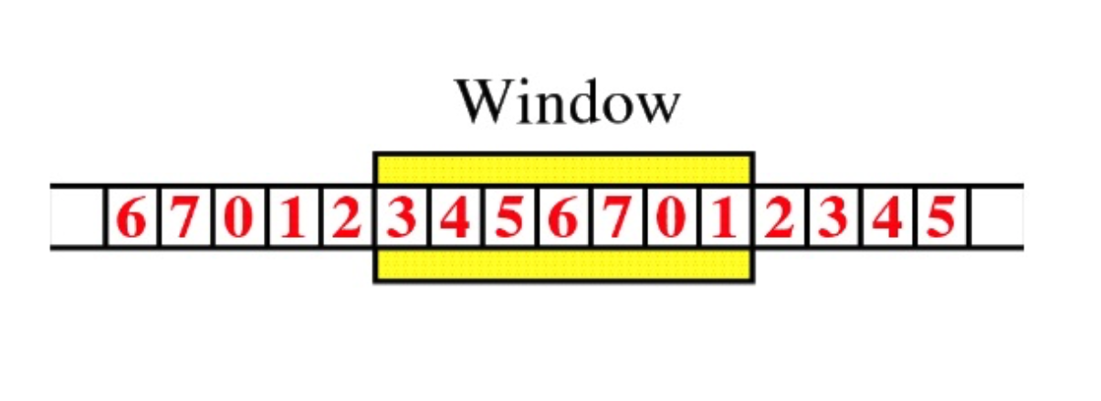
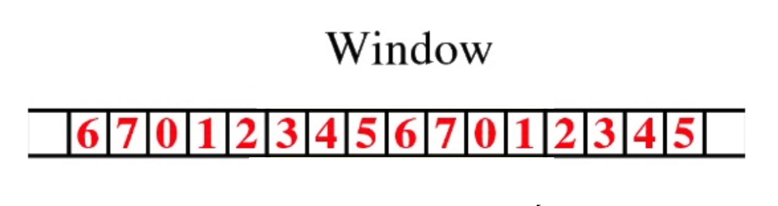
“Sliding” Window Concept
Window of sent
packets – Max 7
None yet ACKed
Packets in buffer waiting
to be sent
Packets sent and
ACKS received
Seq Nos of
packets
Window slides right when a sent packet is ACKed
Packet 3 ACK received
Now packet 2 (waiting in buffer)
can be sent

Slide 32
Pipelined protocols: overview
ACKs: how to manage with losses, delays, duplicates when many pkts
Q: how do we ACK the “multiple” pkts that are in flight?
A: each pkt has a seq#.... limit # pkts in flight (window)….
Go-back-N:
sender can have up to N unack’ed packets in pipeline (window)
receiver only sends cumulative ack
  doesn’t ack packet if there’s a gap
sender has timer for oldest unack’ed packet
  when timer expires, retransmit all unack’ed packets
Selective Repeat:
sender can have up to N unack’ed packets in pipeline
rcvr sends individual ack for each packet (each ack has a specific seq #)
sender maintains timer for each unack’ed packet
  when timer expires, retransmit only that unack’ed packet

Slide 33
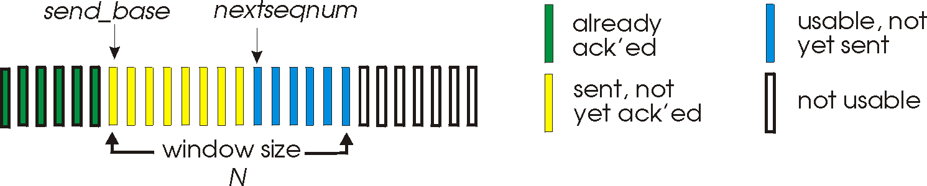
Go-Back-N: sender
k-bit seq # in pkt header
“window” of up to N consecutive unack’ed pkts allowed between sender and receiver
ACK(n+1): ACKs all pkts up to and including seq # n “cumulative ACK” → waiting for next packet with seq # n+1
  may receive duplicate ACKs
timer for oldest in-flight un ACK’ed pkt
timeout(n): retransmit packet n and all unACK’ed pkts in window (note window is all “unack’ed” pkts and unsent pkts)
all ACK’ed packets delivered to upper layer

Slide 34
GBN in action
sender
n=0
sender window (N=4)
receiver
n+1=1
0+1=1
0 1 2 3 4 5 6 7 8
send pkt0
send pkt1
send pkt2
send pkt3
(wait – window full)
0 1 2 3 4 5 6 7 8
receive pkt0, send ack1
receive pkt1, send ack2
receive pkt3, discard,
(re)send ack2
0 1 2 3 4 5 6 7 8
X
0 1 2 3 4 5 6 7 8
loss
0 1 2 3 4 5 6 7 8
rcv ack1, send pkt4
rcv ack2, send pkt5
0 1 2 3 4 5 6 7 8
receive pkt4, discard,
(re)send ack2
-GBN - only one timer
-tracks oldest pkt in queue
-updated every ACK
ignore duplicate ACK
receive pkt5, discard,
(re)send ack2
pkt 2 timeout
GBN – discard all pkts that are
out of order
0 1 2 3 4 5 6 7 8
send pkt2
send pkt3
send pkt4
send pkt5
0 1 2 3 4 5 6 7 8
Timer reset
for pkt(2)
0 1 2 3 4 5 6 7 8
rcv pkt2, send ack3
rcv pkt3, send ack4
rcv pkt4, send ack5
rcv pkt5, send ack6
0 1 2 3 4 5 6 7 8
GBN - resend all pkts
in window (here n=2 onwards)
Timer reset after every received ACK for oldest
unACKed pkt.

Slide 35
Selective repeat
receiver individually acknowledges all correctly received pkts
  buffers pkts, as needed, for eventual in-order delivery to upper layer
sender only resends pkts for which ACK not received
  sender timer for each unACKed pkt (actually, oldest unACKed pkt, timer reset everytime a pkt is ACKed for oldest unACKed packet, all ACKed packets marked as received, and no timer reset if packets are not oldest)
sender window
  N consecutive seq #’s
  Limit on seq #s of sent, unACKed pkts (max window size is set for transmission)

Slide 36
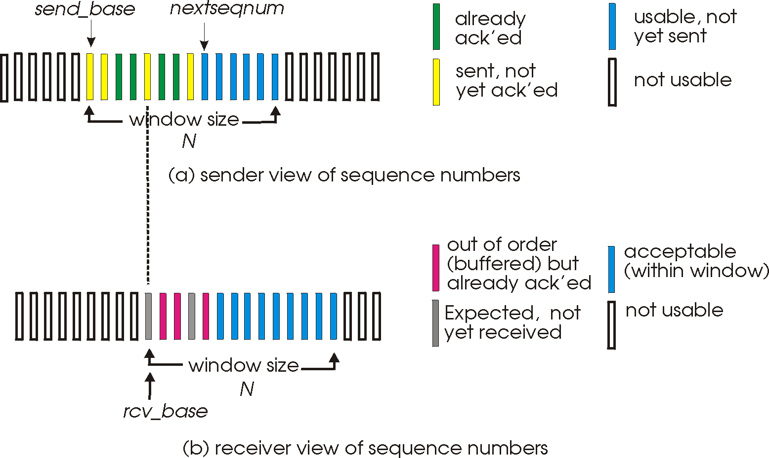
Selective repeat: sender, receiver windows
?
ACKs sent
Not yet received
at sender

Slide 37
Selective repeat in action
sender window (N=4)
sender
receiver
0 1 2 3 4 5 6 7 8
send pkt0
send pkt1
send pkt2
send pkt3
(wait)
0 1 2 3 4 5 6 7 8
receive pkt0, send ack0
receive pkt1, send ack1
receive pkt3, buffer,
send ack3
0 1 2 3 4 5 6 7 8
X
0 1 2 3 4 5 6 7 8
loss
0 1 2 3 4 5 6 7 8
rcv ack0, send pkt4
rcv ack1, send pkt5
0 1 2 3 4 5 6 7 8
deliver pkt0, pkt1
receive pkt4, buffer,
send ack4
SR: every pkt has a timer or oldest unACKed
record ack3 arrived
receive pkt5, buffer,
send ack5
pkt 2 timeout
0 1 2 3 4 5 6 7 8
send pkt2
0 1 2 3 4 5 6 7 8
record ack4 arrived
rcv pkt2; send ack2
deliver pkt2,
pkt3, pkt4, pkt5
0 1 2 3 4 5 6 7 8
record ack5 arrived
0 1 2 3 4 5 6 7 8
Q: what happens when ack2 arrives?
Q: window at receiver?
window moves forward to cover all now ACKed pkts
that are in seq. Here it will be 6 as 3,4,5 all previously ACKed
moves forward to 6 once
pkt 2 arrives

Slide 38

Selective repeat: dilemma
sender window
(after receipt)
receiver window
(after receipt)
0 1 2 3 0 1 2
pkt0
0 1 2 3 0 1 2
pkt1
0 1 2 3 0 1 2
example:
seq #’s: 0, 1, 2, 3
window size=3
0 1 2 3 0 1 2
pkt2
0 1 2 3 0 1 2
0 1 2 3 0 1 2
0 1 2 3 0 1 2
pkt3
X
0 1 2 3 0 1 2
pkt0
will accept packet
with seq number 0
(a) no problem
receiver sees no difference in two scenarios!
duplicate data accepted as new in (b)
receiver can’t see sender side.
receiver behavior identical in both cases!
something’s (very) wrong!
0 1 2 3 0 1 2
pkt0
0 1 2 3 0 1 2
pkt1
0 1 2 3 0 1 2
Q: what relationship between seq # size and window size to avoid problem in (b)?
pkt2
0 1 2 3 0 1 2
0 1 2 3 0 1 2
X
0 1 2 3 0 1 2
X
timeout
retransmit pkt0
X
0 1 2 3 0 1 2
will accept packet
with seq number 0
Unaware it is a DUPLICATE
pkt0
A: window size must be << than
seq # space
(b) oops!
→ half or less

Slide 39
Chapter 3 outline
3.1 transport-layer services
3.2 multiplexing and demultiplexing
3.3 connectionless transport: UDP
3.4 principles of reliable data transfer
3.5 connection-oriented transport: TCP
  segment structure
  reliable data transfer
  flow control
  connection management
3.6 principles of congestion control
3.7 TCP congestion control

Slide 40
TCP: Overview RFCs: 793,1122,1323, 2018, 2581
point-to-point:
  one sender, one receiver
reliable, in-order byte stream:
  no “message boundaries”
pipelined:
  TCP congestion and flow control set window size
full duplex data:
  bi-directional data flow in same connection
  MSS: maximum segment size
connection-oriented:
  handshaking (exchange of control msgs) inits sender, receiver state before data exchange
flow controlled:
  sender will not overwhelm receiver

Slide 41
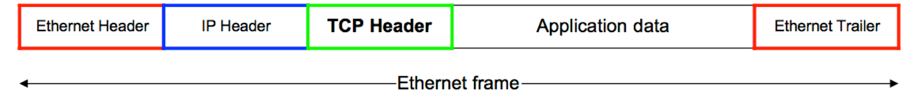
Segments? Packets? Frames?
link layer frame with header and trailer
network layer datagram with header H_{n}
transport layer segment with header H_{t}
message
link_{h}
network_{h}
transport_{h}
link_{t}
MSS
MTU
MSS=Max. Segment Size – Data field of Transport
MTU=Max. Trans. Unit – Data field/Payload of Link

Slide 42
TCP segment structure
TCP uses a default segment size called the Maximum Segment Size – MSS --> “< MTU”
Exchanges that information with receiving side. MSS consists of data portion of TCP segment.
32 bits
U-URG: urgent data
counting
by bytes
of data
(not segments!)
source port #
dest port #
A-ACK: ACK #
field valid
sequence number
acknowledgement number
head
len
U
receive window
A
P-PSH: push data
not
used
P
R
S
F
cwr
ECN
# bytes
rcvr willing
to accept
checksum
Urg data pointer
R-RST, S-SYN, F-FIN:
connection estab
(setup, teardown
commands)
options (variable length – Max 40)
application
data
(variable length)
this points to
control info
embedded in
data when U=1
Internet
checksum
(as in UDP)
cwr, ecn: network
congestion
bits

Slide 43
Sequence Nos
sequence number is 32 bits long
  the range of SeqNo is
      0 <= SeqNo <= 2³² -1 ≈ 4.3 Gbyte
  a sequence number identifies a specific byte in the byte stream. Each byte has a sequence number
  an Initial Sequence Number (ISN) for a new connection is picked randomly at each end of the connection and is exchanged during connection establishment
//
//
//
0
1
1499
1500
2590
2591
5500
//
//
//
Segment 1 – 0 to1499 bytes
Segment 2 – 1500 to 2590 bytes
Segment 3 – 2591 to 5500 bytes

Slide 44
Acknowledgement Nos
ACKs can be piggybacked
  a segment from A -> B can contain an acknowledgement for data sent in the B -> A direction
a hosts uses the acknowledgment field to ACK a pkt
  if a host sends an ACK# in a segment it sets the “ACK flag”
the ACK# contains the next Seq# that a receiving host is expecting to receive from the sender.
  the ACK# for a segment with Seq# 0 and data length of 1500 bytes (0-1499) is = 1500
  next byte TCP receiver is expecting is byte # 1500 (received 0-1499)
  next segment sent from sender should have Seq# = 1500 (1st byte in that segment is # 1500 in the original data byte stream)
//
//
//
0
1
1499
1500
2590
2591
5500
//
//
//
Segment 1 – 0 to 1499 bytes, Seq#0
Segment 2 – 1500 to 2590 bytes, Seq#1500
Segment 3 – 2591 to 5500 bytes, Seq#2591

Slide 45
TCP seq. numbers, ACKs
outgoing segment from sender
sequence numbers:
  byte stream “number” of first byte in segment’s data
acknowledgements:
  seq # of next byte expected from other side
  cumulative ACK
Q: how receiver handles out-of-order segments?
A: TCP spec doesn’t say, - up to implementor – GBN, SACK – discard? rearrange?
source port #
dest port #
sequence number
acknowledgement number
rwnd
checksum
urg pointer
window size
N
  sender sequence number space
sent
ACKed
sent, not-yet ACKed
(“in-flight”)
usable
but not
yet sent
not
usable
incoming segment to sender
source port #
dest port #
sequence number
acknowledgement number
A
rwnd
checksum
urg pointer

Slide 46
TCP seq. numbers, ACKs
Host A
Host B
User
types
‘C’
Host ACKs a previous pkt
Expecting byte #79
Sends character ‘C’ =1 byte with
Seq#42
Seq=42, ACK=79, data = ‘C’
host ACKs receipt of ’C’ by sending #43
and responds with character ‘D’that is Seq#79
Seq=79, ACK=43, data = ‘D’
host ACKs receipt of
byte #79 - ‘D’
Seq=43, ACK=80
Piggybacked ACK
Why?
Just an ACK
simple scenario

Slide 47
TCP round trip time, timeout
Q: how to set TCP timeout value?
longer than RTT
  but RTT varies
too short: premature timeout, unnecessary retransmissions
too long: slow reaction to segment loss
Q: how to estimate RTT?
SampleRTT: measured time from segment transmission until ACK receipt
  ignore retransmissions
SampleRTT will vary, want estimated RTT “smoother”
  average over several recent measurements, not just current SampleRTT

Slide 48
TCP round trip time, timeout
EstimatedRTT = (1- α)*EstimatedRTT + α*SampleRTT
exponential weighted moving average
influence of past sample decreases exponentially fast
typical value: α = 0.125
RTT: gaia.cs.umass.edu to fantasia.eurecom.fr
RTT (milliseconds)
sampleRTT
EstimatedRTT
time (seconds)

Slide 49

TCP round trip time, timeout
timeout interval: EstimatedRTT plus “safety margin”
  large variation in EstimatedRTT -> larger safety margin
estimate SampleRTT deviation from EstimatedRTT:
DevRTT = (1-β)*DevRTT +
β*|SampleRTT-EstimatedRTT|
(typically, β = 0.25)
TimeoutInterval = EstimatedRTT + 4*DevRTT
estimated RTT
“safety margin”
* Check out the online interactive exercises for more examples: http://gaia.cs.umass.edu/kurose_ross/interactive/

Slide 50
Chapter 3 outline
3.1 transport-layer services
3.2 multiplexing and demultiplexing
3.3 connectionless transport: UDP
3.4 principles of reliable data transfer
3.5 connection-oriented transport: TCP
  segment structure
  reliable data transfer
  flow control
  connection management
3.6 principles of congestion control
3.7 TCP congestion control

Slide 51
TCP reliable data transfer
TCP creates rdt service on top of IP’s unreliable service
  pipelined segments
  cumulative acks
  single retransmission timer
retransmissions triggered by:
  timeout events
  duplicate acks
let’s initially consider simplified TCP sender:
  ignore duplicate acks
  ignore flow control, congestion control

Slide 52
TCP sender events:
data rcvd from app:
create segment with seq #
seq # is byte-stream number of first data byte in segment
start timer if not already running
  think of timer as for oldest unacked segment
  expiration interval: TimeOutInterval
timeout:
retransmit segment that caused timeout
restart timer
ack rcvd:
if ack acknowledges previously unacked segments
  update what is known to be ACKed
  start timer if there are still unacked segments

Slide 53
TCP: retransmission scenarios
Host A
Host B
Host A
Host B
SendBase=92
Seq=92, 8 bytes of data
Seq=92, 8 bytes of data
timeout
timeout
Seq=100, 20 bytes of data
ACK=100
X
ACK=100
ACK=120
Seq=92, 8 bytes of data
SendBase=100
Seq=92, 8 bytes of data
SendBase=120
timeout
ACK=100
ACK=120
SendBase=120
lost ACK scenario
premature timeout

Slide 54
TCP: retransmission scenarios
Host A
Host B
Seq=92, 8 bytes of data
Seq=100, 20 bytes of data
timeout
ACK=100
X
ACK=120
Seq=120, 15 bytes of data
timeout better estimate, cumulative ACK

Slide 55
TCP ACK generation [RFC 1122, RFC 2581]
event at receiver
arrival of in-order segment with
expected seq #. All data up to
expected seq # already ACKed
arrival of in-order segment with
expected seq #. One other
segment has ACK pending
arrival of out-of-order segment
higher-than-expect seq. # .
Gap detected
arrival of segment that
partially or completely fills gap
TCP receiver action
delayed ACK. Wait up to 500ms
for next segment. If no next segment,
send ACK
immediately send single cumulative
ACK, ACKing both in-order segments
immediately send duplicate ACK,
indicating seq. # of next expected byte
immediate send ACK, provided that
segment starts at lower end of gap

Slide 56
TCP fast retransmit
TCP fast retransmit
time-out period often relatively long:
  long delay before resending lost packet
detect lost segments via duplicate ACKs.
  sender often sends many segments back-to-back
  if segment is lost, there will likely be many duplicate ACKs (every out of order segment will generate an ACK).
if sender receives 1+3 ACKs for same data (i.e., original + “triple or 3” duplicate ACKs),
resend unacked segment with smallest seq #
  likely that unacked segment lost, so don’t wait for timeout
Note: “triple” duplicate ACKs, means one ACK
and 2 duplicates of that ACK

Slide 57
TCP fast retransmit
Host A
Host B
Seq=92, 8 bytes of data
Seq=100, 20 bytes of data
X
ACK=100
timeout
ACK=100
ACK=100
ACK=100
Seq=100, 20 bytes of data
fast retransmit after sender
receipt of triple duplicate ACK

Slide 58
Chapter 3 outline
3.1 transport-layer services
3.2 multiplexing and demultiplexing
3.3 connectionless transport: UDP
3.4 principles of reliable data transfer
3.5 connection-oriented transport: TCP
  segment structure
  reliable data transfer
  flow control
  connection management
3.6 principles of congestion control
3.7 TCP congestion control

Slide 59
TCP flow control
application
process
application may
remove data from
TCP socket buffers ….
application
TCP socket
receiver buffers
OS
… slower than TCP
receiver is delivering
(sender is sending)
-> this may cause buffer overflow
TCP
code
flow control
IP
code
receiver controls sender, so sender won’t overflow receiver’s buffer by transmitting too much, too fast
from sender
receiver protocol stack

Slide 60
TCP flow control (FC)
receiver “advertises” free buffer space by including rwnd value in TCP header of receiver-to-sender segments
  RcvBuffer size set via socket options (typical default is 4096 bytes)
  many operating systems auto adjust RcvBuffer
sender limits amount of unacked (“in-flight”) data to receiver’s rwnd value (changes value of sending window → FC window = rwnd)
guarantees receive buffer will not overflow
segment sent to sender from receiver
source port #
dest port #
sequence number
acknowledgement number
rwnd
checksum
urg pointer
to application process
RcvBuffer
buffered data
rwnd
free buffer space
rwnd window
if rwnd > unACKed,
then sender can send
more packets up to rwnd
TCP segment payloads
receiver-side buffering
original sending window

Slide 61
Example
receiver ACKs data
closes window
receiver opens window again
Persist Timer
Delay
.1K|SeqNo = 4096
If Delay > Persist Timer
Sender sends a small packet to feel out
receiver incase an ACK with window >0 was lost

Slide 62
Chapter 3 outline
3.1 transport-layer services
3.2 multiplexing and demultiplexing
3.3 connectionless transport: UDP
3.4 principles of reliable data transfer
3.5 connection-oriented transport: TCP
  segment structure
  reliable data transfer
  flow control
  connection management
3.6 principles of congestion control
3.7 TCP congestion control

Slide 63
Connection Management
before exchanging data, sender/receiver “handshake”:
agree to establish connection (each knowing the other willing to establish connection)
agree on connection parameters

Slide 64



Agreeing to establish a connection
2-way handshake:
Q: will 2-way handshake always work in network?
A: No
variable delays
retransmitted messages (e.g. req_conn(x)) due to message loss
message reordering
can’t “see” other side
Let’s talk
ESTAB
OK
ESTAB
choose x
req_conn(x)
ESTAB
acc_conn(x)
ESTAB

Slide 65
TCP 3-way handshake
client state
server state
LISTEN
LISTEN
choose init seq num, x
send TCP SYN msg
SYNSENT
SYNbit=1, Seq=x
choose init seq num, y
send TCP SYNACK
msg, acking SYN
SYN RCVD
SYNbit=1, Seq=y
ACKbit=1; ACKnum=x+1
received SYNACK(x)
indicates server is live;
send ACK for SYNACK;
this segment may contain
client-to-server data
ESTAB
ACKbit=1, ACKnum=y+1
received ACK(y)
indicates client is live
ESTAB

Slide 66
TCP: closing a connection
client, server each close their side of connection
  send TCP segment with FIN bit = 1
respond to received FIN with ACK
  on receiving FIN, ACK can be combined with own FIN
simultaneous FIN exchanges can be handled

Slide 67
TCP: closing a connection
client state
server state
ESTAB
ESTAB
clientSocket.close()
FIN_WAIT_1
can no longer
send but can
receive data
FINbit=1, seq=x
CLOSE_WAIT
ACKbit=1; ACKnum=x+1
can still
send data
FIN_WAIT_2
wait for server
close
LAST_ACK
FINbit=1, seq=y
TIMED_WAIT
can no longer
send data
ACKbit=1; ACKnum=y+1
timed wait
for 2*max
segment lifetime
CLOSED
CLOSED

Slide 68
Chapter 3 outline
3.1 transport-layer services
3.2 multiplexing and demultiplexing
3.3 connectionless transport: UDP
3.4 principles of reliable data transfer
3.5 connection-oriented transport: TCP
  segment structure
  reliable data transfer
  flow control
  connection management
3.6 principles of congestion control
3.7 TCP congestion control

Slide 69
Principles of congestion control
congestion:
informally: “too many sources sending too much data too fast for network to handle”
different from flow control!
manifestations:
  lost packets (buffer overflow at routers)
    results in retransmissions which will increase network load
  long delays (queueing in router buffers)

Slide 70
Chapter 3 outline
3.1 transport-layer services
3.2 multiplexing and demultiplexing
3.3 connectionless transport: UDP
3.4 principles of reliable data transfer
3.5 connection-oriented transport: TCP
  segment structure
  reliable data transfer
  flow control
  connection management
3.6 principles of congestion control
3.7 TCP congestion control

Slide 71
TCP Congestion Control: Principle
Avoid losses from occurring
Q: How to do that? A: Control traffic flow!
A connection knows nothing about the network when it starts up.
  TCP has to learn what is going on: probe – RTT (delays) and losses (timeouts)
  TCP has to adapt once it gets feedback: adjust the flow

Slide 72
TCP Basic Operation
TCP congestion control consists of two phases of traffic transmission
  Slow Start Phase – Network Probing
  Congestion Avoidance Phase – limit transmissions to avoid congestion and thus losses
TCP uses a congestion window “cwnd” at the sender side that controls the number of segments it will transmit
  cwnd is dynamic, a function of perceived network congestion
TCP reacts to network status based on events (timeouts, DUP ACKs) and adapt its behavior

Slide 73
TCP Congestion Control Window
Sender uses a window called the congestion window - cwnd
sender sequence number space
TCP sending rate:
roughly: send cwnd bytes, wait RTT for ACKS, then send more bytes
cwnd
last byte
ACKed
last byte sent
sent, not-yet ACKed
(“in-flight”)
rate
cwnd
~
bytes/sec
sender limits transmission so that:
cwnd changes with network condition – increases and decreases according to perceived congestion
~
RTT
LastByteSent-
LastByteAcked
cwnd
<

Slide 74
TCP Slow Start Phase (SS)
Host A
Host B
Slow start: probe network, grow fast
when connection begins, start with one packet.
  cwnd = 1 MSS
increase rate exponentially until first loss event or threshold (ssthresh) is reached
  increment cwnd by “one” for every ACK received (even if cumulative ACK)
initial rate is slow but ramps up exponentially fast – 1, 2, 4, 8….
one segment
RTT
two segments
3
4
four segments
5
6
7
8
time

Slide 75
TCP Congestion Avoidance (CA)
Congestion Avoidance – linear growth
when cwnd >= ssthresh, grow more slowly
for every received ACK (including cumulative ACK)
  cwnd = cwnd + MSS*(MSS/cwnd)
  i.e., cwnd increases by 1 MSS only when ACKs received = cwnd
  e.g., if cwnd=8, sender has to receive 8 ACKs before cwnd -> 9

Slide 76
TCP Congestion Avoidance Phase (CA)
linear growth after cwnd >= ssthresh
cwnd increments by one when all pkts in cnwd window are ACKed
e.g. cwnd = 8
cwnd +1 = 9 only when 8 ACKs received
note cwnd limits sender window, but sender window <= cwnd
Host A
Host B
cwnd=8
sender window = 4
ACK
sender window = 6
ACK
sender window = 5
ACK
ACK
sender window = 8
ACK
ACK
cwnd=?
ACK
sender window = 5
ACK
cwnd=?
How many ACKs received?
cwnd increases?
How many ACKs received?
cwnd increases?
time

Slide 77
TCP and Network Congestion
TCP reacts to perceived congestion by switching between the two phases - SS and CA – and thus the value of “cwnd”
How does TCP perceive congestion:
  timeout – when a sent packet timer expires TCP assumes the packet is lost dues to congestion and will react accordingly
  receiving duplicate ACKs – when 3 DUPs ACKs have been received for a packet, it assumes the packet is lost
    loss due to congestion?
    loss due to error?
  reaction to these event sets TCP schemes apart

Slide 78
TCP: Detecting & Reacting to a Loss
loss indicated by timeout: TCP goes back to slow start phase
  ssthresh = cwnd/2, cwnd set to 1 MSS again;
  back to slow start: window grows exponentially to ssthresh, then grows linearly

Slide 79
TCP: Detecting & Reacting to DUPs
Receiving 3 duplicate ACKs (1+3 in total):
Classic TCP - TCP TAHOE:
Assumes a loss occurred due to congestion:
  fast retransmit - resends “lost” packet -> does not wait for TIMEOUT
  back to slow start: ssthresh = cwnd/2, cwnd set to 1 MSS
Popular TCP - TCP RENO:
Assumes loss may not be due to congestion as other packets are being received (triggering the DUPs)
  dup ACKs indicate network capable of delivering segments
  treats event as a loss due to error till a timeout occurs
  goes into Fast recovery Phase

Slide 80
Fast Recovery Phase
sets:
  ssthresh=cwnd/2,
  cwnd=ssthresh+3 (for 3 dups received)
resends “lost” packet
if it receives ACK (new ACK) for resent pkt before timeout, it stays goes back to congestion avoidance (CA) phase, and sets cwnd = ssthresh
if timeout occurs for resent pkt before it receives new ACK, it goes into slow start SS, sets:
  ssthresh = cwnd
  cwnd = 1
if it receives a dup ACK again, it sets:
  cwnd = cwnd+1 and continues to send “lost” packet
  wait for new ACK of resent pkt or timeout

Slide 81


Summary: TCP Congestion Control
Classic TCP Tahoe
New
ACK!
New
ACK!
.
duplicate ACK
new ACK
dupACKcount++
new ACK
cwnd = cwnd + MSS (MSS/cwnd)
dupACKcount = 0
transmit new segment(s), as allowed
cwnd = cwnd+MSS
dupACKcount = 0
transmit new segment(s), as allowed
Λ
cwnd = 1 MSS
ssthresh = 64 KB
dupACKcount = 0
cwnd > ssthresh
slow
start
Λ
congestion
avoidance
timeout
ssthresh = cwnd/2
cwnd = 1 MSS
dupACKcount = 0
retransmit missing segment
duplicate ACK
timeout
dupACKcount++
ssthresh = cwnd/2
cwnd = 1 MSS
dupACKcount = 0
retransmit missing segment
timeout
New
ACK!
ssthresh = cwnd/2
cwnd = 1
dupACKcount = 0
retransmit missing segment
New ACK
dupACKcount == 3
cwnd = ssthresh
dupACKcount = 0
dupACKcount == 3
ssthresh= cwnd/2
cwnd = ssthresh + 3
retransmit missing segment
ssthresh= cwnd/2
cwnd = ssthresh + 3
retransmit missing segment
fast
recovery
duplicate ACK
cwnd = cwnd + MSS
transmit new segment(s), as allowed

Slide 82
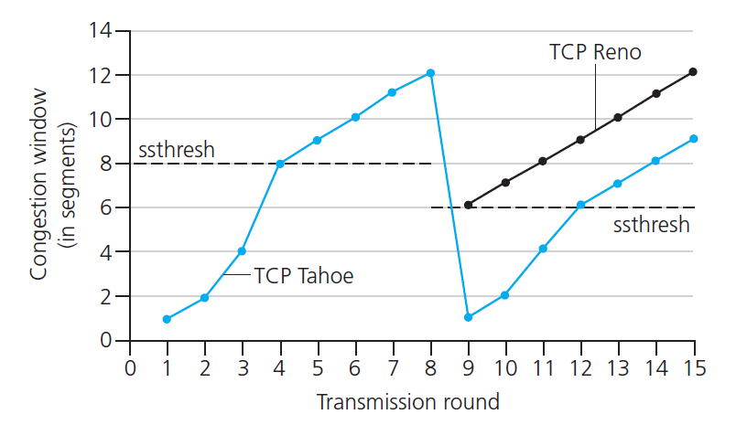
TCP: switching from slow start to CA
Q: when should the exponential increase switch to linear?
A: when cwnd = ssthresh
cwnd = 12
CA
time x
cwnd= 9
Ssthresh starts with default value
CA
SS
on Timeout:
ssthresh is set to 1/2 of cwnd
cwnd = 1
both Tahoe and Reno go to SS
SS
cwnd = 1
on 3 DUP ACKs:
Tahoe goes into SS mode
Reno goes into Fast Recovery mode
Reno in Fast Recov:
cwnd = sshthresh/2 +3 = 9
cwnd = cwnd+MSS for every DUP ACK received
retransmit lost packet, start
If at time x (< Timeout) a new ACK received:
transition to CA with cwnd = sstresh
If time x = and no new ACK
Reno goes back to SS

Slide 83
TCP congestion control principle
based on the Fast Recovery mechanism:
approach: sender increases transmission rate (window size), probing for usable bandwidth, until loss occurs
  Additive Increase: increase cwnd by 1 MSS every RTT (i.e., received ACK) until loss detected (3DUPs)
  Multiplicative Decrease: cut cwnd in half after loss
AIMD
additively increase window size …
…. until loss occurs (then cut window in half)
AIMD saw tooth
behavior: probing
for bandwidth
cwnd: TCP sender
congestion window size
time

Slide 84
Which TCP???
…many TCP flavors.
TCP is implemented at edge, not in Internet so not critical to Internet operations.
Impacts edge devices/apps and their transport across the Internet.
Most popular implementation is Reno. Fast Recovery made a considerable impact on TCP performance. SACK is also enabled by default at session setup time.

Slide 85
TCP Sender Window Size
Which window control packet transmission at the sender?
transit or inflight or (re)transmit window
flow control window
congestion window
Which one??????
TCP selects the smallest of the 3 as its “sending window”
holds back on any “new” transmissions if sender window size is reached

Slide 86
TCP Fairness
fairness goal: if K TCP sessions share same bottleneck link of bandwidth R, each should have average rate of R/K
TCP connection 1
bottleneck
router
capacity R
TCP connection 2

Slide 87
Why is TCP fair?
two competing sessions:
additive increase gives slope of 1, as throughout increases
multiplicative decrease decreases throughput proportionally
R
equal bandwidth share
loss: decrease window by factor of 2
congestion avoidance: additive increase
Connection 2 throughput
loss: decrease window by factor of 2
congestion avoidance: additive increase
Connection 1 throughput
R

Slide 88
Fairness (more)
Fairness and UDP
multimedia apps often do not use TCP
  do not want rate throttled by congestion control
instead use UDP:
  send audio/video at constant rate, tolerate packet loss
Fairness, parallel TCP connections
application can open multiple parallel connections between two hosts
web browsers do this
e.g., link of rate R with 9 existing connections:
  new app asks for 1 TCP, gets rate R/10
  new app asks for 11 TCPs, gets R/2

Slide 89
Explicit Congestion Notification (ECN)
network-assisted congestion control:
two end points negotiate ECN capability in setup phase with options in SYN, SYN ACK packets)
two bits in IP header (ToS field) marked by network router to indicate congestion capability (01 or 10) and congestion (11)
congestion indication carried to receiving host (packet not dropped)
receiver (seeing 11 in IP datagram) sets ECN bit on receiver-to-sender ACK segment to notify sender of congestion (unused flag fields in TCP)
sender reduces cwnd (linearly by one MSS, sometimes 1/2) and sets CRW bit (second unused flag bit) on next segment transmission
if congestion continues, this process is repeated till router buffer clears
source
TCP ACK segment
destination
TCP response segment
application
transport
network
link
physical
CRW=1
application
transport
network
link
physical
ECN=1
ECN=01
ECN=11
IP datagram

