Slide 1
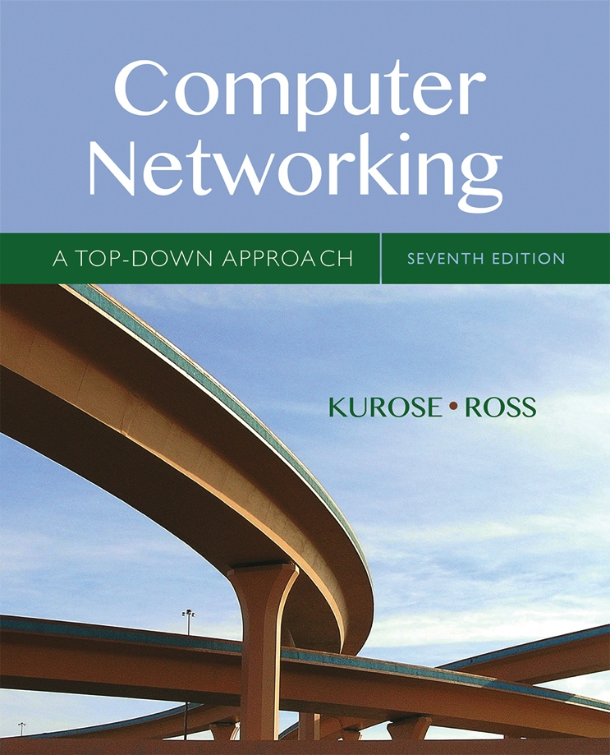

Chapter 5
Network Layer:
The Control Plane
A note on the use of these Powerpoint slides:
We’re making these slides freely available to all (faculty, students, readers). They’re in PowerPoint form so you see the animations; and can add, modify, and delete slides (including this one) and slide content to suit your needs. They obviously represent a lot of work on our part. In return for use, we only ask the following:
Computer Networking: A Top Down Approach
If you use these slides (e.g., in a class) that you mention their source (after all, we’d like people to use our book!)
If you post any slides on a www site, that you note that they are adapted from (or perhaps identical to) our slides, and note our copyright of this material.
Thanks and enjoy! JFK/KWR
All material copyright 1996-2016
J.F Kurose and K.W. Ross, All Rights Reserved
7th edition
Jim Kurose, Keith Ross
Pearson/Addison Wesley
April 2016

Slide 2
Chapter 5: outline
5.1 introduction
Control Plane
Autonomous Systems
5.2 routing protocols
link state
distance vector
5.3 intra-AS routing in the Internet:
RIP
OSPF
5.4 inter-AS routing in the Internet: B

Slide 3
Network-layer functions
Recall: two network-layer functions:
forwarding: move packets from router’s input to appropriate router output
data plane
routing: determine route taken by packets from source to destination
control plane
Two approaches to structuring network control plane:
per-router control (traditional)
logically centralized control (software defined networking)

Slide 4

Per-router control plane
Individual routing algorithm components in each and every router interact with each other in control plane to compute forwarding tables
Routing
Algorithm
control
plane
data
plane

Slide 5
Making Routing Scalable
our routing study thus far - idealized
all routers identical
network “flat”
… not true in practice
scale: with billions of destinations:
can’t store all destinations in routing tables!
routing table exchange would swamp links!
administrative autonomy
internet = network of networks
networks -> autonomous entities
each network admin controls routing and other functions in its own network

Slide 6
Internet approach to scalable routing
aggregate routers into regions known as “autonomous systems” (AS) (a.k.a. “domains”)
an autonomous system (AS) is a region of the Internet that is administered by a single entity and that has a unified routing policy
each autonomous system is assigned an Autonomous System Number (ASN). Each ASN is 32bits
    ASN assigned by Regional Internet Registries
    example ASNs
      U of Ts campus network (AS239)
      Sprint (AS1239, AS1240, AS 6211, …)

Slide 7
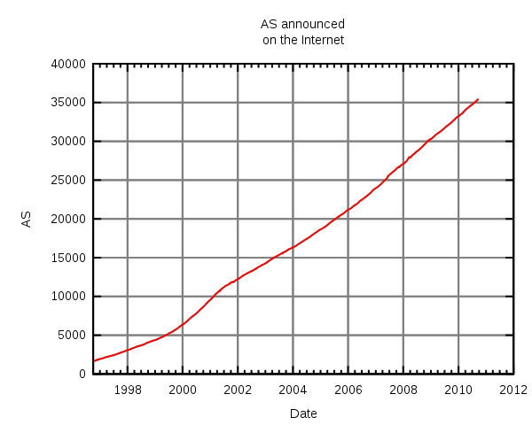
Number of Autonomous Systems
The number of unique autonomous networks
in the routing system of the Internet exceeded 5,000 in 1999,
30,000 in late 2008, 35,000 in mid-2010, 42,000 in late 2012,
54,000 in mid-2016 and 60,000 in early 2018

Slide 8
Autonomous Systems terminology
Stub AS: has connection to only one other AS, only carries local traffic. It can connect to other private networks that are not seen by the Internet. (E.g., UC and CalState network - CENIC)
Multihomed Stub AS: has connection to more than one AS, but only carries local traffic
Transit AS: has connection to more than one AS and carries transit traffic, e.g., ISPs
local traffic: traffic with source and destination in AS
transit traffic: traffic that passes through the AS

Slide 9
Stub and Transit Networks
Private Network: Invisible to Internet
AS 1 is a multi-homed stub network
AS 3 and AS 4 are transit networks
AS 2 and AS 5 are stub networks

Slide 10
Routing and Autonomous Systems
intra-AS routing
routing among hosts, routers in same AS (“network”)
all routers in AS must run same intra-domain routing protocol
routers in different AS can run different intra-domain routing protocol
gateway router: at “edge” of its own AS, has link(s) to router(s) in other AS’es
inter-AS routing
routing among AS’es
there is at least one dedicated router in each AS that handles interdomain traffic – gateway router(s)
gateways perform inter-domain routing (as well as intra-domain routing)

Slide 11
Interdomain and Intradomain routing
routing protocols used inside an AS, referred to as intradomain routing, are called interior gateway protocols (IGP)
  objective: shortest path, only operate within an AS
routing protocols used between ASs, referred to as interdomain routing, are called exterior gateway protocols (EGP)
  objective: satisfy policy of the ASs, not always shortest path

Slide 12
Interdomain and Intradomain Routing
Intradomain Routing
protocols for Intradomain routing are collectively called Interior Gateway Protocols or IGP’s.
popular protocols are:
  RIP (open source, simple, rarely used anymore)
  OSPF (open source, complex, popular)
  IGRP Interior Gateway Routing Protocol (Cisco proprietary for decades, until 2016)
Interdomain Routing
protocols are collectively called Exterior Gateway Protocols or EGP’s.
popular protocols are:
  Border Gateway Protocol (BGP) v4 current

Slide 13
EGP and IGP
1
Interior Gateway Protocol (IGP)
  routing is done based on metrics
  routing domain is one AS
Exterior Gateway Protocol (EGP)
  routing is done based on policies
  routing domain is the entire Internet

Slide 14
Interconnected ASes and forwarding
3c
3a
2c
3b
AS3
2a
1c
2b
AS2
1a
1b
1d
AS1
IP forwarding table configured by both intra- and inter-AS routing algorithm
  intra-AS routing determine entries for destinations within AS
  inter-AS & intra-AS determine entries for external destinations
Intra-AS
Routing
algorithm
Inter-AS
Routing
algorithm
Forwarding
table

Slide 15
Inter-AS tasks
suppose router in AS1 receives datagram destined outside of AS1:
  router should forward packet to gateway router, but which one?
AS1 must:
learn which destinations are reachable through AS2, and which through AS3
propagate this reachability info to all routers in AS1
job of inter-AS routing!
3c
3a
3b
AS3
2c
other
networks
1c
2a
other
networks
1a
2b
1b
AS2
AS1
1d

Slide 16
Multiple Routing Protocols
multiple routing protocols can run on the same router
but only one IGP protocol will be in operation in an AS
if a router is an exterior gateway router then usually one IGP and one EGP protocol will be in operation
each routing protocol updates the routing table accordingly

Slide 17
Chapter 5: outline
5.1 introduction
5.2 routing protocols
link state
distance vector
5.3 intra-AS routing in the Internet:
RIP
OSPF
5.4 inter-AS routing in the Internet: BGP

Slide 18
Routing protocols
Routing protocol goal: determine “good” paths (equivalently, routes), from sending host to receiving host, through network of routers
path: sequence of routers packets will traverse in going from given initial source host to given final destination host
“good”: “ least cost”, “fastest”, “least congested”

Slide 19
Components of a Routing Algorithm
a procedure for sending and receiving reachability information about a network to other routers
a procedure for calculating optimal routes
  Routes are calculated using a shortest path algorithm (least “cost”)
a procedure for reacting to and advertising topology and network condition/status changes

Slide 20
Routing algorithm classification
Q: global or local information?
global:
all routers have complete topology, link cost info
“link state” algorithms
local:
router knows physically-connected neighbors, link costs to neighbors
iterative process of computation, exchange of info with neighbors
“distance vector” algorithms
Q: quasi-static or dynamic?
quasi-static:
routes change slowly over time
  topology driven
dynamic:
routes change more quickly
  periodic update
  in response to link cost changes

Slide 21
Two Shortest Path IGP Routing Algorithms
Distance Vector Routing
each node knows the distance (cost) to its directly connected neighbors
a node periodically sends a list of routing updates to its neighbors
if all nodes update their distances to destinations using neighbor information, the routing tables eventually converge
Link State Routing
each node knows the distance (cost) to its directly connected neighbors
the distance information is flooded to all nodes in the network
each node calculates the routing tables independently using a network map (topology) created by the node using the global information it received

Slide 22
Chapter 5: outline
5.1 introduction
5.2 routing protocols
link state
distance vector
5.3 intra-AS routing in the Internet:
RIP
OSPF
5.4 inter-AS routing in the Internet: BGP

Slide 23
Routing Information Protocol (RIP)
uses distance vector algorithm
  each node only knows link cost to neighbors
  cost usually hop count
  route computation using Bellman Ford’s algorithm
  disseminates full routing table to all neighbors
router advertisements/updates sent to all its neighbors
  carried in RIP messages over UDP
  routing table entries give cost from that node (source) to all other nodes (destinations) in AS

Slide 24
RIP: Basic principles
periodically or triggered by a change, every router sends to its neighbors a complete list of its routes to all destinations within an AS
list contains pairs of: destination, distance (hop count)
receiver replaces/updates entries in its routing table if routing through a neighbor costs less than the current route in its table

Slide 25
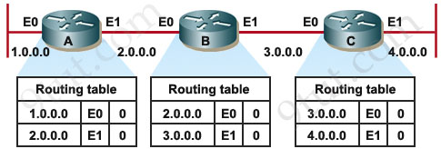
Rip Example
assume:
link cost is “1” on all hops
all updates occur simultaneously
initially each router only knows its directly connected interfaces --> cost = 0

Slide 26
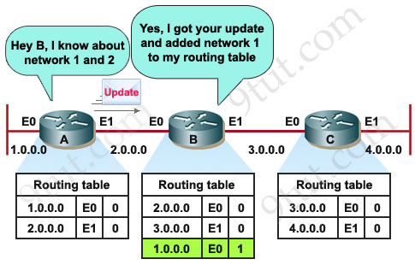
After First Update

Slide 27
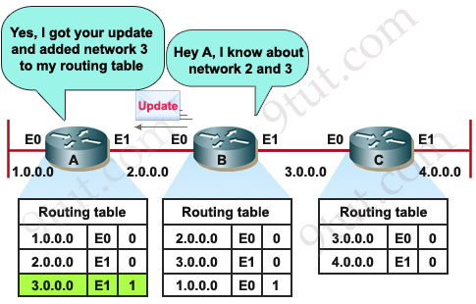
After Second Update

Slide 28
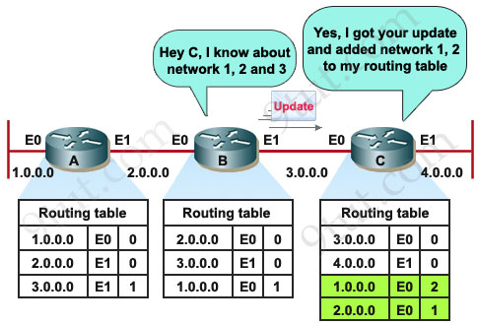
After Third Update

Slide 29
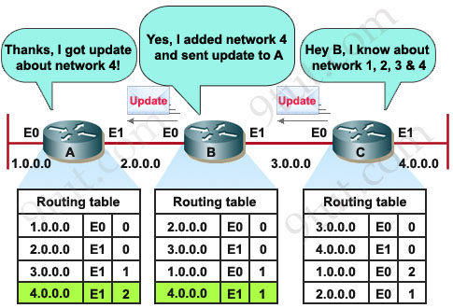
Last Update for Convergence

Slide 30
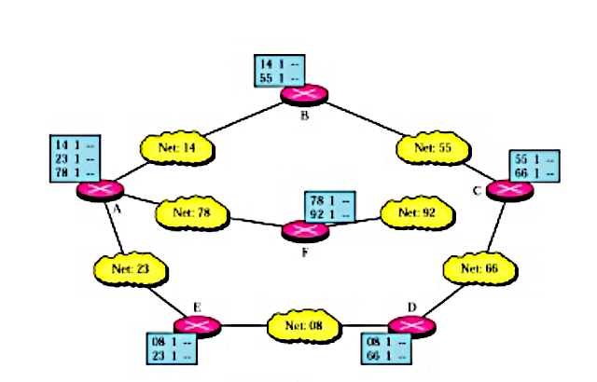
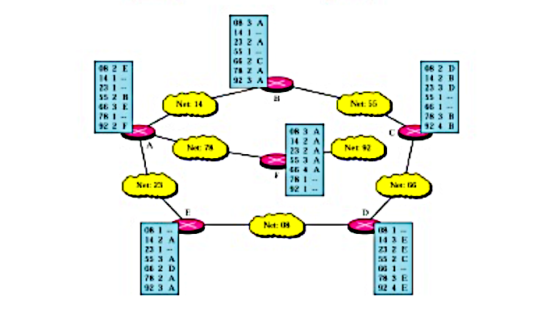
Realiastic Example of RIP

Slide 31
RIP Summary and demise
low overhead – fully distributed … BUT……
slow convergence
limited to 15 hops (max path cost → infinity =16)
only uses local information from immediate neighbors for routing decisions - relies on propagation of information for global view of network – cycle formations
……….
no longer used – Rest in Peace (RIP)

Slide 32
OSPF (Open Shortest Path First)
uses link-state algorithm
  link state packet dissemination
  topology map at each node
  route computation using Dijkstra’s algorithm
router floods OSPF link-state advertisements to all other routers in entire AS
  carried in OSPF messages directly over IP (rather than TCP or UDP – protocol type 89
  link state: for each attached link

Slide 33
OSPF: Basic principles
routers establish a relationship (“adjacency”) with neighbors
each router generates link state advertisements (LSAs) which are distributed to all “adjacent” routers (after routers have established adjacencies).
    LSA = (link id, state of the link, cost, neighbors of the link)
each router maintains a database - topological database or link state database (LSDB).
LSDB consists of all received LSAs with a corresponding seq# (used to verify age of update), which describe the current network topology as a graph with weighted edges
each router uses its link state database to run a shortest path algorithm (Dijikstra’s algorithm) to find the shortest path to each router

Slide 34
Operation of a Link State Routing protocol
Received
LSAs
Dijkstra’s
Algorithm
IP Routing
Table
Link State
Database
LSAs are flooded
to other interfaces

Slide 35
LSA updates
link-state routing protocols generate routing updates only when a change occurs in the network topology
when a link changes state, the device that detected the change creates a link-state advertisement (LSA) concerning that link and sends it to all neighboring devices using a special multicast address
each routing device reads the LSA
  the LSA has a sequence number that allows the router to check to see if it has already seen that update (all link info is stored with a seq#)
  if old, it is discarded, if new, LSDB info updated and LSA “flooded” to neighbors (controlled flooding - not sent in direction LSA was received from).

Slide 36
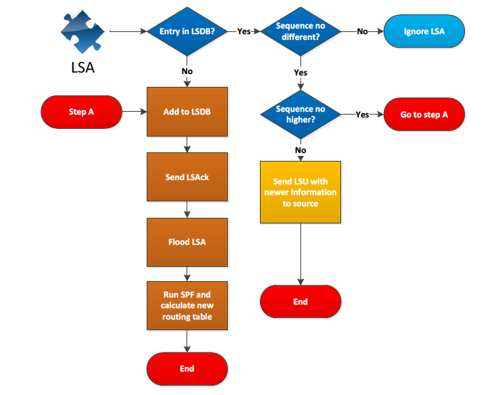
Flow Chart

Slide 37
OSPF Link State Packets
There are five types of Link-State Packets (LSPs).
hello: are used to establish and maintain adjacency with other OSPF routers. They are also used to elect the Designated Router (DR) and BackupDesignated Router (BDR) on multi-access networks.
database description (DBD or DD): contains an abbreviated list (links and seq#) of the sending router’s LSDB and is used by receiving routers to check against their local LSDB to make sure it has the latest information (seq# indicates age of info).
link-state request (LSR): used by routers to request more information about any entry in the DBD
link-state update (LSU): used to reply to LSRs as well as to announce new information (updates). LSUs can contain 7 different types of Link-State Advertisements (LSAs)
link-state acknowledgement (LSAck): sent to confirm receipt of an LSU message (note OSPF does not use TCP)

Slide 38
OSPF Packet Format
OSPF packets are not carried as UDP or TCP payload!
OSPF has its own IP protocol number: 89
TTL: set to 1 (in most cases)
Destination IP: neighbor’s IP address or multicast address for a broadcast environment:
224.0.0.5 (ALLSPFRouters) or 224.0.0.6 (AllDRouters: (designated and backup designated only)

Slide 39
OSPF “advanced” features
security: all OSPF messages authenticated (to prevent malicious intrusion)
multiple same-cost paths allowed (only one path in RIP)
for each link, multiple cost metrics for different TOS (e.g., satellite link cost set low for best effort traffic; but high for real-time services, such as video)
integrated uni- and multi-cast support:
  Multicast OSPF (MOSPF) uses same topology data base as OSPF
hierarchical OSPF in large domains.

Slide 40
Hierarchical OSPF
boundary router
backbone router
backbone
area
border
routers
area 3
internal
routers
area 1
area 2

Slide 41
Hierarchical OSPF
two-level hierarchy: local area, backbone
  link-state advertisements only flooded within an area (local or backbone)
  each router in an area (local or backbone) has:
    detailed area topology;
    direction (shortest path) to networks in other areas obtained from border routers.
backbone & local area routers: only use OSPF internal to their area
area border routers:
  “summarize” distances to networks in own area
  advertise to other Area Border routers to share with routers in their area
boundary (aka gateway) routers: connect to other AS’es

Slide 42
Chapter 5: outline
5.1 introduction
5.2 routing protocols
link state
distance vector
5.3 intra-AS routing in the Internet:
RIP
OSPF
5.4 inter-AS routing in the Internet BGP

Slide 43
Internet inter-AS routing: BGP
BGP (Border Gateway Protocol): the de facto inter-domain routing protocol (v4)
  “glue that holds the Internet together”
BGP provides each AS a means to:
  e(xternal)BGP: obtain destination (network) reachability information from neighboring ASes
  i(nternal)BGP: propagate reachability information to all AS-internal routers.
  determine “good” routes to other networks based on reachability information and policy
allows a network to advertise its existence to rest of Internet: I am here
uses TCP for reliable communications to transmit routing messages

Slide 44
eBGP, iBGP connections
2b
∂
2a
2c
1b
3b
2d
∂
1a
1c
3a
3c
AS 2
1d
3d
AS 1
eBGP connectivity
AS 3
iBGP connectivity
1c
gateway routers run both eBGP and iBGP protools

Slide 45
BGP basics
BGP session: two BGP routers (“peers”) exchange BGP messages over semi-permanent TCP connection:
  BGP is a “path vector” protocol: routers advertise paths to different destination networks
when AS3 gateway router 3a advertises path AS3,X to AS2 gateway router 2c:
  AS3 promises to AS2 it will forward datagrams towards network X
AS 3
3b
AS 1
1b
3a
3c
1a
1c
AS 2
2b
3d
X
1d
2a
2c
BGP advertisement:
AS3, X
2d

Slide 46
Path attributes and BGP routes
advertised network (referred to as prefix in BGP) includes BGP attributes
  prefix + attributes = “route”
three important attributes:
  ORIGIN: advertising AS
  AS-PATH: list of ASes through which advertisement has passed
  NEXT-HOP: indicates specific internal-AS router to next-hop AS
Policy-based routing:
  gateway receiving route advertisement uses import policy to accept/decline path (e.g., never route through AS Y).
  AS export policy also determines whether to advertise path to other neighboring ASes

Slide 47
BGP path advertisement
AS3
3b
AS1
1b
3a
3c
1a
1c
AS2
2b
3d
X
1d
AS3,X
AS2,AS3,X
2a
2c
2d
AS2 router 2c receives path advertisement AS3,X (via eBGP) from AS3 router 3a
based on AS2 import policy, AS2 router 2c accepts path AS3,X, and propagates (via iBGP) to all AS2 routers
based on AS2 export policy, AS2 router 2a advertises (via eBGP) path AS2, AS3, X to AS1 router 1c

Slide 48
BGP path advertisement
AS3
3b
AS1
1b
AS3,X
3a
3c
1a
1c
AS2
2b
3d
X
1d
AS3,X
AS2,AS3,X
2a
2c
2d
gateway router may learn about multiple paths to destination:
AS1 gateway router 1c learns path AS2,AS3,X from 2a
AS1 gateway router 1c learns path AS3,X from 3a
Based on policy, AS1 gateway router 1c chooses path AS3,X, and advertises path within AS1 via iBGP

Slide 49
BGP, OSPF, forwarding table entries
Q: how does router set forwarding table entry to distant prefix?
AS3
3b
AS1
1b
AS3,X
1
AS3,X
3a
3c
1a
2
1c
local link interfaces
at routers 1a, 1d
AS2
2b
3d
X
2
1d
1
AS3,X
AS2,AS3,X
2a
2c
physical link
2d
dest
interface
recall: 1a, 1b, 1d learn about dest X via iBGP from 1c: “path to X goes through 1c”
…
…
…
…
X
1
1d: OSPF routing: to get to 1c, forward over outgoing local interface 1

Slide 50
BGP, OSPF, forwarding table entries
Q: how does router set forwarding table entry to distant prefix?
AS3
3b
AS1
1b
1
3a
3c
1a
2
1c
AS2
2b
3d
X
1d
2a
2c
2d
dest
interface
recall: 1a, 1b, 1d learn about dest X via iBGP from 1c: “path to X goes through 1c”
…
…
…
…
X
2
1d: OSPF intra-domain routing: to get to 1c, forward over outgoing local interface 1
1a: OSPF routing: to get to 1c, forward over outgoing local interface 2

Slide 51
BGP route selection
gateway router may learn about more than one route to destination AS, selects route based on:
  local preference value attribute: policy decision
  shortest AS-PATH
  closest NEXT-HOP internal router: hot potato routing
  additional criteria
Local pref = 10
Local pref
= 100
AS 5
Local pref = 50
Local pref = 80
shortest AS-PATH may not mean shortest router/hop path
best cost intra path may not mean best cost overall

Slide 52
Selective transit
Private Network
Example:
AS 3 carries traffic
between AS 1 and AS 4 and between AS 2 and AS 4
But AS 3 does not carry traffic between AS 1 and AS 2
  The example shows a routing policy. In other words, AS3 is perfectly capable of carrying AS1 -> AS2 traffic, but a policy decision prevents AS1 and AS2 from using AS3 to reach each other. (maybe private network connects AS1 and AS2?)

Slide 53
Customer/Provider and Peers
peers
peers
a stub network typically obtains access to the Internet through a transit network. E.g., AS7 –> AS5 –> AS 8
a transit network that is a provider may be a customer of another network (provider) – AS4 is a customer of AS2 as is AS5.
customer pays provider for service

Slide 54
Customer/Provider and Peers
peers (ISPs, lv 2)
peers (ISPs, lv1)
peers (stubs)
stubs can have peer relationships – direct link, carries no transit
transit networks can have a peer relationship
peers provide transit between their respective customers
peers do not provide transit between peers, i.e., traffic from AS1 to AS3 cannot go through AS2.
peers have to go up one layer to reach another peer if not directly connected
peers normally do not pay each other for service

Slide 55
BGP: achieving policy via advertisements
legend:
provider
B
network
X
W
A
customer
C
network:
Y
Suppose an ISP only wants to route traffic to/from its customer networks (does not want to carry transit traffic between other ISPs)
A advertises path AW to B and to C
W is not B’s customer, B gets no “revenue” for routing any of its traffic.
B does not advertise (selective transit) BAW to X:
  B uses import and export policy to make this decision, wont take (import) from A (or C) re W and won’t send (export) to X)
C will route W traffic and will let customers X and Y know about path CAW

Slide 56
BGP: achieving policy via advertisements
legend:
provider
B
network
X
W
A
customer
C
network:
Y
Suppose an ISP only wants to route traffic to/from its customer networks (does not want to carry transit traffic between other ISPs)
A,B,C are provider networks (transit AS)
X,W,Y are customer (of provider networks) - stub networks, i.e., originate/terminate traffic only
X is dual-homed: attached to two networks
policy to enforce: X cannot route traffic from B to C via itself (X is a stub network)
  .. so X will not advertise to B a route to C (export policy)
  … whereas X does accept routes from C (import policy) and possibly other routes from B (import policy)

Slide 57
Import and Export Policies
Best entry is entered in IP routing table
Policies
Based on attributes
Policies
BGP updates arrive
BGP updates depart

Slide 58
Why different Intra-, Inter-AS routing ?
policy:
inter-AS: manager of an AS wants control over how its traffic is routed externally, and who routes through its net (not applicable for STUB networks).
intra-AS: single admin, so no policy decisions needed
scale:
hierarchical routing saves table size, reduced update traffic
performance:
intra-AS: can focus on performance (e.g., cost)
inter-AS: policy may dominate over performance

Slide 59
BGP interactions
BGP is executed between two routers
  BGP session
  BGP peers
procedure:
  establishes TCP connection (port 179) to BGP peer
  exchange all BGP routes
  as long as connection is alive:
  Periodically send incremental updates
Note: Not all autonomous systems need to run BGP. On many stub networks, the route to the provider can be statically configured

Slide 60
BGP Message Types
BGP messages exchanged between peers over TCP session
BGP messages:
  OPEN (Type 1): opens TCP connection to remote BGP peer (port 179) and authenticates sending BGP peer
  UPDATE (Type 2): advertises new path (or withdraws old)
  KEEPALIVE (Type 3): keeps connection alive in absence of UPDATES; also ACKs OPEN request
  NOTIFICATION (Type 4): reports errors in previous msg; also used to close connection

Slide 61
BGP route updates
BGP route advertisement is sent in a BGP UPDATE message
a route is announced as a Network Prefix, e.g., 10.0.1.0/24, and Attributes
Attributes specify details about a route:
  Mandatory attributes:
ORIGIN
AS_PATH
NEXT_HOP
  many other attributes

Slide 62
ORIGIN attribute
originating domain sends a route to a network (here 10.0.1.0/24) with ORIGIN attribute (AS number)
Network Prefix
10.0.1.0/24,
ORIGIN {1}
10.0.1.0/24,
ORIGIN {1}
10.0.1.0/24,
ORIGIN {1}
10.0.1.0/24
10.0.1.0/24,
ORIGIN {1}
10.0.1.0/24,
ORIGIN {1}

Slide 63
AS-PATH attributes
each AS that propagates a route prepends its own AS number
  AS-PATH creates a full path to reach the network prefix 10.0.1.0/24
path information prevents routing loops from occurring
path information also provides information on the length of a path (no. of ASes enroute, by default, a shorter route is preferred)
Note: BGP aggregates routes according to CIDR rules
10.0.1.0/24,
AS-PATH {4,2,1}
10.0.1.0/24,
AS-PATH {1}
10.0.1.0/24,
AS-PATH {2,1}
10.0.1.0/24,
AS-PATH {1}
10.0.1.0/24,
AS-PATH {3,1}

Slide 64
NEXT-HOP attributes
each router that sends a route advertisement, includes its own IP address of the forwarding port in a NEXT-HOP attribute
the attribute provides information for the routing table of the receiving router in the next AS on the path
10.0.1.0/24,
NEXT-HOP {128.100.11.1}
10.0.1.0/24,
NEXT-HOP {128.143.71.21}

Slide 65
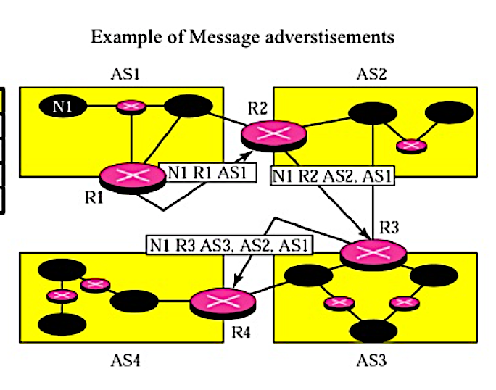
Putting it all together
Where R1, R2, R3 are the IP interfaces of the BGP routers
in each AS facing the exterior, i.e., next hops

Slide 66
BGP NEXT-HOP -> IGP information
E.g., how does R1 learn about route to 10.0.1.0/24???
10.0.1.0/24,
NEXT-HOP {128.100.11.1}
10.0.1.0/24,
NEXT-HOP {128.100.11.1}
At R1:
IGP Routing table
Combined Routing table
At R1
Dest. | Next hop
128.100.11.0/24 | 192.0.1.2
Dest. | Next hop
128.100.11.0/24 | 192.0.1.2
10.0.1.0/24 | 192.0.1.2
iBGP info
Dest. | Next hop
10.0.1.0/24 | 128.100.11.1

