Slide 1
Chapter 6 The Link Layer
and LANs
A note on the use of these Powerpoint slides:
We’re making these slides freely available to all (faculty, students, readers). They’re in PowerPoint form so you see the animations; and can add, modify, and delete slides (including this one) and slide content to suit your needs. They obviously represent a lot of work on our part. In return for use, we only ask the following:
Computer Networking: A Top Down Approach
If you use these slides (e.g., in a class) that you mention their source (after all, we’d like people to use our book!)
If you post any slides on a www site, that you note that they are adapted from (or perhaps identical to) our slides, and note our copyright of this material.
Thanks and enjoy! JFK/KWR
All material copyright 1996-2016
J.F Kurose and K.W. Ross, All Rights Reserved
7th edition Jim Kurose, Keith Ross Pearson/Addison Wesley April 2016

Slide 2
Chapter 6: Link layer and LANs
our goals:
understand principles behind link layer services:
error detection, correction, recovery
sharing a broadcast channel: multiple access
link layer addressing
local area networks: Ethernet, VLANs
instantiation, implementation of various link layer technologies

Slide 3
Link layer, LANs: outline
6.1 Introduction, services
6.2 Error detection, correction
6.3 Multiple access protocols
6.4 Local Area Networks (LANs)
Ethernet
Addressing, ARP
Switches

Slide 4
Link layer: introduction
terminology:
hosts and routers: nodes
communication channels that connect adjacent nodes along communication path: links
point to point:
wired – twisted pair, coax, fiber
wireless – cellular, satellite, microwave
broadcast/shared (wired/wireless) - LANs
layer-2 packet: frame, encapsulates datagram
data-link layer has responsibility of
transferring datagram (message) from a node
to another, physically adjacent, node, over a link

Slide 5
Data Link Layer in IETF
Datagram
Frame
Bits - Signal
Argon
Neon
The actual path
followed by data

Slide 6
Link layer: context
datagram transferred by different link protocols over different type links:
e.g., Ethernet on first link, frame relay on intermediate links, Wifi LAN on last link
datagram encapsulated in a link-layer frame
each link protocol provides different services
e.g., may or may not provide reliable data transport over link
transportation analogy:
trip from Irvine to SF via LA
shuttle: Irvine to LAX
plane: LAX to SFO
Bart: SFO to downtown SF
traveler = datagram
transport segment (e.g., Irvine to LA) = communication link
transportation mode (e.g. shuttle) = link layer protocol - frame
travel plan (Irvine – LAX – SFO- SF) = routing algorithm

Slide 7
Link layer services
framing, link access:
encapsulate datagram into frame, adding header, trailer
access mechanism to channel/link – when to transmit - if shared medium
“MAC” (often referred to as hardware..) addresses used in frame headers to identify source, destination
different from network layer (e.g., IP) address!
flow control:
pacing between adjacent sending and receiving nodes
half-duplex and full-duplex
with half duplex, nodes at both ends of link can transmit, but not at same time
full duplex allows transmission in both directions simultaneously
reliable delivery between adjacent nodes
error detection
error recovery (correction/retransmission)
links have different error rates – recovery?
seldom used on low bit-error links (fiber, coax, ……)
generally on wireless links: high error rates

Slide 8
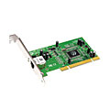
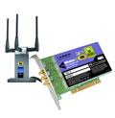
Where is the link layer implemented?
in each and every host
link layer implemented in “adaptor” (aka network interface card NIC) or on a chip
Ethernet card, 802.11 card; Ethernet chipset
implements link, physical layer
attaches into host’s system buses
link-layer is combination of software (addressing, flow control), hardware (framing, error recovery, access control), firmware
application
transport
network
link
cpu
memory
link
physical
host
bus
(e.g., PCI)
controller
physical
transmission
network adapter
card

Slide 9
Adaptors communicating
datagram
datagram
controller
controller
sending host
receiving host
datagram
frame
sending side:
encapsulates datagram in frame
adds error checking bits, flow control, error recovery, etc.
receiving side
looks for errors, flow control, error recovery, etc.
extracts datagram, passes to upper layer at receiving side

Slide 10
Different Types of “Links”
point to point link
nodes/devices are directly connected via a wired to wireless link
broadcast link
nodes/devices are connected via a common link that is shared
link can be wired or wireless
devices/nodes sharing a common link constitute a Local Area Network (LAN)

Slide 11
Data link layer for LANs
With the advent of Local Area Networks (shared links) the data link layer has been split into two sublayers:
Logic Link Control (LLC)
Media Access Control (MAC)
LLC is responsible for the data link layer services
MAC is responsible for device/node access to the shared medium using multiple access protocols
LLC

Slide 12
Link layer, LANs: outline
6.1 Introduction, services
6.2 Error detection, correction
6.3 Multiple access protocols
6.4 Local Area Networks (LANs)
Ethernet
Addressing, ARP
Switches

Slide 13
Reliable or unreliable delivery
errors caused by signal attenuation, noise, interference
error detection:
receiver detects presence of errors in received information
can drop frame and ignore error relying on higher layers
can try to recover
error recovery:
receiver, after detecting errors, can try to recover the data
correction: receiver identifies and corrects the bit error(s)
retransmission: signals sender for retransmission of errored frame

Slide 14
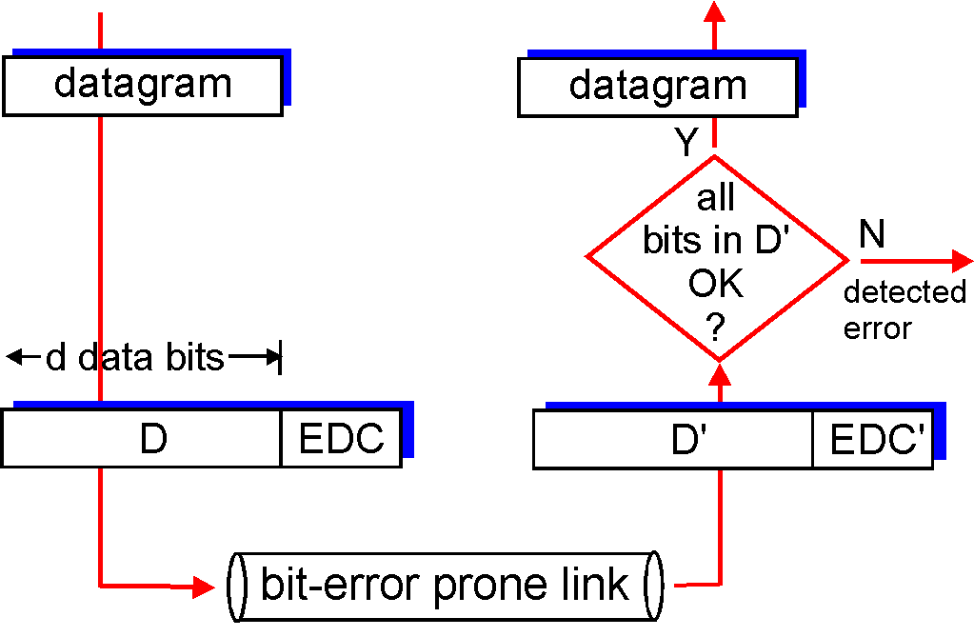
Error detection
EDC = Error Detection and Correction bits (redundancy)
D = Data protected by error checking, may include header fields
Error detection not 100% reliable!
protocol may miss some errors, but rarely
larger EDC field yields better detection and maybe some correction
otherwise
D’=D -> ??
What next?

Slide 15
Error recovery
correction - EDC bits can also be used to correct some bit errors (in conjunction with detection)
correction requires larger number of EDC bits than just detection - high overhead
used for applications that cannot wait for correct data to be retransmitted
retransmission - when error(s) detected
receiver drops packet and data is retransmitted by sender
waits for sender to timeout (no ACK received) and retransmit, or
receiver sends a negative ACK (NACK) (speeds up process)

Slide 16
Link layer, LANs: outline
6.1 Introduction, services
6.2 Error detection, correction
6.3 Multiple access protocols
6.4 Local Area Networks (LANs)
Ethernet
Addressing, ARP
Switches

Slide 17
Broadcast/Shared Network Links
a broadcast (shared transmission link (wired or wireless)) constitutes a Local Area Network (LAN)
multiple devices share the same “link”
how do devices determine when to transmit?
→ Media Access Control (MAC)
shared wire (e.g.,
cabled Ethernet)
shared RF
(e.g., 802.11 WiFi)

Slide 18
Multiple access protocols
single shared link – need a policy to control transmissions
if two or more simultaneous transmissions on the link → collision
collision → interference if node receives two or more signals at the same time
multiple access protocol
distributed algorithm that determines how nodes share link, i.e., determine when node(s) can transmit
communication about link sharing must use link itself!
i.e., inband, no out-of-band communication for coordination

Slide 19
An ideal multiple access protocol
given: broadcast link of rate R bps
desired:
1. when one node wants to transmit, it can send at rate R.
2. when M nodes want to transmit, each can send at average rate R/M
3. fully decentralized:
no special node to coordinate transmissions
no synchronization of clocks, slots
possible????
→ trade off between performance and functionality

Slide 20
Multiple access protocols: taxonomy
three broad classes:
channel (link) partitioning
divide link into smaller “pieces” (time slots, frequency, code)
allocate one piece to each node for exclusive use
Note: used for Satellite, broadcast TV, cellular….
random access
may divide link into smaller pieces
no allocations, allow collisions
“detect/recover” from collisions
“taking turns”
allocation but not fixed
nodes take turns, but nodes with more to send can take longer turns
avoids collisions

Slide 21
Random access protocols
when node has packet to send
transmit
no a priori coordination among nodes
two or more nodes transmit on link at the same slot ➜ “collision” i.e., interference – signal corrupted
random access protocol specifies:
how to detect collisions - signal comparison, no acknowledgement (ACK), etc.
how to recover from collisions (e.g., via delayed retransmissions)

Slide 22
Random access protocol - CSMA
CSMA - carrier sense multiple access
listen before transmit:
if channel sensed idle: transmit entire frame
if channel sensed busy, defer transmission

Slide 23
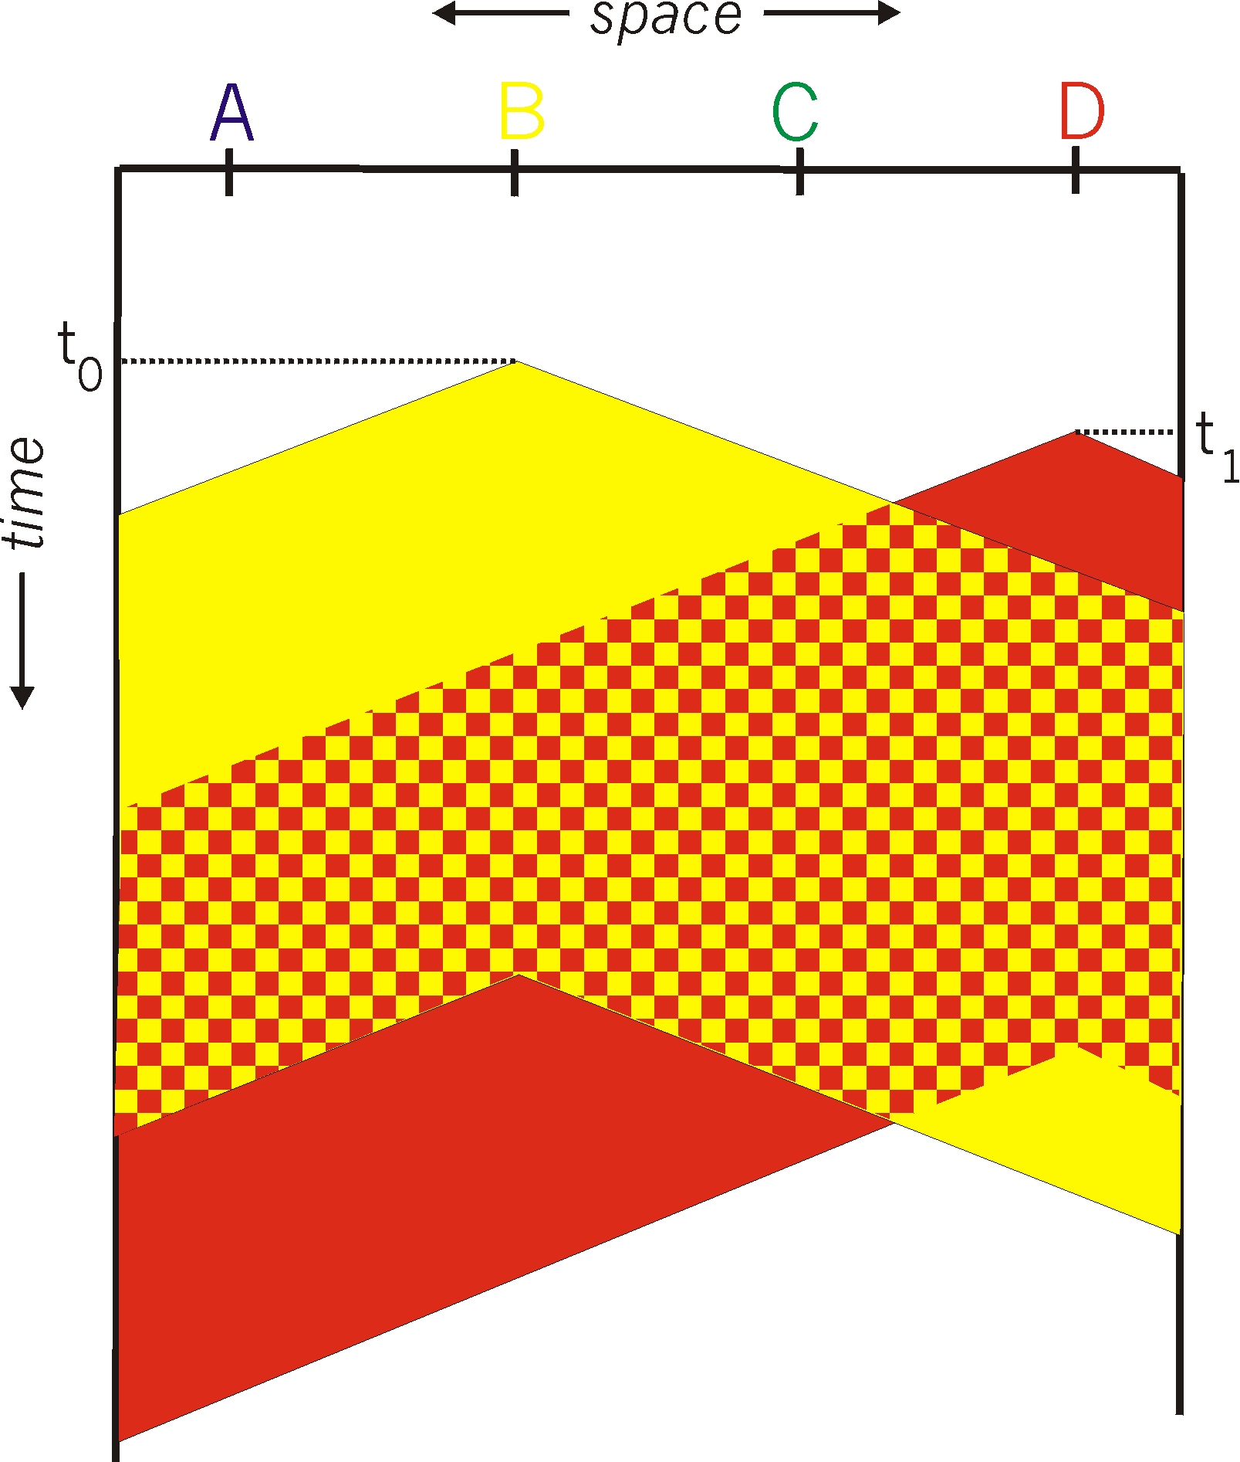
CSMA collisions
spatial layout of nodes
collisions can still occur: propagation delay means two nodes may not hear each other’s transmission
collision: entire packet transmission time wasted
distance & propagation delay play role in in determining collision probability

Slide 24
CSMA/CD (collision detection)
CSMA/CD: carrier sensing, deferral as in CSMA
collisions detected within short time
colliding transmissions aborted, reducing channel wastage
collision detection:
easy in wired LANs: measure signal strengths, compare transmitted and received signals
difficult in wireless LANs: received signal strength overwhelmed by local transmission strength

Slide 25
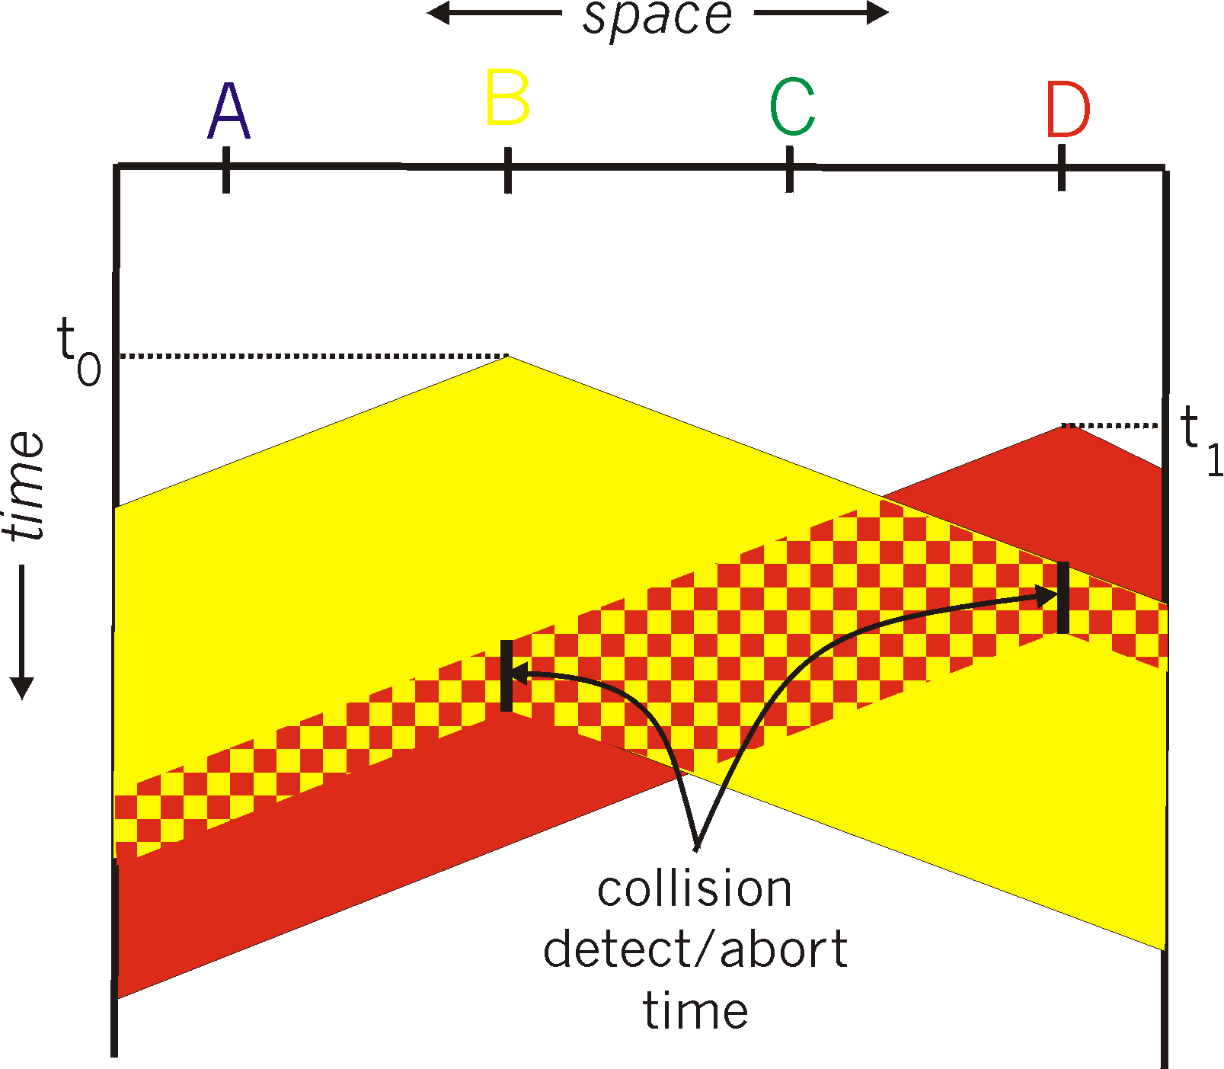
CSMA/CD (collision detection)
spatial layout of nodes

Slide 26
CSMA/CD algorithm
1. NIC receives datagram from network layer, creates frame
2. If NIC senses channel idle, starts frame transmission.
3. If NIC senses channel busy, waits until channel idle, then transmits (sometimes with prob. “p”). Why???
4. If NIC transmits entire frame without detecting another transmission, NIC is done with frame!
5. If NIC detects another transmission while transmitting, aborts and sends jam signal
6. After aborting, NIC of colliding stations enter binary (exponential) backoff:
after mth collision, NIC chooses K randomly from {0,1,2, …, 2^{m}-1}. NIC waits K·512 bit times, returns to Step 2
longer backoff interval with more collisions (m )

Slide 27
Variations of CSMA use different algorithms to determine when to initiate transmission onto the shared medium. A key distinguishing feature of these algorithms is how aggressive or persistent they are in initiating transmission. A more aggressive algorithm may begin transmission more quickly and utilize a greater percentage of available bandwidth of the medium. This is typically at the expense of increased likelihood of collision with other transmitters.
1-persistent 1-persistent CSMA is an aggressive transmission algorithm. When the transmitting node is ready to transmit, it senses the transmission medium for idle or busy. If idle, then it transmits immediately. If busy, then it senses the transmission medium continuously until it becomes idle, then transmits the message (a frame) unconditionally (i.e. with probability=1). In case of a collision, the sender waits for a random period of time and attempts the same procedure again. 1-persistent CSMA is used in CSMA/CD systems including Ethernet.Non-persistent Non persistent CSMA is a non aggressive transmission algorithm. When the transmitting node is ready to transmit data, it senses the transmission medium for idle or busy. If idle, then it transmits immediately. If busy, then it waits for a random period of time (during which it does not sense the transmission medium) before repeating the whole logic cycle (which started with sensing the transmission medium for idle or busy) again. This approach reduces collision, results in overall higher medium throughput but with a penalty of longer initial delay compared to 1–persistent.P-persistent This is an approach between 1-persistent and non-persistent CSMA access modes.^{[1]} When the transmitting node is ready to transmit data, it senses the transmission medium for idle or busy. If idle, then it transmits immediately. If busy, then it senses the transmission medium continuously until it becomes idle, then transmits with probability p. If the node does not transmit (the probability of this event is 1-p), it waits until the next available time slot. If the transmission medium is not busy, it transmits again with the same probability p. This probabilistic hold-off repeats until the frame is finally transmitted or when the medium is found to become busy again (i.e. some other node has already started transmitting). In the latter case the node repeats the whole logic cycle (which started with sensing the transmission medium for idle or busy) again. p-persistent CSMA is used in CSMA/CA systems including Wi-Fi and other packet radio systems.
When broadcasting over vehicular ad hoc networks, the original 1-persistence and p-persistence strategies often cause the broadcast storm problem.^{[citation needed]} To improve performance, engineers developed three modified techniques: weighted p-persistence, slotted 1-persistence, and slotted p-persistence

Slide 28
Link layer, LANs: outline
6.1 Introduction, services
6.2 Error detection, correction
6.3 Multiple access protocols
6.4 Local Area Networks
Ethernet
Addressing, ARP
Switches

Slide 29
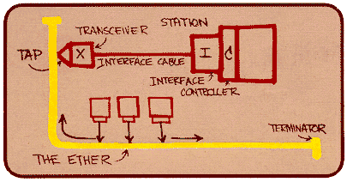
Ethernet
“dominant” wired LAN technology:
single chip, multiple speeds
first widely used LAN technology
simpler, cheap
kept up with speed race: 10 Mbps – 10 Gbps
Metcalfe’s Ethernet sketch

Slide 30
Ethernet: physical topology
bus: popular through mid 90s
all nodes in same collision domain (can collide with each other)
star: prevails today
active switch/hub in center
each “spoke” runs a (separate) Ethernet protocol
switch: nodes do not collide with each other, buffers used
hub: all spokes broadcast their transmissions, no buffering
switch/hub
star
bus: coaxial cable

Slide 31
Ethernet: Data Link Layer
Ethernet’s LLC
connectionless: no handshaking between sending and receiving NICs
unreliable: receiving NIC doesn't send acks or nacks to sending NIC
data in dropped frames not recovered
relies on higher layer reliable data transport (e.g., TCP), otherwise dropped data lost
Ethernet’s MAC protocol: unslotted CSMA/CD with binary exponential backoff

Slide 32
Ethernet frame structure
sending adapter encapsulates network layer datagram in Ethernet frame
preamble:
7 bytes with pattern 10101010 followed by one byte with pattern 10101011
used to synchronize receiver, sender clock rates
type
preamble
dest.
address
source
address
data (payload)
CRC

Slide 33
Ethernet frame structure (more)
addresses: 6 byte (octet) source and destination addresses
if adapter receives frame with matching destination address, or with broadcast address, it passes data in frame to higher layer protocol
otherwise, adapter discards frame
type: indicates which higher layer protocol carried in frame
CRC: cyclic redundancy check bits used by receiver to detect error
error detected: frame is dropped, no recovery
type
preamble
dest.
address
source
address
data (payload)
CRC

Slide 34
Ethernet standards: link & physical layers
many different Ethernet standards – IEEE 802.3
common multiple access protocol and frame format
different speeds: 2 Mbps, 10 Mbps, 100 Mbps, 1Gbps, 10 Gbps, 40 Gbps
different physical layer media: fiber, cable
application
transport
network
link
physical
MAC protocol
and frame format
100BASE-TX
100BASE-T2
100BASE-FX
100BASE-T4
100BASE-SX
100BASE-BX
copper (twisted
pair) physical layer
fiber physical layer

Slide 35
Link layer, LANs: outline
6.1 Introduction, services
6.2 Error detection, correction
6.3 Multiple access protocols
6.4 Local Area Networks
Ethernet
Addressing, ARP
Switches

Slide 36
Device interface addresses
interface address (referred to as: MAC/LAN/Ethernet/physical/hardware address):
function: used ‘locally” to transmit data frame from one device interface to another device interface on same physical layer network – Ethernet, WiFi,…..,
address bits burned in NIC ROM, also sometimes software settable
e.g.: Ethernet – 48bits (6octets): 1a-2f-bb-76-09-ad
ff:ff:ff:ff:ff:ff – all “1”s -> broadcast address on local network
hexadecimal (base 16) notation
(each “numeral” represents 4 bits – 12x4=48)
1=0001, 9=1001, 10=a=1010
11=b=1011, 14=e=1110, 15=f=1111

Slide 37
MAC addresses
each adapter on LAN has unique LAN/MAC/hardware address
devices can have more than one interface/adapter –> one MAC address per adapter (Ethernet, WiFi, cellular)
1A-2F-BB-76-09-AD
wired or
wireless network
adapter
71-65-F7-2B-08-53
58-23-D7-FA-20-B0
0C-C4-11-6F-E3-98

Slide 38
MAC addresses (more)
MAC address allocation administered by IEEE
NIC manufacturer buys portion of MAC address space (to assure uniqueness)
MAC address is a flat address ➜ portability
stays same as you move from one network to another
analogy - like Social Security Number (SSN), wherever you go, it goes with you and stays the same
Internet -> hierarchical address (network-host) ➜ not portable
address based on which network the device is currently connected to, e.g., UCI, Cox OC, Sprint, Starbucks
like postal address, when people move - their postal address changes

Slide 39
Local/Adjacent devices
All devices are on same “network” (137.196.7) can find and reach each other via MAC address
Devices on different “network” (137.196.49) can only be reached via a router using network address
137.196.7.78
137.196.7.1
bd-c4-11-af-55-03
137.196.49.1
1a-2f-bb-76-09-ad
f4-18-13-df-57-93
137.196.7.23
LAN
137.196.7.14
137.196.49.51
LAN
71-65-f7-2b-08-53
58-23-d7-fa-20-b0
18-a4-d7-fa-20-c0
0c-c4-11-6f-e3-98
137.196.49.3
137.196.7.88

Slide 40
Network to MAC address translation
Question: how to determine
an interface’s MAC address when all we know is its “network” address?
each device on the Internet has a unique “network” address associated with where it is located
like a postal address, it changes when the device moves
when a device wishes to send a message to another device, it uses the destination’s (current) network address (obtained from it’s name via DNS)
137.196.7.78
1A-2F-BB-76-09-AD
137.196.7.23
137.196.7.14
LAN
71-65-F7-2B-08-53
58-23-D7-FA-20-B0
0C-C4-11-6F-E3-98
137.196.7.88

Slide 41
ARP: address resolution protocol
137.196.7.78
Question: how to determine
an interface’s MAC address when all we know is its “network” address?
Answer: ARP and ARP table
1A-2F-BB-76-09-AD
137.196.7.23
137.196.7.14
LAN
71-65-F7-2B-08-53
58-23-D7-FA-20-B0
0C-C4-11-6F-E3-98
137.196.7.88
each network device (host, router) has a (ARP) table with:
Network to MAC address mappings for neighboring nodes:
< Network address; MAC address; TTL>
TTL (Time To Live): time after which address mapping will be forgotten
Q: How do devices fill the table with entries? ARP

Slide 42
ARP protocol: same local net
A wants to send datagram to B:
B has to be on same local (physical) network (more later…)
B’s IP address known to A
B’s MAC address not known to A
A broadcasts on local network ARP request packet, containing B’s IP address in data field
destination MAC address of data link frame = ff:ff:ff:ff:ff:ff
all nodes on local network receive ARP request and read
B recognizes its IP address in request
B then sends an ARP reply to A with its (B's) MAC address in the data field
destination MAC address of data link frame = A’s MAC address (B extracted A’s MAC address from received APR request).

Slide 43
Address Translation with ARP
ARP Request: Argon broadcasts an ARP request to all stations on the network: “What is the hardware address of 128.143.137.1?”
128.143.137.1?

Slide 44
Address Translation with ARP
ARP Reply: Router 137 responds with an ARP Reply which contains the hardware address
128.143.137.1?

Slide 45
ARP Transport
ARP message travels in data portion of data link layer frame
we say ARP message is encapsulated in data link frame
query/request has:
destination address: ff:ff:ff:ff:ff:ff
source address: device’s own MAC address
reply has:
destination address: of requesting device
source address: device’s own MAC address
data portion padded with zeroes if ARP message is shorter than minimum data link frame (depends on hardware address length and network address length)
for Ethernet: frame type field 0x0806 used for ARP

Slide 46
ARP Packet

Slide 47
Example
ARP Request from Argon:
Source hardware address: 00:a0:24:71:e4:44 Source protocol address: 128.143.137.144 Target hardware address: 00:00:00:00:00:00 Target protocol address: 128.143.137.1
ARP Reply from Router137:
Source hardware address: 00:e0:f9:23:a8:20 Source protocol address: 128.143.137.1 Target hardware address: 00:a0:24:71:e4:44 Target protocol address: 128.143.137.144
→ Result: an entry in ARP cache:
(128.143.137.1) at 00:e0:f9:23:a8:20 [ether] on eth0

Slide 48
ARP Packet Format
general: can be used with
arbitrary hardware address (not just Ethernet)
arbitrary protocol address (not just IP)
variable length address fields (depends on type of datalink protocol)

Slide 49
Retention of Bindings
sending an ARP request/reply for each IP datagram to same IP address is inefficient
solution -> maintain a table of bindings with a timer
devices maintain a cache of currently used IP addresses and their corresponding hardware addresses
effect
use ARP for first datagram to a destination, place results in table, then quick lookup for MAC address (subsequent packets sent to that same IP address)

Slide 50
ARP Cache/Table
A caches (saves) B’s IP-MAC address pair in an ARP table until information becomes old (times out)
ARP table: < Network address; MAC address; TTL>
TTL (Time To Live): time after which address mapping will be forgotten (used to be 20 mins, now with mobile devices it is barely 30secs)
known as soft state: information that times out (goes away) unless refreshed
nodes sometimes will send a query to check if remote node is still “valid” - if a response is received, it renews the TTL
B should cache A’s information too, sometimes it needs a “data” request from B to A to enable cache
ARP is “plug-and-play”:
nodes create their ARP tables without intervention from net administrator

Slide 51
Example ARP Cache (table)
(128.143.71.37) at 00:10:4B:C5:D1:15 [ether] on eth0
(128.143.71.36) at 00:B0:D0:E1:17:D5 [ether] on eth0
(128.143.71.35) at 00:B0:D0:DE:70:E6 [ether] on eth0
(128.143.136.90) at 00:05:3C:06:27:35 [ether] on eth1
(128.143.71.34) at 00:B0:D0:E1:17:DB [ether] on eth0
(128.143.71.33) at 00:B0:D0:E1:17:DF [ether] on eth0

Slide 52
Things to know about ARP
What happens if an ARP Request is made for a non-existing host?
Several ARP requests are made with increasing time intervals between requests. Eventually, ARP gives up.
What if a host sends an ARP request for its own IP address? Know as gratuitous ARP
No response hopefully
This is useful for detecting if an IP address has already been assigned (via DHCP).

Slide 53
Addressing: routing to another LAN
walkthrough: send datagram from A to B via R
focus on addressing – at IP (datagram) and MAC layer (frame)
assume A knows B’s IP address
assume A knows IP address of first hop router, R (how?)
assume A knows R’s MAC address (how?)
A
B
R
111.111.111.111
222.222.222.222
74-29-9C-E8-FF-55
49-BD-D2-C7-56-2A
222.222.222.220
1A-23-F9-CD-06-9B
111.111.111.112
111.111.111.110
222.222.222.221
CC-49-DE-D0-AB-7D
E6-E9-00-17-BB-4B
88-B2-2F-54-1A-0F

Slide 54
Addressing: routing to another LAN
A creates IP datagram with IP source A, destination B
A creates link-layer frame with R's MAC address as destination address, frame contains A-to-B IP datagram
MAC src: 74-29-9C-E8-FF-55
MAC dest: E6-E9-00-17-BB-4B
IP
Eth
Phy
IP src: 111.111.111.111
IP dest: 222.222.222.222
A
B
R
111.111.111.111
222.222.222.222
74-29-9C-E8-FF-55
49-BD-D2-C7-56-2A
222.222.222.220
1A-23-F9-CD-06-9B
111.111.111.112
111.111.111.110
222.222.222.221
CC-49-DE-D0-AB-7D
E6-E9-00-17-BB-4B
88-B2-2F-54-1A-0F

Slide 55
Addressing: routing to another LAN
frame sent from A to R
frame received at R, datagram removed, passed up to IP
MAC src: 74-29-9C-E8-FF-55
MAC dest: E6-E9-00-17-BB-4B
IP src: 111.111.111.111
IP dest: 222.222.222.222
IP
Eth
Phy
IP src: 111.111.111.111
IP dest: 222.222.222.222
IP
Eth
Phy
A
B
R
111.111.111.111
222.222.222.222
74-29-9C-E8-FF-55
49-BD-D2-C7-56-2A
222.222.222.220
1A-23-F9-CD-06-9B
111.111.111.112
111.111.111.110
222.222.222.221
CC-49-DE-D0-AB-7D
E6-E9-00-17-BB-4B
88-B2-2F-54-1A-0F

Slide 56
Addressing: routing to another LAN
R forwards datagram with IP source A, destination B
R creates link-layer frame with B's MAC address as destination address, frame contains A-to-B IP datagram
MAC src: 1A-23-F9-CD-06-9B
MAC dest: 49-BD-D2-C7-56-2A
IP
Eth
Phy
IP
Eth
Phy
IP src: 111.111.111.111
IP dest: 222.222.222.222
A
B
R
111.111.111.111
222.222.222.222
74-29-9C-E8-FF-55
49-BD-D2-C7-56-2A
222.222.222.220
1A-23-F9-CD-06-9B
111.111.111.112
111.111.111.110
222.222.222.221
CC-49-DE-D0-AB-7D
E6-E9-00-17-BB-4B
88-B2-2F-54-1A-0F

Slide 57
Addressing: routing to another LAN
R forwards datagram with IP source A, destination B
R creates link-layer frame with B's MAC address as destination address, frame contains A-to-B IP datagram
MAC src: 1A-23-F9-CD-06-9B
MAC dest: 49-BD-D2-C7-56-2A
IP
Eth
Phy
IP
Eth
Phy
IP src: 111.111.111.111
IP dest: 222.222.222.222
A
B
R
111.111.111.111
222.222.222.222
74-29-9C-E8-FF-55
49-BD-D2-C7-56-2A
222.222.222.220
1A-23-F9-CD-06-9B
111.111.111.112
111.111.111.110
222.222.222.221
CC-49-DE-D0-AB-7D
E6-E9-00-17-BB-4B
88-B2-2F-54-1A-0F

Slide 58
Addressing: routing to another LAN
R forwards datagram with IP source A, destination B
R creates link-layer frame with B's MAC address as dest, frame contains A-to-B IP datagram
MAC src: 1A-23-F9-CD-06-9B
MAC dest: 49-BD-D2-C7-56-2A
IP src: 111.111.111.111
IP dest: 222.222.222.222
IP
Eth
Phy
A
B
R
111.111.111.111
222.222.222.222
74-29-9C-E8-FF-55
49-BD-D2-C7-56-2A
222.222.222.220
1A-23-F9-CD-06-9B
111.111.111.112
111.111.111.110
222.222.222.221
CC-49-DE-D0-AB-7D
E6-E9-00-17-BB-4B
88-B2-2F-54-1A-0F
* Check out the online interactive exercises for more examples: http://gaia.cs.umass.edu/kurose_ross/interactive/

Slide 59
Security Breaches Related to ARP
ARP spoofing (also known as ARP cache poisoning or ARP poison routing) is a simple form of attacking a network at the data link layer.
the main goal of spoofing is to replace the MAC address associated with an IP address with another (attacker’s) MAC address so that data being sent to that IP address is sent to the attacking host instead.
why is it possible?
ARP is a stateless protocol - automatically updates the ARP cache whenever a new ARP reply is received
no authentication of the peer from which an ARP reply is received
what does this mean?
the goal of the attack is to associate the attacker's host MAC address with the IP address of a target host, so that any traffic meant for the target host will be sent to the attacker's host.
the attacker may choose to inspect the packets (spying), while forwarding the traffic to the actual default destination to avoid discovery, modify the data before forwarding it (man-in-the-middle attack), or launch a denial of service (DOS) attack by causing some or all of the packets on the network to be dropped
defenses:
static IP to MAC mappings in ARP cache – impractical, especially with DHCP
detection and prevention s/w – relies on certification (VPN), or detection of MAC address overwriting,….

Slide 60
Link layer, LANs: outline
6.1 introduction, services
6.2 error detection, correction
6.3 multiple access protocols
6.4 LANs
addressing, ARP
Ethernet
Switches

Slide 61
Ethernet switch
link-layer device: takes an active role
store, forward Ethernet frames
examine incoming frame’s MAC address, selectively forward frame to one-or-more outgoing links when frame is to be forwarded on segment, uses CSMA/CD to access segment
transparent
hosts are unaware of presence of switches
plug-and-play, self-learning
switches do not need to be configured

Slide 62
Switch: multiple simultaneous transmissions
hosts have dedicated, direct connection to switch
switches buffer packets
Ethernet protocol used on each incoming link, but no collisions; full duplex
each link is its own collision domain
switching: A-to-A’ and B-to-B’ can transmit simultaneously, without collisions
A
C’
B
6
1
2
5
4
3
B’
C
A’
switch with six interfaces
(1,2,3,4,5,6)

Slide 63
Switch forwarding table
Q: how does switch know A’ reachable via interface 4, B’ reachable via interface 5?
A
C’
B
A: each switch has a switch table, each entry:
(MAC address of host, interface to reach host, time stamp)
looks like a routing table!
6
1
2
5
4
3
B’
C
A’
Q: how are entries created, maintained in switch table?
something like a routing protocol?
switch with six interfaces
(1,2,3,4,5,6)

Slide 64
Switch: self-learning
Source: A
Dest: A’
switch learns which hosts can be reached through which interfaces
when frame received, switch “learns” location of sender: incoming port
records sender – port pair in switch table
A
A A’
C’
B
6
1
2
5
4
3
B’
C
A’
MAC addr port TTL
A
1
60
Switch table
(initially empty)

Slide 65
Frame Forwarding
assume a MAC frame arrives on port X
Is MAC address of destination in forwarding database for ports A, B, or C ?
Found?
Not found ?
Forward the frame on the stored port
Flood the frame send the frame on all ports except port X

Slide 66
Self Learning (Backwards Learning)
routing tables entries are set automatically with a simple heuristic:
the source address field of a frame that arrives on a port informs the switch that this address (host) is reachable from this port
Port 1
x is at Port 3
Src=y, Dest=x
Src=x, Dest=y
Src=x, Dest=y
Port 4
Src=x, Dest=y
y is at Port 4
Src=x, Dest=y
Port 2
Port 5
Src=x, Dest=y
Src=x, Dest=y
Src=y, Dest=x
Src=x, Dest=y
Port 3
Port 6
Src=x, Dest=y

Slide 67
Self-learning, forwarding: example
enter source in table
Source: A
Dest: A’
frame destination, A’, location unknown:
A
A A’
C’
B
flood
6
1
2
enter source in table
A A’
A A’
A A’
A A’
A A’
5
4
3
destination A location known:
B’
C
A’ A
A’
selectively send on just one link
MAC addr interface TTL
A
1
60
switch table
(initially empty)
A’
4
60

Slide 68
Learning Bridges Algorithm
For each frame received:
the bridge enters the source MAC address and port in forwarding table or refreshes timer of an existing entry (address seen previously and not yet expired)
the bridge looks to find entry for destination MAC address in forwarding database
if port/interface on which frame is received is same as that for destination, drop frame (e.g., broadcast environment, see next slide)
if an entry for destination MAC address exists in forwarding table, reset timer and forward the frame
if entry not found, the bridge floods all ports with the frame except for port on which the frame was received
entries are deleted when timer expires (default is 15 seconds).

Slide 69
Switch & Broadcast Environment
A
D
E
C’
B
1
2
6
3
5
4
F
C
Hub
Address | Port
D | 5
D’ | 5
A’
Broadcast
Environment
D’
switch with six interfaces
(1,2,3,4,5,6)

Slide 70
Switch: frame filtering/forwarding
when frame received at switch:
1. record incoming link, MAC address of sending host
2. index switch table using MAC destination address
3. if entry found for destination then {
if destination on segment from which frame arrived (i.e., same segment) then drop frame
(i.e, destination and source in same direction, no need to forward, see D-D’ next slide)
else forward frame on interface indicated by entry
}
else flood /* forward on all interfaces except arriving
interface */

Slide 71
Interconnecting switches
self-learning switches can be connected together:
S₄
S₁
S₃
A
S₂
D
F
I
B
C
E
G
H
Q: sending from A to G - how does S₁ know to forward frame destined to G via S₄ and S₃?
A: self learning! (works exactly the same as in single-switch case!)

Slide 72
Example
the following packets have been transmitted in the two bridge network below: (Src=A, Dest=F), (Src=C, Dest=A), (Src=E, Dest=C)
After the 3 transmissions: what have the bridges learned?
Bridge 1

Slide 73
Self-learning multi-switch example
Suppose C sends frame to I, I responds to C
S1
Address | Port
C | 1
I | 4
1
S₄
S₁
3
S4
4
1
1
S₃
A
S₂
2
Address | Port
C | 1
I | 3
1
D
F
I
B
C
E
G
H
Q: show switch tables and packet forwarding in S₁, S₂, S₃, S₄
S3
Address | Port
C | 1
I | 2
S2
Address | Port
C | 1

Slide 74
Loops and Routing
N
S₆
P
S₅
O
K
L
M
S₁
S₂
S₄
A
S₃
D
F
I
B
C
E
G
H

Slide 75
Danger of Loops
Consider the two LANs that are connected by two bridges.
Assume host n is transmitting a frame F with unknown destination.
What happens?
Bridges A and B flood the frame to LAN 2 and enter LAN1 as source for host n.
Bridge B sees F on LAN 2, and copies the frame back to LAN 1 as it has no destination for F.
Bridge A does the same.
The copying continues
Where’s the problem? What’s the solution? Prevent looping
F
F
F
F
F
F
F

Slide 76
Spanning Tree
a solution is to prevent loops in the topology
IEEE 802.1d is a standardized algorithm that builds and maintains a spanning tree in a dynamic environment
switches exchange messages to configure the spanning tree (Configuration Bridge Protocol Data Unit - Configuration BPDU)
use flooding - takes sometime to converge
one switch elected as the root
other switches choose shortest path to root
switches that run 802.1d are called transparent bridges

Slide 77
Configuration BPDUs

Slide 78
Creating a Spanning Tree with BPDUs
with the help of the BPDUs:
elect a single bridge as the root bridge.
calculate the distance of the shortest path to the root bridge
each LAN can determine a designated bridge, which is the bridge closest to the root on a shared medium (e.g., Ethernet). The designated bridge will forward packets towards the root bridge.
each bridge can determine a root port, the port that gives the best path to the root.
select ports to be included in the spanning tree (Active and Passive/Blocked).

Slide 79
Spanning Tree example
S₁ – root -> all ports are designated “d”
S₂, S₃, S₄, S₆ – designated bridges -> have a root port “r” and designated ports “d”
S₅ – blocked* -> has a blocked port “b”, has no designated ports, has a root port “r”
N
S₆
P
d
r
S₅
b
O
K
r
S₁
root
d
L
d
d
M
d
d
r
r
r
S₄
A
S₂
S₃
D
F
I
B
C
E
G
H
* Every switch has a “r” port, a switch can have 1 or more designated ports and one or more blocked ports. If it has at least one “d” port it is not a blocked switch, even though it may have 1+ blocked ports.

Slide 80
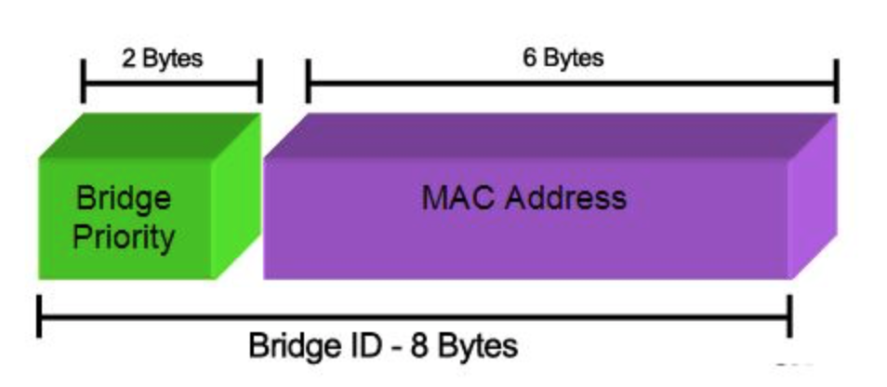
Main Concept
bridges are assigned priorities to “assist” in root election process
each switch has a unique identifier – Bridge ID:
Bridge ID = <bridge priority.(lowest)MAC address> => lowest 8 bytes
a bridge has several MAC addresses (one for each port), picks lowest one for its ID
“bridge priority.(lowest)MAC address” is the bridge ID
each port on a bridge has a unique identifier - port ID
Root Bridge:
the bridge with the lowest Bridge ID is chosen as the root of the spanning tree
Root Port:
each bridge has a root port which points in the direction of the root
this port is identified during the spanning tree process

Slide 81
Building a Spanning Tree
Root Path Cost:
for each bridge, the cost of the min-cost path to the root.
usually it is measured in #hops to the root
Designated Bridge, Designated Port:
single bridge on a LAN that provides the minimal cost path to the root bridge for this LAN:
if two bridges on a LAN have the same cost, one with lowest ID is selected
if the min-cost bridge has two or more ports on the LAN, select port with lowest port ID

Slide 82
Steps of Spanning Tree Algorithm
Determine the root bridge
Determine the root port on all other bridges
Determine the designated port on each LAN
Each bridge sends out BPDUs that contain the following information:
root ID
cost
bridge ID/port ID
root bridge (what the sender thinks it is) root path cost for sending bridge Identifies sending bridge

Slide 83
Ordering of Messages
We can order BPDU messages with the following ordering relation “<<“:
If (R1 < R2)
M1<< M2
elseif ((R1 == R2) and (C1 < C2))
M1 << M2
elseif ((R1 == R2) and (C1 == C2) and (B1 < B2))
M1 << M2
If above holds, M1 is dominant and M2 will change its information to match M1
Else M2 is dominant and M1 changes to follow M2
M1
ID R1
C1
ID B1
<
ID R2
C2
ID B2
M2

Slide 84
Determine the Root Bridge
initially, all bridges assume they are the root bridge.
each bridge B sends BPDUs of this form on its LANs:
each bridge looks at the BPDUs received on all its ports and its own transmitted BPDUs.
root bridge, at any point in time, is the smallest received root ID that has been received so far.
whenever a smaller bridge ID arrives, the root field is updated in a bridges BPDU root bridge field
otherwise bridge maintains the current value
B
0
B

Slide 85
Calculate the Root Path Cost - Determine the Root Port
for a bridge B
determine the min Root Path Cost (Cost) as follows:
if B = R : Cost = 0 (i.e., it is the root)
if B ≠ R: Cost = {Lowest Cost found in a received BPDU with R as root} + 1

Slide 86
Updating and Sharing Information
B’s root port is the port from which B received the lowest cost path to R (in terms of relation “<<‘’). E.g., port A
knowing R and Cost, B can generate a current BPDU with its root port A.
bridge B will only send its current BPDU to a neighbor if it receives “worse news” on any of its ports from that neighbor
it updates its BPDU it if receives “better news” from a neighbor on one of its ports (that port now becomes the root port) and broadcasts an updated “new” BPDU on all its non root ports.
R
Cost
B
A
Worse news
Better news
Current BPDU
BRIDGE
Update BPDU
Update BPDU

Slide 87
In Summary
whenever a bridge B generates an updated BPDU:
B will share the new information on all of its “other” ports
if B received the “better news” on port X, it will send the updated BPDU on all ports except port X
port X is now the root port
B also concludes that it is the designated bridge for the LANs connected to ports A, B, C
R
Cost
B
A

Slide 88
Example
bridge B (ID 8) receives on port “X” the following BPDU from a neighboring bridge (ID 12):
and B’s current BPDU is
because Cost 2 << Cost 3, B will broadcast on its port “X” its current BPDU to let bridge (ID 12) know it has a shorter path to the root bridge (ID 2) via port A (its current root port)
bridge with ID 12 can then decide to use bridge B for its path to the root or stick to its current choice as 2+1 = 3, cost via B, is same cost as it current choice. Bridge ID12 will use the Bridge IDs to break the tie (8 vs ?)!
if instead B’s current BPDU is:
then B will broadcast on all its other ports (A,B,C) the following BPDU:
where “4” (3+1) is new cost from Bridge B on port X to root bridge (ID 2) (via bridge ID 12). And port X is now its root port
R=2
Cost=3
12
C
R=2
Cost=2
8
A
2
5
8
A
2
3+1=4
8
X

Slide 89
Animating the previous example
F
X
A
BRIDGE12
BRIDGE8
B
R=2
Cost=3
12
C
C
R=2
Cost=2
8
A
Bridge8 BPDU is << Received BPDU from Bridge12 via port X
Bridge8 claims it has better INFO (news) (C₈=2 < C₁₂=3
Bridge8 sends its BPDU to neighboring Bridge12 via Port X
X
F
BRIDGE8
BRIDGE12
R=2
Cost=2
8
A
C
Q: What will Bridge12 do? Itsinformation came via port C from a Bridge??
BRIDGE??
A:
R=2
Cost=3
8
F
If ?? > 8 ? e.g. ?? = 20
If ?? < 8 ? e.g. ?? = 4
Changes its choice to Bridge8 to connect to Root via “F”
Retains its choice of Bridge?? to connect to Root via “C”
R=2
Cost=3
12
C

Slide 90
Animating the previous example
F
X
BRIDGE8
A
BRIDGE12
B
R=2
Cost=3
12
C
C
R=2
Cost=5
8
A
Bridge8 BPDU is >> Received BPDU from Bridge12 via port X
Bridge8 claims it has Worse news (C₈=5 > C₁₂=3)
Bridge8 UPDATES its BPDU -> C = 3 + 1 = 4, and Port to Root now is “X”
Bridge8 sends its UPDATED BPDU to its neighbors on ports A,B,C
Ports A, B, C
BRIDGE8
R=2
Cost=4
8
X

Slide 91
Selecting the Ports for the Spanning Tree
now that Bridge B has calculated the root, the root path cost, and the designated bridge and port for each LAN:
B can decide which ports are in the spanning tree:
B’s root port is part of the spanning tree (every bridge has to have a root port)
the ports on all the LANs for which B is the designated bridge are part of the spanning tree (designated ports).
B’s ports that are in the spanning tree will forward packets (=forwarding state)
B’s ports that are not in the spanning tree will not forward packets (=blocking state)
it is possible that a bridge may not be the designated bridge on any LAN (have no designated ports)
all its ports other than the root port are blocked -> blocked bridge

Slide 92
Spanning Tree example
consider the network on the right
assume that the bridges have calculated the designated ports (D), the blocked ports (B) and the root ports (R) as indicated
what is the spanning tree?
B
2
3
1
B
4
5

Slide 93
Block Diagram of Spanning Tree
D
D
B2
R
D
R
R
B1
B3
B4
B
B
D
R
B5
D
D

Slide 94
Routes to and from PCs
D
D
PC1
B2
PC1
B
R
D
R
R
2
3
B1
B3
B4
1
B
B
B
D
PC2
4
R
PC2
PC1 ping PC3?
PC2 ping PC1?
Path of ARP, ICMP
Bridge Tables
B5
5
D
D
PC3
PC3

Slide 95
Spanning Tree example
Assume S₂ ID < S₆ ID
N
S₆
d
P
r
S₅
O
b
K
r
L
M
d
d
root
S₁
S₂
d
r
d
d
r
r
S₄
A
S₃
D
F
I
B
C
E
G
H

Slide 96
Health of the Spanning Tree
consider the network on the right - if link between S₅ and S₂ goes down or S₂ fails -> tree is damaged
N
S₆
d
P
S₅ is now isolated and cannot send to, or receive traffic from, the rest of the tree
using “hello” messages, the switches will notice the failure of a component and re-calculate the spanning tree
r
S₅
O
b
K
r
L
M
d
root
X
d
S₁
S₂
d
d
d
r
r
r
S₄
A
S₃
D
F
I
B
C
E
G
H

Slide 97
Detecting and Recovering from Failures
hello messages are generated periodically by the root switch, which sends them out on each link to the next level of switches
every switch that receives a hello message, replaces the bridge ID with its own, and passes it on to the next level of switches
all switches receive the hello messages on their root ports, and forward them via their designated ports
if a switch does not receive a hello message within a certain period of time (fixed interval), it starts a “recovery” timer that is 3x the hello message interval
if that timer expires, it will assume the tree is broken and initiate the “spanning tree” process
when a problem is detected by a switch (i.e., timer expired), it resets all its ports and initiates the spanning tree algorithm by sending out a BPDU declaring itself as Root.
S₆
d
“hello”
r
S₅
0
S₅
S₅
b
r
“hello”
d
root
X
“hello”
d
S₁
S₅
0
S₅
d
“hello”
“hello”
S₂
d
r
d
r
“hello”
r
S₄
S₃
I
G
H
S₅
0
S₅

Slide 98
Switches vs. routers
application
transport
network
link
physical
both are store-and-forward:
routers: network-layer devices (examine network-layer headers)
switches: link-layer devices (examine link-layer headers)
both have forwarding tables:
routers: compute tables using routing algorithms, IP addresses
switches: learn forwarding table using flooding, learning, MAC addresses
datagram
frame
link
physical
frame
switch
network
link
physical
datagram
frame
application
transport
network
link
physical

Slide 99
VLANs: motivation
consider:
CS user moves office to EE, but wants connect to CS switch?
single broadcast domain:
all layer-2 broadcast traffic (ARP, DHCP, unknown location of destination MAC address) must cross entire LAN
security/privacy, efficiency issues
Computer
Science
Computer
Engineering
Electrical
Engineering

Slide 100
VLANs
port-based VLAN: switch ports grouped (by switch management software) so that single physical switch ……
Virtual Local
Area Network
1
7
9
15
2
8
10
16
switch(es) supporting VLAN capabilities can be configured to define multiple virtual LANS over single physical LAN infrastructure.
…
…
Electrical Engineering
(VLAN ports 1-8)
Computer Science
(VLAN ports 9-15)
… operates as multiple virtual switches
1
7
9
15
2
8
10
16
…
…
Electrical Engineering
(VLAN ports 1-8)
Computer Science
(VLAN ports 9-16)

Slide 101
Port-based VLAN
router
traffic isolation: frames to/from ports 8, 9-16 can only reach ports 8, 9-16
can also define VLAN based on MAC addresses of endpoints, rather than switch port
1
7
9
15
2
8
10
16
dynamic membership: ports can be dynamically assigned among VLANs
…
…
Electrical Engineering
(VLAN ports 1-8)
Computer Science
(VLAN ports 9-15)
forwarding between VLANS: done via routing (just as with separate switches)
in practice vendors sell combined switches plus routers

Slide 102
VLANS spanning multiple switches
1
7
9
15
1
3
5
7
2
8
10
16
2
4
6
8
…
…
Electrical Engineering
(VLAN ports 1-8)
Computer Science
(VLAN ports 9-15)
Ports 2,3,5 belong to EE VLAN
Ports 4,6,7,8 belong to CS VLAN
trunk port: carries frames between VLANS defined over multiple physical switches
frames forwarded within a VLAN between trunked switches can’t be plain Ethernet frames (must carry VLAN ID info)
802.1q protocol adds/removes additional header fields for frames forwarded between trunk ports

Slide 103
802.1Q VLAN frame format
type
preamble
dest.
address
source
address
data (payload)
CRC
802.1 frame
type
preamble
dest.
address
source
address
data (payload)
CRC
802.1Q frame
2-byte Tag Protocol Identifier
(hex value: 81:00)
Recomputed
CRC
Tag Control Information (12 bit VLAN ID field,
3 bit priority field like IP TOS)

Slide 104
Link layer, LANs: outline
6.1 introduction, services
6.2 error detection, correction
6.3 multiple access protocols
6.4 LANs
addressing, ARP
Ethernet
switches
VLANS
6.5 link virtualization: MPLS

Slide 105
Multiprotocol label switching (MPLS)
initial goal: high-speed IP forwarding using fixed length label (instead of IP address)
fast lookup using fixed length identifier (rather than shortest prefix matching)
borrowing ideas from Virtual Circuit (VC) approach
but IP datagram still keeps IP address!
PPP or Ethernet
header
IP header
remainder of link-layer frame
MPLS header
Exp: experimental
S: end of stacked MPLS labels
TTL: time to live
label
Exp
S
TTL
20
3
1
5

Slide 106
MPLS capable routers
a.k.a. label-switched router
forward packets to outgoing interface based only on label value (don’t inspect IP address)
MPLS forwarding table distinct from IP forwarding tables
flexibility: MPLS forwarding decisions can differ from those of IP
use destination and source addresses to route flows to same destination differently (traffic engineering)
re-route flows quickly if link fails: pre-computed backup paths (useful for VoIP)

Slide 107
MPLS versus IP paths
R6
D
R4
R3
R5
A
R2
IP routing: path to destination determined by destination address alone
IP router

Slide 108
MPLS versus IP paths
entry router (R4) can use different MPLS routes to A based, e.g., on source address
R6
D
R4
R3
R5
A
R2
IP routing: path to destination determined by destination address alone
IP-only
router
MPLS routing: path to destination can be based on source and destination address
fast reroute: precompute backup routes in case of link failure
MPLS and
IP router

Slide 109
MPLS signaling
modify routing protocols to carry info used by MPLS routing,
e.g., link bandwidth, amount of “reserved” link bandwidth
entry MPLS router uses RSVP-TE signaling protocol to set up MPLS forwarding at downstream routers
R6
RSVP-TE
D
R4
R5
modified
link state
flooding
A

Slide 110
MPLS forwarding tables
Note: the first and intermediate MPLS
routers on a path assign an out label
to datagrams
in out out
label label dest interface
10 A 0
in out out
label label dest interface
12 D 0
8 A 1
10 6 A 1
12 9 D 0
R6
0
0
D
1
1
R4
R3
R5
0
0
A
R2
in out out
label label dest interface
R1
in out out
label label dest interface
6 - A 0
8 6 A 0

Slide 111
Link layer, LANs: outline
6.1 introduction, services
6.2 error detection, correction
6.3 multiple access protocols
6.4 LANs
addressing, ARP
Ethernet
switches
VLANS
6.5 link virtualization: MPLS
6.6 data center networking
6.7 a day in the life of a web request

Slide 112
Link layer, LANs: outline
6.1 introduction, services
6.2 error detection, correction
6.3 multiple access protocols
64 LANs
addressing, ARP
Ethernet
switches
VLANS
6.5 link virtualization: MPLS
6.6 data center networking
6.7 a day in the life of a web request

Slide 113
Synthesis: a day in the life of a web request
journey down protocol stack complete!
application, transport, network, link
putting-it-all-together: synthesis!
goal: identify, review, understand protocols (at all layers) involved in seemingly simple scenario: requesting www page
scenario: student attaches laptop to campus network, requests/receives www.google.com

Slide 114
A day in the life: scenario
browser
DNS server
Comcast network
68.80.0.0/13
school network
68.80.2.0/24
web page
web server
Google’s network
64.233.160.0/19
64.233.169.105

Slide 115
A day in the life… connecting to the Internet
DHCP
DHCP
UDP
IP
Eth
Phy
connecting laptop needs to get its own IP address, addr of first-hop router, addr of DNS server: use DHCP
DHCP
DHCP
DHCP
DHCP
DHCP request encapsulated in UDP, encapsulated in IP, encapsulated in 802.3 Ethernet
DHCP
DHCP
UDP
IP
Eth
Phy
DHCP
DHCP
DHCP
DHCP
router
(runs DHCP)
Ethernet frame broadcast (dest: FFFFFFFFFFFF) on LAN, received at router running DHCP server
Ethernet demuxed to IP demuxed, UDP demuxed to DHCP

Slide 116
A day in the life… connecting to the Internet
DHCP
DHCP
UDP
IP
Eth
Phy
DHCP server formulates DHCP ACK containing client’s IP address, IP address of first-hop router for client, name & IP address of DNS server
DHCP
DHCP
DHCP
encapsulation at DHCP server, frame forwarded (switch learning) through LAN, demultiplexing at client
DHCP
DHCP
UDP
IP
Eth
Phy
DHCP
DHCP
DHCP
router
(runs DHCP)
DHCP
DHCP client receives DHCP ACK reply
Client now has IP address, knows name & addr of DNS
server, IP address of its first-hop router

Slide 117
A day in the life… ARP (before DNS, before HTTP)
DNS
UDP
IP
Eth
Phy
before sending HTTP request, need IP address of www.google.com: DNS
DNS
DNS
DNS
ARP
ARP query
DNS query created, encapsulated in UDP, encapsulated in IP, encapsulated in Eth. To send frame to router, need MAC address of router interface: ARP
ARP
ARP reply
Eth
Phy
ARP query broadcast, received by router, which replies with ARP reply giving MAC address of router interface
router
(runs DHCP)
client now knows MAC address of first hop router, so can now send frame containing DNS query

Slide 118
A day in the life… using DNS
DNS
UDP
IP
Eth
Phy
DNS
DNS server
DNS
UDP
IP
Eth
Phy
DNS
DNS
DNS
DNS
DNS
DNS
DNS
DNS
Comcast network
68.80.0.0/13
IP datagram forwarded from campus network into Comcast network, routed (tables created by RIP, OSPF, IS-IS and/or BGP routing protocols) to DNS server
router
(runs DHCP)
IP datagram containing DNS query forwarded via LAN switch from client to 1st hop router
demuxed to DNS server
DNS server replies to client with IP address of www.google.com

Slide 119
A day in the life…TCP connection carrying HTTP
HTTP
HTTP
TCP
IP
Eth
Phy
SYNACK
SYN
SYNACK
SYN
SYNACK
SYN
SYN
to send HTTP request, client first opens TCP socket to web server
router
(runs DHCP)
TCP
IP
Eth
Phy
TCP SYN segment (step 1 in 3-way handshake) inter-domain routed to web server
SYNACK
SYN
SYNACK
SYN
SYNACK
SYNACK
SYN
web server responds with TCP SYNACK (step 2 in 3-way handshake)
web server
64.233.169.105
TCP connection established!

Slide 120
A day in the life… HTTP request/reply
HTTP
HTTP
TCP
IP
Eth
Phy
web page finally (!!!) displayed
HTTP
HTTP
HTTP
HTTP
HTTP
HTTP
HTTP
HTTP
HTTP request sent into TCP socket
router
(runs DHCP)
IP datagram containing HTTP request routed to www.google.com
HTTP
HTTP
TCP
IP
Eth
Phy
HTTP
HTTP
HTTP
web server responds with HTTP reply (containing web page)
HTTP
web server
64.233.169.105
IP datagram containing HTTP reply routed back to client

Slide 121
Chapter 6: Summary
principles behind data link layer services:
error detection, correction
sharing a broadcast channel: multiple access
link layer addressing
instantiation and implementation of various link layer technologies
Ethernet
switched LANS, VLANs
virtualized networks as a link layer: MPLS
synthesis: a day in the life of a web request (to be done at the end of course)

