Slide 1
Chapter 4 Network Layer:
The Data Plane
A note on the use of these Powerpoint slides:
We’re making these slides freely available to all (faculty, students, readers). They’re in PowerPoint form so you see the animations; and can add, modify, and delete slides (including this one) and slide content to suit your needs. They obviously represent a lot of work on our part. In return for use, we only ask the following:
Computer Networking: A Top Down Approach
If you use these slides (e.g., in a class) that you mention their source (after all, we’d like people to use our book!)
If you post any slides on a www site, that you note that they are adapted from (or perhaps identical to) our slides, and note our copyright of this material.
Thanks and enjoy! JFK/KWR
All material copyright 1996-2016
J.F Kurose and K.W. Ross, All Rights Reserved
7th edition Jim Kurose, Keith Ross Pearson/Addison Wesley April 2016

Slide 2
Chapter 4: outline
4.3 IP: Internet Protocol
DHCP
NAT

Slide 3
DHCP: Dynamic Host Configuration Protocol
Goal: mechanism to enable a host to dynamically obtain its IP
address from a network server when it joins a network
server “leases” address to a host for a specified amount of time, host can renew the lease
address released by host when done – non permanent address
allows reuse of addresses in an address pool, reducing the number of required addresses
method by which mobile users can obtain an IP address – obtain an address upon arrival, release when moving away

Slide 4
DHCP client-server scenario
DHCP
Server sees request and responds with an IP address
DHCP
server
223.1.1.0/24
223.1.1.1
223.1.2.1
223.1.1.2
arriving DHCP
client needs
address in this
network
223.1.1.4
223.1.2.9
223.1.3.27
223.1.2.2
223.1.1.3
223.1.2.0/24
223.1.3.1
223.1.3.2
223.1.3.0/24

Slide 5
DHCP Server Scenarios
DHCP Scenarios:
a network can have a dedicated DHCP server or you can configure the local network router to act as a DHCP server
or
a DCHP server may not be on same subnet, in that case, the local router will forward the request to the DHCP server on behalf of the client, i.e., acting as a relay agent/proxy ( has to be enabled)
or
there maybe more than one DHCP server on the network.
all, or some, will respond to a client request
client picks one of the responses, usually first response that comes in and binds with that server leasing the IP address

Slide 6
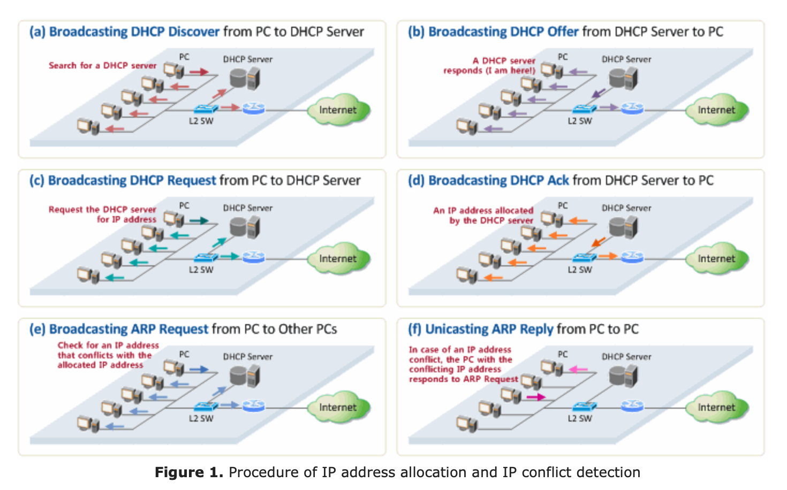
Overview of DHCP

Slide 7
DHCP: Dynamic Host Configuration Protocol
DHCP Configuration Steps:
host broadcasts “DHCP discover” msg
DHCP server responds with “DHCP offer” msg
host acknowledges server’s offer with “DHCP request” msg
DHCP server binds the IP address with “DHCP ack” msg
host broadcasts an ARP request with its allocated IP address to check if another host out there has the same IP address – a pre-caution
if conflict, reject offer and start over with a new request

Slide 8
Step 1: Search for DHCP servers & Offer
DCHP DISCOVER
DCHP OFFER

Slide 9
Discover and Offer Interactions
the client broadcasts a DHCPDISCOVER message on its local physical subnet (if server remote, router will act as proxy and forward to a server)
the DHCPDISCOVER message may include some options such as a network address suggestion and/or lease duration
the DHCP server on the network will respond with a DHCPOFFER message that includes an available network address (allocated IP address) and other configuration options.
the host may get more than one offer if there are several servers in the network
the DHCP server records the address as offered to the client to prevent that same address from being offered to other clients in the event of further DHCPDISCOVER messages being received before the first client has completed its configuration by ACKing the offer

Slide 10
What is in the Offer from Server
encapsulation of DHCP OFFER, frame forwarded to client, demuxing up to DHCP at client
DHCP
UDP
IP
Eth
Phy
DHCP
DHCP
offer more that just an IP address - client now knows its:
IP address and prefix (e.g. ,1.1.1.10/24)
lease time (e.g., 3600secs)
name and IP address of DNS server (e.g., 10.1.1.1
IP address of its first-hop router (default) (e.g., 1.1.1.1)
DHCP
DHCP
Client
IP 0.0.0.0
Mac m1
DHCP
DHCP
UDP
IP
Eth
Phy
DHCP server
IP 1.1.1.254/24
Mac m2
DHCP
DHCP
DHCP
DHCP server formulates DHCP OFFER containing client’s IP address/prefix, IP address of first-hop router for client, name & IP address of DNS server
DHCP

Slide 11
Step 2: Accepting offer from a server & ACK
DCHPREQUEST Accepts one offer
DHCPACK
Firms up lease
At this time, the DHCP client can start to use the IP address

Slide 12
Request - Accept Offer, Lease Confirmation
client accepts offer it receives from a server by sending a DHCPRequest message
the client may receive several DHCPOFFER messages from active servers.
it will choose one based on the configuration and lease parameters offered.
it broadcasts the DHCPREQUEST message that includes the server identifier indicating which offer/server it accepted
the servers receive the DHCPREQUEST broadcast from the client
all the servers not selected by the DHCPREQUEST message use the message as notification that the client has declined the offer and release the “reserved” IP address back to the pool
the selected server acknowledges the request with a DHCPACK (confirming the lease) and commits the binding
the combination of client hardware and assigned network address constitute a unique identifier for the client's lease and are used by both the client and server to identify the lease in any further DHCP messages between the server and client.

Slide 13
What is in Request from Client
DHCP request bytes encapsulated in UDP packet, encapsulated in IP datagram, encapsulated in 802.1 Ethernet frame
DHCP
DHCP
UDP
IP
Eth
Phy
DHCP
DHCP
DHCP
DHCP
Ethernet frame broadcast on LAN, received at DHCP server
DHCP
DHCP
UDP
IP
Eth
Phy
DHCP
DHCP
DHCP
DHCP server
DHCP
1.1.1.254
Ethernet frame demuxed to IP dartagram, demuxed UDP packet, demuxed to DHCP application bytes

Slide 14
Step 3: Before full commitment from Client
When the client receives the DHCPACK message confirming the configuration/leasing parameters:
the client performs a final check on the parameters with an ARP to the “your IP” address to make sure no one responds (i.e., has that address on the network
all is fine when no response comes back,
the client is now configured
the client sets a timer for the duration of the lease and notes the lease identification cookie specified in the DHCPACK message
if the client detects a problem with the parameters in the DHCPACK message (e.g., the address is already in use on the network), the client sends a DHCPDECLINE message to the server and restarts the configuration process.

Slide 15
Summary of DHCP Interactions

Slide 16
DHCP: more than IP address
DHCP returns more than just an IP address on subnet:
network mask (indicating network versus host portion of address)
its address (i.e., DHCP server)
address of first-hop (default) router for client
name and IP address of DNS server

Slide 17
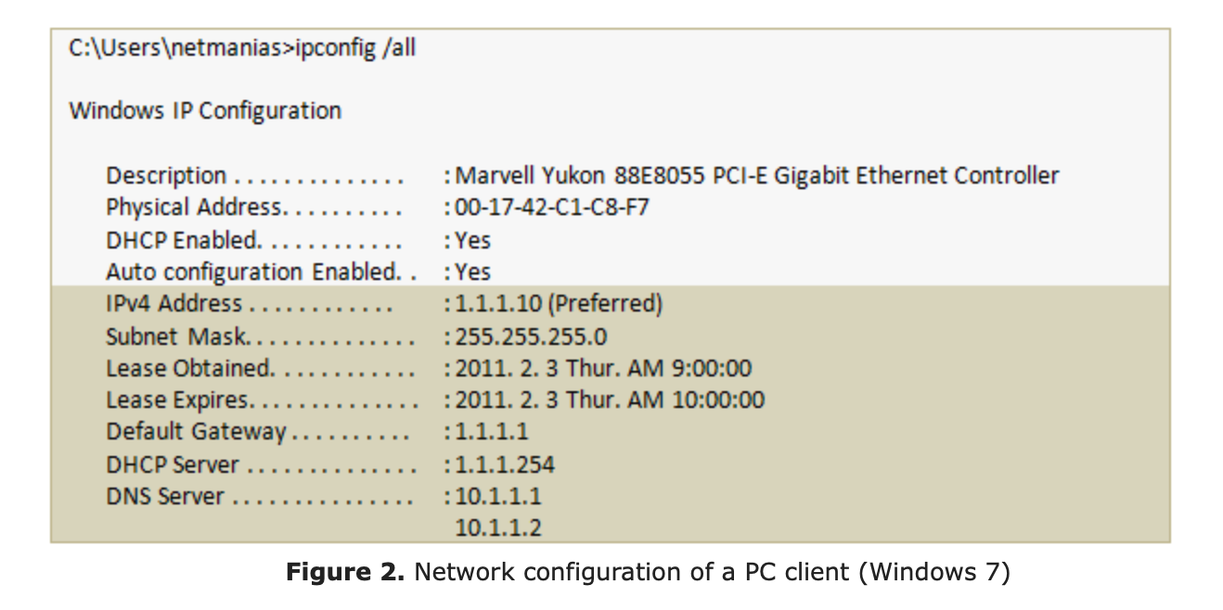
Client Configuration

Slide 18
DHCP client-server scenario
DHCP server: 223.1.2.5
DHCP discover
arriving
client
src : 0.0.0.0, 68
dest.: 255.255.255.255,67
yiaddr: 0.0.0.0
transaction ID: 654
Broadcast: is there a DHCP server out there?
Client sends broadcast message over UDP to port 67 (reserved for DHCP) on the server, from port 68, asking for IP address
DHCP server responds offering an IP address that the client can use from pool of addresses it has available.
DHCP offer
src: 223.1.2.5, 67
dest: 255.255.255.255, 68
yiaddrr: 223.1.2.4
transaction ID: 654
lifetime: 3600 secs
Broadcast: I’m a DHCP server! Here’s an IP address you can use
DHCP request
Note: there could be several DHCP servers that might respond to client.
Client chooses one to bind with and responds to that server accepting its IP address
src: 0.0.0.0, 68
dest:: 255.255.255.255, 67
yiaddrr: 223.1.2.4
transaction ID: 655
lifetime: 3600 secs
Broadcast: OK. I’ll take that IP address!
Server sends final ACK binding that IP address and blocking for x secs
DHCP ACK
src: 223.1.2.5, 67
dest: 255.255.255.255, 68
yiaddrr: 223.1.2.4
transaction ID: 655
lifetime: 3600 secs
Broadcast: OK. You’ve got that IP address!

Slide 19
DHCP client-server data exchange
DHCP server: 1.1.1.254
DHCP discover
arriving
client
src, port: 0.0.0.0, 68
dest, port: 255.255.255.255, 67
DHCPDiscover
yiaddr: 0.0.0.0
transaction ID: 654
DHCP offer
src: 1.1.1.254, 67
dest: 255.255.255.255, 68
DHCPOffer
yiaddr: 1.1.1.10/24
transaction ID: 654
DHCP serverID: 1.1.1.254
lifetime: 3600 secs
DHCP request
Messages all broadcast
IP allocation phase:
IP src: 0.0.0.0
IP destination: 255.255.255
Mac Source: client
Mac Dest: ff:ff:ff:ff:ff:ff
src: 0.0.0.0, 68
dest:: 255.255.255.255, 67
DHCPRequest
yiaddrr: 1.1.1.10/24
transaction ID: 655
DHCP serverID: 1.1.1.254
lifetime: 3600 secs
DHCP ACK
src: 223.1.2.5, 67
dest: 255.255.255.255, 68
DHCPAck
yiaddrr: 1.1.1.10/24
transaction ID: 655
DHCP serverID: 1.1.1.254
lifetime: 3600 secs
Messages now unicast
IP Usage phase:
src addr: 1.1.1.10/24

Slide 20
DHCP Set Up Messages are Broadcast

Slide 21
Step 4: Lease Renewal
Renewing a Lease (sent when 50% of lease has expired)
client sends a DHCPREQUEST to DHCP server requesting an extension
if DHCP server responds with:
DHCPACK - client gets to extend the lease for another full period
DHCPNACK – client has to release address when timer expires

Slide 22
Summary of Lease Renewal

Slide 23
Step 5: DHCP Release
the client can choose to terminate the lease at any point during the lease period by sending a DHCPRELEASE message to the DHCP server it has “lease” with.
by terminating the lease, it releases the IP address allocated to it by that server
note that not all clients will go thru the release phase, they let the lease run out
DCHP RELEASE

Slide 24
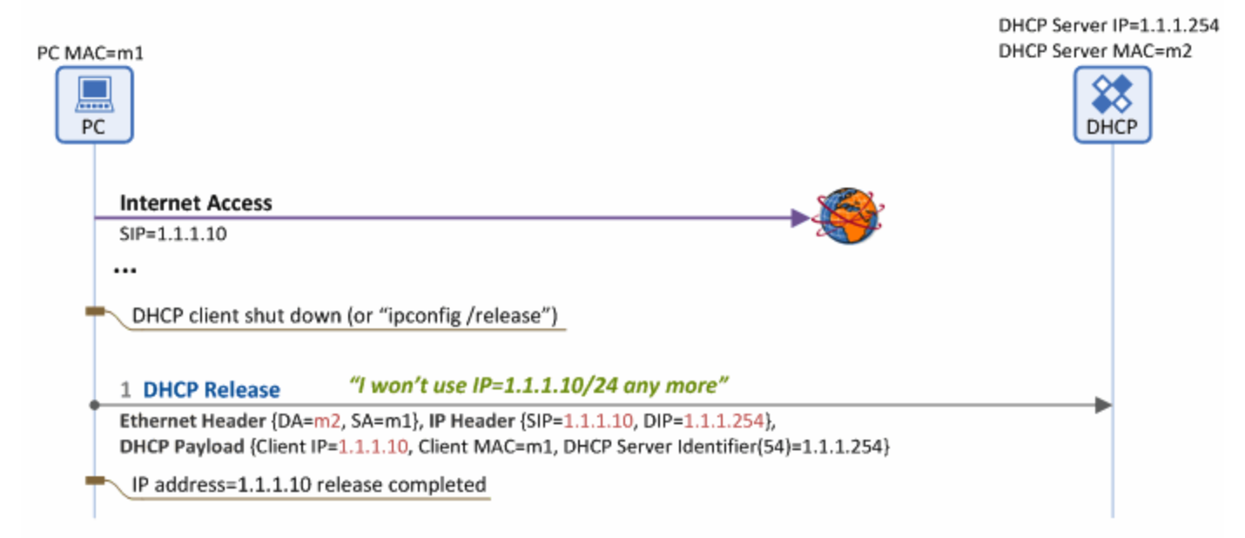
Summary of Address Release

Slide 25
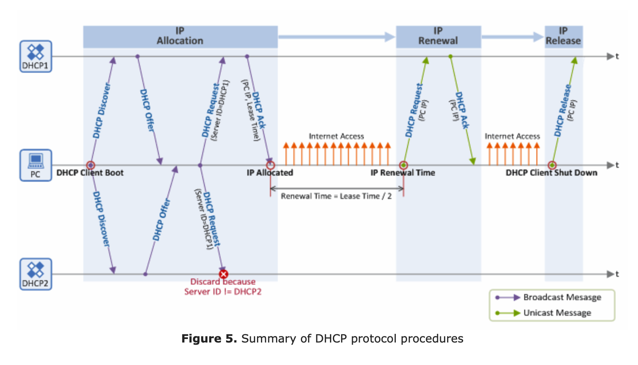
Summary of DHCP Operation

Slide 26
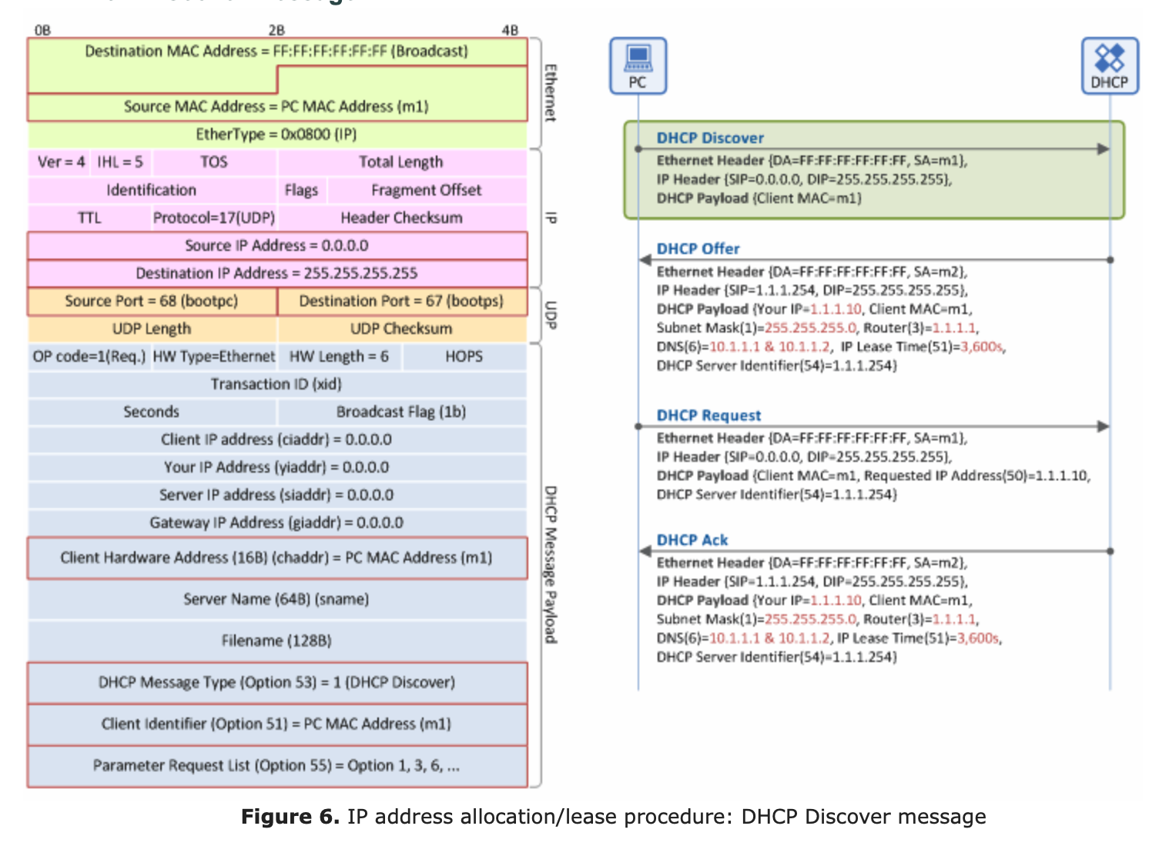
DHCP Discover Message Format

Slide 27
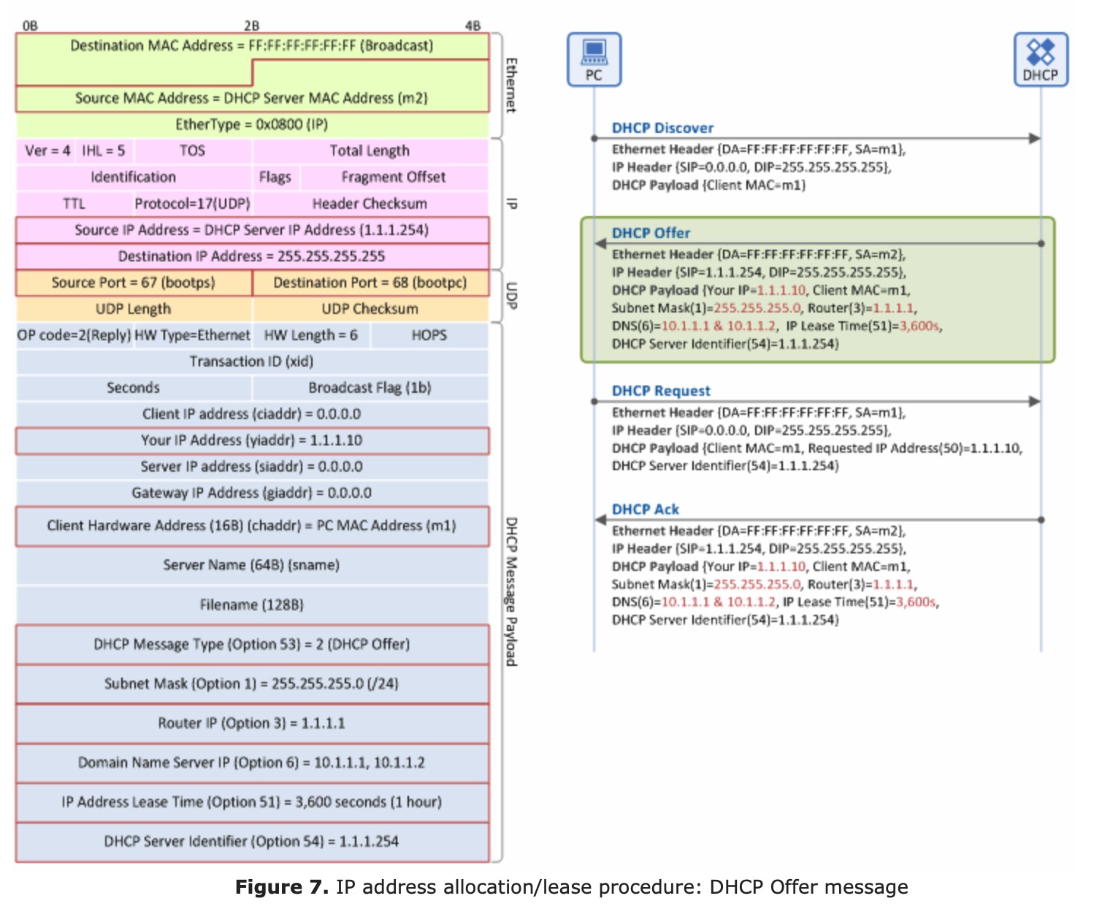
DHCP Offer Message Format

Slide 28
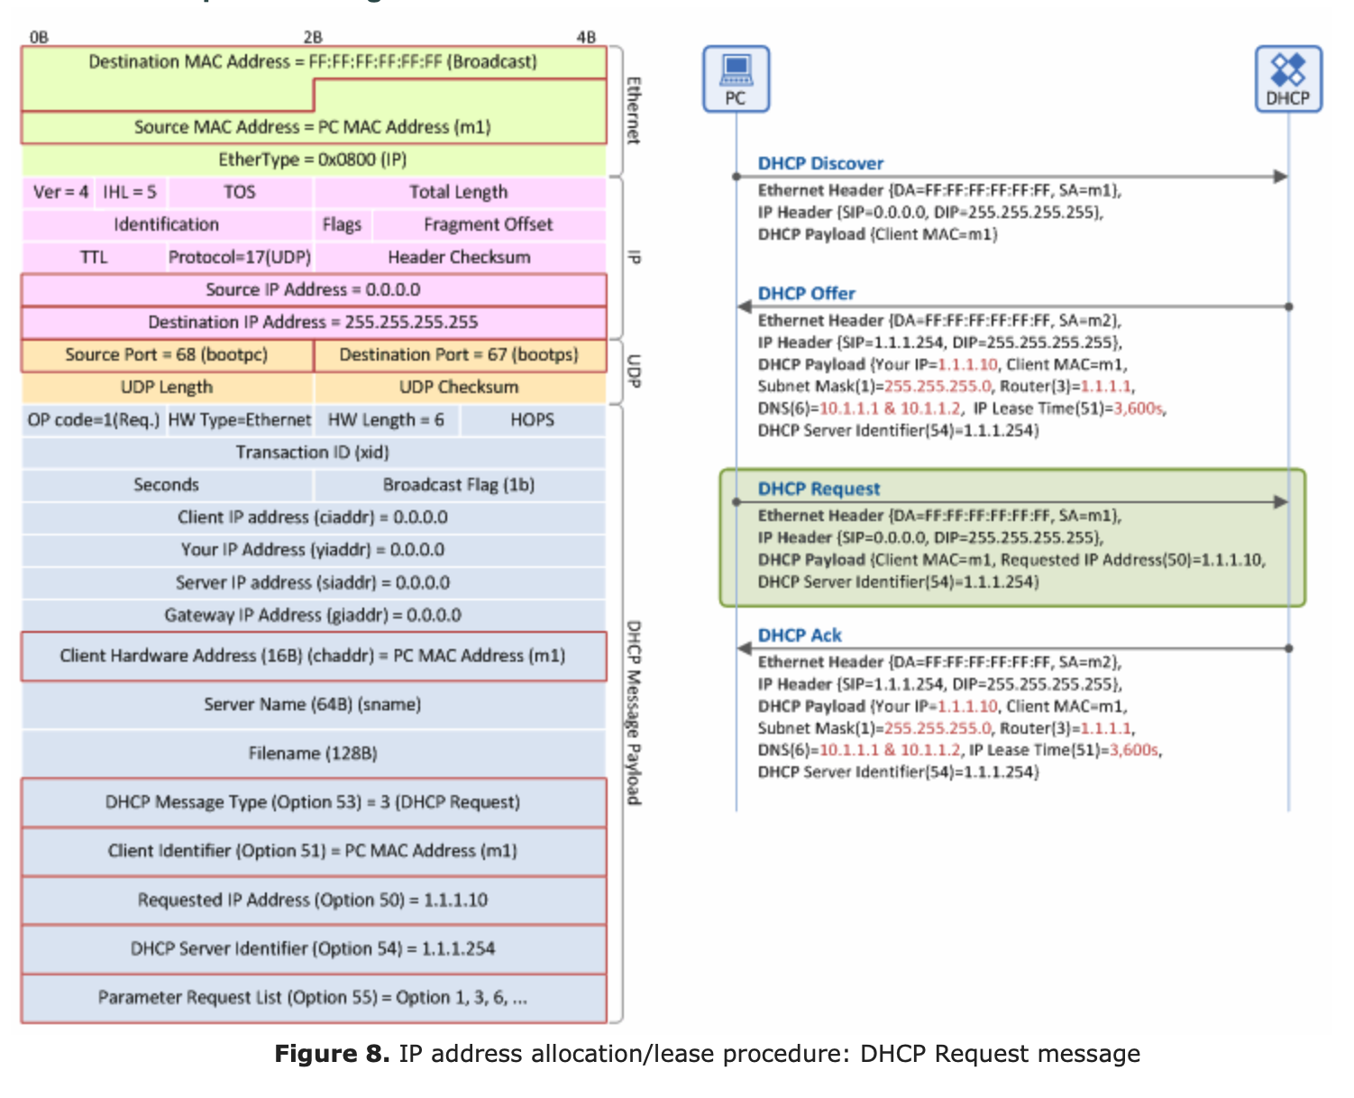
DHCP Request Message Format

Slide 29
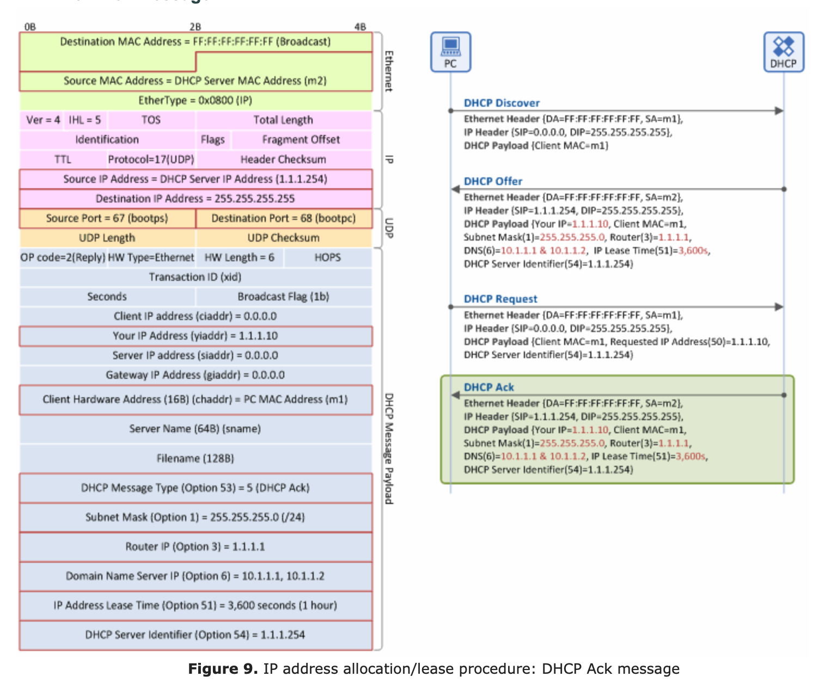
DHCPACK Message Format

Slide 30
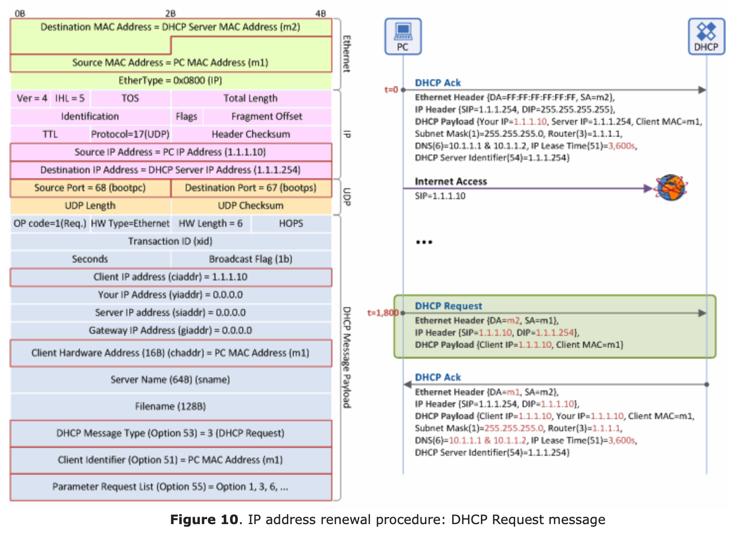
DHCP Renewal Message Format

Slide 31
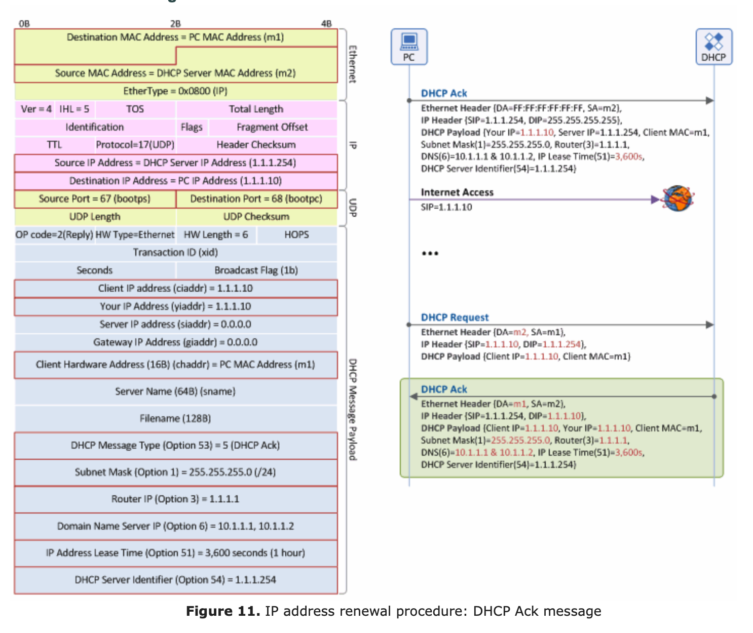
DHCP Renewal ACK Message Format

Slide 32
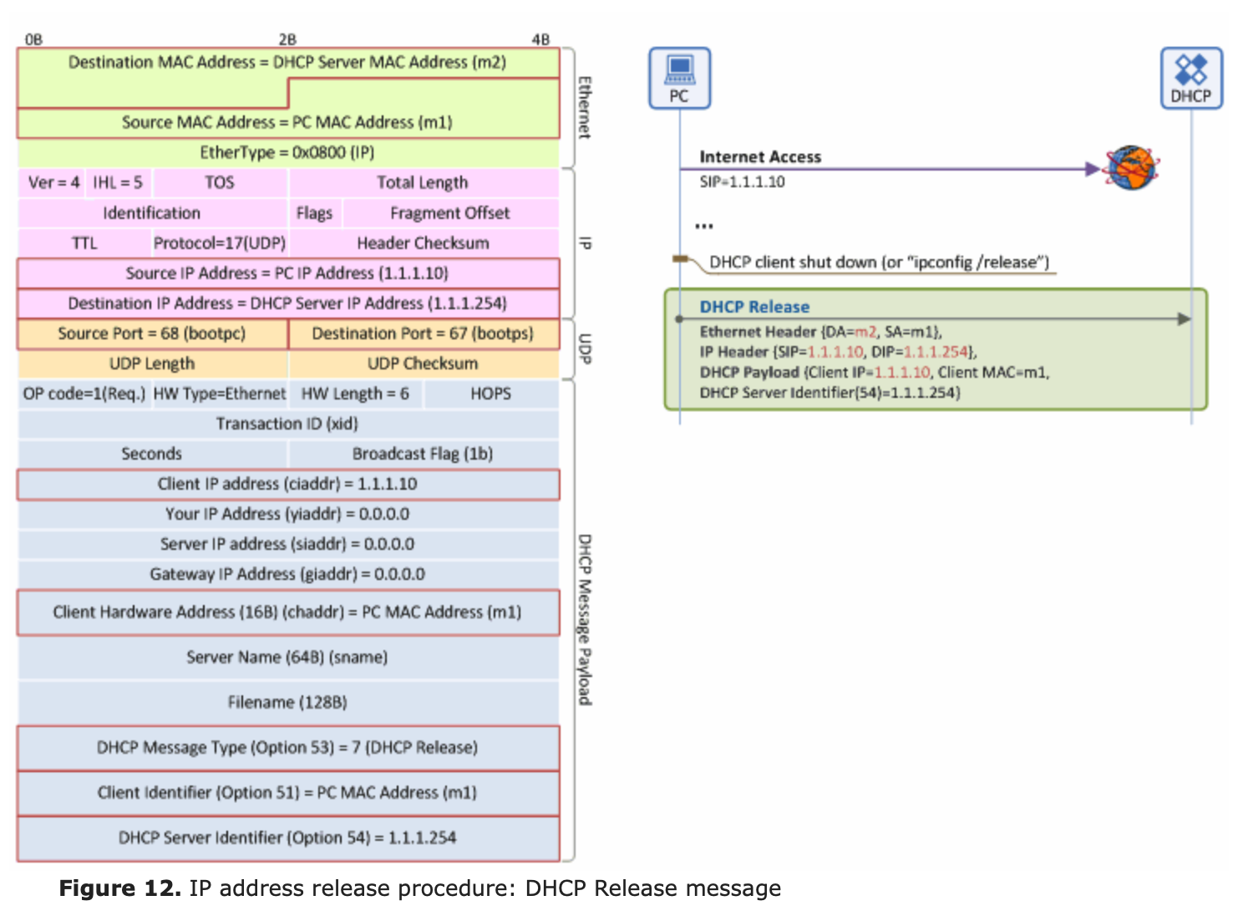
DHCP Release Message Format

Slide 33
Differences in DHCP Implementation
in some situations, the client can request a particular IP address in the “Discover” msg
if it does that, it sets the broadcast flag in the ”Discover” msg to “0”, which means, please send me ”Offer” to my requested IP address (i.e., unicast the offer to me)
if that address is available, the DHCP server will oblige, allocate requested IP address as “Your IP addr”, set the broadcast flag to “0” too, and unicast the msg to the client at that IP address
all the msgs going forward between server and client will be unicast

Slide 34
DHCP Set Up Msgs not all Broadcast

Slide 35
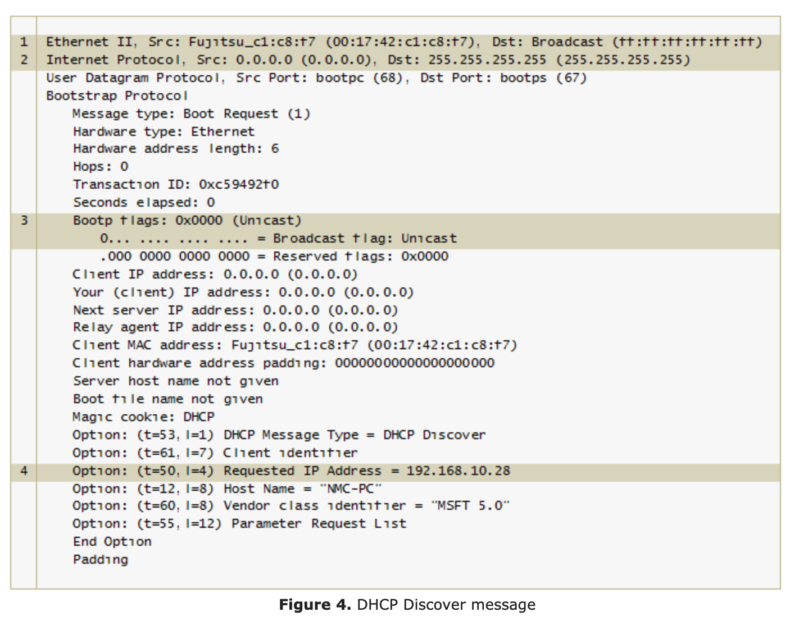
Unicasting Scenario – Discover Msg

Slide 36
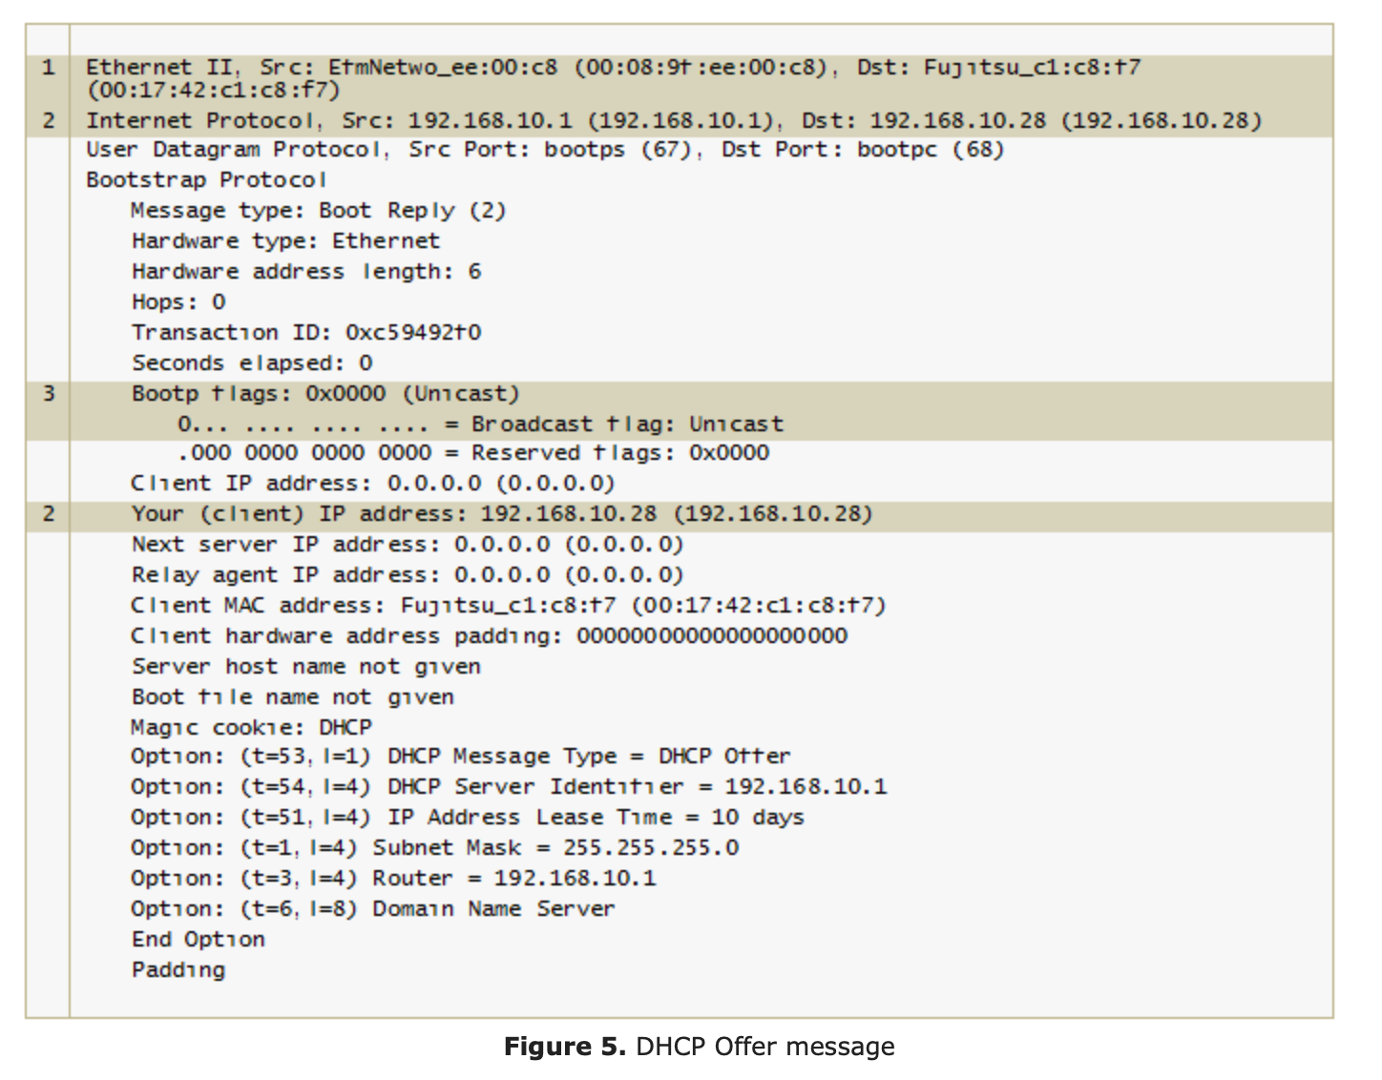
Unicasting Scenario – Offer Msg

Slide 37
DHCP Relay
Not all subnets have a DHCP server
Sometimes there is only one DHCP server for an organization
Not all routers are setup as DHCP servers on subnets
The router of a subnet with no DHCP service is then responsible for relaying the message to the DHCP server (has to be enabled, if not it will discard all DHCP broadcast messages)

Slide 38
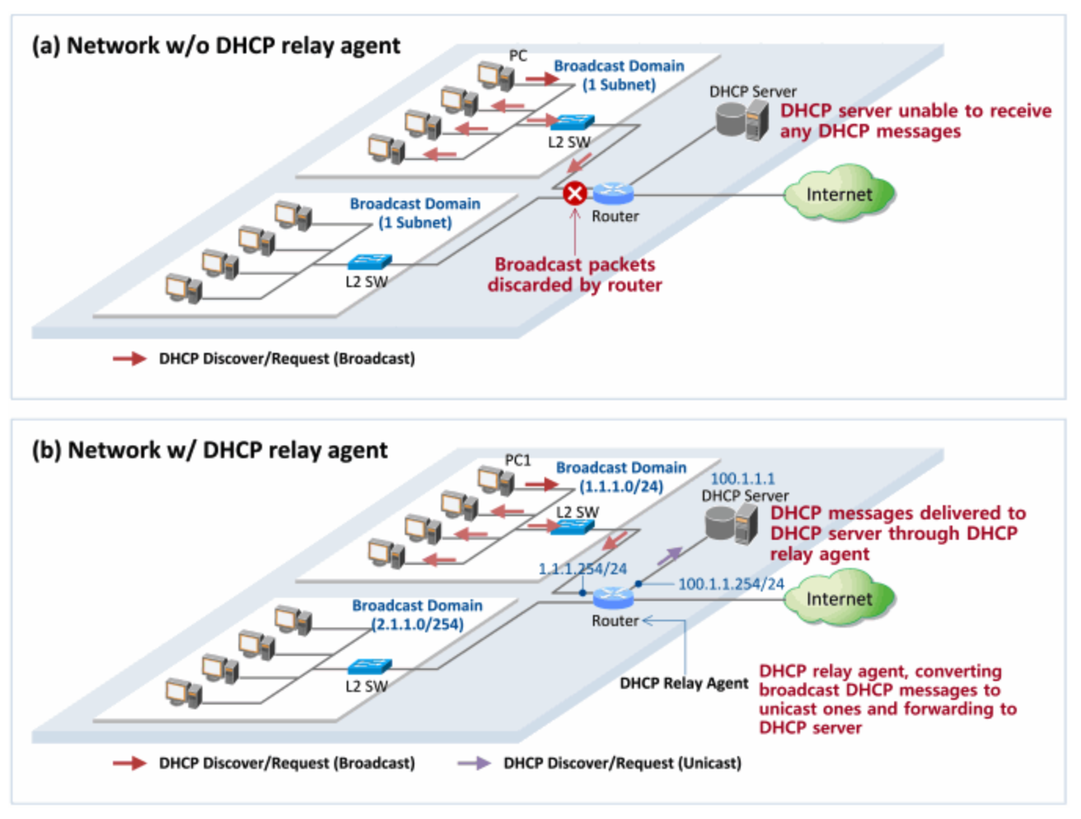
Using a Relay Agent

Slide 39
Using a DHCP Relay Agent
[DHCP client (PC) -> DHCP server] DHCP Discover Message
When a client PC broadcasts a DHCP Discover message, a DHCP relay agent receives and converts the message (SIP=DHCP Relay Agent, DIP=DHCP Server), and forwards (unicasts) it to the DHCP server (here, SIP=Source IP address, DIP=Destination IP address in IP header).
[DHCP client (PC) <- DHCP server] DHCP Offer Message
When the DHCP server unicasts a DHCP Offer message to the DHCP relay agent (SIP=DHCP Server, DIP=DHCP Relay Agent), the DHCP relay agent converts the received message and broadcasts it to the client PC (Note: messages are not broadcasted in all cases. See above).
[DHCP client (PC) -> DHCP server] DHCP Request Message
When the client PC broadcasts a DHCP Request message, the DHCP relay agent converts the received message (SIP=DHCP Relay Agent, DIP=DHCP Server), and forwards (unicasts) it to the DHCP server.
[DHCP client (PC) <- DHCP server] DHCP Ack Message
When the DHCP server unicasts a DHCP Ack message to the DHCP relay agent (SIP=DHCP server, DIP=DHCP Relay Agent), the DHCP relay agent converts and broadcasts the message to the client PC (Note: Messages are not broadcasted in all cases.).

Slide 40
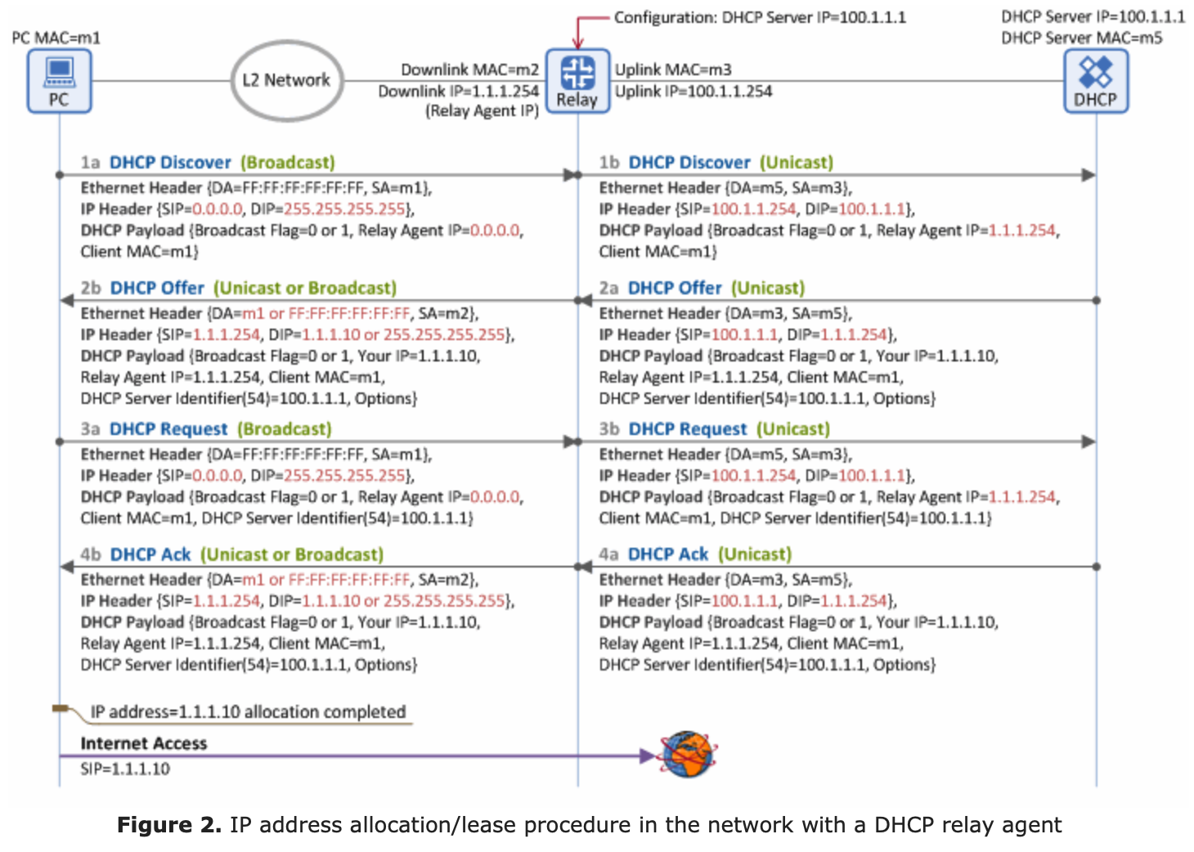
Using a Relay Agent – Getting an Address

Slide 41
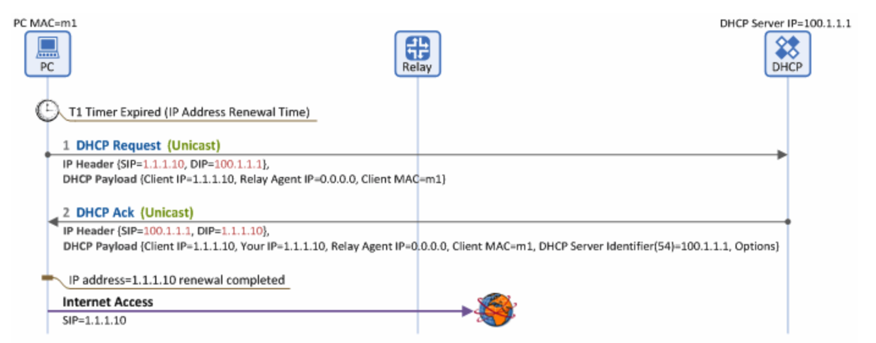
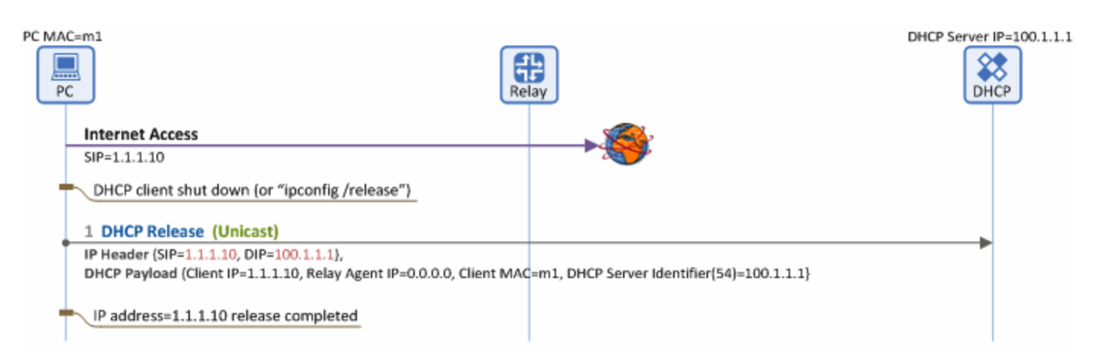
Using a Relay Agent Renewal and Release

Slide 42
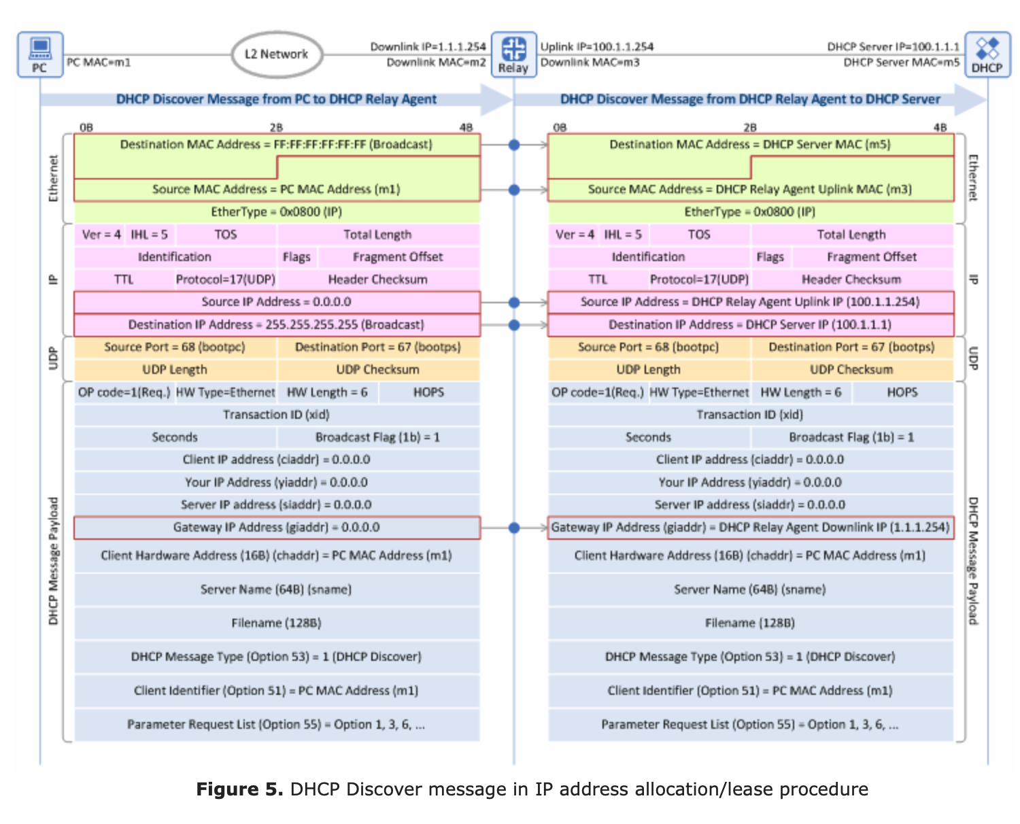
Discover Message with Relay

Slide 43
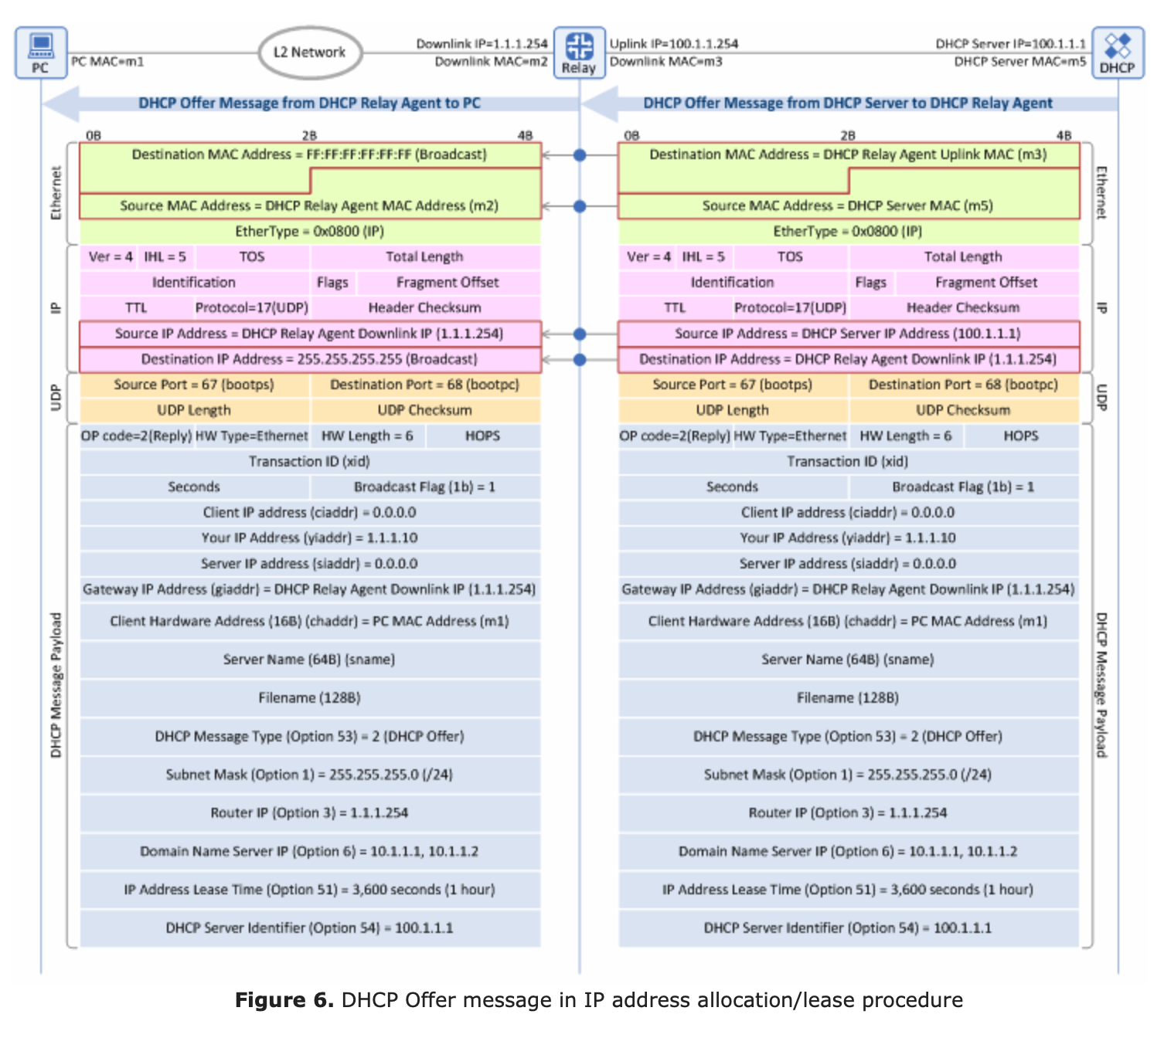
Offer Message with Relay

Slide 44
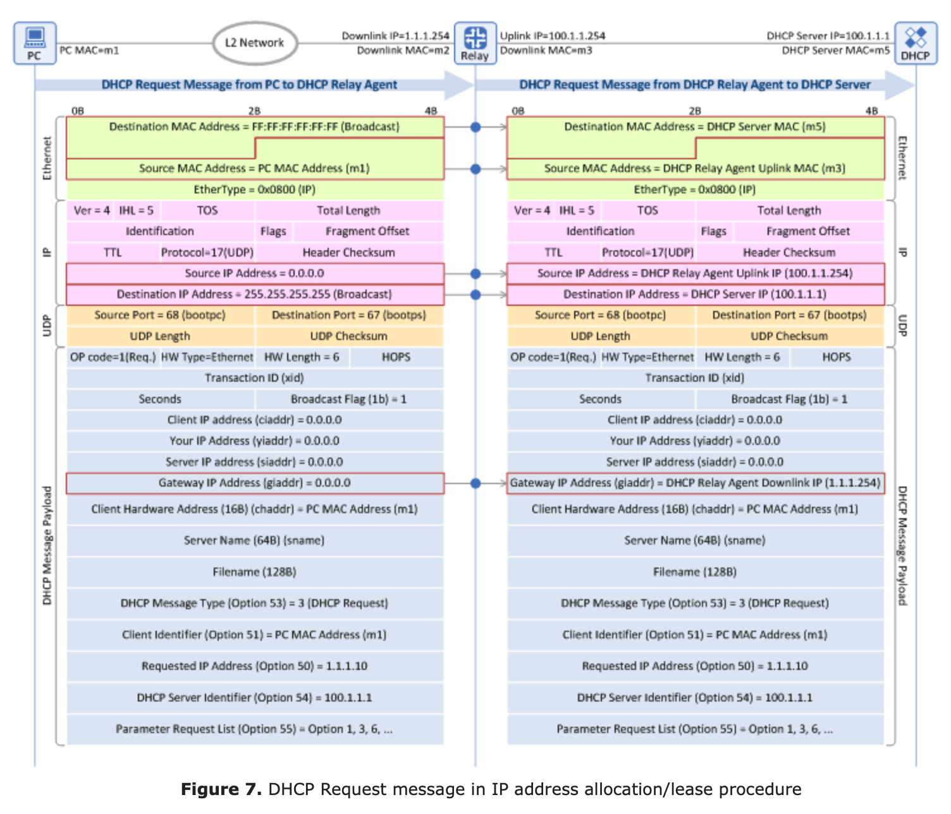
Request Message with Relay

Slide 45
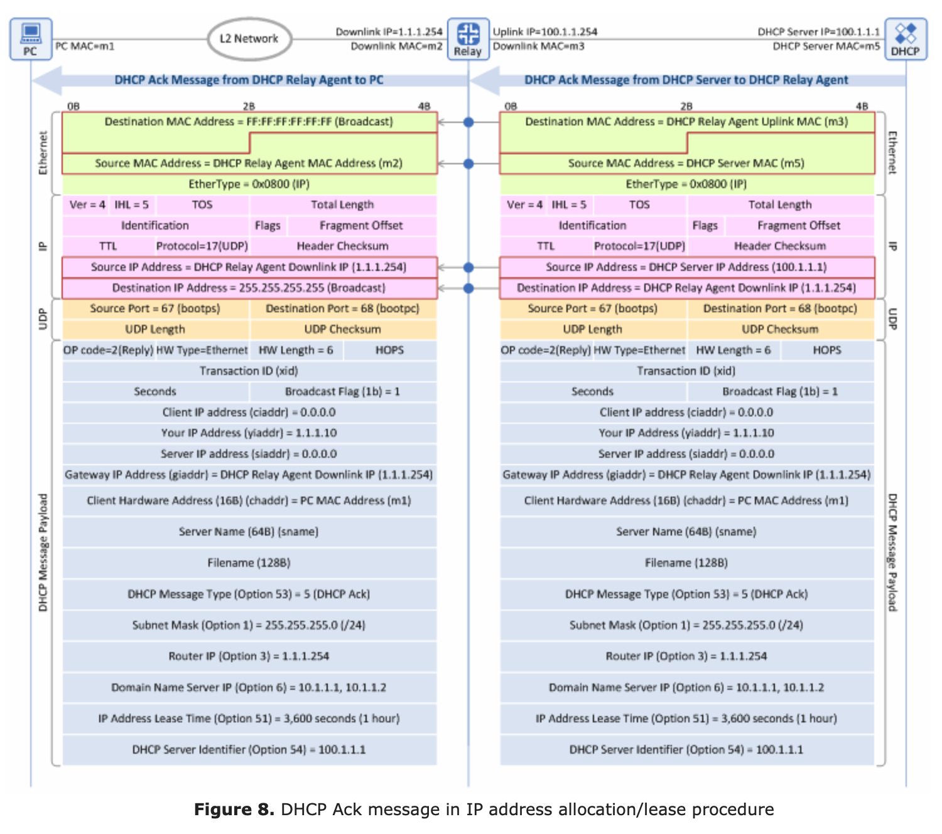
ACK Message with Relay

Slide 46
Chapter 4: Outline
4.3 IP: Internet Protocol
DHCP
NAT

Slide 47
Network Address Translation - NAT
translation from internal, hidden IP addresses, to valid, external Internet addresses
saves costs
increases the number of available addresses
secure – devices behind a firewall

Slide 48
NAT Terminology
The notion of a session:
“A session endpoint for TCP or UDP is an (IP address, port number) pair, and a particular session is uniquely identified by its two session endpoints.”
From the perspective of a host, a session is effectively identified by the 4-tuple (local IP, local port, remote IP, remote port).
The direction of a session is normally direction of the first packet that initiates the session: i.e., the initial SYN packet for TCP, or the first user datagram for UDP.
The most common type of NAT is traditional or outbound NAT - provides an asymmetric bridge between a private network and a public network.
Outbound NAT has two sub-varieties: Basic NAT, which only translates IP addresses, and Network Address/Port Translation (NAPT), which translates entire session endpoints.

Slide 49
Private Network
a Private IP network is an IP network that is not accessible to the Internet
it is closed and self contained.
IP addresses in a private network can be assigned arbitrarily
not registered and not guaranteed to be globally unique
Generally, private networks use addresses from the following experimental address ranges (non-routable addresses):
10.0.0.0 – 10.255.255.255
172.16.0.0 – 172.31.255.255
192.168.0.0 – 192.168.255.255
private networks can be connected to the Internet via a router but the devices are not directly accessible from the outside – NOT VISIBLE in Global INTERNET

Slide 50
Private Networks and IP Addresses
Private IP Addresses
Not Globally Unique
Private Networks Invisible to
Global Internet
Public IP Addresses

Slide 51
Network Address Translation (NAT)
Traditional NAT is a method that enables hosts on private networks to communicate with hosts on the public Internet
only allows private → public connections
NAT is run on routers that connect private networks to the public Internet, to
replace the IP address-port pair of an IP packet with another IP address-port pair at the boundary of a private network
Outbound Traffic – Private to Public (Private Host IP to Public IP)
Inbound Traffic – Public to Private (Public IP to Private Host IP)

Slide 52
Basic operation of NAT
Router IP address: 128.143.71.21
PUBLIC ADDRESS of PRIVATE Network
NAT device has address translation table
one to one address translation

Slide 53
Pooling of IP addresses
Scenario: Corporate network has hosts but only a small number of hosts need to connect to the global internet at any point in time – need only a few public IP addresses
NAT solution:
corporate network is managed with a private address space
NAT device, located at the boundary between the corporate network and the public Internet, manages a pool of public IP addresses
when a host from the corporate network sends an IP datagram to a host in the public Internet, the NAT device picks a public IP address from the address pool, and binds this address to the private address of the host

Slide 54
Pooling of IP addresses
Router accepts all addresses in pool:
128.143.71.0 – 128.143.71.30
128.143.71.21

Slide 55
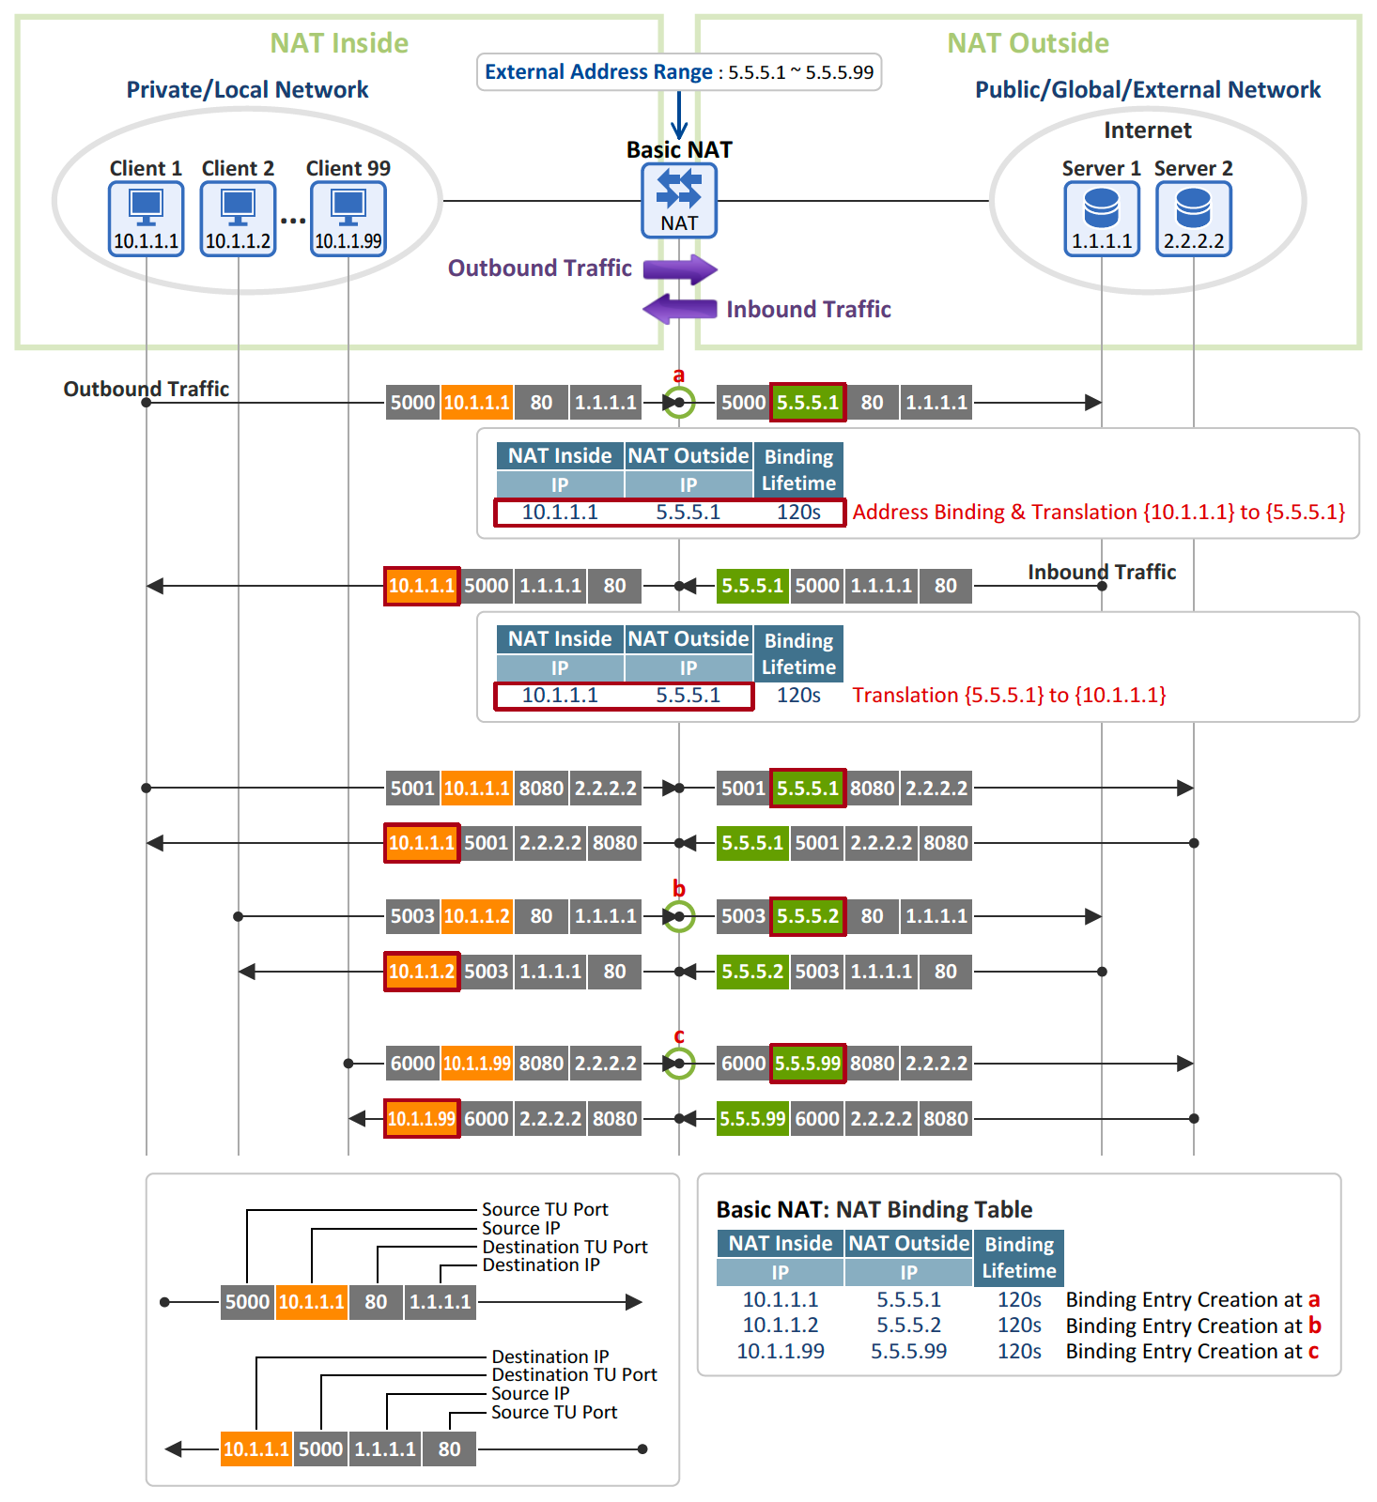
Several Device Pooling

Slide 56
Supporting migration between network service providers
Scenario: The IP addresses of a corporation are obtained from a service provider. Changing the current service provider to another requires changing all IP addresses in the network
NAT solution:
assign private addresses to the hosts of the corporate network
NAT device has static address translation entries which bind the private address of a host to an individual public address
migration to a new network service provider merely requires an update of the NAT device – change the IP bindings in its table. The migration is not noticeable to the hosts on the network
Note:
the difference to the use of NAT with IP address pooling is that the mapping of public and private IP addresses is static

Slide 57
Supporting migration between network service providers
x

Slide 58
IP Masquerading – Most Common NAT
Common names: Network Address and Port Translation (NAPT), Port Address Translation (PAT)
Scenario: Single public IP address is mapped to multiple hosts in a private network
NAT solution:
assign private addresses to the hosts of the corporate network
NAT device modifies the port numbers for outgoing traffic

Slide 59
IP Masquerading

Slide 60
NAT: network address translation
NAT translation table
WAN side addr LAN side addr
2: NAT router
changes datagram
source addr from
10.0.0.1, 3345 to
138.76.29.7, 5001,
updates table
1: host 10.0.0.1
sends datagram to
128.119.40.186, 80
138.76.29.7, 5001 10.0.0.1, 3345
…… ……
S: 10.0.0.1, 3345
D: 128.119.40.186, 80
10.0.0.1
1
2
S: 138.76.29.7, 5001
D: 128.119.40.186, 80
10.0.0.4
10.0.0.2
138.76.29.7
S: 128.119.40.186, 80
D: 10.0.0.1, 3345
4
S: 128.119.40.186, 80
D: 138.76.29.7, 5001
3
10.0.0.3
4: NAT router
changes datagram
dest addr from
138.76.29.7, 5001 to 10.0.0.1, 3345
3: reply arrives
dest. address:
138.76.29.7, 5001
* Check out the online interactive exercises for more examples: http://gaia.cs.umass.edu/kurose_ross/interactive/

Slide 61
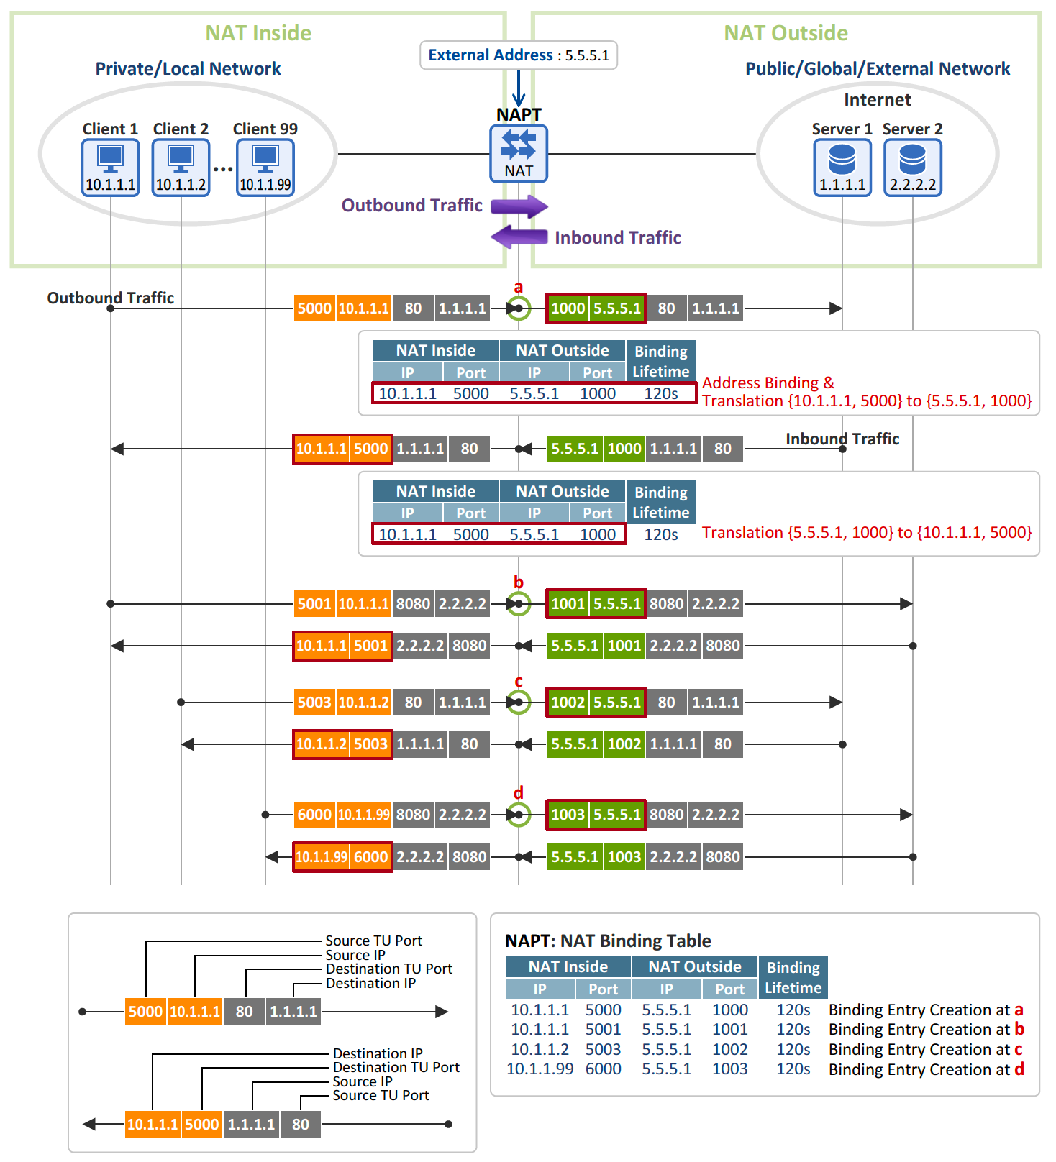
Several Device NAPT

Slide 62
Load balancing of servers
Scenario: Balance the load on a set of identical servers that represent ONE service to the outside world. Service is accessible via a single IP address
NAT solution:
the servers are assigned different private addresses
NAT device acts as a proxy for requests to the Server from the public network
the NAT device changes the destination IP address of arriving packets to one of the private addresses of a Server
a sensible strategy for balancing the load of the servers is to assign the addresses of the servers in a round-robin fashion

Slide 63
Load balancing of servers
This is a situation where one public address is shared by several machines
inside a private network for the sole purpose of load balancing.
Public Source
Address
Source: 213.168.12.3
Destination: 10.0.1.4
Here we see that IP address 128.143.71.21 is shared by several machines and is the address assigned to the “Server” as seen from the outside world.
The NAT device uses a round robin technique to distribute the incoming requests to the servers.
The source addresses of incoming requests are used to distinguish between the traffic streams connected to the internal servers.

Slide 64
Many “Other” Possible NAT Scenarios
Public host wants to reach a host on a private network
Two clients reside behind the same NAT, on one private network
The clients reside behind different NATs, different private networks
The clients each reside behind two levels of NAT: a common “first-level”NAT deployed by an ISP for example, and distinct “second-level” NATs such as consumer NAT routers for home networks
Complex Scenarios!

Slide 65
NAT: Public Services and P2P
NAT gateways can route traffic that is addressed to a host behind a NAT device ONLY if it has a public IP address allocated to it (i.e., directly/uniquely mapped to its internal address – a one-to-one mapping)
services such as Web hosting, FTP, can be addressed by the one-to-one mapping of a specific IP address
P2P services inside private networks (Skype, Spotify, etc.) cannot be hosted unless a specific server in the public network, called a moderator/tracker/rendezvous is used to serve as a go between/relay to set up the connection

Slide 66
Solving the “Inbound” NAT Problem
The key lies to making machines inside a private network, i.e., behind a NAT gateway, reachable from the outside, (i.e., the public Internet) –> traversing the NAT device
one of the most effective methods of establishing peer-to-peer communication between hosts on different private networks is known as “hole punching”
unfortunately, no NAT traversing technique works with all existing NATs, because NAT behavior is not standardized
hole punching uses NAPT
A detailed article on Hole Punching:
https://bford.info/pub/net/p2pnat/

Slide 67
P2P - Public to Private Connection
Scenario one peer is in the public domain and the other peer is in a private network. Peer in public wants to connect to peer in private
the application on the public host has to force the host in the private network (i.e., behind the NAT gateway) to initiate a connection to the public host, that is seeking to connect to the host in the private network
since NAT gateways allow inbound traffic, i.e., replies to requests originating from the inside
we need to mimic a scenario in which the target (private) host is poked to originate the connection to the outside host so that the outside host can send its connection request as “inbound traffic”.
in other words, the connection request from the public host to the private host should seem like (i.e., masquerade as) a reply to the host in the private network
→ “Connection Reversal”

Slide 68
Traversal By Connection “Reversal” Using a Server
Going from a host/peer on the public IP internet to a host/peer on a private network with no dedicated public IP address allocation/mapping
if B (public host) wants to initiate a connection to A (private host), any direct connection attempt to A will not be routed by the Internet as A does not have a valid IP address
use a “rendezvous” server, listening on a global IP address through a persistent TCP or UDP connection
the two client hosts, A and B, each initiate persistent TCP or UDP connections to a well-known “rendezvous” server S, at S’s public IP address YY and a predetermined port number XX
B relays a connection request to A through the server S, asking A to attempt a “reverse” connection back to B
when A, receives the request, it initiates a connection to B
this connection attempt works because B is not behind a NAT and A’s NAT interprets the connection as an outgoing session
B can now send its application request to A
B’s communication appears as inbound traffic to host A to the NAT gateway and the connection between the two hosts can proceed

Slide 69
Connection Reversal
Switch a Public to Private connection to a Private to Public connection
request Private to initiate the connection
request sent via Server S
Public to Private

Slide 70
P2P both behind NAT - Relaying
Relaying - A reliable, but least efficient method for P2P communication across a NAT, is simply to make the communication look to the network like standard client/server communication, by relaying via a “rendezvous” server
two private hosts, A and B, each initiate persistent TCP or UDP connections to a “rendezvous” server S, at S’s public IP address YY and a predetermined port number XX
the two clients simply use the server S to relay messages between them along along their already-established client/server connections,
server S forwards the messages in both directions
connections (TCP and UDP) have to be persistent
NAT times out UDP NAPT connections, host has to continue sending “keep alive” UDP packets to the server to maintain the connection
TCP session has to be kept alive too

Slide 71
Relaying with a Server: Different NATs

Slide 72
Relaying with a Server: Same NAT
Same NAT
Why use relaying?
With a /8 prefix the clients can find each other
DHCP - addresses not fixed, Server S may use other host identifying means

Slide 73
Eliminating the Server Relaying Function Hole Punching – UDP P2P applications
UDP hole punching enables two clients to set up a direct P2P UDP session with the help of a well-known “rendezvous” server, even if the clients are both behind NATs
eliminates the “rendezvous” server function after connection setup.
hole punching assumes that the two clients, A and B, already have active UDP sessions with a “rendezvous” server S
when a client registers with S, the server records two endpoints for that client:
the (IP address, UDP port) pair that the client is using to talk with router – private pair
the (IP address, UDP port) pair that the server observes the client to be using to talk with it the server S - public pair
we refer to the first pair as the client’s private endpoint and the second as the client’s public endpoint.

Slide 74
Obtaining the Clients’ Private and Public Addresses
The “rendezvous” server S will obtain:
the client’s private endpoint from the client itself in a field in the body of the client’s registration message
and
obtain the client’s public endpoint from the source IP address and source UDP port from the in the IP and UDP headers of the registration message.

Slide 75
Hole Punching Using Endpoints
Different NATS
Public
End Point
Private
End Point

Slide 76
Hole Punching Using End Points
Same NAT
Why use relaying?
With a /8 prefix the clients can find each other
DHCP - addresses not fixed, Server S may use other host identifying means
Public
End Point
Private
End Point

Slide 77
UDP Hole Punching
A initially does not know how to reach B, so A asks S for help establishing a UDP session with B.
S replies to A with a message containing B’s public and private endpoints. At the same time, S uses its UDP session with B to send B a connection request message containing A’s public and private endpoints. Once these messages are received, A and B know each other’s public and private endpoints.
When A receives B’s public and private endpoints from S, A starts sending UDP packets to both of these endpoints, and subsequently “locks in” whichever endpoint first elicits a valid response from B.
Similarly, when B receives A’s public and private endpoints in the forwarded connection request, B starts sending UDP packets to A at each of A’s known endpoints, locking in the first endpoint that works.
The order and timing of these messages are not critical as long as they are asynchronous.
If both A and B are on the same NAT device the private endpoints will work as they will respond first.
If they are not, then only the public endpoints will work to connect.

Slide 78
Hole Punching Process – Same NAT
Each Client has a live registered session with Server S
Which Connection??
Internal or External?

Slide 79
After Hole Punching: Same NAT

Slide 80
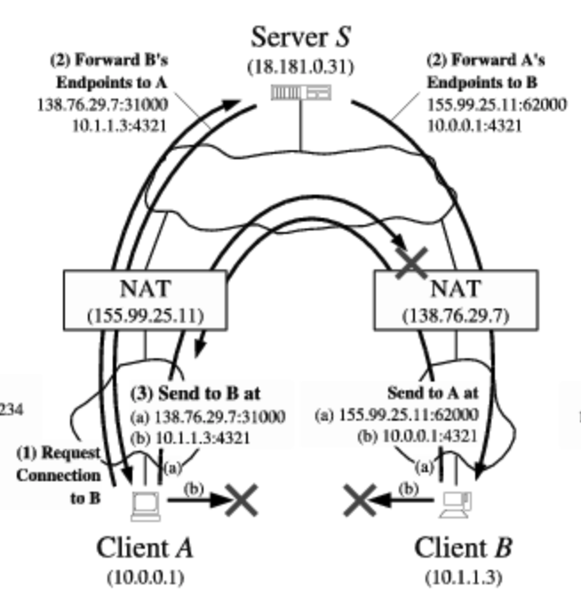
Hole Punching Process – Different NATs
Which Connection?
Private wont work - Different NATs

Slide 81
After Hole Punching: Different NATs
Public
Session A-B
Connection - A to Router 10.0.0.1 155.99.25.11
Connection - Router to Router 155.99.25 138.76.29.7
Connection - Router to B 138.76.29.7 10.1.1.3

Slide 82
NAT Pros
local network uses just one IP address as far as outside world is concerned:
range of addresses not needed from ISP: just one IP address for all devices
can change addresses of devices in local network without notifying outside world
can change ISP without changing addresses of devices in local network
Inherent/built in security - devices inside local net not explicitly addressable/visible by outside world

Slide 83
NAT Cons
16-bit port-number field:
60,000 simultaneous connections with a single LAN-side address!
NAT is controversial:
routers should only process up to layer 3
address shortage should be solved: -> IPv6
violates end-to-end argument
NAT existence and usage must be taken into account by app designers, e.g., P2P applications (rendezvous servers, addresses in payload, etc.)

