Slide 1

Governor’s Office of
Homeland Security & Emergency Preparedness
Business
EOC

Slide 2
The Emergency Management Process
LEGEND
State
Agency
Assets
Status Feedback
ESF
Contracts
Rents
etc.
Request for Support
Business
EOC
Parish
EOC
State
Operations
Federal
Assistance
Parish
Assets
EMAC
State
To State
Assets
Contracts
Rents
etc.

Slide 3
Support Request To State
Request Methodology
Primary: WebEOC
Other: FAX, Phone, e-mail,
800/700 MHz Statewide
radio, Satellite phone
ESF-7 Unified Logistics
Business EOC
  VOAD
  Private Industry
  Faith Based
Provides
Support & Tracks
Request
Receives, Validates,
Authorizes &
Tracks Support
Status
Request
Maintain Linkage
Status
Request For Support
Provide SITREP

Slide 4

Unified Command
Structure
Unified Command Group
GOHSEP EOC
Operations
Section
GOHSEP
Plans & Intel
Section
GOHSEP
LANG
GOHSEP
DOA
Unified
Logistics
Section
Admin &
Finance
Section
GOHSEP
LANG
DOA
Human
Services
Branch
DSS
DHH
Plans &
Intelligence
Branch
LANG
GOHSEP
LSP
Support
Branch
LANG
GOHSEP
Purchasing
& Contracting
Branch
DOA
GOHSEP
Emergency
Services
Branch
GOHSEP
LSP
Technical
Specialist
Branch
Services
Branch
LANG
GOHSEP
Accounting,
Budget,
Audit & Doc
Branch
DOA
GOHSEP
NWS
USGS
USCG
USACE
LSUES
LSU CERA
Infrastructure
Support
Branch
DOTD
LPSC
NIMSAT
Business
EOC
NIMSAT
SDMI
LA-VOAD
Transportation
Pre-Storm
Evacuation
Branch
DOTD
LSP
(DSS
DHH)
LANG
Military
Support
Branch
Notes:
LSU CERA – Coastal Emergency Risk Assessment

Slide 5




www.LABEOC.com
Louisiana Business Emergency Operations Center
A Partnership Of

Slide 6
Need to Enhance Collaboration
LABEOC
Nonprofit/
Philanthropic Sector
Public Sector
Private Sector

Slide 7
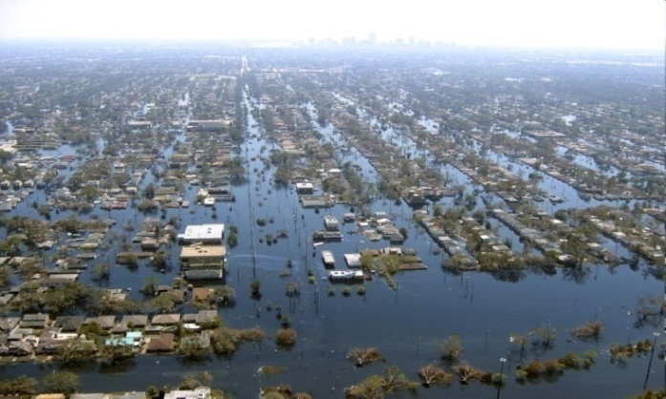
Private Sector
Disaster Recovery and Resiliency are directly connected to the private and nonprofit sector
Owns 98% supply chains and distribution networks
Operates 85% of Critical Infrastructures and Key Resources (CIKR)
Has the expertise and assets, but unable to support without organized direction
Notes:
After Katrina and Rita, started getting calls regarding gaps in tools. Would have been better to plan prior to the event. Saw the same thing with Gustav and Ike.
2. Post-Katrina we quickly saw the opportunity to bring private sector best-practices into the public sector’s approach to disaster management..
EX: Wal Mart able to get in to Slidell faster than government
Lack of access made solving problems more difficult – saw that had we had access, we could have worked more quickly and communicated useful information…

Slide 8
LABEOC Mission
To support disaster management in Louisiana by developing an accurate understanding of economic impacts to critical infrastructures and major economic drivers, as well as facilitating the coordination of businesses and volunteer organizations with the public sector through enhanced resource and information management.
Through the Louisiana BEOC, the State of Louisiana will improve disaster preparedness and response, reduce reliance on FEMA and other federal assistance, thereby maximizing business, industry and economic stabilization, returning the business environment to normal operations as quickly as possible.

Slide 9
Proposed Organizational Summary
B-EOC Incident Commander
Deputy Incident Commander
PIO
Technical Services Staff
Operations Section
Planning Section
Logistics Section
Business Analysis
Communications
Business Ops Branch
Security/Safety
VOAD Ops Branch
Time Keeping
Admin/Finance

Slide 10
LaBEOC Goals
Goal 1: Facilitate bi-directional communication of critical information between the public sector and businesses to acquire comprehensive situational awareness
Goal 2: Coordinate voluntary donations from businesses, VOADs and individuals
Goal 3: Maximize the use of Louisiana businesses, or national private sector resources, to provide needed emergency unplanned products and services
Goal 4: Assist GOHSEP Unified Logistics Element (ULE) team in coordinating products and services with Louisiana, regional, and national businesses & their supply chains

Slide 11
LaBEOC Goals
Goal 5: Estimate economic impacts of the disaster to LED-identified major economic drivers across the state, as well as to GOHSEP-identified Critical Infrastructure and Key Resources (CIKR) assets, and the resulting impacts to the state and national economy.
  Reach out to businesses through LED and GOHSEP regional teams (pre-disaster) as well as through the BEOC portal (post-disaster) to capture operational status and impacts
  Identify critical roadblocks to recovery

Slide 12

Information Collected from Businesses
Willingness to Participate
Post-storm Status
Supply Chain Disruptions
Critical Recovery Needs
Availability of Products and Services for Possible Government Contracts
Individual Economic Impact

Slide 13

Summary: LaBEOC Objectives
Serve as situational awareness communications hub
Manage donations from businesses, VOAD’s and individuals
Determine ability of Louisiana’s private sector resources to support disaster response – faster, cheaper!
Assist GOHSEP ULE in coordinating pre-qualified vendors for contracting
Coordinate the assessment of economic impact on affected businesses and communities

Slide 14
Governor’s Office of
Homeland Security & Emergency Preparedness
Business
EOC

