Slide 1
USC Institute for Creative Technologies
Randall W. Hill, Jr., Ph.D.
Executive Director
The projects or efforts depicted were or are sponsored by the U.S. Army Research, Development, and Engineering Command (RDECOM) Simulation Training and Technology Center (STTC). The content or information presented does not necessarily reflect the position or the policy of the Government, and no official endorsement should be inferred.
Notes:
OLD NOTES: This summer marks the 10th anniversary of the Institute for Creative Technologies. It was established at the University of Southern California as a university affiliated research center under the sponsorship of the United States Army.
The ICT has a strategic relationship with the Army and with DOD – our charter is to be responsive to Army needs and to perform world class research that revolutionize the way training is performed. This is all done in partnership with the Simulation & Training Technology Center in Orlando, and with RDECOM.
Remarkable progress has been made, both in terms of scientific advancement and the application of the resulting technologies to military problems.
Today I will give you a glimpse of the technology and its applications to training.

Slide 2
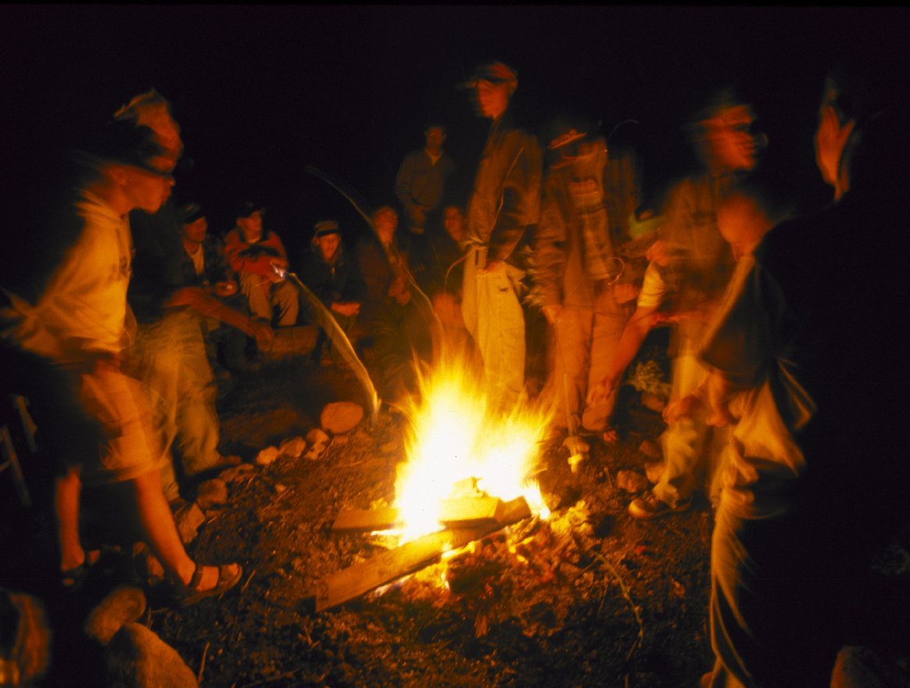
ICT
What We Do
Develop high-tech tools and merge them with classic storytelling to pioneer new ways to teach, train and interact.
Stories are the creative conversion of life itself into a more powerful, clearer, more meaningful experience. They are the currency of human contact.
- Robert McKee
Notes:
ICT is where storytelling meets simulation. Our brains are wired to enjoy and remember stories. Stories affect our emotions and they are memorable. They also happen to be the most ancient way of passing knowledge from human to human. “There have been great societies that did not use the wheel, but there are no societies that did not tell stories.” Ursula Le Guin
Yet this is where the DOD found itself in 1997. Billions of dollars were being invested in training simulators but something was missing – immersion – they were boring. They were dull.
This was where the idea for the ICT was born – what if you could take the power of storytelling and merge it with an advanced simulator? And what if we could advance the state of the art of the simulations themselves so that one could create synthetic experiences so compelling that the participants react as though the simulation is real? Could we create experiences that engage the mind, the body and the emotions, that will result in learning that is deep and that sticks? This was what was behind the genesis of ICT as an Army-sponsored research center.

Slide 3
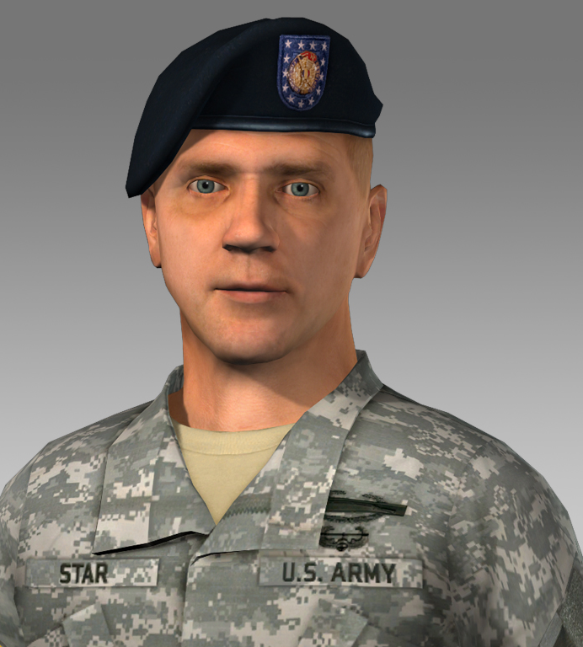
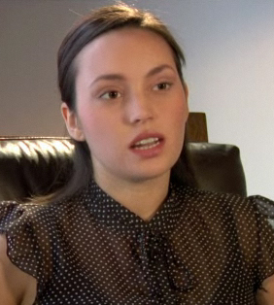
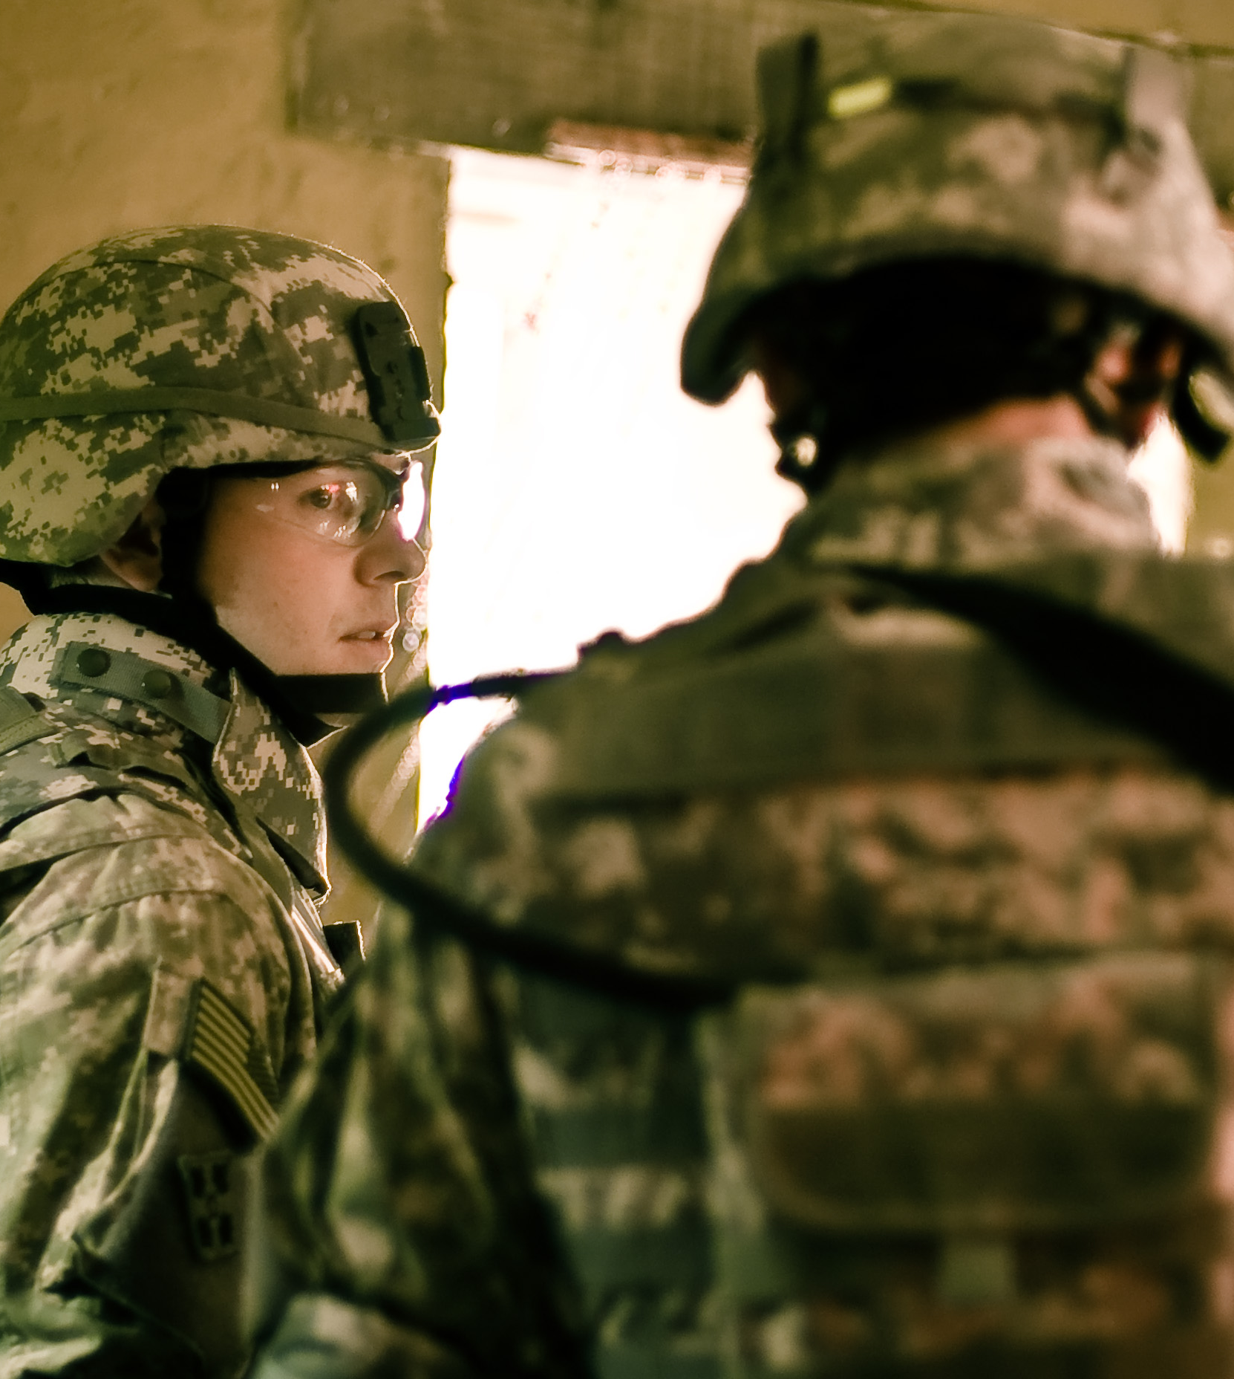
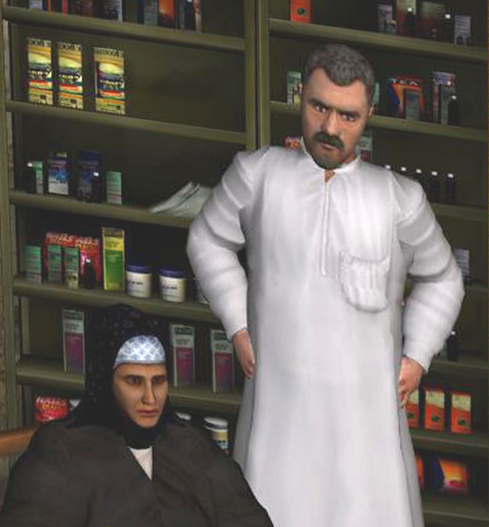
Core Areas
Immersion
Virtual Humans
Graphics
Games & Simulation
Narrative & Storytelling
Learning Sciences
Notes:
OLD NOTES:
To accomplish this vision and this mission, our research program is structured around six pillars –
Immersion – to engage all the human senses
VH –to inhabit the virtual world and to engage in person to person interaction
Graphics – to engage the visual sense with highly realistic environments, objects and people
Games & simulation – platforms for delivering an interactive experience, but the design principles that make them especially engaging.
Narrative & storytelling – pervasive use of storytelling, one of the oldest and most engaging forms of virtual on the planet
Learning sciences – we seek to make the engaging experience and effective learning experience.

Slide 4
UrbanSim
Cognitive Training for Command in Complex Operations

Slide 5
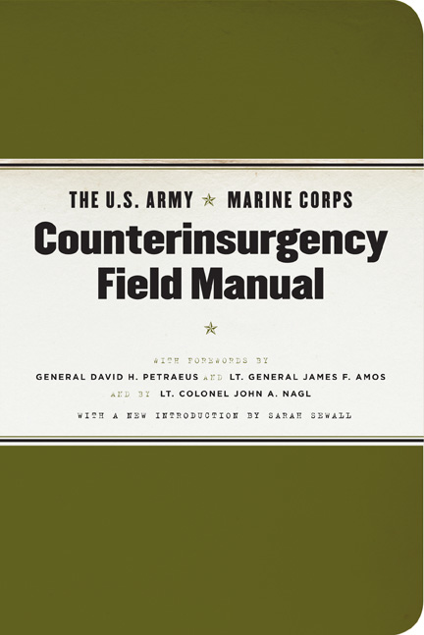
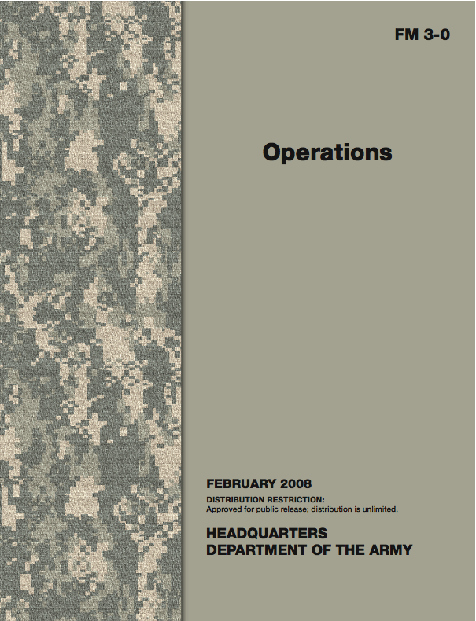
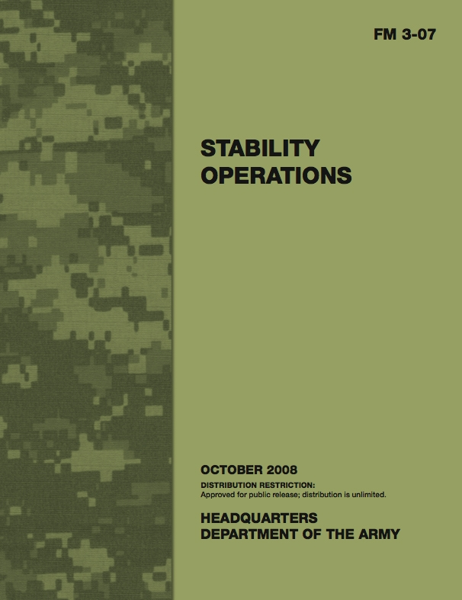
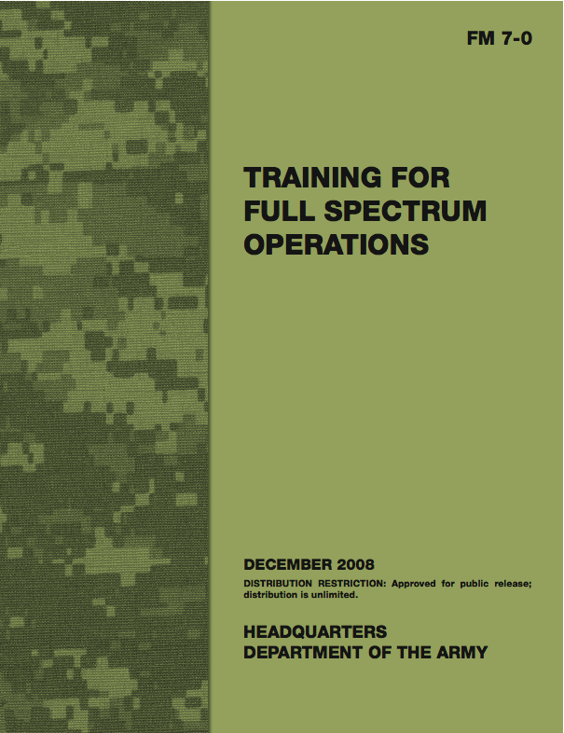
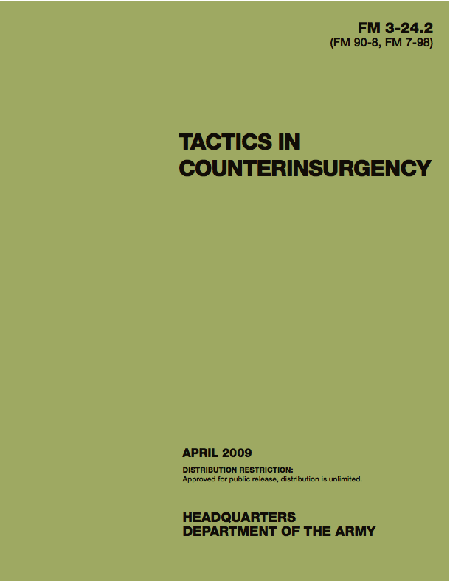
Problem / Solution
Problem: Simulation-based training for complex operations
Shift toward stability and counterinsurgency operations
Doctrine has changed, Instruction has changed
New training technologies are needed now
Solution: UrbanSim Learning Package
A multimedia primer and game-based practice environment
A cognitive training tool for practicing the art of battle command
the new doctrine of counterinsurgency

Slide 6
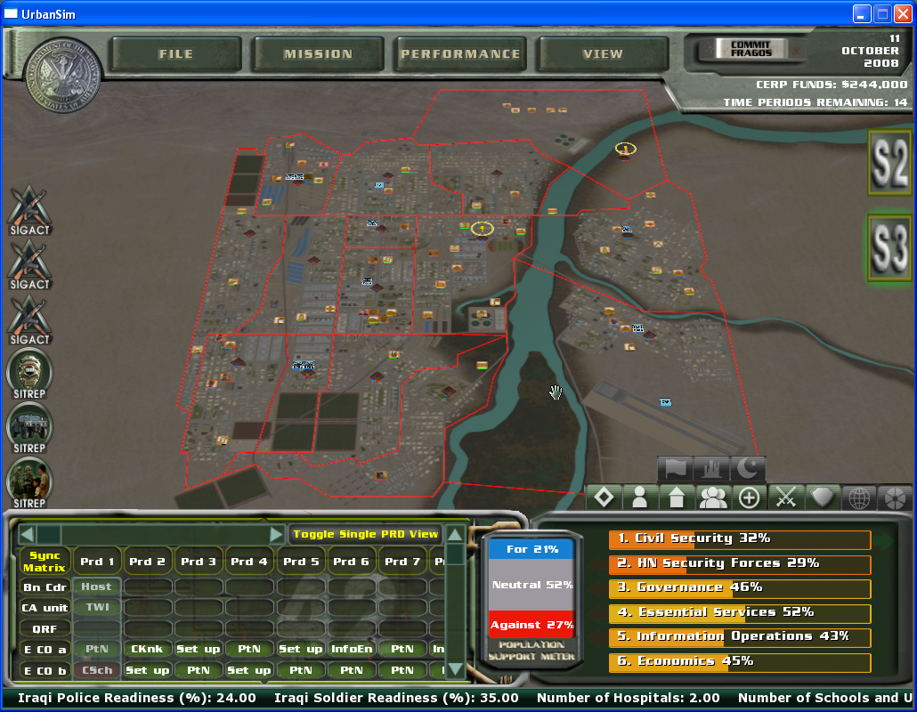
UrbanSim Learning Package
Primer: Web-based multimedia instruction on stability and counterinsurgency
Practice Environment: Game-based cognitive trainer

Slide 7
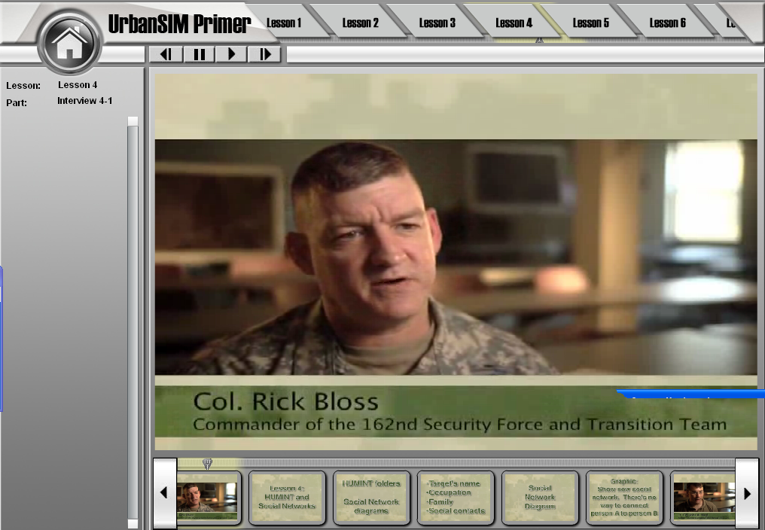
UrbanSim Primer
Web-based multimedia instruction
Fundamentals of counterinsurgency and stability operations
8 Primer Lessons
Population is the center of Gravity
Brigade Commander’s Products
Intelligence gathering and analysis
HUMINT & Social networks
Battalion Commander’s products
Anticipating 2nd and 3rd order effects
Executing a COIN operation
COIN Assessment
Concept introduction / Doctrine / Practical application / Application in UrbanSim

Slide 8
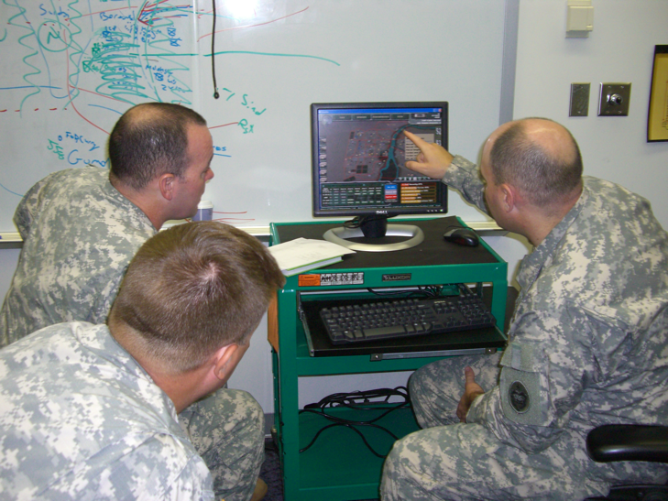
UrbanSim Practice Environment
Student to practice a complex operations, from planning through to assessment
Analogous to a turn-based strategy game
e.g. Civilization, Age of Empires
e.g. SimCity for Iraq and Afghanistan
Targets battalion and brigade commanders
esp. Students at School for Command Prep
Applicable to other echelons and staff officers
Military Decision Making Process (MDMP) and art of battle command
Plan, Prepare, Execute, Assess
Understand, Visualize, Describe, Direct, Lead, Assess
Varied use cases
2 students, collaborative learning
Significant role for classroom instructor
Used over 3 days of instruction

Slide 9
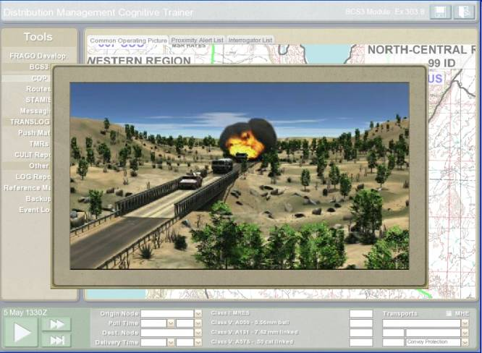
UrbanSim
DMCTI
Instructional Primer
Battalion Commanders practice
Developing situational understanding
Directing action
Assessing performance
Anticipate 2nd and 3rd order effects
Game-based, cognitive tool for training logisticians
Analysis
Planning
Decision making
Winner of 2008 Army Annual Modeling & Simulation Award

Slide 10
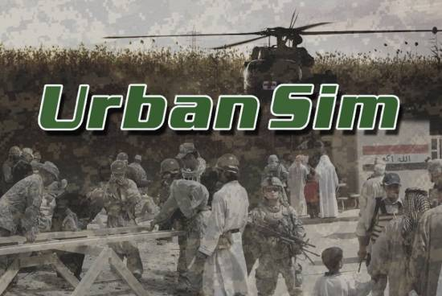
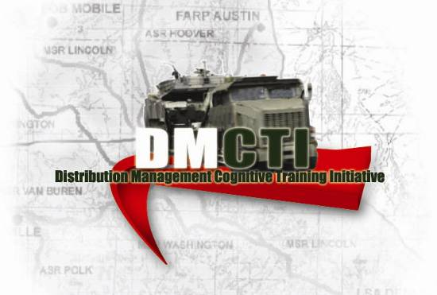
Systems Loosely Joined for Training
Systems Loosely Joined for ACTION
Ground
Truth
Storytelling
Notes:
Situational awareness, planning and decision making in disaster relief operations
Common architecture and delivery

Slide 12
Research & Development Portfolio for 2010
BASIC RESEARCH
APPLIED RESEARCH
PROTOTYPE/DEMO
Virtual Humans
Mixed Reality (MxR)
Development
Emotions
Speech Recognition
Nonverbal Behavior Understanding
Process and Knowledge
Representation
Natural Language Understanding
Behavior and Gesturing
Cognitive Architecture
Integrated Virtual Humans
Digital Backlot
UrbanSIM
Story Representation Management
Military Terrain for Games Pipeline (MTGP)
Mixed Reality (MxR)
Virtual Officer Leadership Trainer (VOLT)
Social Simulation
COSMOS
Immersive Naval Officer Training
System (INOTS)
Graphics
Coming Home
(TOPPS-VW)
Mobile Counter-IED Interactive
Trainer (MCIT)
Multi-view Facial Geometry
Facial Cartography
3D Display Systems
Learning Sciences
FITE JCTD
SimCoach
Learning Sciences
Virtual Patient
Pedagogical
Catalysts
BRAVEMIND PTSD Therapy
VR Cognitive Performance
Aptitude Test
Assessing & Improving Design
Virtual Interpersonal Skill Trainer
Fallen Eagle – Ethics Movies
Technologies for Accelerated Continuous Learning (TACL)
IGEL
Tutoring for Practice
Notes:
Virtual Officer Leadership Trainer (VOLT)

Slide 13
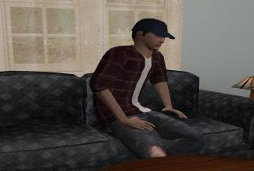
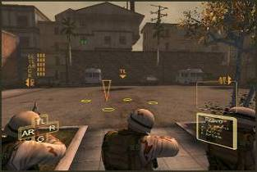
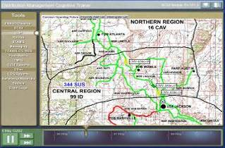
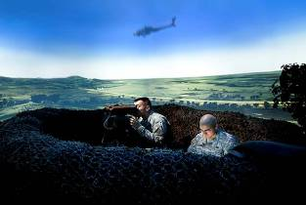
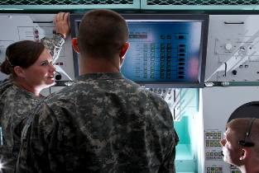
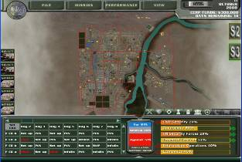
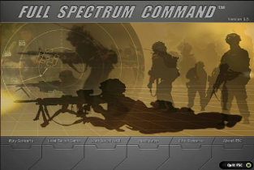
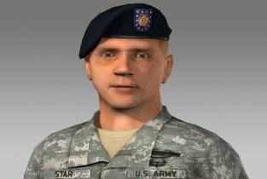
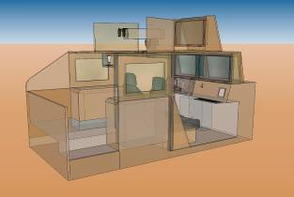
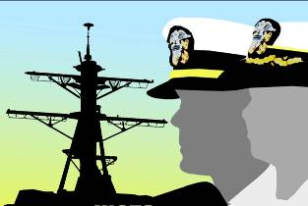
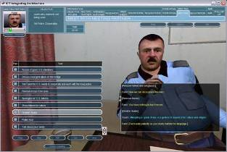
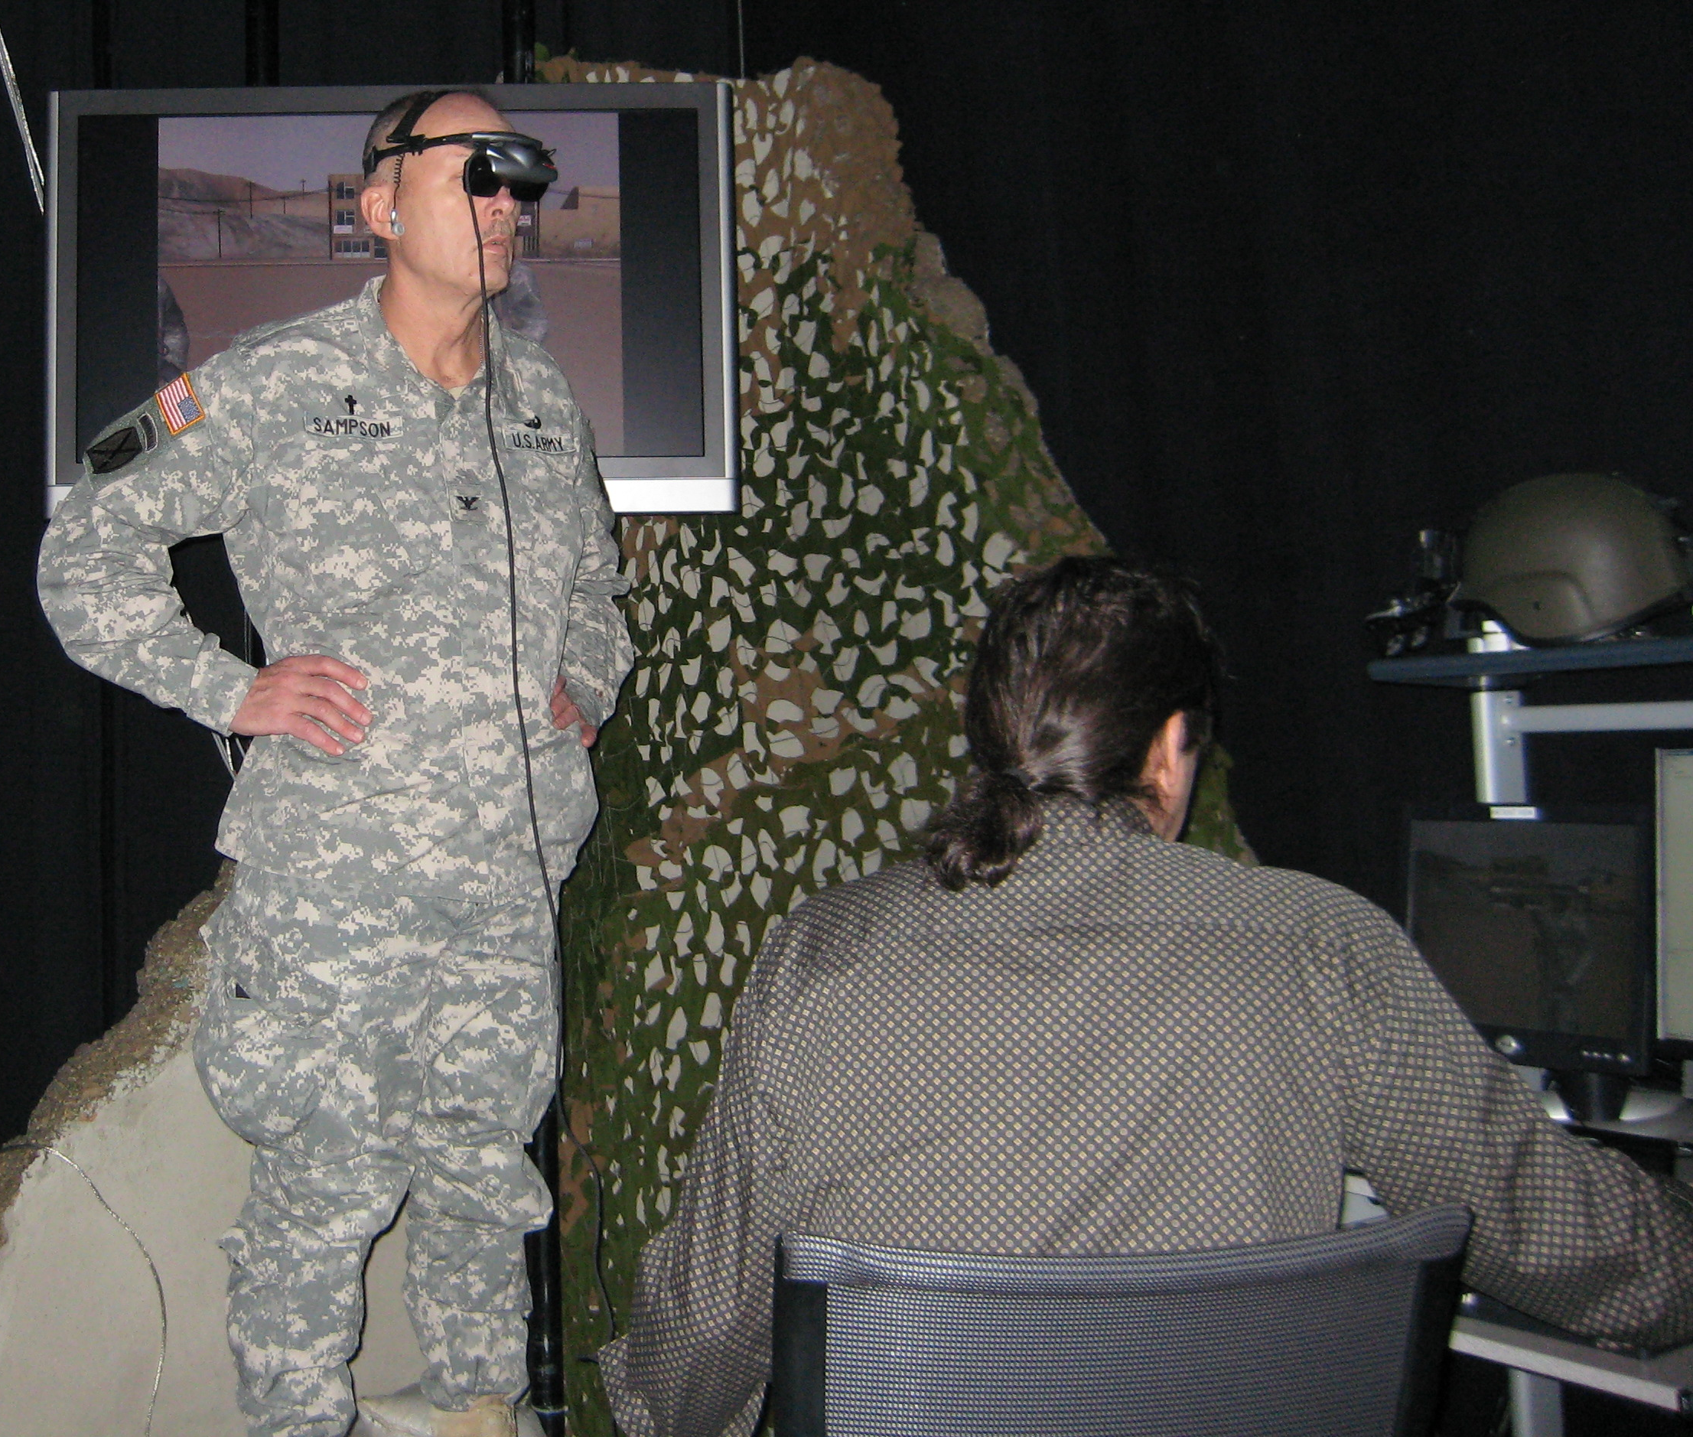
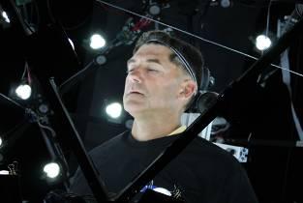
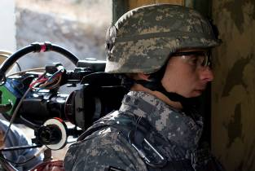
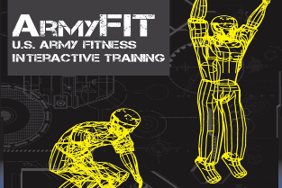
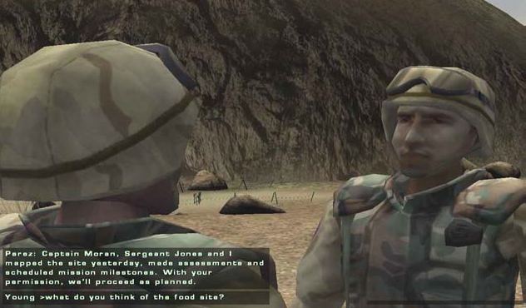
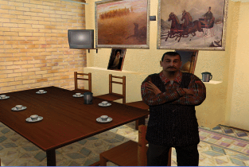
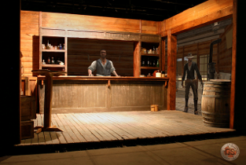
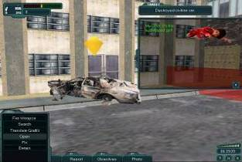
Application Prototypes
Virtual Patient
FSW
DMCTI
JFETS
CAD-TS
UrbanSIM
FSC
SGT Star
MCIT
INOTS
BiLAT
PTSD Therapy
FITE
SimCoach
AXL
ArmyFit
Leaders
IEWTPT
Gunslinger
SLIM-ES3
Notes:
OLD NOTES: leverage lessons learned from previous ICT research projects and incorporate those lessons in subsequent endeavors
using multiple forms of training technologies

