Slide 1
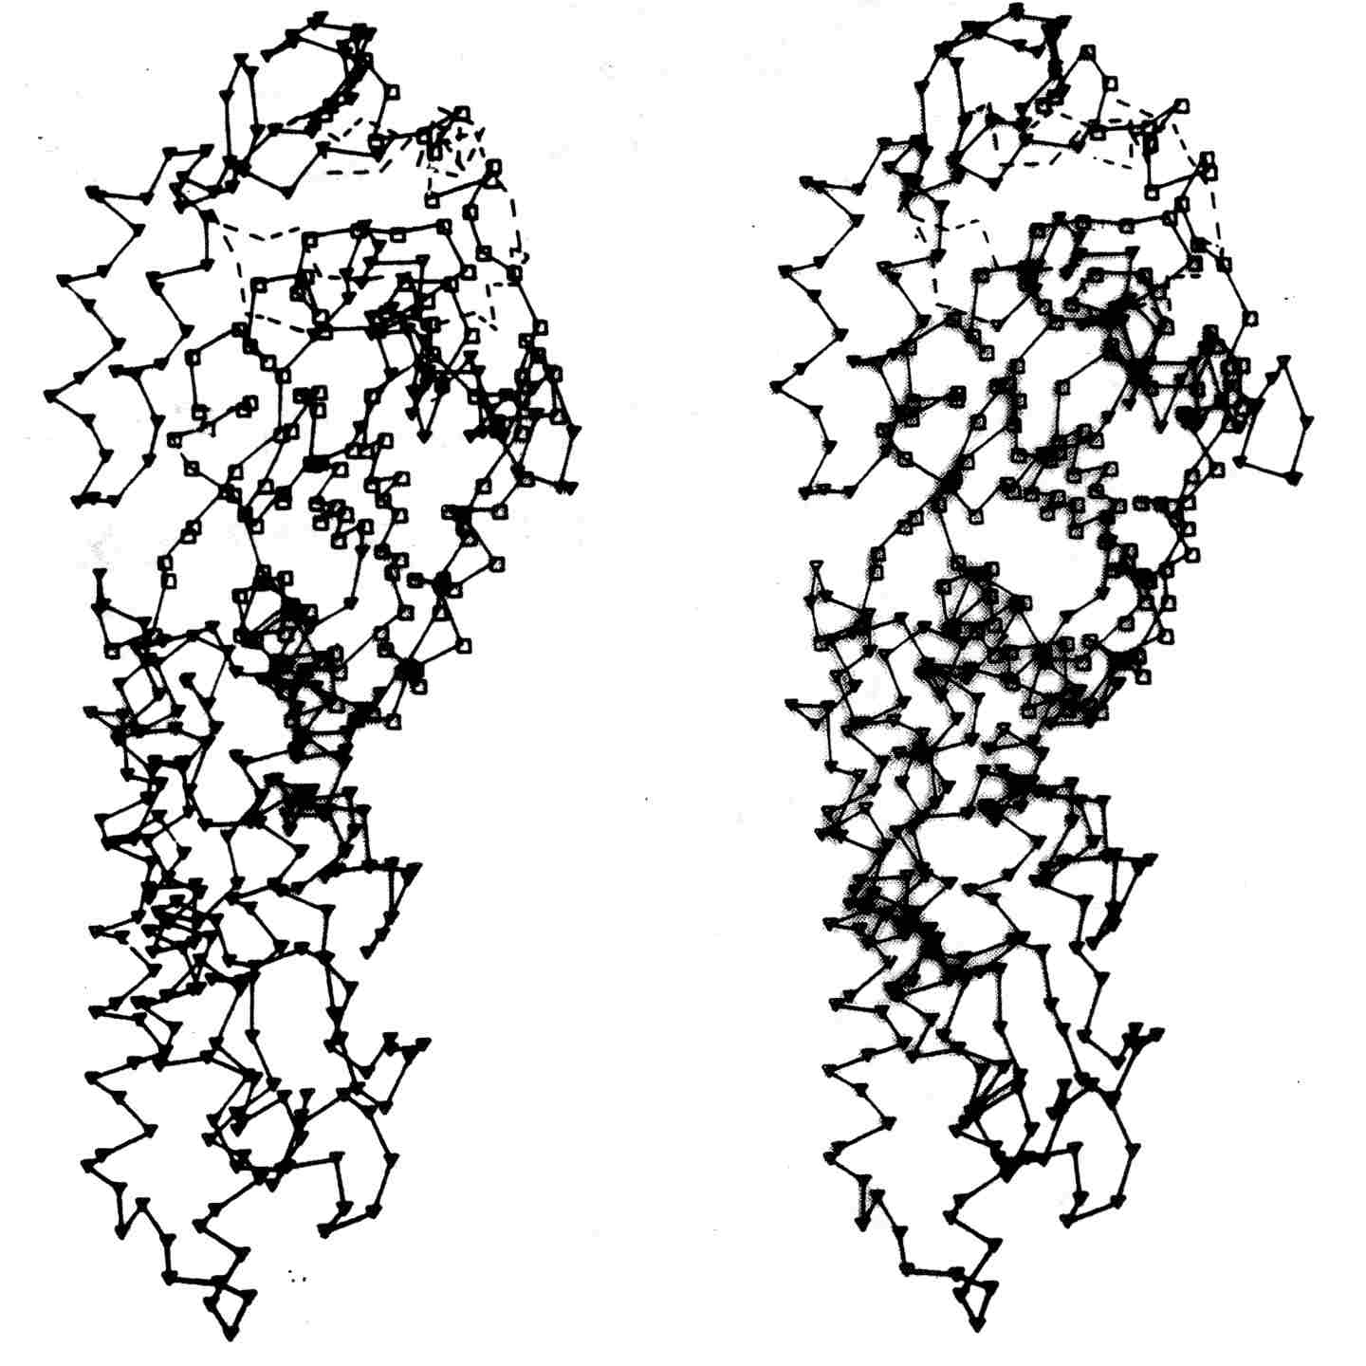
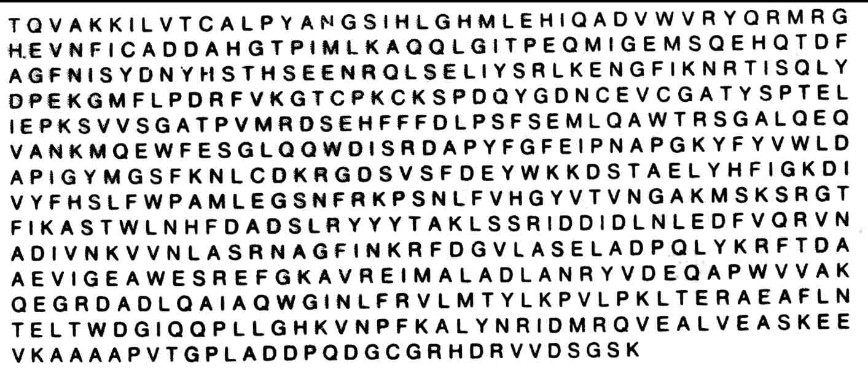
Protein structure prediction

Slide 2
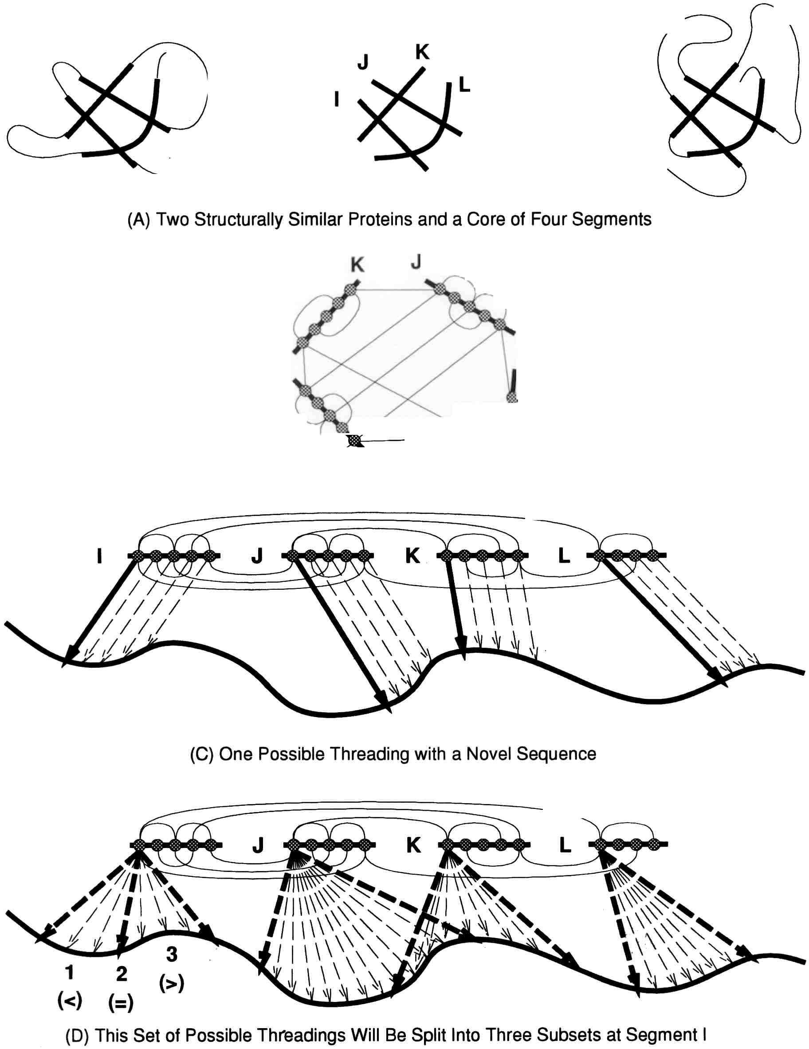
“Protein Threading”

Slide 3
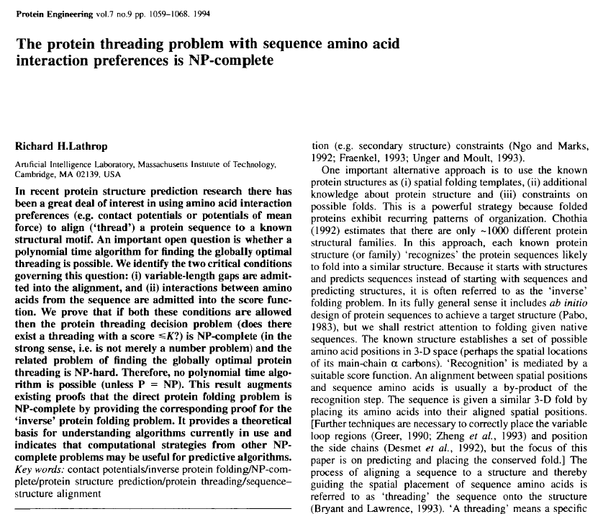

Slide 4
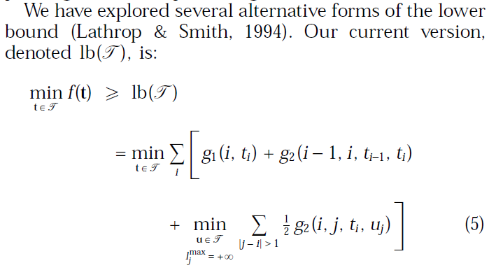
Heuristic (Objective) Function

Slide 5
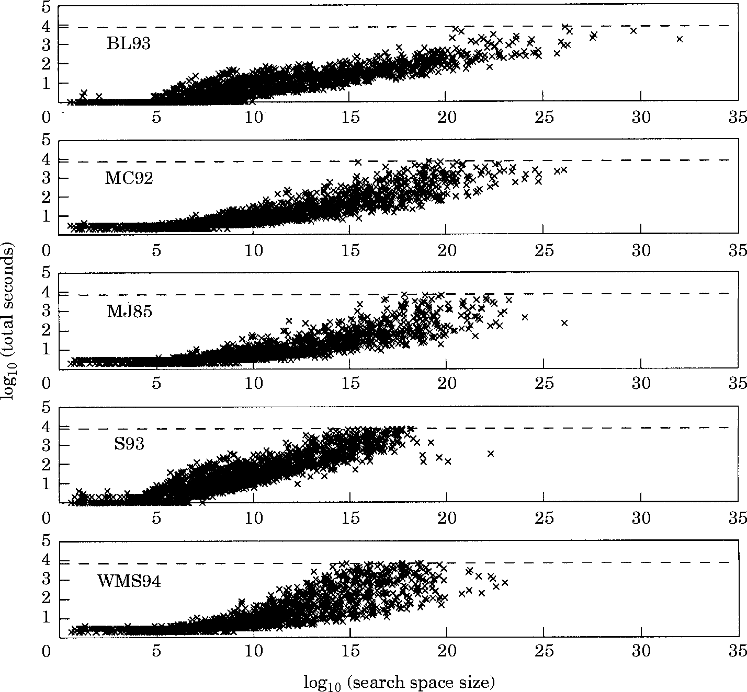
The time required to find the global minimum is shown on log-log axes as a function of search space size.

Slide 6
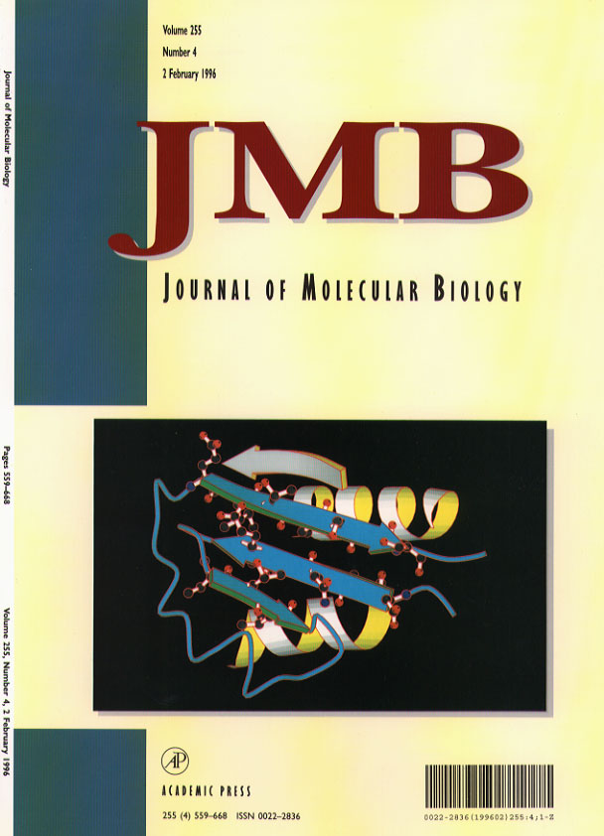
“Global Optimum Protein Threading with Gapped Alignment and Empirical Pair Score Functions”
Lathrop and Smith
J. Mol. Biol. 255(1996)641-665

