Slide 1
Informatics 121 Software Design I
Lecture 2
Duplication of course material for any commercial purpose without the explicit written permission of the professor is prohibited.

Slide 2
Today’s lecture
One design exercise
Reflection
Second assignment
Note: there will be a discussion Friday

Slide 3
Your third design exercise
Design and build a structure that spans two bases…
…such that the distance between the two bases is maximized…
…out of Play-Doh, wire, paper, and dowels…
…in 1 hour.
(We will take some pictures)

Slide 4
Available materials
8 dowels
3 feet of wire
10 sheets of paper
3 large cans of Play-Doh

Slide 5
Process
Design, phase 1 20 minutes hand in 3 different candidate designs
Build, phase 1 15 minutes
Design, phase 2 15 minutes hand in 1 final design
Build, phase 2 10 minutes

Slide 6
Constraints
The structure must be able to suspend, for a minimum of 15 seconds, one large, full can of Play-Doh
in the middle of the structure
in one other place of your choosing
not overlapping with a base
not overlapping with the middle
The dowels and paper must remain in tact
The structure as built should reflect the design you specified
During design, you have no access to materials

Slide 7
Prize
Each member of the winning team receives a $25 Amazon.com gift card
The longest span wins
as long as it reflects the design you specified

Slide 8
Reflection
How much could you draw upon your existing knowledge of bridges?

Slide 9
Reflection
How did you know what would and would not work?

Slide 10
Reflection
How useful was it to create three designs in phase 1?

Slide 11
Reflection
Did you attempt to build all three designs in phase 1?

Slide 12
Reflection
What did you learn during the first build phase?

Slide 13
Reflection
What did your second design phase focus on?

Slide 14
Reflection
Could you faithfully build your final design?

Slide 15
Reflection
Did you faithfully build your final design?

Slide 16
Reflection
Did you feel constrained by your design when you were building in phase 2?

Slide 17
Reflection
What was the most valuable phase, and why?

Slide 18
Reflection
Would you rather have had a single, 1 hour long, build phase?

Slide 19
Reflection
Did you want more time to experiment (i.e., build phase 1)?

Slide 20
Reflection
Did you want more time to design?

Slide 21
Reflection
What is the key idea underlying your final design?

Slide 22
Reflection
What influence did the constraints have?
limited materials
supporting a can of Play-Doh in two places
nature of the bases
limited build time
…

Slide 23
Reflection
How did you negotiate these constraints?

Slide 24
Reflection
Which representation(s) did you use while designing?

Slide 25
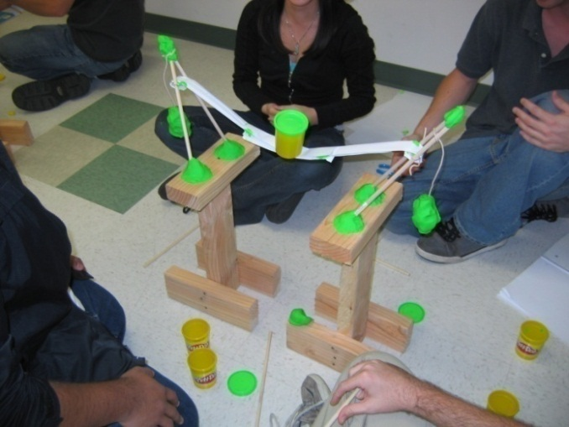
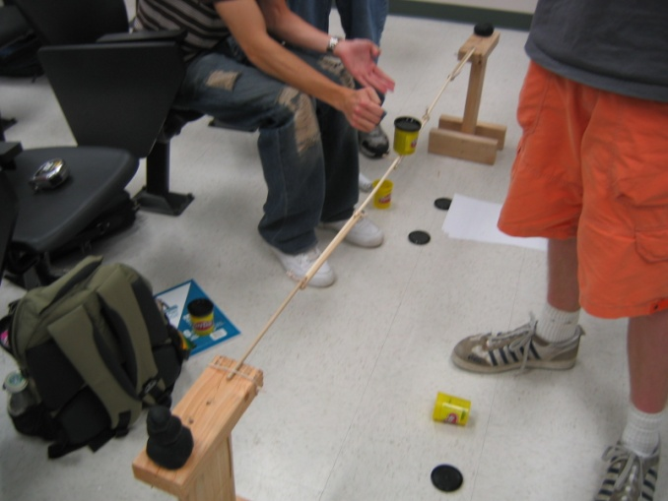
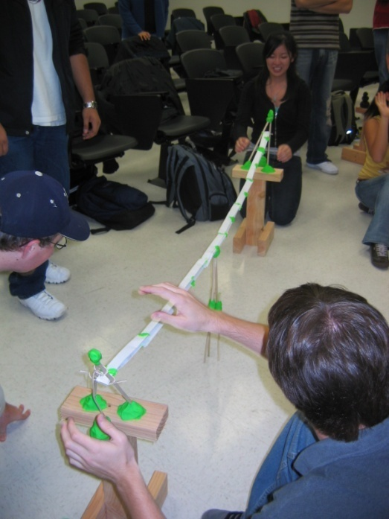
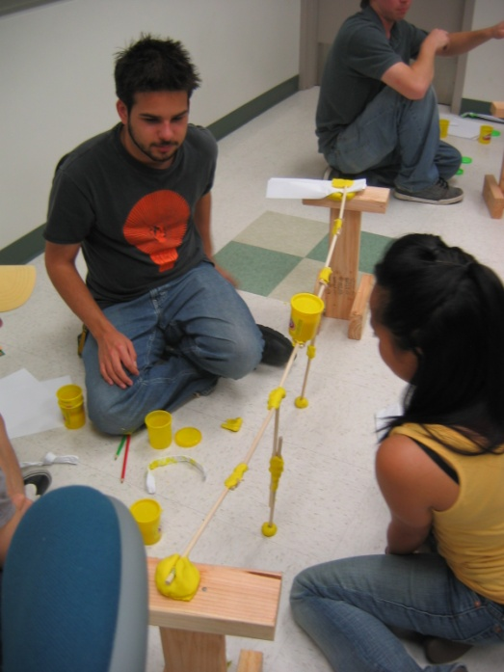
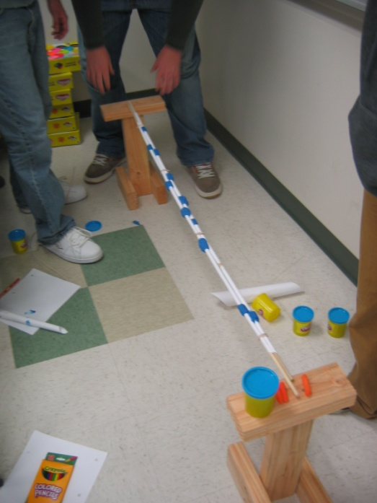
Some past examples

Slide 26
Second assignment
Read “Chapter 1” by Alex Baker, Marian Petre, and André van der Hoek
available on the class web site
Provide a 1 page summary highlighting…
…five major lessons to learn from this text
…how these lessons relate to the design exercises we performed in class today
Due Thursday

