Slide 1
Informatics 121 Software Design I
Lecture 3
Duplication of course material for any commercial purpose without the explicit written permission of the professor is prohibited.

Slide 2
Today’s lecture
Defining design
Design studio 1

Slide 3
Defining design
Decision making, in the face of uncertainty, with high penalties for error
To choose the things we use shall look as they do
A creative activity—it involves bringing into being something new and useful that has not existed previously
Relating product with situation to give satisfaction
The imaginative jump from present facts to future possibilities
To form a plan or scheme of, to arrange or conceive in the mind, … for later execution

Slide 4
Defining design
To initiate change in man-made things
To plan or intend for a purpose
To work out a solution in one’s mind
The transition from possible solutions to a specific one
…

Slide 5
Three themes
Design focuses on identifying a novel envisioned future
Design involves deliberate decision-making and planning; it is not simply acting out of impulse
The design decisions are consequential: there are stakeholders who must be satisfied with the result

Slide 6
Informatics 121 definition
To decide upon a plan for change in the world that, when realized, satisfies stakeholders

Slide 7
Design
designer
plan
maker
change in the world
other stakeholders
audience
experiences

Slide 8
Design fields
Architecture design
Graphic design
Fashion design
Game design
Chip design
Car design
Urban design
Product design
Interior design
…

Slide 9
Design fields
Architecture design
Graphic design
Fashion design
Game design
Chip design
Car design
Urban design
Product design
Interior design
…
Writing
Painting
Sculpting
Music composition
…

Slide 10
Design
designer
plan
maker
change in the world
other stakeholders
audience
experiences

Slide 11
Design a luxury airplane
designer
plan
maker
change in the world
other stakeholders
audience
experiences

Slide 12
Design a library
designer
plan
maker
change in the world
other stakeholders
audience
experiences

Slide 13
Design an award for excellence in advertising
designer
plan
maker
change in the world
other stakeholders
audience
experiences

Slide 14
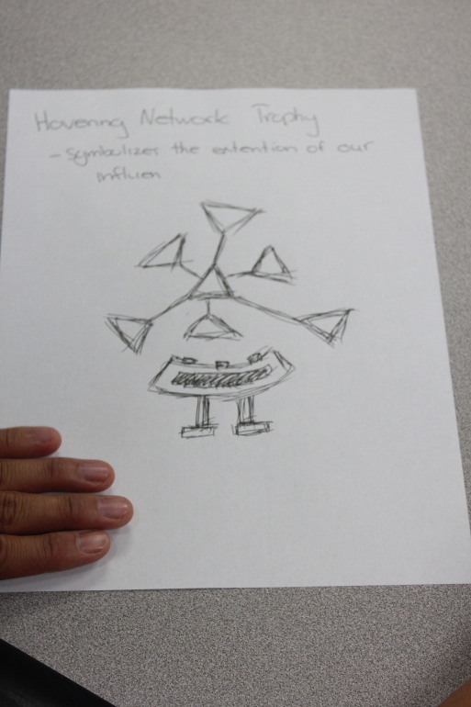
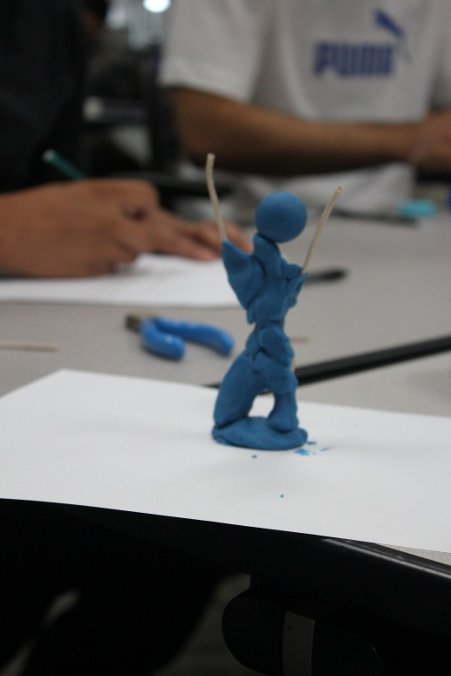
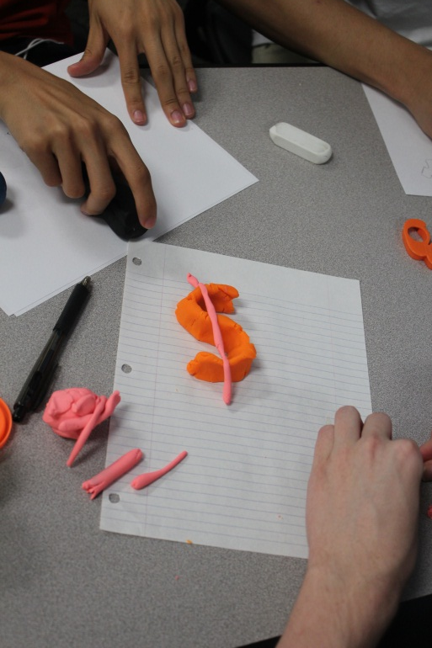
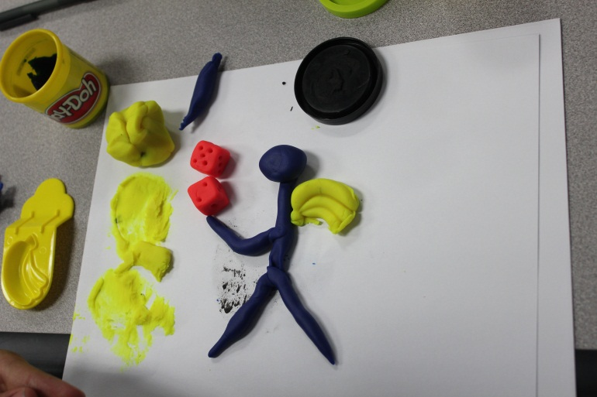
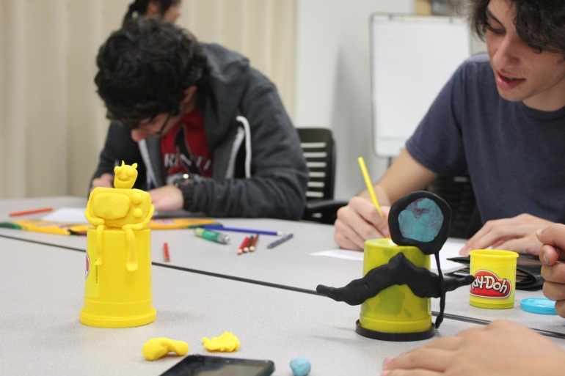
Design an award for excellence in advertising

Slide 15
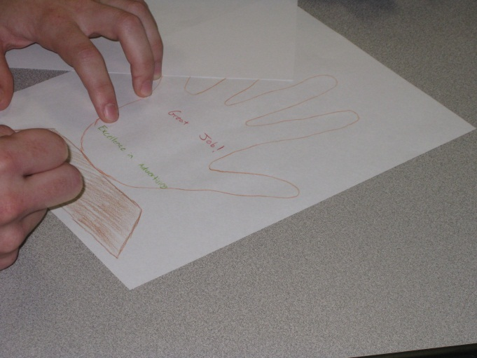
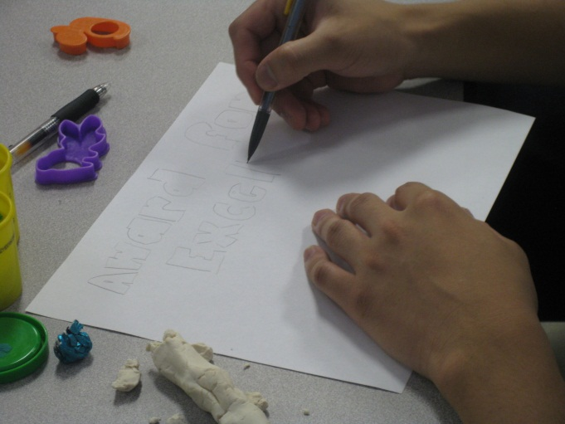
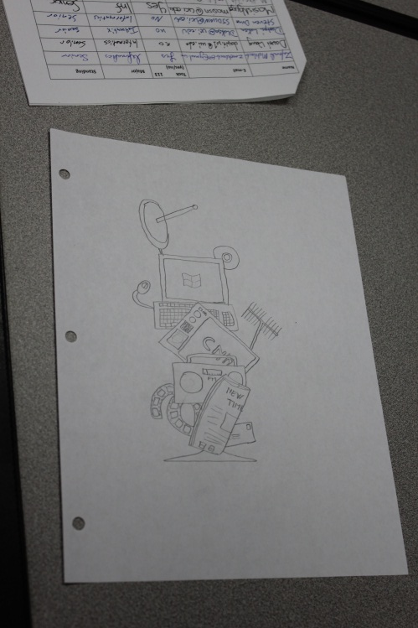
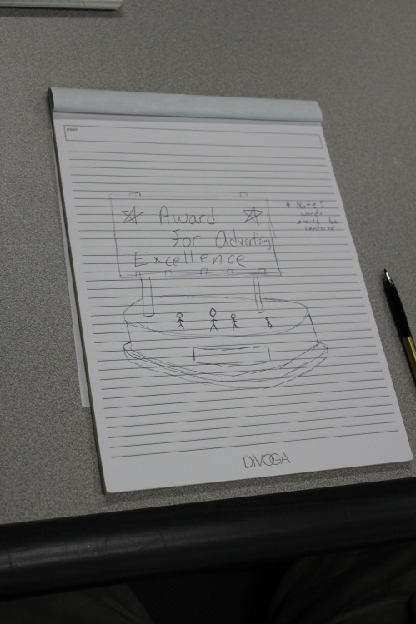
Design an award for excellence in advertising

Slide 16
Design the ideal classroom seat
designer
plan
maker
change in the world
other stakeholders
audience
experiences

Slide 17
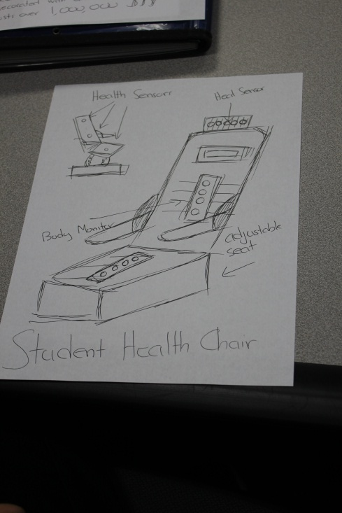
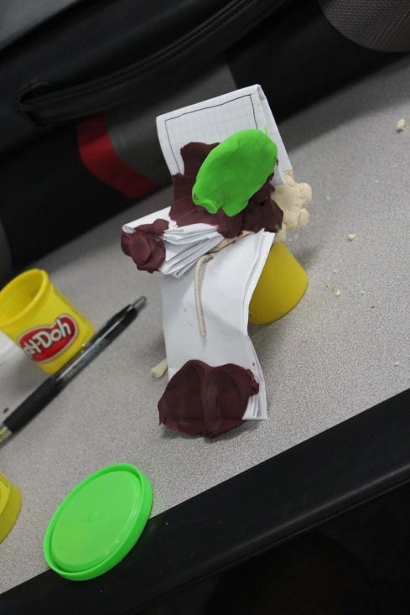
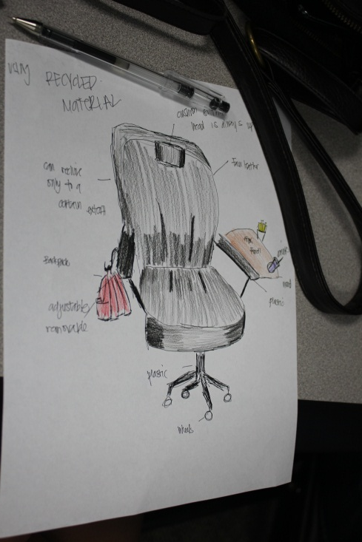
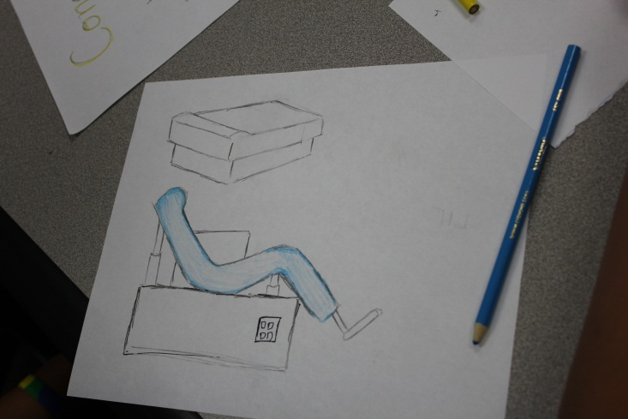
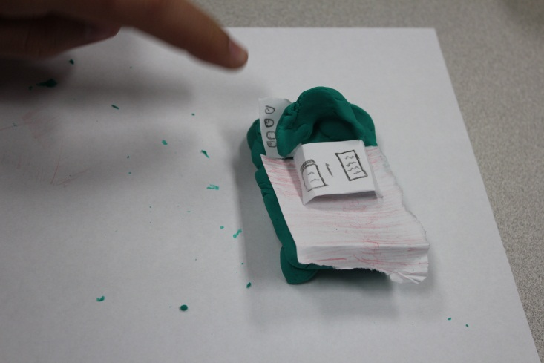
Design the ideal classroom seat

Slide 18
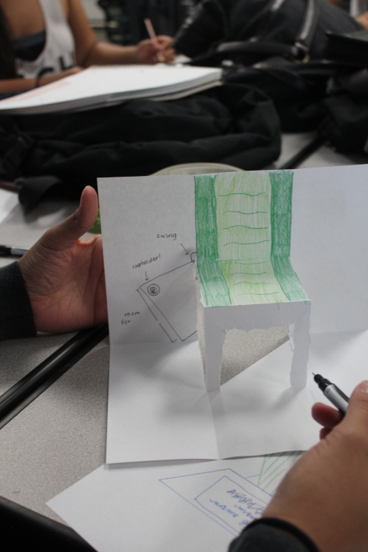
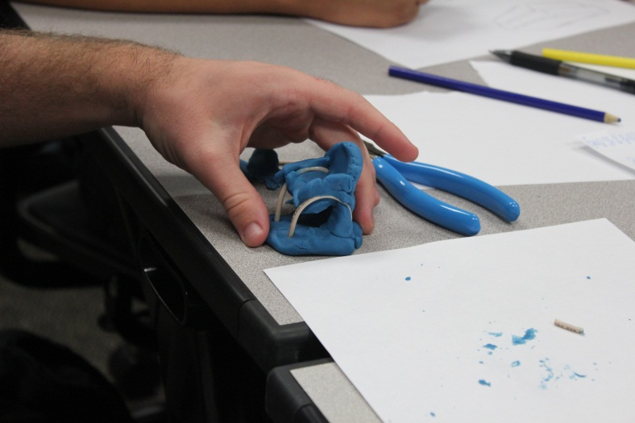
Design the ideal classroom seat

Slide 19
Design fields
Architecture design
Graphic design
Fashion design
Game design
Chip design
Car design
Urban design
Product design
Interior design
…
Writing
Painting
Sculpting
Music composition
…

Slide 20
Design fields
Architecture design
Graphic design
Fashion design
Game design
Chip design
Car design
Urban design
Product design
Interior design
…
Writing
Painting
Sculpting
Music composition
…
Software design

Slide 21
Software design
designer
plan
maker
change in the world
other stakeholders
audience
experiences

Slide 22
Software design
software designer
software
compiler
runnable program
other stakeholders
users
experiences

Slide 23
Design studio 1
You are tasked with designing an “highway electronic signage system” to replace the old-fashioned roadway signs in use now
Identify the different audiences and what their experiences should be
Identify the other stakeholders and the goals they may have
Clearly document these in a typewritten document, to be handed in on Tuesday, October 4, at the beginning of class
separate list of audience and experiences
separate list of other stakeholders and goals

Slide 24
Design studio 1
Assignment is on an individual basis, but will be continued in class on Tuesday
You should identify as broad an audience and experiences as possible
You should identify as broad a range of other stakeholders and goals as possible
The overall focus is on brainstorming
your document does not need to have lengthy narratives (but should be clear)

