Slide 1
Informatics 121 Software Design I
Lecture 6
Duplication of course material for any commercial purpose without the explicit written permission of the professor is prohibited.

Slide 2
Today’s lecture
Design essence and tradeoffs
Design studio 2 (video analysis)

Slide 3
Informatics 121 definition
To decide upon a plan for change in the world that, when realized, satisfies stakeholders

Slide 4
Design
designer
plan
maker
change in the world
other stakeholders
audience
experiences

Slide 5
Four types of design
what is it to accomplish?
satisfactory experience
how does one interact with it?
change in the world
what is its conceptual core?
plan for realization
what are its implementation details?

Slide 6
Four types of design
desirability
what is it to accomplish?
satisfactory experience
how does one interact with it?
change in the world
feasibility
what is its conceptual core?
plan for realization
what are its implementation details?

Slide 7
Difficulty #1: problem, solution, change
The understanding of a design problem goes hand-in-hand with the understanding of its design solution
This understanding may well change, sometimes dramatically so, during the design project
The challenge is to anticipate this volatility and identify and focus on the essence of the design problem at hand

Slide 8
Four types of design
what is it to accomplish?
satisfactory experience
how does one interact with it?
change in the world
what is its conceptual core?
plan for realization
what are its implementation details?

Slide 9
Difficulty #2: success, failure, tradeoffs
A design’s success is not absolute, but judged relative to other possible designs that could have been made
A designer must deal with tradeoffs all the time, and cannot make all stakeholders equally satisfied with the change in the world
The challenge is to identify and address key tradeoffs early

Slide 10
Four types of design
what is it to accomplish?
satisfactory experience
how does one interact with it?
change in the world
what is its conceptual core?
plan for realization
what are its implementation details?

Slide 11
Difficulty #3: quality, cost, time
There is no optimal solution to a design problem, designers must find a solution that is good enough
The challenge is to find key quality and cost considerations early

Slide 12
Four types of design
what is it to accomplish?
satisfactory experience
how does one interact with it?
change in the world
what is its conceptual core?
plan for realization
what are its implementation details?

Slide 13
Difficulty #4: longevity
A change in the world may last for a very long time…
…and may well need to accommodate future changes in the world
The challenge is to identify and balance present needs with future possibilities

Slide 14
Four types of design
what is it to accomplish?
satisfactory experience
how does one interact with it?
change in the world
what is its conceptual core?
plan for realization
what are its implementation details?

Slide 15
Focus on essence and tradeoffs
Thou shall focus on the difficult parts first
Thou shall focus on the difficult parts second
Thou shall focus on the difficult parts third
…

Slide 16
Focus on essence and tradeoffs
Thou shall focus on the difficult parts first
Thou shall focus on the difficult parts second
Thou shall focus on the difficult parts third
…
What are the most important decision points, what are your options, and how do the options relate?

Slide 17
Essence and tradeoffs
Highway electronic signage system
Disney electronic queue management system
Electronic health records system
Mars planetary rover software
Google Mail
Google Docs

Slide 18
Design studio 2
Design an educational traffic flow simulation program
A 2-page briefing is provided, listing the main requirements for the system
You will produce the design over a number of weeks, through a variety of structured exercises and arguments
This will be an individual assignment, with group exercises worked in

Slide 19
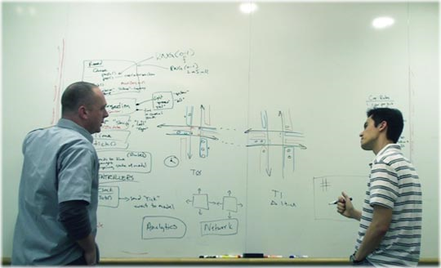
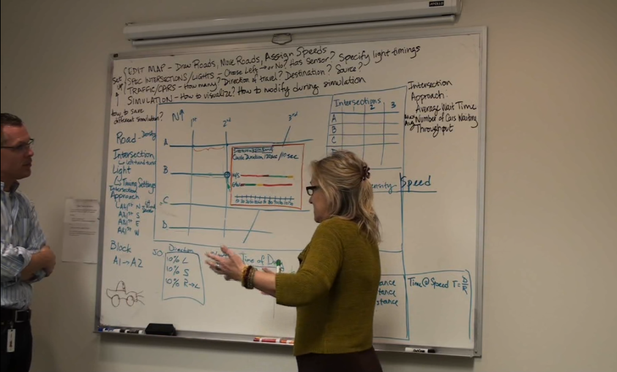
Design studio 2
This exact same design prompt was given to professional software designers
1 hour and 50 minutes at the regular whiteboard

Slide 20
Design studio 2
Watch the video, carefully
Identify…
…five decisions points that the designers encountered
…the options they considered
…any relationships among the options
Focus on essence and tradeoffs

Slide 21
Design studio 2
Hand in a document, at the beginning of class, Tuesday
Bring two copies

