Slide 1
Informatics 121
Software Design I
Lecture 11
Duplication of course material for any commercial purpose without the explicit written permission of the professor is prohibited.

Slide 2
Discussion
There will be no discussion this Friday

Slide 3
Today’s lecture
Design methods (interaction design)

Slide 4
Intermezzo
Experts are skeptical
Experts simulate continually
Experts draw examples alongside their diagrams
Experts test across representations
Experts prototype concepts
Experts involve the user
Experts are alert to evidence that challenges their theory

Slide 5
Software design methods
 | Application design | Interaction design | Architecture design | Implementation design
Analysis | competitive testing contextual inquiry feature comparison stakeholder analysis task analysis | critical incident technique interaction logging personas scenarios | framework assessment model-driven engineering quality-function-deployment reverse engineering world modeling | release planning summarization test-driven design visualization
Synthesis | affinity diagramming concept mapping mind mapping morphological chart | design/making participatory design prototyping storyboarding | architectural styles generative programming component reuse decomposition | pair programming refactoring search software patterns
Evaluation | requirements review role playing wizard of oz | cognitive walkthrough evaluative research heuristic evaluation think-aloud protocol | formal verification simulation weighted objectives | correctness proofs inspections/reviews parallel deployment testing

Slide 6
Software design methods
 | Application design | Interaction design | Architecture design | Implementation design
Analysis | competitive testing contextual inquiry feature comparison stakeholder analysis task analysis | critical incident technique interaction logging personas scenarios | framework assessment model-driven engineering quality-function-deployment reverse engineering world modeling | release planning summarization test-driven design visualization
Synthesis | affinity diagramming concept mapping mind mapping morphological chart | design/making participatory design prototyping storyboarding | architectural styles generative programming component reuse decomposition | pair programming refactoring search software patterns
Evaluation | requirements review role playing wizard of oz | cognitive walkthrough evaluative research heuristic evaluation think-aloud protocol | formal verification simulation weighted objectives | correctness proofs inspections/reviews parallel deployment testing

Slide 7
Critical incident technique
Critical incident technique is the process of retroactively obtaining and analyzing accounts of experiences, positive and negative, with a product at a critical moment

Slide 8
Procedure
Identify the incident
Review the incident
Identify the issues

Slide 9
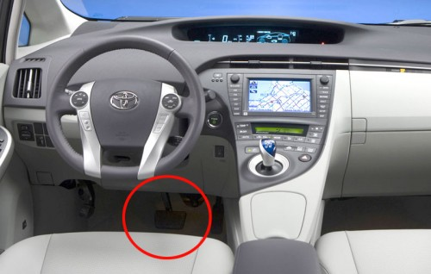
Example: identify the incident
“As of the end of last year, we had dozens of complaints from dealers in Japan and North America. What the report suggests is that sometimes the braking system in the Prius can stop working on bumpy and slippery roads.”

Slide 10
Example: review the incident
Document the critical incident
  circumstances
  user actions
  sentiment
  actual outcome
  desired outcome
Recreate the incident

Slide 11
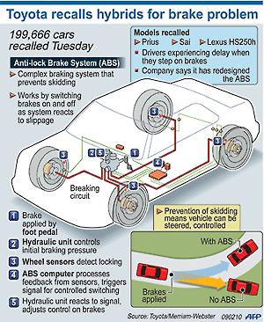
Example: identify the issues
“A power steering pressure hose in the engine may be the wrong length and could rub against a brake tube. That could create a hole in the tube, causing brake fluid to drain.”

Slide 12
Typical notation: report
“In this report, we detail our findings regarding the brake system of the Prius, and the reports we have received regarding its failure at certain safety-critical moments. Our report is based on 57 interviews with individuals who experience the problem, and details the circumstances under which the problem occurred, the analysis we performed to unearth the root cause, and our suggestions for fixing the problem. …”

Slide 13
Criteria for successful use
Access to rich accounts of the critical incident
Ideally, a set of similar critical incidents with both positive and negative experiences
Deep and careful analysis that avoids ‘foregone’ conclusions

Slide 14
Strengths and weaknesses
Strengths
Weaknesses
Identifies how well the current design supports critical moments
May well lead to suggestions that improve the design throughout, rather than just at a critical moment
Helps avoid drastic, repeated failures in future
Focuses on patching the existing design, rather than fundamental innovation

Slide 15
Variants
Diary studies
Interviews

Slide 16
Software design methods
 | Application design | Interaction design | Architecture design | Implementation design
Analysis | competitive testing contextual inquiry feature comparison stakeholder analysis task analysis | critical incident technique interaction logging personas scenarios | framework assessment model-driven engineering quality-function-deployment reverse engineering world modeling | release planning summarization test-driven design visualization
Synthesis | affinity diagramming concept mapping mind mapping morphological chart | design/making participatory design prototyping storyboarding | architectural styles generative programming component reuse decomposition | pair programming refactoring search software patterns
Evaluation | requirements review role playing wizard of oz | cognitive walkthrough evaluative research heuristic evaluation think-aloud protocol | formal verification simulation weighted objectives | correctness proofs inspections/reviews parallel deployment testing

Slide 17
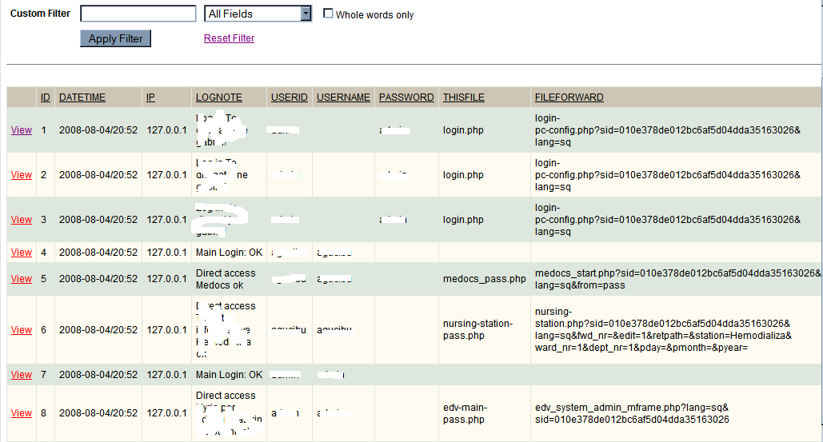
Interaction logging
Interaction logging is the process of purposefully and automatically collecting data regarding the interaction behavior of users

Slide 18
Procedure
Decide what to measure
Decide how to measure
Implement and deploy
Analyze

Slide 19
Example: decide what to measure
How often do the nurses invoke the help function?
What is the most frequently used part of the program?
Which parts of the program are rarely, or never, used?
How much time do nurses spend entering patient info?

Slide 20
Example: decide how to measure
Instrument the software to track all menu invocations
  help
  most frequently used
  rarely, if ever, used
Instrument the software to measure the time it takes from the first to the last field that a nurse fills out, as well as the time it then takes to submit
  time spent entering patient info

Slide 21
Example: implement and deploy
Straightforward, as it typically does not include any visible changes to the user
Be mindful of privacy laws and concerns

Slide 22
Example: analyze
On average, help is invoked three times a day
Entering patient information and entering prescription information are the two most often used parts of the program, followed by entering insurance information
Patient contact information is never entered

Slide 23
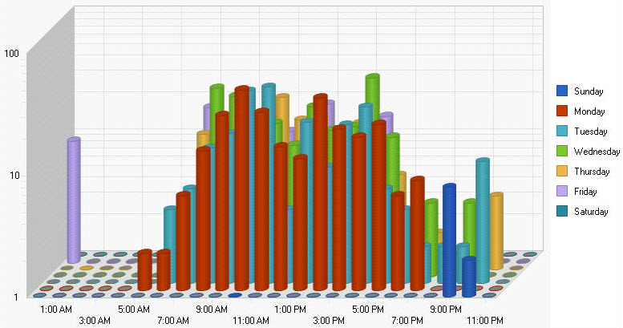
Typical notation: graphs
Notation is strongly dependent on the type of information captured in the logs and the analyses performed on it

Slide 24
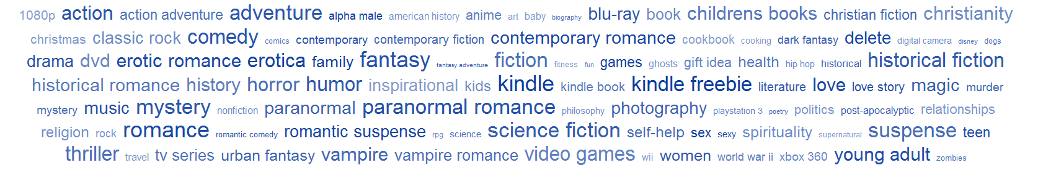
Alternative notation: word clouds
Notation is strongly dependent on the type of information captured in the logs and the analyses performed on it

Slide 25
Criteria for successful use
Rich and detailed information captured in the logs
Requires strong analytic capabilities, typically with tool support
Specific, focused questions

Slide 26
Strengths and weaknesses
Strengths
Weaknesses
Reveals actual user behavior
Sets a baseline for comparison to future designs
Once built, can help to identify shifting trends in user behavior over time
Logs are persistent, and can be revisited for other analyses later
Only reveals behavior, not how the user actually experiences the product
Limited to the current system; does not focus on innovation
Analysis is only as good as the data that is captured

Slide 27
Software design methods
 | Application design | Interaction design | Architecture design | Implementation design
Analysis | competitive testing contextual inquiry feature comparison stakeholder analysis task analysis | critical incident technique interaction logging personas scenarios | framework assessment model-driven engineering quality-function-deployment reverse engineering world modeling | release planning summarization test-driven design visualization
Synthesis | affinity diagramming concept mapping mind mapping morphological chart | design/making participatory design prototyping storyboarding | architectural styles generative programming component reuse decomposition | pair programming refactoring search software patterns
Evaluation | requirements review role playing wizard of oz | cognitive walkthrough evaluative research heuristic evaluation think-aloud protocol | formal verification simulation weighted objectives | correctness proofs inspections/reviews parallel deployment testing

Slide 28
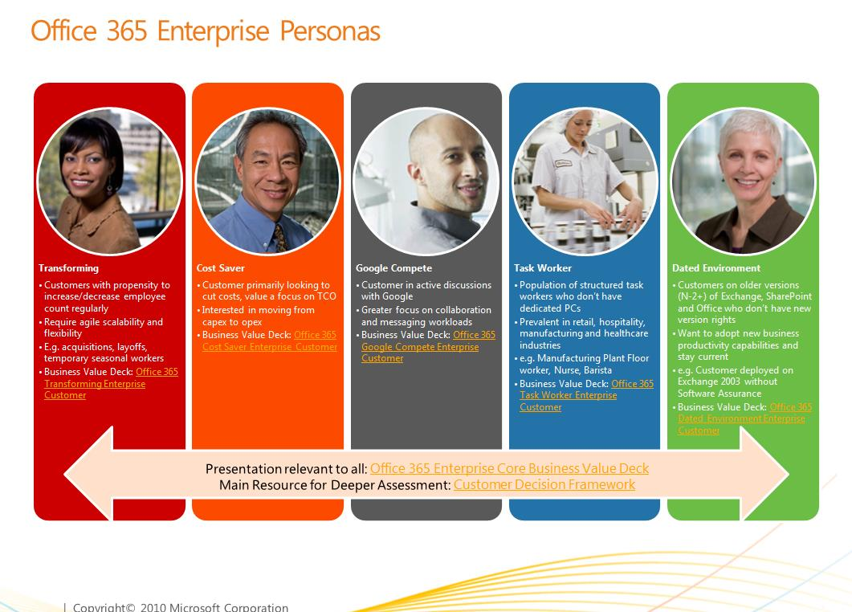
Personas
Personas is the process of developing meaningful and relatable user profiles that capture common behaviors

Slide 29
Procedure
Collect data through field research
Segment the users into archetypes
Create the personas

Slide 30
Example: collect data through field research
Observations
Interviews
Ethnography

Slide 31
Example: segment the users into archetypes
Organize the individual users into groups
  affinity diagramming
  two-dimensional axes
  informal clustering
Typically repeated multiple times to explore different user characteristics
Recombine characteristics into hypothetical users who are both representative of a larger group and different amongst each other

Slide 32
Example: create the personas
Name the archetype and associate an image
Briefly introduce their life situation
Briefly describe their goals
Briefly describe their characteristic behaviors
Usually, between three and five personas are created, at most one page each

Slide 33

Typical notation: cards

Slide 34
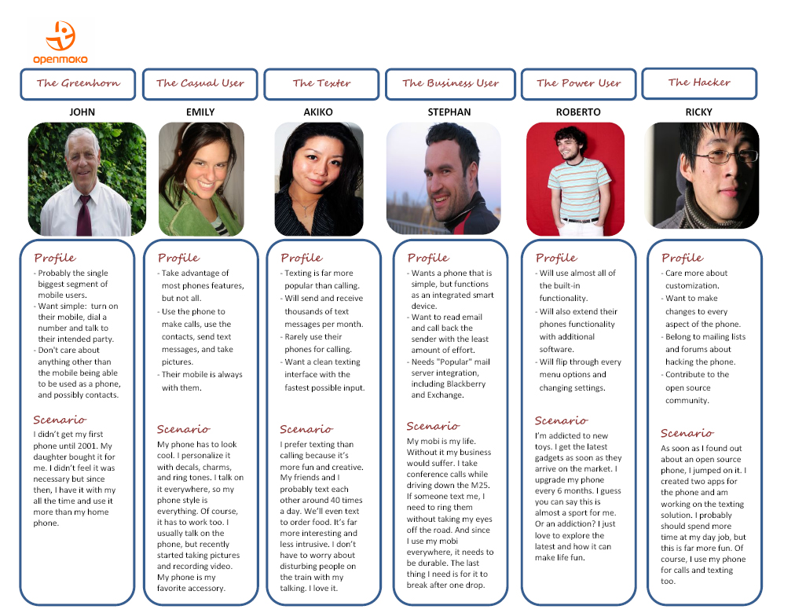
Typical notation: table

Slide 35
Criteria for successful use
Must be based on actual, in-depth field research
Must focus on key differentiating characteristics that might influence the design project

Slide 36
Strengths and weaknesses
Strengths
Weaknesses
Explicitly brings users into the design process
Builds a shared understanding of the audience among the design team members
Provides an implicit test for future design ideas
Helps focus on essence
Might distance the designer from actual users and overly focus on the personas
Might distance the designer from a-typical users
Tends to work less well for design projects involving complex work practices

Slide 37
Software design methods
 | Application design | Interaction design | Architecture design | Implementation design
Analysis | competitive testing contextual inquiry feature comparison stakeholder analysis task analysis | critical incident technique interaction logging personas scenarios | framework assessment model-driven engineering quality-function-deployment reverse engineering world modeling | release planning summarization test-driven design visualization
Synthesis | affinity diagramming concept mapping mind mapping morphological chart | design/making participatory design prototyping storyboarding | architectural styles generative programming component reuse decomposition | pair programming refactoring search software patterns
Evaluation | requirements review role playing wizard of oz | cognitive walkthrough evaluative research heuristic evaluation think-aloud protocol | formal verification simulation weighted objectives | correctness proofs inspections/reviews parallel deployment testing

Slide 38
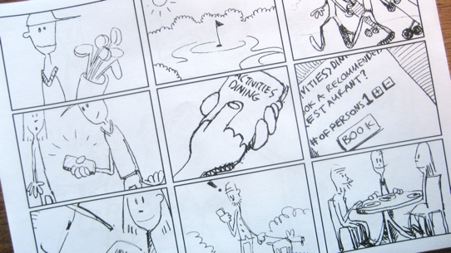
Storyboarding
Storyboarding is the process of visually communicating expected interactions in context

Slide 39
Procedure
Decide upon interaction
Decide upon story to be told
Decide upon level of artistic detail
Draw and annotate story
Iterate

Slide 40
Decide upon interaction
Mary is exploring the online book collection
Mary is reading an excerpt from one book
Tom buys the book in his car

Slide 41
Decide upon story to be told
While Mary is exploring the online book collection, she is pleasantly surprised to find that an author that she liked before has written a new book and she orders it
While Mary is exploring the online book collection, she very much likes the automated recommendation that the system makes based on books she purchased in the past
While Tom is driving in the car, he uses his mobile phone to order the book, but has to stop to actually type in requisite credit card information on the ordering screen

Slide 42
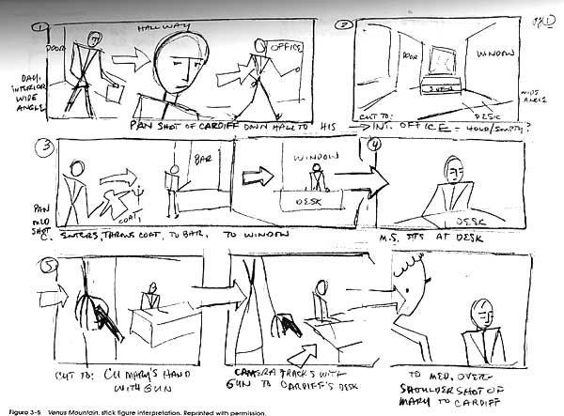
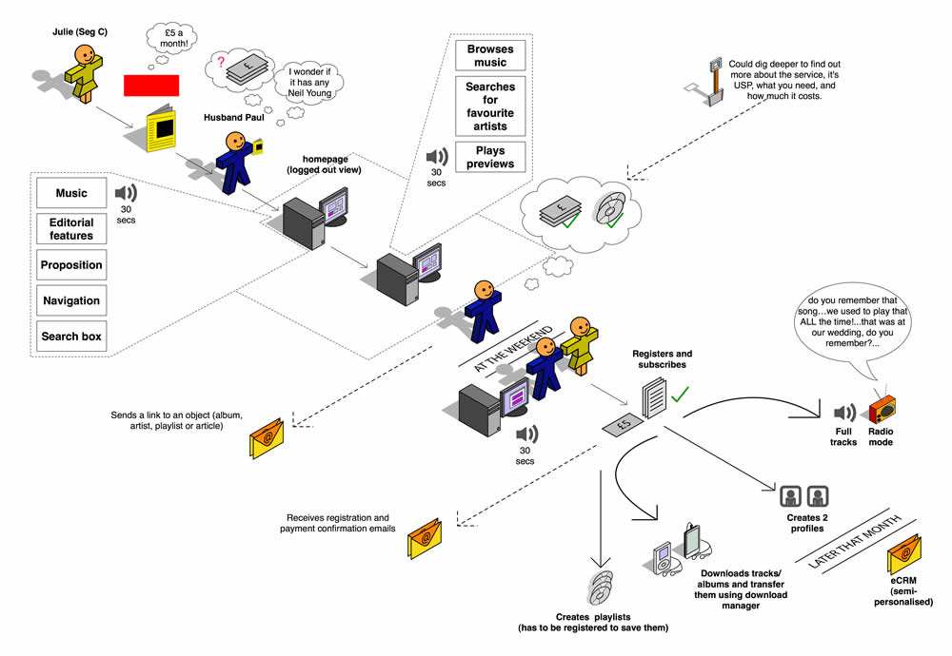
Example: decide upon level of artistic detail

Slide 43
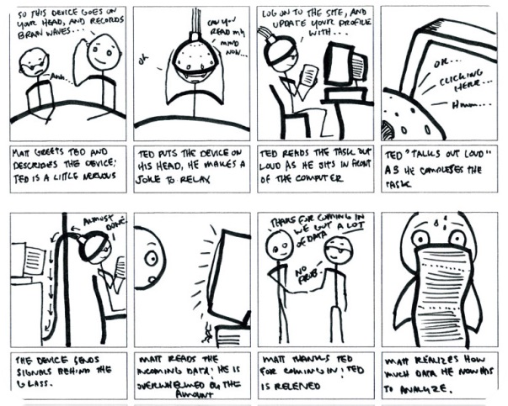
Example: draw and annotate story

Slide 44
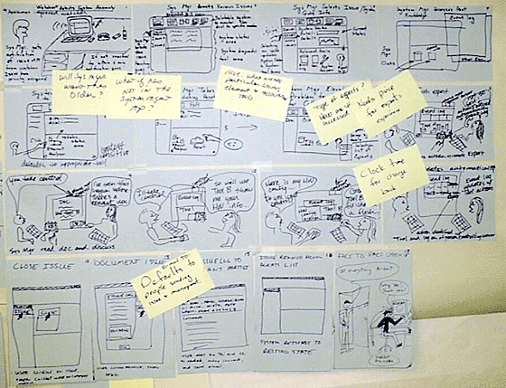
Example: iterate

Slide 45
Typical notation: storyboard

Slide 46
Criteria for successful use
Develop short effective stories
Apply a strong sense of aesthetics
Must be open to storyboarding multiple ideas
Should have a definite sense of possible solutions
Collaborate

Slide 47
Strengths and weaknesses
Strengths
Weaknesses
Tangible nature invites early feedback
Brings an increased focus on how the users might expect to interact with the product
Builds a shared understanding of the audience and interactions among the design team
Provides an implicit baseline for future design ideas
Stops well short of designing the actual interface in detail
Might distance the designer from undocumented storyboards
Can be difficult to ensure that the storyboards represent the audience accurately

Slide 48
Software design methods
 | Application design | Interaction design | Architecture design | Implementation design
Analysis | competitive testing contextual inquiry feature comparison stakeholder analysis task analysis | critical incident technique interaction logging personas scenarios | framework assessment model-driven engineering quality-function-deployment reverse engineering world modeling | release planning summarization test-driven design visualization
Synthesis | affinity diagramming concept mapping mind mapping morphological chart | design/making participatory design prototyping storyboarding | architectural styles generative programming component reuse decomposition | pair programming refactoring search software patterns
Evaluation | requirements review role playing wizard of oz | cognitive walkthrough evaluative research heuristic evaluation think-aloud protocol | formal verification simulation weighted objectives | correctness proofs inspections/reviews parallel deployment testing

Slide 49
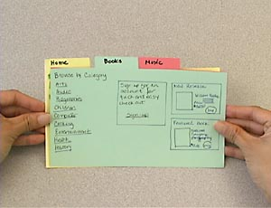
Prototyping
Prototyping is the process of creating tangible artifacts embedding the envisioned design solution

Slide 50
Procedure
Decide the purpose
Decide the fidelity and medium
Create the prototype

Slide 51
Example: decide the purpose
Obtain feedback from the client
Obtain feedback from potential users
Obtain feedback from other stakeholders
Explore alternatives more concretely

Slide 52
Example: decide the fidelity and medium
Low fidelity
  paper prototype
Medium fidelity
  wireframes
  mock-ups
High fidelity
  actual running software

Slide 53
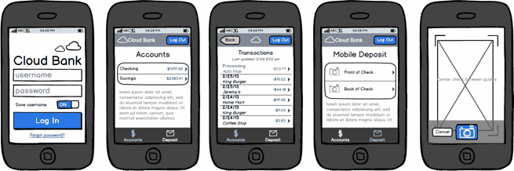
Example: decide the details

Slide 54

Example: paper prototype
http://youtu.be/GrV2SZuRPv0

Slide 55
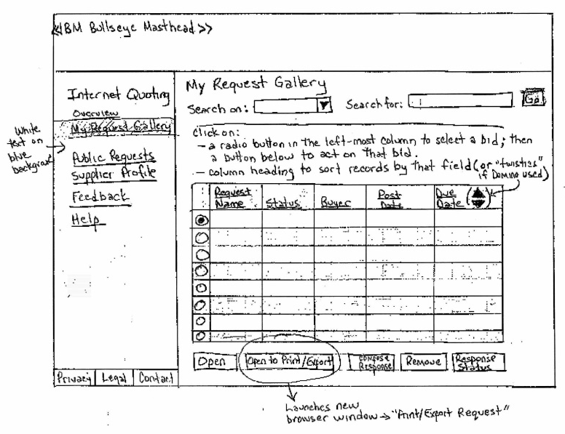
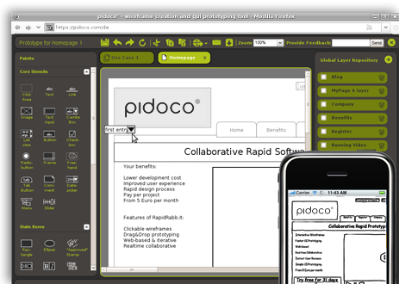
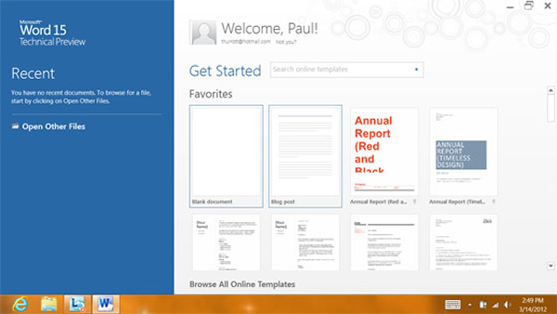
Typical notation: tangible

Slide 56
Criteria for successful use
Strong sense of aesthetics and attention to detail
Must be open to prototyping multiple design ideas
Should have a definite sense of possible solutions
Collaborate

Slide 57
Strengths and weaknesses
Strengths
Weaknesses
Tangible nature invites early yet detailed feedback
Low fidelity prototyping is a lightweight approach that still yields good results
Tool support is readily available
The higher the fidelity, the more expensive the endeavor
Could lead to too much focus on the visual appearance instead of the supporting the actual tasks at hand

Slide 58
Software design methods
 | Application design | Interaction design | Architecture design | Implementation design
Analysis | competitive testing contextual inquiry feature comparison stakeholder analysis task analysis | critical incident technique interaction logging personas scenarios | framework assessment model-driven engineering quality-function-deployment reverse engineering world modeling | release planning summarization test-driven design visualization
Synthesis | affinity diagramming concept mapping mind mapping morphological chart | design/making participatory design prototyping storyboarding | architectural styles generative programming component reuse decomposition | pair programming refactoring search software patterns
Evaluation | requirements review role playing wizard of oz | cognitive walkthrough evaluative research heuristic evaluation think-aloud protocol | formal verification simulation weighted objectives | correctness proofs inspections/reviews parallel deployment testing

Slide 59
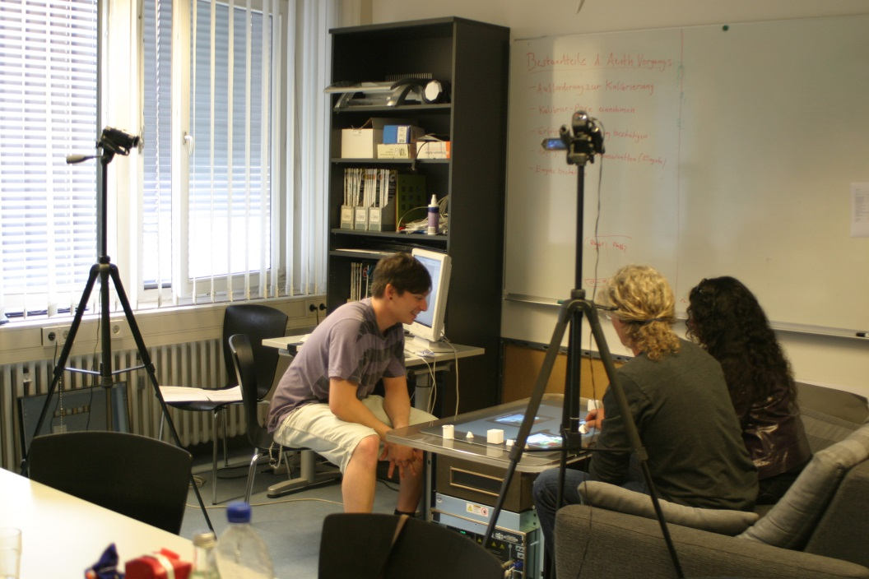
Evaluative research
Evaluative research is the process of testing the designed interactions with real prospective users

Slide 60
Procedure
Choose demographics
Define a set of representative tasks
Choose deployment strategy
Choose metrics
Perform the tasks
Analyze results

Slide 61
Example: choose demographics
Random sample among all potential users
Targeted selection of potential spokespeople
Anyone willing to try
Task experts

Slide 62
Example: define a set of representative tasks
Find the book ‘Software Designers in Action’ and order it
Find five books that are similar to this book, and choose the book that is most similar
Post a review of this book
Order a prescription for patient X consisting of 20 pills of penicillin, at a dosage of 250mg, 2 pills per day
Change the prescription for patient X to 10 pills at a dosage of 500mg, 1 pill a day

Slide 63
Example: choose deployment strategy
Usability lab
Native environment
Crowdsourcing

Slide 64
Example: choose metrics
Time spent in completing tasks
Number of clicks per completed task
Number of tasks completed
Number of mistakes made
Number of requests for help
Eye focus where expected
…

Slide 65
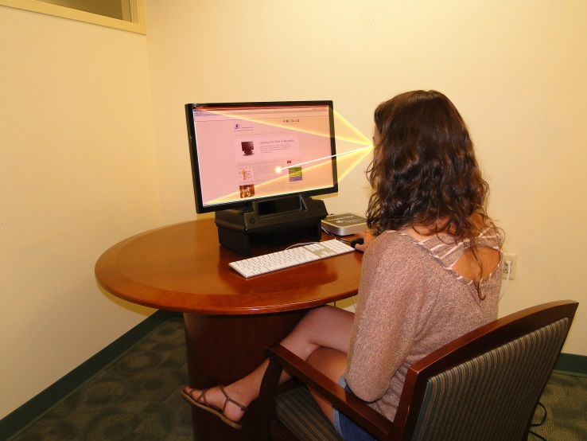

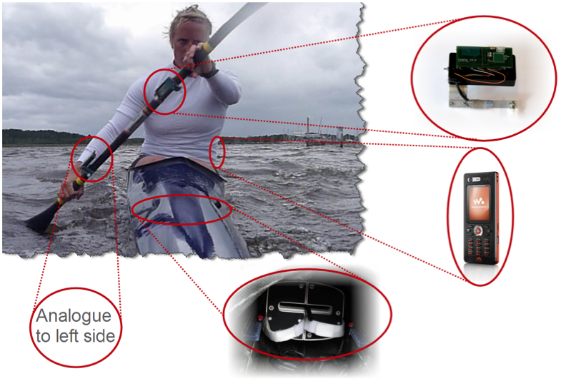
Example: perform the tasks

Slide 66
Example: perform the tasks

Slide 67
Example: analyze results
Posting a review is the most mistake-prone activity, and also involves the greatest amount of clicks
Help was only asked when a prescription needed to be changed
Eye focus was relatively constant across all tasks, suggesting no fundamental issues

Slide 68
Typical notation: table
 | Participant 1 | Participant 2 | Participant 3
Time spent | 22 minutes | 30 minutes | 28 minutes
Number of clicks | 9.2 | 7.1 | 8.2
Completed tasks | 23 | 29 | 21
Mistakes | 8 | 7 | 6
Help requests | 3 | 7 | 2
Eye focus | 22% | 17% | 31%
… | … | … | …

Slide 69
Criteria for successful use
The design solution must be sufficiently complete to enable real use
The tasks must be representative of the future use by the eventual audience
Must have a clear sense of the what the evaluative research is to accomplish

Slide 70
Strengths and weaknesses
Strengths
Weaknesses
Feedback from actual users
Can reach a broad audience
Builds a benchmark for future improvements
Feedback might be broader than just the goal of the study
Can be difficult to conduct
Requires appropriate resources
Feedback may be confined to what the users already know
  existing way of working

Slide 71
Software design methods
 | Application design | Interaction design | Architecture design | Implementation design
Analysis | competitive testing contextual inquiry feature comparison stakeholder analysis task analysis | critical incident technique interaction logging personas scenarios | framework assessment model-driven engineering quality-function-deployment reverse engineering world modeling | release planning summarization test-driven design visualization
Synthesis | affinity diagramming concept mapping mind mapping morphological chart | design/making participatory design prototyping storyboarding | architectural styles generative programming component reuse decomposition | pair programming refactoring search software patterns
Evaluation | requirements review role playing wizard of oz | cognitive walkthrough evaluative research heuristic evaluation think-aloud protocol | formal verification simulation weighted objectives | correctness proofs inspections/reviews parallel deployment testing

Slide 72
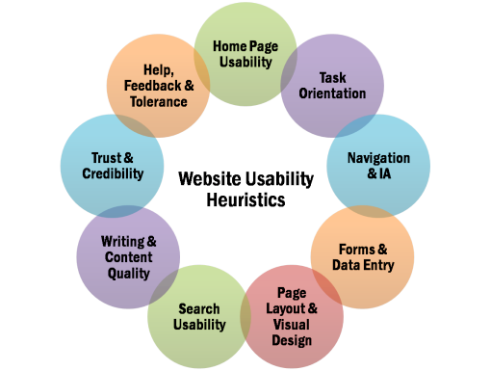
Heuristic evaluation
Heuristic evaluation is the process of assessing a user interface against a standard set of criteria

Slide 73
Procedure
Choose heuristics
Choose evaluators
Identify goal of the interface
Define a set of representative tasks
Perform tasks
Tabulate results

Slide 74
Example: choose heuristics
Nielsen’s heuristics of user interface design
Gerhardt-Powals’ cognitive engineering principles
Standards
  accessibility
  responsive design
  color guides
Internal, company guidelines

Slide 75
Example: choose evaluators
Choose the number of evaluators
  typically three to five
Choose required background
  ideally, user interface experts
  ideally, complementary skills

Slide 76
Example: identify goal of the interface
The goal of the interface is to both make it possible for individuals to quickly find and order the book they need and for individuals to explore the richness of the collection that is available
The goal of the interface is to allow doctors to easily order the right prescription for their patients while at the same time minimizing the number of wrong prescriptions being ordered

Slide 77
Example: define a set of representative tasks
Find the book ‘Software Designers in Action’ and order it
Find five books that are similar to this book, and choose the book that is most similar
Post a review of this book
Order a prescription for patient X consisting of 20 pills of penicillin, at a dosage of 250mg, 2 pills per day
Change the prescription for patient X to 10 pills at a dosage of 500mg, 1 pill a day

Slide 78
Example: perform the tasks
Each evaluator performs the set of tasks on their own and, per tasks, and ranks how the interface supports the task in terms of the heuristics

Slide 79
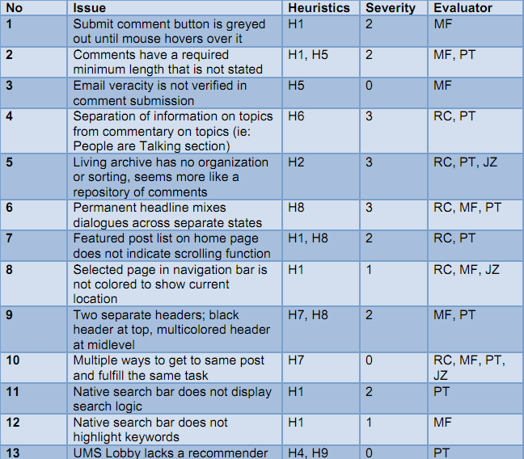
Example: tabulate results

Slide 80
Typical notation: table

Slide 81
Criteria for successful use
The evaluators must be well-versed in the heuristics
Application of multiple evaluators
Requires attention to detail

Slide 82
Strengths and weaknesses
Strengths
Weaknesses
Is based on best practices
Useful to iron out problems before testing with real users
Can be performed relatively quickly
Can be used on early design artifacts
Result sharing improves design practice
Focuses on problems, does not identify opportunities
Will not uncover all problems, because of a focus on a given set of heuristics

Slide 83
Variants
Cognitive walkthrough

Slide 84
Software design methods
 | Application design | Interaction design | Architecture design | Implementation design
Analysis | competitive testing contextual inquiry feature comparison stakeholder analysis task analysis | critical incident technique interaction logging personas scenarios | framework assessment model-driven engineering quality-function-deployment reverse engineering world modeling | release planning summarization test-driven design visualization
Synthesis | affinity diagramming concept mapping mind mapping morphological chart | design/making participatory design prototyping storyboarding | architectural styles generative programming component reuse decomposition | pair programming refactoring search software patterns
Evaluation | requirements review role playing wizard of oz | cognitive walkthrough evaluative research heuristic evaluation think-aloud protocol | formal verification simulation weighted objectives | correctness proofs inspections/reviews parallel deployment testing

Slide 85
Design studio 3
Part 1:
  apply the heuristic evaluation design method to your own team’s interaction design for the educational traffic simulator
    score your design on each of the 10 dimensions (1 low, 10 high)
    provide a rationale for each of these scores (e.g., which task, what worked and did not work)
Part 2:
  evaluate the work of the professionals who designed the educational traffic simulator
    watch the video
    provide a 3-4 page essay discussing their work in the context of what we have learned in class thus far

Slide 86
Design studio 3
Part 2:
  evaluate the work of the professionals who designed the educational traffic simulator
    provide a 3-4 page essay discussing their work in the context of what we have learned in class thus far
      audience, other stakeholders, goals, constraints, assumptions
      application design
      interaction design
      architecture design

Slide 87
Design studio 3
Download the amberpoint video
  http://pebble.ics.uci.edu:80/design-workshop
  username: andre
  password: andre123
Note: the video is large
This is an individual assignment
Both parts are due Tuesday 12/02 at the beginning of class

