Slide 1
Informatics 121 Software Design I
Lecture 7
Duplication of course material for any commercial purpose without the explicit written permission of the professor is prohibited.

Slide 2
Today’s lecture
Design methods (application design)

Slide 3
Intermezzo: what experts do
Experts keep options open
Experts make provisional decisions
Experts see error as opportunity
Experts make tradeoffs
Experts prioritize among stakeholders
Experts adjust to the degree of uncertainty present

Slide 4
Design cycle
synthesize
goals
constraints
assumptions
decisions
ideas
analyze
evaluate

Slide 5
Design method
A self-contained, structured technique that guides a designer in advancing some aspect of the design project at hand
Serves as a bridge from the overall process of design to actual individual and collaborative design work

Slide 6
Characteristics of design methods
Each design method suits a specific purpose with respect to the design cycle and overall design project
Each design method expects a certain context for it to lead to optimal results
Applying just one design method rarely suffices (but still may help)

Slide 7
Software design methods
 | Application design | Interaction design | Architecture design | Implementation design
Analysis | competitive testing contextual inquiry feature comparison stakeholder analysis task analysis | critical incident technique interaction logging personas scenarios | framework assessment model-driven engineering quality-function-deployment reverse engineering world modeling | release planning summarization test-driven design visualization
Synthesis | affinity diagramming concept mapping mind mapping morphological chart | design/making participatory design prototyping storyboarding | architectural styles generative programming component reuse decomposition | pair programming refactoring search software patterns
Evaluation | requirements review role playing wizard of oz | cognitive walkthrough evaluative research heuristic evaluation think-aloud protocol | formal verification simulation weighted objectives | correctness proofs inspections/reviews parallel deployment testing

Slide 8
Software design methods
 | Application design | Interaction design | Architecture design | Implementation design
Analysis | competitive testing contextual inquiry feature comparison stakeholder analysis task analysis | critical incident technique interaction logging personas scenarios | framework assessment model-driven engineering quality-function-deployment reverse engineering world modeling | release planning summarization test-driven design visualization
Synthesis | affinity diagramming concept mapping mind mapping morphological chart | design/making participatory design prototyping storyboarding | architectural styles generative programming component reuse decomposition | pair programming refactoring search software patterns
Evaluation | requirements review role playing wizard of oz | cognitive walkthrough evaluative research heuristic evaluation think-aloud protocol | formal verification simulation weighted objectives | correctness proofs inspections/reviews parallel deployment testing

Slide 9
Software design methods
 | Application design | Interaction design | Architecture design | Implementation design
Analysis | competitive testing contextual inquiry feature comparison stakeholder analysis task analysis | critical incident technique interaction logging personas scenarios | framework assessment model-driven engineering quality-function-deployment reverse engineering world modeling | release planning summarization test-driven design visualization
Synthesis | affinity diagramming concept mapping mind mapping morphological chart | design/making participatory design (parallel) prototyping storyboarding | architectural styles generative programming component reuse decomposition | pair programming refactoring search software patterns
Evaluation | requirements review role playing wizard of oz | cognitive walkthrough evaluative research heuristic evaluation think-aloud protocol | formal verification simulation weighted objectives | correctness proofs inspections/reviews parallel deployment testing

Slide 10
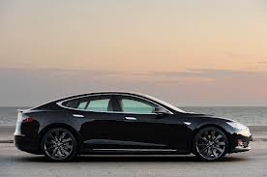
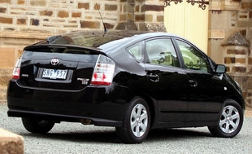
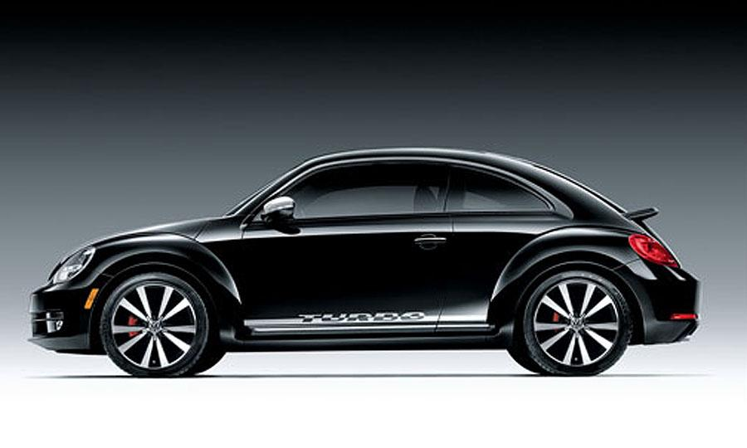
Feature comparison
Feature comparison is the process of conducting research to learn about the features of competing products
Tesla Model S
Toyota Prius
Volkswagen Beetle

Slide 11
Procedure
Identify competitors and their products
Establish dimensions for comparison
Conduct research
Analyze results

Slide 12
Example: identify competitors and their products
Tesla Model S
Toyota Prius
Volkswagen Beetle

Slide 13
Example: establish dimensions for comparison
Type of engine
Miles per gallon
Range on a single refuel/recharge
Number of passengers
Number of doors
…

Slide 14
Example: conduct research
Request brochures
Visit manufacturer web site
Visit independent review web site (e.g., J.D. Powers)
Visit car dealers
Ask friends
…

Slide 15
Example: analyze results
 | Tesla Model S | Toyota Prius | Volkswagen Beetle
Type of engine | Fully electric | Hybrid | Gasoline
Miles per gallon | 89 | 50 | 32
Range on a single refuel/recharge | 300 | 540 | 594
Number of passengers | 7 | 5 | 4
Number of doors | 4 | 4 | 4
… | … | … | …

Slide 16
Example: analyze results
A fully electric vehicle reduces the driving range significantly
A hybrid car may represent an appropriate tradeoff between driving range and fuel efficiency
Four doors is standard
Tesla Model S, except for its driving range, is (tied for) best in all categories, and therefore perhaps our main competitor
…

Slide 17
Typical notation: comparison matrix
 | Tesla Model S | Toyota Prius | Volkswagen Beetle
Type of engine | Fully electric | Hybrid | Gasoline
Miles per gallon | 89 | 50 | 32
Range on a single refuel/recharge | 300 | 540 | 594
Number of passengers | 7 | 5 | 4
Number of doors | 4 | 4 | 4
… | … | ...

Slide 18
Alternative notation: radar chart

Slide 19
Criteria for successful use
Direct or indirect access to the specifications of the competing products
Creation of a meaningful set of dimensions for comparison
Appropriate depth of analysis

Slide 20
Strengths and weaknesses
Strengths
Weaknesses
Helps identify key competitors
Creates a detailed account of competing products
Builds an understanding of the full landscape as it exists today
range of feature sets
differentiation
best practices
Lightweight design method
Focuses on the present, not what competing products might look like in the (near) future
Reinforces existing boundaries, perhaps stifling creativity
Lightweight design method

Slide 21
Software design methods
 | Application design | Interaction design | Architecture design | Implementation design
Analysis | competitive testing contextual inquiry feature comparison stakeholder analysis task analysis | critical incident technique interaction logging personas scenarios | framework assessment model-driven engineering quality-function-deployment reverse engineering world modeling | release planning summarization test-driven design visualization
Synthesis | affinity diagramming concept mapping mind mapping morphological chart | design/making participatory design (parallel) prototyping storyboarding | architectural styles generative programming component reuse decomposition | pair programming refactoring search software patterns
Evaluation | requirements review role playing wizard of oz | cognitive walkthrough evaluative research heuristic evaluation think-aloud protocol | formal verification simulation weighted objectives | correctness proofs inspections/reviews parallel deployment testing

Slide 22
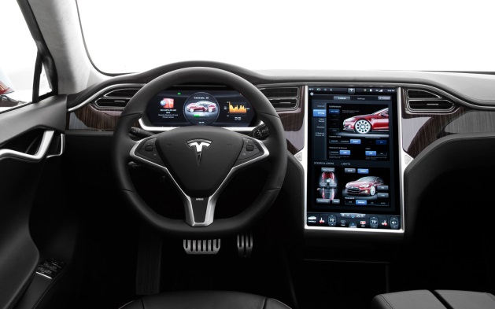
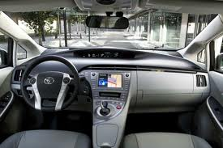
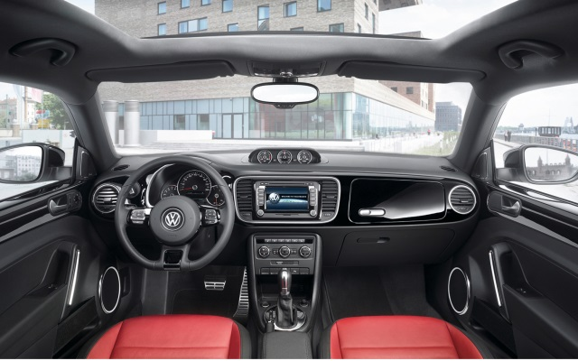
Competitive testing
Competitive testing is the process of conducting research to evaluate the usability and learnability of competing products
Tesla Model S
Toyota Prius
Volkswagen Beetle

Slide 23
Procedure
Identify competitors and their products
Establish dimensions for comparison
Develop scenarios, tasks, and scripts
Recruit participants
Conduct experiment
Analyze results

Slide 24
Example: identify competitors and their products
Tesla Model S
Toyota Prius
Volkswagen Beetle

Slide 25
Example: establish dimensions for comparison
Usability
number of completed tasks
time it takes to complete tasks
number of steps it takes to complete tasks
ability to complete tasks without taking one’s eyes off the road
Learnability
number of times the user fails
number of times the user must execute the same function before completing it seamlessly the first time
number of times the user must request assistance

Slide 26
Example: develop scenarios, tasks, and scripts
Scenario
a person is driving in remote country side, and is lost; the gas tank is becoming empty, and it is getting late
Tasks
find a hotel and obtain directions to it
locate a gas station on the way and adjust the route to stop by the station
Script
imagine you are driving in remote country side, have become lost, …
use the navigation system to find a hotel and obtain directions to it
now that you have been driving for a while, you notice gas tank is almost empty
use the navigation system to locate a gas station on the way and adjust the route to stop by the station

Slide 27
Example: recruit participants
Set up a testing station at a rural, but still well-traveled, road in Oregon, stop motorists, and ask them to participate
Draw an advertisement in the local newspaper
Social media recruiting
Use an external recruitment service to target particular (typically representative) demographics

Slide 28
Example: conduct experiment
Start the experiment by asking the participant to start driving
Execute the script by reading the relevant portions when it is time to do so
Observe and/or video/audio tape the participant as they execute the tasks in the script
Repeat the script several times, so to be able to assess learnability

Slide 29
Example: analyze results
 | Tesla Model S | Toyota Prius | Volkswagen Beetle
Number of completed tasks | 14 | 7 | 12
Time to complete tasks | 30/65 seconds | 30/N.A. seconds | 40/45 seconds
Number of steps | 8/9 | 6/N.A. | 6/7
Not taking one’s eyes off the road | fail | fail | fail
Number of failures | 0/0 | 0/7 | 0/2
First time seamlessly | 1/1 | 1/N.A. | 1/3
Number of requests for assistance | 0/0 | 0/5 | 0/1
… | … | … | …

Slide 30
Example: analyze results
Tesla Model S has the superior navigation system in terms of success rate, but is slower than the Volkswagen Beetle for the second task and also requires more steps for both tasks
Offering assistance mattered on the Volkswagen Beetle
All of the systems fail in not distracting the driver away from the road
All of the systems let the user succeed in the first task the first time

Slide 31
Typical notation: comparison matrix
 | Tesla Model S | Toyota Prius | Volkswagen Beetle
Number of completed tasks | 14 | 7 | 12
Time to complete tasks | 30/65 seconds | 30/N.A. seconds | 40/45 seconds
Number of steps | 8/9 | 6/N.A. | 6/7
Not taking one’s eyes off the road | fail | fail | fail
Number of failures | 0/0 | 0/7 | 0/2
First time seamlessly | 1/1 | 1/N.A. | 1/3
Number of requests for assistance | 0/0 | 0/5 | 0/1
… | … | … | …

Slide 32
Alternative notation: report
“In this report, we compare the car navigation systems of the Tesla Model S, Toyota Prius, and Volkswagen Beetle. We focused on usability and learnability, so to understand the experience of the users in the short-term while they get used to the system and in the long-term after they have gotten accustomed to it. Our report is based on…”

Slide 33
Criteria for successful use
Direct access to the competing products
Creation of a meaningful set of dimensions for comparison
In-depth collection of data during the experiment
one-shot opportunity
Appropriate depth of analysis
Unbiased test administration

Slide 34
Strengths and weaknesses
Strengths
Weaknesses
Helps identify key competitors
Helps identify how individuals experience the competing products
Builds an understanding of the full landscape as it exists today
what factors drive how people experience a product
Identifies weaknesses in competing products
Identifies potential pitfalls to avoid
Focuses on the present, not what competing products might look like in the (near) future
Reinforces existing boundaries, perhaps stifling creativity
May exhibit bias
Lessons that can be learned depend strongly on the scenarios and tasks

