Slide 1
Informatics 121 Software Design I
Lecture 17
Duplication of course material for any commercial purpose without the explicit written permission of the professor is prohibited.

Slide 2
Discussion
No discussion this Friday

Slide 3
Today’s lecture
Architecture design

Slide 4
Architecture
“The conceptual core”
“That what really makes it work”
“Principal set of design decisions”
“Essence of the solution”

Slide 5
Architecture

Slide 6
Architecture

Slide 7
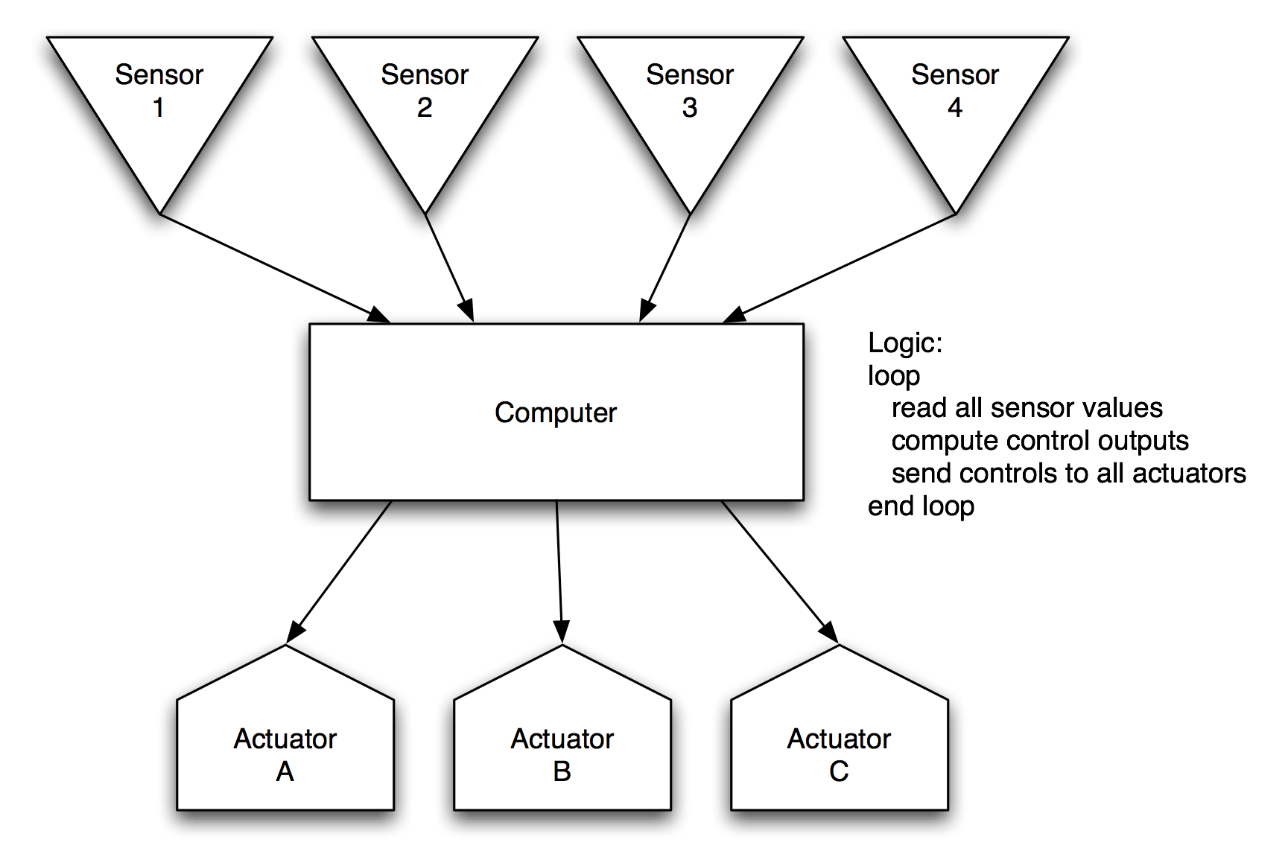
Architecture

Slide 8
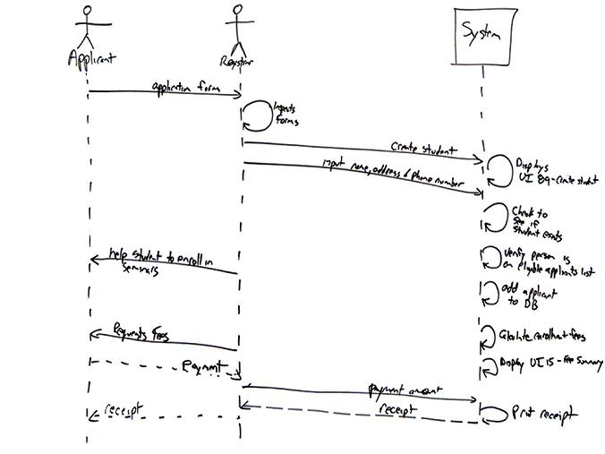
Architecture

Slide 9
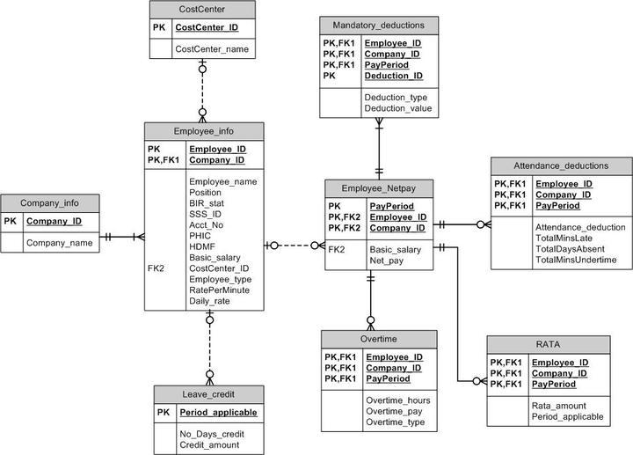
Architecture

Slide 10
Architecture
Components and connectors
Data model
Protocol
Interface
Naming
Algorithm
…

Slide 11
Software design methods
 | Application design | Interaction design | Architecture design | Implementation design
Analysis | competitive testing contextual inquiry feature comparison stakeholder analysis task analysis | critical incident technique interaction logging personas scenarios | framework assessment model-driven engineering quality-function-deployment reverse engineering world modeling | release planning summarization test-driven design visualization
Synthesis | affinity diagramming concept mapping mind mapping morphological chart | design/making participatory design prototyping storyboarding | architectural styles architectural tactics component reuse decomposition | pair programming refactoring search software patterns
Evaluation | requirements review role playing wizard of oz | cognitive walkthrough evaluative research heuristic evaluation think-aloud protocol | formal verification simulation weighted objectives | correctness proofs inspections/reviews parallel deployment testing

Slide 12
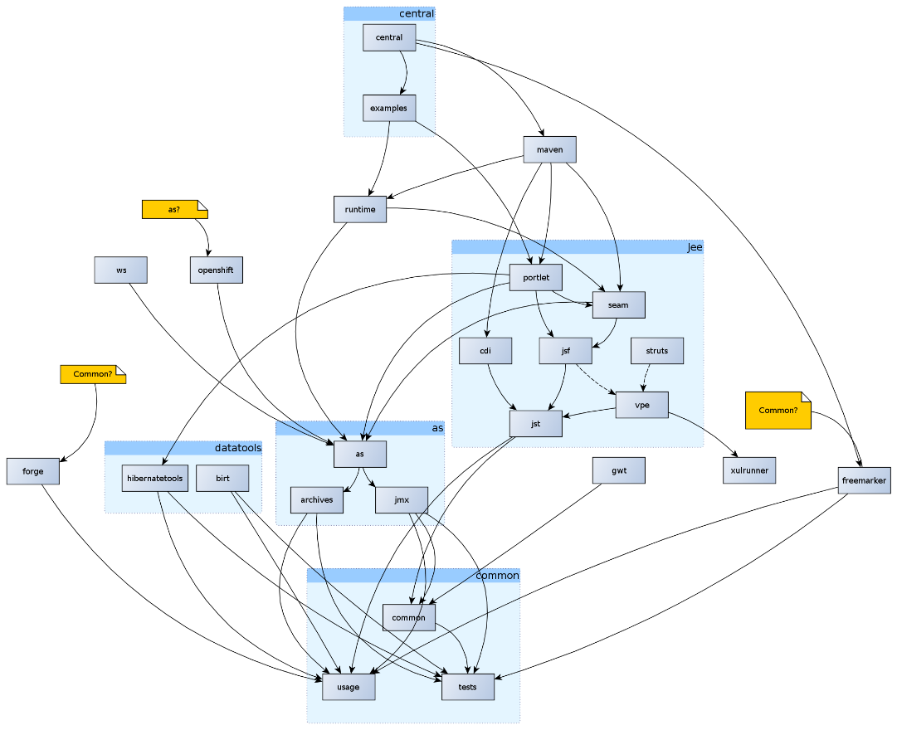
Decomposition
Decomposition is the process of breaking a larger problem into smaller, independently addressable parts

Slide 13
Procedure
Determine criteria by which to decompose the problem
Determine the parts by applying the criteria
Identify the interfaces through which the parts interact

Slide 14
Example: determine criteria by which to…
Information hiding
Separation of concerns
Anticipation of change
Incrementality
Reusability
Generality

Slide 15
Example: determine the parts by applying the…
Consider all of the functionality that must be addressed
Suggest components and make diagrams
Work with other developers
Use tools

Slide 16
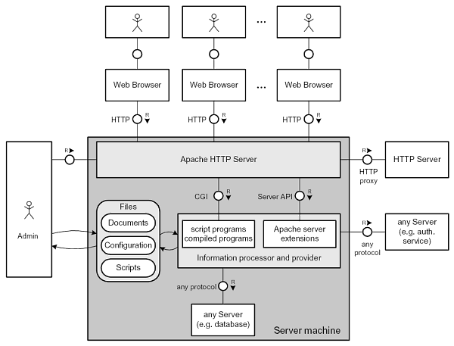
Example: determine the parts by applying the…

Slide 17
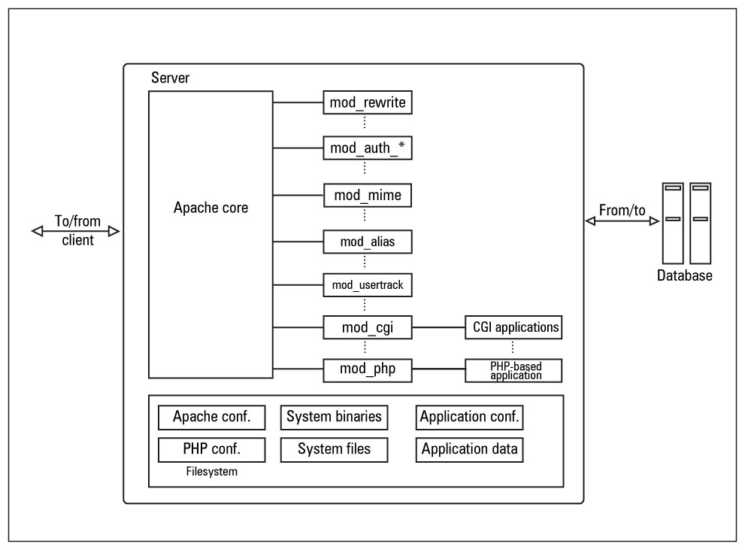
Example: determine the parts by applying the…

Slide 18
Example: identify the interfaces…
Hypertext Transfer Protocol (HTTP)
GET
HEAD
POST
PUT
DELETE
TRACE
OPTIONS
CONNECT
PATCH

Slide 19
Example: identify the interfaces…
http://httpd.apache.org/docs/2.4/mod/
http://httpd.apache.org/docs/2.4/mod/directives.html
http://httpd.apache.org/docs/2.4/mod/core.html
http://httpd.apache.org/docs/2.2/developer/hooks.html

Slide 20
Typical notation: diagram

Slide 21
Typical notation: API specification
void debug( java.lang.CharSequence )
Send a message to the user in the debug error level.
void debug( java.lang.CharSequence, java.lang.Throwable )
Send a message (and accompanying exception) to the user in the debug error level. The error's stacktrace will be output when this error level is enabled.
void debug( java.lang.Throwable )
Send an exception to the user in the debug error level. The stack trace for this exception will be output when this error level is enabled.
void info( java.lang.CharSequence )
Send a message to the user in the info error level.
void info( java.lang.CharSequence, java.lang.Throwable )
Send a message (and accompanying exception) to the user in the info error level. The error's stacktrace will be output when this error level is enabled.
void info( java.lang.CharSequence )
Send an exception to the user in the info error level. The stack trace for this exception will be output when this error level is enabled.
…

Slide 22
Criteria for successful use
Should fully or near-fully understand the functionality that must be provided
Must identify and apply proper criteria
Should think deeply
Must iterate

Slide 23
Strengths and weaknesses
Strengths
Weaknesses
Is the fundamental design method in software engineering that applies in numerous situations
Is the only way to address large-scale problems
Helps increase the ability to develop the software in parallel
Necessary precision frequently leads to the need to clarify other aspects of the design
Often degenerates into unprincipled discussion
Certain concerns remain crosscutting, meaning that an ‘ideal’ decomposition cannot be attained
Can be very labor intensive
Can remain subjective

Slide 24
Practice: frietwagens

