Slide 1
Informatics 121 Software Design I
Lecture 8
Duplication of course material for any commercial purpose without the explicit written permission of the professor is prohibited.

Slide 2
Today’s lecture
Midterm
Design artifacts
Design notations
Expert behaviors
Design studio 2

Slide 3
Midterm
All material up to and including today
Closed book; bring pen/pencil/eraser
Theory and practice

Slide 4
Sample question
The definition of design used in Informatics 121 is:

Slide 5
Sample question
Name the four types of design that must be addressed in software design:

Slide 6
Sample question
Why do experts prefer to work with others?

Slide 7
Sample question
Name the four types of design that must be addressed in software design:

Slide 8
Sample question
Suppose you are to design a new web app that allows anyone to track any flight, its departure and destination airport, where it currently is in route, and its anticipated arrival time. List a possible goal, constraint, assumption, decision, and idea for the web app as related to application design:

Slide 9
Sample question
Suppose you are to design a new application that monitors all food trucks in Orange County, what they serve, where they are, and where they will be. Using the mindmap design method, perform a small brainstorming session (25-30 nodes) surrounding an important question that would help you make progress on the essence of this design problem:

Slide 10
Questions?

Slide 11
Design
designer
plan
maker
change in the world
other stakeholders
audience
experiences

Slide 12
A design artifact
An externalized representation used to further a design project
goals, constraints, assumptions, ideas, decisions
design problem, design solution, or both
partial or complete
fluid or frozen

Slide 13
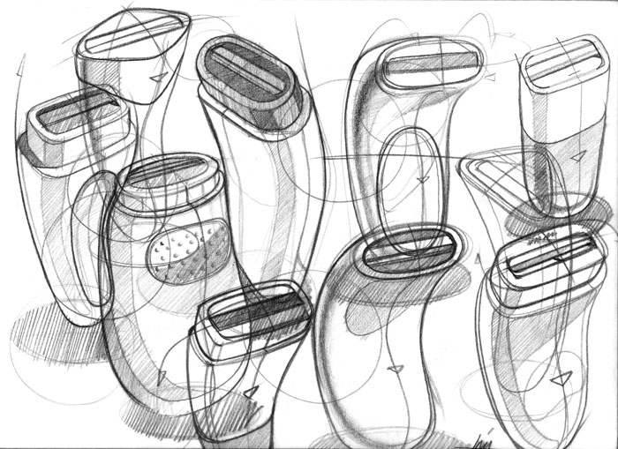
Example

Slide 14
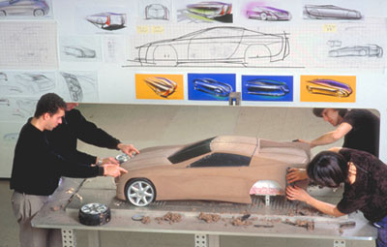
Example

Slide 15
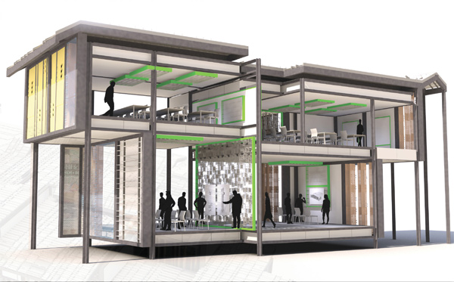
Example

Slide 16
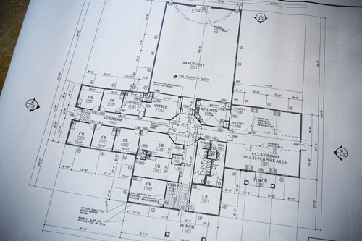
Example

Slide 17
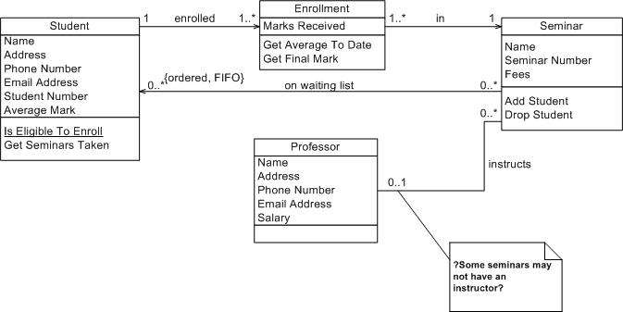
Example

Slide 18
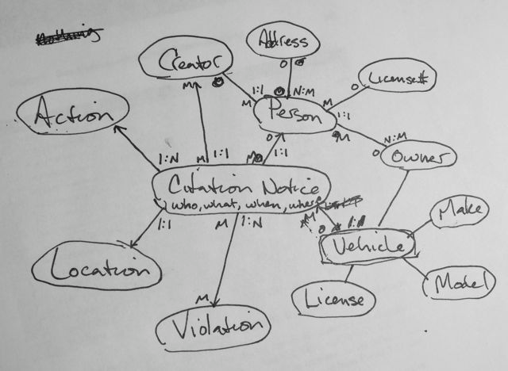
Example

Slide 19
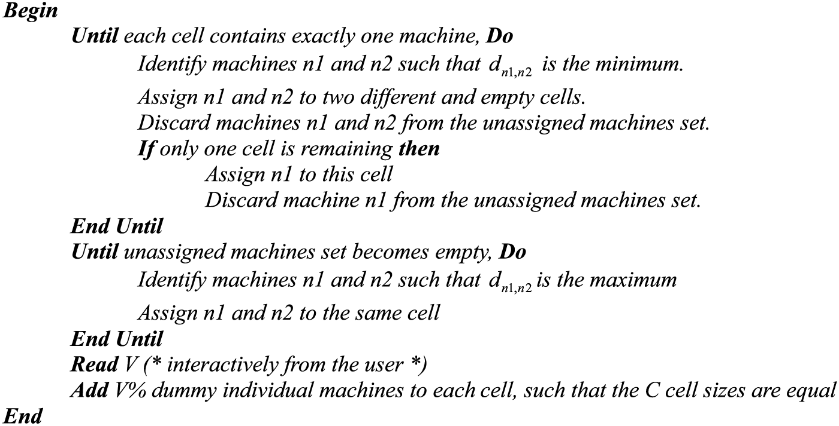
Example

Slide 20
Purpose of design artifacts
Design artifacts to think
Design artifacts to talk
Design artifacts to prescribe

Slide 21
Thinking design artifact

Slide 22
Thinking design artifact

Slide 23
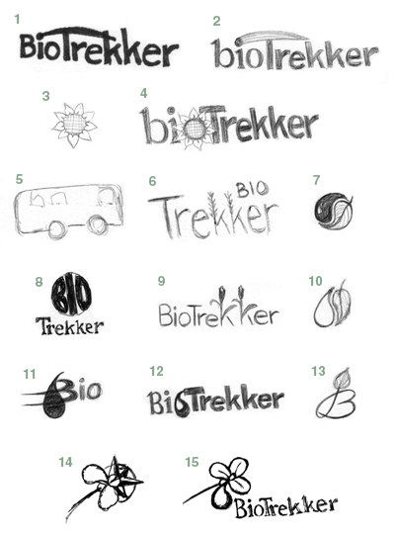
Thinking design artifact

Slide 24
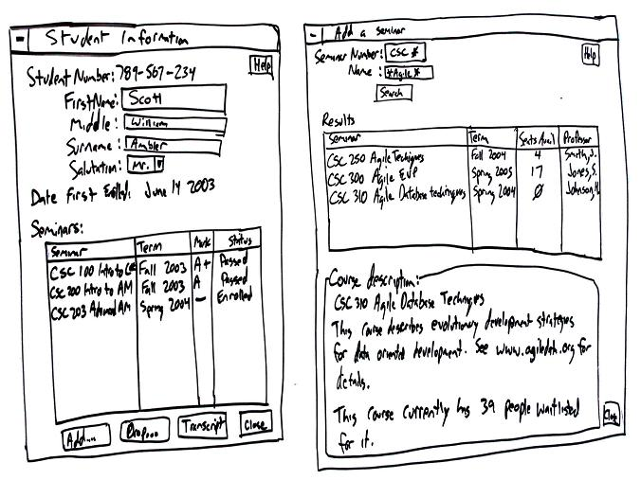
Thinking design artifact

Slide 25
Talking design artifact

Slide 26
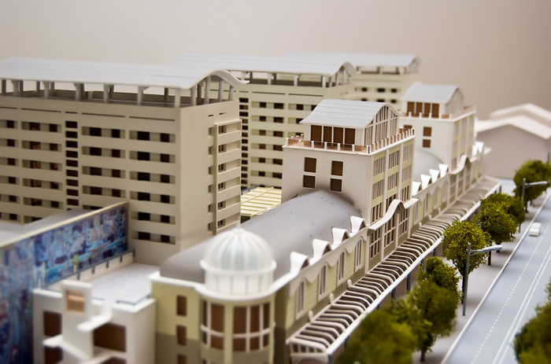
Talking design artifact

Slide 27
Talking design artifact

Slide 28
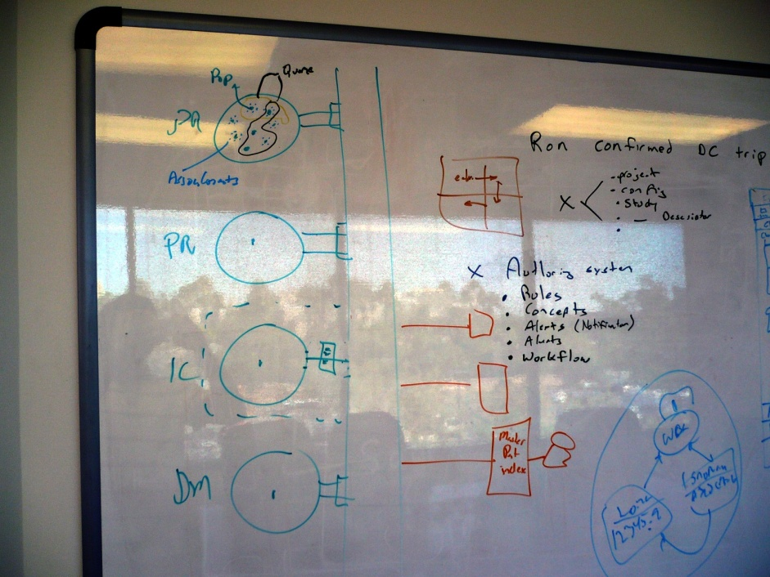
Talking design artifact

Slide 29
Prescribing design artifact

Slide 30
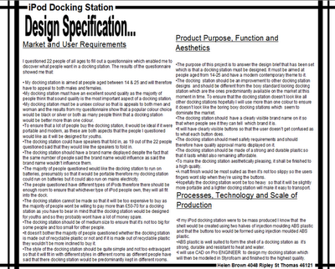
Prescribing design artifact

Slide 31
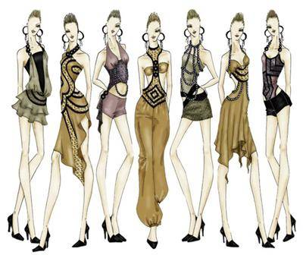
Prescribing design artifact

Slide 32
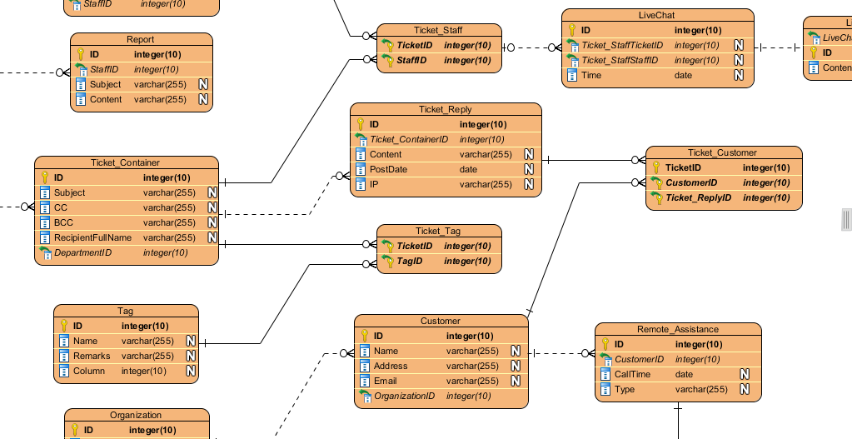
Prescribing design artifact

Slide 33
Abstraction
An abstraction is formed by reducing the information content of a concept or an observable phenomenon, typically to retain only information which is relevant for a particular purpose
choice of what to include
choice of what not to include
Each abstraction makes some information readily available at the expense of obscuring or removing other information

Slide 34
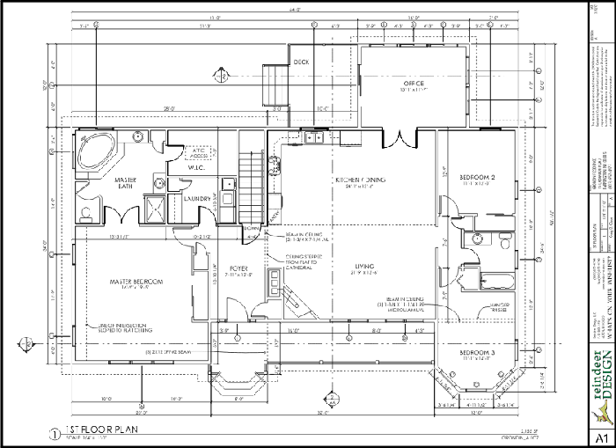
Floor plan

Slide 35
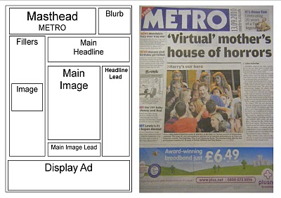
Page layout

Slide 36
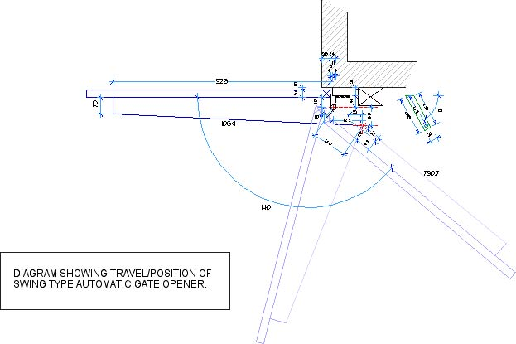
Mechanical engineering diagram

Slide 37
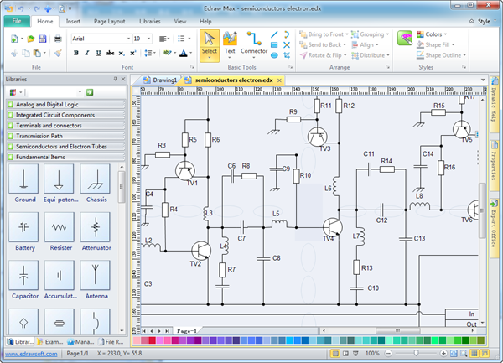
Schematic

Slide 38
Product sketch

Slide 39
Model

Slide 40
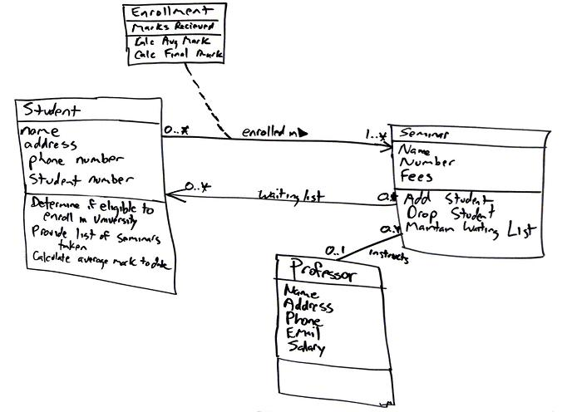
Class diagram

Slide 41
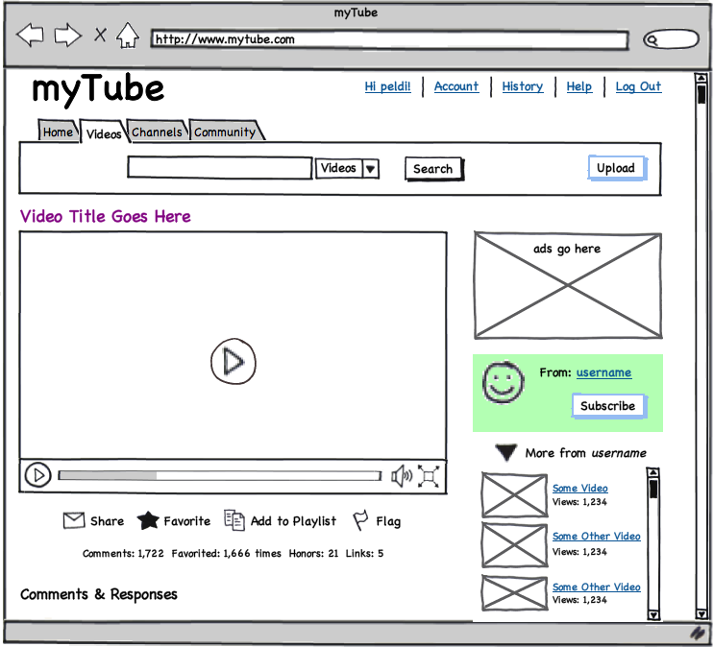
User interface mock-up
[balsamiq]

Slide 42
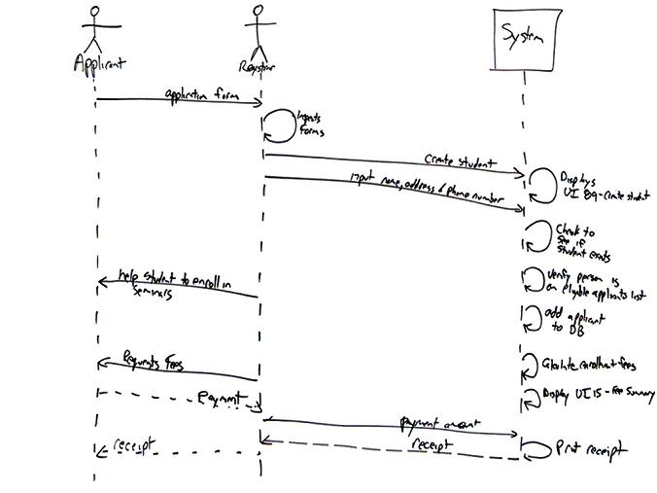
Sequence diagram

Slide 43
Design notation
A design notation offers a language for specifying certain aspects of a design artifact
textual and/or graphical vocabulary for specifying individual and composite elements
rules governing how individual elements can be combined into composite elements
implicit and/or explicit semantics for giving meaning
Each design notation is typically suited for a particular domain and a particular purpose
Every design notation invariably introduces abstraction

Slide 44
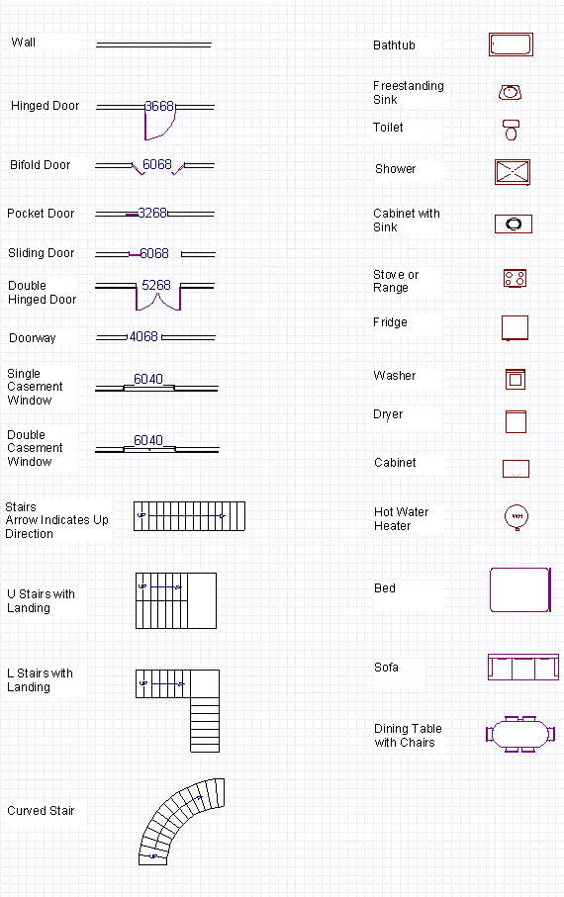
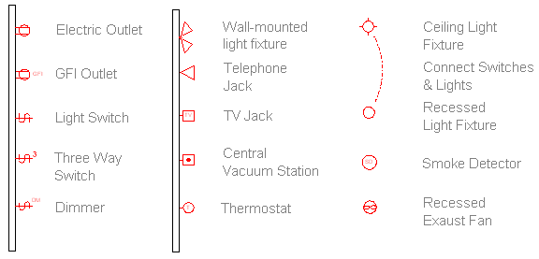
Example notation

Slide 45
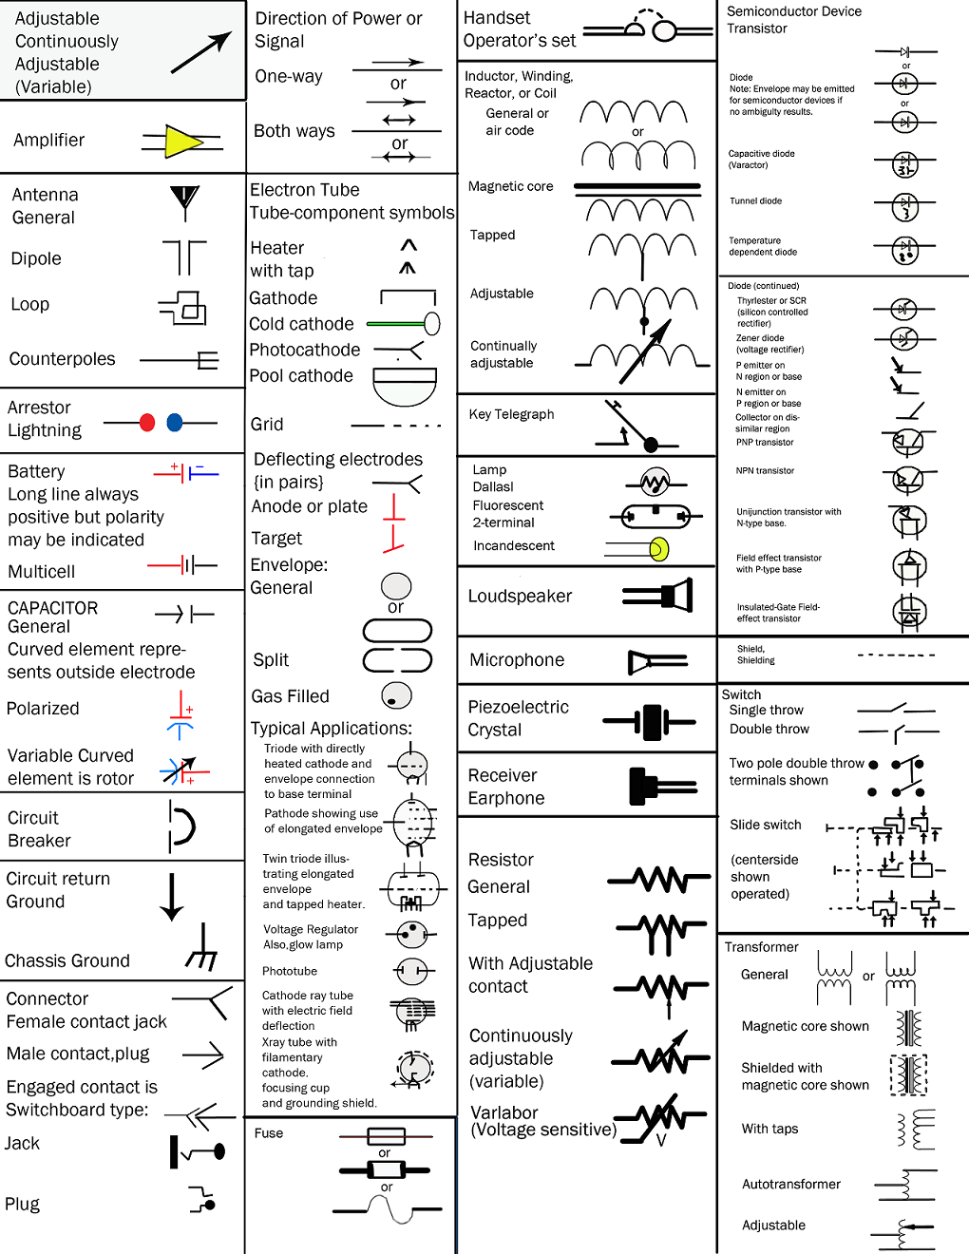
Example notation

Slide 46
Example notation

Slide 47
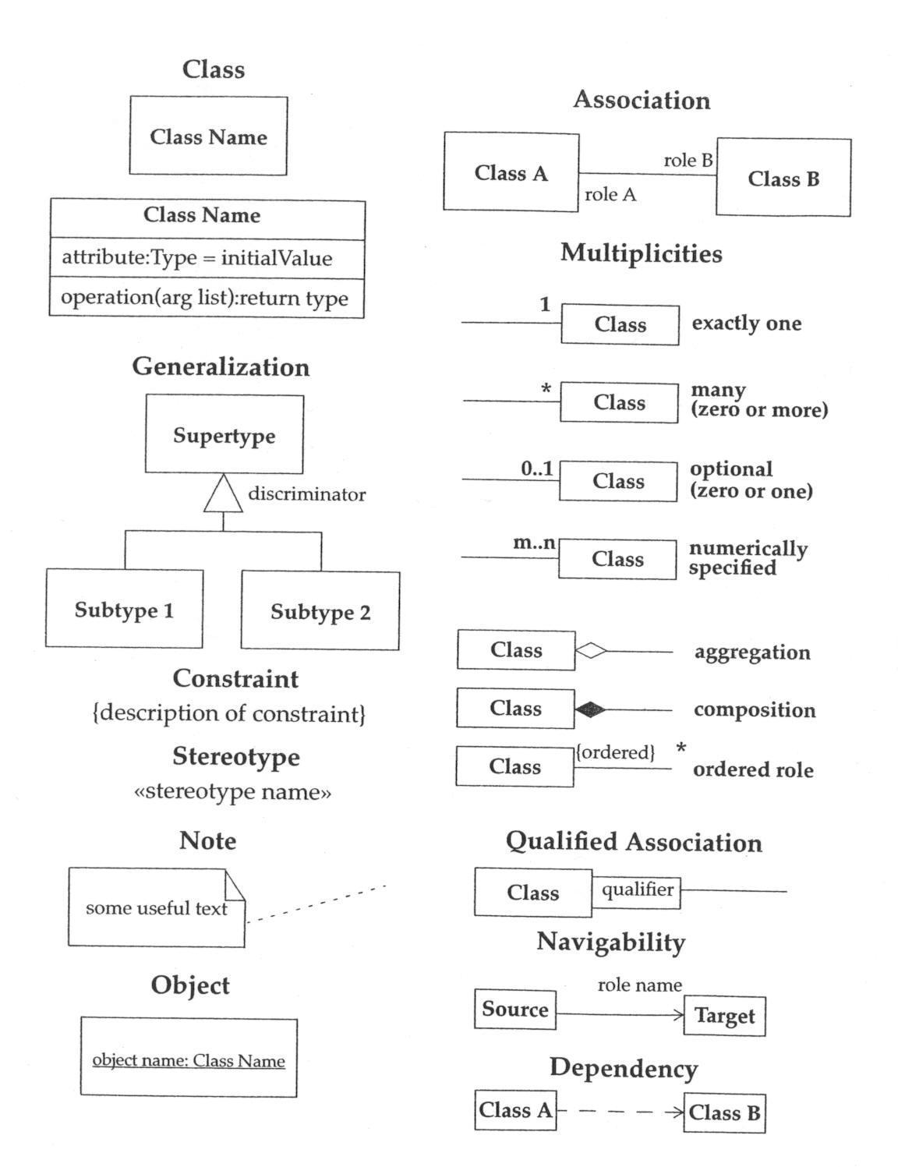
Example notation

Slide 48
Example notation

Slide 49
Considerations in choosing a design notation
Who is the audience?
What is the objective?
What is the timeframe?

Slide 50
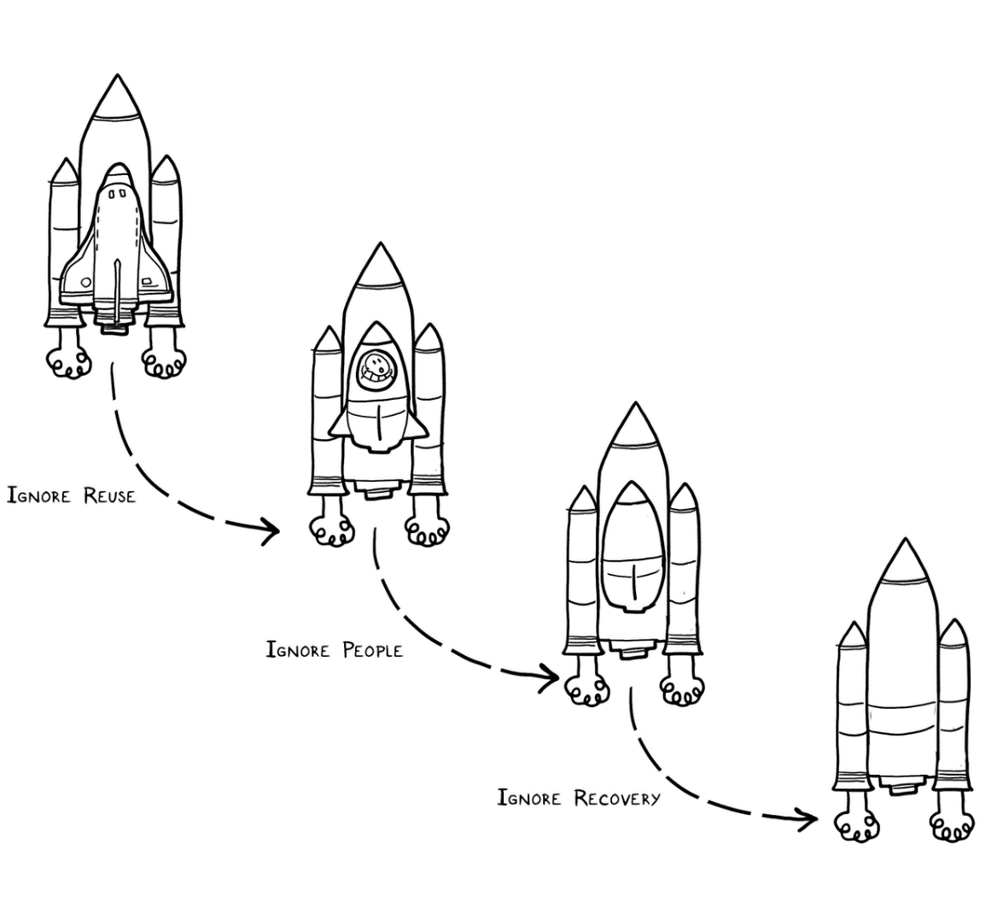
Experts solve simpler problems first

Slide 51
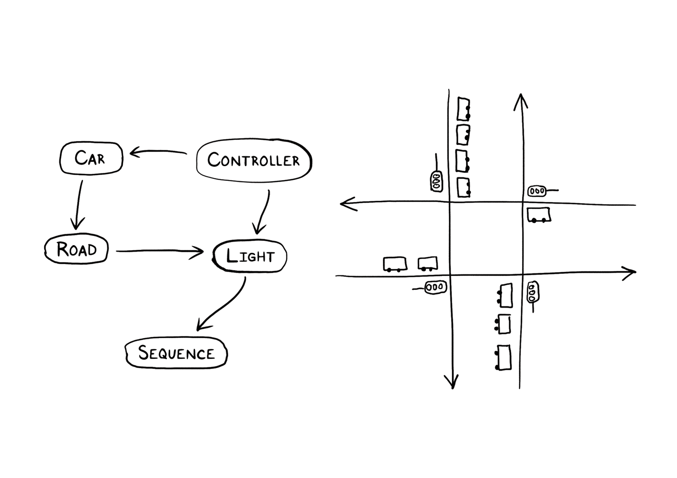
Experts draw the problem as much as they draw the solution

Slide 52
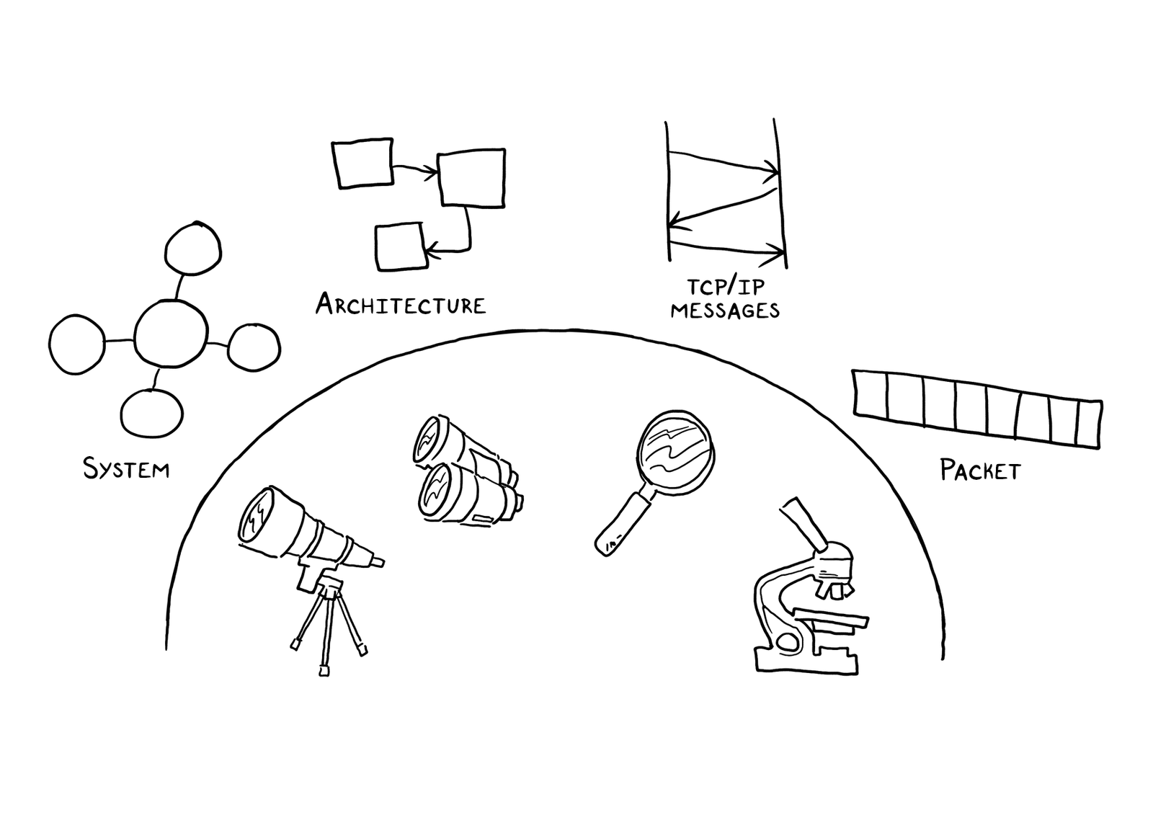
Experts move among levels of abstraction

Slide 53
Experts go as deep as needed

Slide 54
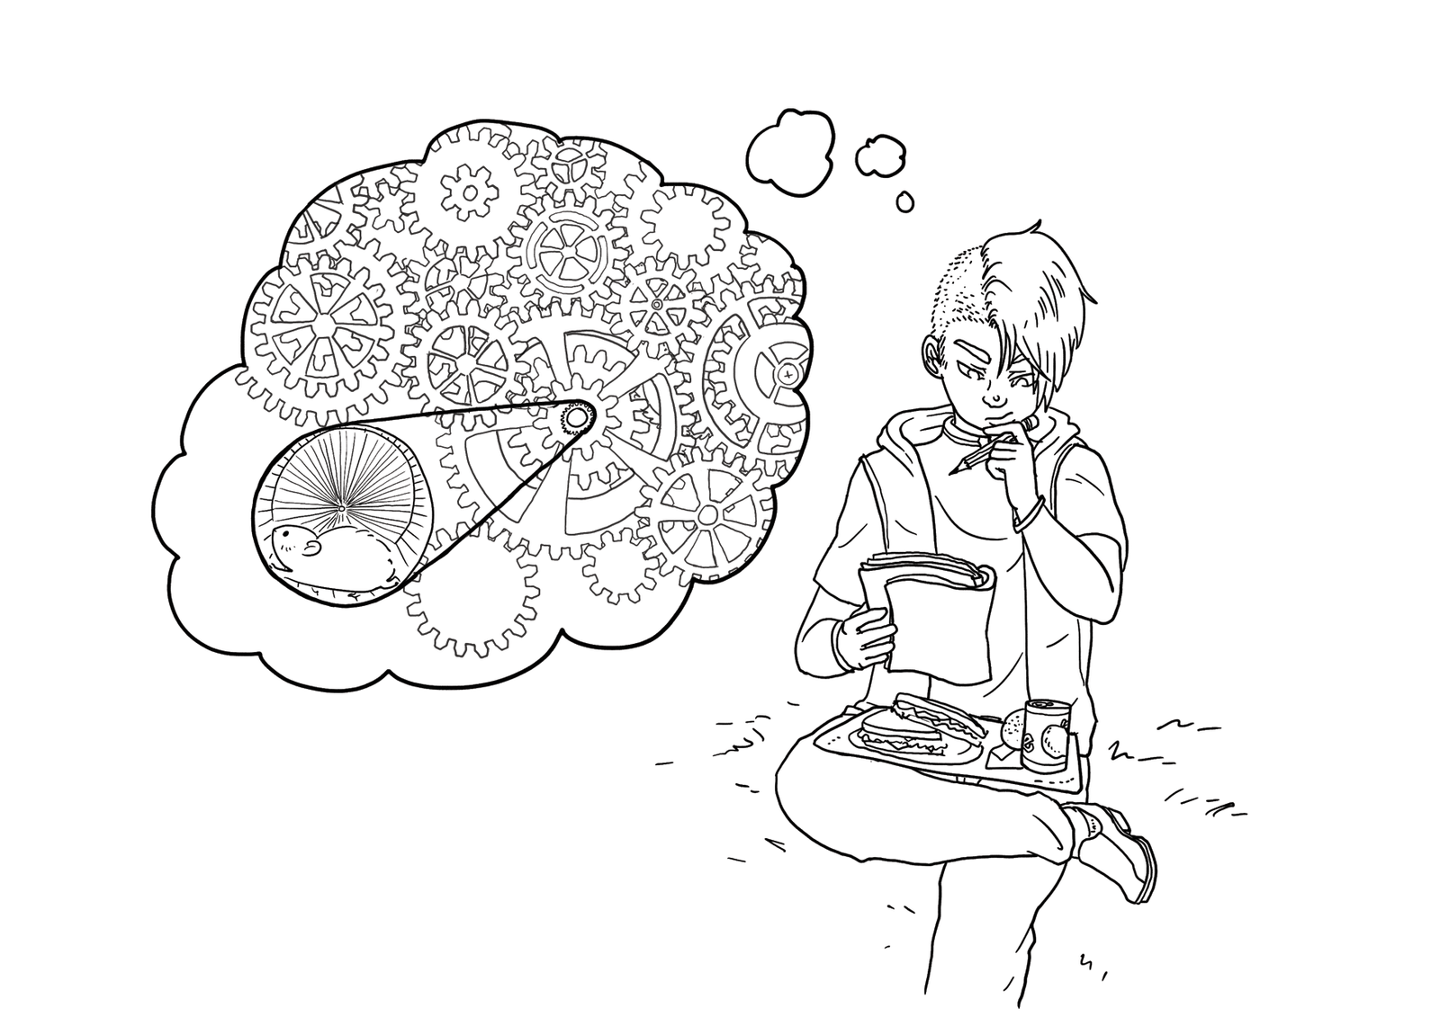
Experts simulate continually

Slide 55
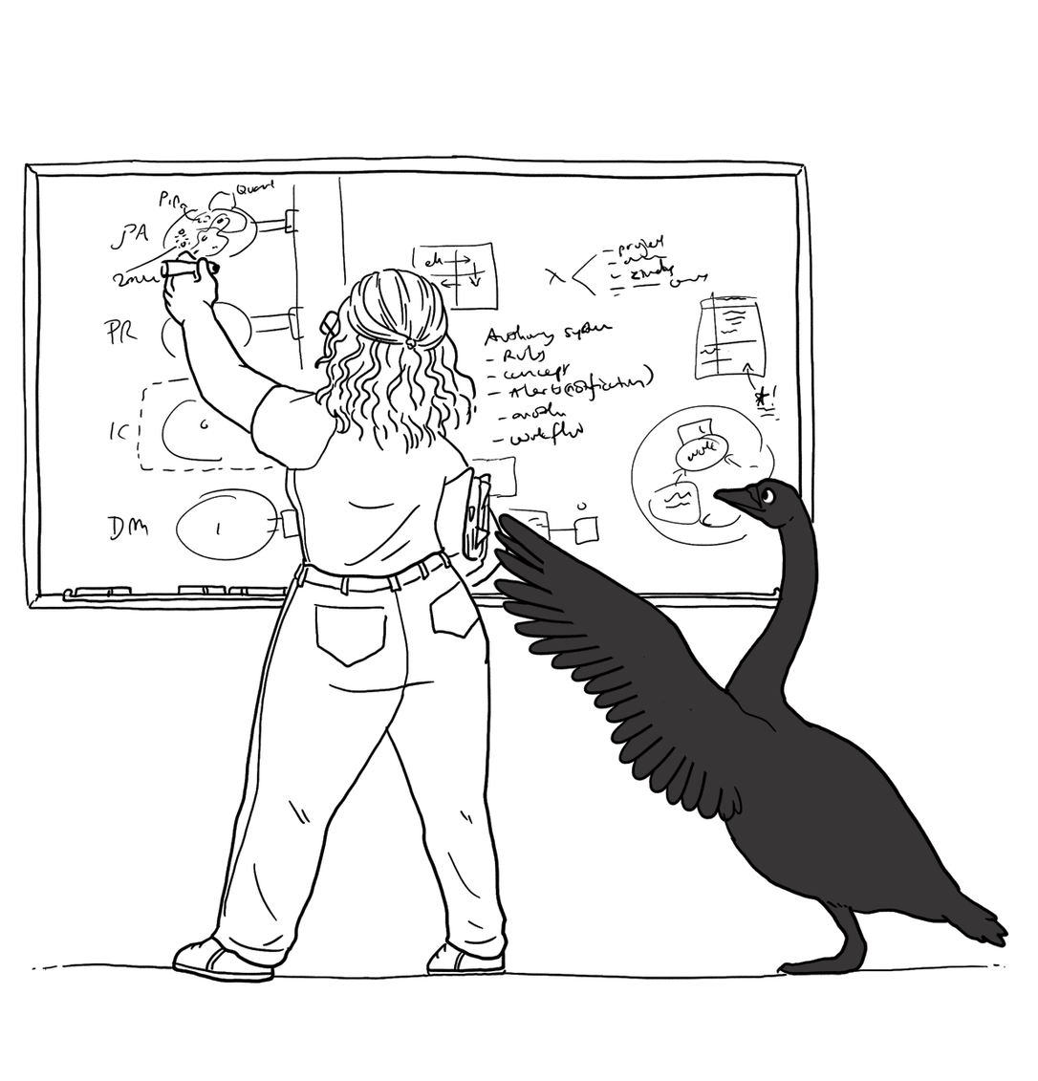
Experts are alert to evidence that challenges their theory

Slide 56
Experts think about what they are not designing

Slide 57
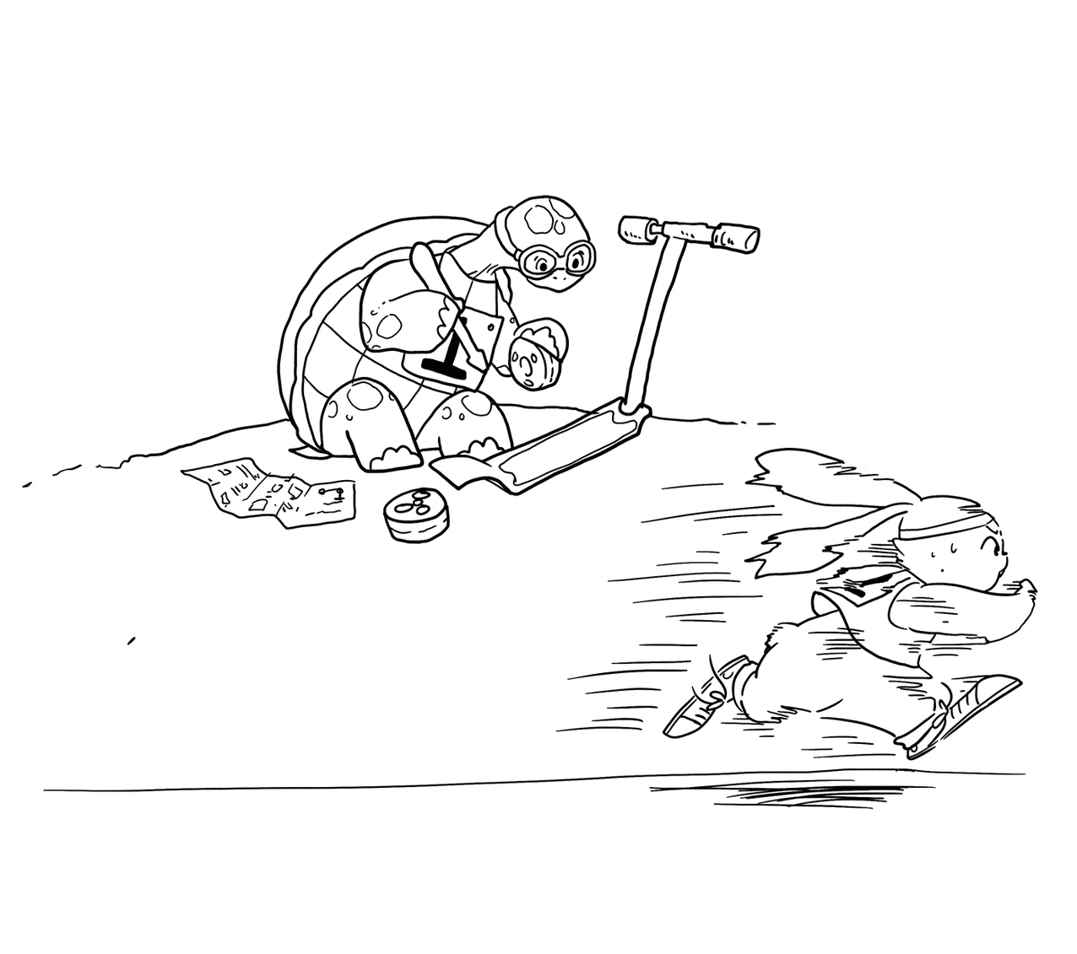
Experts invest now to save time later

Slide 58
Design studio 2 (part 1)
As a team, design an educational traffic simulator based on the design prompt we handed out in class
Make sure to consider at least three different approaches, highlight tradeoffs among the approaches, and discuss why you chose the approach you took
briefly document the approaches you considered but did not adopt
Your group will be announced at the start of your discussion

Slide 59
Design studio 2 (part 1)
Focus
predicting the future
making tradeoffs
managing bias
accommodating change
balancing cost, quality, and effort
solving a problem, now and later

Slide 60
Design studio 2 (part 1)
Practice what you have learned about experts:
solve simpler problems first
draw the problem as much as they draw the solution
move among levels of abstraction
go as deep as needed
simulate continually
are alert to evidence that challenges their theory
think about what they are not designing
invest now to save time later

Slide 61
Design studio 2 (part 1)
Practice what you have learned about experts:
focus on the essence
prefer solutions that they know work
address knowledge deficiencies
generate alternatives
are skeptical

Slide 62
Design studio 2 (part 1)
Bring one printed copy to class, Thursday November 9
make sure to identify all group members
make sure to identify your discussion time
No extensions, not even for reduced points

Slide 63
Design studio 2 (part 1)
Team members will assess other team members
in terms of the contributions they make
in terms of enabling others to make contributions

