Slide 1
Informatics 121 Software Design I
Lecture 10
Duplication of course material for any commercial purpose without the explicit written permission of the professor is prohibited.

Slide 2
Announcements
There will be discussion this Friday
Midterm is this Tuesday, November 6
Bring your student ID, we will be checking it

Slide 3
Today
Design studio 2
Unified Modeling Language (UML)
Design practice

Slide 4
Design studio 2
Any questions?

Slide 5
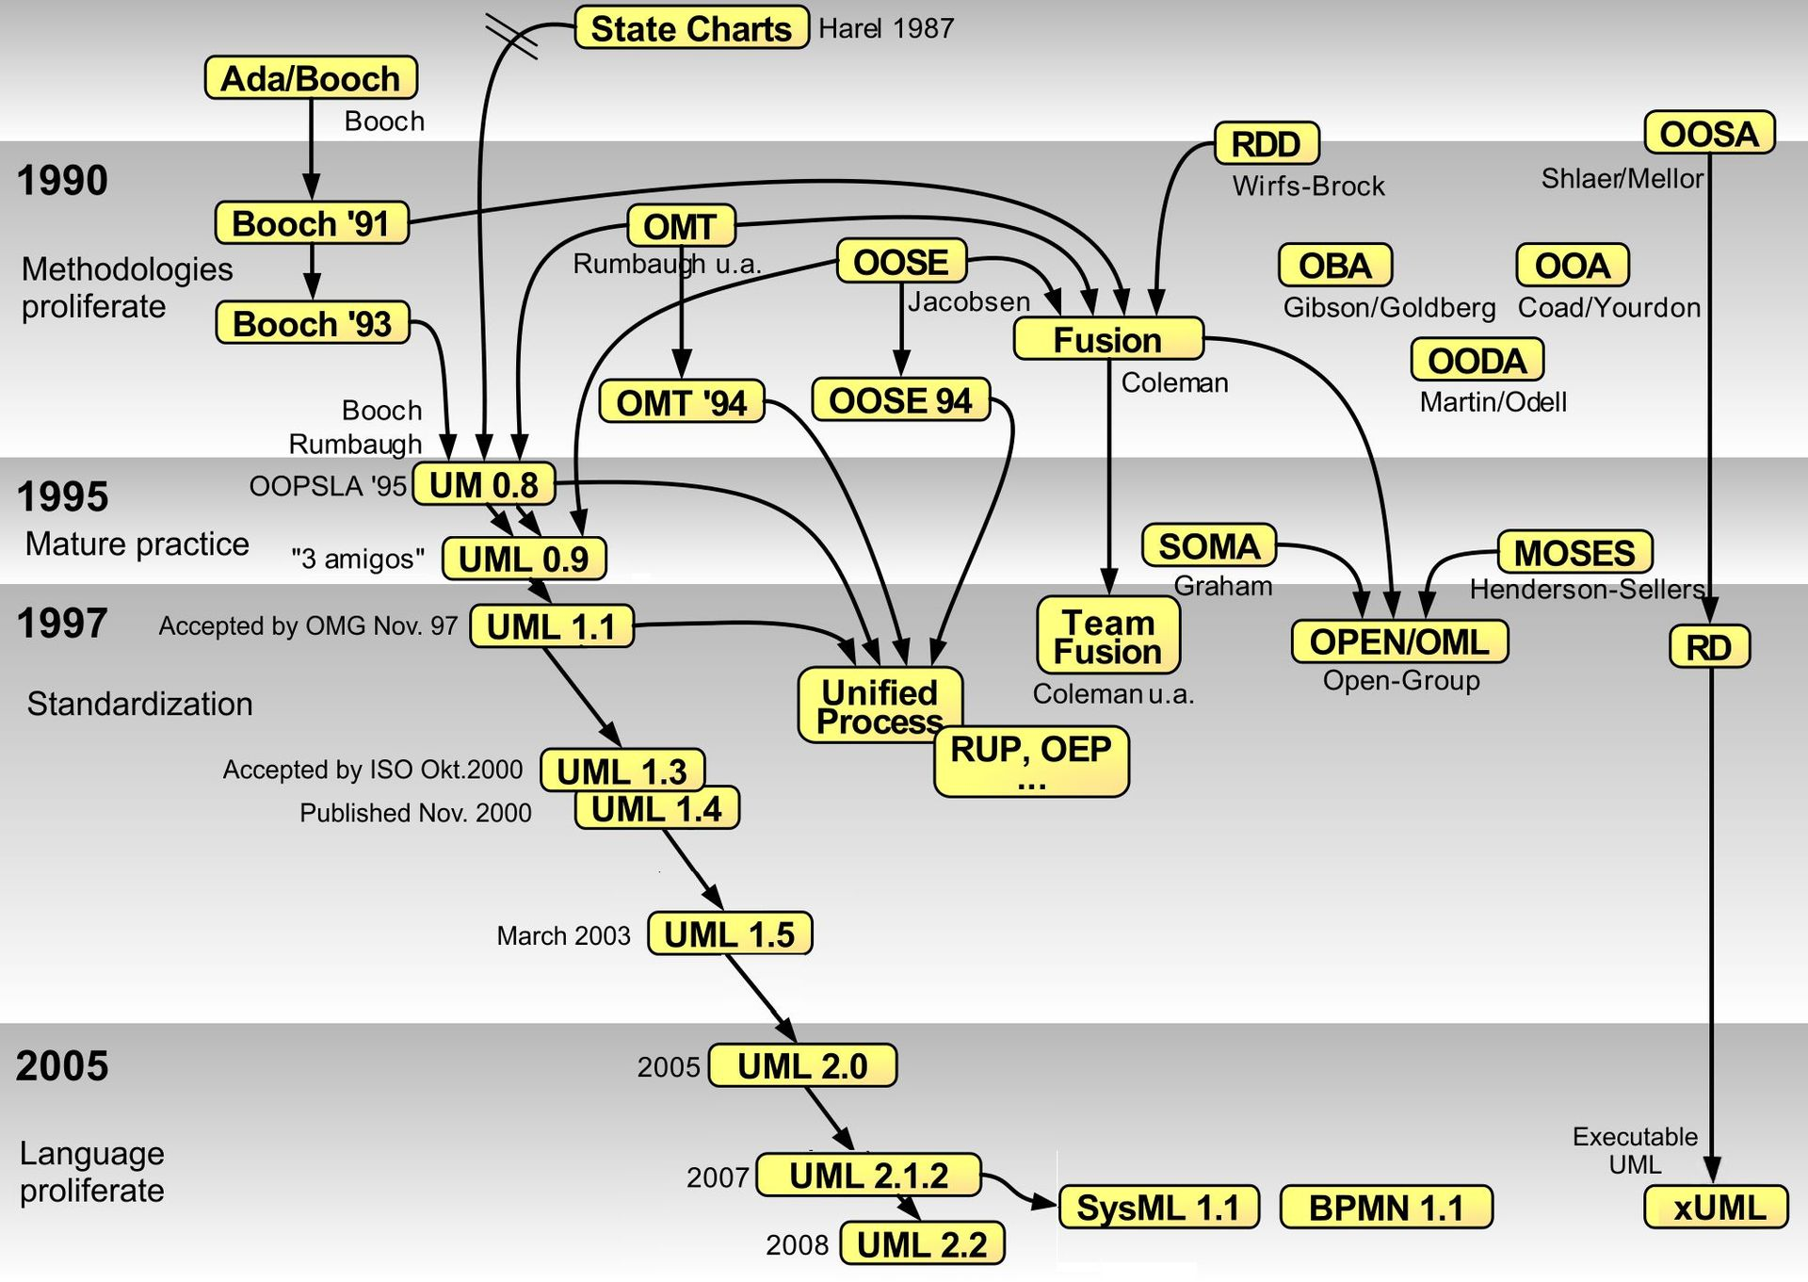
History of (some) software design notations
Notes:
By Guido Zockoll, Axel Scheithauer & Marcel Douwe Dekker (Mdd) - Translation and update of File:OO-historie-2.svg by AxelScheithauer, Okt 6, 2009, CC BY-SA 3.0, https://commons.wikimedia.org/w/index.php?curid=23052855

Slide 6
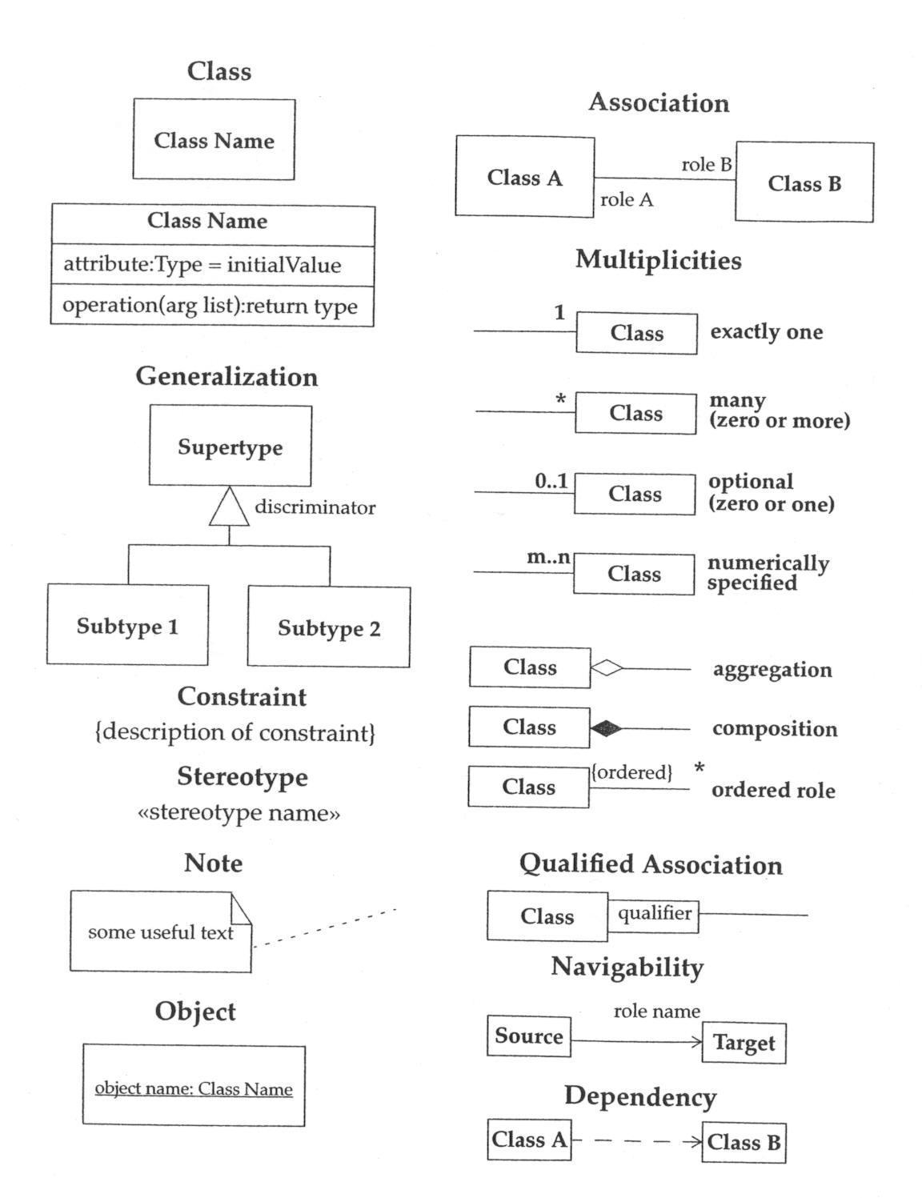
UML class diagrams

Slide 7
Association, aggregation, composition
Association
most general kind of relationship
instructor <teaches a> class, kid <plays with a> friend
Aggregation
more specific kind of relationship
has-a relationship, is-a-part-of relationship
child can exist independent of the parent
bird <is-part-of-a> flock, airplane type <has-a> engine model
Composition
more specific yet
consists-of relationship, contains relationship
child cannot exist independent of the parent
house <consists-of a> room, university <contains a> department

Slide 8
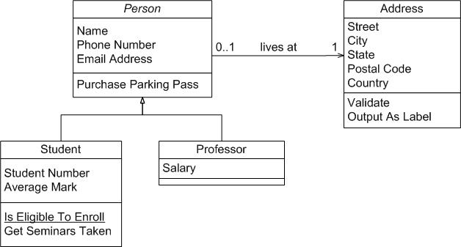
UML example

Slide 9
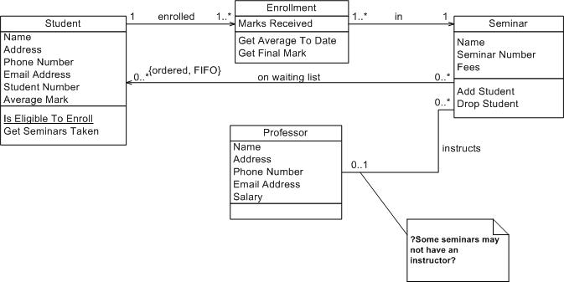
UML example

Slide 10
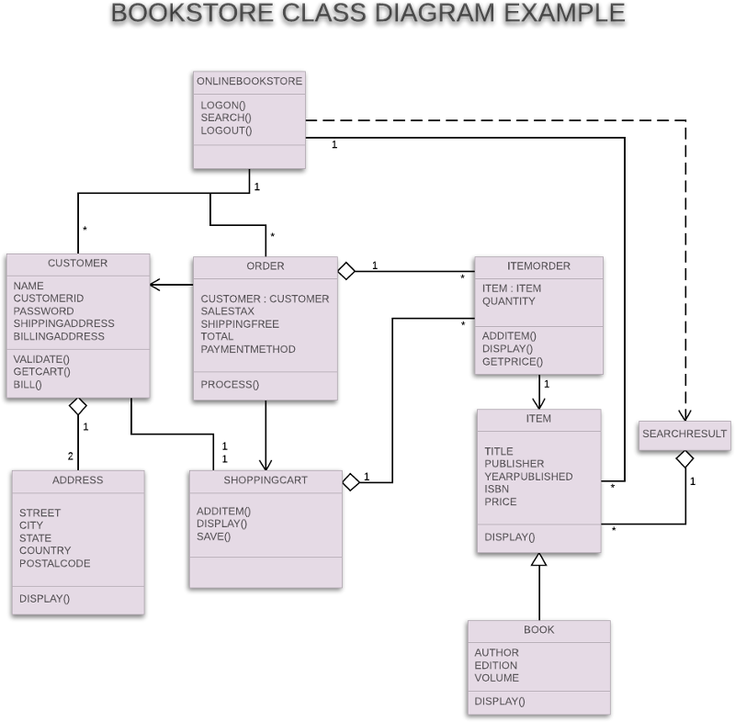
UML example

Slide 11
UML example

Slide 12
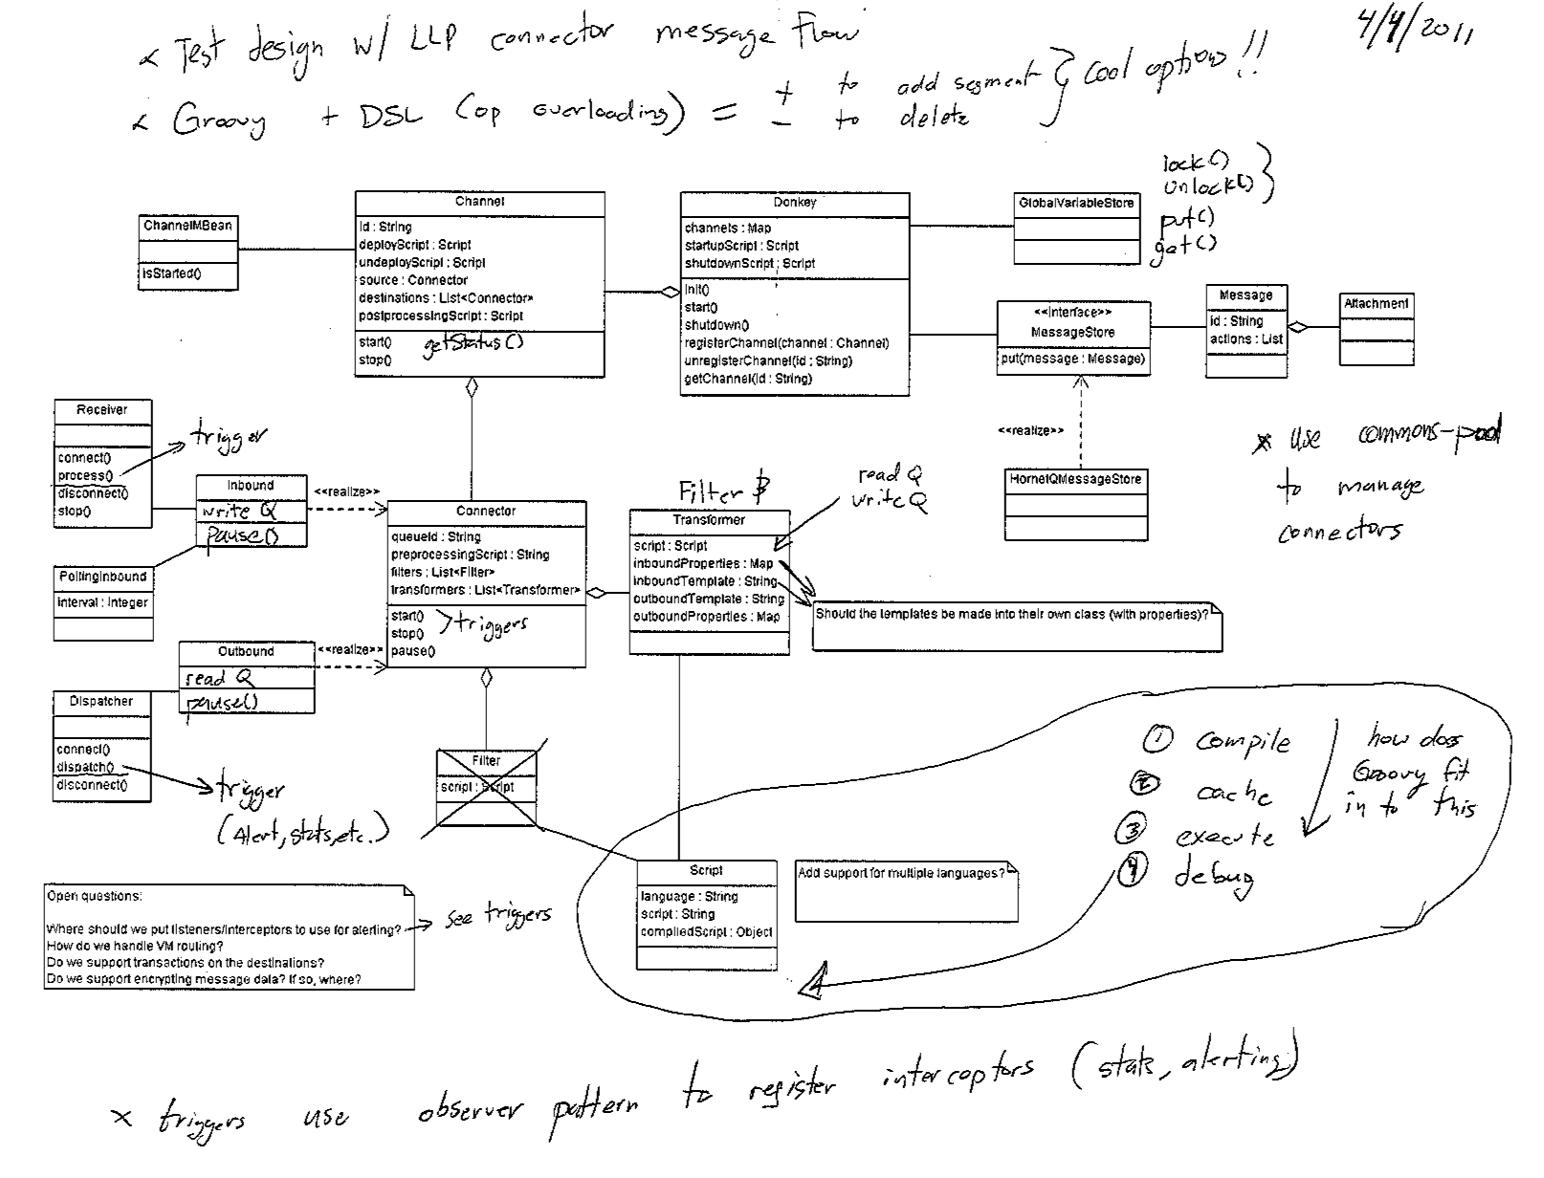
UML example

Slide 13
UML example
Notes:
This is an update to the first UML diagram made to look nicer and incorporate the comments.

Slide 14
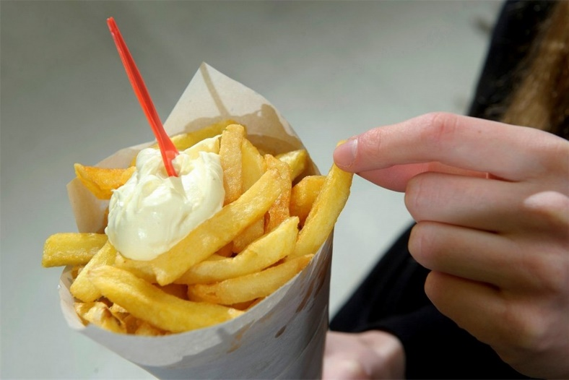
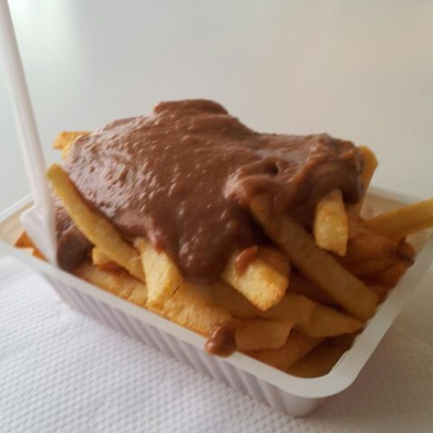
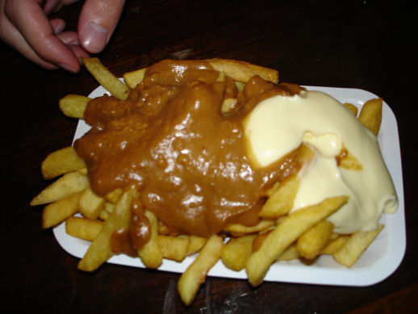
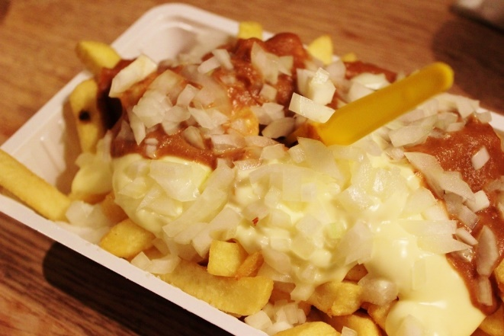
French fries and mayonnaise

Slide 15
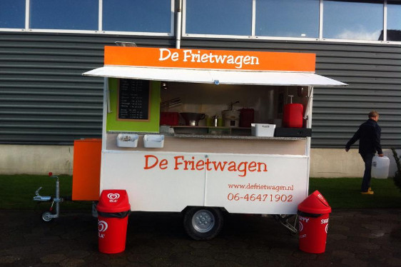
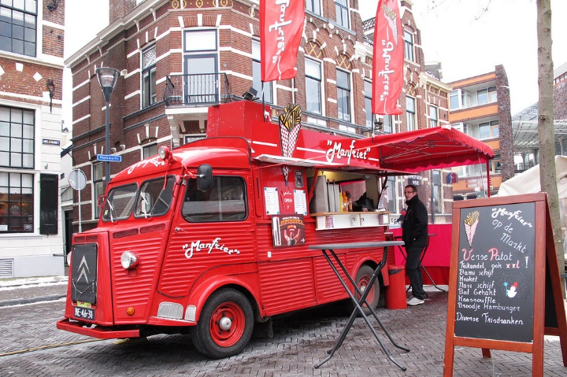
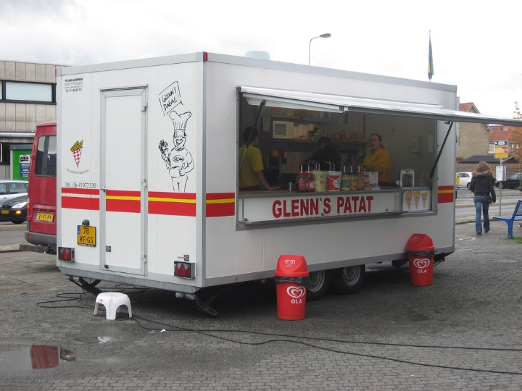
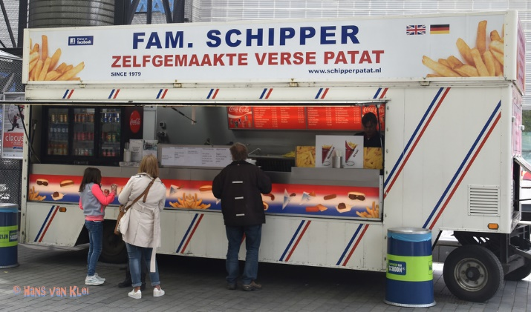
French fries and mayonnaise

Slide 16
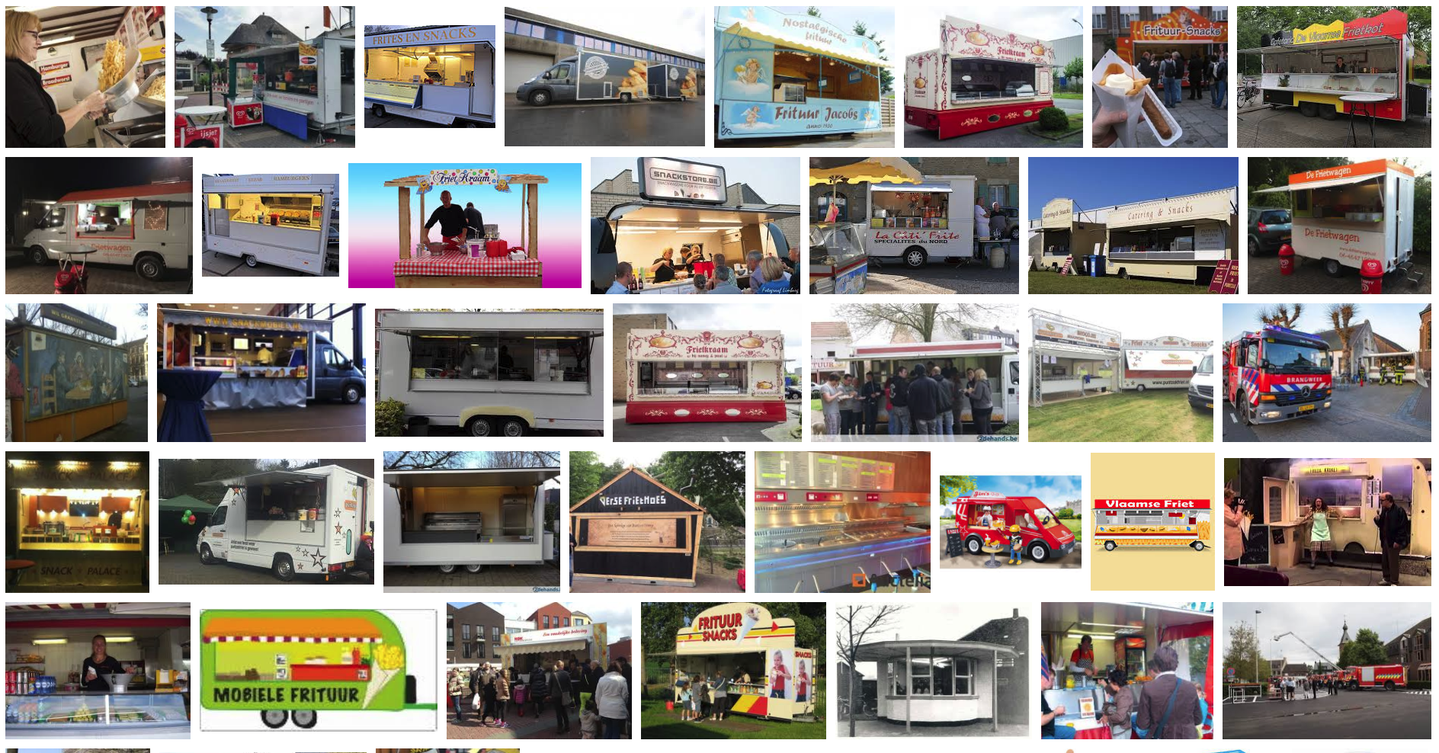
French fries and mayonnaise

Slide 17
French fries and mayonnaise
Multiple frietwagens
Multiple employees
Varied menus
Varied pricing
with ‘grouping’
I owe you’s
Inventory
Different reports

