Slide 1
Informatics 121 Software Design I
Lecture 15
Duplication of course material for any commercial purpose without the explicit written permission of the professor is prohibited.

Slide 2
Announcement
There will be no class Thursday and no discussion Friday

Slide 3
Today’s lecture
Design studio 3
Design methods

Slide 4
Design studio 3
Questions?

Slide 5
Software design methods
 | Application design | Interaction design | Architecture design | Implementation design
Analysis | competitive testing contextual inquiry feature comparison stakeholder analysis task analysis | critical incident technique interaction logging personas scenarios | framework assessment model-driven engineering quality-function-deployment reverse engineering world modeling | release planning summarization test-driven design visualization
Synthesis | affinity diagramming concept mapping mind mapping morphological chart | design/making participatory design prototyping storyboarding | architectural styles generative programming component reuse decomposition | pair programming refactoring search software patterns
Evaluation | requirements review role playing wizard of oz | cognitive walkthrough evaluative research heuristic evaluation think-aloud protocol | formal verification simulation weighted objectives | correctness proofs inspections/reviews parallel deployment testing

Slide 6
Software design methods
 | Application design | Interaction design | Architecture design | Implementation design
Analysis | competitive testing contextual inquiry feature comparison stakeholder analysis task analysis | critical incident technique interaction logging personas scenarios | framework assessment model-driven engineering quality-function-deployment reverse engineering world modeling | release planning summarization test-driven design visualization
Synthesis | affinity diagramming concept mapping mind mapping morphological chart | design/making participatory design prototyping storyboarding | architectural styles generative programming component reuse decomposition | pair programming refactoring search software patterns
Evaluation | requirements review role playing wizard of oz | cognitive walkthrough evaluative research heuristic evaluation think-aloud protocol | formal verification simulation weighted objectives | correctness proofs inspections/reviews parallel deployment testing

Slide 7
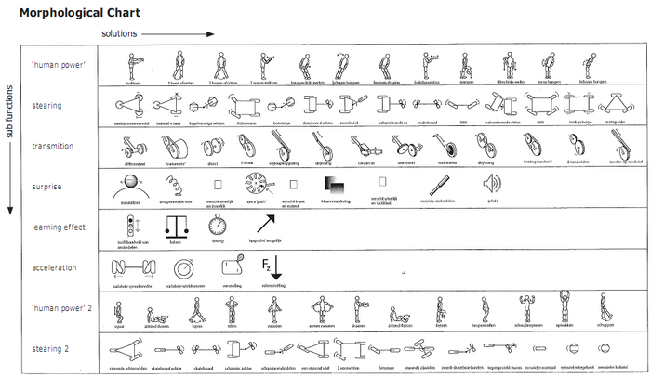
Morphological chart
Morphological chart is the process of generating ideas in an analytical and systematic manner

Slide 8
Procedure
List the features or functions that are essential to the product
For each feature or function, list the means by which it might be achieved
derive these systematically
Identify feasible combinations

Slide 9
Example: list the features or functions…
Engine
Shifting
Drive
Brakes
Steering
…

Slide 10
Example: list the means by which…
Engine | Fully electric | Hybrid | Gasoline | Diesel
Shifting | Automatic | Semi-automatic | Manual
Drive | Front-wheel | Rear-wheel | All-wheel
Brakes | Standard | Anti-lock
Steering | Regular | Power
… | … | … | …

Slide 11
Example: identify feasible combinations
Engine | Fully electric | Hybrid | Gasoline | Diesel
Shifting | Automatic | Semi-automatic | Manual
Drive | Front-wheel | Rear-wheel | All-wheel
Brakes | Standard | Anti-lock
Steering | Regular | Power
… | … | … | …

Slide 12
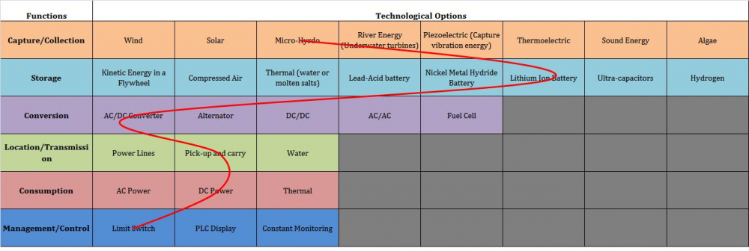
Typical notation: morphological chart

Slide 13
Criteria for successful use
The various features or functions of the eventual design solution must be well understood
The various features or functions of the eventual design solution must be relatively independent
The various means per feature or function must not be infinite, and principally relate to one another so a systematic articulation can uncover all of them

Slide 14
Strengths and weaknesses
Strengths
Weaknesses
Helps break down the design problem into features or functions
Systematic manner of deriving possible means
Avoids possible bias toward certain means
Helps identify and consider novel/unusual combinations
Applicable only to design problems where the features or functions of the design solution are well understood
Quickly leads to too many possible combinations
No valuation attached to individual means

Slide 15
Software design methods
 | Application design | Interaction design | Architecture design | Implementation design
Analysis | competitive testing contextual inquiry feature comparison stakeholder analysis task analysis | critical incident technique interaction logging personas scenarios | framework assessment model-driven engineering quality-function-deployment reverse engineering world modeling | release planning summarization test-driven design visualization
Synthesis | affinity diagramming concept mapping mind mapping morphological chart | design/making participatory design prototyping storyboarding | architectural styles generative programming component reuse decomposition | pair programming refactoring search software patterns
Evaluation | requirements review role playing wizard of oz | cognitive walkthrough evaluative research heuristic evaluation think-aloud protocol | formal verification simulation weighted objectives | correctness proofs inspections/reviews parallel deployment testing

Slide 16
Role playing
Role playing is the process of acting out the experience of a user with the envisioned design solution

Slide 17
Procedure
Identify the situation, tasks, and roles
Enact the situation and tasks
Take notes

Slide 18
Example: identify the situation, tasks, and roles
The situation concerns a patient in a hospital bed who has to use the tray table
The tasks include
the patient eats their meal
the nurse replaces bandages
The roles are the patient (of several kinds, e.g., a patient with arthritis, a patient with a broken arm, a small person, a large person) and the nurse

Slide 19
Example: enact the situation

Slide 20
Example: take notes
The patient found it difficult to operate the tray table with one hand
The patient could not raise or lower the tray table
The patient and nurse collided in terms of who ‘owned’ the table

Slide 21
Example: enact the situation
http://youtu.be/hkAFdIrTR00

Slide 22
Typical notation: notes
The patient found it difficult to operate the tray table with one hand
The patient could not raise or lower the tray table
The patient and nurse collided in terms of who ‘owned’ the tray table

Slide 23
Criteria for successful use
The people involved in role play must be willing to improvise
The people involved in role play must be willing to ‘truly’ step into the user role
The scenario and tasks should be played out multiple times
Notes should be taken by an auxiliary person
Props may help

Slide 24
Strengths and weaknesses
Strengths
Weaknesses
Helps the designer envision the user experience more vividly
Can be used to enact situations and tasks to which the designer does not have direct access
May uncover assumptions that are not readily apparent in more traditional design artifacts
Relatively lightweight method
Depends strongly on people’s willingness to role play and not be self-conscious in doing so
Depends strongly on people’s imagination, and understanding of the typical (and a-typical) user
Difficult to do well for software

Slide 25
Variants
Bodystorming
Simulation exercises

Slide 26
Software design methods
 | Application design | Interaction design | Architecture design | Implementation design
Analysis | competitive testing contextual inquiry feature comparison stakeholder analysis task analysis | critical incident technique interaction logging personas scenarios | framework assessment model-driven engineering quality-function-deployment reverse engineering world modeling | release planning summarization test-driven design visualization
Synthesis | affinity diagramming concept mapping mind mapping morphological chart | design/making participatory design prototyping storyboarding | architectural styles generative programming component reuse decomposition | pair programming refactoring search software patterns
Evaluation | requirements review role playing wizard of oz | cognitive walkthrough evaluative research heuristic evaluation think-aloud protocol | formal verification simulation weighted objectives | correctness proofs inspections/reviews parallel deployment testing

Slide 27
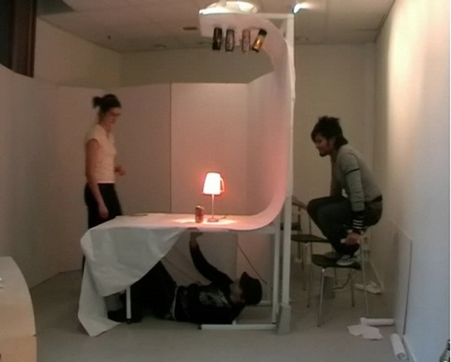
Wizard of Oz
Wizard of Oz is the process of evaluating an envisioned design solution during which the user interacts with a system that is seemingly real, but actually involves a person who generates the system responses from behind the scenes

Slide 28
Procedure
Identify the situation and tasks
Create the physical environment
Enact the situation and tasks
Take notes

Slide 29
Example: identify the situation and tasks
The situation concerns a future television that is voice and gesture controlled
The tasks include turning on/off the television, selecting particular channels to watch, reading e-mail, etc.

Slide 30
Example: create the physical environment
Primary room includes a television and a couch to simulate a living room
Primary room includes a hidden camera behind the television, facing the couch
Television displays the output of a computer
Computer is hidden in a different room, with the operator able to see what the camera is recording in the primary room

Slide 31
Example: enact the scenario and tasks
http://youtu.be/vcxlI0wI_7A

Slide 32
Example: take notes
The actual gestures performed by the user are imprecise
The voice commands differed strongly in pronunciation from user to user

Slide 33
Typical notation: notes
The actual gestures performed by the user are imprecise
The voice commands differed strongly in pronunciation from user to user

Slide 34
Criteria for successful use
The experience must be realistic
The ‘wizard’ must behave consistently
The tasks do not involve direct manipulation

Slide 35
Strengths and weaknesses
Strengths
Weaknesses
Identifies problems with the design concept early
Can evaluate design solutions that are difficult to prototype
Can involve actual future users
Relatively inexpensive
Requires training of the wizard
Difficult to provide the realism and consistency necessary
Can only simulate relatively simple experiences
Difficult to mimic software

Slide 36
Software design methods
 | Application design | Interaction design | Architecture design | Implementation design
Analysis | competitive testing contextual inquiry feature comparison stakeholder analysis task analysis | critical incident technique interaction logging personas scenarios | framework assessment model-driven engineering quality-function-deployment reverse engineering world modeling | release planning summarization test-driven design visualization
Synthesis | affinity diagramming concept mapping mind mapping morphological chart | design/making participatory design prototyping storyboarding | architectural styles generative programming component reuse decomposition | pair programming refactoring search software patterns
Evaluation | requirements review role playing wizard of oz | cognitive walkthrough evaluative research heuristic evaluation think-aloud protocol | formal verification simulation weighted objectives | correctness proofs inspections/reviews parallel deployment testing

Slide 37
Personas
Personas is the process of developing meaningful and relatable user profiles that capture common behaviors

Slide 38
Procedure
Collect data through field research
Segment the users into archetypes
Create the personas

Slide 39
Example: collect data through field research
Observations
Interviews
Ethnography

Slide 40
Example: segment the users into archetypes
Organize the individual users into groups
affinity diagramming
two-dimensional axes
informal clustering
Typically repeated multiple times to explore different user characteristics
Recombine characteristics into hypothetical users who are both representative of a larger group and different amongst each other

Slide 41
Example: create the personas
Name the archetype and associate an image
Briefly introduce their life situation
Briefly describe their goals
Briefly describe their characteristic behaviors
Usually, between three and five personas are created, at most one page each

Slide 42
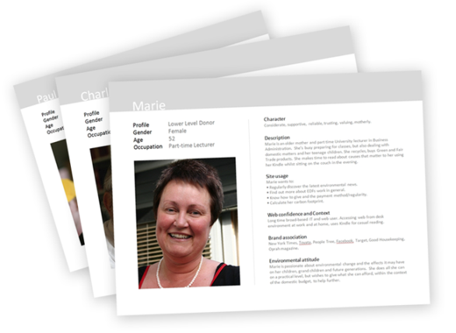
Typical notation: cards

Slide 43
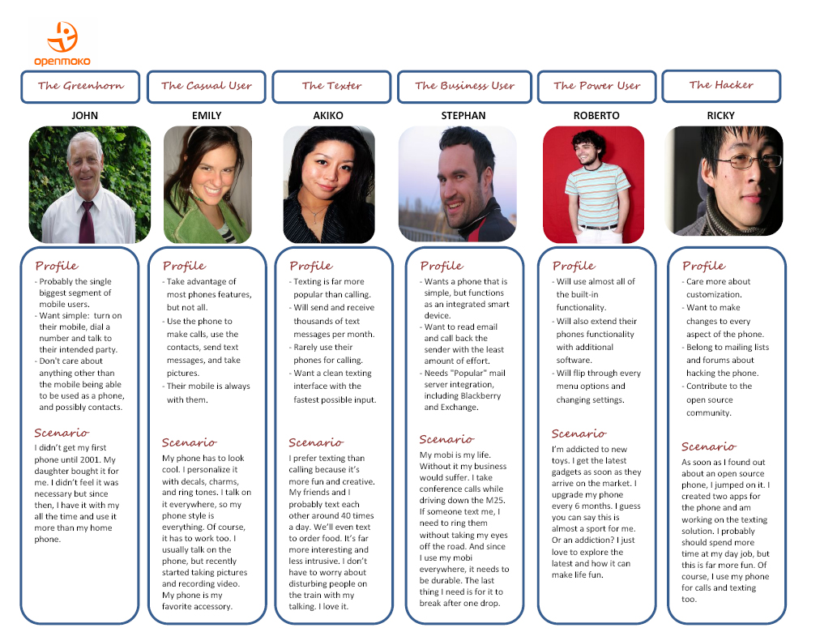
Typical notation: table

Slide 44
Criteria for successful use
Must be based on actual, in-depth field research
Must focus on key differentiating characteristics that might influence the design project

Slide 45
Strengths and weaknesses
Strengths
Weaknesses
Explicitly brings users into the design process
Builds a shared understanding of the audience among the design team members
Provides an implicit test for future design ideas
Helps focus on essence
Might distance the designer from actual users and overly focus on the personas
Might distance the designer from a-typical users
Tends to work less well for design projects involving complex work practices

Slide 46
Software design methods
 | Application design | Interaction design | Architecture design | Implementation design
Analysis | competitive testing contextual inquiry feature comparison stakeholder analysis task analysis | critical incident technique interaction logging personas scenarios | framework assessment model-driven engineering quality-function-deployment reverse engineering world modeling | release planning summarization test-driven design visualization
Synthesis | affinity diagramming concept mapping mind mapping morphological chart | design/making participatory design prototyping storyboarding | architectural styles generative programming component reuse decomposition | pair programming refactoring search software patterns
Evaluation | requirements review role playing wizard of oz | cognitive walkthrough evaluative research heuristic evaluation think-aloud protocol | formal verification simulation weighted objectives | correctness proofs inspections/reviews parallel deployment testing

Slide 47
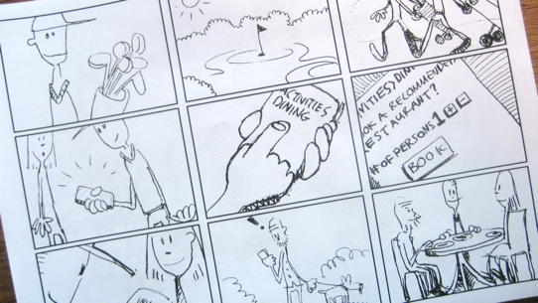
Storyboarding
Storyboarding is the process of visually communicating expected interactions in context

Slide 48
Procedure
Decide upon interaction
Decide upon story to be told
Decide upon level of artistic detail
Draw and annotate story
Iterate

Slide 49
Decide upon interaction
Mary is exploring the online book collection
Mary is reading an excerpt from one book
Tom buys the book in his car

Slide 50
Decide upon story to be told
While Mary is exploring the online book collection, she is pleasantly surprised to find that an author that she liked before has written a new book and she orders it
While Mary is exploring the online book collection, she very much likes the automated recommendation that the system makes based on books she purchased in the past
While Tom is driving in the car, he uses his mobile phone to order the book, but has to stop to actually type in requisite credit card information on the ordering screen

Slide 51
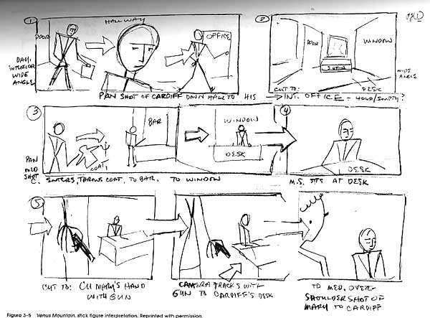
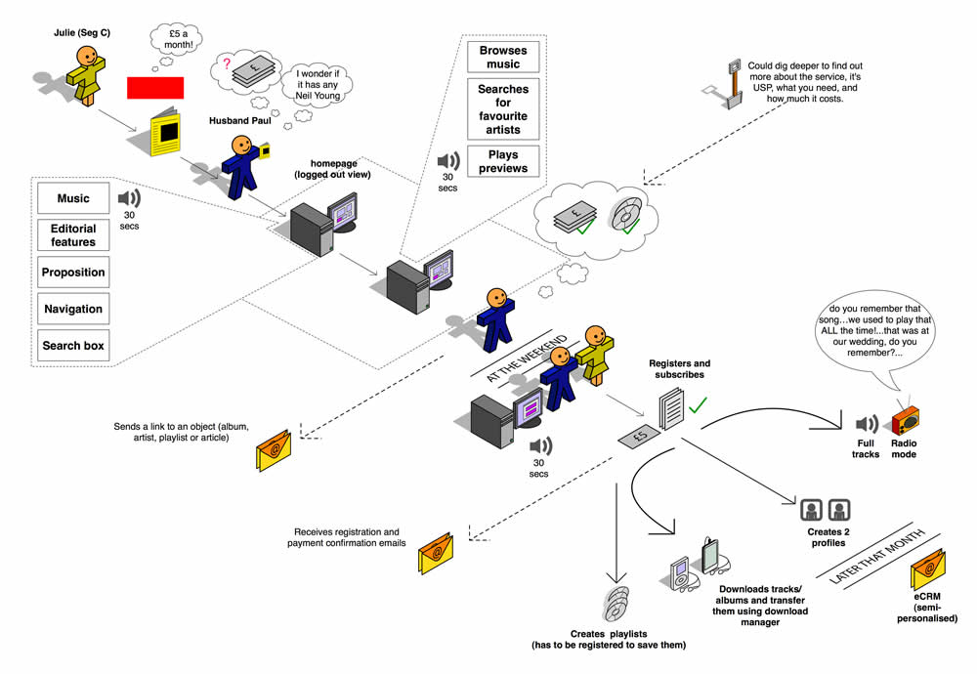
Example: decide upon level of artistic detail

Slide 52
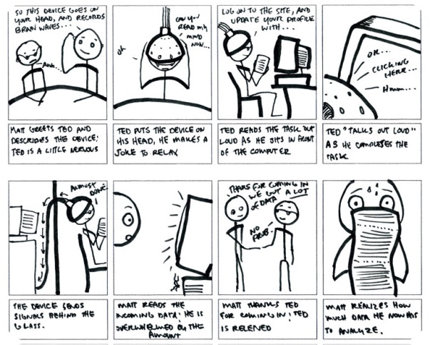
Example: draw and annotate story

Slide 53
Example: iterate

Slide 54
Typical notation: storyboard

Slide 55
Criteria for successful use
Develop short effective stories
Apply a strong sense of aesthetics
Must be open to storyboarding multiple ideas
Should have a definite sense of possible solutions
Collaborate

Slide 56
Strengths and weaknesses
Strengths
Weaknesses
Tangible nature invites early feedback
Brings an increased focus on how the users might expect to interact with the product
Builds a shared understanding of the audience and interactions among the design team
Provides an implicit baseline for future design ideas
Stops well short of designing the actual interface in detail
Might distance the designer from undocumented storyboards
Can be difficult to ensure that the storyboards represent the audience accurately

Slide 57
Software design methods
 | Application design | Interaction design | Architecture design | Implementation design
Analysis | competitive testing contextual inquiry feature comparison stakeholder analysis task analysis | critical incident technique interaction logging personas scenarios | framework assessment model-driven engineering quality-function-deployment reverse engineering world modeling | release planning summarization test-driven design visualization
Synthesis | affinity diagramming concept mapping mind mapping morphological chart | design/making participatory design prototyping storyboarding | architectural styles generative programming component reuse decomposition | pair programming refactoring search software patterns
Evaluation | requirements review role playing wizard of oz | cognitive walkthrough evaluative research heuristic evaluation think-aloud protocol | formal verification simulation weighted objectives | correctness proofs inspections/reviews parallel deployment testing

Slide 58
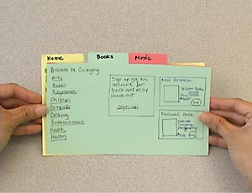
Prototyping
Prototyping is the process of creating tangible artifacts embedding the envisioned design solution

Slide 59
Procedure
Decide the purpose
Decide the fidelity and medium
Create the prototype

Slide 60
Example: decide the purpose
Obtain feedback from the client
Obtain feedback from potential users
Obtain feedback from other stakeholders
Explore alternatives more concretely

Slide 61
Example: decide the fidelity and medium
Low fidelity
paper prototype
Medium fidelity
wireframes
mock-ups
High fidelity
actual running software

Slide 62
Example: decide the details

Slide 63
Example: paper prototype
http://youtu.be/GrV2SZuRPv0

Slide 64
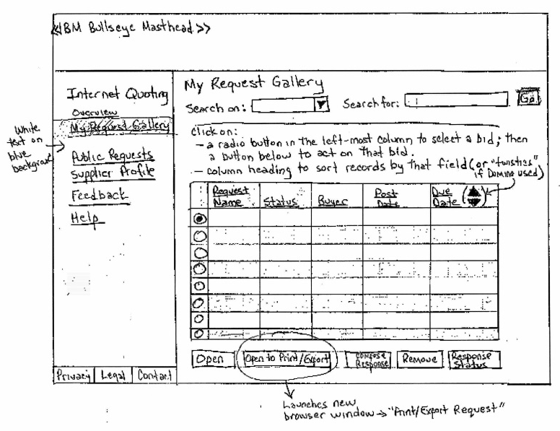
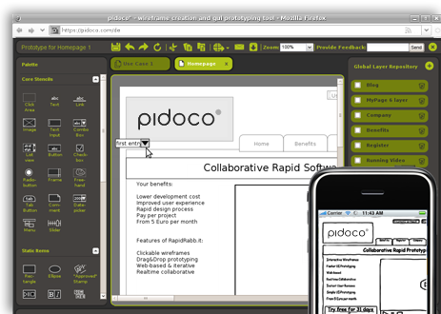
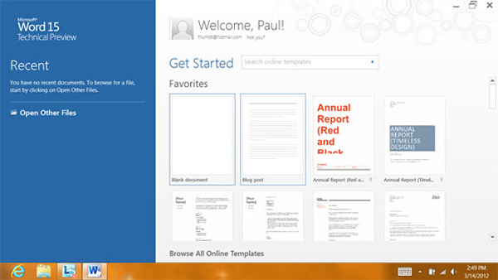
Typical notation: tangible

Slide 65
Criteria for successful use
Strong sense of aesthetics and attention to detail
Must be open to prototyping multiple design ideas
Should have a definite sense of possible solutions
Collaborate

Slide 66
Strengths and weaknesses
Strengths
Weaknesses
Tangible nature invites early yet detailed feedback
Low fidelity prototyping is a lightweight approach that still yields good results
Tool support is readily available
The higher the fidelity, the more expensive the endeavor
Could lead to too much focus on the visual appearance instead of the supporting the actual tasks at hand

