Slide 1
Informatics 121 Software Design I
Lecture 16
Duplication of course material for any commercial purpose without the explicit written permission of the professor is prohibited.

Slide 2
Announcements
There will be discussion this Friday

Slide 3
Today’s lecture
Design studio 3
Architecture design

Slide 4
Design studio 3

Slide 5
Architecture
“The conceptual core”
“That what really makes it work”
“Principal set of design decisions”
“Essence of the solution”

Slide 6
Architecture

Slide 7
Architecture

Slide 8
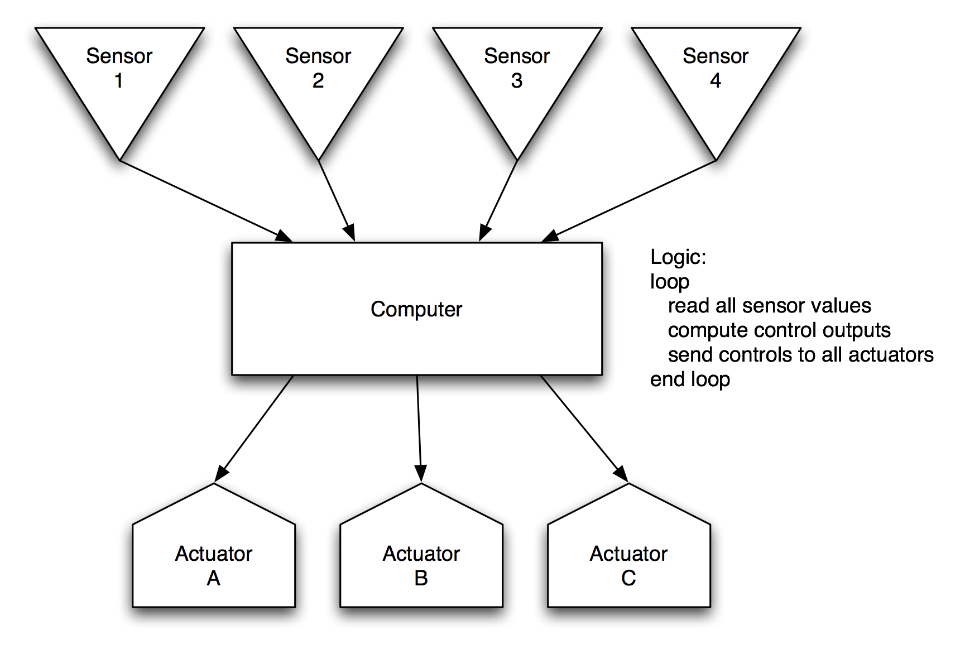
Architecture

Slide 9
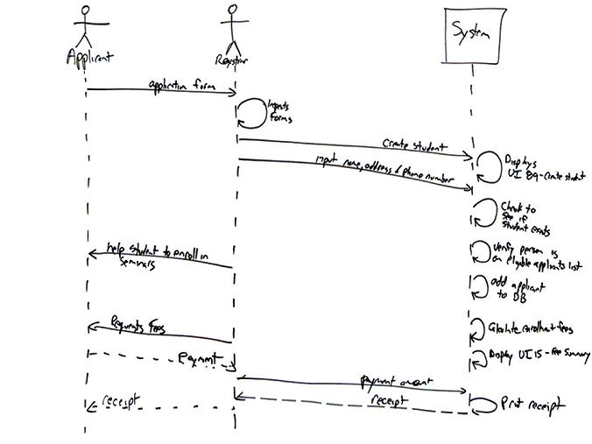
Architecture

Slide 10
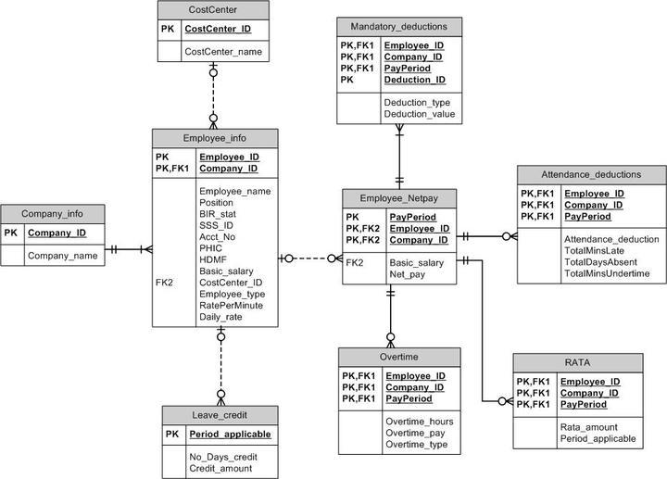
Architecture

Slide 11
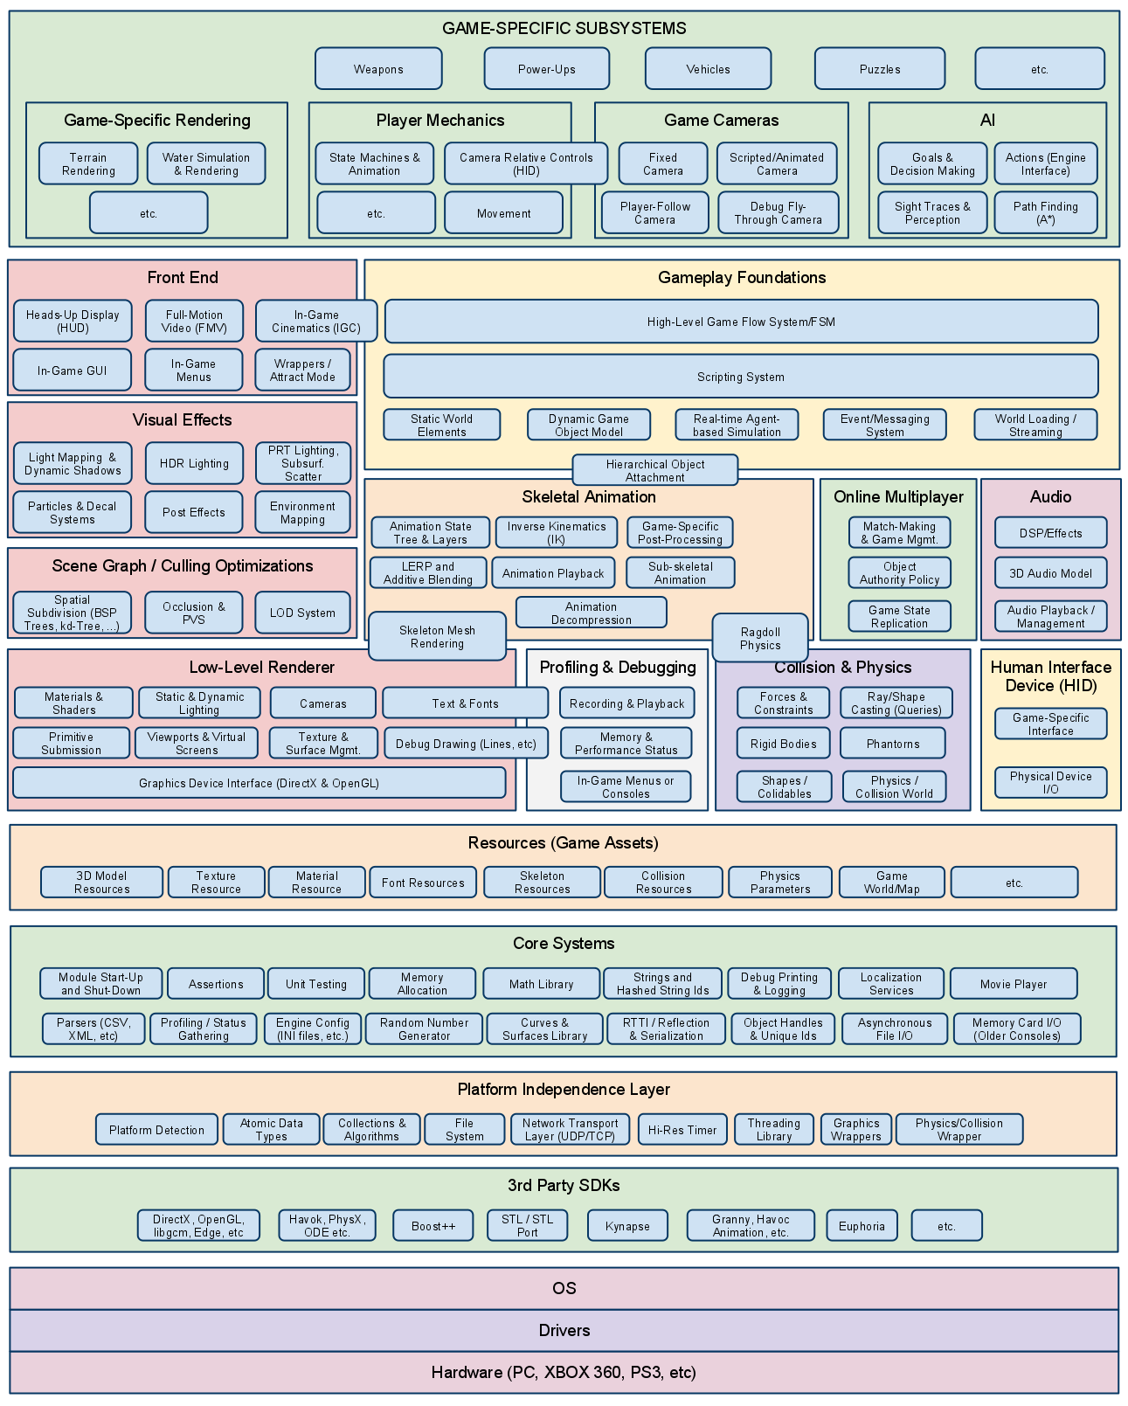
Architecture

Slide 12
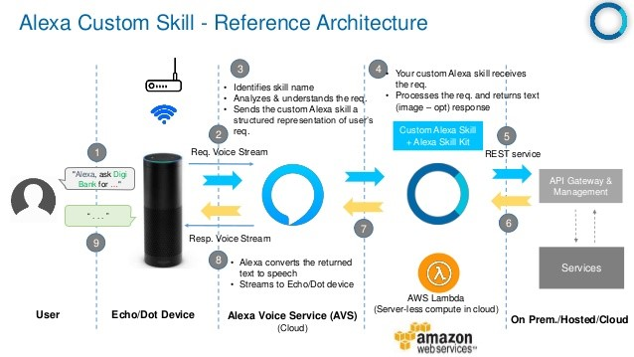
Architecture

Slide 13
Architecture
Components and connectors
Data model
Protocol
Interface
Naming
Algorithm
…

Slide 14
Practice: instant message

