Slide 1
Informatics 121 Software Design I
Lecture 18
Duplication of course material for any commercial purpose without the explicit written permission of the professor is prohibited.

Slide 2
Today’s lecture
Wrap up
Final

Slide 3
This course answered three primary questions
What is (software) design?
How to engage in good software design?
What are the habits of professional software designers?

Slide 4
Our definition
To decide upon a plan for a novel change in the world that, when realized, satisfies stakeholders

Slide 5
Four types of software design
what is it to accomplish?
application design
satisfactory experience
how does one interact with it?
interaction design
change in the world
what is its conceptual core?
architecture design
plan for realization
what are its implementation details?
implementation design

Slide 6
Design cycle
synthesize
goals
constraints
assumptions
decisions
ideas
analyze
evaluate

Slide 7
Realistic design process
what is it to accomplish?
satisfactory experience
how does one interact with it?
change in the world
what is its conceptual core?
plan for realization
what are its implementation details?

Slide 8
Design method
A self-contained, structured technique that guides a designer in advancing some aspect of the design project at hand
Serves as a bridge from the overall process of design to actual individual and collaborative design work

Slide 9
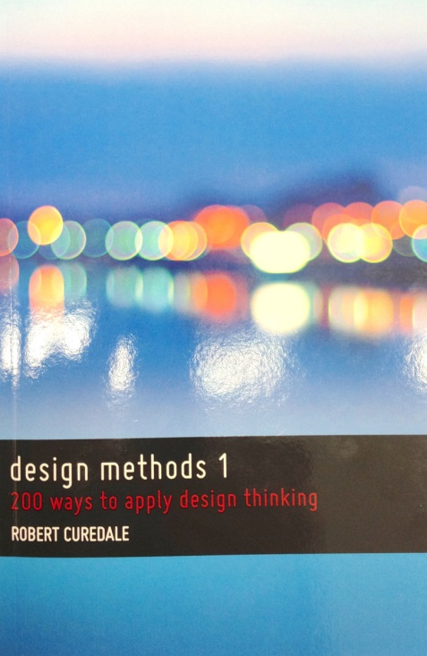
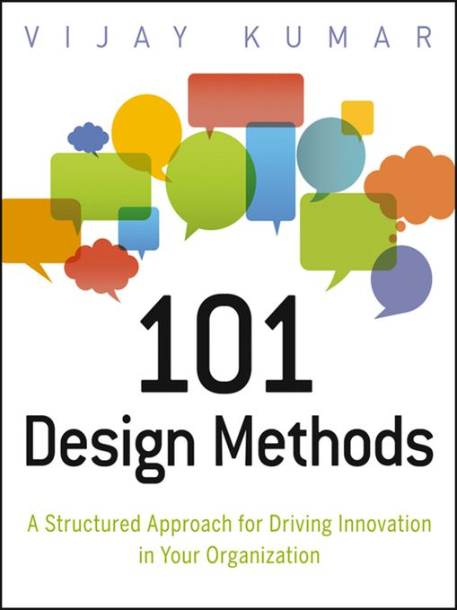
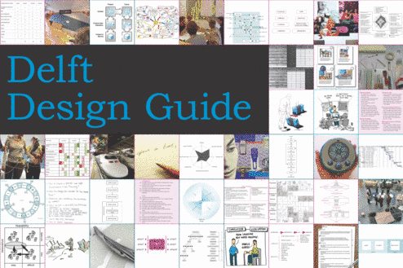
Design methods today

Slide 10
Software design methods
 | Application design | Interaction design | Architecture design | Implementation design
Analysis | competitive testing contextual inquiry feature comparison stakeholder analysis task analysis | critical incident technique interaction logging personas scenarios | framework assessment model-driven engineering quality-function-deployment reverse engineering world modeling | release planning summarization test-driven design visualization
Synthesis | affinity diagramming concept mapping mind mapping morphological chart | design/making participatory design prototyping storyboarding | architectural styles generative programming component reuse decomposition | pair programming refactoring search software patterns
Evaluation | requirements review role playing wizard of oz | cognitive walkthrough evaluative research heuristic evaluation think-aloud protocol | formal verification simulation weighted objectives | correctness proofs inspections/reviews parallel deployment testing

Slide 11
From software life cycles to design methods
design problem
design solution
design project
Which set of design methods is appropriate to use, when, to successfully complete a design project?

Slide 12
Two fundamental challenges
The nature of software
The nature of people

Slide 13
Three design studios
FamilyMonitor
Educational traffic simulator
Collaborative math learning with Alexa

Slide 14
Three design studios
FamilyMonitor
Educational traffic simulator
Collaborative math learning with Alexa
Not nearly enough practice, yet

Slide 15
In sum
Understanding all of the design activities that take place in software engineering
Significant shift to this kind of overall approach to software development (innovation, creativity, design)
If you just pick up one method, at one moment in time, and it helps you, that would be an important result
Design methods are much more broadly applicable than the specific ‘box’ in which they are placed

Slide 16
But what I care most about...
...is that you start thinking like experts do, and reflect upon your own practice in terms of what is known about expert design behavior

Slide 17
Additional courses
Informatics 122
technical: patterns, UML, reverse engineering, component reuse, …
Informatics 124
technical: internet architectures, distributed systems, programming, …
Informatics 131
conceptual: user interface design, principles, evaluation, …
Informatics 133
technical: user interaction design, mobile devices, design methods, …

Slide 18
Back to this course
Fuzziness
Insufficient detail
Insufficient instructions
Bad team work
Low grades
Madness

Slide 19
Final

Slide 20
Thank you…
…and good luck on your final!

