Slide 1
Informatics 121 Software Design I
Lecture 3
Duplication of course material for any commercial purpose without the explicit written permission of the professor is prohibited.

Slide 2
Today
French fries and mayonnaise
Software designers
French fries and mayonnaise (redux)
Reflection

Slide 3
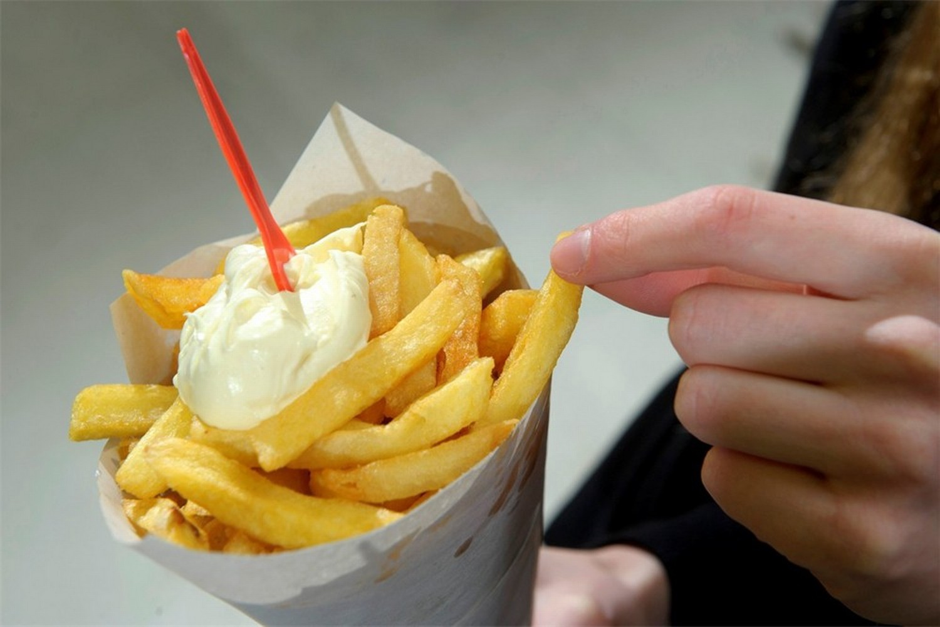
French fries and mayonnaise

Slide 4
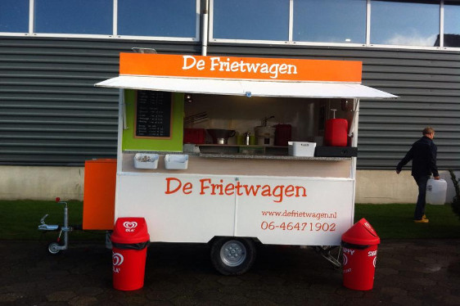
French fries and mayonnaise

Slide 5
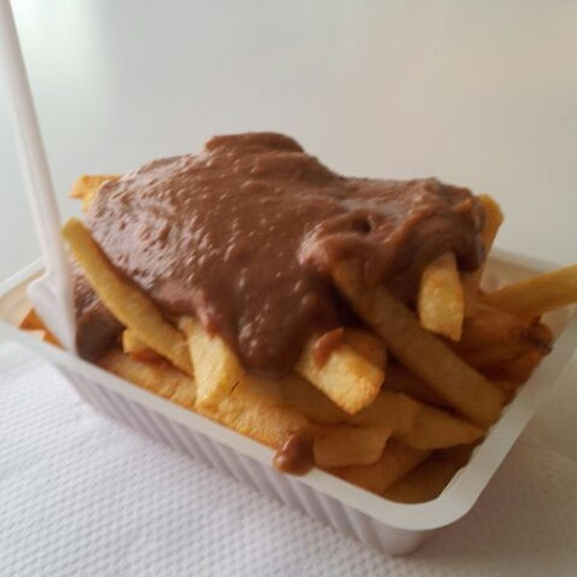
French fries and mayonnaise

Slide 6
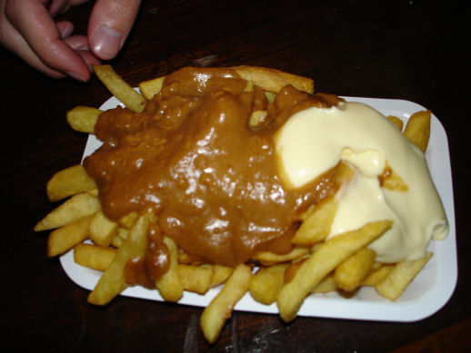
French fries and mayonnaise

Slide 7
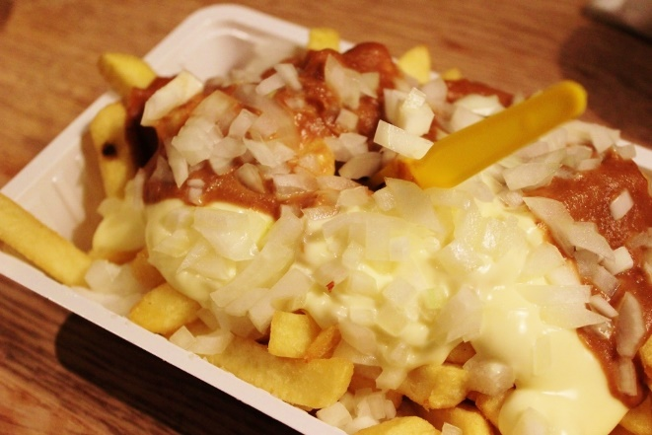
French fries and mayonnaise

Slide 8
Reflection
What went well?
What did not go well?
What are you most worried about in terms of progress at this time?
What would you like to do different?
What might we be mixing up?

Slide 9
Software designer
Problem solver
Creative
Maker
Skeptic
Collaborator
Pragmatist

Slide 10
Reflection
What would you like to do different?
designer
plan
maker
change in the world
other stakeholders
audience
experiences

Slide 11
French fries and mayonnaise

Slide 12
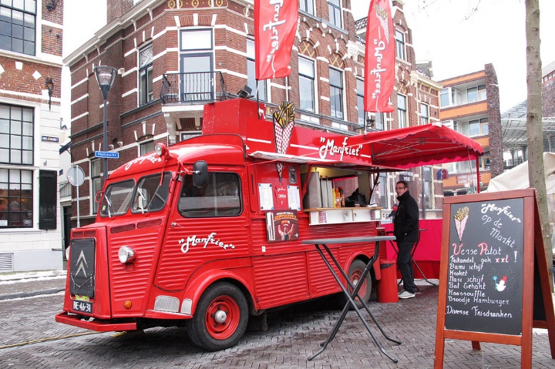
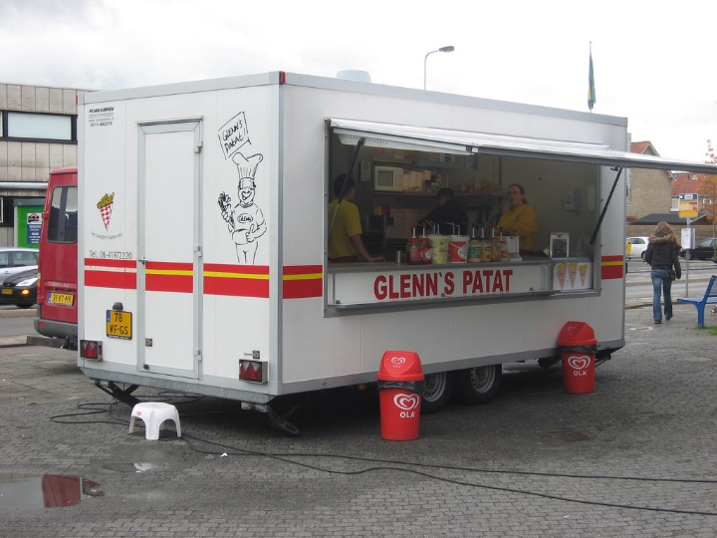
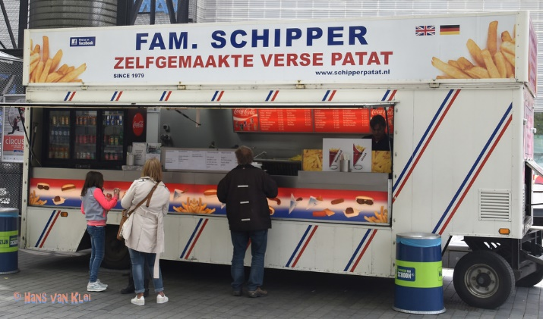
French fries and mayonnaise

Slide 13
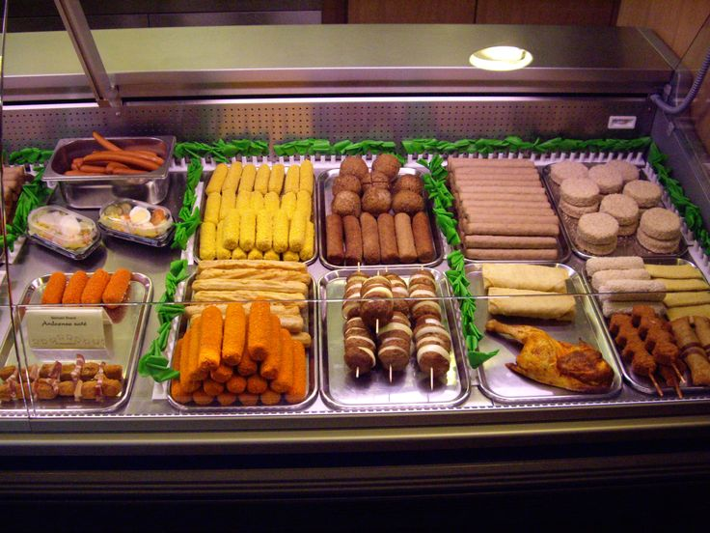
French fries and mayonnaise

Slide 14
Reflection
What went well?
What did not go well?
What did you learn about the problem?
What did you not learn about the problem?
What did you learn about the solution?
What did you not learn about the solution?

Slide 15
Reflection
Were you a problem solver, creative, skeptic, maker, collaborator, or pragmatist?
What are you most worried in terms of this design challenge?
What was different the second time?

Slide 16
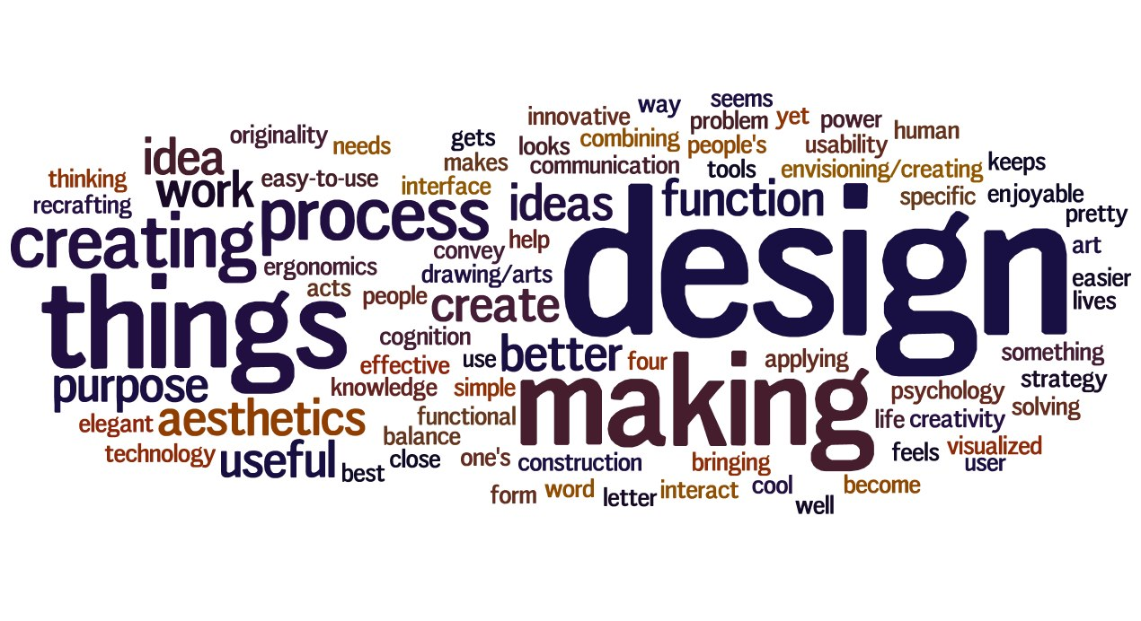
A design mindset

