Slide 1
Informatics 121 Software Design I
Lecture 5
Duplication of course material for any commercial purpose without the explicit written permission of the professor is prohibited.

Slide 2
Discussion
There will be discussion this upcoming Friday
Please join your designated discussion

Slide 3
Today
Expert behaviors
French fries and mayonnaise
Design studio 1

Slide 4
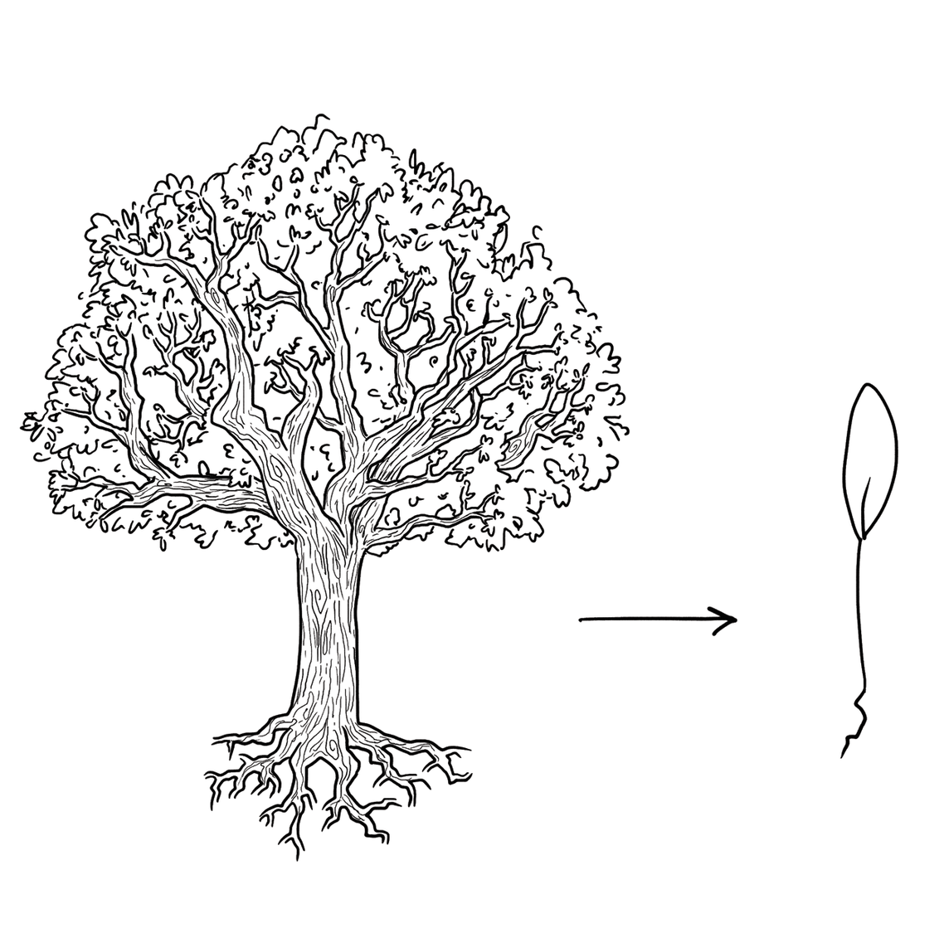
Experts focus on the essence

Slide 5
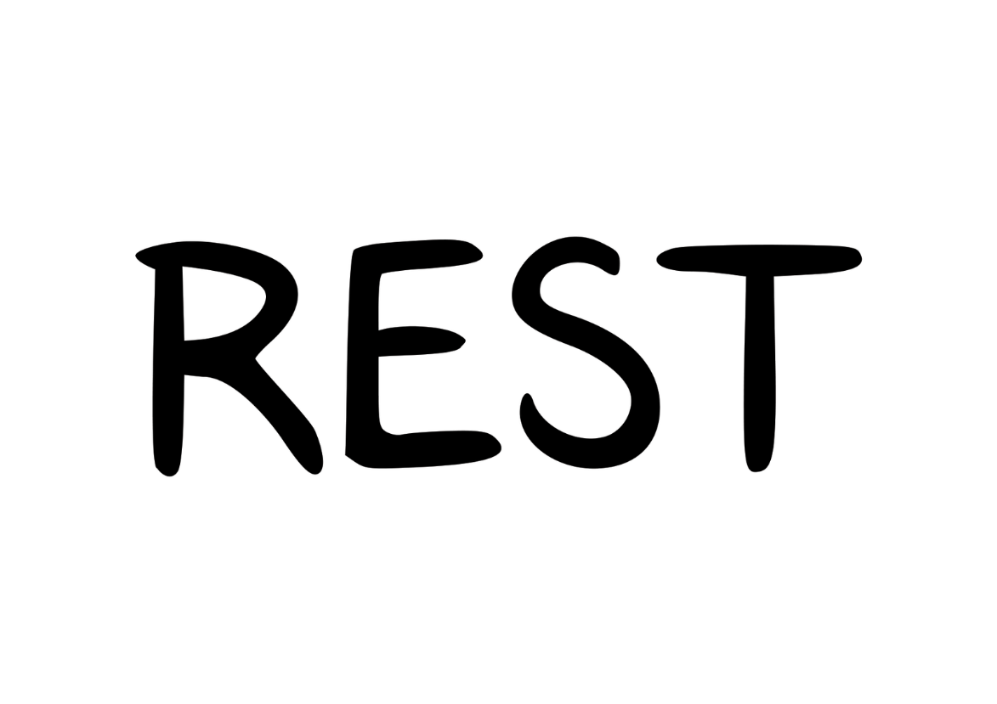
Experts prefer solutions that they know work

Slide 6
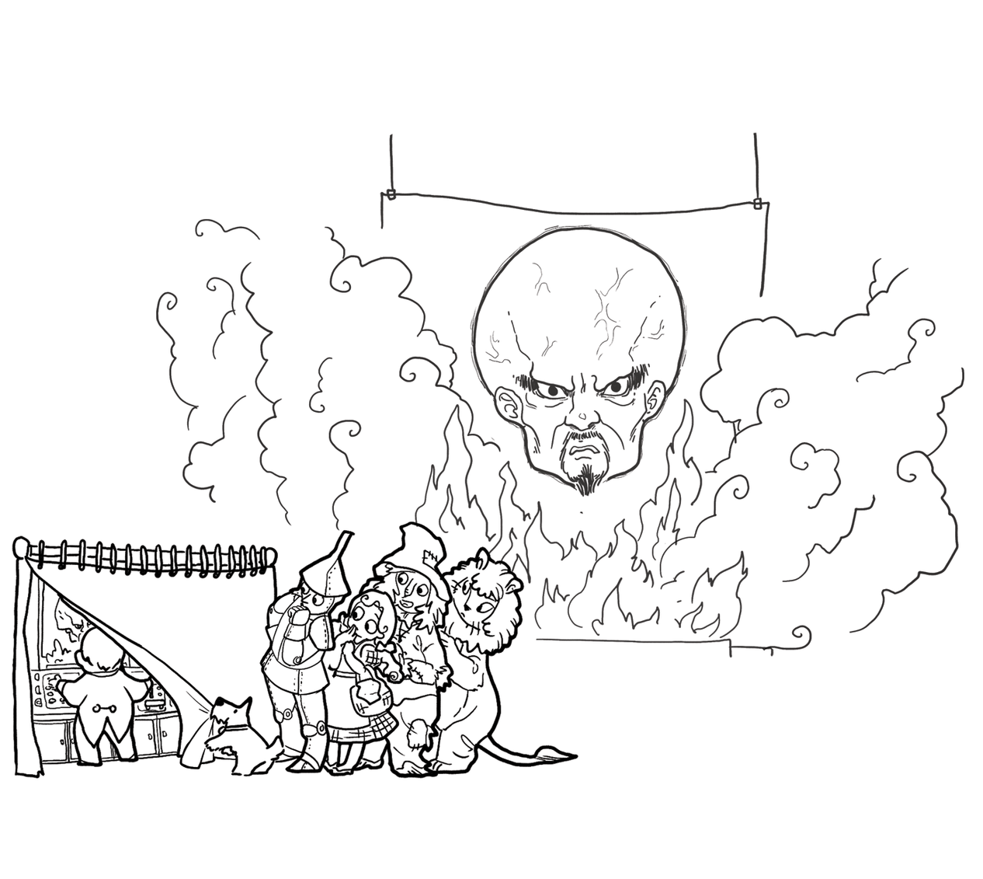
Experts address knowledge deficiencies

Slide 7
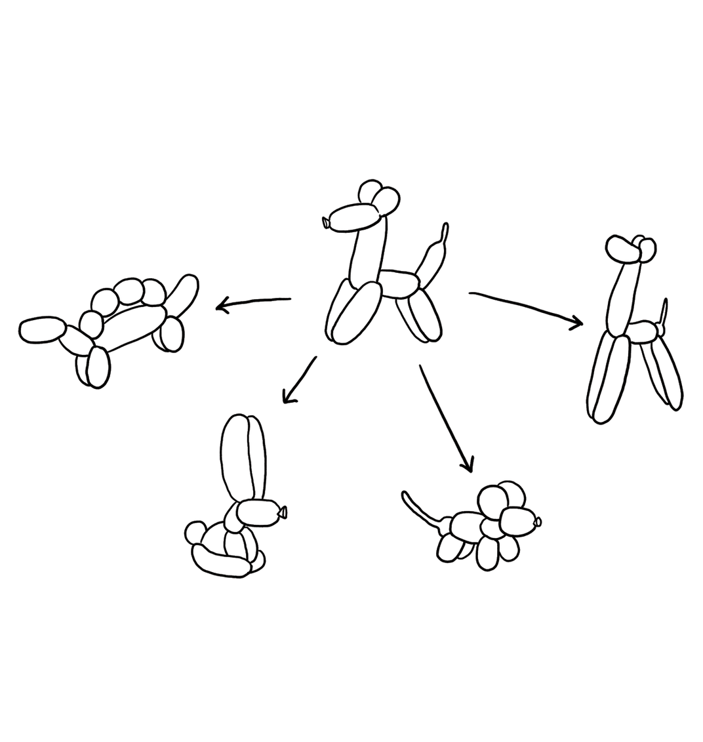
Experts generate alternatives

Slide 8
Experts are skeptical

Slide 9
Design cycle
synthesize
goals
constraints
assumptions
decisions
ideas
analyze
evaluate

Slide 10
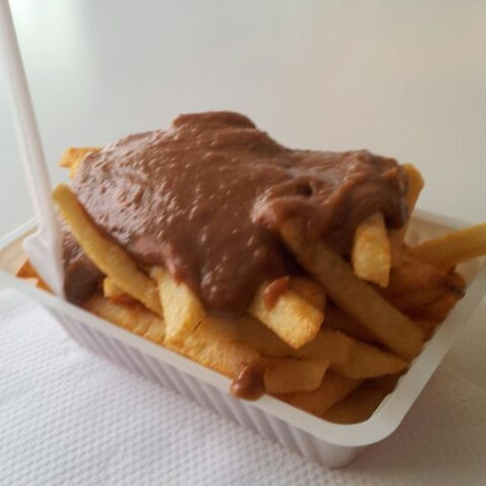
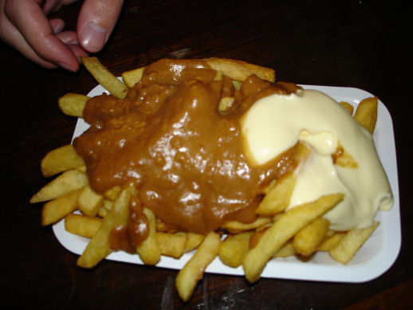
French fries and mayonnaise

Slide 11
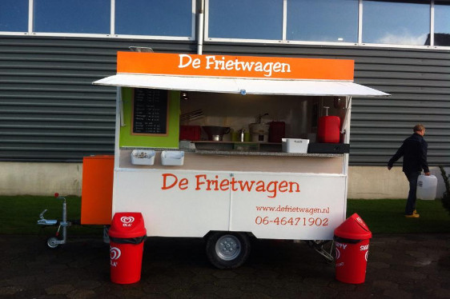
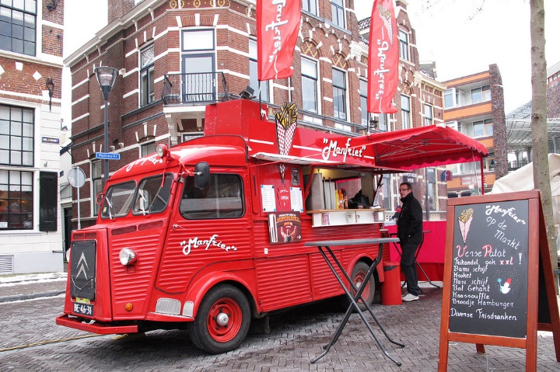
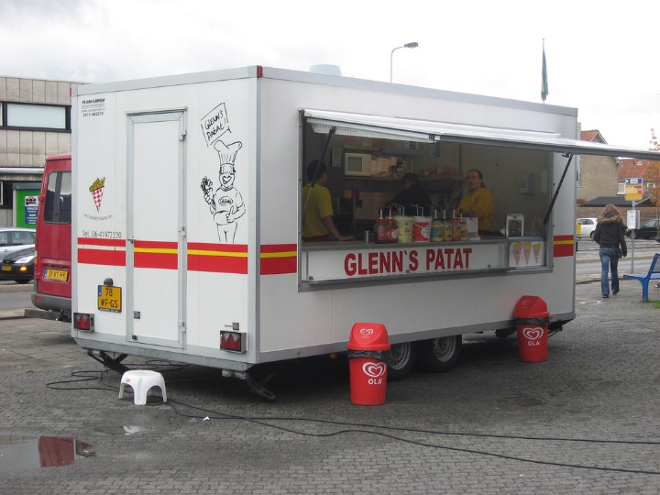
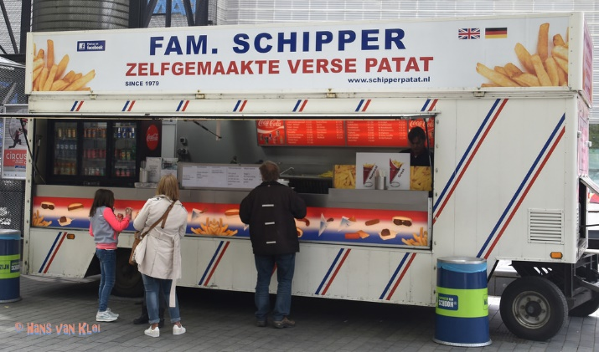
French fries and mayonnaise

Slide 12
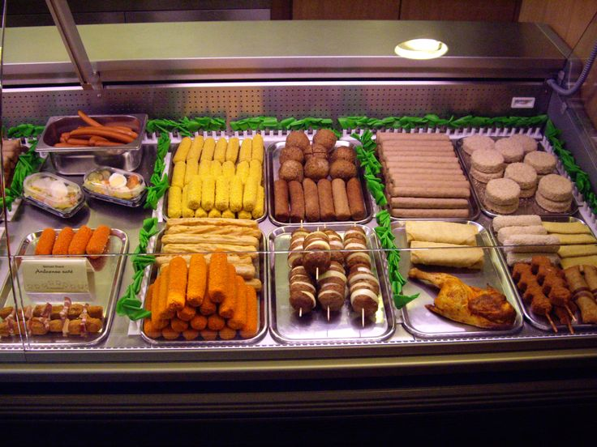
French fries and mayonnaise

Slide 13
Reflection
What went well?
What did not go well?
What did you learn about the problem?
What did you not learn about the problem?
What did you learn about the solution?
What did you not learn about the solution?

Slide 14
Reflection
What were key steps forward?
Did it help to consider goals, constraints, assumptions, ideas, and decisions separately?
Did it help to explicitly step through analysis, synthesis, evaluation?
How will you make sure to continue to do this?

Slide 15
Design studio 1
Your client is FamilyMonitor, a new company that recognizes the importance of always knowing the whereabouts of one’s family members. FamilyMonitor in particular wants to alert family members of the ‘abnormal’: when a family member is not traveling or at a place where they normally would go or be.
The company has sought you out, because you are an excellent designer. All of the software design is in your hands, as FamilyMonitor has the idea protected (meaning no competition), but has no idea how to actually design the software.

Slide 16
Design studio 1 (part 1)
Identify possible audiences and other stakeholders
Identify possible goals, constraints, and assumptions
Bring two printed copies to discussion, this Friday
one for the TAs
one for your group
Your group will be announced at the start of your discussion

Slide 17
Design studio 1 (part 2)
As a team, design the consumer facing side of FamilyMonitor in terms of the functionality it will offer and how users will interact with it
Make sure that you explicitly identify goals, constraints, and assumptions
Make sure to consider at least three different approaches, highlight tradeoffs among the approaches, and discuss why you chose the approach you took
briefly document the approaches you considered but did not adopt

Slide 18
Design studio 1 (part 2)
Practice what you have learned about experts:
focus on the essence
prefer solutions that they know work
address knowledge deficiencies
generate alternatives
are skeptical
Due Tuesday October 23, at noon (through GradeScope)
make sure to identify all group members

Slide 19
Design studio 1 (part 2)
Team members will assess other team members
in terms of the contributions they make
in terms of enabling others to make contributions

