Slide 1
Informatics 121 Software Design I
Lecture 6
Duplication of course material for any commercial purpose without the explicit written permission of the professor is prohibited.

Slide 2
Discussion
There will be discussion this upcoming Friday
Please join your designated discussion

Slide 3
Today
Four types of design
French fries and mayonnaise
Design studio 1

Slide 4
Design
designer
plan
maker
change in the world
other stakeholders
audience
experiences

Slide 5
Feasibility and desirability
feasibility
designer
plan
maker
change in the world
other stakeholders
audience
experiences

Slide 6
Feasibility and desirability
feasibility
designer
plan
maker
change in the world
other stakeholders
audience
experiences
desirability

Slide 7
Four types of design
desirability
what is it to accomplish?
how does one interact with it?
feasibility
what is its conceptual core?
what are its implementation details?

Slide 8
Four types of design
what is it to accomplish?
satisfactory experience
how does one interact with it?
change in the world
what is its conceptual core?
plan for realization
what are its implementation details?

Slide 9
Four types of software design
what is it to accomplish?
application design
satisfactory experience
how does one interact with it?
interaction design
change in the world
what is its conceptual core?
architecture design
plan for realization
what are its implementation details?
implementation design

Slide 10
Design a mobile phone messaging system
what is it to accomplish?
application design
satisfactory experience
how does one interact with it?
interaction design
change in the world
what is its conceptual core?
architecture design
plan for realization
what are its implementation details?
implementation design

Slide 11
Design a word processor
what is it to accomplish?
application design
satisfactory experience
how does one interact with it?
interaction design
change in the world
what is its conceptual core?
architecture design
plan for realization
what are its implementation details?
implementation design

Slide 12
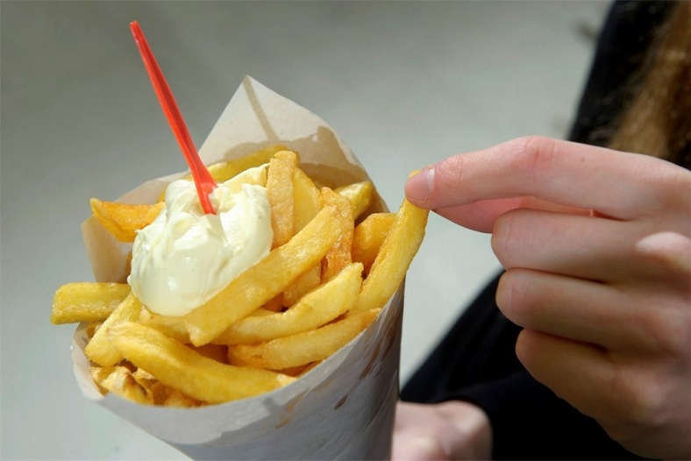
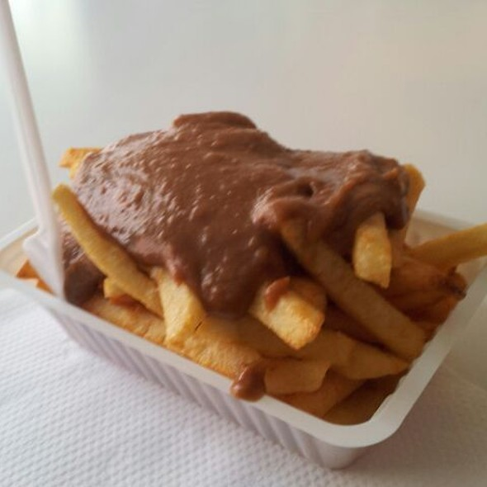
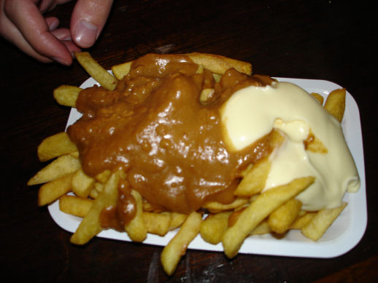
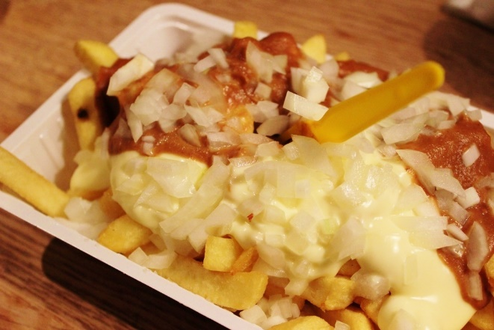
French fries and mayonnaise

Slide 13
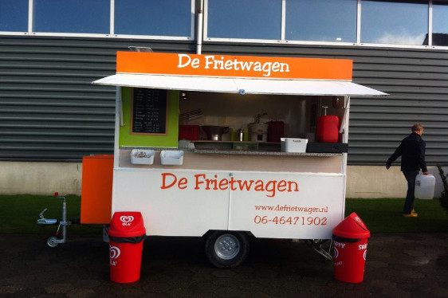
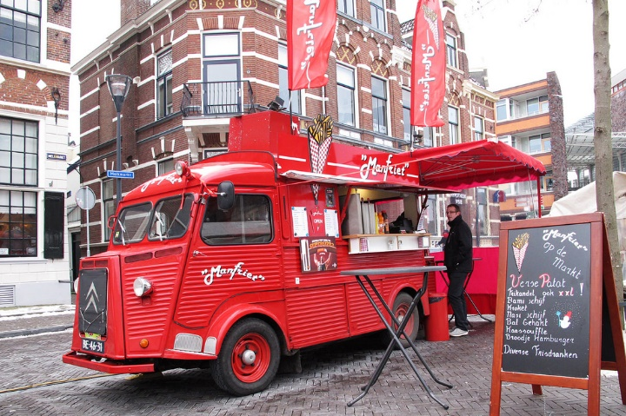
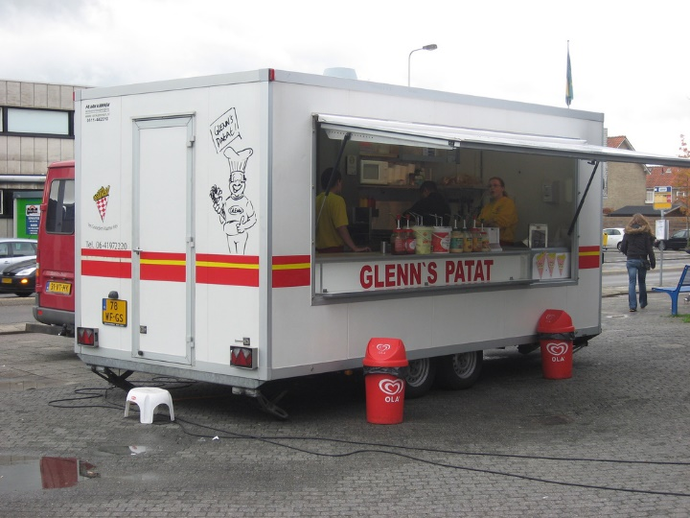
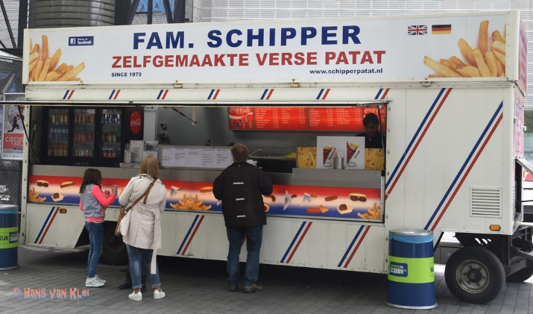
French fries and mayonnaise

Slide 14
Experts...
...focus on the essence
...prefer solutions that they know work
...address knowledge deficiencies
...generate alternatives
...are skeptical

Slide 15
Design studio 1 (part 2)
As a team, design the consumer facing side of FamilyMonitor in terms of the functionality it will offer and how users will interact with it
Make sure that you explicitly identify goals, constraints, and assumptions
Make sure to consider at least three different approaches, highlight tradeoffs among the approaches, and discuss why you chose the approach you took
briefly document the approaches you considered but did not adopt

Slide 16
Design studio 1 (part 2)
Practice what you have learned about experts:
focus on the essence
prefer solutions that they know work
address knowledge deficiencies
generate alternatives
are skeptical
Due Tuesday October 23, at noon (through GradeScope)
make sure to identify all group members

Slide 17
Design studio 1 (part 2)
Team members will assess other team members
in terms of the contributions they make
in terms of enabling others to make contributions

