Slide 1
Informatics 121 Software Design I
Lecture 11
Duplication of course material for any commercial purpose without the explicit written permission of the professor is prohibited.

Slide 2
Announcements
Discussion today
No class Monday (President’s Day)

Slide 3
Today
Design practice

Slide 4
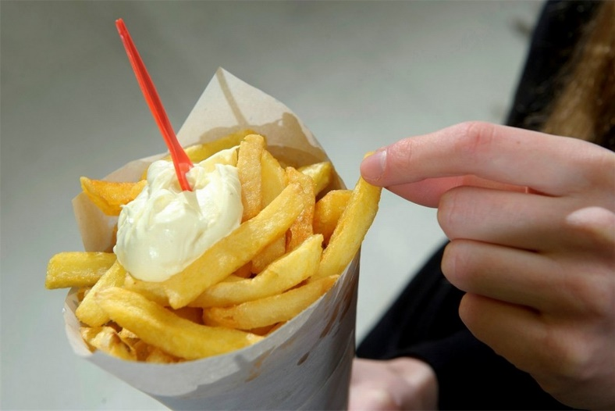
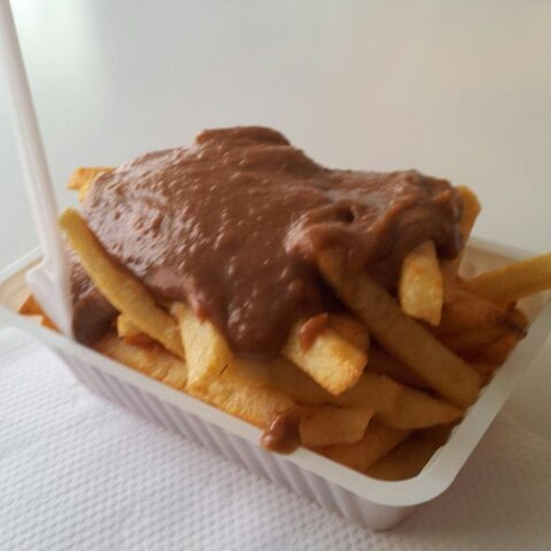
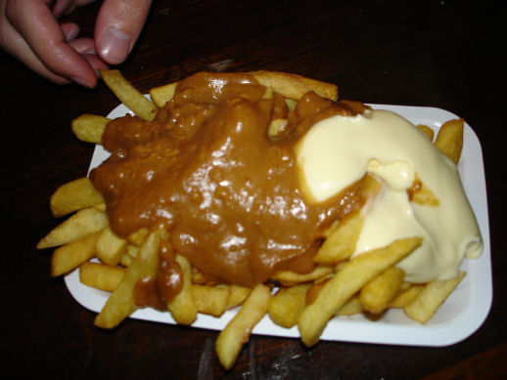
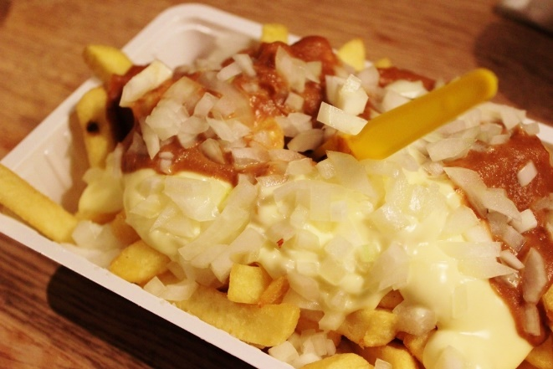
French fries and mayonnaise

Slide 5
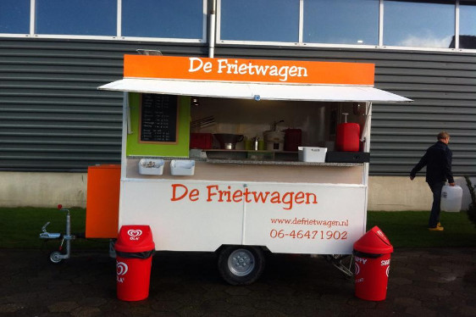
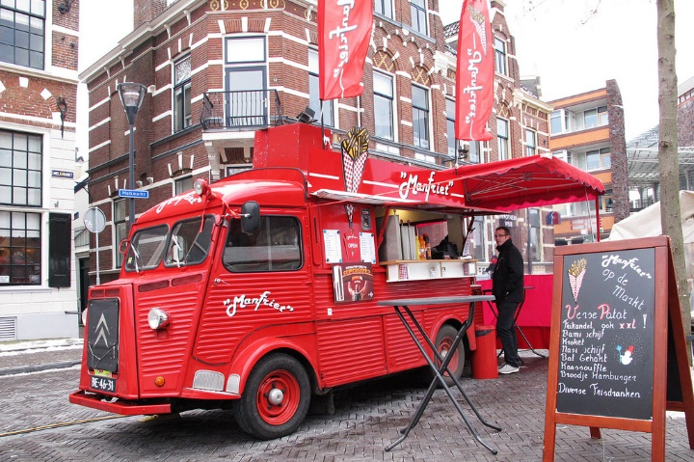
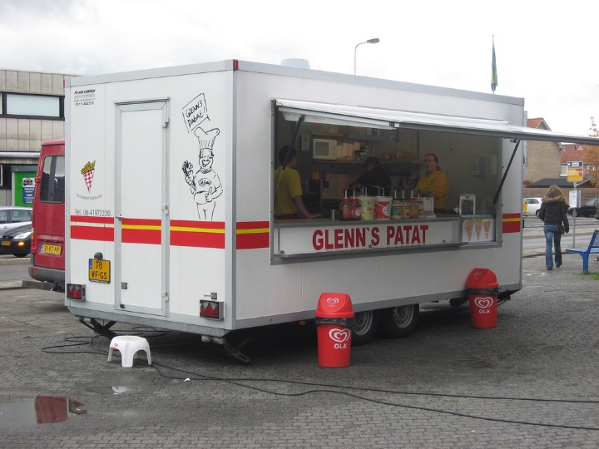
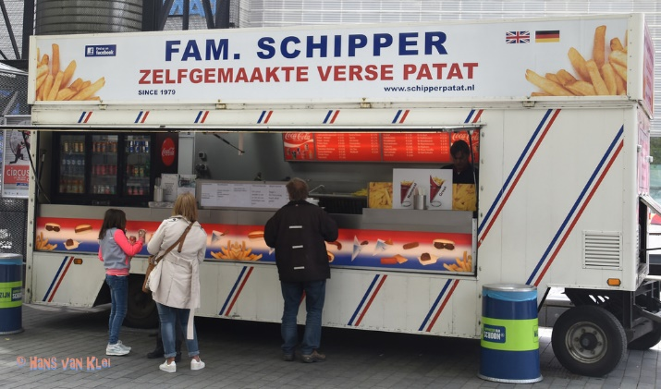
French fries and mayonnaise

Slide 6
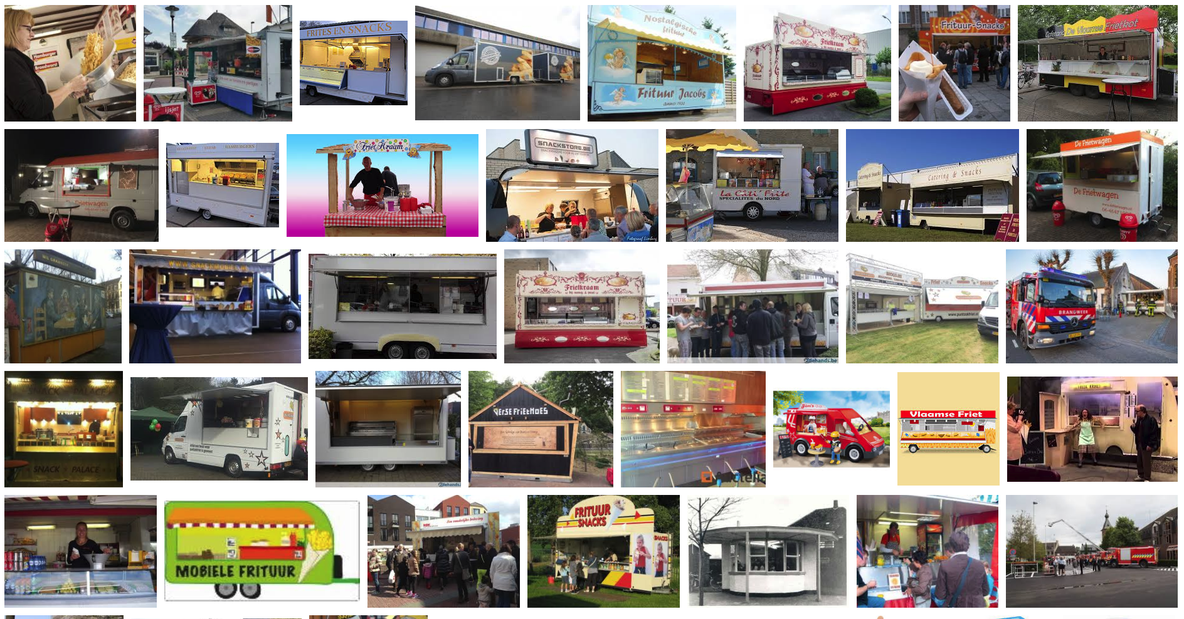
French fries and mayonnaise

Slide 7
French fries and mayonnaise
Multiple frietwagens
Multiple employees
Varied menus
Varied pricing
with ‘grouping’
I owe you’s
Inventory
Different reports

