Slide 1
Informatics 121 Software Design I
Lecture 12
Duplication of course material for any commercial purpose without the explicit written permission of the professor is prohibited.

Slide 2
Announcement
There will be discussion Friday!

Slide 3
Today’s lecture
Design studio 2, part 1 reflection
Design studio 2, part 2

Slide 4
What was difficult about this design studio?
Why?

Slide 5
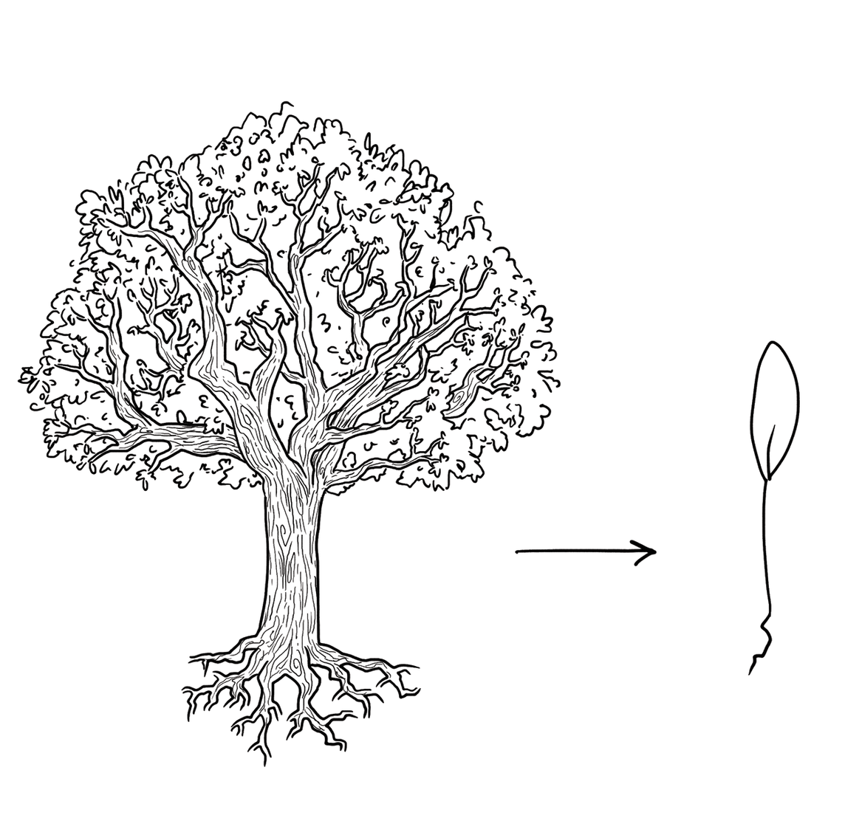
Where lies the essence of this design problem?

Slide 6
What past solutions that work did you prefer?

Slide 7
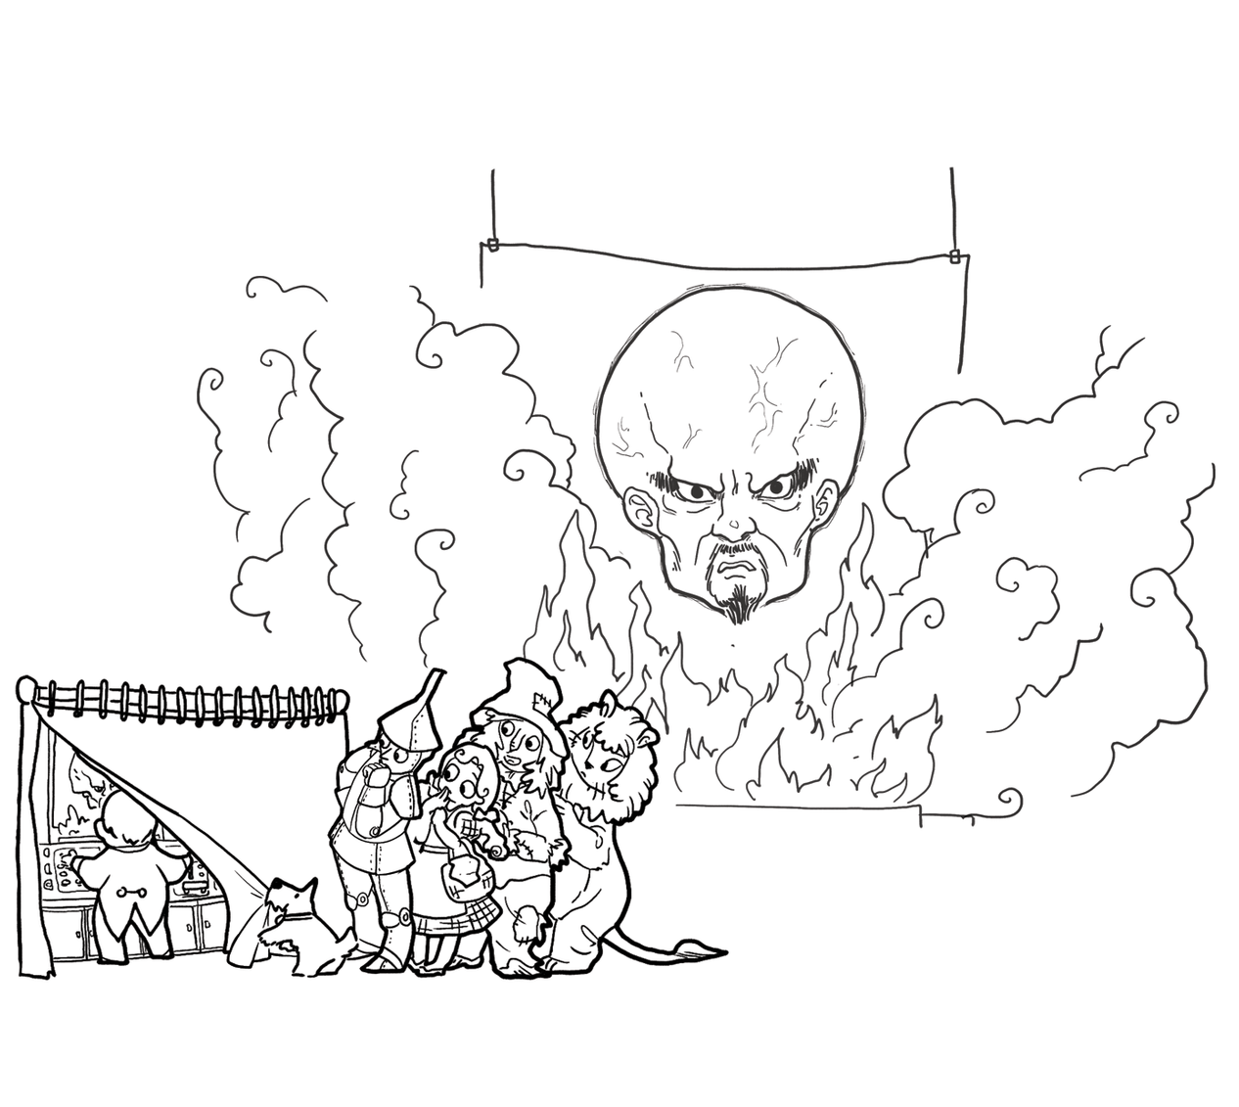
What knowledge deficiencies did you address?

Slide 8
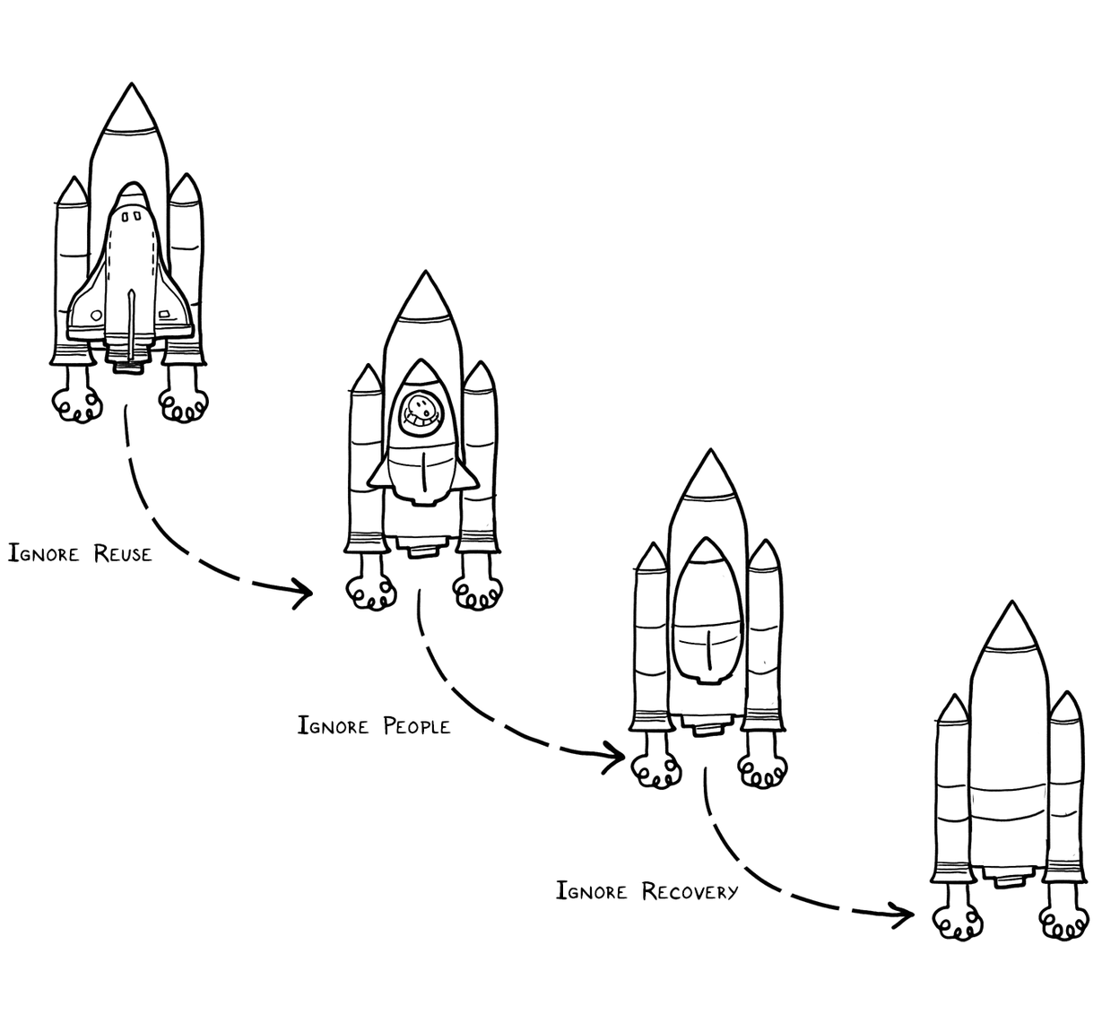
What simpler problems could you solve first?

Slide 9
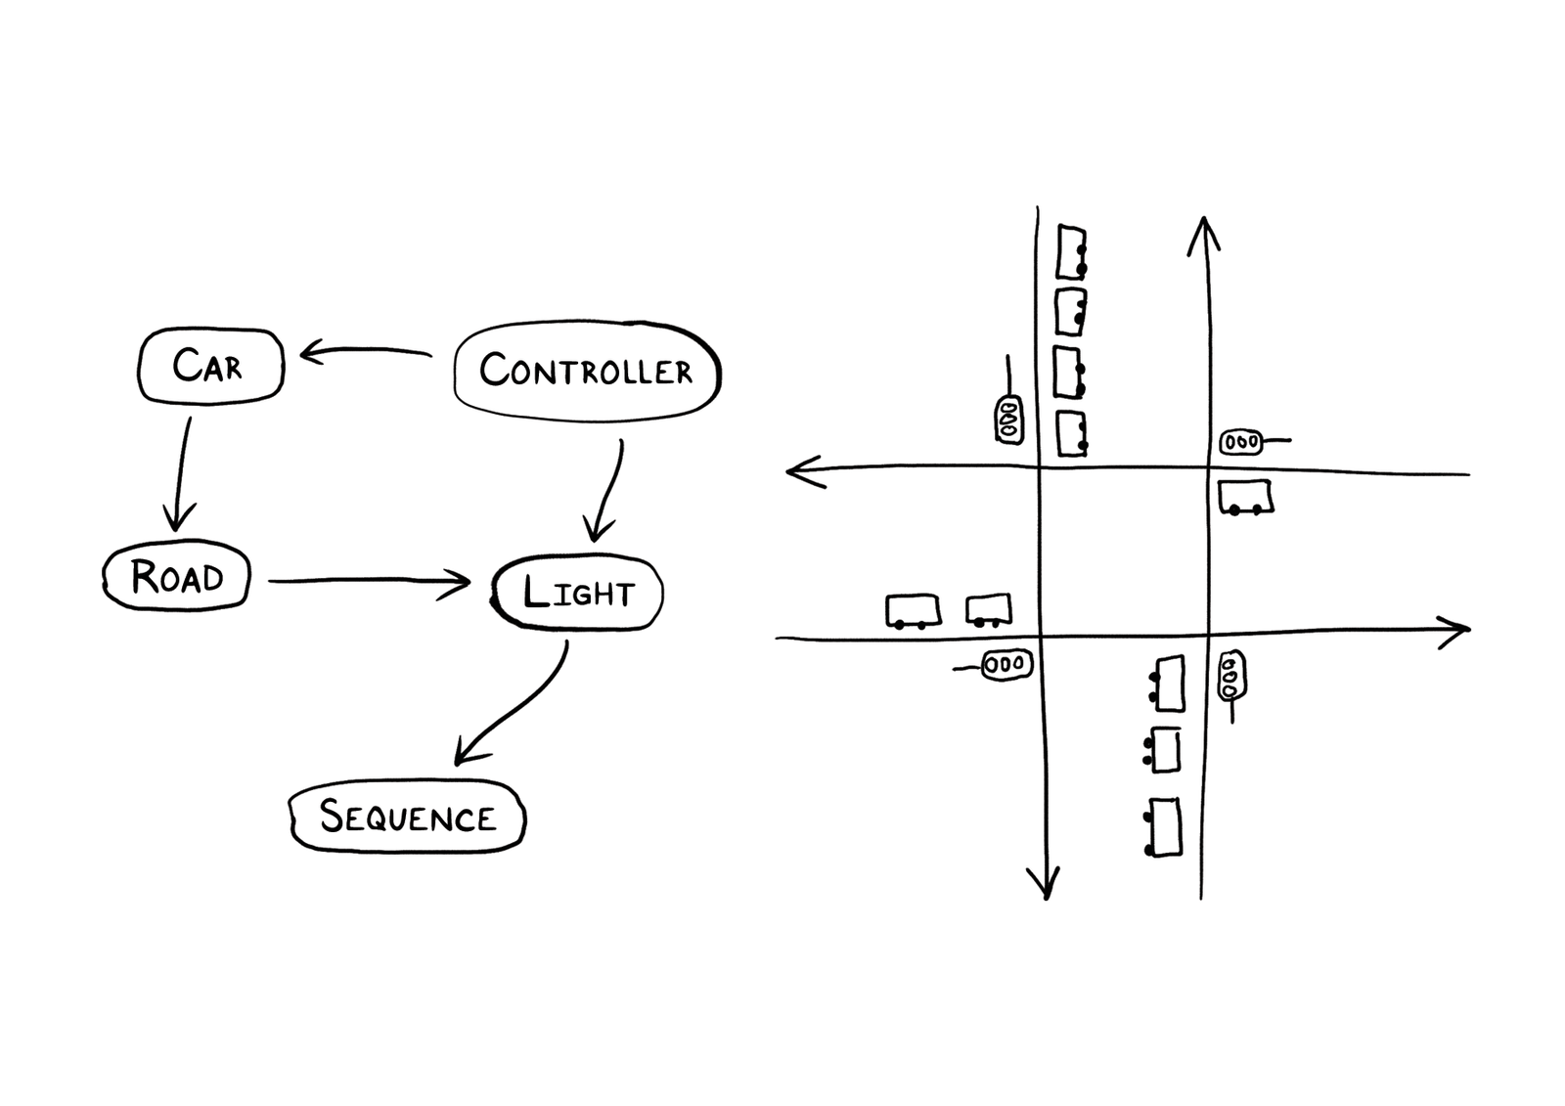
Did you draw the problem as much as you drew the solution?

Slide 10
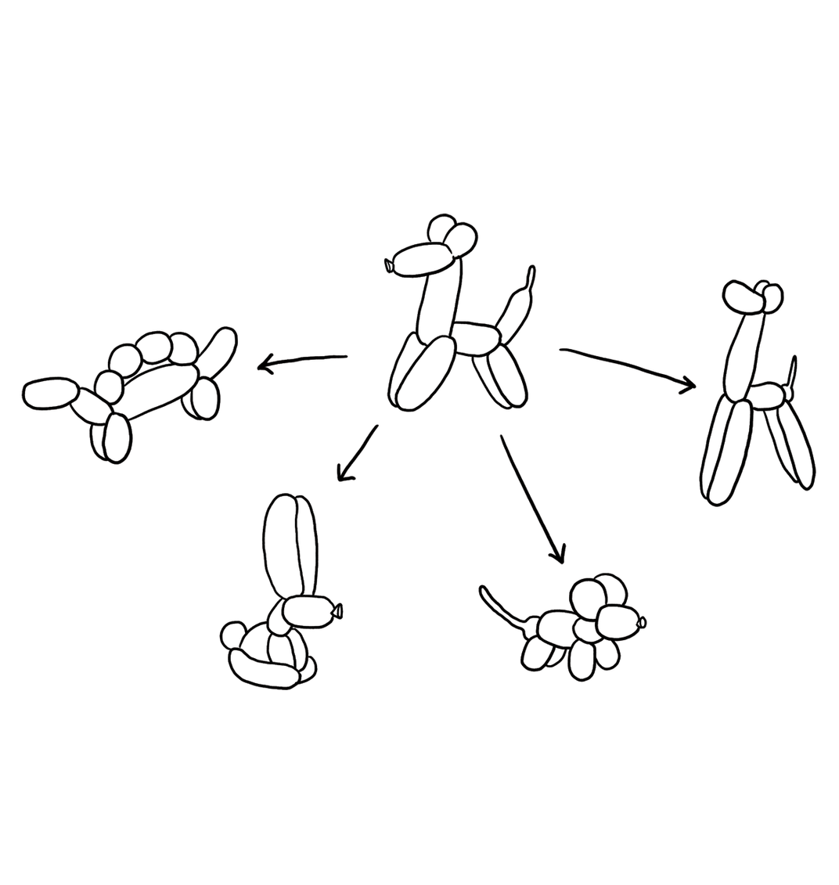
What alternatives did you generate?

Slide 11
When did you go as deep as needed?

Slide 12
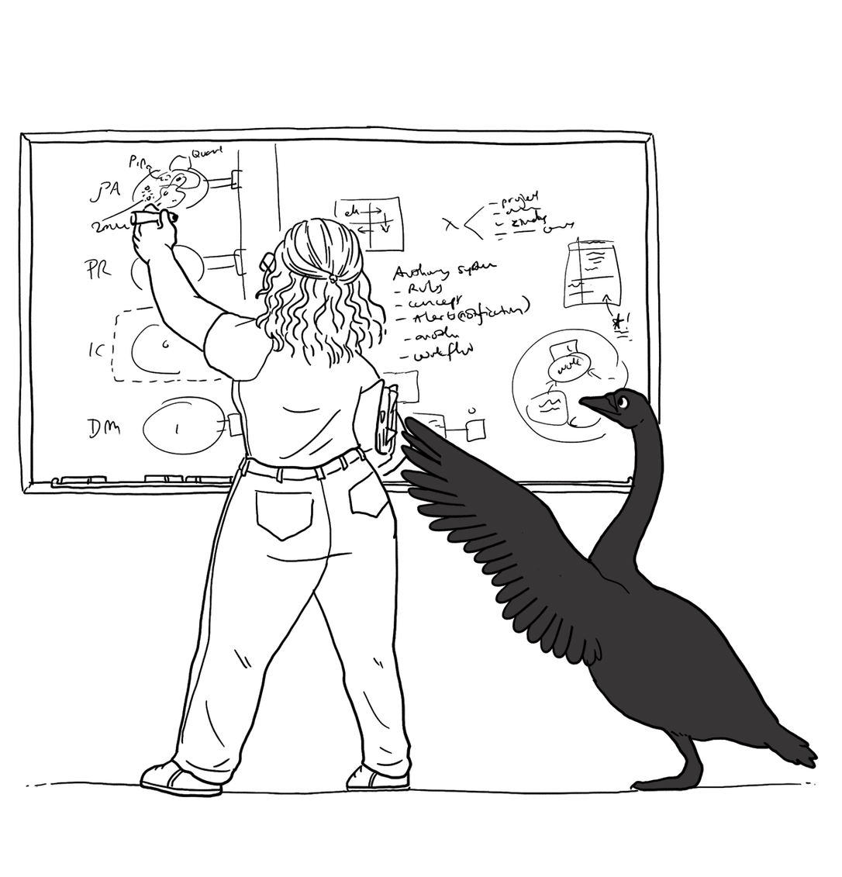
Did you find evidence that challenges your theory?

Slide 13
How were you skeptical?

Slide 14
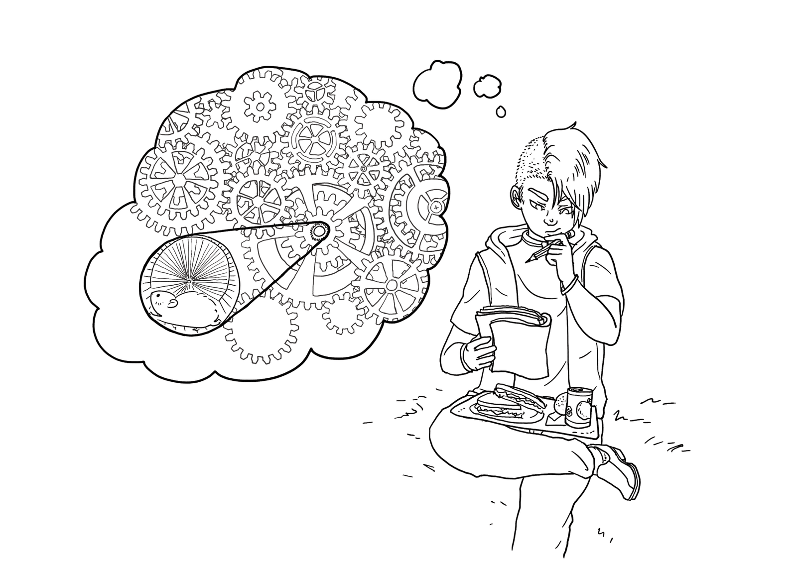
What did simulating continuously reveal?

Slide 15
Did you think about what you are not designing?

Slide 16
If you had more time, what would you have done?
Why?

Slide 17
Design studio 2 (part 2)
As a team, design an educational traffic simulator based on the new design prompt we handed out in class
Document the impact that the new requirements have on your original design
what were strengths of the original design
what were weaknesses of the original design
Same group

Slide 18
Design studio 2 (part 2)
Bring two printed copies to class, Wednesday February 28
make sure to identify all group members
make sure to identify your discussion time
Reflection counts as much as the new design
No extensions

