Slide 1
Informatics 121 Software Design I
Lecture 15
Duplication of course material for any commercial purpose without the explicit written permission of the professor is prohibited.

Slide 2
Announcement
There will be discussion Friday!

Slide 3
Today’s lecture
Design methods
Design studio 3

Slide 4
Software design methods
 | Application design | Interaction design | Architecture design | Implementation design
Analysis | competitive testing contextual inquiry feature comparison stakeholder analysis task analysis | critical incident technique interaction logging personas scenarios | framework assessment model-driven engineering quality-function-deployment reverse engineering world modeling | release planning summarization test-driven design visualization
Synthesis | affinity diagramming concept mapping mind mapping morphological chart | design/making participatory design prototyping storyboarding | architectural styles generative programming component reuse decomposition | pair programming refactoring search software patterns
Evaluation | requirements review role playing wizard of oz | cognitive walkthrough evaluative research heuristic evaluation think-aloud protocol | formal verification simulation weighted objectives | correctness proofs inspections/reviews parallel deployment testing

Slide 5
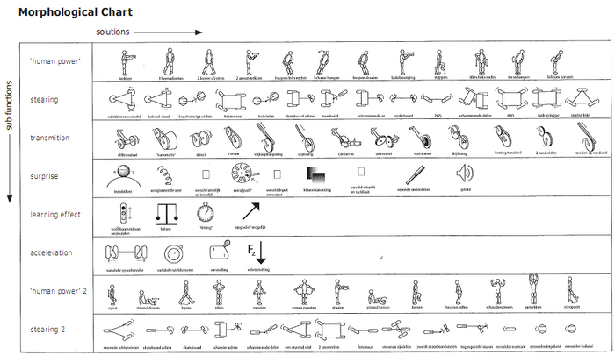
Morphological chart
Morphological chart is the process of generating ideas in an analytical and systematic manner

Slide 6
Procedure
List the features or functions that are essential to the product
For each feature or function, list the means by which it might be achieved
derive these systematically
Identify feasible combinations

Slide 7
Example: list the features or functions…
Engine
Shifting
Drive
Brakes
Steering
…

Slide 8
Example: list the means by which…
Engine | Fully electric | Hybrid | Gasoline | Diesel
Shifting | Automatic | Semi-automatic | Manual
Drive | Front-wheel | Rear-wheel | All-wheel
Brakes | Standard | Anti-lock
Steering | Regular | Power
… | … | … | …

Slide 9
Example: identify feasible combinations
Engine | Fully electric | Hybrid | Gasoline | Diesel
Shifting | Automatic | Semi-automatic | Manual
Drive | Front-wheel | Rear-wheel | All-wheel
Brakes | Standard | Anti-lock
Steering | Regular | Power
… | … | … | …

Slide 10
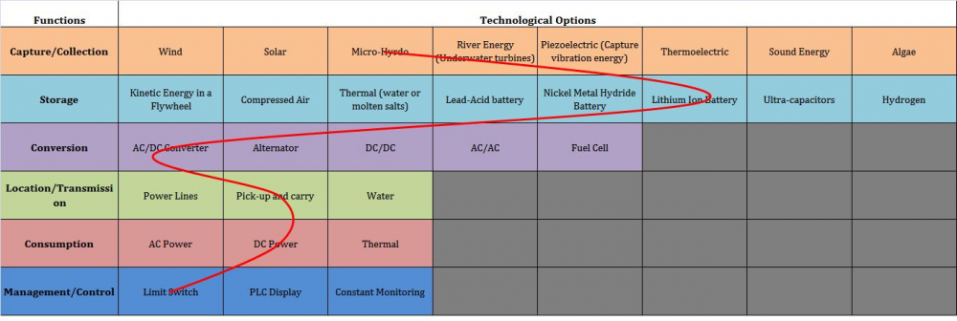
Typical notation: morphological chart

Slide 11
Criteria for successful use
The various features or functions of the eventual design solution must be well understood
The various features or functions of the eventual design solution must be relatively independent
The various means per feature or function must not be infinite, and principally relate to one another so a systematic articulation can uncover all of them

Slide 12
Strengths and weaknesses
Strengths
Weaknesses
Helps break down the design problem into features or functions
Systematic manner of deriving possible means
Avoids possible bias toward certain means
Helps identify and consider novel/unusual combinations
Applicable only to design problems where the features or functions of the design solution are well understood
Quickly leads to too many possible combinations
No valuation attached to individual means

Slide 13
Practice
Educational traffic light simulator

Slide 14
Software design methods
 | Application design | Interaction design | Architecture design | Implementation design
Analysis | competitive testing contextual inquiry feature comparison stakeholder analysis task analysis | critical incident technique interaction logging personas scenarios | framework assessment model-driven engineering quality-function-deployment reverse engineering world modeling | release planning summarization test-driven design visualization
Synthesis | affinity diagramming concept mapping mind mapping morphological chart | design/making participatory design prototyping storyboarding | architectural styles generative programming component reuse decomposition | pair programming refactoring search software patterns
Evaluation | requirements review role playing wizard of oz | cognitive walkthrough evaluative research heuristic evaluation think-aloud protocol | formal verification simulation weighted objectives | correctness proofs inspections/reviews parallel deployment testing

Slide 15
Role playing
Role playing is the process of acting out the experience of a user with the envisioned design solution

Slide 16
Procedure
Identify the situation, tasks, and roles
Enact the situation and tasks
Take notes

Slide 17
Example: identify the situation, tasks, and roles
The situation concerns a patient in a hospital bed who has to use the tray table
The tasks include
the patient eats their meal
the nurse replaces bandages
The roles are the patient (of several kinds, e.g., a patient with arthritis, a patient with a broken arm, a small person, a large person) and the nurse

Slide 18
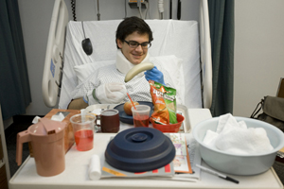
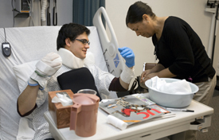
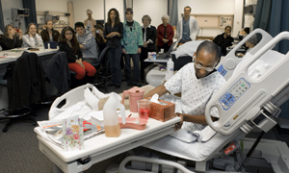
Example: enact the situation

Slide 19
Example: take notes
The patient found it difficult to operate the tray table with one hand
The patient could not raise or lower the tray table
The patient and nurse collided in terms of who ‘owned’ the table

Slide 20
Example: enact the situation
http://youtu.be/hkAFdIrTR00

Slide 21
Typical notation: notes
The patient found it difficult to operate the tray table with one hand
The patient could not raise or lower the tray table
The patient and nurse collided in terms of who ‘owned’ the tray table

Slide 22
Criteria for successful use
The people involved in role play must be willing to improvise
The people involved in role play must be willing to ‘truly’ step into the user role
The scenario and tasks should be played out multiple times
Notes should be taken by an auxiliary person
Props may help

Slide 23
Strengths and weaknesses
Strengths
Weaknesses
Helps the designer envision the user experience more vividly
Can be used to enact situations and tasks to which the designer does not have direct access
May uncover assumptions that are not readily apparent in more traditional design artifacts
Relatively lightweight method
Depends strongly on people’s willingness to role play and not be self-conscious in doing so
Depends strongly on people’s imagination, and understanding of the typical (and a-typical) user
Difficult to do well for software

Slide 24
Variants
Bodystorming
Simulation exercises

Slide 25
Software design methods
 | Application design | Interaction design | Architecture design | Implementation design
Analysis | competitive testing contextual inquiry feature comparison stakeholder analysis task analysis | critical incident technique interaction logging personas scenarios | framework assessment model-driven engineering quality-function-deployment reverse engineering world modeling | release planning summarization test-driven design visualization
Synthesis | affinity diagramming concept mapping mind mapping morphological chart | design/making participatory design prototyping storyboarding | architectural styles generative programming component reuse decomposition | pair programming refactoring search software patterns
Evaluation | requirements review role playing wizard of oz | cognitive walkthrough evaluative research heuristic evaluation think-aloud protocol | formal verification simulation weighted objectives | correctness proofs inspections/reviews parallel deployment testing

Slide 26
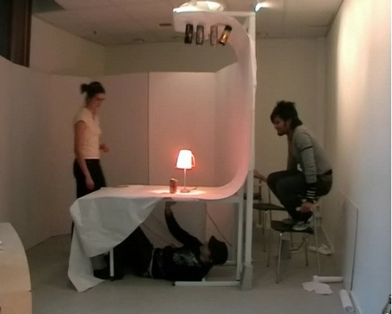
Wizard of Oz
Wizard of Oz is the process of evaluating an envisioned design solution during which the user interacts with a system that is seemingly real, but actually involves a person who generates the system responses from behind the scenes

Slide 27
Procedure
Identify the situation and tasks
Create the physical environment
Enact the situation and tasks
Take notes

Slide 28
Example: identify the situation and tasks
The situation concerns a future television that is voice and gesture controlled
The tasks include turning on/off the television, selecting particular channels to watch, reading e-mail, etc.

Slide 29
Example: create the physical environment
Primary room includes a television and a couch to simulate a living room
Primary room includes a hidden camera behind the television, facing the couch
Television displays the output of a computer
Computer is hidden in a different room, with the operator able to see what the camera is recording in the primary room

Slide 30
Example: enact the scenario and tasks
http://youtu.be/vcxlI0wI_7A

Slide 31
Example: take notes
The actual gestures performed by the user are imprecise
The voice commands differed strongly in pronunciation from user to user

Slide 32
Typical notation: notes
The actual gestures performed by the user are imprecise
The voice commands differed strongly in pronunciation from user to user

Slide 33
Criteria for successful use
The experience must be realistic
The ‘wizard’ must behave consistently
The tasks do not involve direct manipulation

Slide 34
Strengths and weaknesses
Strengths
Weaknesses
Identifies problems with the design concept early
Can evaluate design solutions that are difficult to prototype
Can involve actual future users
Relatively inexpensive
Requires training of the wizard
Difficult to provide the realism and consistency necessary
Can only simulate relatively simple experiences
Difficult to mimic software

Slide 35
Variants
Bodystorming
Simulation exercises

Slide 36
Design studio 3
Design studio 3 is now out, with instructions handed out in class

