Slide 1
Informatics 121 Software Design I
Lecture 17
Duplication of course material for any commercial purpose without the explicit written permission of the professor is prohibited.

Slide 2
Announcements
No class Wednesday (Andre traveling)

Slide 3
Today’s lecture
Design studio 3
Design methods

Slide 4
Design studio 3
Questions?

Slide 5
Software design methods
 | Application design | Interaction design | Architecture design | Implementation design
Analysis | competitive testing contextual inquiry feature comparison stakeholder analysis task analysis | critical incident technique interaction logging personas scenarios | framework assessment model-driven engineering quality-function-deployment reverse engineering world modeling | release planning summarization test-driven design visualization
Synthesis | affinity diagramming concept mapping mind mapping morphological chart | design/making participatory design prototyping storyboarding | architectural styles generative programming component reuse decomposition | pair programming refactoring search software patterns
Evaluation | requirements review role playing wizard of oz | cognitive walkthrough evaluative research heuristic evaluation think-aloud protocol | formal verification simulation weighted objectives | correctness proofs inspections/reviews parallel deployment testing

Slide 6
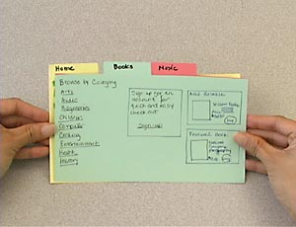
Prototyping
Prototyping is the process of creating tangible artifacts embedding the envisioned design solution

Slide 7
Procedure
Decide the purpose
Decide the fidelity and medium
Create the prototype

Slide 8
Example: decide the purpose
Obtain feedback from the client
Obtain feedback from potential users
Obtain feedback from other stakeholders
Explore alternatives more concretely

Slide 9
Example: decide the fidelity and medium
Low fidelity
paper prototype
Medium fidelity
wireframes
mock-ups
High fidelity
actual running software

Slide 10
Example: decide the details

Slide 11
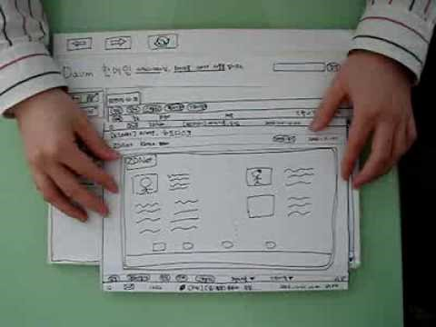
Example: paper prototype
http://youtu.be/GrV2SZuRPv0

Slide 12
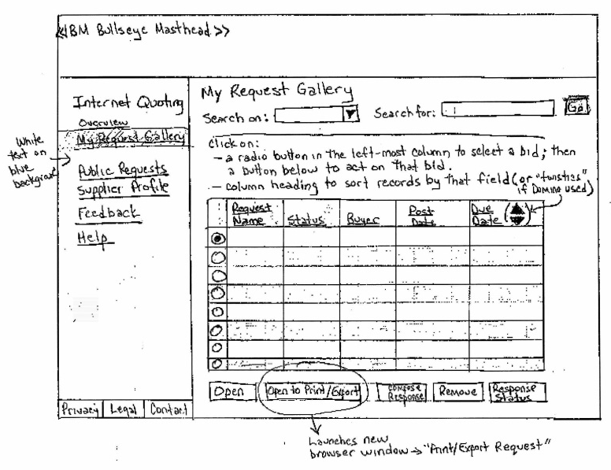
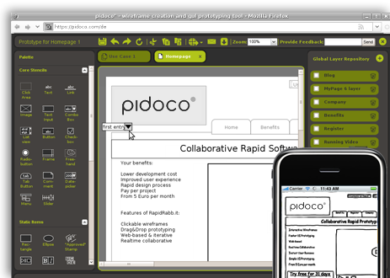
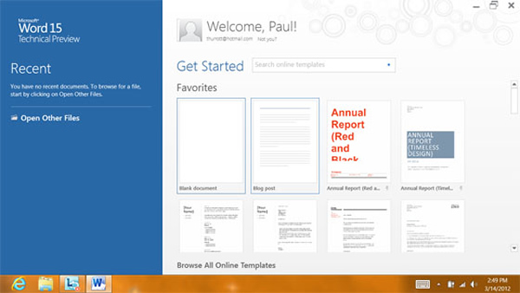
Typical notation: tangible

Slide 13
Criteria for successful use
Strong sense of aesthetics and attention to detail
Must be open to prototyping multiple design ideas
Should have a definite sense of possible solutions
Collaborate

Slide 14
Strengths and weaknesses
Strengths
Weaknesses
Tangible nature invites early yet detailed feedback
Low fidelity prototyping is a lightweight approach that still yields good results
Tool support is readily available
The higher the fidelity, the more expensive the endeavor
Could lead to too much focus on the visual appearance instead of the supporting the actual tasks at hand

Slide 15
Software design methods
 | Application design | Interaction design | Architecture design | Implementation design
Analysis | competitive testing contextual inquiry feature comparison stakeholder analysis task analysis | critical incident technique interaction logging personas scenarios | framework assessment model-driven engineering quality-function-deployment reverse engineering world modeling | release planning summarization test-driven design visualization
Synthesis | affinity diagramming concept mapping mind mapping morphological chart | design/making participatory design prototyping storyboarding | architectural styles generative programming component reuse decomposition | pair programming refactoring search software patterns
Evaluation | requirements review role playing wizard of oz | cognitive walkthrough evaluative research heuristic evaluation think-aloud protocol | formal verification simulation weighted objectives | correctness proofs inspections/reviews parallel deployment testing

Slide 16
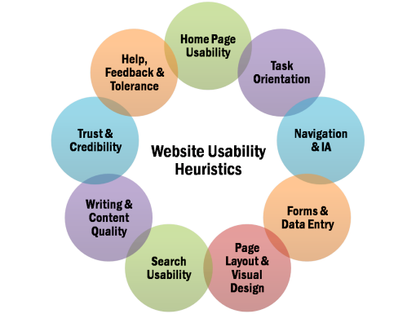
Heuristic evaluation
Heuristic evaluation is the process of assessing a user interface against a standard set of criteria

Slide 17
Procedure
Choose heuristics
Choose evaluators
Identify goal of the interface
Define a set of representative tasks
Perform tasks
Tabulate results

Slide 18
Example: choose heuristics
Nielsen’s heuristics of user interface design
Gerhardt-Powals’ cognitive engineering principles
Standards
accessibility
responsive design
color guides
Internal, company guidelines

Slide 19
Example: choose evaluators
Choose the number of evaluators
typically three to five
Choose required background
ideally, user interface experts
ideally, complementary skills

Slide 20
Example: identify goal of the interface
The goal of the interface is to both make it possible for individuals to quickly find and order the book they need and for individuals to explore the richness of the collection that is available
The goal of the interface is to allow doctors to easily order the right prescription for their patients while at the same time minimizing the number of wrong prescriptions being ordered

Slide 21
Example: define a set of representative tasks
Find the book ‘Software Designers in Action’ and order it
Find five books that are similar to this book, and choose the book that is most similar
Post a review of this book
Order a prescription for patient X consisting of 20 pills of penicillin, at a dosage of 250mg, 2 pills per day
Change the prescription for patient X to 10 pills at a dosage of 500mg, 1 pill a day

Slide 22
Example: perform the tasks
Each evaluator performs the set of tasks on their own and, per tasks, and ranks how the interface supports the task in terms of the heuristics

Slide 23
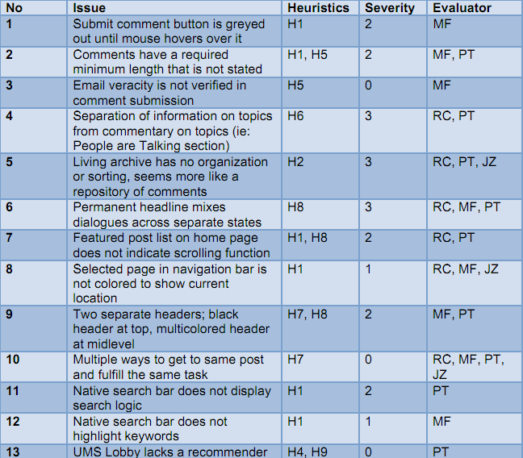
Example: tabulate results

Slide 24
Typical notation: table

Slide 25
Criteria for successful use
The evaluators must be well-versed in the heuristics
Application of multiple evaluators
Requires attention to detail

Slide 26
Strengths and weaknesses
Strengths
Weaknesses
Is based on best practices
Useful to iron out problems before testing with real users
Can be performed relatively quickly
Can be used on early design artifacts
Result sharing improves design practice
Focuses on problems, does not identify opportunities
Will not uncover all problems, because of a focus on a given set of heuristics

Slide 27
Variants
Cognitive walkthrough

Slide 28
Nielsen’s Heuristics of User Interface Design
(handout)

