Slide 1
Informatics 121 Software Design I
Lecture 5
Duplication of course material for any commercial purpose without the explicit written permission of the professor is prohibited.

Slide 2
Announcements
There will be discussion today
must attend your designated discussion, as this is the first time your group meets and starts its design process for design studio 1, part 2

Slide 3
Today
Four types of design
Expert behaviors
Design studio 1

Slide 4
Design
designer
plan
maker
change in the world
other stakeholders
audience
experiences

Slide 5
Feasibility and desirability
feasibility
designer
plan
maker
change in the world
other stakeholders
audience
experiences

Slide 6
Feasibility and desirability
feasibility
designer
plan
maker
change in the world
other stakeholders
audience
experiences
desirability

Slide 7
Four types of design
desirability
what is it to accomplish?
how does one interact with it?
feasibility
what is its conceptual core?
what are its implementation details?

Slide 8
Four types of design
what is it to accomplish?
satisfactory experience
how does one interact with it?
change in the world
what is its conceptual core?
plan for realization
what are its implementation details?

Slide 9
Four types of software design
what is it to accomplish?
application design
satisfactory experience
how does one interact with it?
interaction design
change in the world
what is its conceptual core?
architecture design
plan for realization
what are its implementation details?
implementation design

Slide 10
Design a mobile phone messaging system
what is it to accomplish?
application design
satisfactory experience
how does one interact with it?
interaction design
change in the world
what is its conceptual core?
architecture design
plan for realization
what are its implementation details?
implementation design

Slide 11
Design a word processor
what is it to accomplish?
application design
satisfactory experience
how does one interact with it?
interaction design
change in the world
what is its conceptual core?
architecture design
plan for realization
what are its implementation details?
implementation design

Slide 12
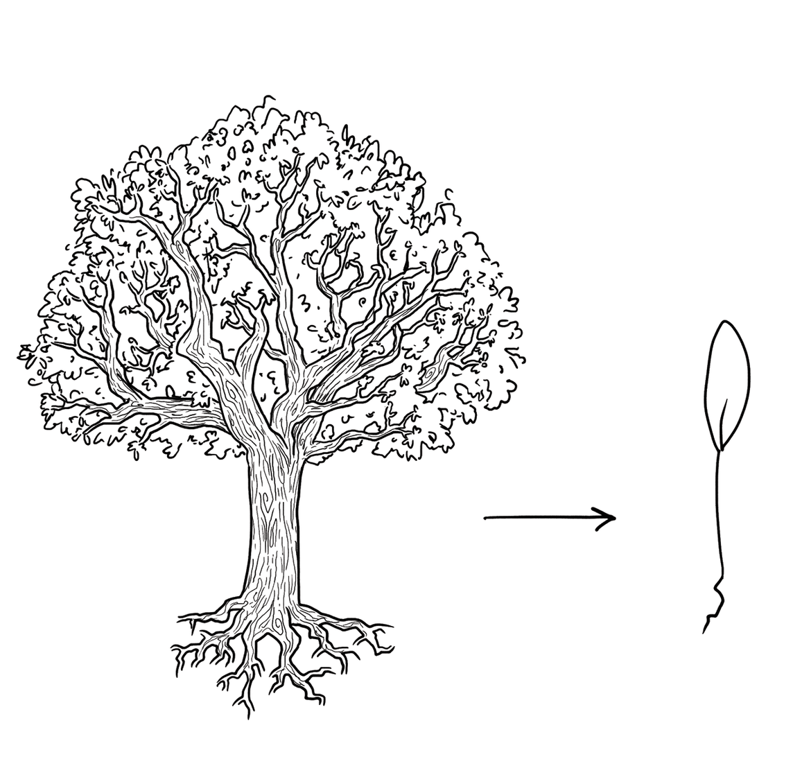
Experts focus on the essence

Slide 13
Experts prefer solutions that they know work

Slide 14
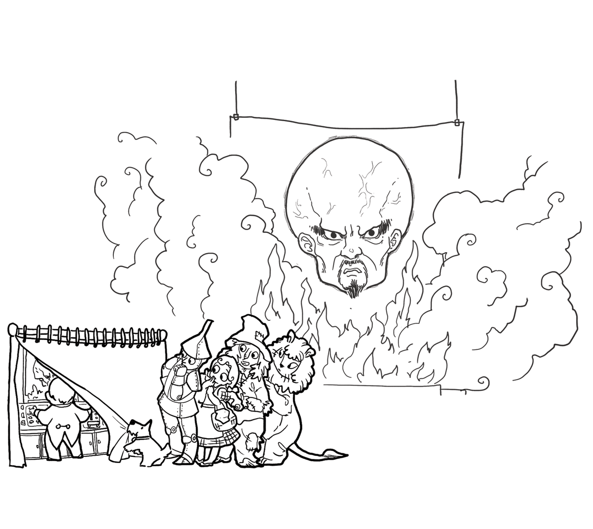
Experts address knowledge deficiencies

Slide 15
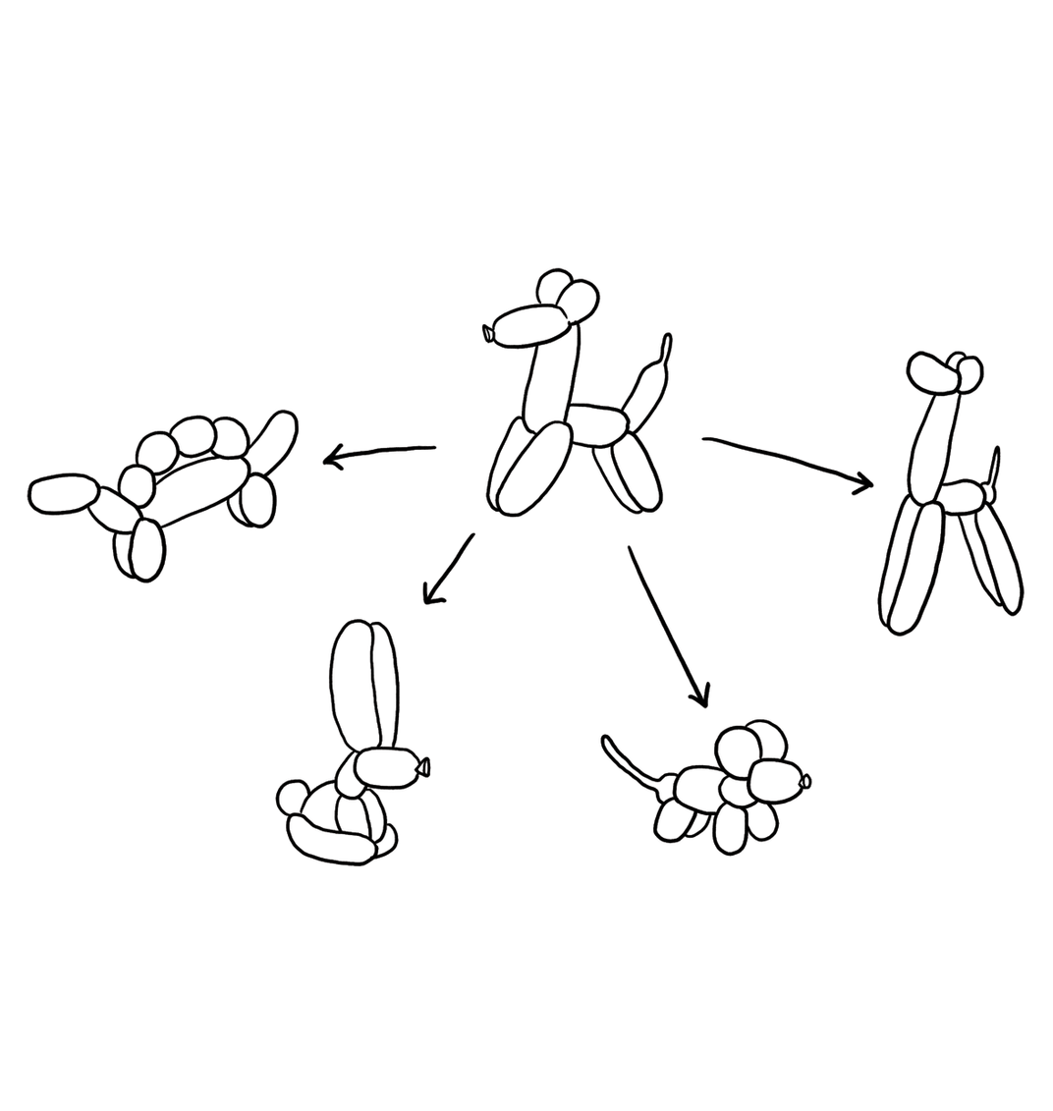
Experts generate alternatives

Slide 16
Experts are skeptical

Slide 17
Design a word processor
what is it to accomplish?
application design
satisfactory experience
how does one interact with it?
interaction design
change in the world
what is its conceptual core?
architecture design
plan for realization
what are its implementation details?
implementation design

Slide 18
Design studio 1
Your client is TransportationAssist, a new company that recognizes the potential of smart phones to help elderly in ‘getting around’ in their day-to-day lives.
The company particularly is invested in two new directions: (1) assisting elderly in taking public transportation, helping them getting from one destination to another, and (2) tracking their whereabouts so others can check in on them.
The company has sought you out, because you are an excellent designer. All of the software design is in your hands, as TransportationAssist has the idea protected (meaning no competition), but has no idea how to actually design the software.

Slide 19
Design studio 1 (part 1)
Identify the audience and other stakeholders
Identify possible goals, constraints, and assumptions
Bring two printed copies to discussion, next Friday
one for the TAs
one for your group
Your group will be announced at the start of your discussion

Slide 20
Design studio 1 (part 2)
As a team, design the consumer facing side of TransportationAssist in terms of:
the functionality it will offer
how users will interact with it
Make sure that you explicitly identify goals, constraints, and assumptions
Make sure to consider at least three different approaches, highlight tradeoffs among the approaches, and discuss why you chose the approach you took
briefly document the approaches you considered but did not adopt

Slide 21
Design studio 1 (part 2)
Practice what you have learned about experts:
focus on the essence
prefer solutions that they know work
address knowledge deficiencies
generate alternatives
are skeptical
Bring one printed copy to class, Monday February 5
make sure to identify all group members

Slide 22
Design studio 1 (part 2)
Team members will assess other team members
in terms of the contributions they make
in terms of enabling others to make contributions

