Slide 1
Informatics 121 Software Design I
Lecture 8
Duplication of course material for any commercial purpose without the explicit written permission of the professor is prohibited.

Slide 2
Announcement
Design studio 2 will be out Wednesday, not today

Slide 3
Today
Design studio 1 debrief

Slide 4
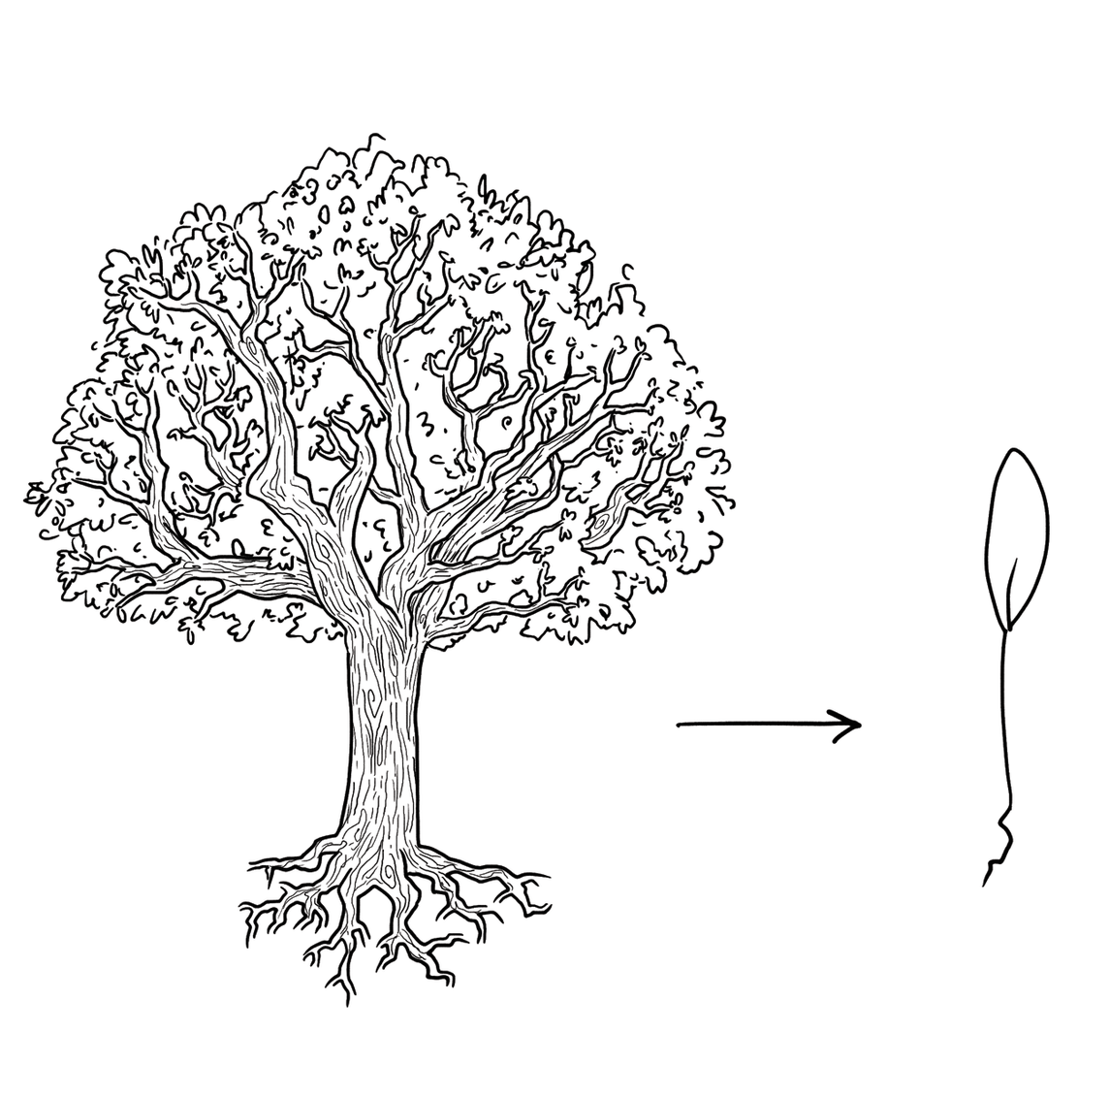
Where lies the essence of this design problem?

Slide 5
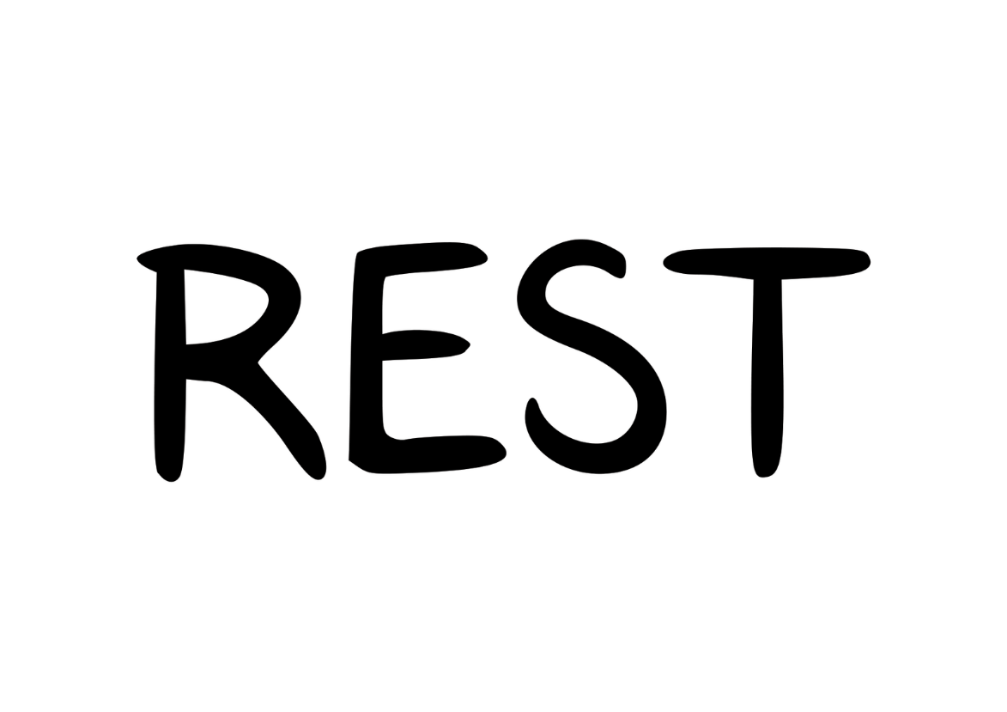
What past solutions that work did you prefer?

Slide 6
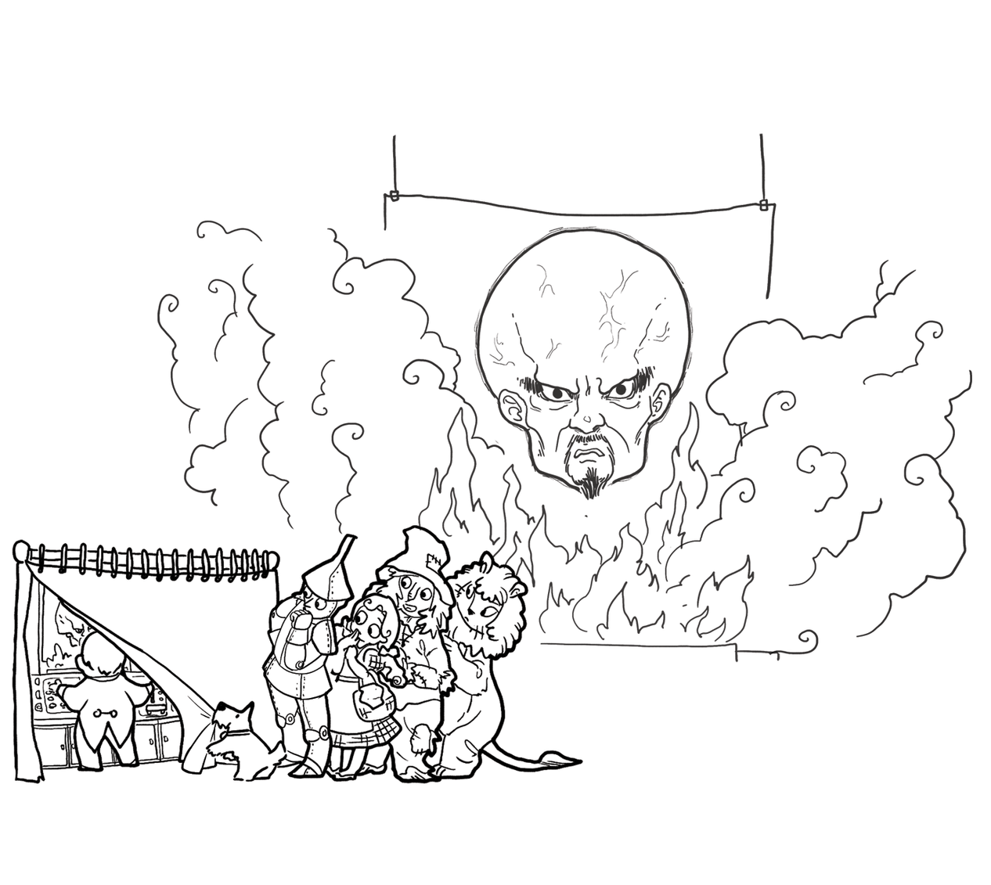
What knowledge deficiencies did you address?

Slide 7
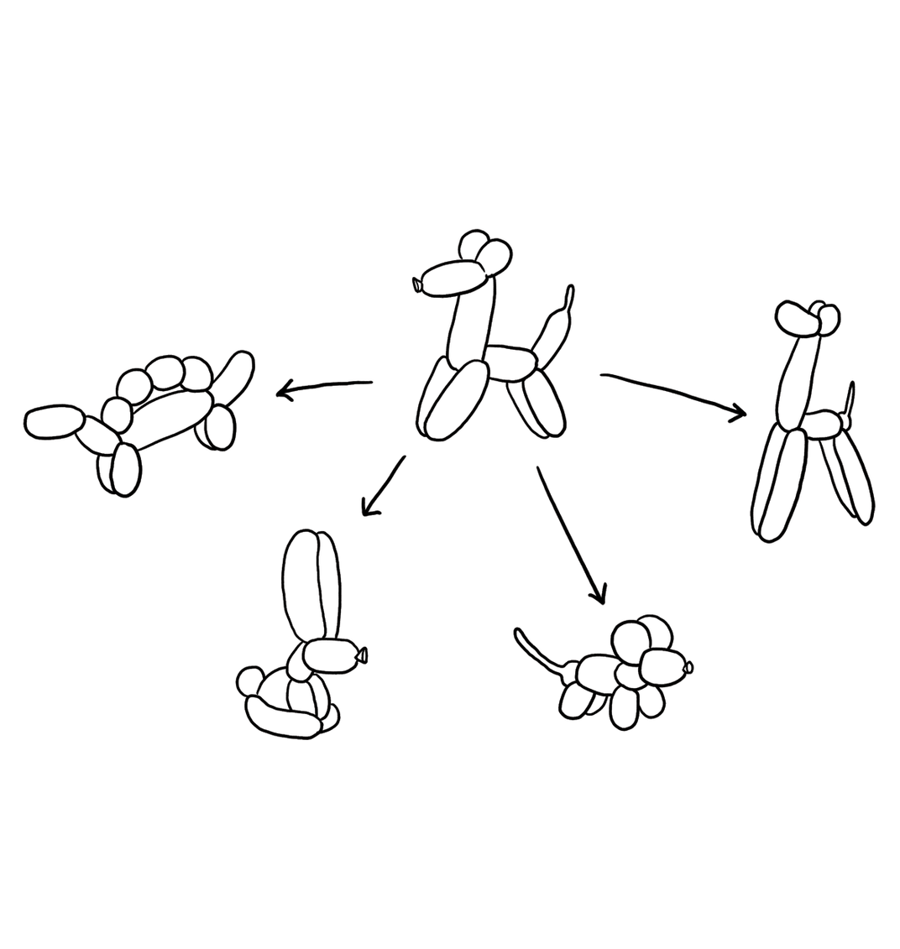
What alternatives did you generate?

Slide 8
How were you skeptical?

Slide 9
What was difficult about this design studio?
Why?

Slide 10
If you had more time, what would you have done?
Why?

Slide 11
How much did you feel you were engaging in...
...predicting the future
...making tradeoffs
...managing bias
...accommodating change
...balancing cost, quality, and effort
...solving a problem, now and later

Slide 12
Did you keep this in mind?
designer
plan
maker
change in the world
other stakeholders
audience
experiences

Slide 13
Did you keep this in mind?
synthesize
goals
constraints
assumptions
decisions
ideas
analyze
evaluate

Slide 14
How would you have structured the studio?

