Slide 1
Informatics 121 Software Design I
Lecture 9
Duplication of course material for any commercial purpose without the explicit written permission of the professor is prohibited.

Slide 2
Announcements
No office hours today
Discussion today

Slide 3
Today’s lecture
Expert behaviors
Design studio 2
Design artifacts
Design notations

Slide 4
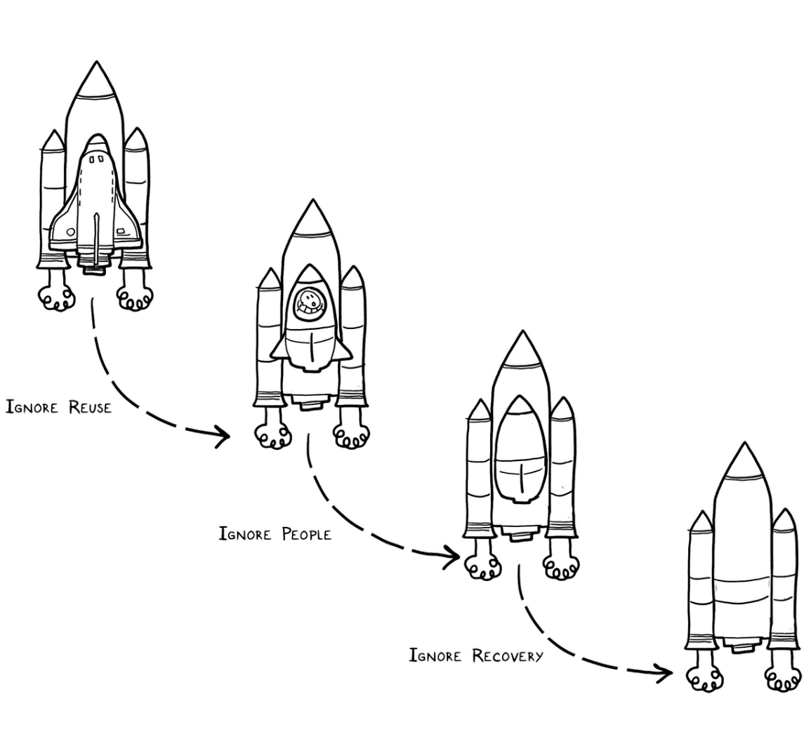
Experts solve simpler problems first

Slide 5
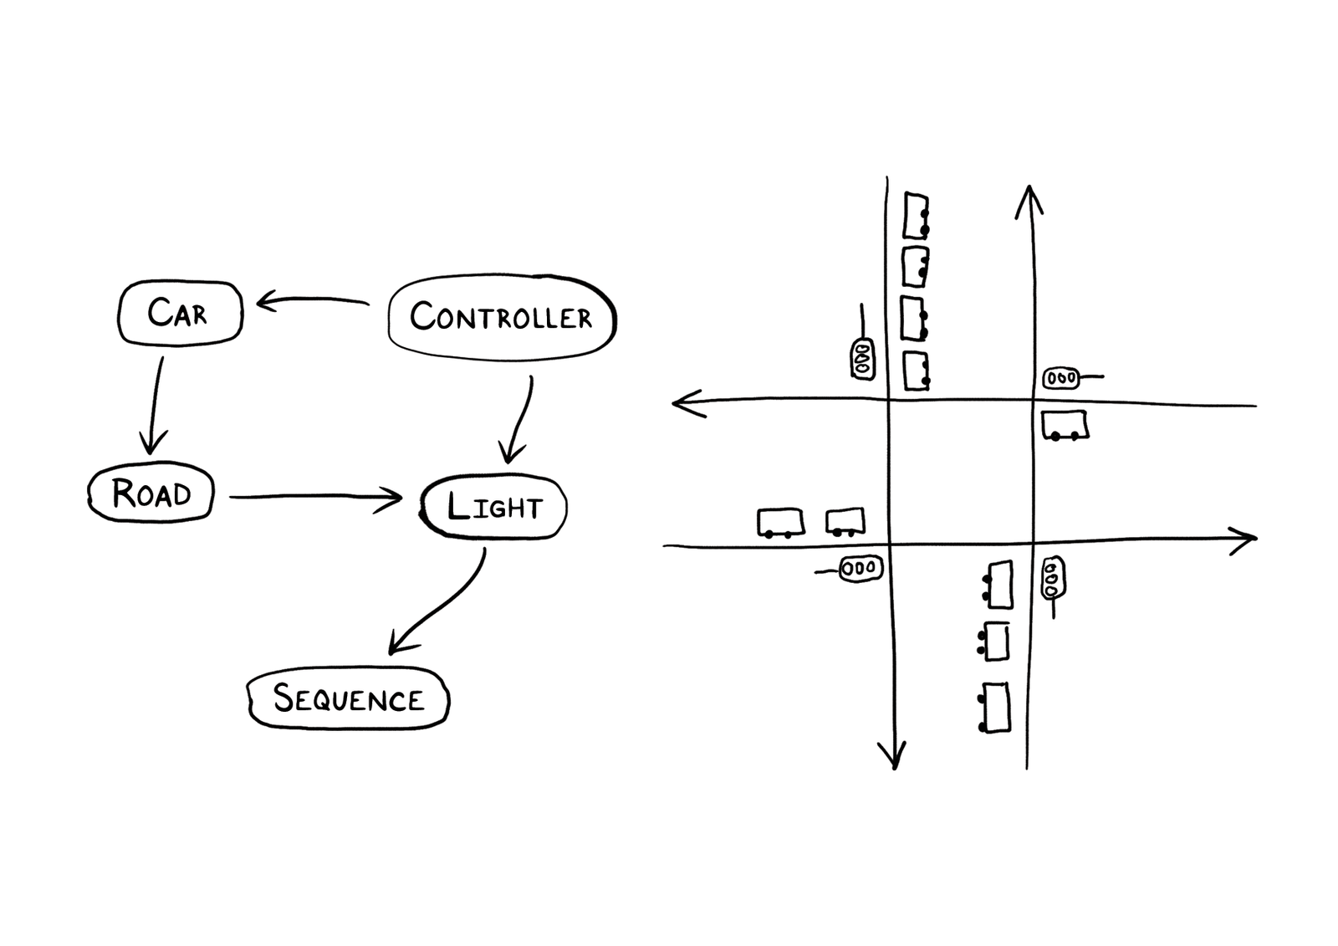
Experts draw the problem as much as they draw the solution

Slide 6
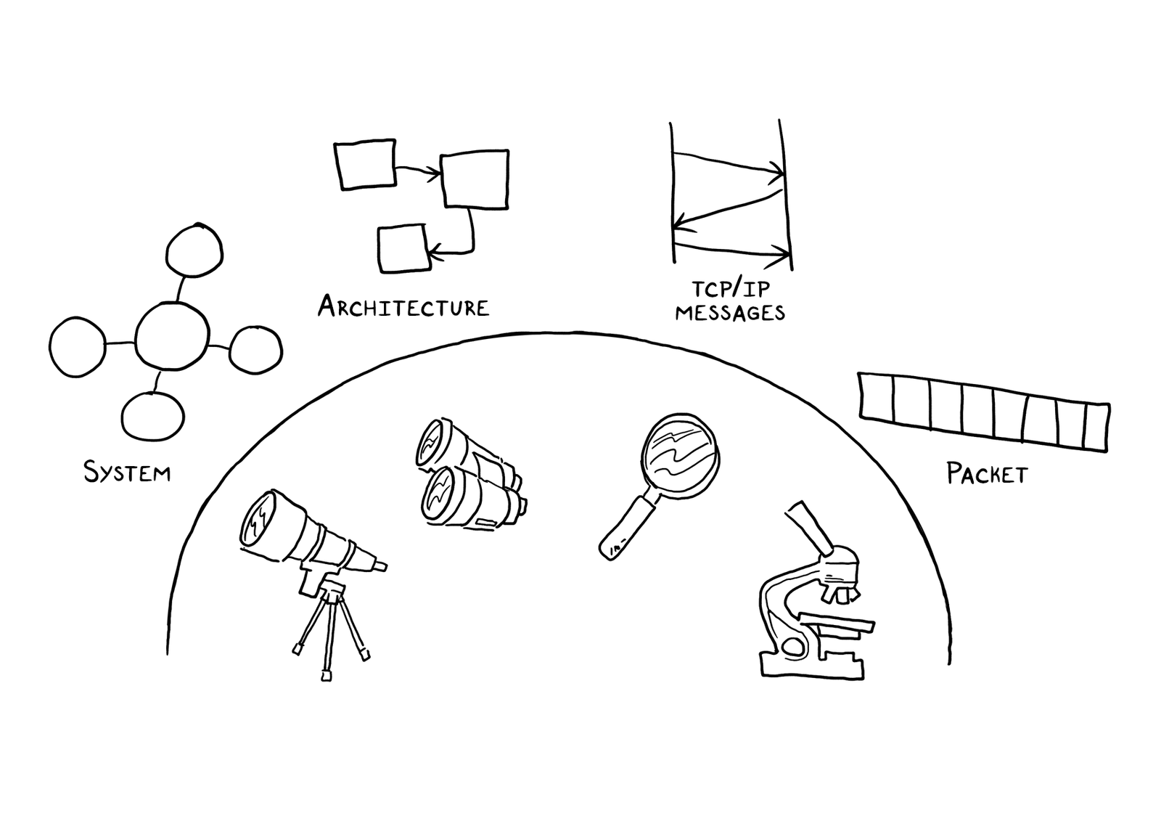
Experts move among levels of abstraction

Slide 7
Experts go as deep as needed

Slide 8
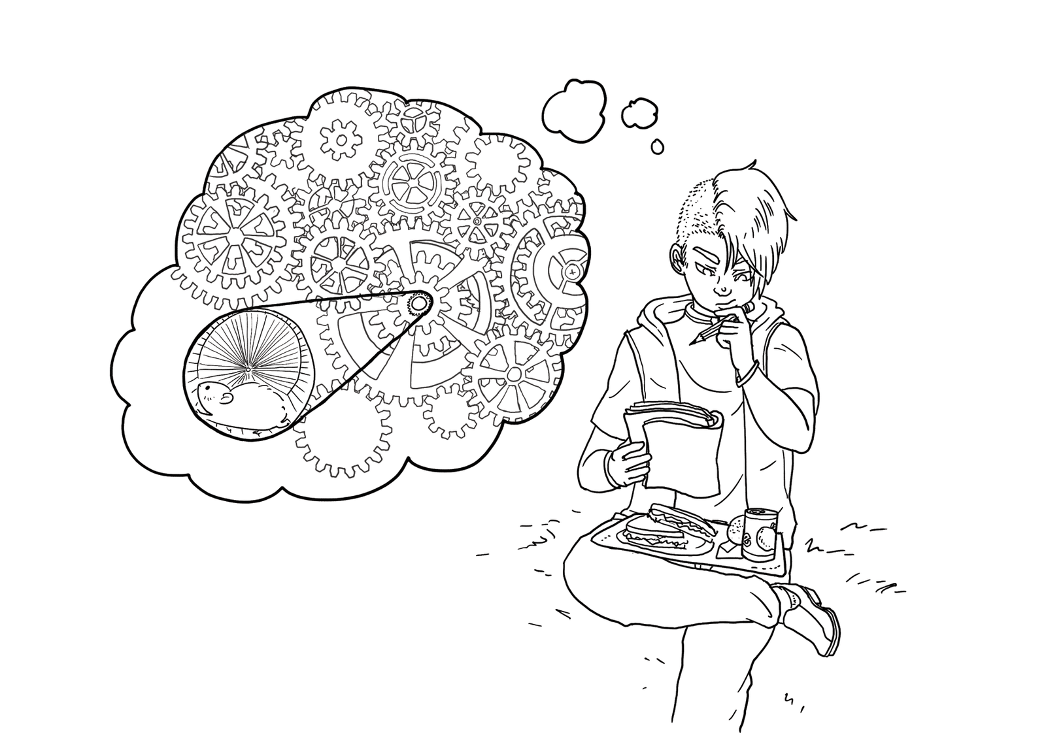
Experts simulate continually

Slide 9
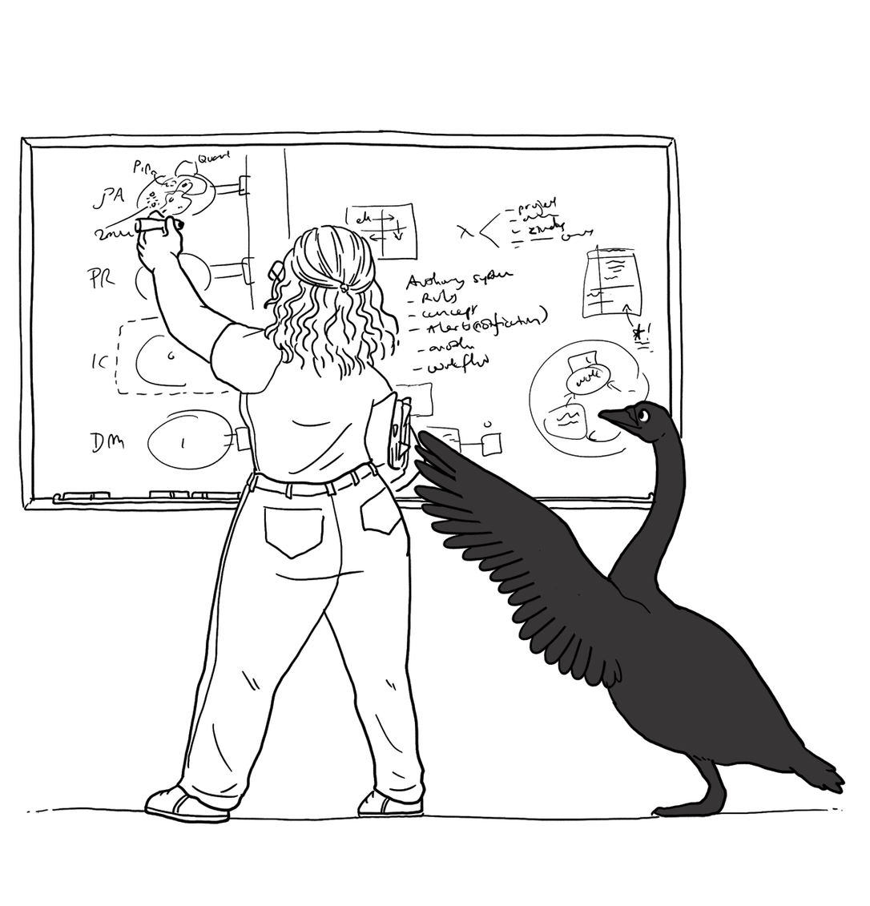
Experts are alert to evidence that challenges their theory

Slide 10
Experts think about what they are not designing

Slide 11
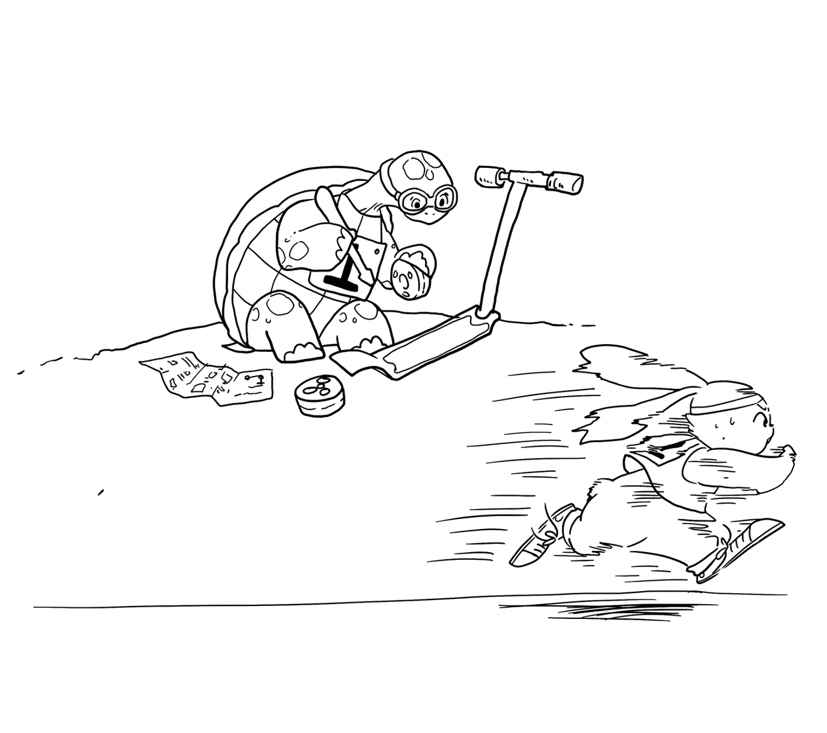
Experts invest now to save time later

Slide 12
Design studio 2 (part 1)
As a team, design an educational traffic simulator based on the design prompt that was e-mailed to class
Make sure to consider at least three different approaches, highlight tradeoffs among the approaches, and discuss why you chose the approach you took
briefly document the approaches you considered but did not adopt
Your group will be announced at the start of your discussion

Slide 13
Design studio 2 (part 1)
Focus
predicting the future
making tradeoffs
managing bias
accommodating change
balancing cost, quality, and effort
solving a problem, now and later

Slide 14
Design studio 2 (part 1)
Practice what you have learned about experts:
solve simpler problems first
draw the problem as much as they draw the solution
move among levels of abstraction
go as deep as needed
simulate continually
are alert to evidence that challenges their theory
think about what they are not designing
invest now to save time later

Slide 15
Design studio 2 (part 1)
Practice what you have learned about experts:
focus on the essence
prefer solutions that they know work
address knowledge deficiencies
generate alternatives
are skeptical

Slide 16
Design studio 2 (part 1)
Bring one printed copy to class, Wednesday February 21
make sure to identify all group members
make sure to identify your discussion time
No extensions, not even for reduced points

Slide 17
Design studio 2 (part 1)
Team members will assess other team members
in terms of the contributions they make
in terms of enabling others to make contributions

Slide 18
Questions?

Slide 19
Design
designer
plan
maker
change in the world
other stakeholders
audience
experiences

Slide 20
A design artifact
An externalized representation used to further a design project
goals, constraints, assumptions, ideas, decisions
design problem, design solution, or both
partial or complete
fluid or frozen

Slide 21
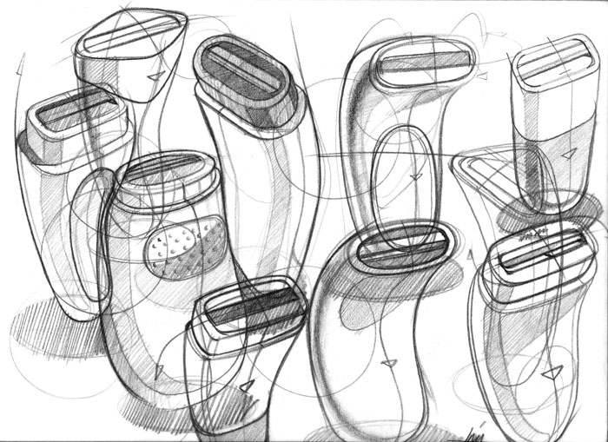
Example

Slide 22
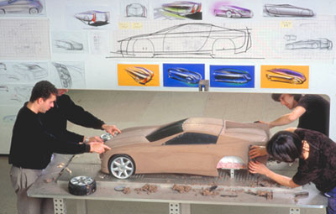
Example

Slide 23
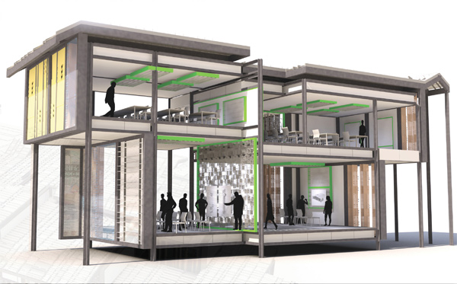
Example

Slide 24
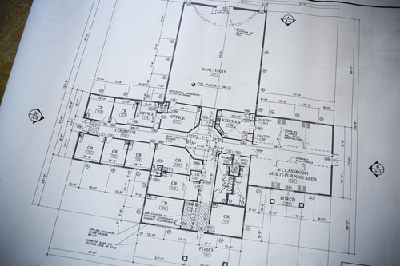
Example

Slide 25
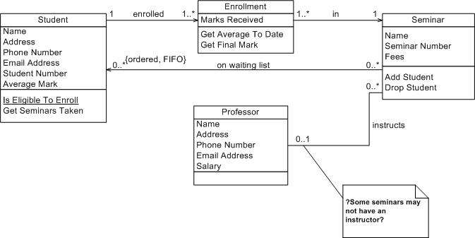
Example

Slide 26
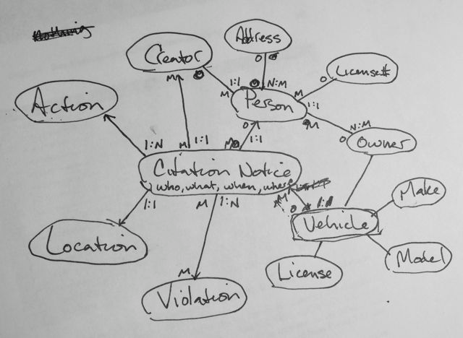
Example

Slide 27
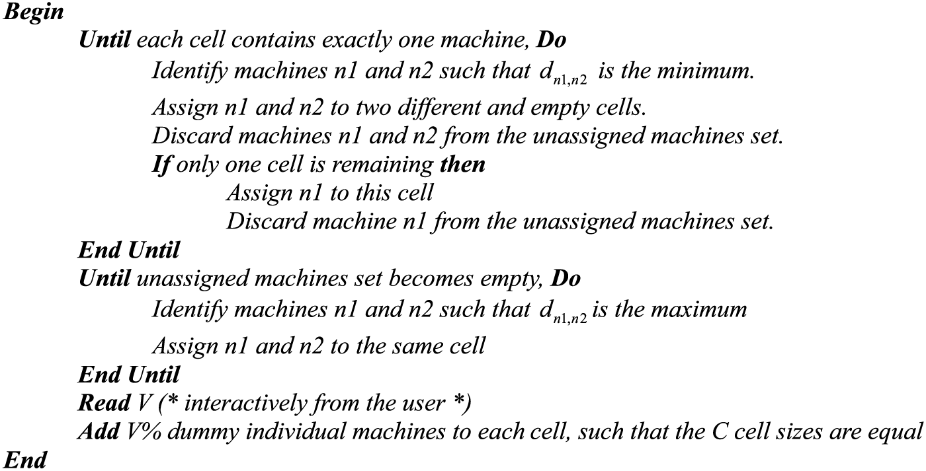
Example

Slide 28
Purpose of design artifacts
Design artifacts to think
Design artifacts to talk
Design artifacts to prescribe

Slide 29
Thinking design artifact

Slide 30
Thinking design artifact

Slide 31
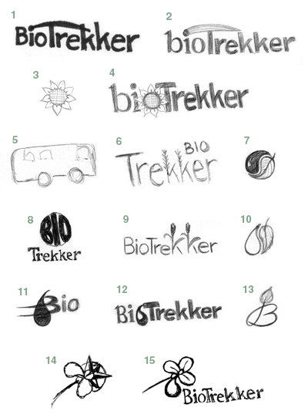
Thinking design artifact

Slide 32
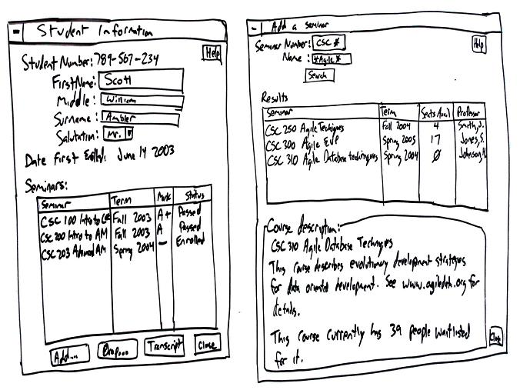
Thinking design artifact

Slide 33
Talking design artifact

Slide 34
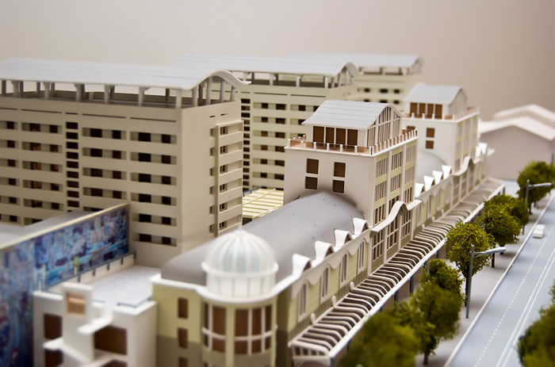
Talking design artifact

Slide 35
Talking design artifact

Slide 36
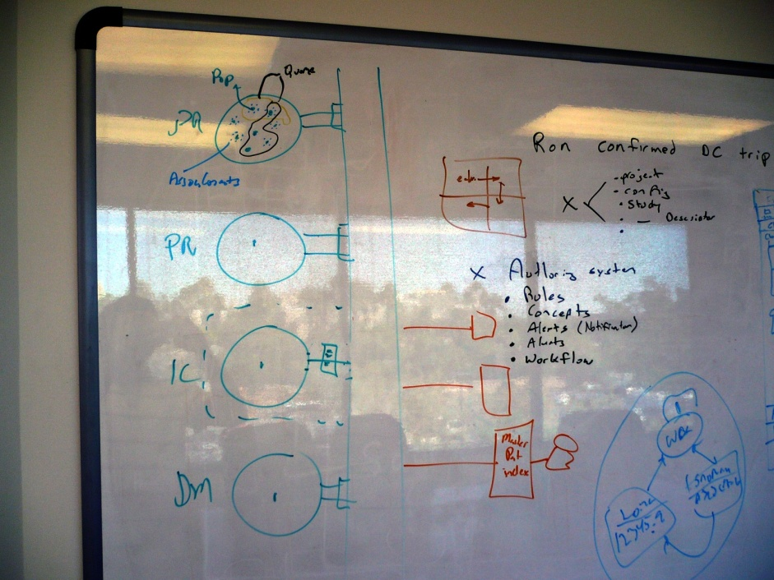
Talking design artifact

Slide 37
Prescribing design artifact

Slide 38
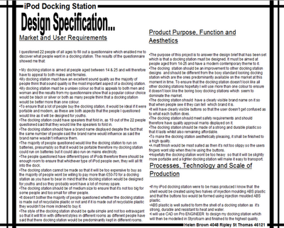
Prescribing design artifact

Slide 39
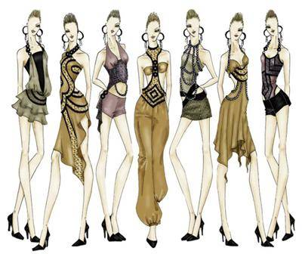
Prescribing design artifact

Slide 40
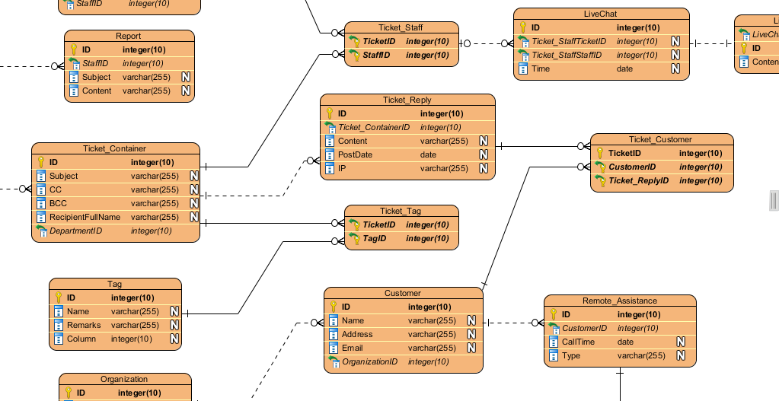
Prescribing design artifact

