Slide 1
Informatics 121 Software Design I
Lecture 12
Duplication of course material for any commercial purpose without the explicit written permission of the professor is prohibited.

Slide 2
Announcements
Design studio 1 grades are out
1 week regrade request window
Class survey is out
please respond
There will be discussion this Friday

Slide 3
Today’s lecture
Design studio 2 debrief
Design studio 2, part 2

Slide 4
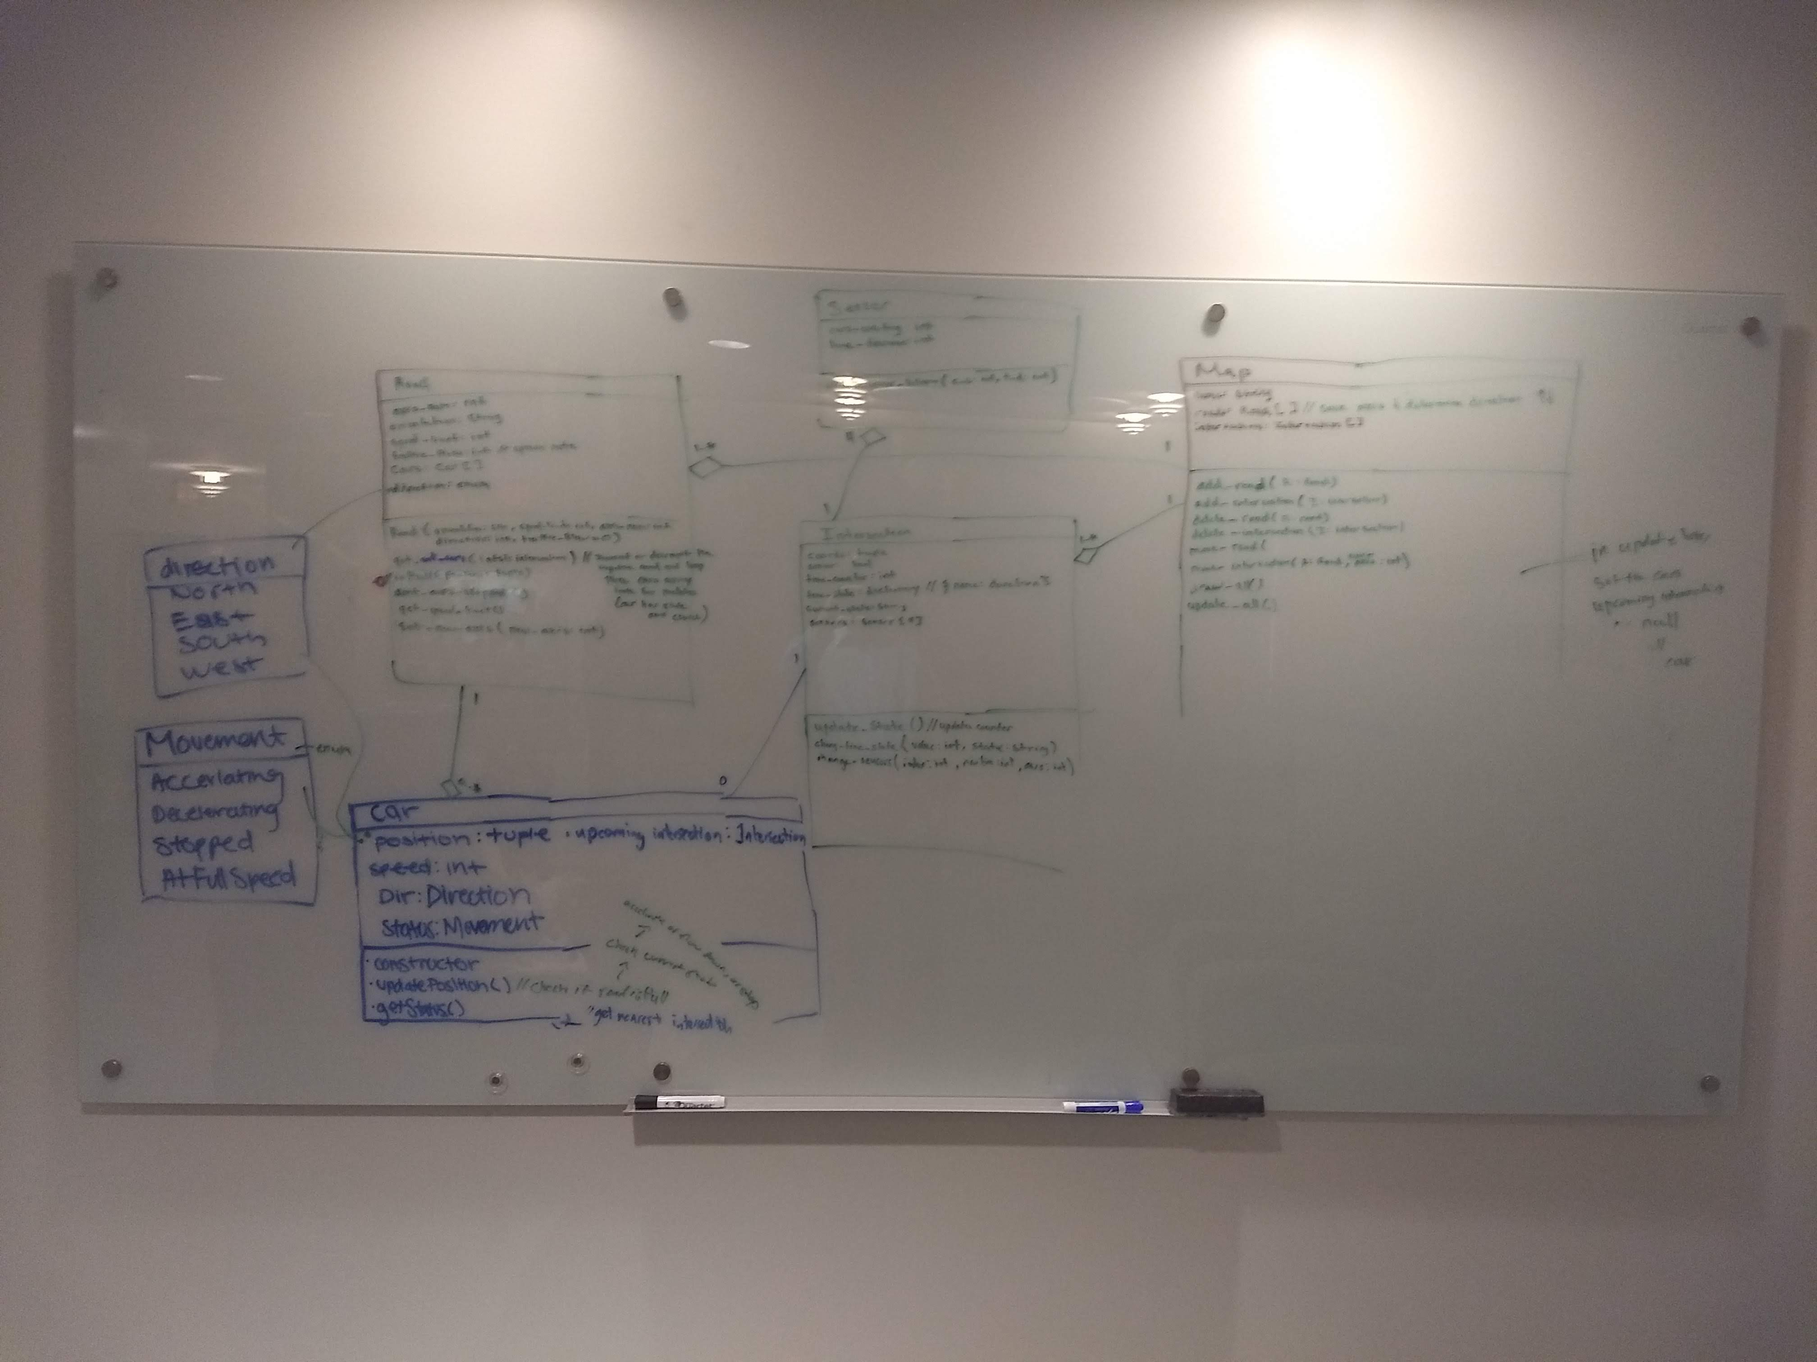
Design studio 2 debrief

Slide 5
Design studio 2 debrief
Essence?
Solutions that work?
Knowledge deficiencies?
Alternatives?
Skeptical?

Slide 6
Design studio 2 debrief
Solve simpler problems first?
Go as deep as needed?
Simulate continually?
Are alert to evidence that challenges their theory?
Think about what they are not designing?
Invest now to save time later?

Slide 7
Design studio 2 (part 2)
As a team, design an educational traffic simulator based on the new design prompt we handed out in class
Document the impact that the new requirements have on your original design
what were strengths of the original design
what were weaknesses of the original design
Same group

Slide 8
Design studio 2 (part 2)
Due through GradeScope, Tuesday February 26, at noon
make sure to identify all group members
make sure to identify your discussion time
No extensions, not even for reduced points

